Slide 1
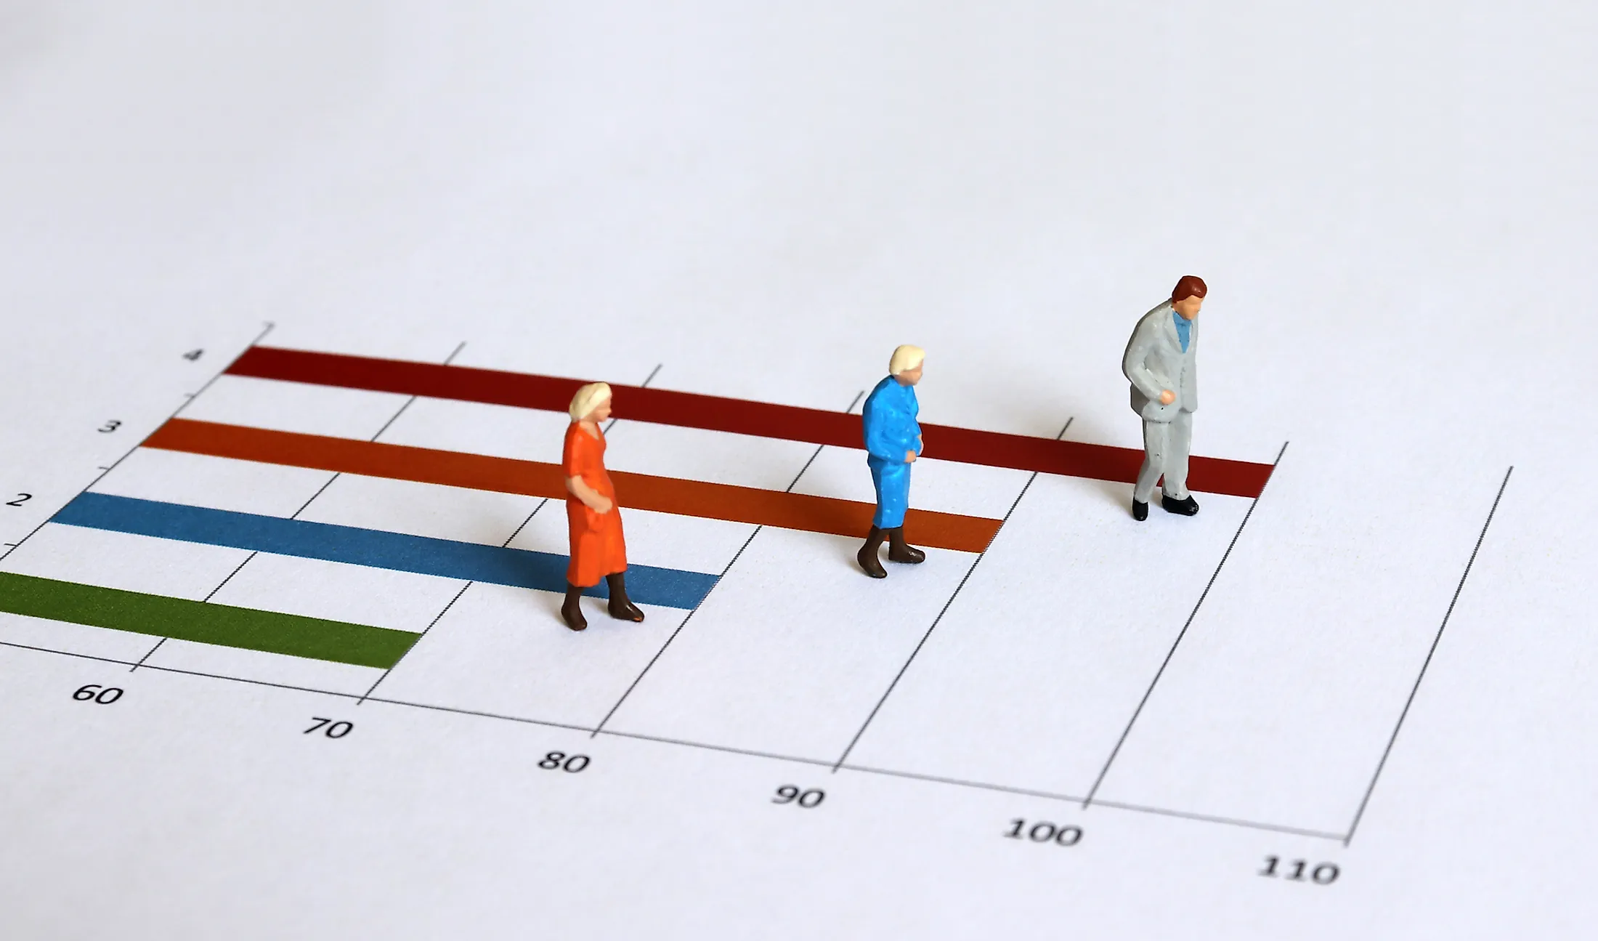
Life Expectancy Prediction

Slide 2
Appendix
Problem Statement
Benefits of predicting life expectancy
Methodology
Findings/Challenges
Future Work - Improvements
Conclusion

Slide 3
Problem Statement
Life expectancy is the average time a person anticipates to live based on several factors.
Life expectancy is affected by numerous factors such as socioeconomic, genetic, environmental etc.
The research proposes the prediction of the life expectancy of a person given the essential parameters with the help of ML
Notes:
Everything has an expiration date; humans are no exception either.
Life Expectancy measures the average time a human expects to live based on different parameters such as age, gender, environment, medical history, lifestyle choices, etc.
Many researchers have tried predicting the life expectancy in the past. Although the prediction of life expectancy is not a hundred percent accurate, but still its prediction can provide many benefits such as→ Next slide

Slide 4
Benefits of predicting life expectancy
Assists in choosing the best method of treatment and procuring medical services.
Paves a path for a risk-support model for the elderly according to the predicted risk.
Motivates people to make healthier lifestyle choices as they become more aware of their general health.
Notes:
Everything has an expiration date; humans are no exception either.
Life Expectancy measures the average time a human expects to live based on different parameters such as age, gender, environment, medical history, lifestyle choices, etc.
Many researchers have tried predicting the life expectancy in the past. Although the prediction of life expectancy is not a hundred percent accurate, but still its prediction can provide many benefits such as→ Next slide

Slide 5
The main question of this project is to figure out the main effective predictors of life expectancy. In a nutshell, we need to answer the question that if a health organization/country wants to improve life expectancy somewhere, What variables can they change so that they reach their goal?
Objective: Identify if there are any geographic, de
Improvisation:
Include less words/points
iNTRODUCTION
Gtell them what we’ll discuss today
Talk about the dataset
Taken from kaggle and WHO
Contains X rows and y columns
Various imp features such as country, GDP,Status,...
Present some exploration and visualisation
Try to show the map
Talk about key insights
What is the GDP
Show the graph and talk about insight
Insights from analysis

Slide 6
Issues we may encounter.
Issues might arise due to the dataset being imbalanced while training the regression model.
We might not have enough data for training and testing the model, which might result in Overfitting/Underfitting models.
Issues related to the missing values can also lead to an adverse impact on the accuracy of the ML model.
We are not sure if the factors considered for predicting the life expectancy are enough to make a accurate prediction.

Slide 7
Take away

Slide 9
1. Change research questions
2. which methods produce the best model accuracy?
3. Explore variables which are strongly correlated - Sagar
4. Export the gif and maybe try adding it to the ppt
5. Highlight points
6. Make changes in the variable table - Sagar
Note: Threshold 0.2 > corr

Slide 10
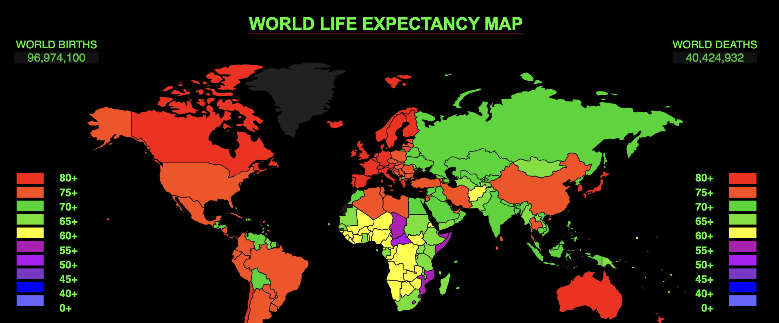
Exploration-Average life expectancy around the world

Slide 11
Exploration-Average life expectancy around the world

Slide 12
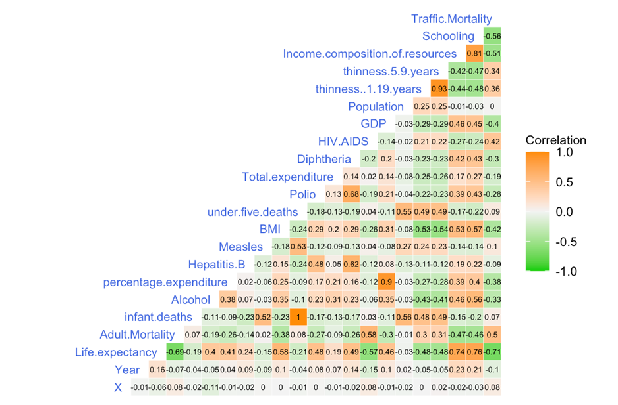
Exploring Life Expectancy- factors having greater influence on life expectancy

Slide 13
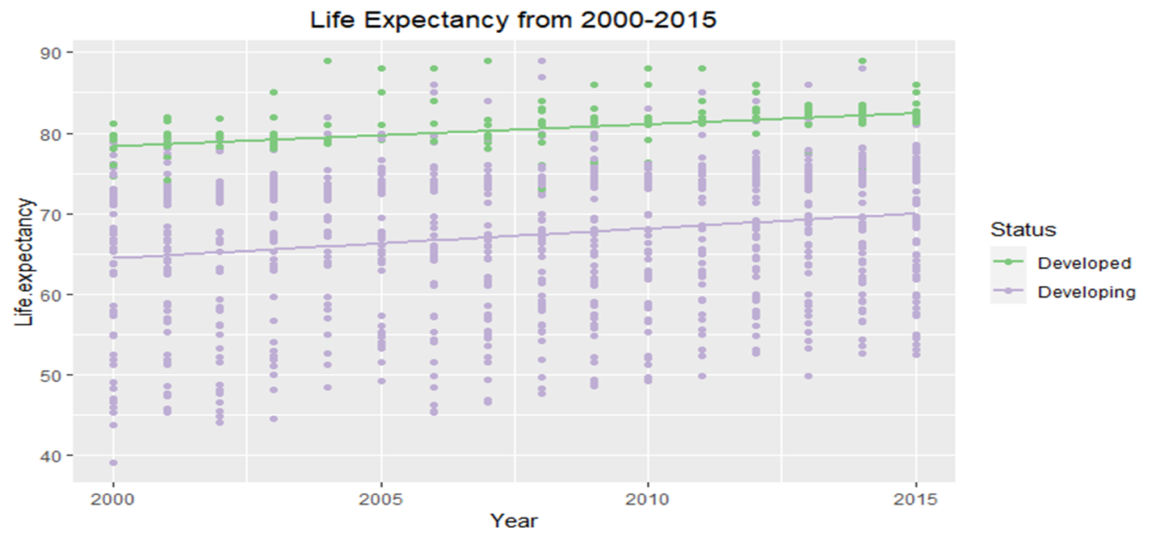
Developed Vs Developing

Slide 14
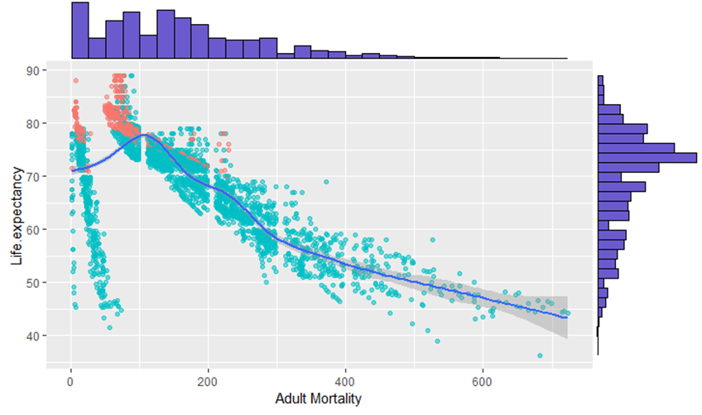
Adult Mortality vs Life Expectancy
Developed countries have low adult mortality rates compared to developing countries.
Countries with lower adult mortality rate has higher life expectancy rate.

Slide 15
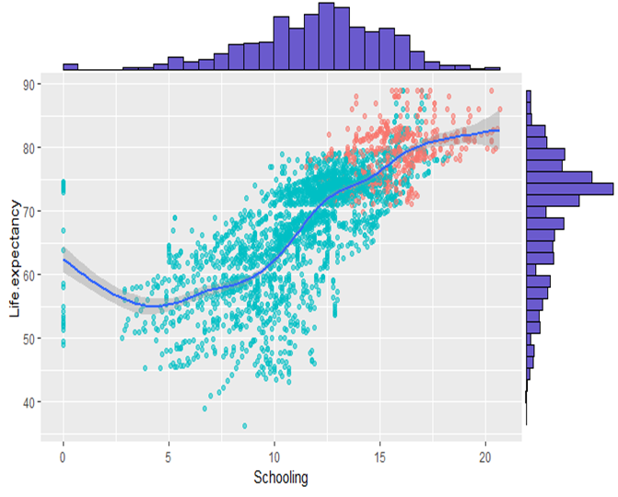
Schooling vs life expectancy
This visualization shows a strong correlation between life expectancy and schooling, we are getting a Pearson Correlation Coefficient value of 0.76
This implies that greater schooling period would lead to a higher life expectancy.
Due to the strong linear correlation, regression methods could be considered to predict life expectancy.

