Slide 1
Life Expectancy Prediction

Slide 2
Contents to be
discussed
Problem statement - Kritika
Benefits -> stakeholders (from the analytics) - Kritika
Methodology
- Dataset
- EDA
- Regression model - discussion
Findings/Challenges
Future Work - Improvements
Take away

Slide 3
Problem Statement
Life expectancy is the average time a person anticipates to live based on several factors.
The dataset given by WHO represents the same & here we are trying to predict the life expectancy of a country.
Although the estimation of life expectancy is not always precise, it can be used to guide treatment decisions and the purchase of medical services.
It also clears the way for a risk-support approach for the elderly based on the anticipated risk.

Slide 4
Benefits of this analysis to the stakeholders
Broader area of interest.
It also paves a path for a risk-support model for the elderly according to the predicted risk.
This study can help public to work upon the factors that affect the longevity of their life.
Can help Govt. to focus on investments that should be made in healthcare sector to improve the existing facilities in order to boost the life expectancy of their citizens.
Notes:
Health care is an important sector
5. Can help Govt. to focus on investments that should be made in healthcare sector to improve the existing facilities in order to boost the life expectancy of their citizens.

Slide 5
About the Dataset
Life Expectancy dataset provided by WHO
Attributes:
Life expectancy , Adult Mortality, Infant deaths
Deaths caused by Alcohol, Hepatitis B, Measles
BMI, Percentage expenditure on Health Care, etc
Data collected from 2000 to 2015 for 193 different countries

Slide 6
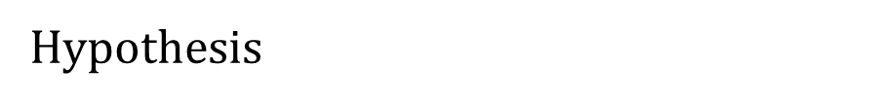
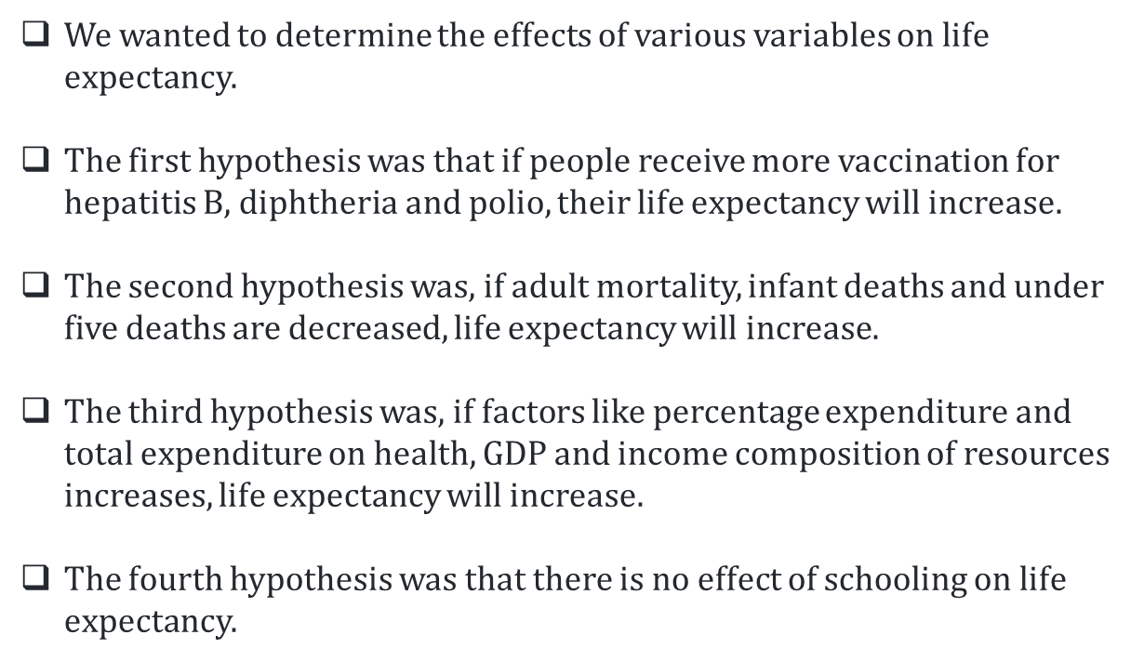

Slide 7
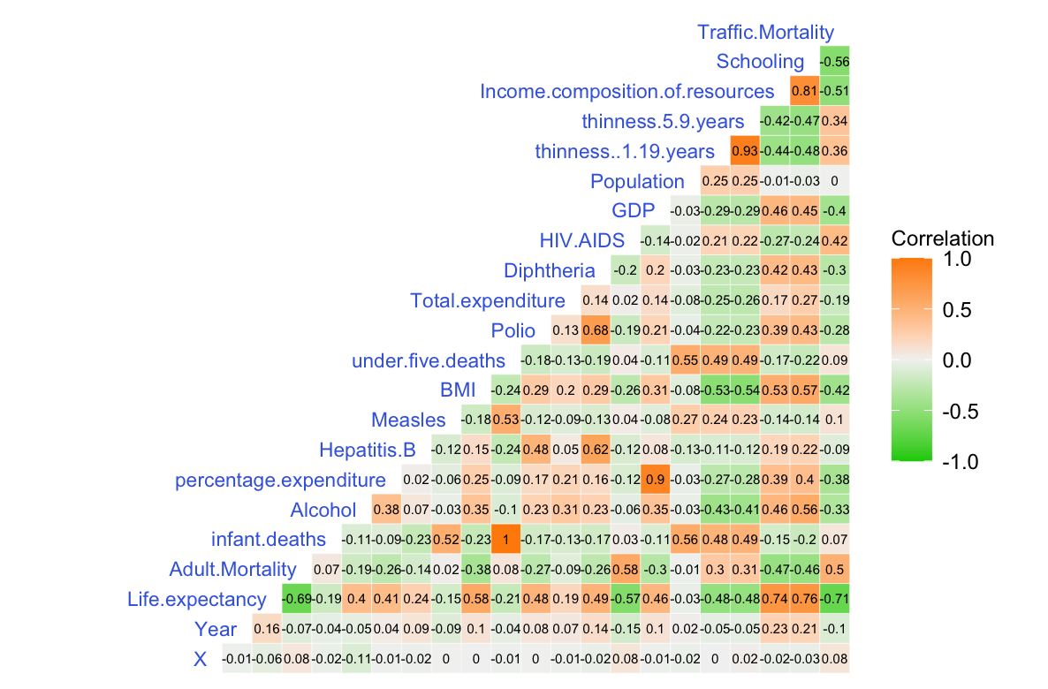
Exploring Life Expectancy - factors having greater influence on life expectancy

Slide 8
Some Visual Insights from the Dataset

Slide 9
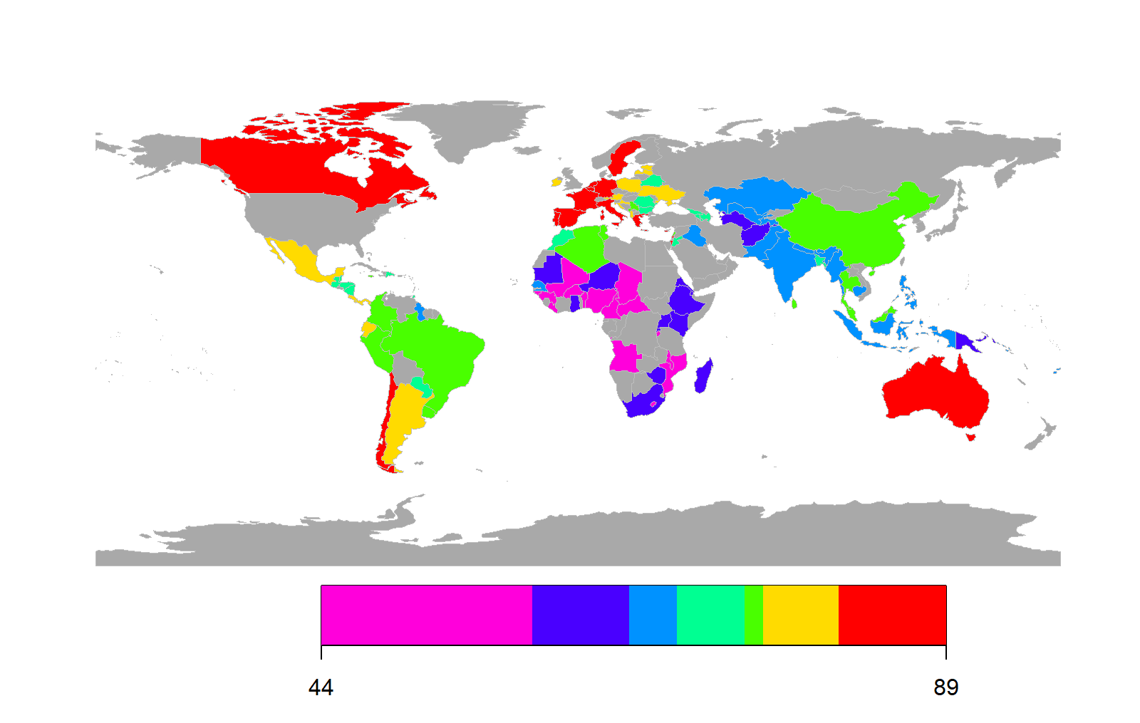
Geographic
Life Expectancy
Life Expectancy vary widely by country.
81.5
Little correlation between geographical location and life expectancy.
Geographical location is not a strong indicator of Life Expectancy
Notes:
We analyse the datasets containing data collected from 2000-2015 of the world
The data contained demographic, geographic and economic data of each country .
We began by creating a heat map of life expectancy for each country where the number represents the overall life expectancy and the colors represent how high or how
low the life expectancy is
The darker red the country is the higher the life expectancy for that country and the pink color represents the lower life expectancy of the country
Point 1
However as high and low values are spread throughout the map there is point 2
Finally we concluded that the no.3
Our next step was to identify the demographic, economic and few other feature differences between the higher and lower countries to check the correlated features between them

Slide 10
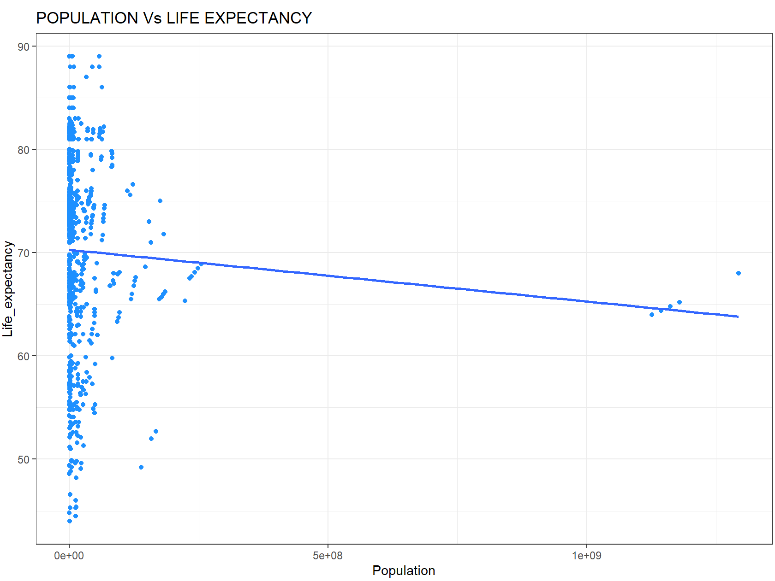
Population
No Linear Correlation
Life Expectancy
Little to no correlation between Life Expectancy and Population
Larger Population
Notes:
We created a scatterplot in which we plotted countries based on their life expectancy and population to see if there was any correlation between them.
The higher up the scatterplot the longer the life expectancy of the country is
The further to the right the country is plotted the larger their population. And the line that goes between the two is looking for the correlation between the two is testing for correlation
Meaning if these two points are correlated.
As we can see we found that there is point1

Slide 11
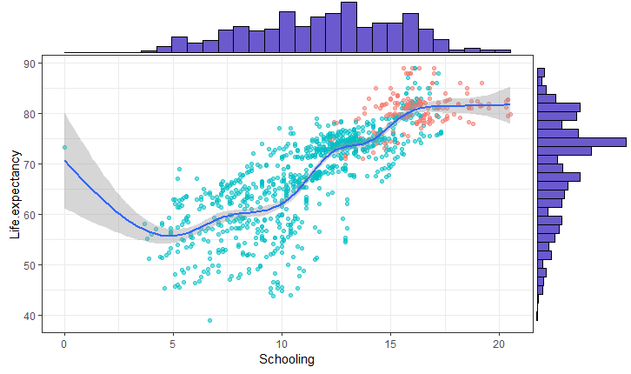
Schooling
0.76
Correlation coefficient
Positive correlation between schooling and life expectancy.
Greater schooling period would lead to a higher life expectancy.

Slide 12
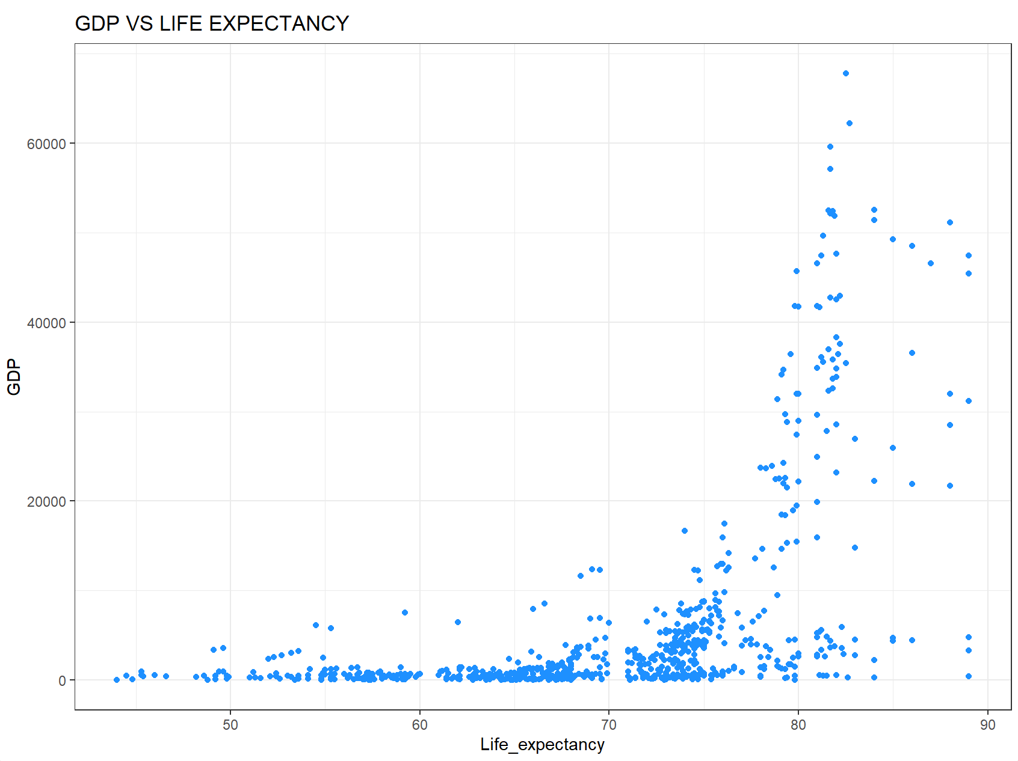
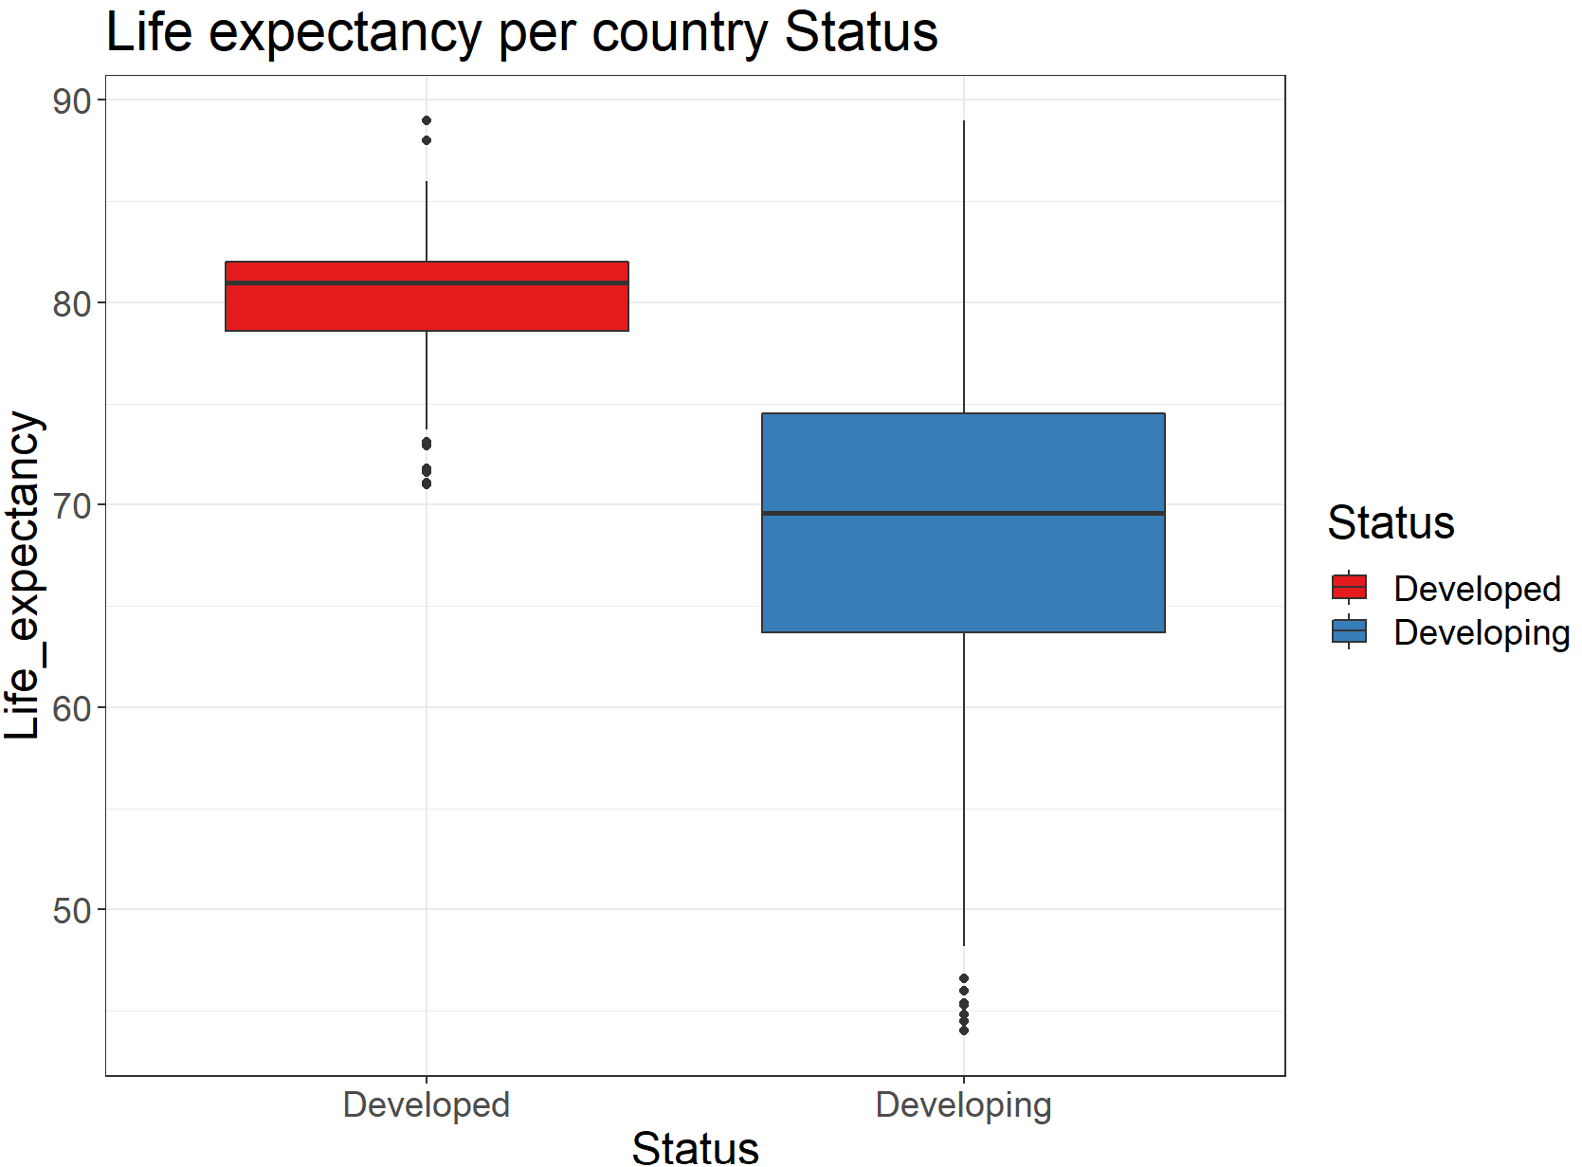
Wealth
Strong correlation between Gross Domestic product(GDP) and Life Expectancy
Richer countries have higher average life expectancy.

Slide 13
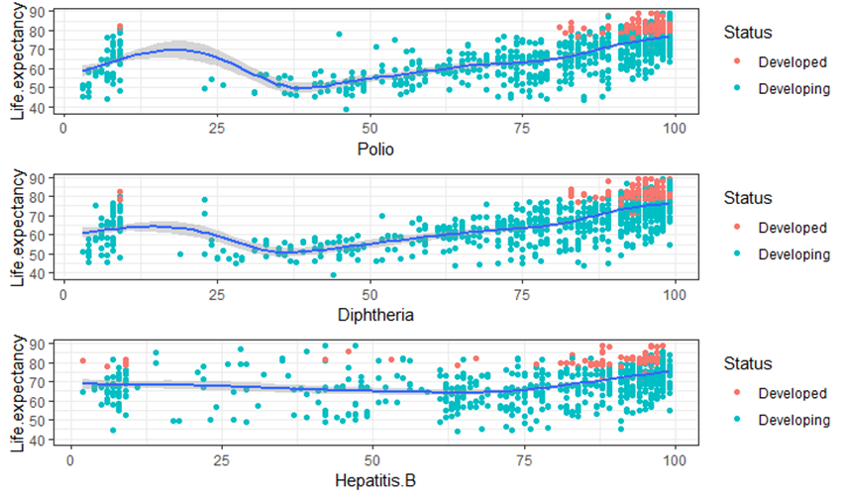
Health

Slide 14
Take away

Slide 15
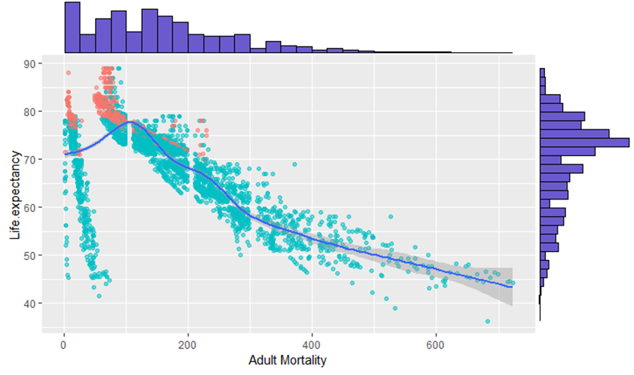
Adult Mortality vs Life Expectancy
Developed countries have low adult mortality rates compared to developing countries.
Countries with lower adult mortality rate has higher life expectancy rate.

Slide 16
Insights
1
2
3
Wealthier countries and the country that have sustained their economic growth have higher average life expectancy.
Healthier countries also tend to have educated population.
However, healthier countries also tend to be wealthy
Evidence suggests that
wealth, schooling and life expectancy go together.

Slide 17
Findings and challenges
The result indicated that most of the missing data was for population, Hepatitis B and GDP. The missing data were from less known countries like Vanuatu, Tonga, Togo,Cabo Verde etc.
Issues might arise due to the dataset being imbalanced while training the regression model.
We might not have enough data for training and testing the model, which might result in Overfitting/Underfitting models.
Issues related to the missing values can also lead to an adverse impact on the accuracy of the ML model.
We are not sure if the factors considered for predicting the life expectancy are enough to make a accurate prediction.

