Slide 1




How to make a video call
So the first thing that we need to do is to figure out which device you are going to make the video call on.
You can do this using your Android phone or tablet, iPhone, iPad, a mac or a PC (Windows)
Also for all of these make sure your connected to WiFi or via a network cable for your internet access.
So first step is to click on which one you have:
iPhone
iMac
iPad
Android phone/tablet
Windows 10

Slide 2
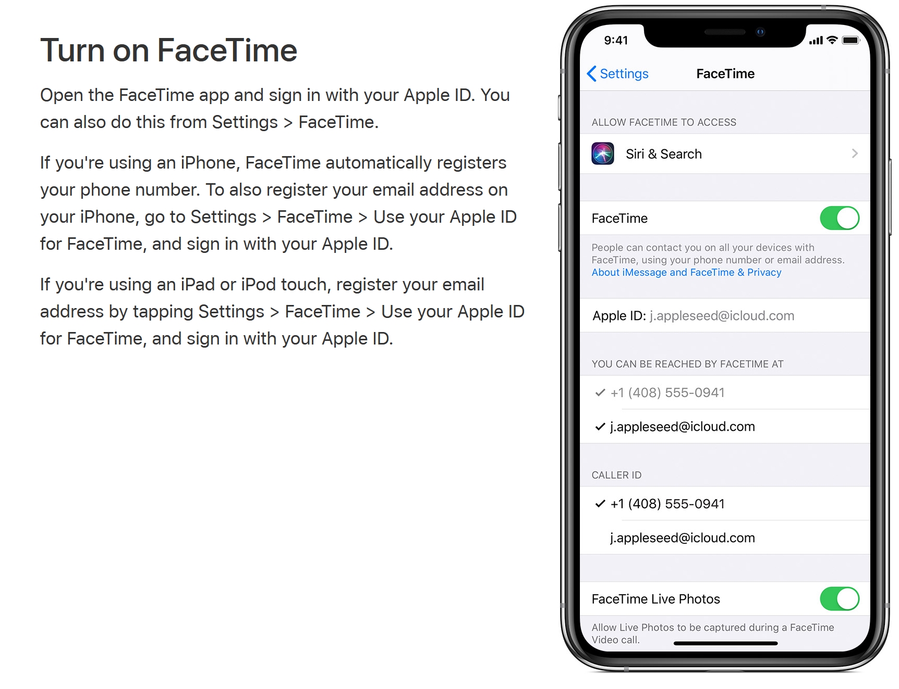
Apple iPhone
OK, let’s get you chatting with your loved ones on video.
The best thing to use for video calling on Apple devices is called FaceTime. FaceTime only works on Apple devices.
I’ve borrowed bits from the Apple support page for this because there's no use having a dog and barking yourself!
So first of all we don’t need to install FaceTime as it’s already installed on your device. We do however, need to activate the application for it.
To do this you will need your Apple ID:

Slide 3
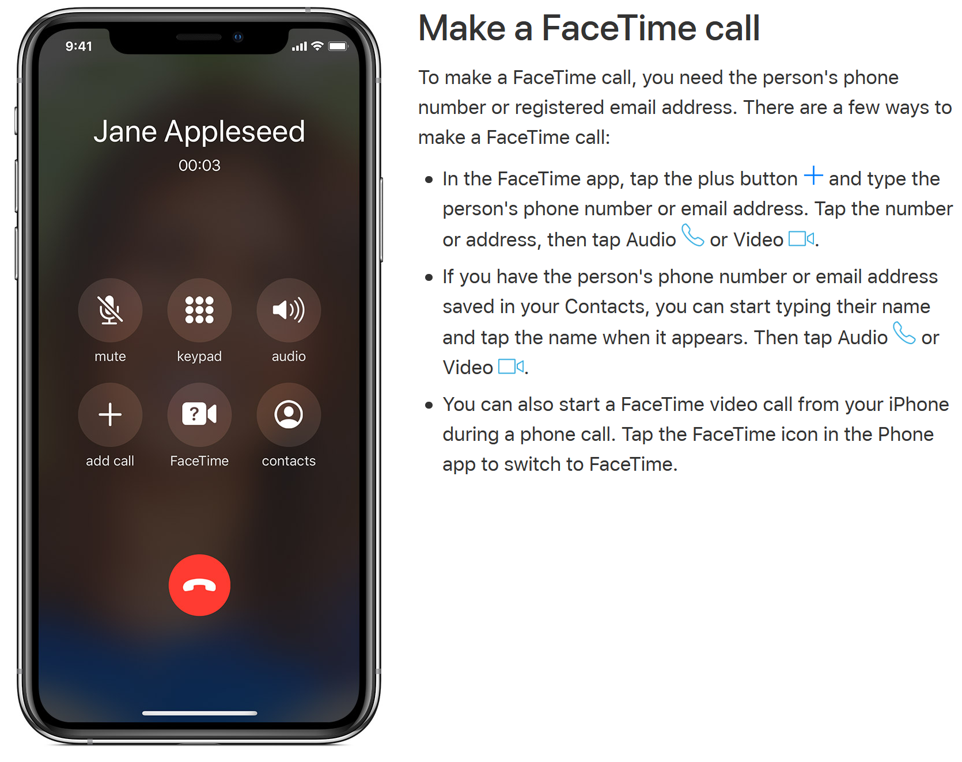
Apple iPhone
After you’ve done that you can make and receive FaceTime calls.
Here is how to make a call yourself:

Slide 4
Apple iMac
Read the below guide:
Click here the access the manufacturer’s guide to use FaceTime.
Skype
To install skype go here and download the version you need: https://www.skype.com/en/get-skype/
Find the file you downloaded and double click it. Follow the on screen instructions.
After you’ve installed Skype have a look at this guide → here

Slide 5
Apple iPad
Below you will find links to assist you in the set up of FaceTime and making calls on your Apple iPad:
Setup FaceTime
Make Calls

Slide 6
Android Devices
For people using Android devices you have a few options on which application you want to use. We recommend using the same programme that the people you will be frequently contacting currently use.
Apps you can use:
Skype
WhatsApp
You can install all of these via the Play Store. If you’ve not used this before you can find a guide by clicking → here
Here is a guide on using Skype for Android → here
o

Slide 7
Windows 10
In Windows 10 you can use quite a few different applications to make video calls but we are going to focus on the most popular ones.
Those are Skype & Zoom
We recommend using the same program that the people you will be frequently contacting currently use.
Skype:
To install Skype click on the link and when asked to run or save choose run, you’ll then get another prompt, choose yes. Ninite will then run (that's what's installing Skype for us). When it’s finished you can go on and start to use Skype.
Skype link
After you’ve installed Skype have a look at this guide → here
Zoom:
To install Zoom click the link and when asked to run or save choose run, you’ll then get another prompt, choose yes. Ninite will then run (that's what's installing Zoom for us). When it’s finished you can go on and start to use Zoom.
Zoom link
After you’ve installed Zoom have a look at this guide → here

