Slide 1
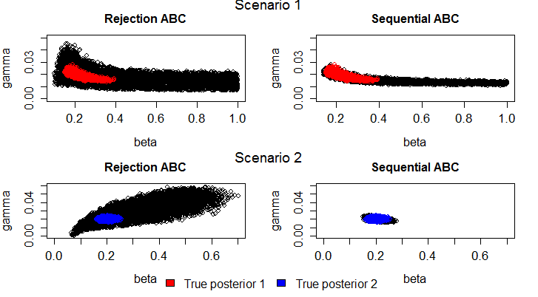
Calibrating Models to Data: A Comparison of Methods
RQ: Which calibration method performs best?
Fig. 1 Comparing model calibration methods with the “true posterior”
Zenabu Suboi & Marijn C. Hazelbag

Slide 2
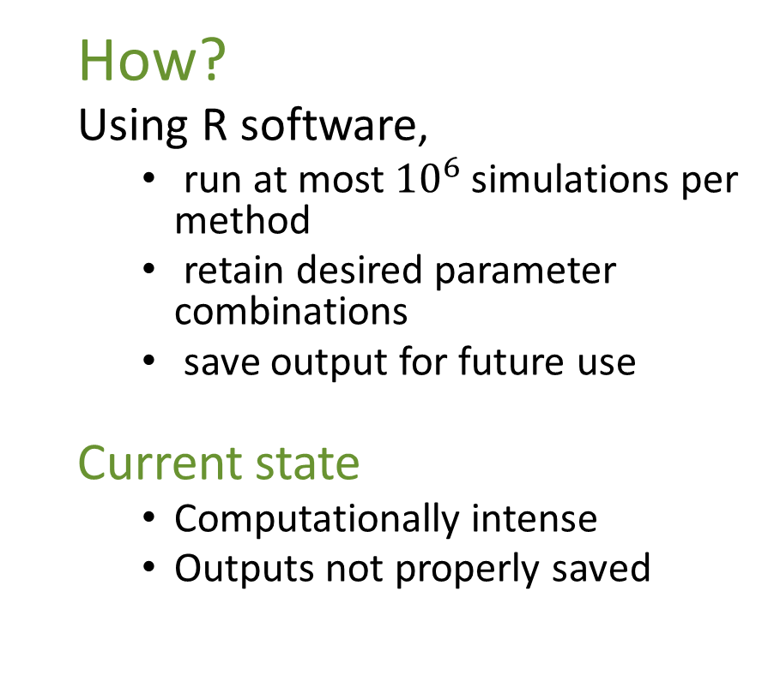
Requirements
How?
Using R software,
run at most ${10}^{6}$ simulations per method
retain desired parameter combinations
save output for future use
Current state
Computationally intense
Outputs not properly saved
Plan
Run simulations faster
Parallel?
HPC?
Properly save and organize outputs
Expected Output
Data frame of retained parameter combinations
Plot of posterior

Slide 3
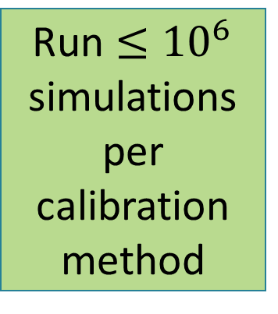
Flow Diagram
Run $≤{10}^{6}$ simulations per calibration method
Retain parameter combinations
Plot posterior for each calibrationmethod
Save outputs for comparison

Slide 4
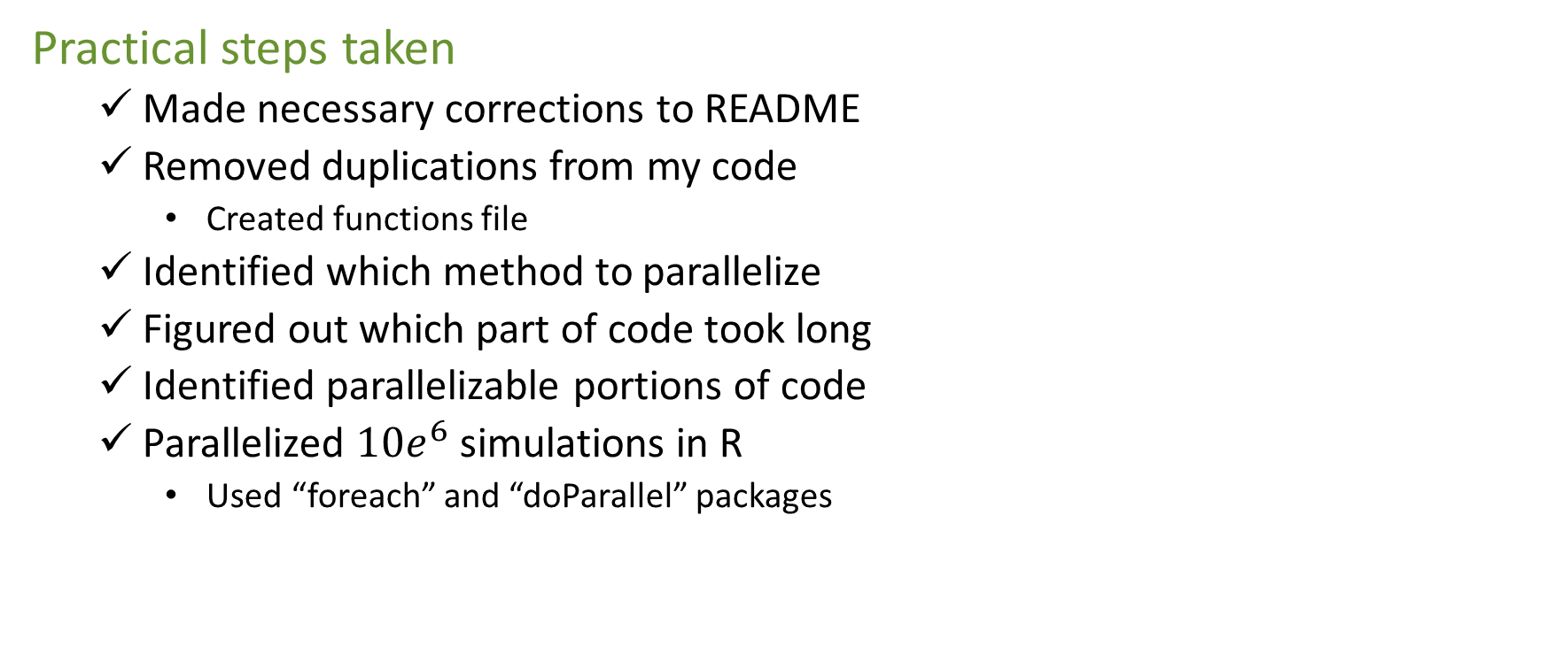
Hackathon…
Practical steps taken
Made necessary corrections to README
Removed duplications from my code
Created functions file
Identified which method to parallelize
Figured out which part of code took long
Identified parallelizable portions of code
Parallelized $10e^{6}$ simulations in R
Used “foreach” and “doParallel” packages

Slide 5
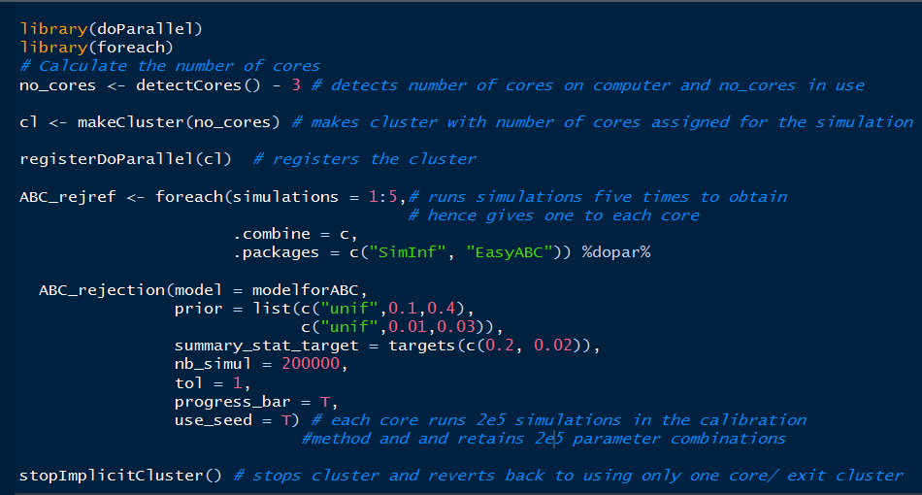
Parallel Code Used

Slide 6
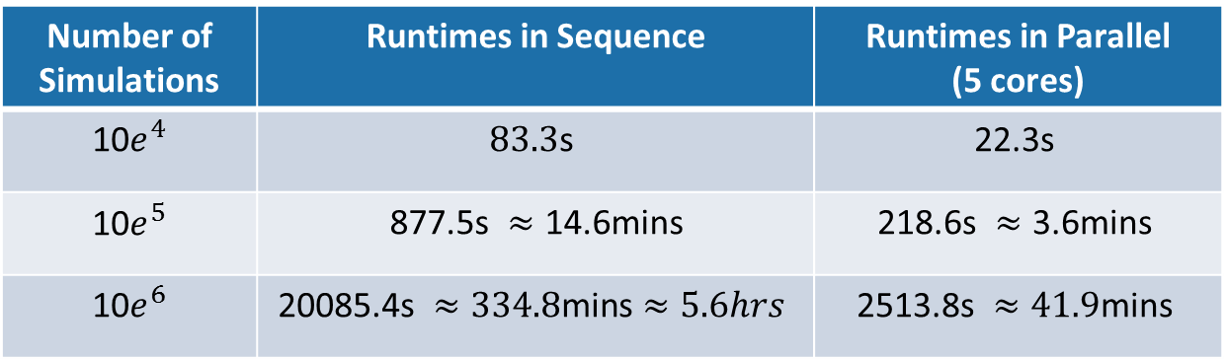
Results
Table 1: Runtimes times for running Rejection ABC in sequence and parallel
Number of Simulations | Runtimes in Sequence | Runtimes in Parallel (5 cores)
10$e^{4}$ | $$\text{8}\text{3.3}\text{s}$$ | $$\text{22.3}\text{s}$$
10$e^{5}$ | $\text{877.5}\text{s} ≈\text{14}\text{.6}\text{mins}$ | $$\text{218.6}\text{s} ≈\text{3.6}\text{mins}$$
10$e^{6}$ | $$\text{20085.4}\text{s} ≈\text{334.8}\text{mins}≈5.6hrs$$ | $$\text{2513.8}\text{s} ≈\text{41.9}\text{mins}$$

Slide 7
What Next?
Run the other methods
Save posterior
Produce plots
Organize outputs

Slide 8
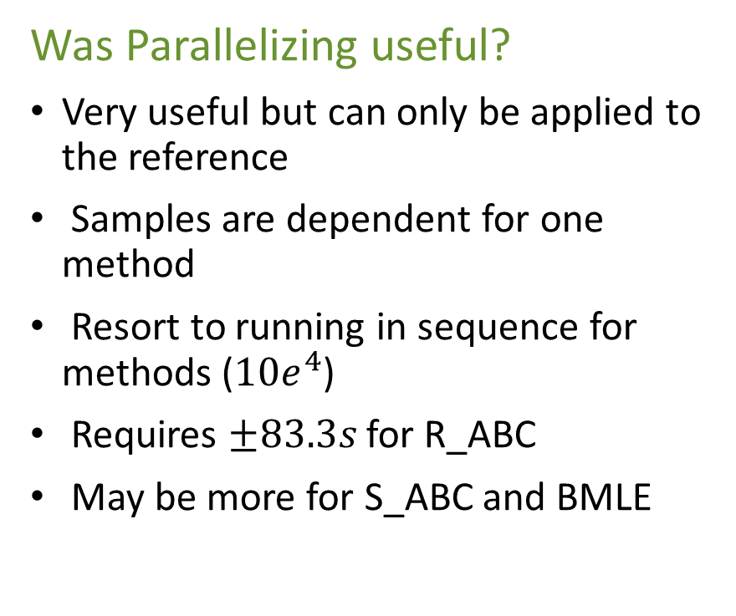
Conclusion
Goal for SEAMS workshop
Run simulations faster
What I achieved
Tidied up my code
Got a functions file
Code made shorter and neat
Code runs faster
Saved in binary to conserve memory
Was Parallelizing useful?
Very useful but can only be applied to the reference
Samples are dependent for one method
Resort to running in sequence for methods (${10e}^{4}$)
Requires $±83.3s$ for R_ABC
May be more for S_ABC and BMLE

Slide 9
Acknowledgements
SEAMS faculty and Mentors
SACEMA
Fellow participants
Thank You

