Slide 1
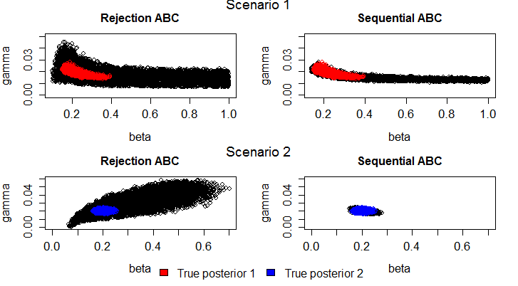
Calibrating Models to Data: A Comparison of Methods
RQ: Which calibration method performs best?
Fig. 1 Comparing model calibration methods with the “true posterior”
Zenabu Suboi & Marijn C. Hazelbag

Slide 2
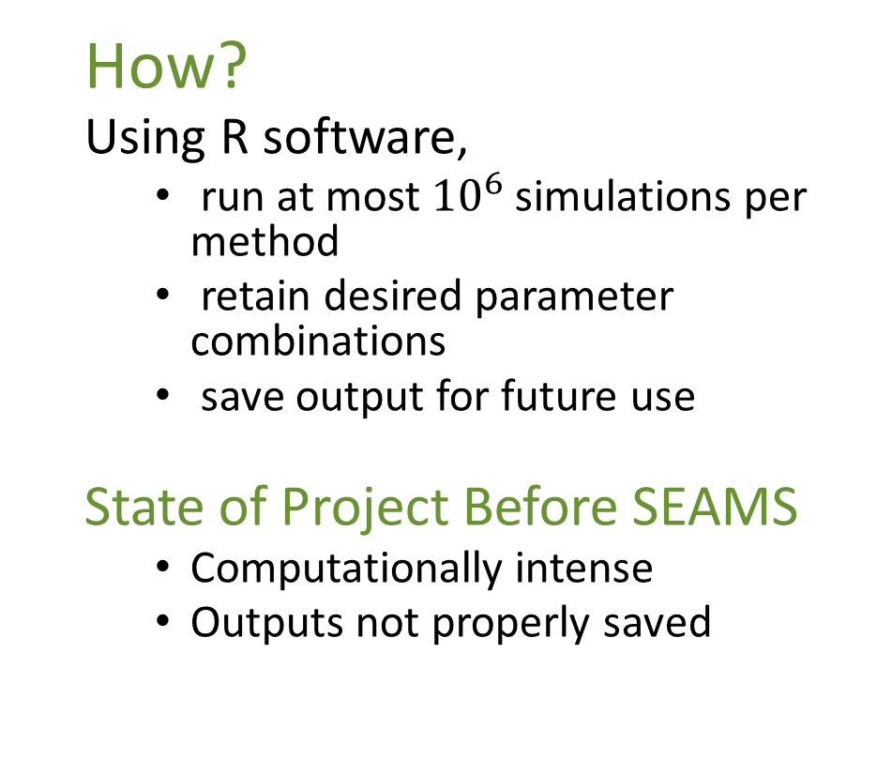
Requirements
How?
Using R software,
run at most ${10}^{6}$ simulations per method
retain desired parameter combinations
save output for future use
State of Project Before SEAMS
Computationally intense
Outputs not properly saved
Plan
Run simulations faster
Parallel?
HPC?
Properly save and organize outputs
Expected Output
Data frame of retained parameter combinations
Plot of posterior

Slide 3
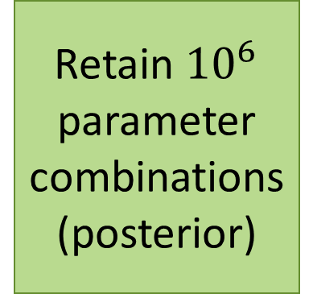
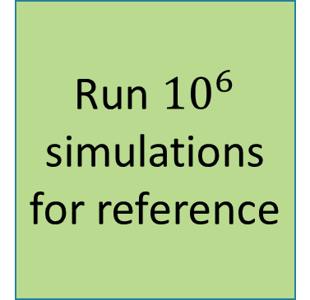

Flow Diagram & Minimum Goal
Run ${10}^{6}$ simulations
for reference
Retain ${10}^{6}$ parameter combinations
(posterior)
Save posterior for comparison
Run ${10}^{4}$ simulations for each calibration method
Minimum goal

Slide 4
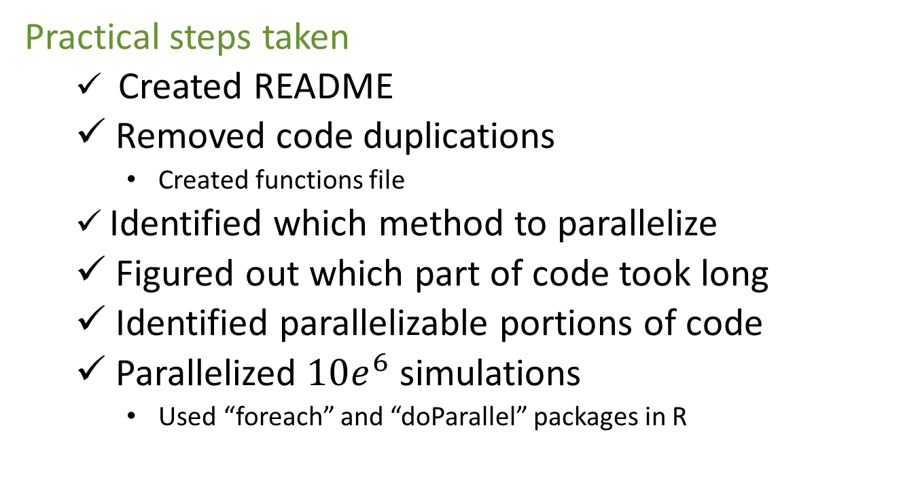
Hackathon…
Practical steps taken
Created README
Removed code duplications
Created functions file
Identified which method to parallelize
Figured out which part of code took long
Identified parallelizable portions of code
Parallelized $10e^{6}$ simulations
Used “foreach” and “doParallel” packages in R

Slide 5
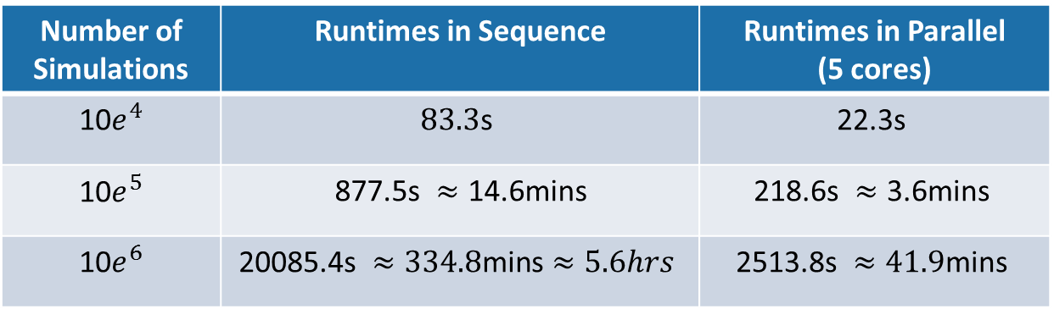
Results
Table 1: Runtimes for running Rejection ABC in sequence and parallel
Number of Simulations | Runtimes in Sequence | Runtimes in Parallel (5 cores)
10$e^{4}$ | $$\text{8}\text{3.3}\text{s}$$ | $$\text{22.3}\text{s}$$
10$e^{5}$ | $\text{877.5}\text{s} ≈\text{14}\text{.6}\text{mins}$ | $$\text{218.6}\text{s} ≈\text{3.6}\text{mins}$$
10$e^{6}$ | $$\text{20085.4}\text{s} ≈\text{334.8}\text{mins}≈5.6hrs$$ | $$\text{2513.8}\text{s} ≈\text{41.9}\text{mins}$$

Slide 6
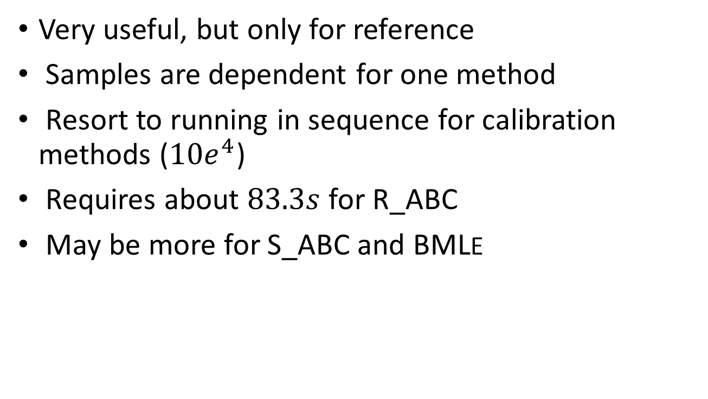
Was Parallelizing useful?
Very useful, but only for reference
Samples are dependent for one method
Resort to running in sequence for calibration methods (${10e}^{4}$)
Requires about $83.3s$ for R_ABC
May be more for S_ABC and BMLE

Slide 7
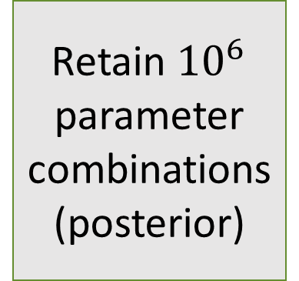
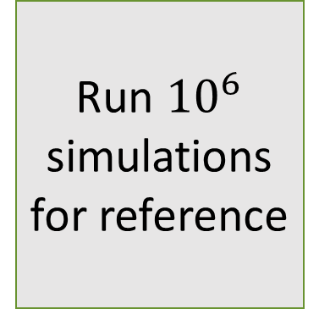

What Next?
Run ${10}^{6}$ simulations
for reference
Retain ${10}^{6}$ parameter combinations
(posterior)
Save posterior for comparison
Run ${10}^{6}$ simulations for each calibration methods
Organize outputs in one file
Produce plots for comparison
Save posterior of each method for comparison

Slide 8
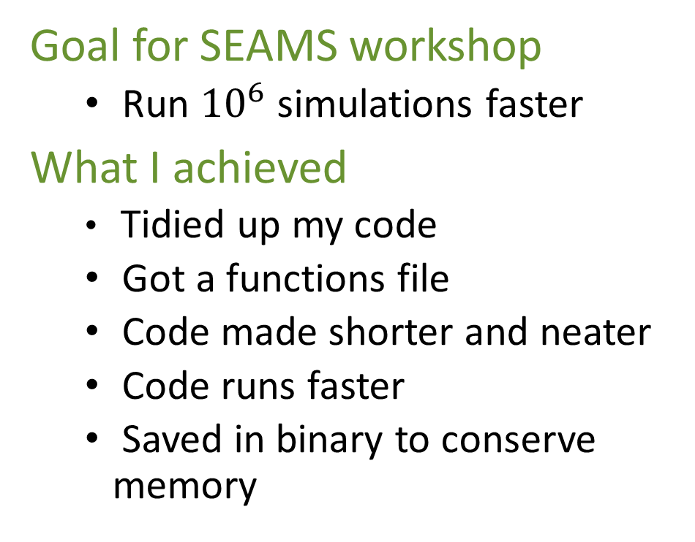
Conclusion
Goal for SEAMS workshop
Run ${10}^{6}$ simulations faster
What I achieved
Tidied up my code
Got a functions file
Code made shorter and neater
Code runs faster
Saved in binary to conserve memory

Slide 9
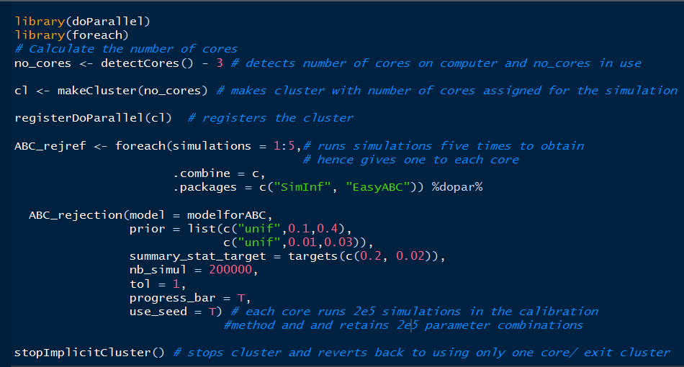
Parallel Code Used

Slide 10
Acknowledgements
SEAMS faculty and Mentors
SACEMA
Fellow participants
Thank You

