Slide 1
Use of Machine learning approaches to understand the key drivers of malaria intervention impact in Ghana
Zenabu Suboi
2nd September 2025

Slide 2
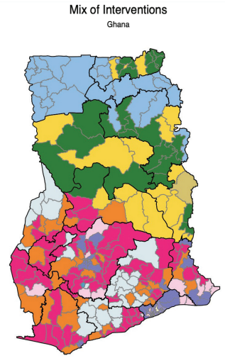
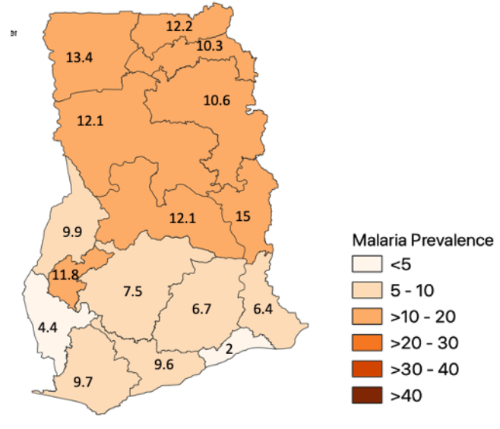
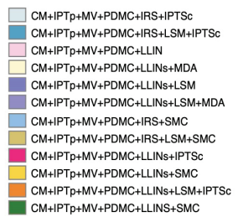
Malaria prevalence in Ghana
Source: U.S. President’s Malaria Initiative Ghana Malaria Profile (2023)
Source: Ghana NMESP 2024-2028.
Notes:
Malaria is endemic in Ghana, contributing majorly to most outpatient consultations
Peak transmission:
July-November (Northern Ghana)
May-July and October-November (Southern Ghana)

Slide 3
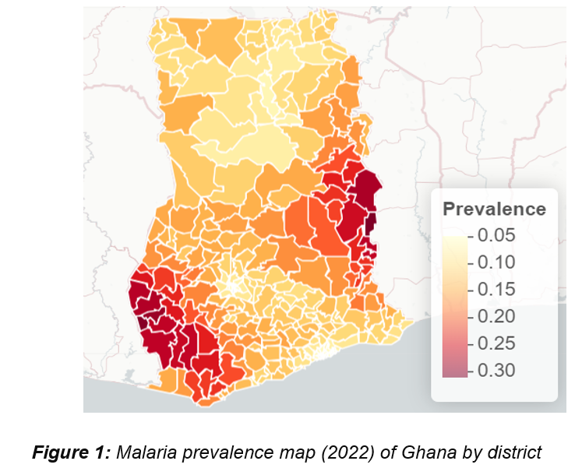
Malaria prevalence in Ghana
Source: Ghana NMESP 2024-2028.
Notes:
Malaria is endemic in Ghana, contributing majorly to most outpatient consultations
Peak transmission:
July-November (Northern Ghana)
May-July and October-November (Southern Ghana)

Slide 4
Question
What are the key drivers of impact of malaria interventions in Ghana?
Modeling can help identify the key drivers
These drivers can help prioritize future data collection
Better informed models can increase trust in model outputs
Notes:
What are the inputs of our model that need to be well estimated to increase credibility in our model outputs?

Slide 5
Approach
Perform a global sensitivity analysis (GSA) to identify these inputs
expensive
~7M
OpenMalaria (OM) model
OM simulations
(large set)
Perform GSA
OpenMalaria (OM) model
OM simulations
(small set)
Train ML emulator & predict OM outputs
Perform GSA
Notes:
GSA method to use enables us to identify the inputs that matter
It requires a large number of input samples to reliably identify the inputs
OM simulations are expensive

Slide 6
Approach
Once trained, emulators are reusable
Predict output at different coverage levels for specific settings
Easily adaptable to answer different questions
Using the trained emulator, we can answer the question of indirect protection offered by an intervention

Slide 7
Thank you for your attention

