Slide 1
POTENTIAL IMPACT OF PMI FINANCING ON MALARIA BURDEN IN GHANA
March 2025

Slide 2
Background – Malaria in Ghana
Malaria is still a major public health concern in Ghana
It accounts for 40% of outpatient visits to hospitals
IRS and SMC are part of the effective malaria control interventions and are usually prioritized in malaria control programs

Slide 3
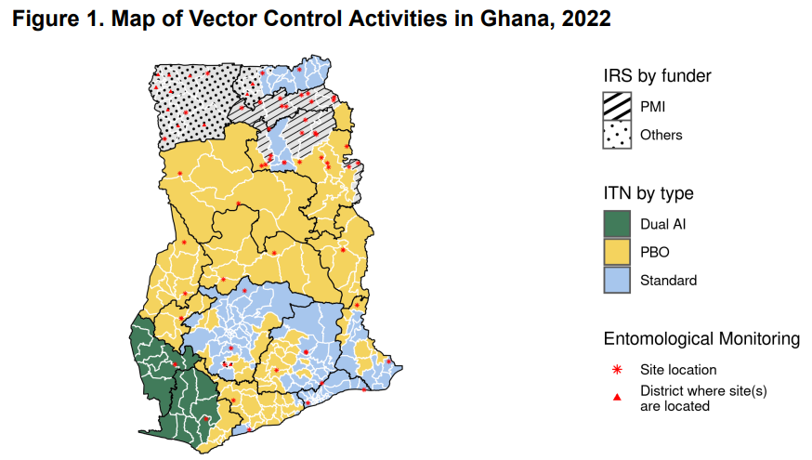
Background – IRS in Ghana is Partly Funded by PMI
Source: FY-2024-Ghana-MOP

Slide 4
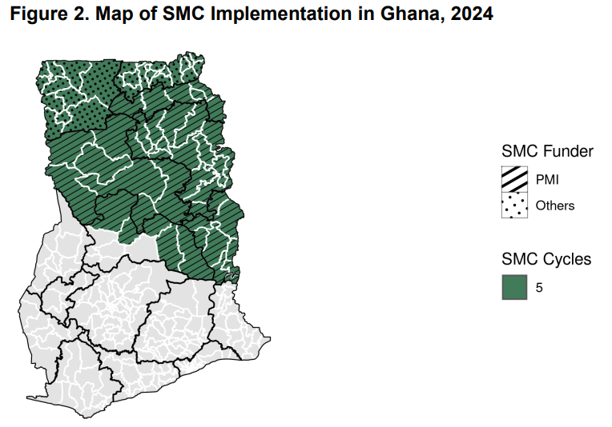
Background – SMC in Ghana is largely funded by PMI
Source: FY-2024-Ghana-MOP

Slide 5
Background – Malaria in Ghana
The immediate and longer-term future of PMI financing is currently uncertain
Given how effective IRS and SMC are to overall malaria control in Ghana, their inclusion or removal has the potential to significantly impact total malaria burden in Ghana.
We simulate the potential impact of IRS and SMC inclusion and removal on malaria burden in Ghana from 2025-2027

Slide 6
Methods
Used OpenMalaria to simulate malaria transmission in Ghana to explore the impact of removing IRS and SMC in the years 2025-2027 on severe and uncomplicated malaria
2 scenarios were simulated:
BAU - IRS and SMC deployments continue as usual in the years 2025-2027
noSMC_IRS - IRS and SMC removed in the years 2025-2027

Slide 7
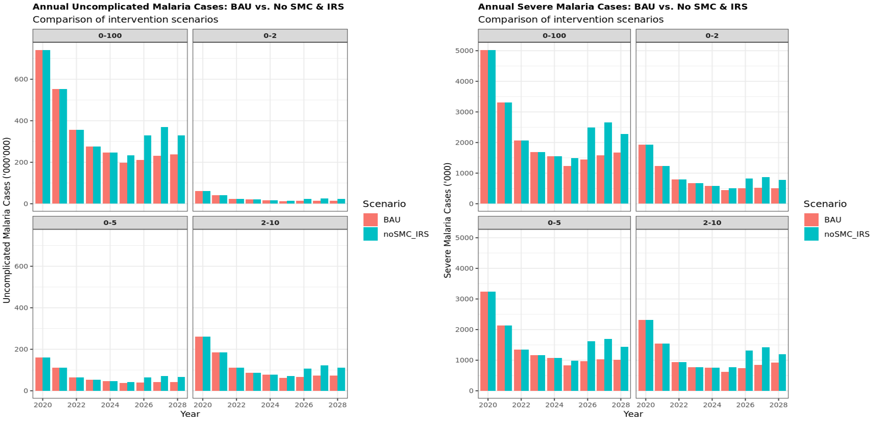
Results – Annual Uncomplicated and Severe Malaria Cases

Slide 8
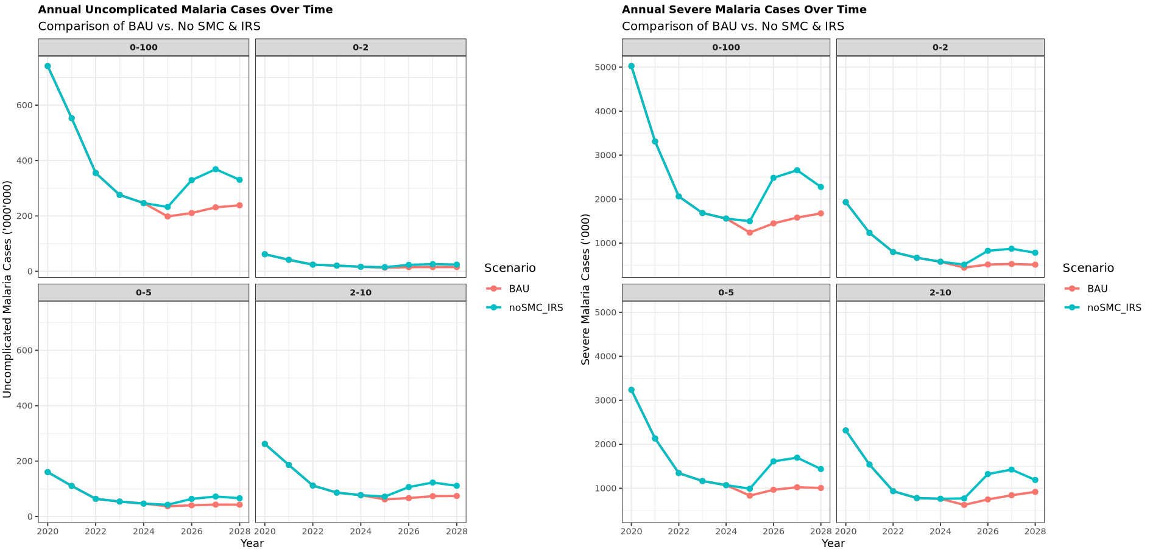
Results – Annual Uncomplicated and Severe Malaria Cases Over Time

Slide 9
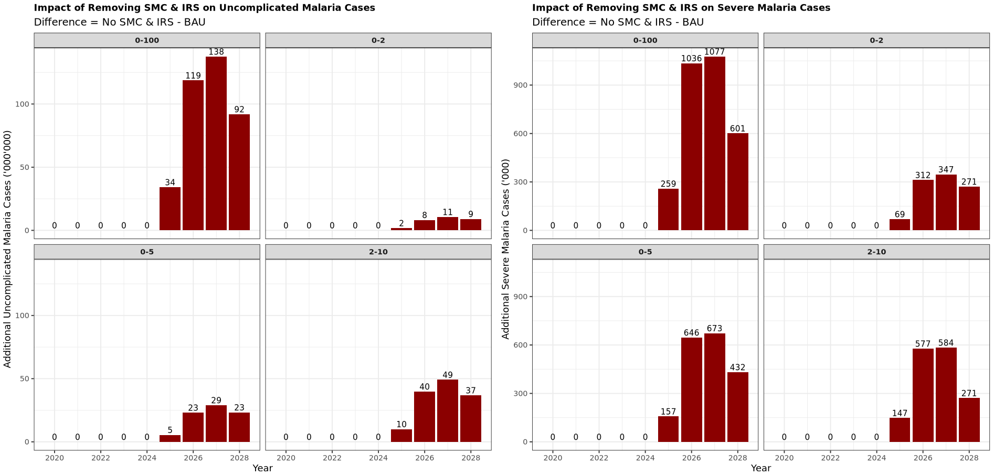
Results – Additional Number of Malaria Cases Due to Removal of IRS and SMC

Slide 10
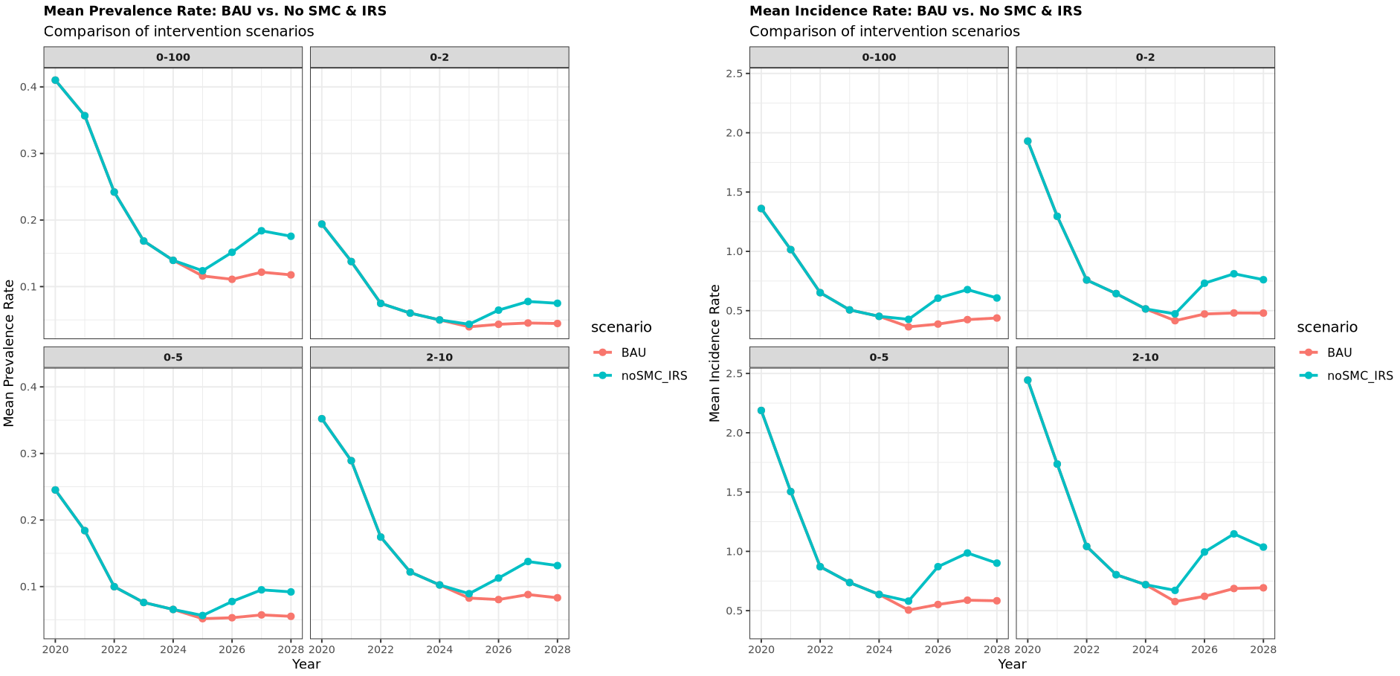
Results – Mean Prevalence and Incidence Rates

Slide 11
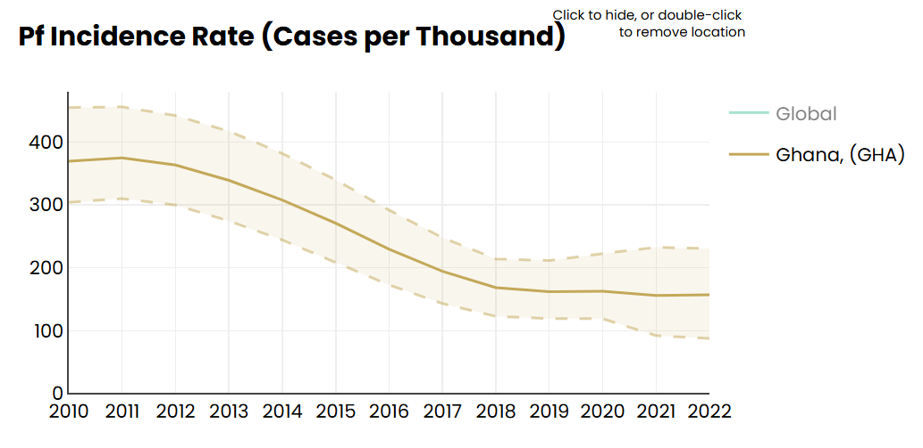
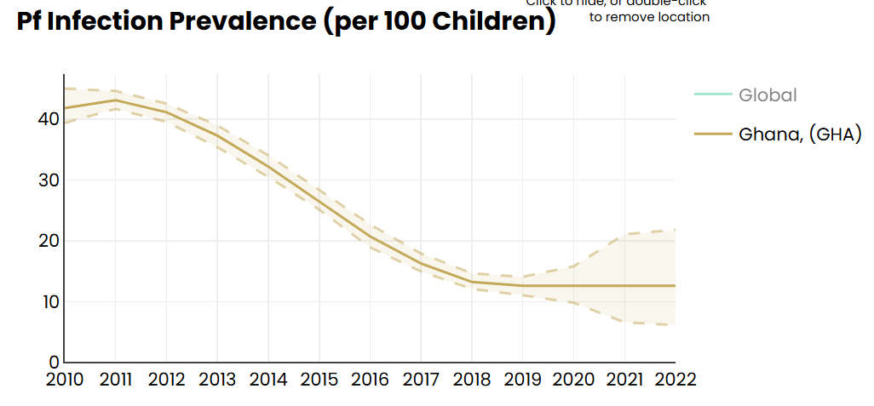
Results – Comparison with MAP estimates

