Slide 1
Calibration of Models to Data: A comparison of Methods

Slide 2
Introduction
Calibrating Mathematical and computer simulation models to data allows for uncertainty to be quantified while increasing confidence in the validity and reliability of the model and its predictions
Complex models are often fitted to data using simulation-based calibration
Several methods have been developed with little or no consensus on their performance
We compared the performance of 5 methods that differed in their Goodness-of-Fit (GOF) measures and parameter search strategies

Slide 3
Methods: Calibration Methods
 | Basic | Adaptive Sampling
Distance-based GOF (Approximate Bayesian Computation (ABC)) | Rejection ABC | ABC with Sequential Monte Carlo (AbcSmc) Sequential ABC-Lenormand (Seq ABC)
Surrogate Likelihood-based GOF | Bayesian calibration with Sampling Importance Resampling (BcSIR) | Bayesian calibration with Incremental Mixture Importance Sampling (BcIMIS)
Notes:
Two main components of model-calibration methods are the parameter-search strategy and the goodness-of-fit (GOF) measure; many options exist for each of these
GOF measures based on a surrogate likelihood function: the likelihood of observing the target statistic under the assumption that the model output is a random draw from a presumed distribution (e.g. binomial for prevalence statistics). As the model output is not necessarily distributed as presumed, we refer to this likelihood as the “surrogate” likelihood

Slide 4
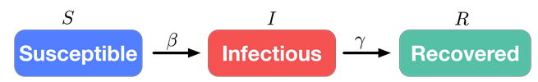
Methods: Model and stochastic framework used
SimInf: A Framework for Data-Driven Stochastic Disease Spread Simulations.
integrates infection dynamics in subpopulations as continuous-time Markov chains using the Gillespie stochastic simulation algorithm
The package contains template models and can be extended with user-defined models

Slide 5
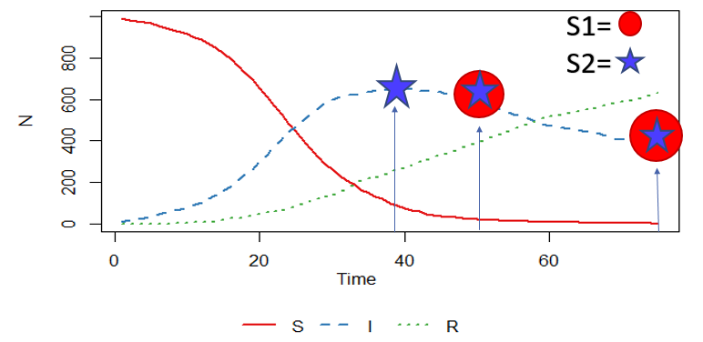
Methods: Simulation setup
Scenario 1 (S1) =
Two targets +
60 000 Model runs
Scenario 2 (S2) = Three targets +
75 000 Model runs
Targets were obtained using known parameter values (beta =0.2. gamma = 0.02)

Slide 6
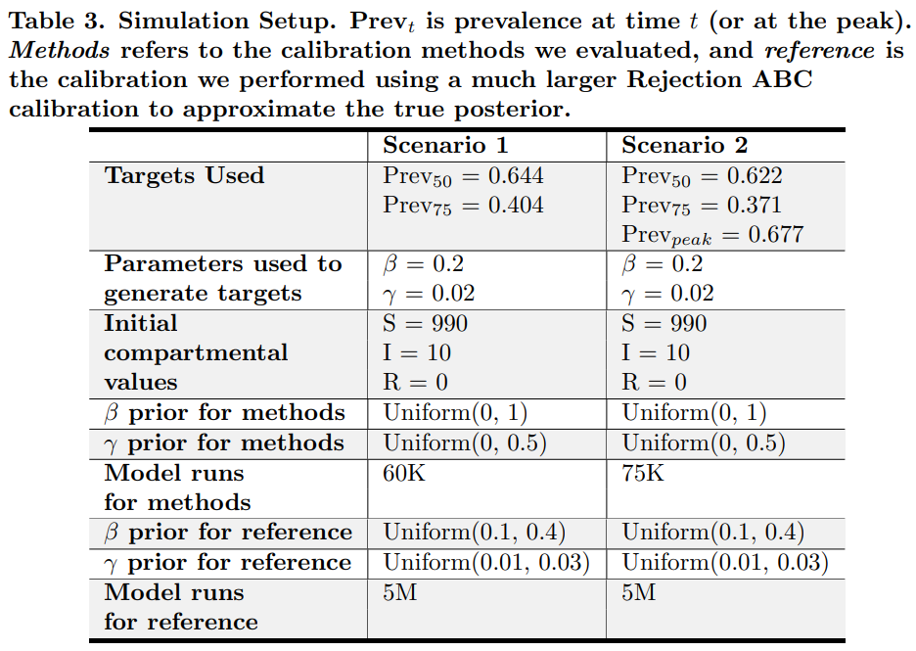
Methods: Simulation setup

Slide 7
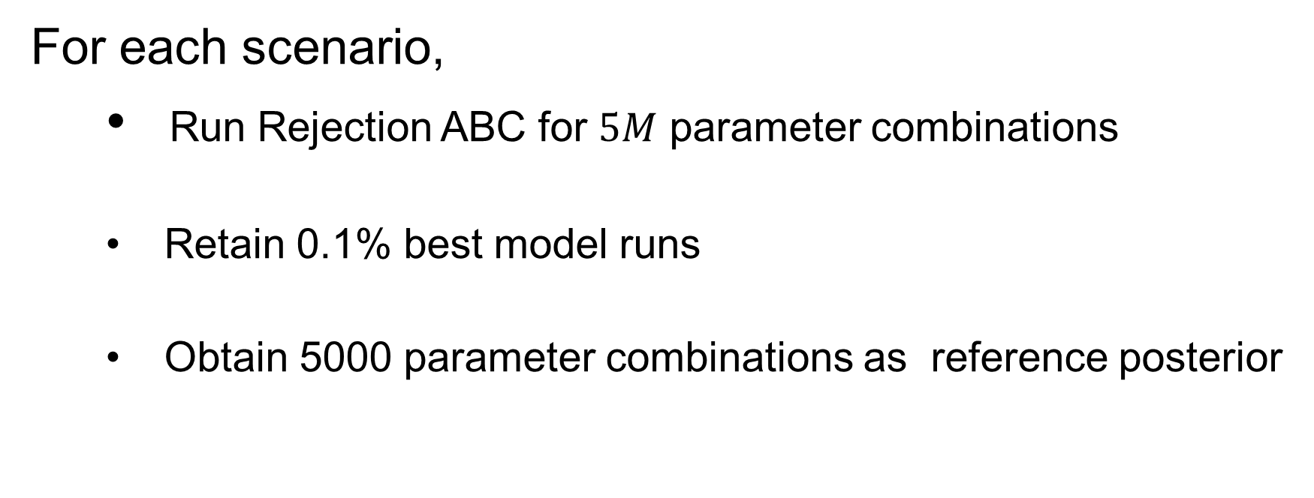
Methods: Reference
For each scenario,
Run Rejection ABC for $5M$ parameter combinations
Retain 0.1% best model runs
Obtain 5000 parameter combinations as reference posterior

Slide 8
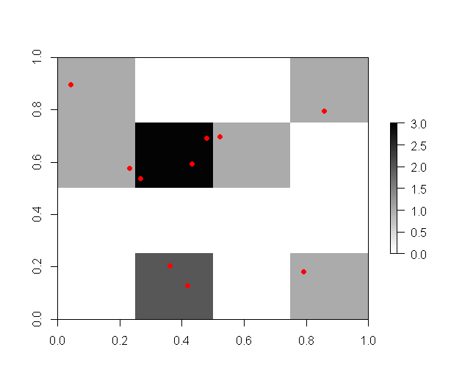
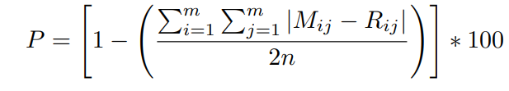
Methods: Performance measures
Percentage overlap
Quantile-Quantile plots
R0 and DT
Percentage overlap calculation

Slide 9
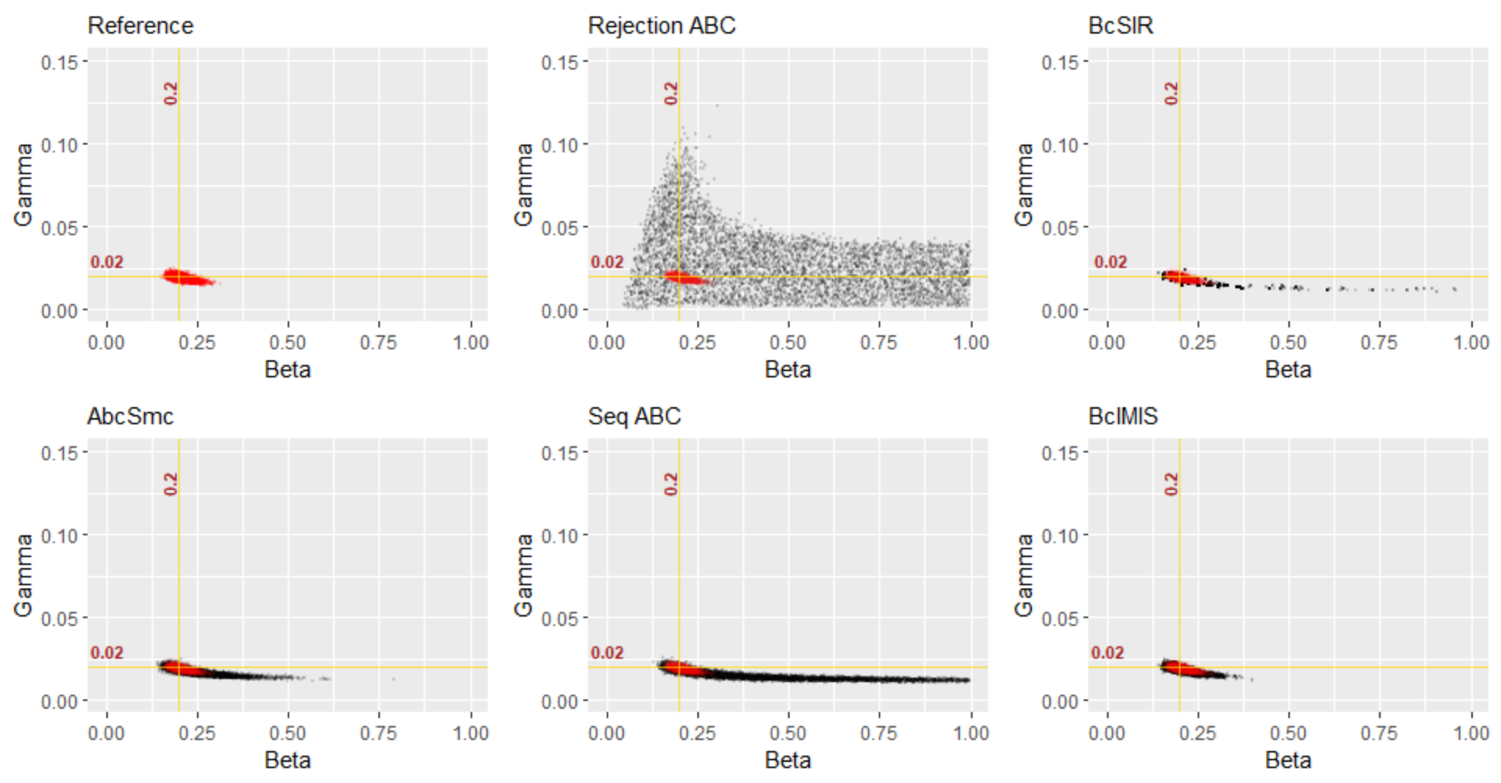
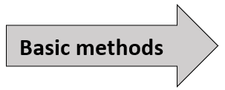
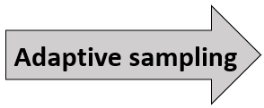
Results: Posterior plots – S1

Slide 10
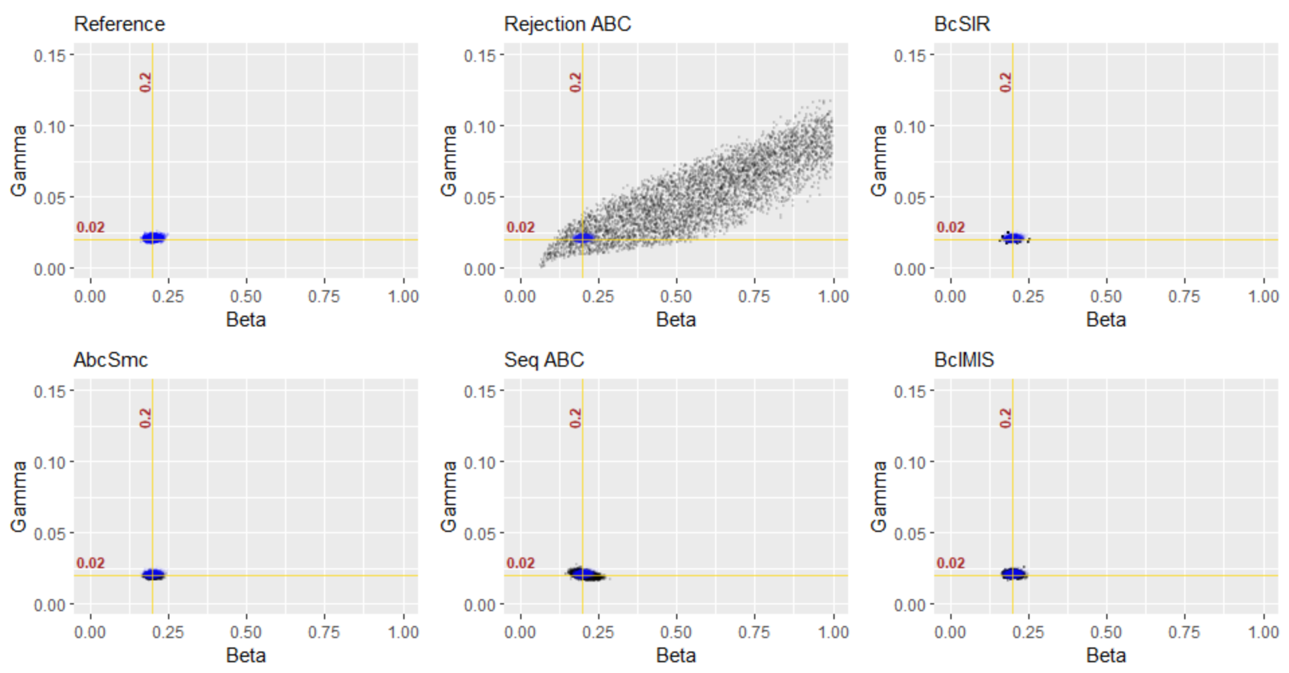
Results: Posterior plots – S2

Slide 11
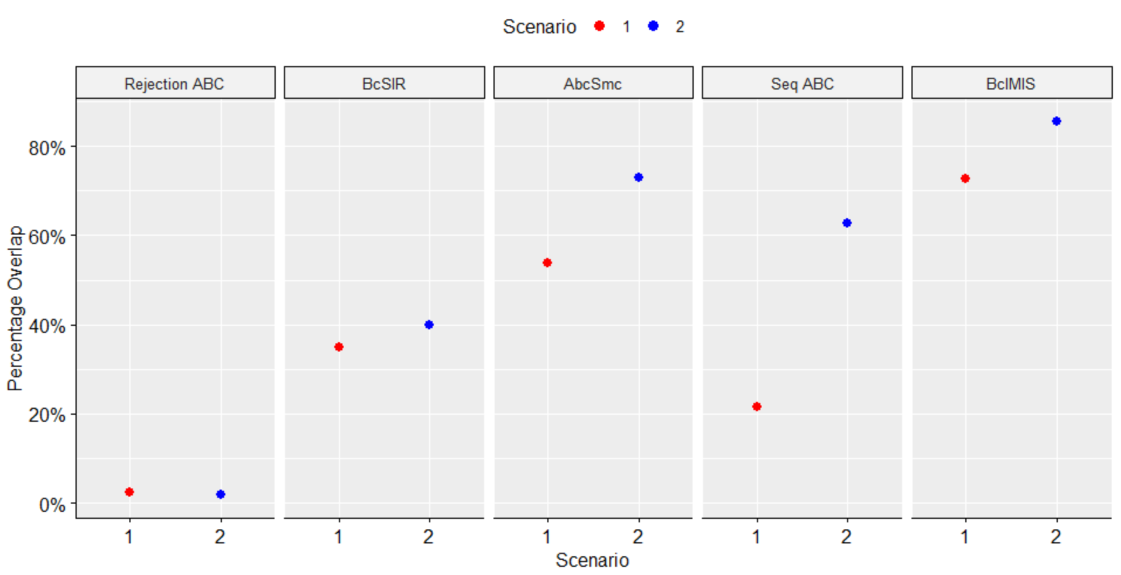
Results: Percentage overlap plot

Slide 12
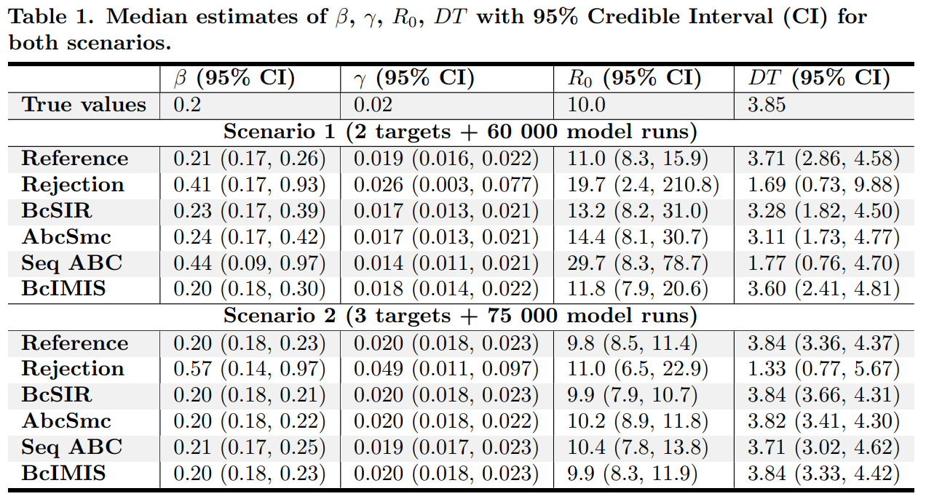
Results: Parameter estimates with uncertainty

Slide 13
Limitations
We are unsure to what extent our findings are generalizable.
we only saved computational time once, which did not allow us to account for variability between run-times
We did not use Latin squares or any other smart design for sampling parameters
We did not explore the use of multiple settings for the algorithm parameters

Slide 14
Conclusion
Basic methods led to sub-optimal results.
Surrogate Likelihood-based methods outperformed distance measure ones.
Adaptive sampling methods considerably improved efficiency over basic methods.
Use of adaptive sampling methods and or a supercomputer may be necessary for calibrating complex models.

Slide 15
Conclusion
In summary, the choice for one adaptive sampling method over another is context-dependent, conditional on computational cost, the model and the availability of programming skills in the modelling group

