Slide 1
Amazon
Tableau Analysis
– Value ratios and proportions have been altered to protect sensitive data

Slide 2
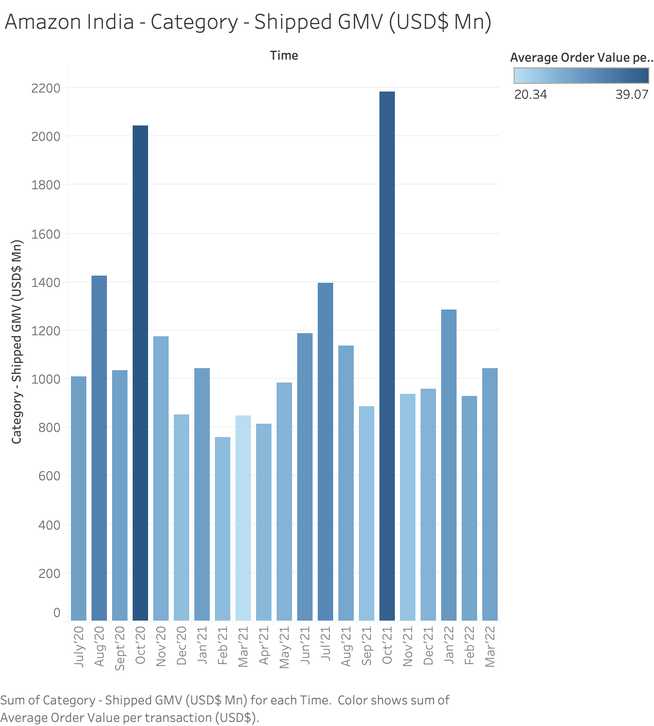

Slide 3
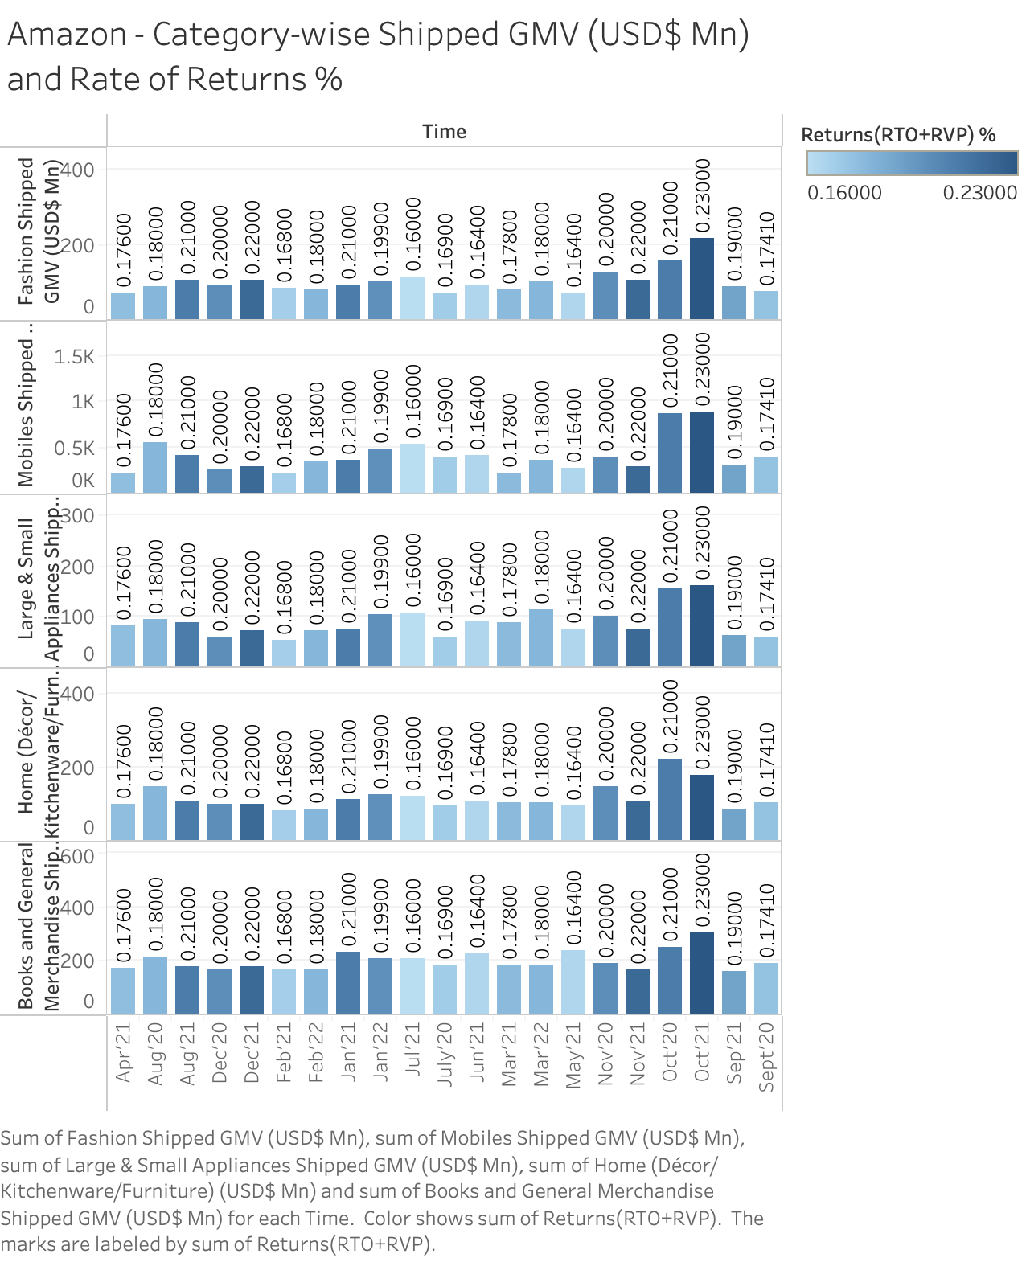

Slide 4
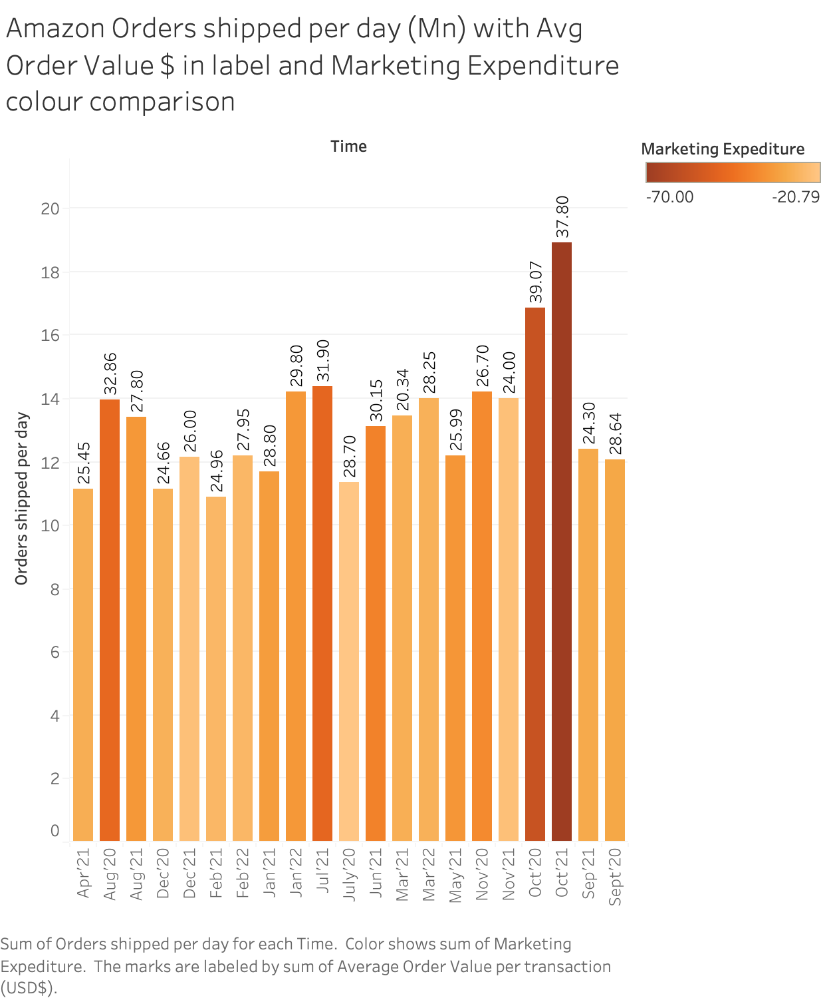

Slide 5
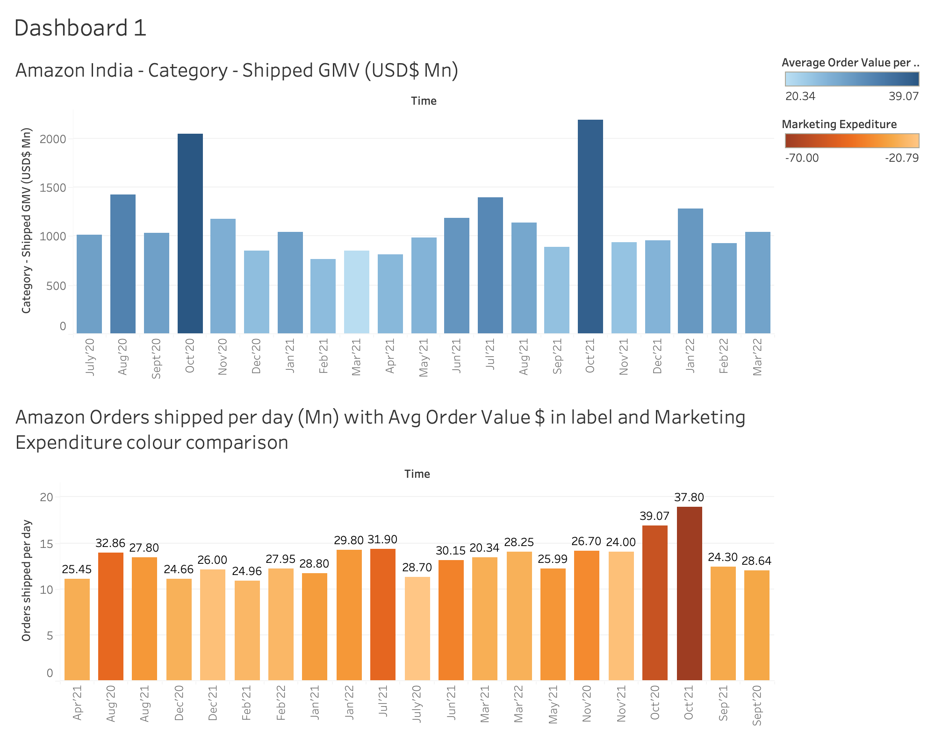

Slide 6
