Slide 1
Amazon
File created on: 3/19/24 9:38:45 AM EDT

Slide 2
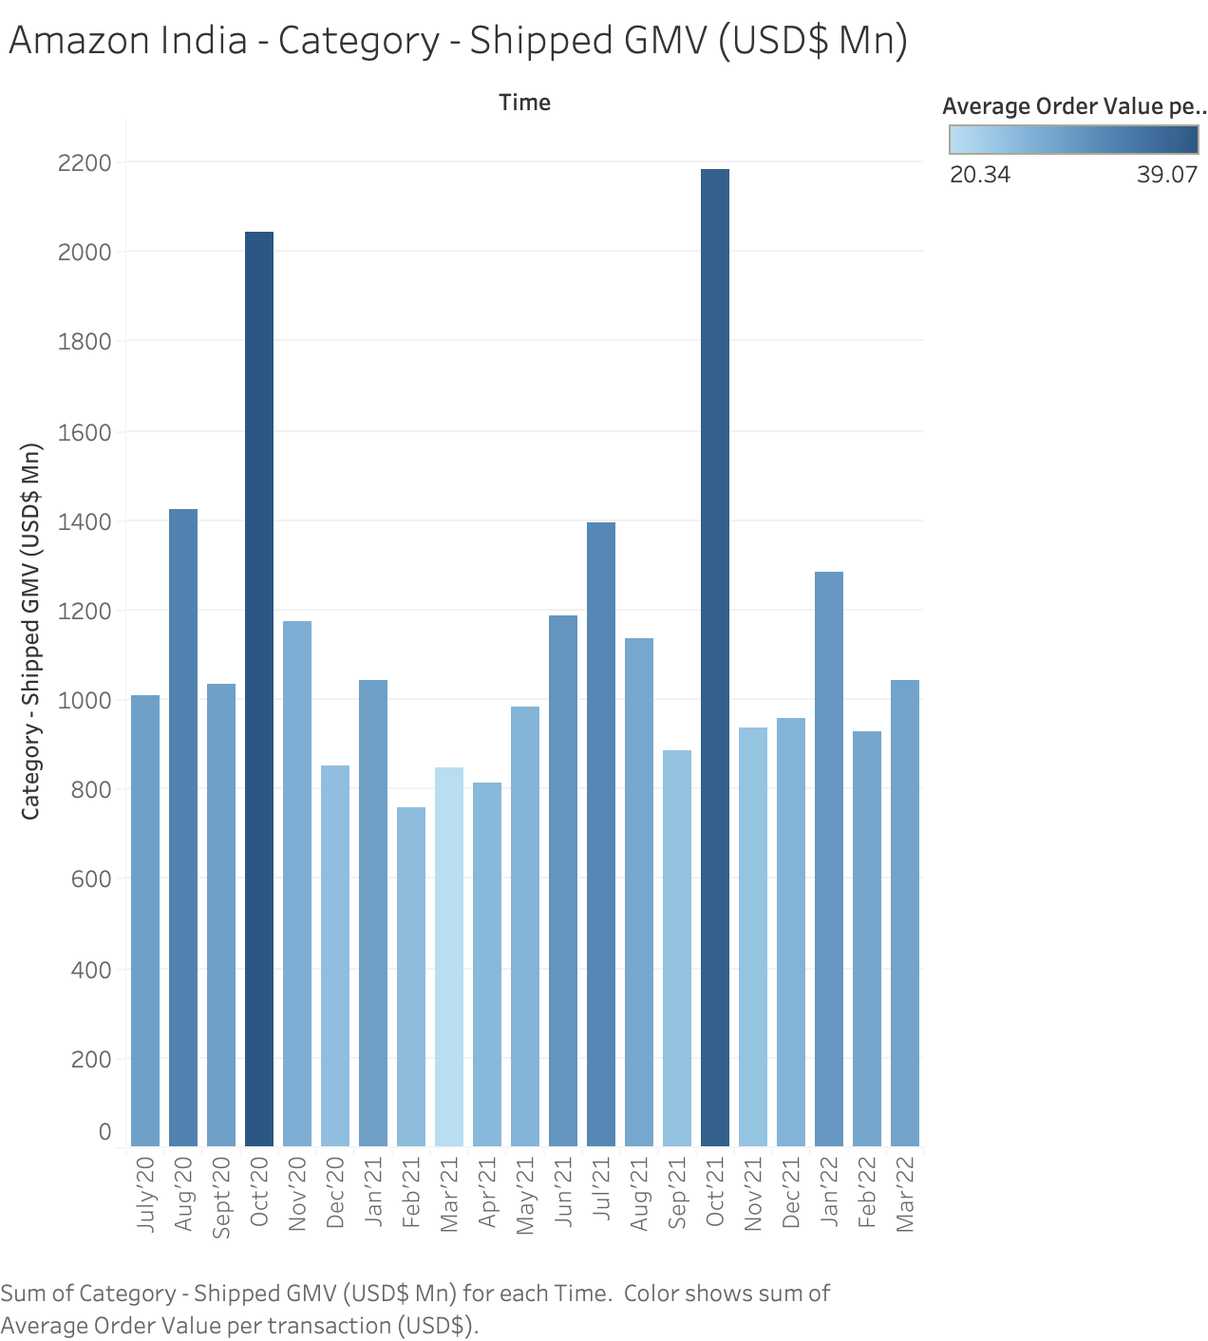

Slide 3
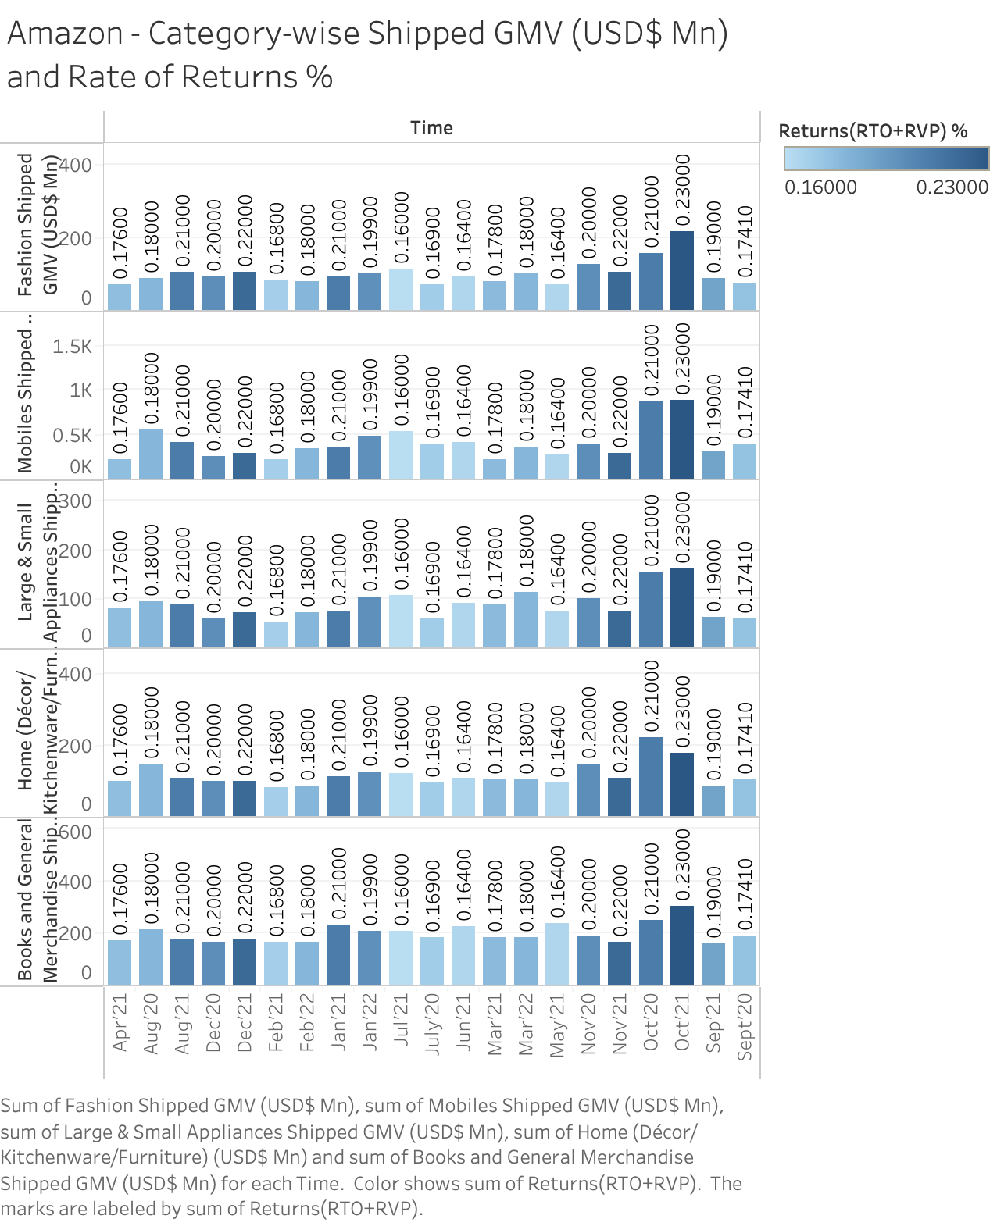

Slide 4
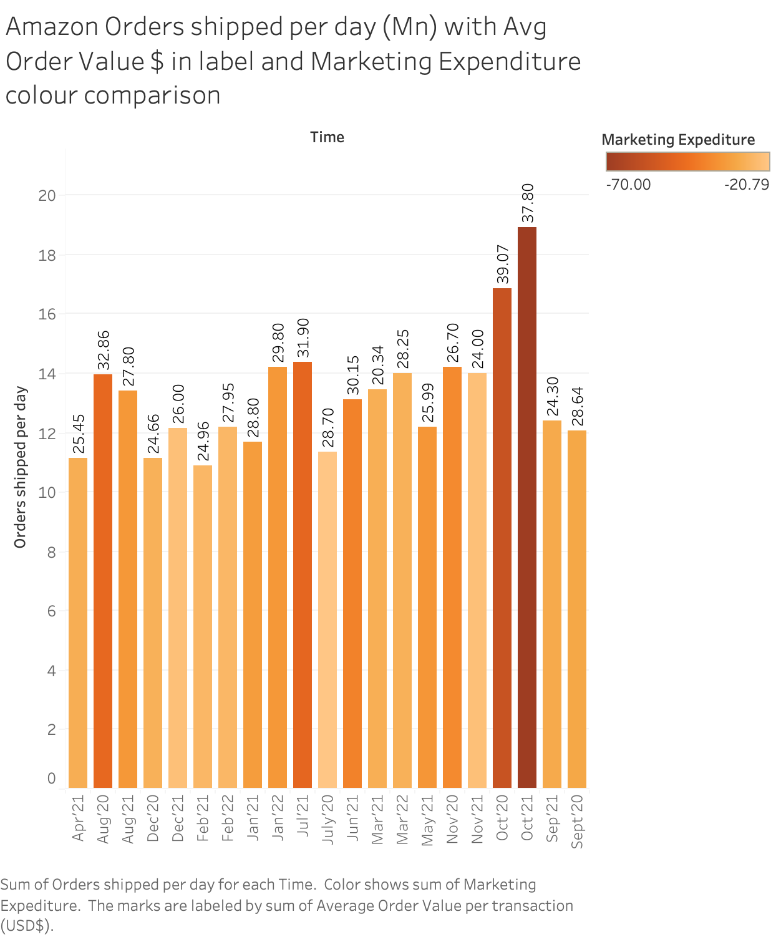

Slide 5
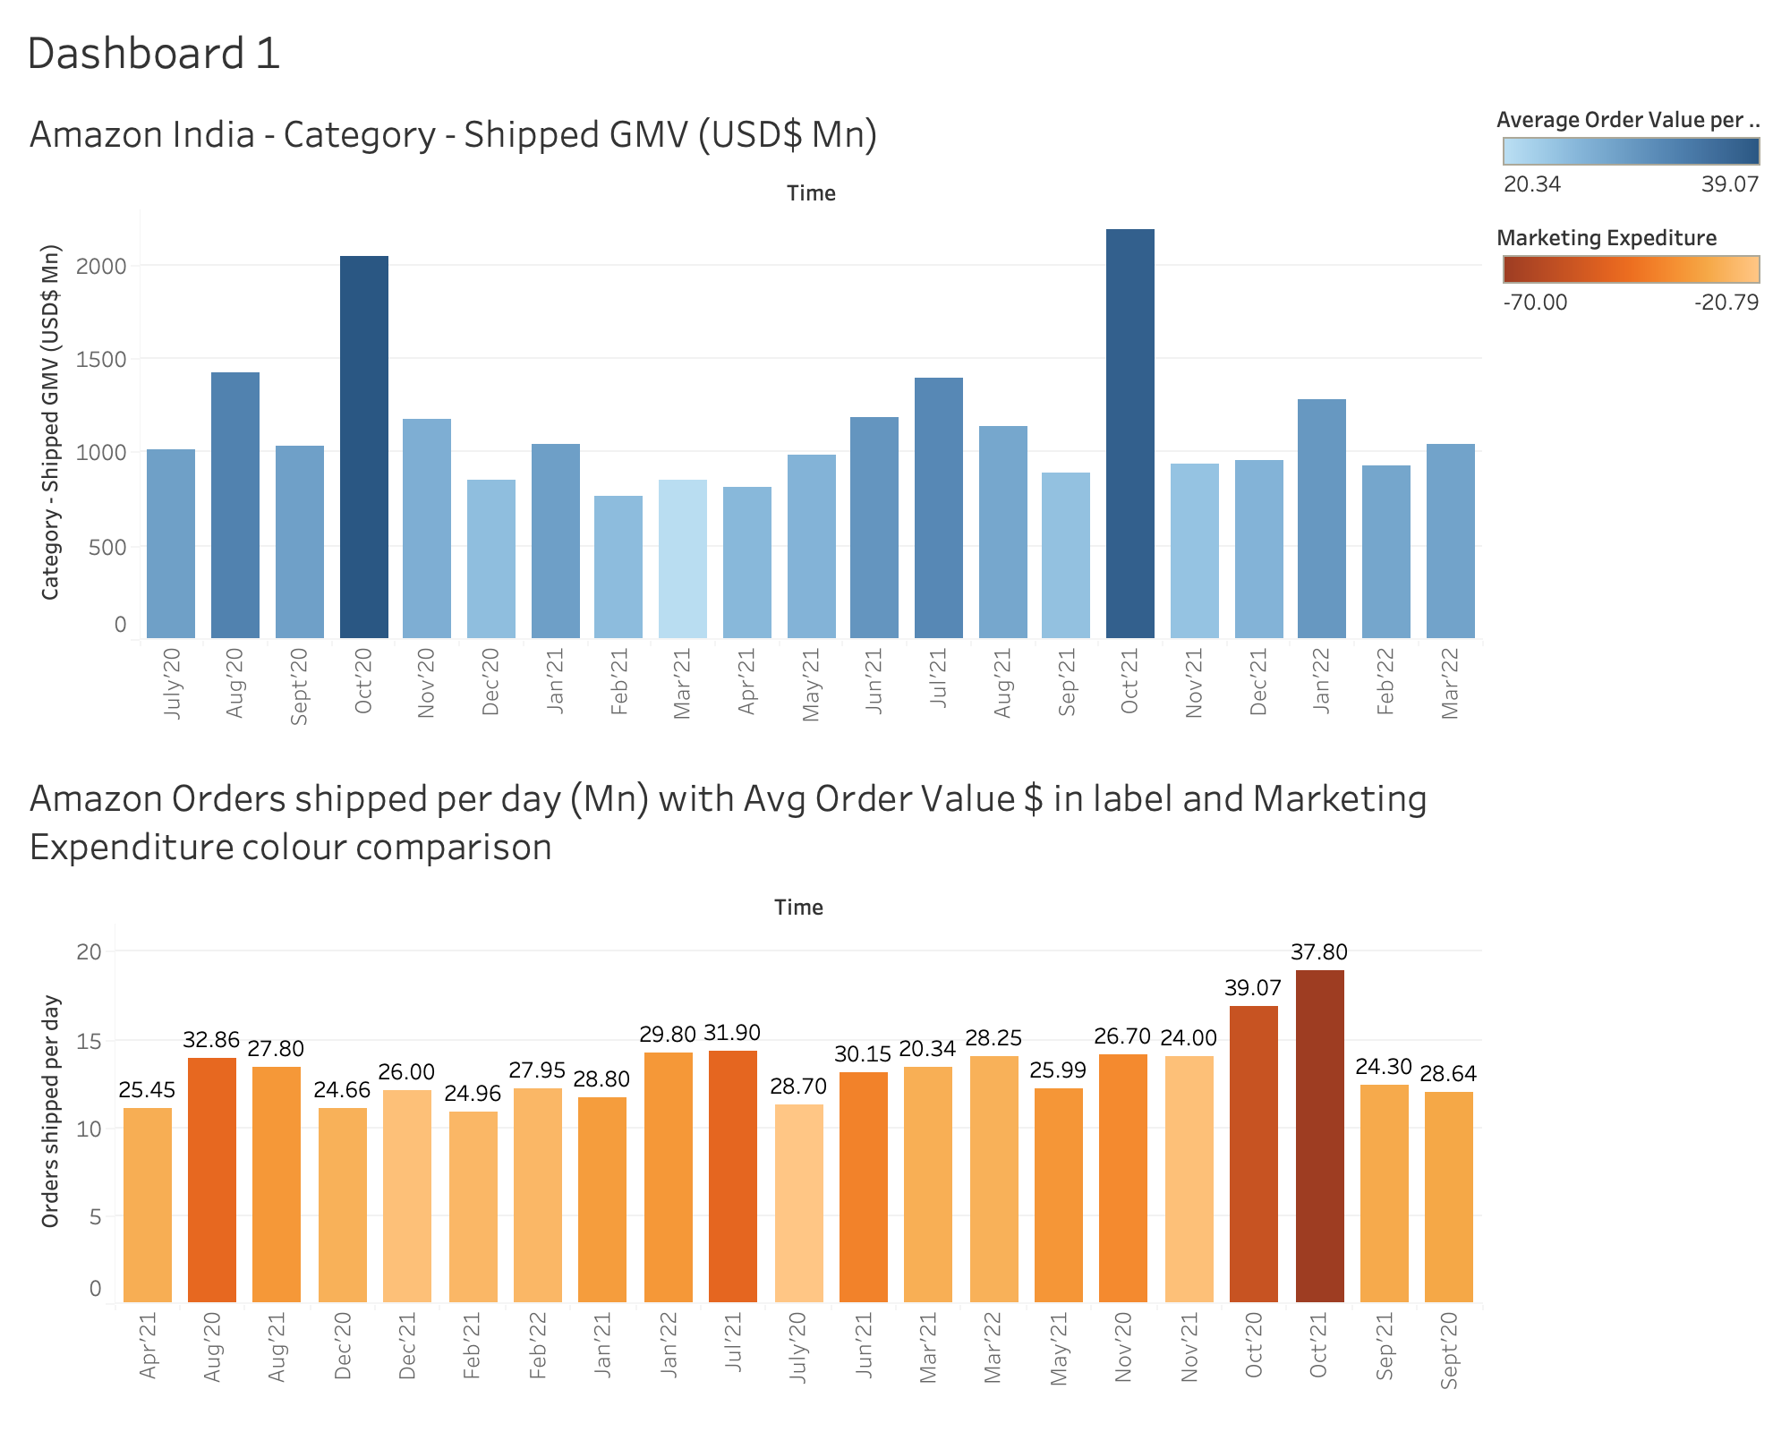

Slide 6
