Slide 1

Zend Framework 1.0.3
Built by Zend Technologies, Inc. and hundreds of other contributors from around the world:
Zend Framework is the leading open-source PHP framework and it has a flexible architecture that lets you easily build modern web apps & web services.
“Last year, when we investigated what PHP framework to use to create a service portal for our 19,000 advertisers and publishers, we chose Zend Framework because we were convinced that with Zend’s backing this project would deliver the most value of all PHP frameworks. We are very happy with the outcome, we delivered the portal in 6 months and our traffic and customer satisfaction rates have soared as a result.” --Ed Kozek, Vice President
Product Engineering, Right Media

Slide 2
Zend Framework 1.0.3
Built by Zend Technologies, Inc. and hundreds of other contributors from around the world:
Zend Framework is the leading open-source PHP framework and it has a flexible architecture that lets you easily build modern web apps & web services.
“We are using Zend Framework to power our public website and online store, as well as our partner portal and customer relationship management as well. In conjunction with our own in-house libraries it has made development and deployment much easier.”
-- Dave Lyon, ContentWatch, Inc. http://www.contentwatch.com

Slide 3
Zend Framework 1.0.3
Built by Zend Technologies, Inc. and hundreds of other contributors from around the world:
Zend Framework is the leading open-source PHP framework and it has a flexible architecture that lets you easily build modern web apps & web services.
“MVC will in fact become the jewel in the crown for ZF ... I love the importance given to decoupling and the release that this gives me from that ‘locked in feeling’ experienced on so many otherwise worthy frameworks elsewhere. As I experience it, ZF is truly first a library and that almost magically then forms an elegant framework by its innate design.”
-- Mark Maynereid,
Zend Framework User & Community Member

Slide 4
Zend Framework 1.0.3
Built by Zend Technologies, Inc. and hundreds of other contributors from around the world:
Zend Framework is the leading open-source PHP framework and it has a flexible architecture that lets you easily build modern web apps & web services.
“I have no qualifications, certifications or commercial experience. I hadn't touched PHP in close to 18 months until a week ago. In 3 days, the Zend Framework hasn't just become my Swiss army knife—it's like my tent, I wouldn't want to be without it. I've not used one other library that has enabled me to do so much, so easily.” -- L. Barton, new ZF User

Slide 5
Zend Framework 1.0.3
Built by Zend Technologies, Inc. and hundreds of other contributors from around the world:
Zend Framework is the leading open-source PHP framework and it has a flexible architecture that lets you easily build modern web apps & web services.
“We have been bowled over by the productivity we gained from the very beginning. There are so many helper functions available to us that make our lives so much simpler. For instance, using just 5 or 6 lines of code to integrate a partner company’s data, Oodle advertisements, that would have taken us several pages of code to do otherwise. You can’t usually buy that kind of productivity!”
-- Colin Seaman, Lead Architect
Adooda (http://adooda.co.uk)

Slide 6
Zend Framework 1.0.3
Built by Zend Technologies, Inc. and hundreds of other contributors from around the world:
Zend Framework is the leading open-source PHP framework and it has a flexible architecture that lets you easily build modern web apps & web services.
“From the start we have embraced and contributed to the Zend Framework project and we are very excited to deliver our product QEDWiki—the centerpiece of the IBM Mashup Starter Kit—all based on Zend Framework 1.0”
-- David Boloker, Chief Technical Officer and IBM Distinguished Engineer,
Emerging Internet Technologies,
IBM Software Group

Slide 7
Zend Framework — Jolt Award Nomination
Agenda
What is Zend Framework (ZF)?
Why Zend Framework?
Where can I learn more about Zend Framework?

Slide 8
Zend Framework — Jolt Award Nomination
Agenda
What is Zend Framework (ZF)?
Why Zend Framework?
Where can I learn more about Zend Framework?

Slide 9
Zend Framework — Jolt Award Nomination
What is Zend Framework?
What is a software ‘framework’? It’s a ‘skeleton’ of code upon which one can build an application, specific to your domain.
Why are frameworks useful to large companies?
  A headstart — cohesive set of best practices / easier hiring & staffing
  Faster time-to-market than just writing PHP from ‘scratch’
  An education — high quality code helps programmers learn/communicate using patterns language & more
Why is Zend Framework a free open-source project?
  Source is viewable—even under a restrictive license, it’s got to be viewable to be usable, regardless of the license
  Open-source—is the model that all competing frameworks follow
  Hundreds contribute—Wikipedia an example—community is essential

Slide 10
Zend Framework — Jolt Award Nomination
Agenda
What is Zend Framework (ZF)?
Why Zend Framework?
Where can I learn more about Zend Framework?

Slide 11
Zend Framework Advantages
Best Practices—As an exemplar, ZF is best practice.
Productive—reuse code quickly and often.
Simple & Easy—just like PHP, ZF is easy to adopt.
Extensible & Flexible—customize & add your value.
High Quality—rigorously tested + built-in tests to use.
Friendly License—new BSD = reuse code however you like; Apache-like CLA = safety for corporations.
Modern—web services, syndication, AJAX, search, +

Slide 12
Zend Framework In a nutshell
The leading open-source PHP framework has a flexible architecture that lets you easily build modern web applications and web services
| Page <number>
Notes:
Another major milestone, the GA - Release of Zend Framework 1.0.0 on July 2, 2007
“Extending the art & spirit of PHP, Zend Framework is based on simplicity, object-oriented best practices, corporate friendly licensing, and a rigorously tested agile codebase all focused on the challenges of building more secure, reliable, and modern Web 2.0 applications & web services, and consuming widely available APIs from leading vendors like Google, Amazon, Yahoo! / Flickr and hot new API providers and cataloguers like StrikeIron and ProgrammableWeb”

Slide 13
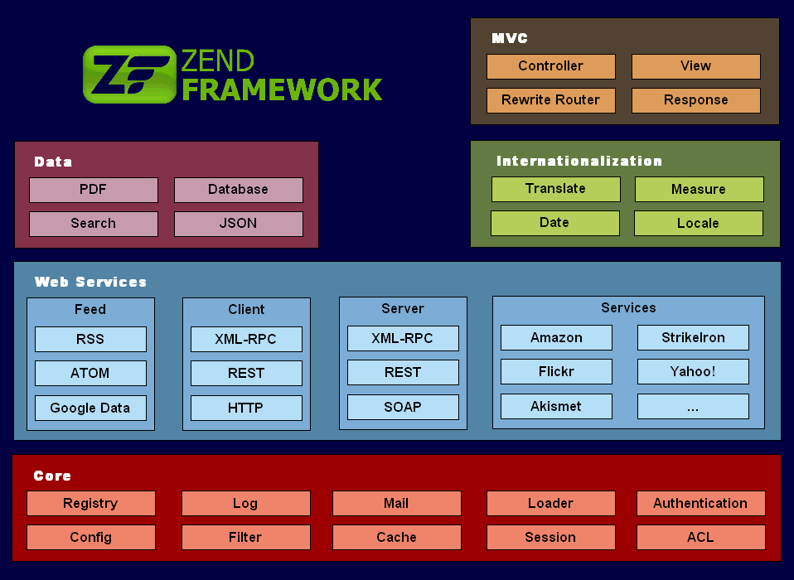
Zend Framework Components
Notes:
The overall picture. ZF consists of a number of components, organized into five major groups (color blocks). Key value-add pieces in Core, MVC crucial, Database of course, plus AJAX/JSON, Search, PDF, I18N, and of course Web Services (click)…
We are getting really good feedback on the ‘use-at-will’ (flexible) architecture from industry analysts, technical press, and especially from corporate / large enterprise clients.
Many other frameworks require an ‘all-or-nothing’ approach, whereas with ZF one can gradually adopt & migrate to it more easily.
Our focus is on creating an ecosystem of web services and APIs providers (turquoise blue box ‘surround’ animation).

Slide 14
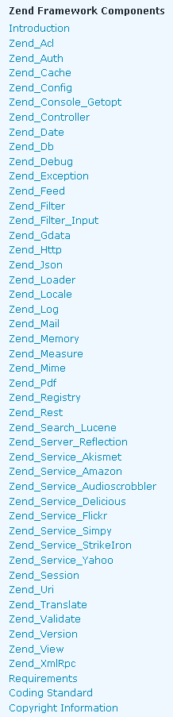
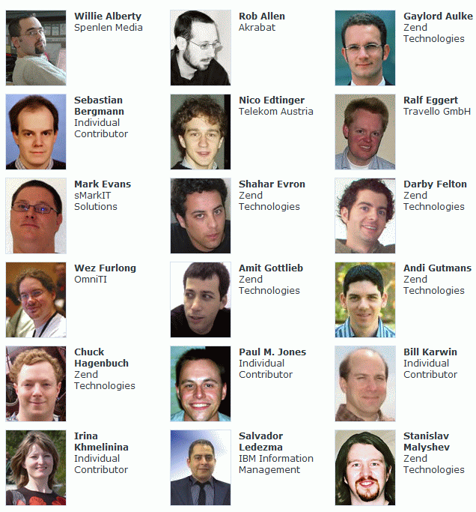
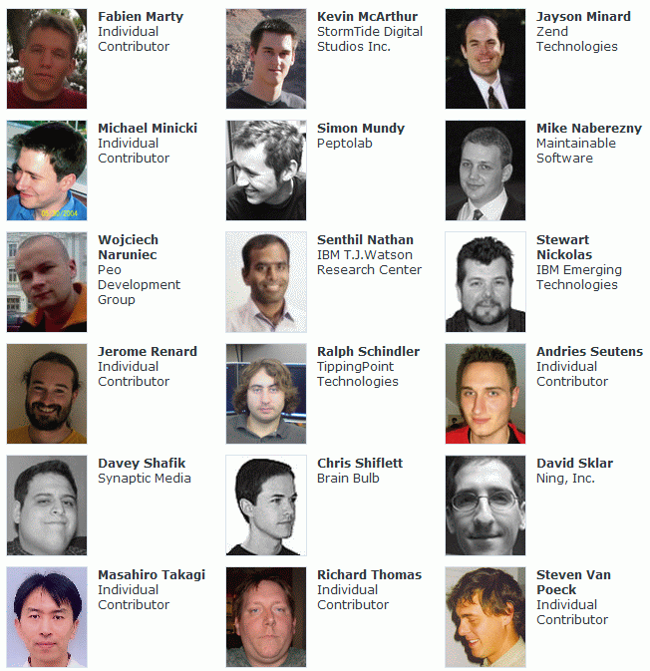
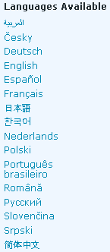





Zend Framework Facts
300+ registered contributors
Large enterprise contributors
140,000 lines of PHP code
90,000 lines of test code
87,000 words of documentation
translated into 16 languages
As of 29-Nov-2007:
2,832,000+ total downloads, 388,000+ unique downloads

Slide 15
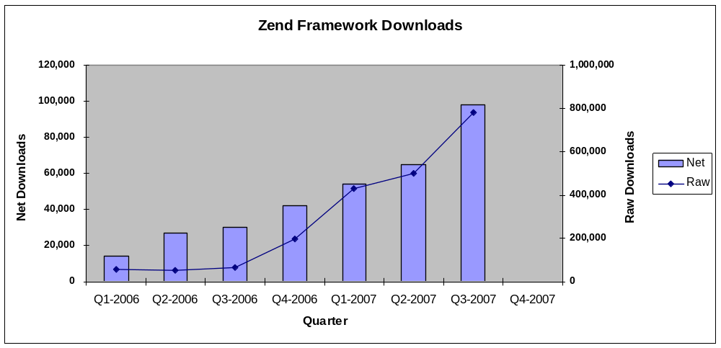
Zend Framework ~ 1M downloads projected Q4
Total (raw) downloads 2.83 million+ Total (net) “uniques” 388,000+
Notes:
Q1 2006 was only March (one month), so the initial downloads upon announcement were quite high with the interest generated.

Slide 16






Zend Framework APIs & Web Services
Our Partners:
“We have created a StrikeIron API in Zend Framework because of its Web services consumption capabilities and the momentum it is experiencing as a platform for developing Web applications. This makes it extremely easy for PHP developers to access multiple StrikeIron services in a consistent way, greatly extending the capabilities of Web apps that utilize Zend Framework.”
— Bob Brauer, CEO
StrikeIron
Some of the
Web Services we include as a part of Zend Framework:
simpy
del.icio.us

Slide 17
Zend Framework Real Business Value
Q: What do large enterprises want to know about Zend overall?
A: Zend Solution: It’s our sole business to know PHP—best practices w/ Zend Framework; integrated tools w/ Zend Studio; managed PHP w/ Zend Core; high-performance deployment w/ our application server: Zend Platform.
Q: ZF high points specific to business managers / CxOs / VPs?
A: Best Practices, consistency across projects, free of legal constraints, supported by Zend, has an ecosystem
Q: ZF high points specific to enterprise developers?
A: productivity, Best Practices, good documentation, modern & object-oriented, “safe” (Zend is the leader, mainstream, can be justified to manager), easier to hire talent/large open-source community, tools support

Slide 18
Zend Framework — Jolt Award Nomination
Agenda
What is Zend Framework (ZF)?
Why Zend Framework?
Where can I learn more about Zend Framework?

Slide 19
Zend Framework — Jolt Award Nomination
Zend Framework Resources:
Framework site: http://framework.zend.com
Introductory screencasts: http://mitchellhashimoto.com/zend-framework-tutorials/getting-started ~ Mitch shows you how to download and install Zend Framework and build your first ZF MVC application (screencasts in 4 segments of 5 min each)
Case Studies: http://framework.zend.com/whyzf/casestudies
MVC Quick Start (part of the ZF Reference Guide): http://framework.zend.com/manual/en/zend.controller.html#zend.controller.quickstart

Slide 20

Thanks for your consideration, we’re proud of all the Zend Framework community has accomplished in a very short period of time (ZF 1.0.3)!

