Slide 1

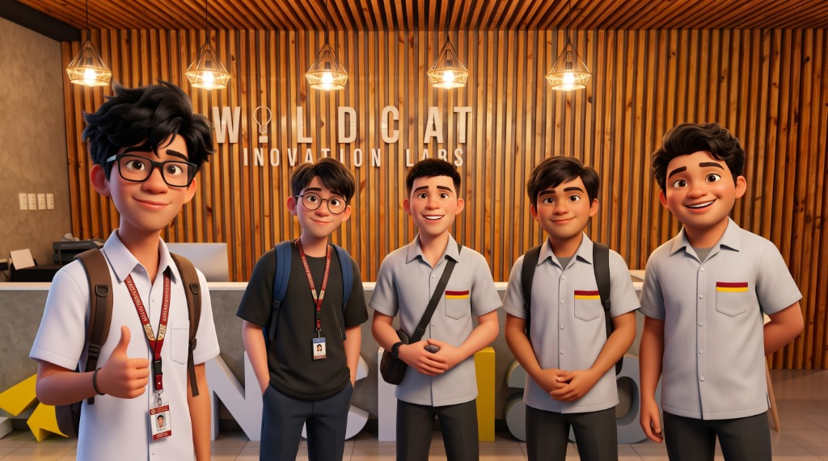
PlayIT
15 of 16
Offline phonics for Grade 1 learners
children chose the happy face
An Offline-First Gamified Early Literacy Mobile Application Using the DepEd Marungko Approach
Group 56 · IT411 Capstone & Research 2 · CCS, CIT-University
The Problem
Our Solution
1
One teacher, many readers
A phonics game where Lily the Tarsier teaches letter sounds, listens to the child, and cheers them on.
Little one-on-one time for letter sounds.
2
Few materials at home
Worksheets cannot listen or answer back.
3
No steady internet
100% offline
Hears the child
Marungko order
Most reading apps need a connection.
How It Works
26 letters · 7 chapters · m, s, a, i first
fresh
screenshot
assets/screen_hearit.png
fresh
screenshot
assets/screen_sayit.png
fresh
screenshot
assets/screen_findit.png
fresh
screenshot
assets/screen_blendit.png
fresh
screenshot
assets/screen_parent.png
For parents
›
›
›
Parent Zone shows progress in plain words and saves a PDF report.
1 Hear It
2 Say It
3 Find It
4 Blend It
Kotlin + Jetpack Compose
Clean Architecture, MVVM
Room database + Vosk speech
No internet permission
Results & Validation
PROJECTED — replace with real results before printing
Round 2 · 30 participants: 16 Grade 1 learners · 9 parents · 5 teachers
Our users: Grade 1 learners, observed while playing
The bridge to the child: parents and teachers (1 to 5)
15 of 16
Parents: useful for learning at home (n = 9), goal 4.2
chose the happy face after playing
4.5 / 5
12 of 16
Parents: offline is practical for us (n = 9)
passed Say It on the first try
4.8 / 5
13 of 16
Teachers: teaching quality, 7 items (n = 5), goal 4.0
finished a letter with no adult help
4.7 / 5
“The app is very useful and engaging for Grade 1 learners.” — DepEd Grade 1 teacher, Round 1 (T-1)
Software quality: 691 automated unit tests pass, 0 fail
Impact
Our Team
QR code
(square)
assets/qr_pitch.png
Scan to Watch Our 2-Minute Project Pitch
Reading practice anywhere: no signal, no load, no ads.
Next: measure reading gains over a full term.
Zendrix Riva (Lead)
John James Palis
Kaysean Miel
Ashlee Skye Durano
Erik Samuel Bien
Adviser: Mr. Joemarie C. Amparo
Selected References
Brooke, J. (1996). SUS: A quick and dirty usability scale. In Usability Evaluation in Industry.
Davis, F. D. (1989). Perceived usefulness, perceived ease of use, and user acceptance of information technology. MIS Quarterly, 13(3).
Ehri, L. C., Deffner, N. D., & Wilce, L. S. (1984). Pictorial mnemonics for phonics. Journal of Educational Psychology, 76(5).
Gonzalez-Frey, S. M., & Ehri, L. C. (2021). Connected phonation is more effective than segmented phonation. Scientific Studies of Reading, 25(3).

