Slide 1

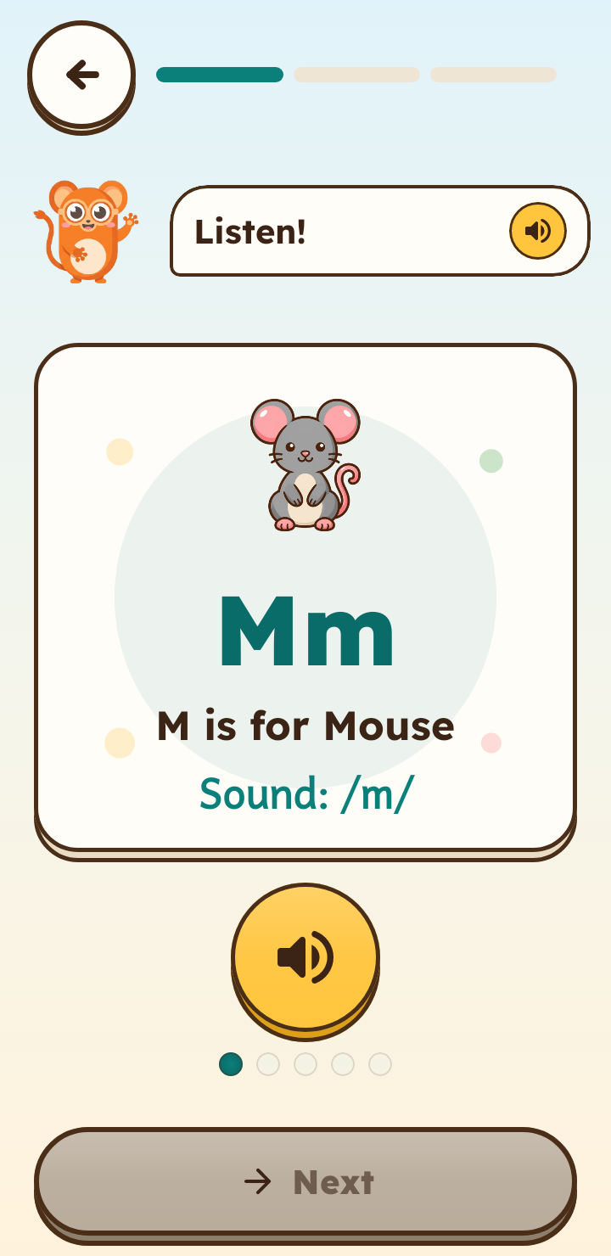
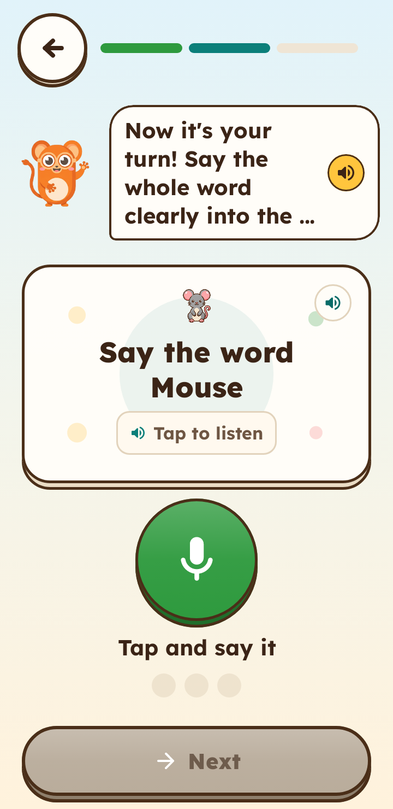
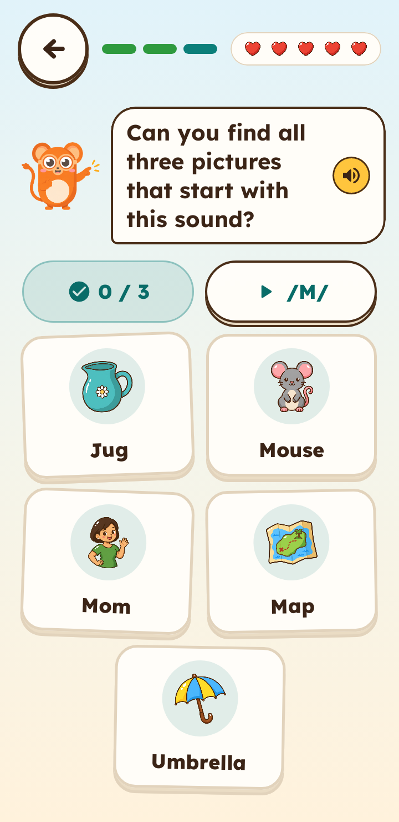
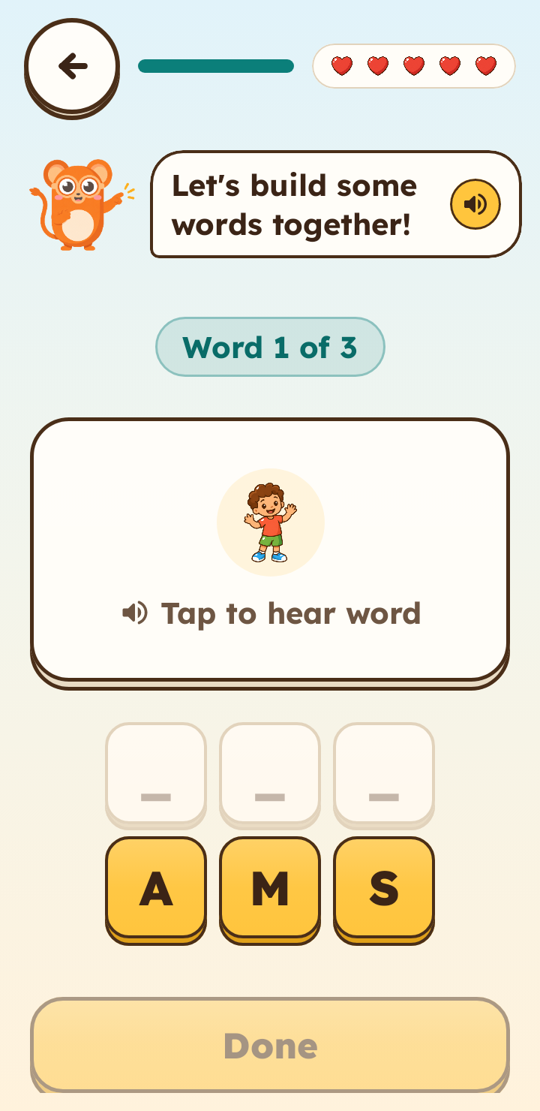
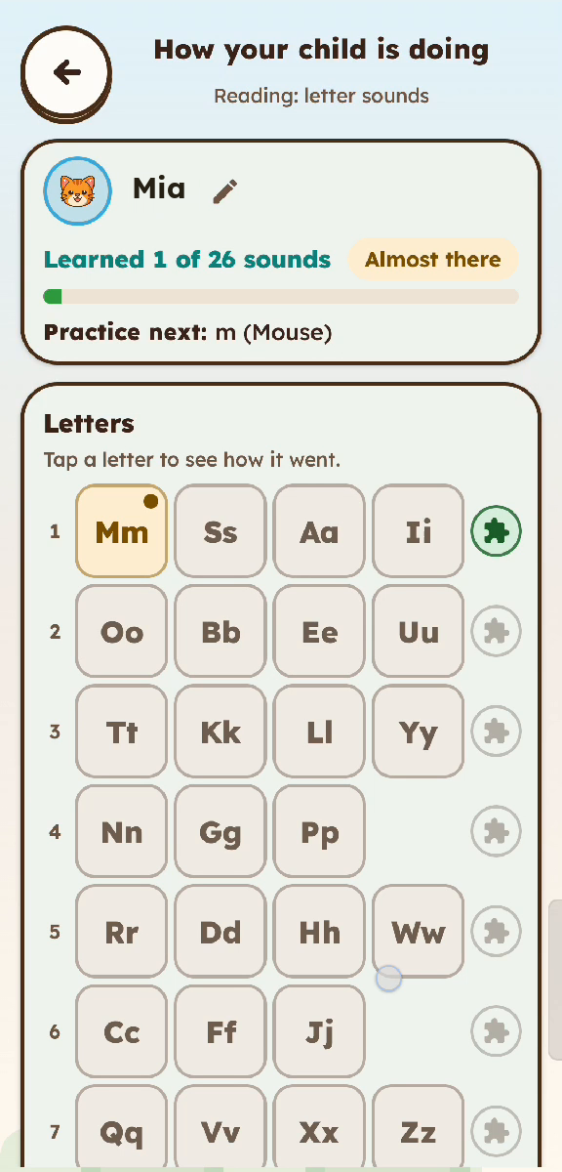
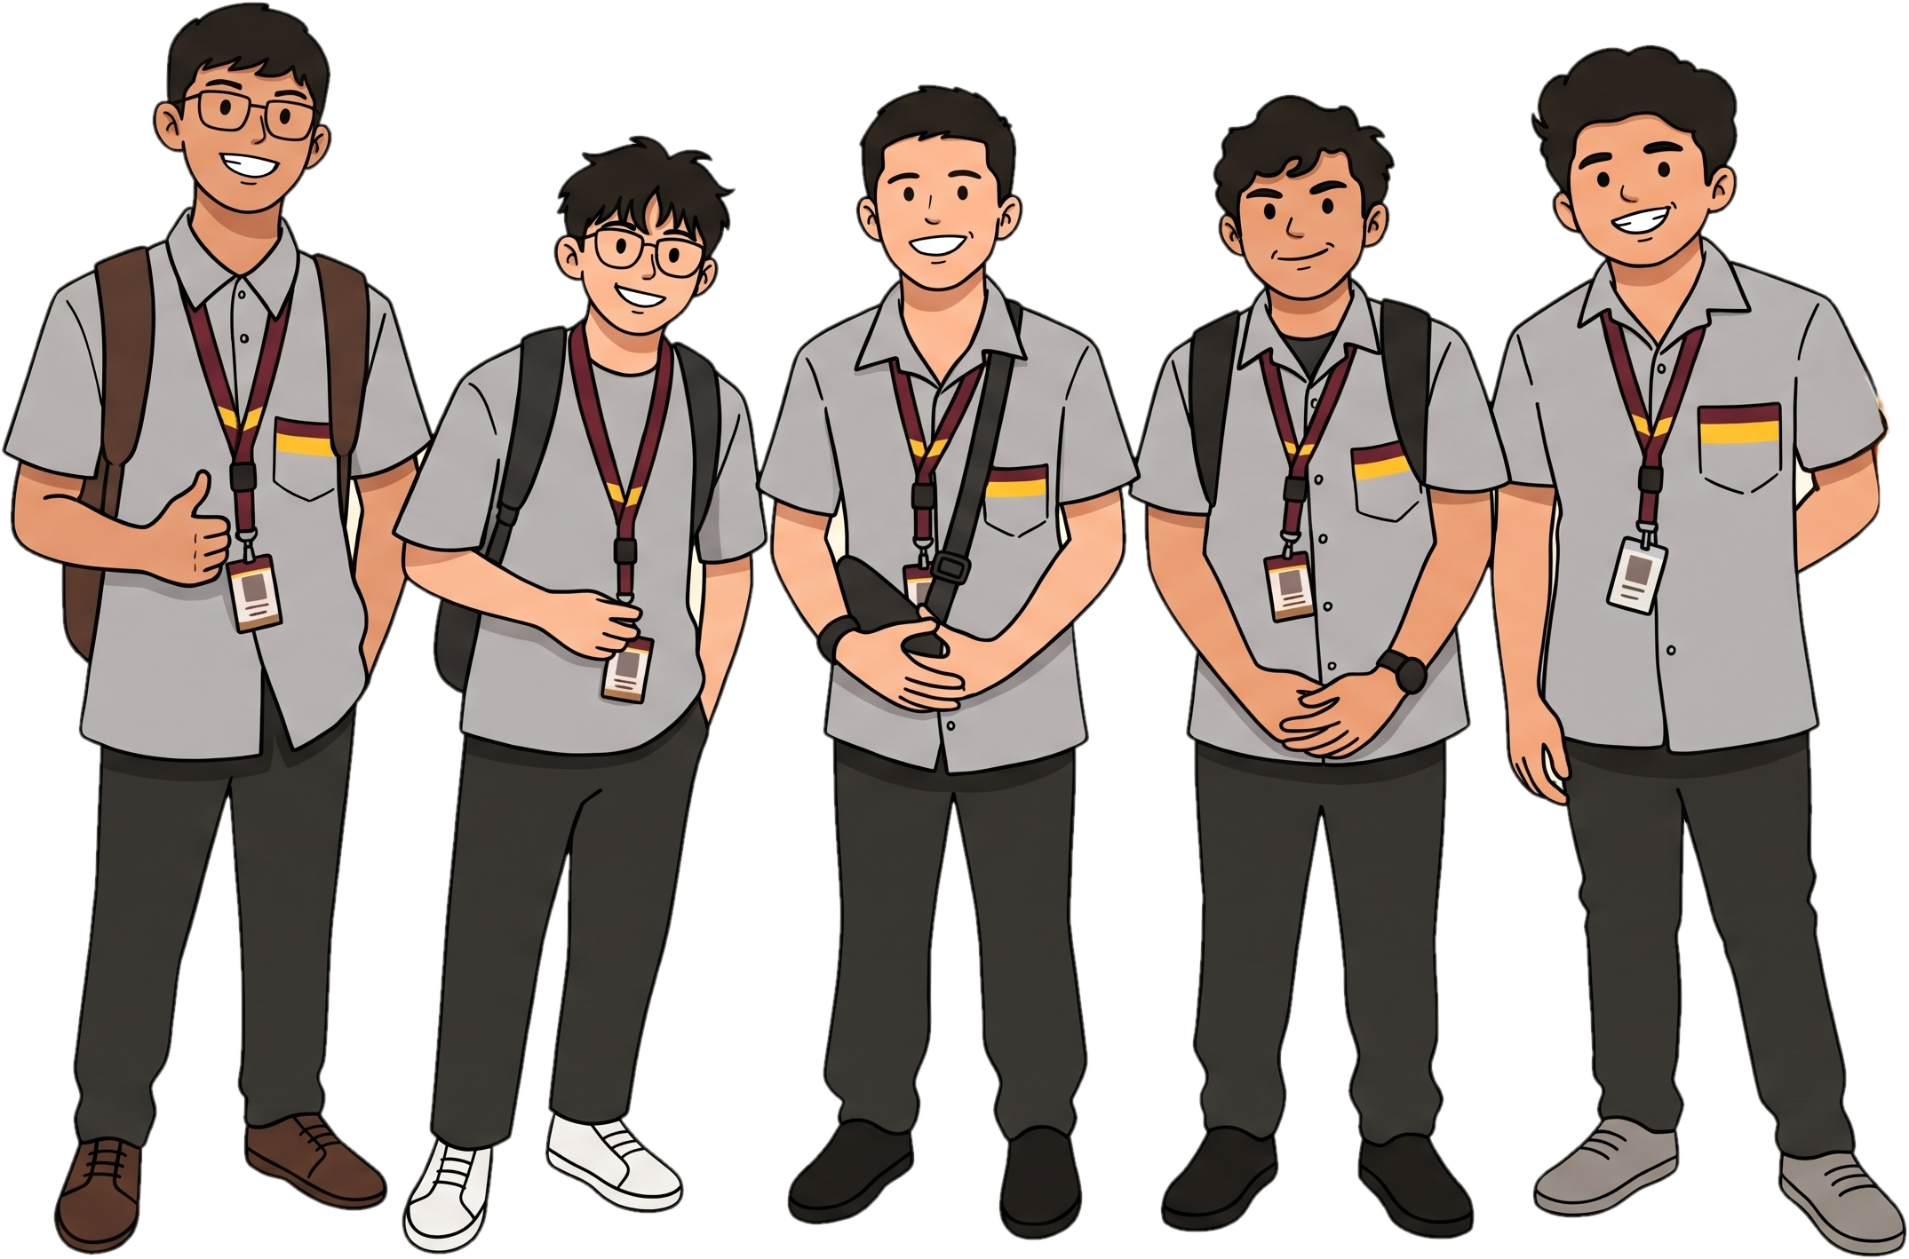

PlayIT
15 of 16
Offline phonics for Grade 1 learners
children chose the happy face
An Offline-First Gamified Early Literacy Mobile Application Using the DepEd Marungko Approach
Group 56 · IT411 Capstone & Research 2 · CCS, CIT-University
The Problem
Our Solution
1
One teacher, many readers
A phonics game where Lily the Tarsier teaches letter sounds, listens to the child, and cheers them on.
Little one-on-one time for letter sounds.
2
Few materials at home
Worksheets cannot listen or answer back.
3
No steady internet
100% offline
Hears the child
Marungko order
Most reading apps need a connection.
How It Works
26 letters · 7 chapters · m, s, a, i first
For parents
›
›
›
Parent Zone shows progress in plain words and saves a PDF report.
1 Hear It
2 Say It
3 Find It
4 Blend It
Kotlin + Jetpack Compose
Clean Architecture, MVVM
Room database + Vosk speech
No internet permission
Results & Validation
Rounds 1–2 · 30 participants: 16 Grade 1 learners · 5 parents/adults · 9 teachers
Our users: Grade 1 learners, observed while playing
The bridge to the child: parents and teachers (1 to 5)
15 of 16
Parents/adults: Grade 1 fit (n = 5)
chose the happy face after playing
4.6 / 5
14 of 16
Parents/adults: would recommend (n = 5)
said they would play it again
4.4 / 5
15 of 16
Teachers: R2 teaching, 16 items (n = 5), goal 4.0
liked the characters (top face)
4.7 / 5
“The app is very useful and engaging for Grade 1 learners.” — DepEd Grade 1 teacher, Round 1 (T-1)
SUS usability: 75.5 (n = 5) · Software tests: 691 pass, 0 fail
Impact
Our Team
Scan to Watch Our 2-Minute Project Pitch
Reading practice anywhere: no signal, no load, no ads.
Next: measure reading gains over a full term.
Zendrix Riva (Lead)
Erik Samuel Bien
Ashlee Skye Durano
Kaysean Miel
John James Palis
Adviser: Mr. Joemarie C. Amparo
Selected References
Brooke, J. (1996). SUS: A quick and dirty usability scale. In Usability Evaluation in Industry.
Davis, F. D. (1989). Perceived usefulness, perceived ease of use, and user acceptance of information technology. MIS Quarterly, 13(3).
Ehri, L. C., Deffner, N. D., & Wilce, L. S. (1984). Pictorial mnemonics for phonics. Journal of Educational Psychology, 76(5).
Gonzalez-Frey, S. M., & Ehri, L. C. (2021). Connected phonation is more effective than segmented phonation. Scientific Studies of Reading, 25(3).

