Slide 1
Team Name
🤖🏁 Turing Test Flag
AI Reporting Feature for Compliance
Erin Pangilinan I Dave Howard I Brandon Rutter-Daywater
GH - @erinjerri I @zefosec I @blruda
Notes:
Erin

Slide 2
Open Source and Enterprise project compliance experts need better surfacing of vulnerabilities to AI-g.
Increasing Complexity: AI-generated code is becoming more complex, making it difficult to identify vulnerabilities.
Compliance Challenges: Ensuring compliance with cybersecurity standards is time-consuming and error-prone.
Lack of Visualization Tools: Current tools do not provide intuitive visualizations for AI-generated code risks, and checks for this type of compliance are not integrated in the development cycle.
PROBLEM
Notes:
Note: some compliance standards require NO code be generated by AI - testing for that could decrease compliance risk

Slide 3
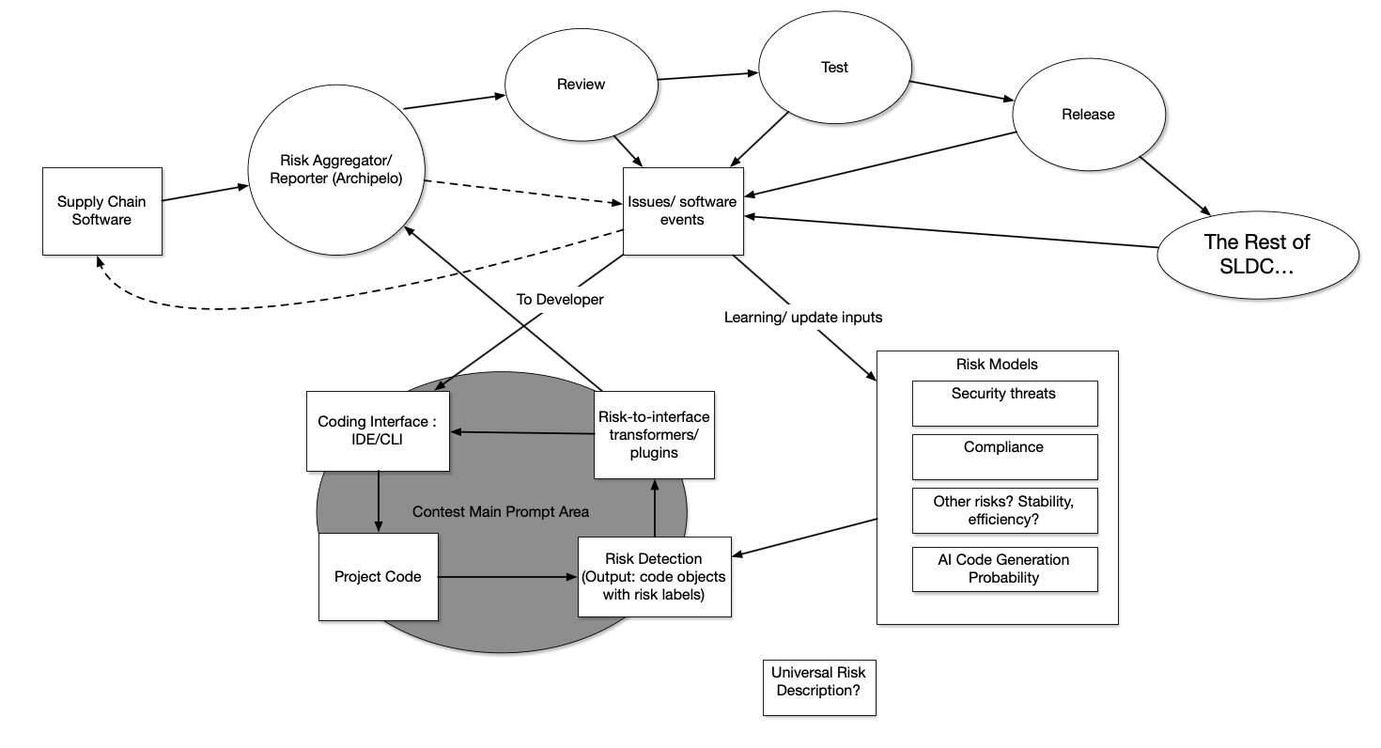
Framing Our Solution
Notes:
Brandon
Here’s that diagram of software supply chain, Archipelo risk reporting, and the broader SLDC. - more accurate now that we’ve actually worked on a solution. Dotted lines, “learning/update inputs”, and “universal risk description” are future work in the direction of automated learning of risks in a way that could be integrated into streamlined tools for developers and the broader development team. The grey blob represents the area around the initial request for this challenge, integration of security and compliance features into the coding interface. (next)

Slide 4
Framing Our Solution
Notes:
Brandon
Today’s Turing Test Flag Team efforts focused mainly in this area, prototyping a solution for the detection of AI generated code in a way that it can be exposed both to the developers pre-commit, and to consumers of the CI-level aggregated risk reports from Archipelo. This conceptual solution could be extended to other types of risk models, including those that already exist but are currently only reported at the CI level.

Slide 5
A Python based script/integration using AI foundation model to return confidence level reflecting how much of a code base was written by an AI.
We report scores both to coding interface for devs, and to Archipelo/CI for transparency and collaboration across dev, security, and compliance teams
Benefits: Turing Flag improves efficiency and accuracy for cybersecurity compliance experts, while allowing developers to review and address issues pre-commit.
SOLUTION OVERVIEW

Slide 6
FEATURES
Solution #1
Compliance Dash Feature - The chart that goes into Archipelo Dashboard
The Dashboard displays a quick overview within a code repository project, including for each file the % confidence it was written by AI.
Integrated with other Archipelo risk reports.
Solution #2
VS Code Command Line Data Visualization Dashboard - Identify Percentage of AI for each file, or for file currently being edited.

Slide 7
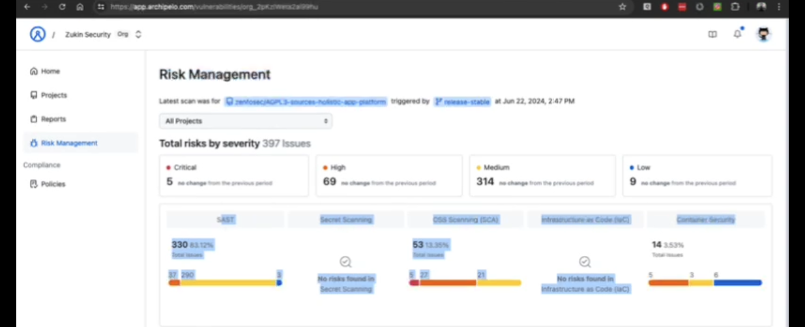
Solution #1: Compliance DSash Feature
Notes:
Erin

Slide 8
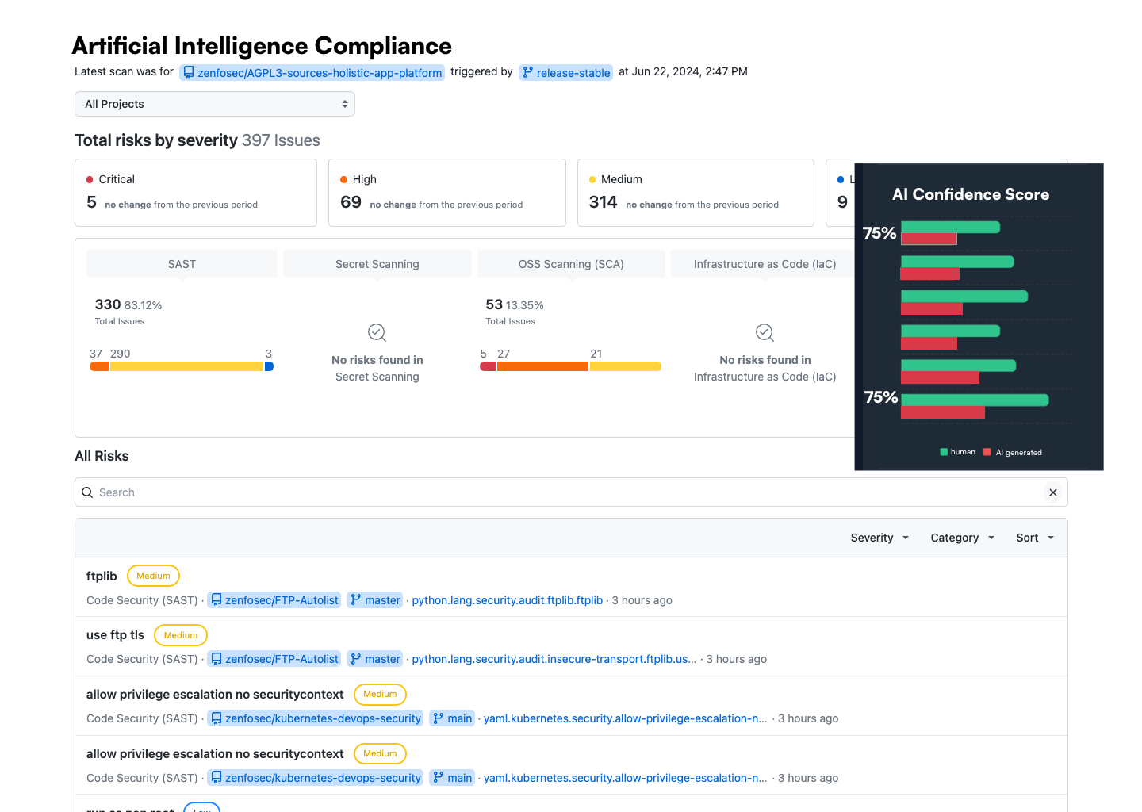
// Added Dashboard Component Visualizing AI Identifier

Slide 9
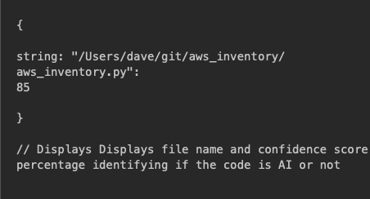
JSON
Notes:
Erin

Slide 10
CLI-based AI Flag
This Python code shows a quick dashboard overview within a code repository project the % confidence score of the code base being an AI generated..
Notes:
Dave

Slide 11
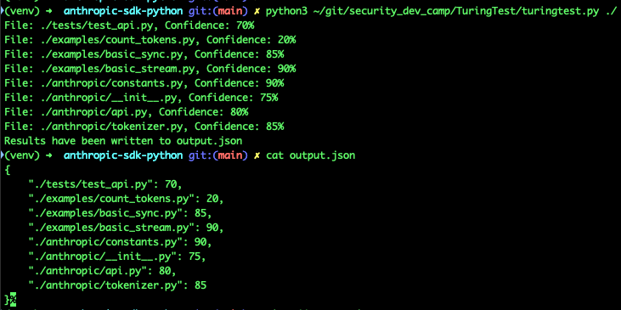
CLI Screenshot
Each file and risk score, confidence level
Watch output
List of files the repo
Each one has confidence score
This Dashboard displays shows a quick dashboard overview within a code repository project the % and score of.
AI-Powered Analysis:
Use AI tools to analyze code and detect AI-generated code.

Slide 12
If we had more time, we would develop out an integration more fully with other foundation models and a real VS Code extension plugin.
Extension of this integration approach to other risk types.
Code splitting could be used for AI/ML detection of other risk types.
FUTURE WORK

Slide 13
Foundation Models 🤖
GPT 3.5 Turbo
Stuff we used to ask questions
Anthropic - test code base
Perplexity
Copilot
Gemini
ChatGPT
Coded in: 🐍 Python, JavaScript (JS) with VSCode and MacDown (md)
UI: 🎨
Sketch for basic graphics. Trying TailwindCSS Flowbite framework with Apex Charts
In the future may use one of these two data visualization libraries:
d3.js (component) https://observablehq.com/@d3/horizontal-bar-chart/2?intent=fork
Observable (bar chart race component) https://observablehq.com/d/86edbe38b1e690f7
or other data visualization dashboards for compliance dashboard.
For the cli dashboard would create a ViM theme component for a pretty visualization. // Erin
TECH STACK/TOOLS USED

