Slide 1

GLUCOSE
ASSISTANT
GROUP 16
Li, Nanxi
Li, Yuanqing
Ge, Kang
Zeng, qingxiu

Slide 2
01. Project Overview
Two Typical Profiles
Our NLP-Powered Solution
Over Cautious Patients - Normal glucose fluctuations often lead to anxiety and unnecessary hospital visits
Passive Patients - Rarely record their glucose levels due to the inconvenience of manual logging and delayed feedback
To propose a Natural Language Blood Glucose Assistant that allows patients to record and understand their blood sugar levels through simple natural language input.

Slide 3
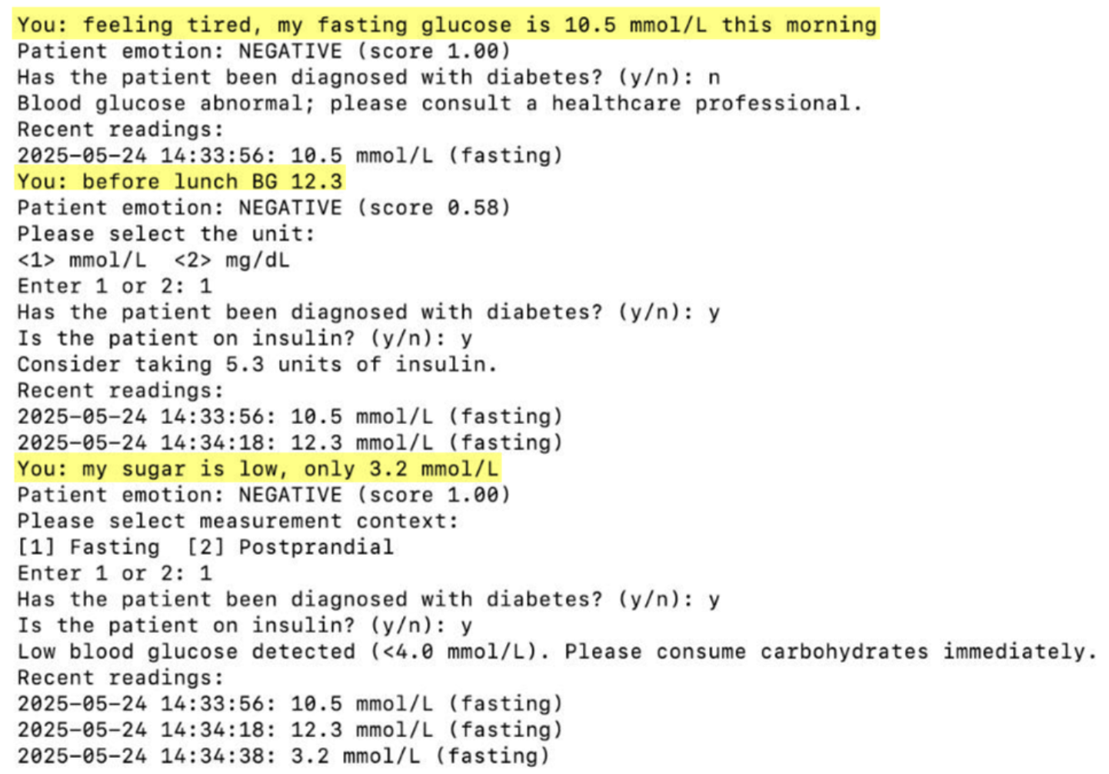
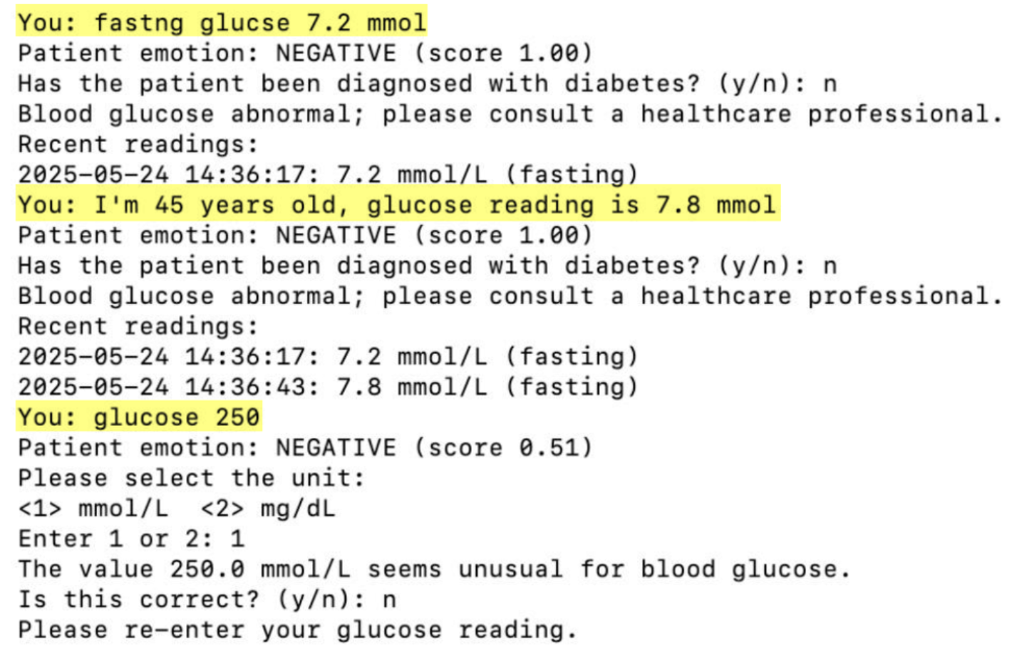
01. Project Overview

Slide 4


02. Value Extraction
Number Detection
Identify all numeric values in text
Keyword Proximity
Calculate distance to glucose-related keywords
Range Validation
Check if values fall within valid ranges
Interference Exclusion
Remove non-glucose numbers (age, time, weight)
Best Match Selection
Choose most likely glucose value
Valid Ranges
• mmol/L: 1.0 - 35.0 • mg/dL: 20 - 600
Keywords: glucose, blood sugar, bg, reading, etc.
Exclusions: years old, am/pm, kg, pounds, etc.

Slide 5







03. Additional Features
Emotion Detection
Measurement Context Inference
Trend Analysis
View History
Personalized Feedback
Fuzzy Matching
Unit Recognition

Slide 6
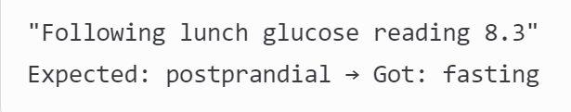
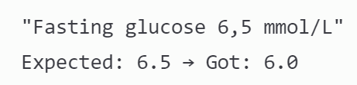
04. Evaluation Error Analysis
Two Errors Identified (2/54 cases)
Error: Context Detection
Issue: Complex meal phrase not recognized
Optimization: Expand meal vocabulary dictionary + improve temporal expression parsing
Error: Value Extraction
Issue: Comma decimal format not supported
Optimization: Add international number format support + localization handling

