Slide 1
FedCav: Contribution-aware Model Aggregation on Distributed Heterogeneous Data in Federated Learning
Hui Zeng¹, Tongqing Zhou¹, Yeting Guo¹, Zhiping Cai¹, Fang Liu ²
¹ College of Computer, National University of Defense Technology
² School of Design, Hunan University
Notes:
Hello, everyone. I’m pleased to have the opportunity to talk at this meeting. Now, I would like to share our work. “FedCav: Contribution-aware Model Aggregation on Distributed Heterogeneous [ˌhetərəˈdʒiːniəs] Data in Federated Learning.

Slide 2
Outline
Background
Observation and Problem Statement
Our Solution
Experiments
Conclusion
Notes:
We have five parts in this presentation

Slide 3


Two main problems in AI
Background
data privacy
data island
Notes:
OK, let’s begin the first part. With the development of AI, the data become more and more important. However, there are two important bottlenecks limiting the development of AI. One is the data privacy problem. More and more people concerns about their personal data privacy, for it’s sensitive to their personality. Many countries have launched the laws about data privacy, such as GDPR in Europe. Another is the data island phenomenon, the data in each party or client does not share with each other. This cause the limitations in data usage. Especially in distributed systems, the influence of these two bottleneck is significant.

Slide 4
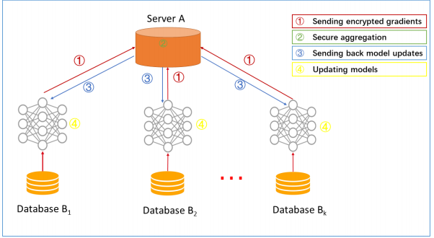
Federated Learning
Federated Learning (FL) allows multiple distributed devices to cooperatively train models in parallel while preserving data privacy
Notes:
The emerging[iˈmɜːrdʒɪŋ] federated learning paradigm[ˈpærədaɪm] allows multiple distributed devices to cooperatively train models in parallel with the raw data retained locally. Compared with the traditional machine learning, FL build a good performance global model without exposing the raw data. As shown in the slice,we demonstrate a typical FL process based on the widely adopted FedAvg for aggregation. As shown, local training is performed using the latest global model, while a new global model is attained by taking the average of all the locally trained models.

Slide 5
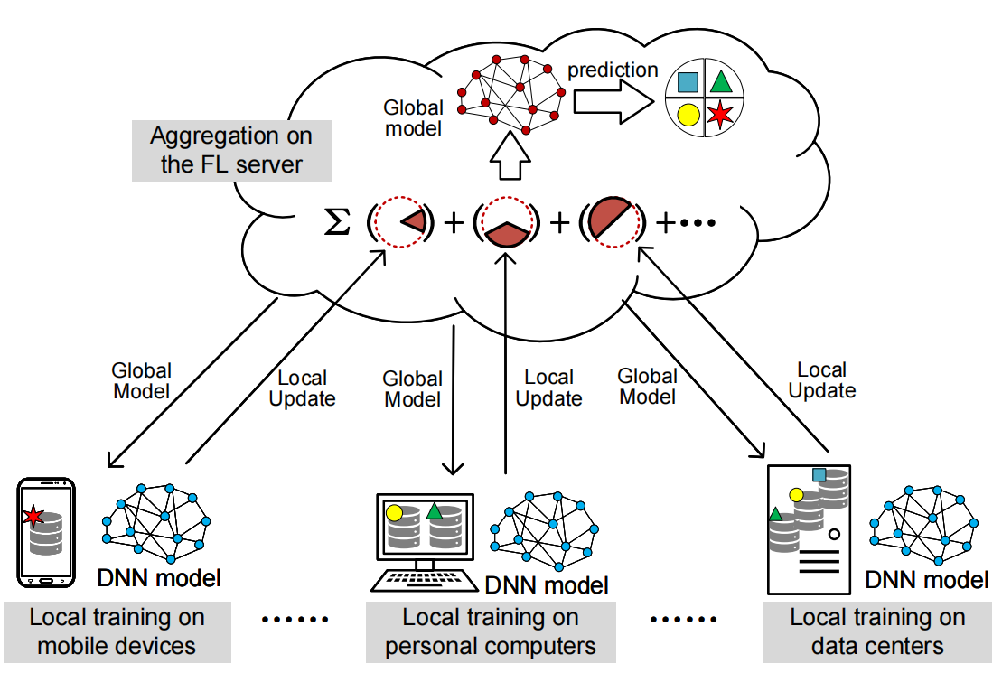
Data Heterogeneity Problem in FedAvg
Data Heterogeneity
Global non-IID
Local class imbalanced
Problem
Slow convergence
Low training performance
Notes:
However, the FedAvg is criticized to have degraded performance when given heterogeneous training data in practice. Generally, the data distributed on clients are non-independent or identical non-IID and class imbalanced.
Global Non-IID represents the difference between each client.Local class imbalanced means the number of each class data should be different, some class might have more instances or samples, some only have few.
We find two problems both in our analysis and following experiment. They are slow convergence and low training performance.

Slide 6
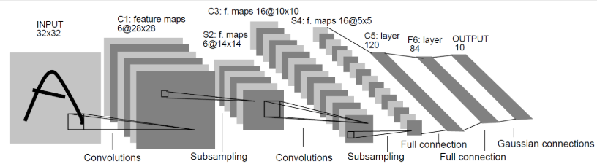



Observations of FL with heterogeneous data
Setup -- Observation experiment
Dataset：MNIST
Training Model：LeNet-5
Table 1. Three different types of data distribution
Notations | Description
IID & balanced | Global IID and Local class balanced
non-IID & balanced | Global non-IID and Local class balanced
non-IID & imbalanced | Global non-IID and Local class imbalanced, the variance of each class is σ
Notes:
In this part, we conclude and analyze data statistical heterogeneous and investigate the influence of data heterogeneous on model performance in FL. We demonstrate the experiment. We use the digital handwriting dataset MNIST, and a basic CNN called LeNet-5. According to the analysis before. We build three different type data distribution, IID & balance, non-IID & balance, and non-IID & imbalance. IID & balance, global IID and local class balance, most researches based on this setting. Non-IID and balance, global non-IID, but the local data is class balance. Non-IID & class imbalanced, the setting is more similar in real world, in the experiment, we set a parameter sigma to control how imbalance the local data is.

Slide 7
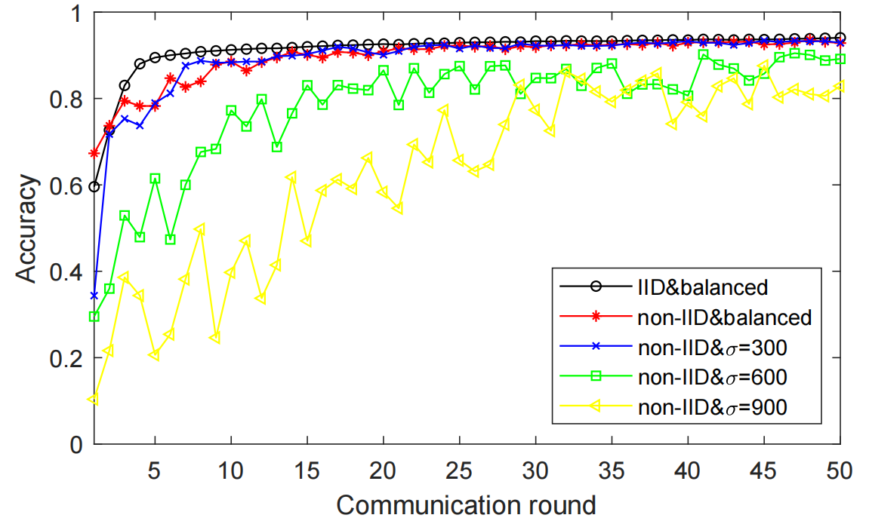
Observation Results
Results
Slow convergence
balanced: 5~10
imbalanced: 20~35
Low training performance
balanced: ~95%
imbalanced: 80% ~ 93%
Notes:
As shown, we can observe that there are two main features. One is the slow convergence[kənˈvɜːrdʒəns], with the balanced data, FedAvg only needs 5 to 10 communication rounds, but with the imbalanced data, FedAvg needs more than 20 or 35 communication rounds. Another is the low training performance, with the balanced data, FedAvg can get near 95% classification accuracy. But with the imbalanced data, the accuracy ranges from 80% to 93%, and from the curve we can see that they are more unstable.

Slide 8







Problem Statement
Observation analysis
Reality
Slow convergence
Low training performance
Heterogeneous Data
FedAvg
Data size = Contribution
Data size ≠ Contribution
Which is more valuable?
G-board
Animal pictures
Notes:
In summary, we can conclude that the experiment in observation indicted the heterogeneous data will cause the slow convergent and low training performance. The reason might be the FedAvg give more weight on these large data. The data with small samples needs more time for the global model to learn. In other words, FedAvg consider that the data with more samples are more valuable than small size data. However, in reality, the data with more samples do not represent they carry more information. For example, When using G-board to typing, the word ‘SOS’ is not as regular as the word ‘me’. and the ‘SOS’ is more valuable than ‘me’, for ‘SOS’ indicates dangerous. The animal photos, the pictures of pandas are more valuable than the pictures of cats. Cats are normal and can see everywhere, the photo can easily get, but the pandas not.

Slide 9
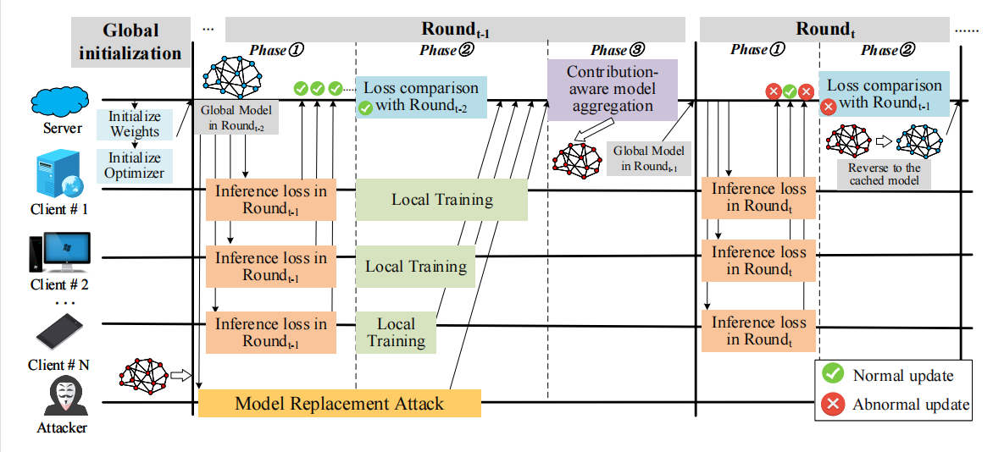
Our Solution
FedCav workflow
Detection mechanism
Contribution-aware model aggregation
Notes:
We first show our solution called FedCav. The framework contains two parts. One is the contribution-aware model aggregation. Considering the malicious attack might use our methods to attack, we design a simple but effective detect mechanism. The workflow of FedCav are shown in the picture. At the beginning of Federated Learning training process, the cloud server initialize the global model and deploy to clients. The clients download the global model and training the model based on their local data, at the same time, compute a value called inference loss, which is the global model loss value in each client. After finishing training, the clients upload their updates to the server, and aggregate the updates by using contribution-aware aggregation methods. Meanwhile, the server needs to recognize whether the updates is abnormal. By comparing the inference loss with historical values, each client reports the status, and the final decision is consistent with the majority. Once a abnormal update occurs, the server will reverse the global model to cached one.

Slide 10
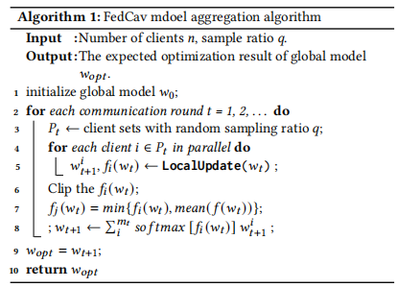

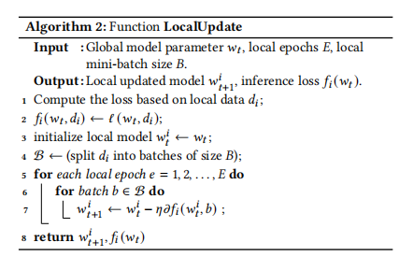
Contribution-aware model aggregation
Measure the potential contribution
Notes:
This part is the detail about contribution-aware aggregation methods. In our analysis[əˈnæləsɪs], the clients make more contributions to the model improvement should have more weights in aggregation. So how to measure the contribution at the same time preserve the privacy. We design a value called inference loss, which is the loss function value of the global model on the client local data. If the inference loss is large, this means the global model needs pay more attention to the local data. As shown in the slice, in the client side, the client not only needs to perform local training but also need to calculate an extra value. In the server side, the server will aggregate the local model updates weighted by softmax of the inference loss. The reason why to use softmax is that softmax can scale up the maximum[ˈmæksɪməm], so the client with high inference loss can get more attention compared with linear function. At the same time, we find it necessary to clip the inference loss, we want to scale up the contribution of high inference loss clients, but it should limited by a certain range. So we use the widely used methods to clip the inference loss.

Slide 11




Model replacement attack
(Simple & Low cost)
Cloud
Cloud
Healthy global model
＋
0
＋
－
＋
Updates
Download
Convergent
Upload
Upload
Update ≈ 0
Update =
－
... ...
Attacker
Malicious model
Clients
Attacker
Malicious model
Notes:
The model replacement attack is one of the common attack in FL, it is simple & low cost. The attacker might use the contribution-aware aggregation method to perform the model replacement attack. The detail of how the model replacement attack is shown in the slice.

Slide 12



Detection mechanism
Comparing the inference loss with historical value.
The final decision is consistent with the majority
Reversing the current model to cached one.
Notes:
Facing this attack, we need to design a detect mechanism in our framework. We reuse the inference loss uploaded from clients. Comparing the inference loss with historical value, if the value increases greatly, the client reports a abnormal, the final decision is consistent with the majority shown in this cases. Once a abnormal update is detected out, the server will reverse the global model to cached one, which greatly reduce the time to fix the poisoned model.

Slide 13




Experiment
Setup -- Dataset & Models
Dataset | Samples | Training Model
MNIST |  | LeNet-5[1]
FMNIST(Fashion-MNIST) |  | 9-layers CNN
CIFAR-10 |  | Resnet18[2]
[1]Yann Lecun, Leon Bottou, Y. Bengio, and Patrick Haffner. 1998. Gradient-Based Learning Applied to Document Recognition. Proc. IEEE (1998), 2278 – 2324.
[2]He, K., Zhang, X., Ren, S., & Sun, J. (2016). Deep residual learning for image recognition. In Proceedings of the IEEE conference on computer vision and pattern recognition (pp. 770-778).
Notes:
To better get the performance of our framework, we have some experiments. First, I will introduce the basic settings in our experiments. We use three widely used datasets, the cases of the datasets and corrsponding training models are shown in the table.

Slide 14
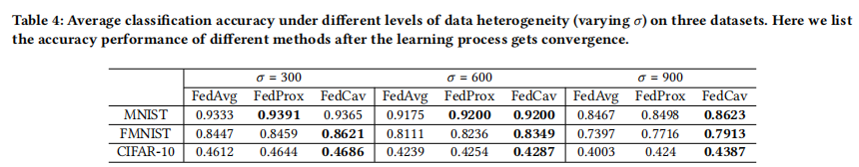
Results -- Classification performance
FedProx: Tian Li, Anit Kumar Sahu, Manzil Zaheer, et al. 2018. Federated optimization in heterogeneous networks. arXiv preprint arXiv:1812.06127 (2018).
Notes:
We first evaluate the performance of contribution-aware aggregation method. We set three different heterogeneous data distribution network, the parameter sigma have the same meaning with above experiments. We can get the result that the performance is higher than other baselines.

Slide 15
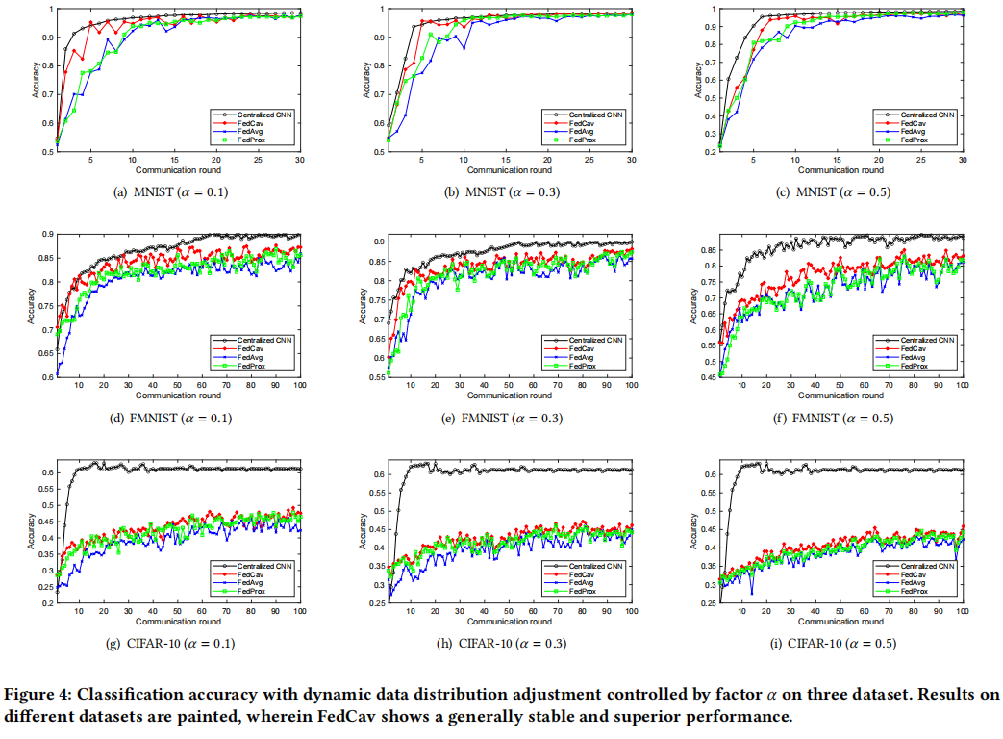
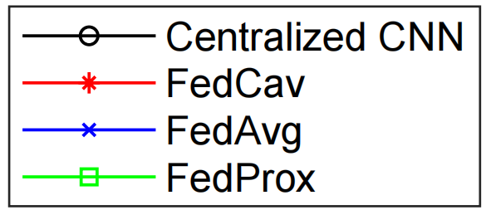
Results -- Classification accuracy with dynamic environment
Fewer rounds to achieve a certain accuracy
Notes:
Then, according to our analysis in heterogeneous data, the data is dynamically changing. So we simulate a dynamic changing network, at each communication round, there are some fresh data collected by the clients, and the fresh data size is controlled by parameter alpha. We can see that if there is fresh data, the FedCav only needs fewer communication rounds to get a certain accuracy.

Slide 16
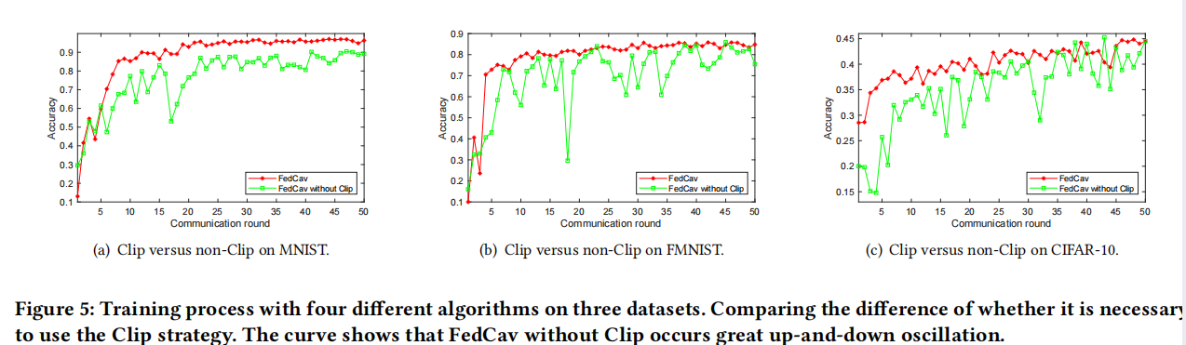
Results -- Impact of Clip strategy
Notes:
In this part, we evaluate the impact of clip strategy, we compare the two methods, one is the FedCav using clip strategy, another is not, we can see that the FedCav without clip strategy occurs great up-and-down, it is not stable for us to use the methods.

Slide 17
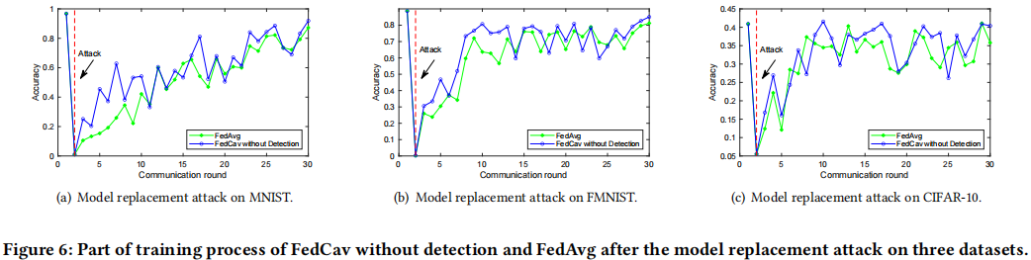
Results -- Impact of model replacement attack
Notes:
In this part, we simulate the model replacement attack, we first compared the performance of FedAvg and FedCav without detection, the results are shown in the pictures, we can see that the FedCav without detection still have a little superiority[suːˌpɪriˈɔːrəti] than FedAvg, this is because the FedCav make the clients contribute more after attack, so it can recover from the attack quickly.

Slide 18
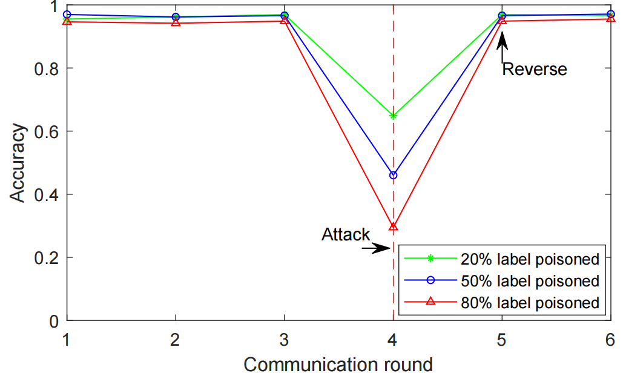
Results -- Reverse to cached one
Reverse the current model to cached one
Three different strengths of attacks
Notes:
At last, we evaluate the detect mechanism, we perform three different strengths of attacks, the malicious model is trained by 20% 、50% and 80% label poisoned malicious model. We find that our framework can detect out the abnormal update and reverse the global model to healthy one.

Slide 19
Conclusion
Problem: Address the data heterogeneous problem in FL
Observation: Heterogeneous data cause the slow convergent and low training accuracy.
Key idea: Contribution-aware model aggregation. Aggregate with the contribution not the data size. Also consider malicious attack.
Evalution: Higher classification accuracy (~2.4%) than baselines on average, fewer communication rounds (~34%) to achieve convergence
Notes:
Ultimately, the main problem our paper wants to solve is the heterogeneous data problem in FL, in observation, we find that the heterogeneous data will cause the slow convergent and low training accuracy. we propose the FedCav framework. In FedCav, we design the contribution-aware model aggregation and we also consider the malicious attack. In our evaluation, our methods have better performance than baselines near 2.4% and needs less communication rounds to achieve convergence (~34%).

Slide 20
Thank you!
Hui Zeng¹, Tongqing Zhou¹, Yeting Guo¹, Zhiping Cai¹, Fang Liu ²
¹ College of Computer, National University of Defense Technology
² School of Design, Hunan University
Email: zenghui116@nudt.edu.cn
Notes:
Ok, that’s all my viewpoints. Thank you very much for your kind attention. It's my first time to deliver a reports at acadamic meetings. Any questions are welcomed if I don't explain something clearly.

