Slide 1

MSDS696_C70 Data Science Practicum II Reddit sentiment Analysis
Dawit Gedibe 12/10/2020

Slide 2
Contents
Introduction
goals
Methods
Analysis
Sentiment Analysis
Challenges
Conclusion
References

Slide 3
Introduction
The project that is based on Reddit data, which is a community platform that a millions of users posts, comment and share media contents across the word
The project is a sentiment analysis on posts and comments of users that is taken for a year span.

Slide 4
goals
The goal of this project is to get the sentiment value of users posts and comments towards the ‘data science ‘ topic
To be able to see a trend of a daily post or comments of reddit users about the topic
To be able to use and see both (VADER and word2vec ) model with Tensorflow library for sentiment analysis.

Slide 5
Method used
Reddit can be accessed through the API endpoints exposed. Commonly known as PRAW which stands for Python Reddit API Wrapper
The other API is pushshift.io, which doesn’t need developer credential as PRAW.
pushshift API used for the advantages of fetching more than a page load ( 1000 rows max in PRAW)

Slide 6
Continued . . .
Once data is fetched it’s bulk inserted to mongodb instance on a fly.
The advantage of having mongodb here is that since the schema for content and post submission is different they both can reside in the same collection.
mongo provides flexibility to manipulate data form into which ever data frame needed to be created for.
For example the mongo query below helps to project concatenated data into a data frame
pipline = [ { '$project': { 'text':{'$concat':['$title', " ", '$selftext']}}}]
sub_concat = pd.DataFrame(list(db['Reddit_Data'].aggregate(pipline)))
sub_concat.head()

Slide 7
Continued . . .
Data frame created from mongodb queries , computation and timeseries analysis carried out
VADER used to compute sentiment value for a body and title value of reddit comment and title fields respectively
word2vec algorithm used for more precision and compared with VADER

Slide 8
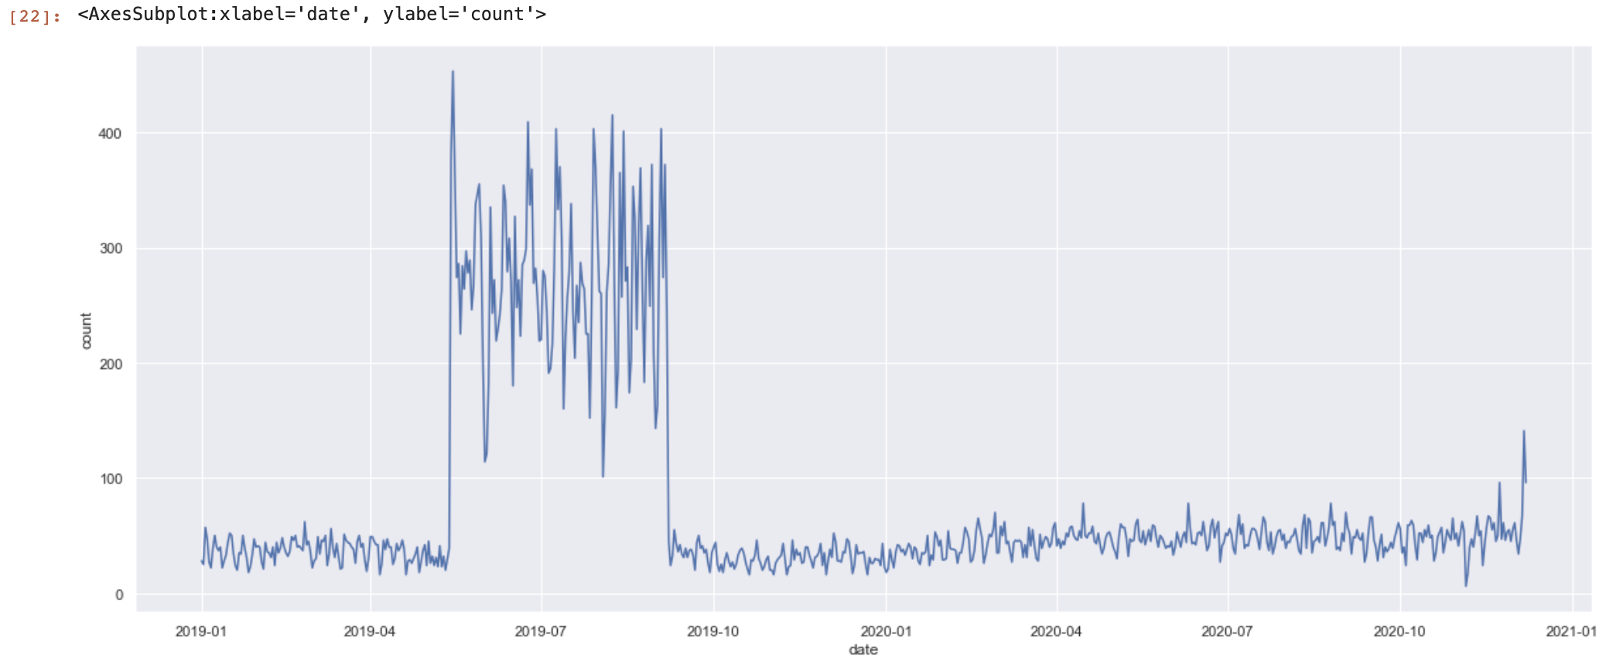
Analysis
The first trend to see with process was how many posts of the key word ‘data science’ over the past year.

Slide 9
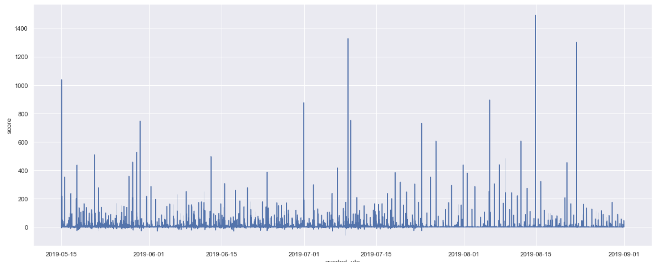
Continued . . .
Another trend to pick was the score a specific posts for some period of time

Slide 10
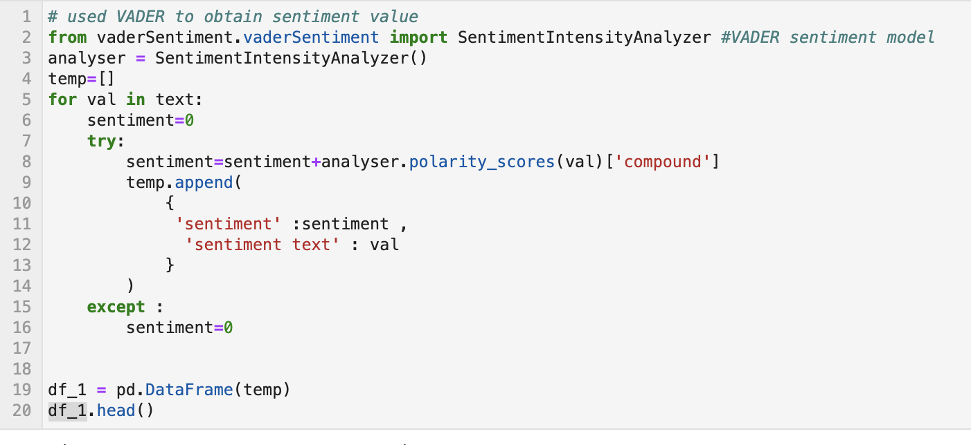
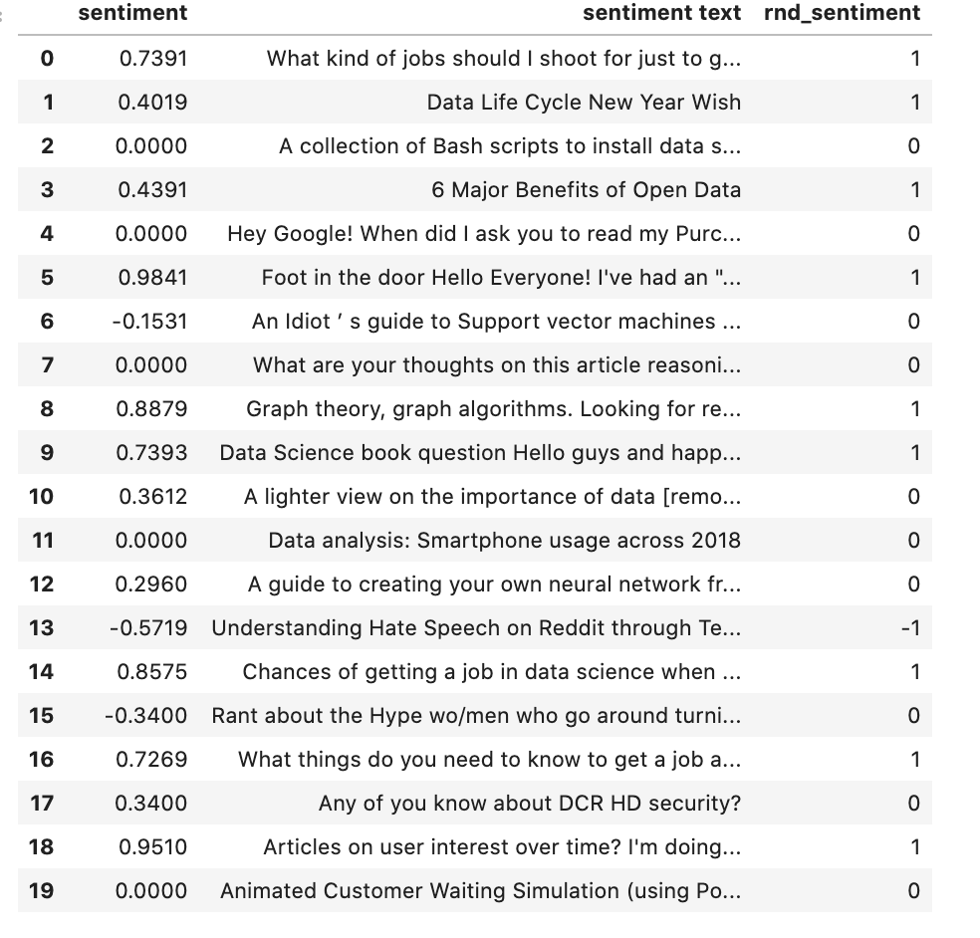
Sentiment Analysis
The first sentiment analysis was using VADER

Slide 11
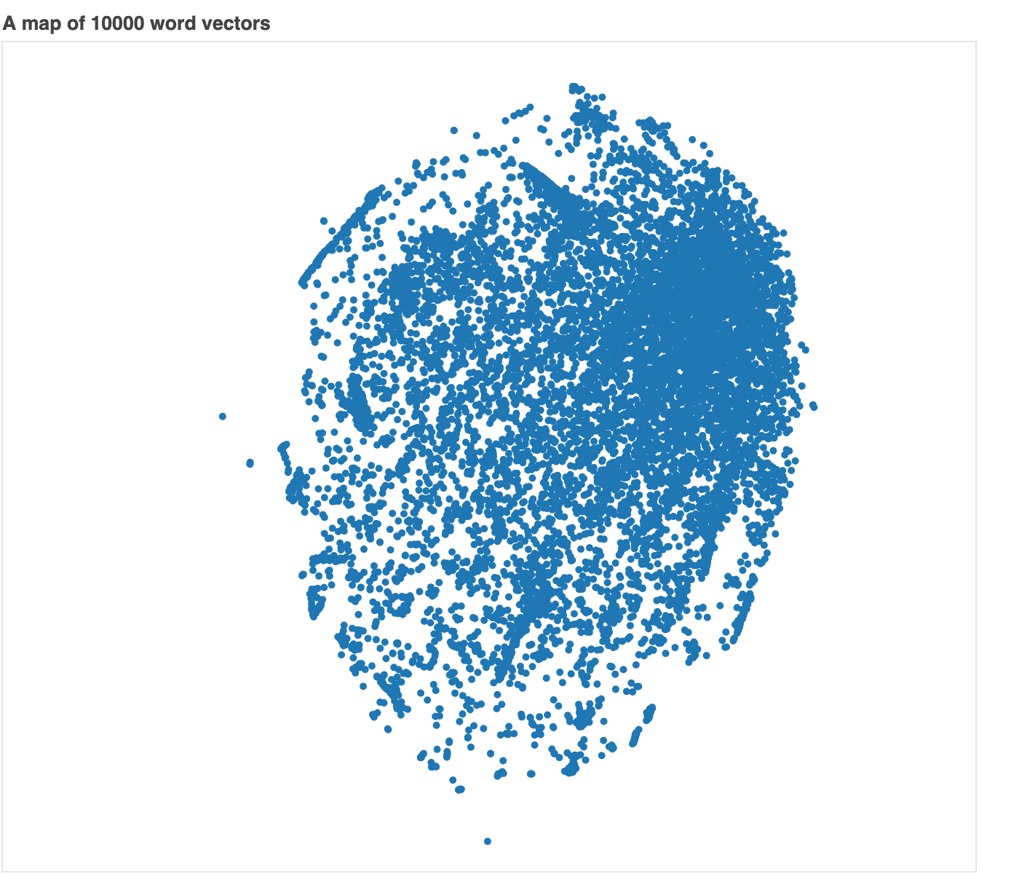
Sentiment Analysis Contd..
Using WORD2VEC

Slide 12
challenges
PRAW has a limit to back fill a year or more old data.
sentimental value for data science topics ,lack of interpretation for sentimental values other than ‘good’ or ’bad’
Novice to Tensorflow

Slide 13
Conclusion
The project could be more extended for more use, such as what is the most well known key in the world of data science for the last 5 years ?, what is the perception of a reddit community for certain topic so on.
Word2Vec has advantages over bag of words and IF-IDF scheme
NLP has a steep learning curve as there are many algorithms today.

Slide 14
References
For VADER http://comp.social.gatech.edu/papers/icwsm14.vader.hutto.pdf
For word2vec
https://radimrehurek.com/gensim/models/doc2vec.html

