Slide 1
Training Images
Data Augmentation
Deep ConvNet
Training
SVM
Training
Testing
Images
SVM
Deep ConvNet
Prediction

Slide 2
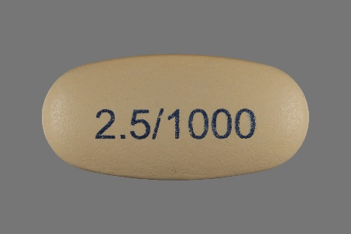
512
63
32
32
15
15
15
15
15
512
63
15
32
32
15
15
15
15
Conv1
pool1
conv21
conv22
conv31
conv32
conv41
conv42
conv5
fc1
fc2
5
96
256
256
256
384
256
256
256
1024

Slide 3
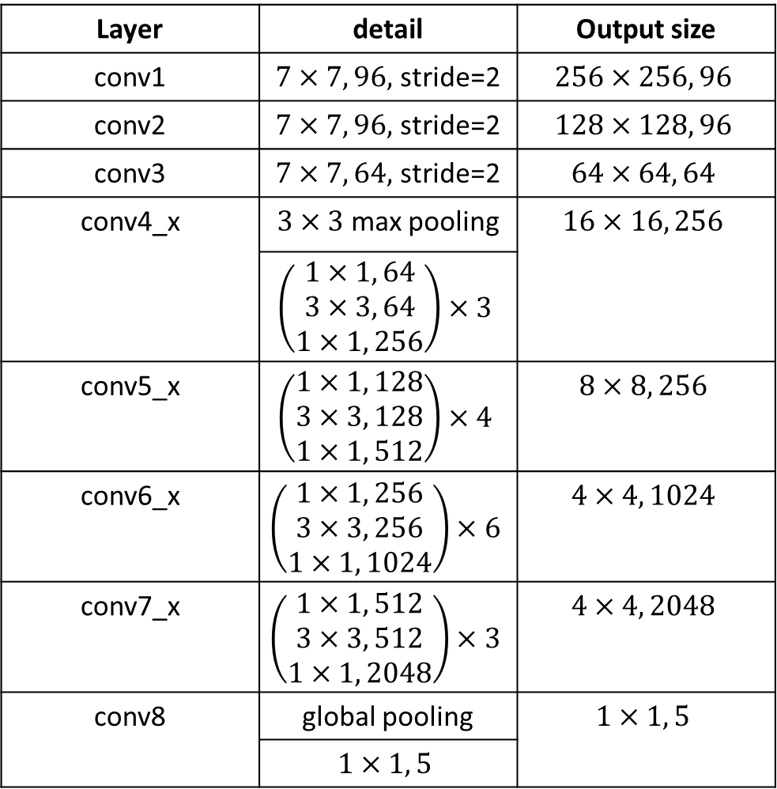
Layer | detail | Output size
conv1 | $7×7, 96,$ stride=2 | $$256×256, 96$$
conv2 | $7×7, 96,$ stride=2 | $$128×128, 96$$
conv3 | $7×7, 64,$ stride=2 | $$64×64, 64$$
conv4_x | $3×3$ max pooling | $$16×16, 256$$
 | $$\left(\begin{aligned}1×1, 64 \\ 3×3, 64 \\ 1×1, 256\end{aligned}\right)×3$$
conv5_x | $$\left(\begin{aligned}1×1, 128 \\ 3×3, 128 \\ 1×1, 512\end{aligned}\right)×4$$ | $$8×8, 256$$
conv6_x | $$\left(\begin{aligned}1×1, 256 \\ 3×3, 256 \\ 1×1, 1024\end{aligned}\right)×6$$ | $$4×4, 1024$$
conv7_x | $$\left(\begin{aligned}1×1, 512 \\ 3×3, 512 \\ 1×1, 2048\end{aligned}\right)×3$$ | $$4×4, 2048$$
conv8 | global pooling | $$1×1, 5$$
 | $$1×1, 5$$

Slide 4
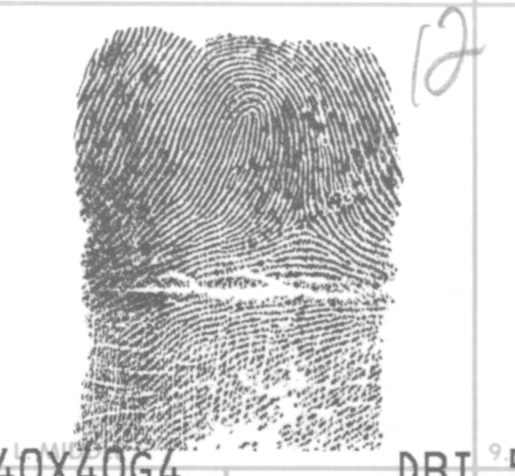
512
256
128
512
256
128
1
1
Flatten
ResNet-50 layers
5
Conv1
conv2
5
96
96

Slide 5
