Slide 1
企业服务总线
Enterprise Service Bus
顾冉
IBM软件部
guran@cn.ibm.com

Slide 2
议程
SOA 和 ESB基本概念
标准的企业服务总线：WebSphere ESB
高级的企业服务总线：WebSphere Message Broker
IBM ESB的独特优势
IBM ESB案例分享

Slide 3
SOA和ESB

Slide 4




IT构架的演变
The next stage of integration
先进构架
面向服务体系架构
SOA
过渡架构
企业应用整合
传统架构
基于消息传递的模式
通过企业服务总线实现服务的整合集中和流程实现
借助标准的接口灵活地连接，实现真正的随需应变
通过HUB模式实现应用之间的整合
很容易管理大量的连接和系统
应用之间点对点的连接
实现简单、基本的信息交互和数据传递
Flexibility
As Patterns Have Evolved, So Has IBM
Notes:
The desire to make IT more flexible is not new. Indeed, it is as old as the IT industry itself. Each of these integration techniques has its place and is appropriate for handling certain situations.
SOA blends the best of all these concepts into one new architecture. But it’s important to recognize that SOA is not the end of the road either, It’s the next step in the evolution of flexible infrastructures.

Slide 5
什么是SOA？为什么采用SOA？
一种充分利用开放标准，将软件资产展现为服务的结构
提供软件资产标准的展现和交互途径
在开发其他应用的时候，可以将独立的软件资产封装为一个一个的“积木”
更注重应用之间的装配而不是实现细节
封装可以实现重用
采用独立的实现接口描述，容易整合各种应用
由于明确定义了应用系统间的接口，容易实现应用流程模型－－就象搭积木！

Slide 6
关键概念
SOA通过明确的定义和松散藕荷来提升系统间的弹性:
Service：服务
  任何事情都可以是一个服务, 一个实现了唯一功能的自包容的实体
Service 交互
  外部用户调用服务
  服务可以彼此交互，调用操作和交换数据
  Service交互可以是间接的
Service 编排
  通过调用服务, 可以编排实现业务流程
Service 发现
  一个注册的服务可以在构建时或者运行时被发现
Discovery
Service
Discovery
Discovery
Registry
Agency
Agency
Agency
Publish
Publish
Find
Find
Service
Client
Service
Client
Service
Service
Service
Service
Service
Service
Description
Requestor
Description
Requestor
Provider
Interact
Provider
Interact
Notes:
Of all of these dynamic Service Discovery at runtime is probably least used at the moment

Slide 7
Service Interaction
Service
Service
Enterprise Service Bus
Client
Service
Service
企业服务总线(ESB)概念经常用来表示服务互相交互的机制，它提供
了通信的基础架构
企业服务总线应当提供:
  一致的、位置透明的、协议独立的手段来实现交互
  一致的、位置透明的交互意味服务消费者和提供者之间可以是间接的
  无论何种通信服务，应提供端到端的连通保证

Slide 8
什么是Enterprise Service Bus？
An Enterprise Service Bus is a core component of a Services Oriented Architecture …
  它连接和集成企业和组织的IT infrastructure, across many
  locations, 支持不同的transport services, and…
  它可以自动路由消息并且提供系统级的功能，如：消息的格式自动
  转换, and…
  必须是基于标准的规范, and…
  这些必须是安全的、可靠的，并且在高负荷的情况下可管理

Slide 9







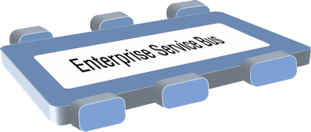













ESB应该有哪些服务？
An Enterprise Service Bus (ESB) is a flexible connectivity infrastructure for integrating applications and services.
An ESB powers your SOA by reducing the number, size, and complexity of interfaces.
传输服务
安全、可靠的数据传输
永久性/非永久性
同步/异步
仲裁服务
路由
格式转换
事件服务
事件发现和发布
Publish / Subscribe
Shape = Protocol
Color = Data type

Slide 10
传统架构：面临很多问题
一个商业公司实际业务系统的拓扑图
Depository
Vendor Setup
Vendor
Process Servers
Banks
Customer Perceived
Budget
Maintenance
(Imaging)
NEW Soundscan
Shows
VAN
Universal Account
In-Stock
Analysis Tool
Printer
S20-Sales
Mesa Data
Reconcilliation
这样的架构下，企业面临着什么样的问题？
开发和维护应用接口将会变得很困难，开销变得很昂贵
Maintenance
Polling
Auto
Hand Scan
Printer PO
Customer
Replenishment
Apps
Reports
Insertions
Sales
Order
Due Dates
Calendar
Orders
Print Costing
Corrections
Warehouse
Broadcast
General
Invoice App
Management
Stores & Mrkts
Filter
Maintenance
Interface
PO
Smart Plus
Smart Plus
Millennuim 3.0
Sales Posting
Launcher
Cell
Return to
Tally Sheet
Mill.
Phones
Post Load
Vendor
Credit App
Stock Options
Employee
Equifax
Billing
Solution
Resource
Change Notice
Software
Satellite
Scheduling
A04 - Cust
System
-Promo
On-line New
Refund Chks
DFK
1
Analysis
Resumix
Hire Entry
P01-
AAS
Price
Employee
Marketing
Cobra
P09 - P17
Masterfile
Support
Bus Systems
Cyb.
ABC
website
- ISP
CTS
Co
Home
Cycle Physical
Tracking
ACH
Prodigy
V04-Sign
Deliveries
Inventory
Banks - ACH and Pos to
POS
System
CTO
-
Pay
Transfers
Host to AS400
Plan Administrators
Stock
Communication
(401K, PCS, Life)
Spec Source
SKU Tracking
Status
Counts
Price
Testing
Supplier
Employee
Intercept
Sales
Scanning
Layaways
Compliance
Purchase
Tax
Spec
PO
Scorecard
Source
Receiving
SKU
Mkt
Performance
Bonus/HR
Reactions
Polling
Price Management
Inventory Info
Coop
SKU Selection
DRK
System
Tool
ABBX
Customer Repair
I35 Early Warning
Planning
Rebate
SKU Rep
Tracking
System
Store
Transfer
SKU
Purchase
Monitor
PowerSuite
General
Information
Order
Ad Expense
Ledger
Store
Tex A
Sign
Scorecard
System
N.
Count Corrections
Store Budget
“Point-to-point interfaces result in an ever-increasing maintenance burden.”
— Gartner, March 2005 ¹
Tx
Writer
Merchandise
Media
Reporting
Workspace
Analysis
BMP - Bus
EDI
performance Mngt
Mngr Approval
Coordinator
Batch Forcasting
AIMS
AP
Journal Entry Tool Kit
Ad Measurement
Cellular
INVENTORY CONTROL APPS - PC
INVENTORY CONTROL APPS - PC
ACCTS REC APPS - PC
Ad
AIMS
Rollover
OTHER APPS - PC
Launcher
Reporting
House
PSP
Op.
Recon
Charges
Capital
File
Data Warehouse
In-Home
Projects
SS
Connect 3
Credit
Repair
Connect 3
Connect 3
Cash Receipts/Credit
Fixed
PDF Transfe
Reports
Misc Accounting/Finance Apps - PC/NT
Warranty
Assets
Billing
Repair
Cash Over/
System
Short
1 Consequences of Waivers From Enterprise Architecture Standards” by Greta A. James
Notes:
We find that most companies have an IT infrastructure that is a result of years of adding and subtracting components to meet changing needs—and it’s become a big, convoluted mess.
This diagram shows an actual application architecture. What we’re looking at are all the applications—and the service components they encompass—within a single enterprise.
Gartner quote:
Consequences of Waivers From Enterprise Architecture Standards
Greta A. James
Publication Date: 9 March 2005/ID Number: G00126205

Slide 11
总线架构：让企业更多关注于自己的核心业务，而不是IT系统
分析决策
快速增加新的系统
和服务
营销管理
客户服务
客户关系
管理
企业服务总线
集中平台
改变其中的系统或服务
对现有系统影响最小
监控系统
客户缴费
市场管理
需求管理
新缴费
系统
旧缴费
系统
Notes:
The ESB allows you to focus on your core business. It enables you to add new services faster and to change services with minimal impact to existing services.

Slide 12
两种关键需求决定了两种不同的ESB解决方案
1
If all your applications conform to the Web Services standards…
2
If not all your applications conform to the Web Services standards…
Travel
Reservation
Process
Check
Traveler
Service
Check Credit
Service
Book Flight
Service
Travel
Reservation
Process
Check
Traveler
Application
Check Credit
Application
Book Flight
Application
Enterprise Service Bus
ADVANCED Enterprise Service Bus
Hotel
Availability
Service
Flight
Availability
Service
Book Hotel
Service
Book Car
Service
Hotel
Availability
Service
Flight
Availability
Application
Book Hotel
Application
Book Car
Application
…then all you may require is an ESB focused on standards-based service integration.
…then you may require a more advanced ESB focused on the integration of services with existing non-services assets.
Notes:
If all your applications conform to the Web Services standards, you may only need an ESB focused on the integration of these standards-based interfaces.
However, if not all your applications conform to the SOA standards, you may need something more advanced that can mediate between the SOA standards and everything else.

Slide 13


IBM ESB解决方案
1
核心版
ESB: WebSphere ESB, a new product that delivers an Enterprise Service Bus.
2
高级版
Advanced ESB: WebSphere Message Broker, a new version of our proven product that delivers an advanced Enterprise Service Bus.
Only IBM delivers the most comprehensive Enterprise Service Bus solutions to power your SOA!
Notes:
We are thus announcing two products. The first, WebSphere ESB v6, which is devoted to the integration of standards-based interfaces. The second, WebSphere Message Broker v6, which is a new version of our proven Message Broker product but with additional features to deliver an advanced Enterprise Service Bus.

Slide 14




WebSphere ESB and WebSphere Message Broker
高级版
核心版
ESB:
WebSphere ESB
Advanced ESB:
WebSphere Message Broker
Web Services connectivity
and data transformation
Universal connectivity and data transformation
HTTP
JMS
WebSphere MQ
HTTP
JMS
Web Services
XML
WebSphere
Adapters
Plus the following:
WebSphere MQ
Weblogic JMS®
Biztalk®
TIBCO Rendezvous®
Web Services
XML
MQe
Multicast
Tuxedo®
FTP
TIBCO EMS JMS®
COBOL
Copybook
HIPAA
EDI-FACT
HL7
SonicMQ JMS®
WebSphere Adapters
ACORD
Real-time IP
AL3
Word/Excel/PDF
SWIFT
FIX
ebXML
EDI-X.12
MQTT
Custom Formats
Customers face a range of ESB requirements. As a result, any given project might require an ESB or an Advanced ESB… OR BOTH.
Notes:
The two products work together. WebSphere ESB delivers an Enterprise Service Bus that will connect applications that have standards based interfaces such as HTPP, JMS, and XML data formats.
WebSphere Message Broker is designed for universal connectivity, whether the applications do or do not comply to standards! Therefore it has robust support for data formats such as EDI, SWIFT, FIX, COBOL Copybooks, HIPAA, ACORD, HL7, custom formats, etc. The Broker also handles a multitude of different connection types allowing you to integrate virtually your entire enterprise.

Slide 15
标准的企业服务总线
WebSphere ESB

Slide 16




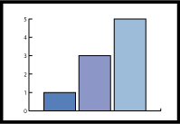
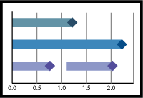


WebSphere ESB在业务整合参考架构中的战略地位
WebSphere Modeler
开发平台
Rational Application Developer
业务绩效管理服务
WebSphere Monitor
交互服务
流程服务
信息服务
WebSphere
Portal Server
WebSphere
Process Server
WebSphere Information Integrator
WebSphere MQ
WebSphere ESB
WebSphere Message Broker
企业服务总线
WebSphere Adapters
HATS
DB2 II Classic
业务应用服务
应用和数据访问服务
合作伙伴服务
WebSphere Partner Gateway
WebSphere
Application Server
业务应用和数据服务
企业应用和数据
基础架构服务

Slide 17

WebSphere ESB 架构
Messaging:
Clients:
JMS 1.1
C++
Client
.Net
Client
Java and C/C++
Web Services
Client
MQ
interoperability
Lightweight
Java Client
coming
WebSphere ESB
WebSphere
Integration
Developer
WebSphere
Adapter
Support
XSLT
Message
Logger
Mediation
Function
Message
Router
DB
Lookup
SCA
Programming
Model:
Web
Services:
WebSphere Application Server
Tivoli Access Manager
DB2 Universal Database
Edge Components
SOAP/
HTTP
SCA
SOAP/
JMS
WS-*
UDDI
Registry 3.0
SDO
Notes:
This is a high level architectural view of the WebSphere ESB product. From a messaging perspective we offer support for JMS 1.1 via the WebSphere Messaging support in WAS (native JMS provider), and interoperability with MQ. Clients for C++, .NET, Web Services (Java and C/C++) and a Lightweight Java client (future release). Full support for J2C (JCA adapters), and full support for the SCA programming model which we will discuss in further detail in the subsequent slides. In addition we have a full complement of Web Services offerings including su[pport for SOAP over HTTP or SOAP over JMS transports, WS-*: We have atomic and security, WSRM is planned for future releases but its not yet a standard and full support for UDDI V3.g

Slide 18

WebSphere ESB的位置
Increased capabilities / automation
WebSphere Process Server
Business Process
For customers who want a higher level solution to design, automate and manage composite applications and operational business processes. Built on WebSphere ESB.
Superset
WebSphere ESB
A new product that delivers an Enterprise Service Bus. Provides Web Services connectivity and data transformation. Built on WebSphere Application Server.
ESB
WebSphere Application Server
A world-class J2EE foundation providing industry-leading levels of availability, scalability, and performance.
Subset
Notes:
WebSphere ESB is only one piece of the complete solution that IBM offers for transport, mediation, process, and transformation needs. On the left hand side of this picture, you can see how WebSphere ESB and WebSphere Process Server build on top of one another, WESB to deliver a mediation and connectivity layer, and WPS to deliver a business process management layer. In a similar way, WebSphere Message Broker builds on top of the word class transport within WebSphere MQ to provide transformation and universal connectivity. The stacks interoperate to provide a comprehensive solution.

Slide 19
WebSphere ESB中的模块(Module)
Interactions with external service requesters and providers defined by imports and exports
  Import/export interfaces are defined using the Web Services Description Language (WSDL)
    Which may contain several service operations
  Different kinds of requester and provider are made available via different bindings for the imports and exports
Export
Mediation
module
Import
Notes:
A mediation module is similar to a message flow, although the Export and Import are technically not part of the mediation module.

Slide 20
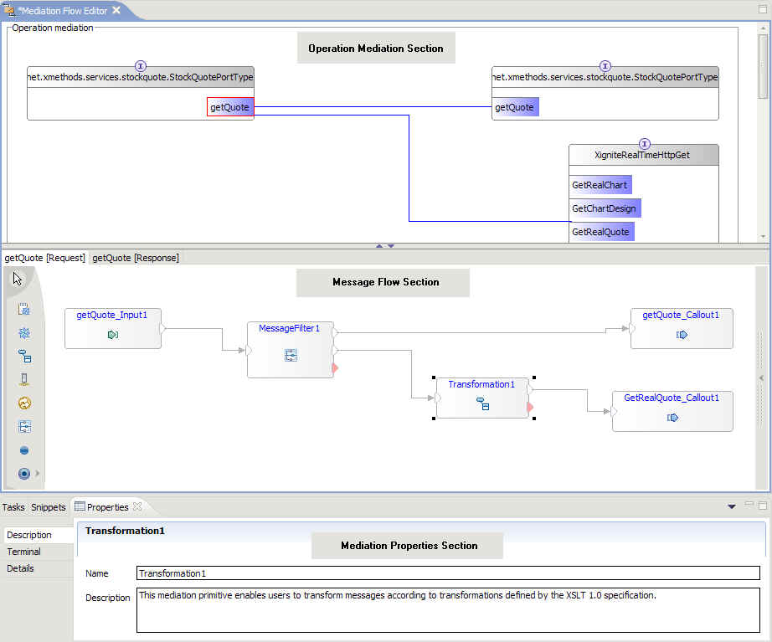
Flow编程模型
通过可视化的方式完成组件的装配和消息流的实现
  类似于WMB中流的实现方式
不需要写任何整合逻辑的代码
支持自定义组件和第三方组件库的调用
Notes:
Built-in nodes include XSLT, logger, database lookup and other nodes…

Slide 21

XQuote
IBM Hurley
England
IBM Hurley
England
Mediation
module
Notes:
Requests for a stock quote come into the ESB from a servlet.
The incoming message is a SOAP/JMS message which is then passed through the Bus from the export to the import
The export passes the converted SOAP/HTTP message to the external Web Service (XQuote)
The reply is passed back through the Bus to the export.
A financial services company is planning a phased rollout of an interactive web-based stock market service to its customers using Servlet technology. This service will include a simple stock quote service built using an Enterprise Service Bus (ESB) infrastructure. The company wants to differentiate itself from its competition and has chosen to do this by offering tiered levels of service and by proactively offering real-time stocks to their “gold” customers (customers who pay a subscription).
An ESB is used as the basis for deployment of these capabilities so as to allow the company to respond in a flexible and non-disruptive way to the changing requirements which are expected to arise.
This scenario is implemented in five phases:
The basic quote service is made available to customers by invoking an XQuote Web Service to retrieve 20 minute delayed quotes.
Once the service is up and running the company will start logging all requests to the service to satisfy audit requirements.
A new subscription service is added for gold customers. This service allows users who pay a subscription fee to receive real time stock quotes rather than delayed pricing for standard customers. The XIgnite stock quote service is used to retrieve real-time quotes for these gold customers.
Behavior of the XQuote Service identifies a bug in the Servlet. The problem is fixed by updating the Mediation to avoid the problem.
More error handling is added to the solution so that failures in the flow are reported to a business dashboard via a CEI event (the dashboard application itself is out of scope of this scenario).

Slide 22
XQuote
IBM Hurley
England
IBM Hurley
England
Mediation
module
IBM Hurley
England
IBM Hurley
England
logger
Notes:
This time, the request is passed through a Mediation Module.
The Mediation Module uses a MessageLogger Mediation Primitive to log the message to a database.
The Request continues on its way as before: passed to the import to be sent to XQuote.

Slide 23
XQuote
IBM Hurley
England
IBM Hurley
England
Mediation
module
XIgnite
IBM Hurley
England
logger
DB
Lookup
filter
transform
XYZ
Notes:
This time, when the request passes through the Mediation Module, a DataBaseLookup Primitive is used to look up the userid in a table of “gold” users, then a Filter is applied
If the user is a gold customer, the request will be passed to a different external Web Service (offered by XIgnite) otherwise it will continue as before.
Because the message formats differ, the request is first passed through an XSLT Primitive that will transform the message using an XPath expression.
The response from XIgnite will also need to be transformed as part of the Mediation so that the format is as expected.

Slide 24
WebSphere ESB
易用的企业服务总线
WebSphere Integration Developer
  Integrated visual development environment for development of integration logic
  Minimal knowledge of Java or J2EE
  Based on Eclipse 3.0
Develop, build, test, deploy and manage services components
  Visual development experience for standards-based artifacts like XML schema, WSDL, XSLT, etc
  Declaration of services and connectivity through a visual composition model
  Easy orchestration of mediation functions
    Intelligent routing, enrichment, and transformation
  Connect between service-oriented and message-oriented services
  Role-based support provides a simplified administration experience
Notes:
WebSphere ESB is designed to be easy to use from both a tools and a runtime perspective. WebSphere Integration Developer, the tool that works with WebSphere ESB, is built for an integration developer—someone who understands IT systems and architectures but who is not a Java developer.
Both WESB and WID are designed to help customers get up and running quickly and easily, with comprehensive out of the box documentation and a simplified and visual development environment. A visual composition model allows easy orchestration of mediation functions. The fact that the tool is role based makes administration much easier.
Additional Notes:
The mediation flow editor provides a uniform approach to author the processing of message-based one-way model (message-oriented) and request-response based two-way model (service-oriented).
WebSphere ESB and WebSphere Integration Developer are sold separately. WID costs $3500/ per seat. For planning purposes, prices for WebSphere ESB are projected to be $25K per CPU, however, this is subject to change.

Slide 25
WebSphere ESB的易用性
Capabilities
  Message transformation
    Mapping (XSLT / graphical interface)
      Access to message header and body content
    Interface mapping
  Message enrichment from database content
  Flow of control (business logic)
  Logging
  Custom nodes
    Java code (visual editor)
Deployment
  Eclipse tooling produces mediation module
    contains mediation flow definition
  Unit test environment embedded in tooling
  Deployment as EAR to runtime server

Slide 26
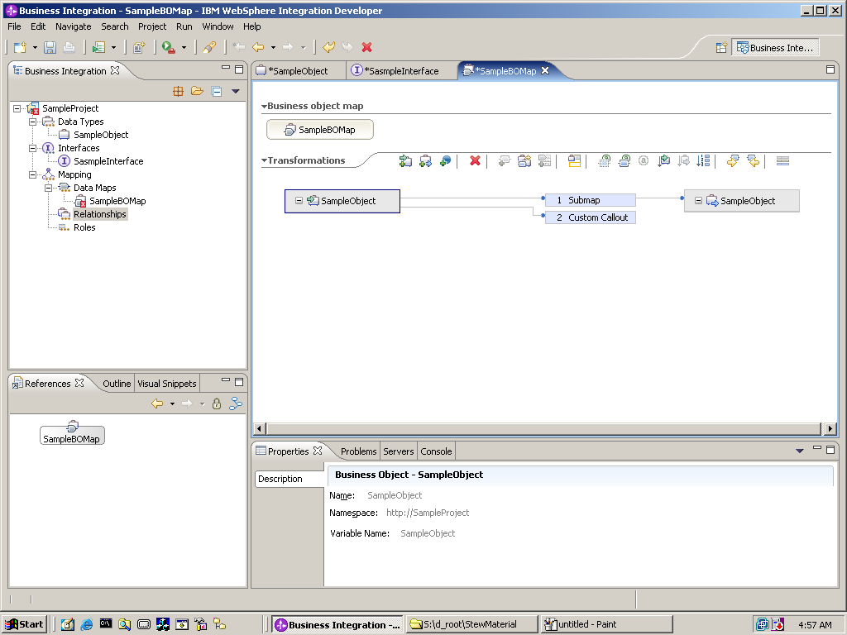
可视化开发工具

Slide 27
WebSphere ESB
提供标准的Web Services连接, 基于消息和服务的整合
ESB的连通性
Web Services
Supports messaging protocols provided by WebSphere Messaging
  JMS 1.1
    Supports point-to-point and Publish and Subscribe
  Connectivity to WebSphere MQ
Programming Environments
  J2EE and Java
  C++ client
  .Net client
  Java and C++ Web Services Client
  Lightweight Java Client
  JAX/RPC
WebSphere Adapters
  Both new JCA 1.5 and existing WBI Adapters
Notes:
Additional information about listed features:
Gain support for a variety of messaging protocols including JMS 1.1
JMS 1.1 provided by WebSphere Application Server
Can exploit a variety of transports, including TCP/IP, SSL, and HTTP(S)
Allows interoperation with the WebSphere family, eg, WAS, MQ, Message/Event Brokers
Utilize a broad range of interaction models (request/reply, point-to-point, publish/subscribe, etc.) to meet your requirements
Leverage advanced Web services support to incorporate leading edge capabilities
SOAP/HTTP, SOAP/JMS, WSDL 1.1
UDDI 3.0 Service Registry, Web Services Gateway
WS-* Standards including WS-Security, WS-Atomic Transactions
Take advantage of a comprehensive clients package to extend your environment
Message Service Client for C/C++ extends the JMS model for messaging to non-Java applications.
Message Service Client for .Net enables legacy or .NET applications to participate in JMS-based information flows
Web Services Client is a JAX-RPC-like web services client for C++ to enables users to connect to Web services hosted on WebSphere from within a C++ environment
J2EE client support from WebSphere Application Server, including Web services Client, EJB Client, and JMS Client
Additional Notes for Possible Questions:
Q. What are your plans for a Services Registry?
A. Today you can store and locate information about services through the IBM WebSphere UDDI Registry. You can discover services in the registry when developing new services, and at run-time your mediations can access the registry. In the near future, a Services Registry in WebSphere ESB will allow you to locate and manage services in your registry through a flexible registration and query interface either through a UI or an API that can be used in packaged or custom tools. Longer term, you’ll be able to integrate your service registry entities and your general metadata and work with them as a unit, e.g., through shared classification schemes, a common approach to querying and manipulating your metadata and registry content.

Slide 28
WebSphere ESB
提供标准的Web Services连接, 基于消息和服务的整合
处理应用整合逻辑
客户化的路由方式
  Transport/protocol specific routing and content based routing
不同协议之间的转换
  HTTP
  IIOP
  JMS
不同格式之间的转换
  XML
  SOAP
  JMS messages
  when used with adapters,
  many more
与数据库之间能够良好的协作
  Support for message logging to database and message augmentation by database lookup
Notes:
Additional information about listed features:
Gain support for a variety of messaging protocols including JMS 1.1
JMS 1.1 provided by WebSphere Application Server
Can exploit a variety of transports, including TCP/IP, SSL, and HTTP(S)
Allows interoperation with the WebSphere family, eg, WAS, MQ, Message/Event Brokers
Utilize a broad range of interaction models (request/reply, point-to-point, publish/subscribe, etc.) to meet your requirements
Leverage advanced Web services support to incorporate leading edge capabilities
SOAP/HTTP, SOAP/JMS, WSDL 1.1
UDDI 3.0 Service Registry, Web Services Gateway
WS-* Standards including WS-Security, WS-Atomic Transactions
Take advantage of a comprehensive clients package to extend your environment
Message Service Client for C/C++ extends the JMS model for messaging to non-Java applications.
Message Service Client for .Net enables legacy or .NET applications to participate in JMS-based information flows
Web Services Client is a JAX-RPC-like web services client for C++ to enables users to connect to Web services hosted on WebSphere from within a C++ environment
J2EE client support from WebSphere Application Server, including Web services Client, EJB Client, and JMS Client
Additional Notes for Possible Questions:
Q. What are your plans for a Services Registry?
A. Today you can store and locate information about services through the IBM WebSphere UDDI Registry. You can discover services in the registry when developing new services, and at run-time your mediations can access the registry. In the near future, a Services Registry in WebSphere ESB will allow you to locate and manage services in your registry through a flexible registration and query interface either through a UI or an API that can be used in packaged or custom tools. Longer term, you’ll be able to integrate your service registry entities and your general metadata and work with them as a unit, e.g., through shared classification schemes, a common approach to querying and manipulating your metadata and registry content.

Slide 29
WebSphere ESB
提升性价比
Gain a cost effective solution for services integration
  Leverage your SOA IT investments by quickly building a flexible integration infrastructure to extend the value of your existing investments, regardless of vendor
  Modular approach supports ability to start small and grow as fast as the business requires
  Extensive business and IT standards support facilitate greater interoperability & portability
Utilize first class support for hundreds of ISV solutions
  Extensive WebSphere Adapter support, including new JCA-based adapters
  Support for numerous ISVs within the WebSphere Platform partner ecosystem
Save time and development costs by utilizing pre-built mediation functions
  Mediations operate on messages/events as they are passed between service requesters and service providers
  Operate on both One-Way and Request-Response interactions
  Pre-built mediation functions allow mediations to be visually composed and include XML transformation, message logging, message routing, and database lookup,
  Customers can augment the function provided by the supplied primitives by programming their own ‘custom primitives’
Dynamically re-configure to meet changing business needs
  WebSphere ESB runtime provides the administrator with the ability to reconfigure service interactions
  Avoid system downtime by adding or replacing integration logic dynamically
Notes:
Beyond its intelligent connectivity and ease of use benefits, WebSphere ESB is designed to improve your time to value. As a cost effective solution for services integration, WESB is designed to make SOA “real” and as such will allow you to Leverage your SOA IT investments by quickly building a flexible integration infrastructure to extend the value of your existing investments, regardless of vendor. Its modular approach supports ability to start small and grow as fast as the business requires, and the extensive business and IT standards support facilitate greater interoperability & portability.
First class support for hundred of ISV solutions through extensive WebSphere Adapter support and the numerous WAS and MQ partners in the WebSphere Partner ecosystem make it easy to connect to your existing assets. Pre-built mediation functions save time and money because very little additional development is required. Furthermore, with WebSphere ESB you save time when you can change your service interactions without taking your system down.
Additional Notes:
Complete Mediation list, dellivered at eGA:
XSLT
MessageLogger
MessageRouter
Fail
Stop
DatabaseLookup
Custom Component

Slide 30
WebSphere ESB
与WebSphere平台无缝整合
Leverages WebSphere qualities of service
  Inherits the WebSphere runtime for world class scalability, clustering, and fail-over
  Utilizes the common WebSphere Administrative Console to enable system management across WebSphere Application Server, WebSphere ESB, and WebSphere Process Server
  Addresses end-to-end security requirements on authentication, resource access control, data integrity, confidentiality, privacy, and secure interoperability
Easily extends to leverage WebSphere Platform as needs dictate
  Customers with the right skills can take full advantage of the underlying capabilities of WebSphere Application Server Network Deployment
  Extend your existing WebSphere MQ messaging foundation to integrate new environments in an open, standards-based way
  Common tooling and administration means the move from WebSphere ESB to WebSphere Process Server is painless
Integrates with IBM Tivoli security, directory, and systems management offerings
  Includes Tivoli Access Manager, for optional use, to deliver a secure, unified and personalized experience that will help manage growth and complexity
  Integrates with IBM Tivoli Composite Application Manager for SOA for added monitoring and management capabilities
Notes:
Finally, WebSphere ESB offers what similar offerings do not—seamless integration with the WebSphere Platform. As I mentioned before, WebSphere ESB is built on top of WebSphere Application Server Network Deployment. As such, it inherits all of the market-leading qualities of service, including scalability, clustering, and fail-over, uutilizes the common WebSphere Administrative Console to enable system management across WebSphere Application Server, WebSphere ESB, and WebSphere Process Server, and aaddresses end-to-end security requirements on authentication, resource access control, data integrity, confidentiality, privacy, and secure interoperability
Because WebSphere ESB is built on this foundation, customers can easily extend to leverage WebSphere Platform as needs dictate. Customers with the right skills can take full advantage of the underlying capabilities of WebSphere Application Server Network Deployment. Extend your existing WebSphere MQ messaging foundation to integrate new environments in an open, standards-based way. Finally, ccommon tooling and administration means the move from WebSphere ESB to WebSphere Process Server is painless.
WebSphere ESB integrates with other IBM Software offerings, as well, including IBM Tivoli security, directory, and systems management offerings. WESB includes Tivoli Access Manager, for optional use, to deliver a secure, unified and personalized experience that will help manage growth and complexity, and it integrates with IBM Tivoli Composite Application Manager for SOA for added monitoring and management capabilities.
Managing composite applications based on service oriented architectures present a mix of new and traditional challenges, as services need to be treated by the management infrastructure as first-class managed objects, conforming to defined service characteristics. IBM Tivoli Composite Application Manager for SOA helps you monitor, manage and control these service-based applications. This solution is integrated with the IBM Tivoli Enterprise Portal, which enables end-to-end resource, application, transaction and service management across your IT infrastructure.

Slide 31
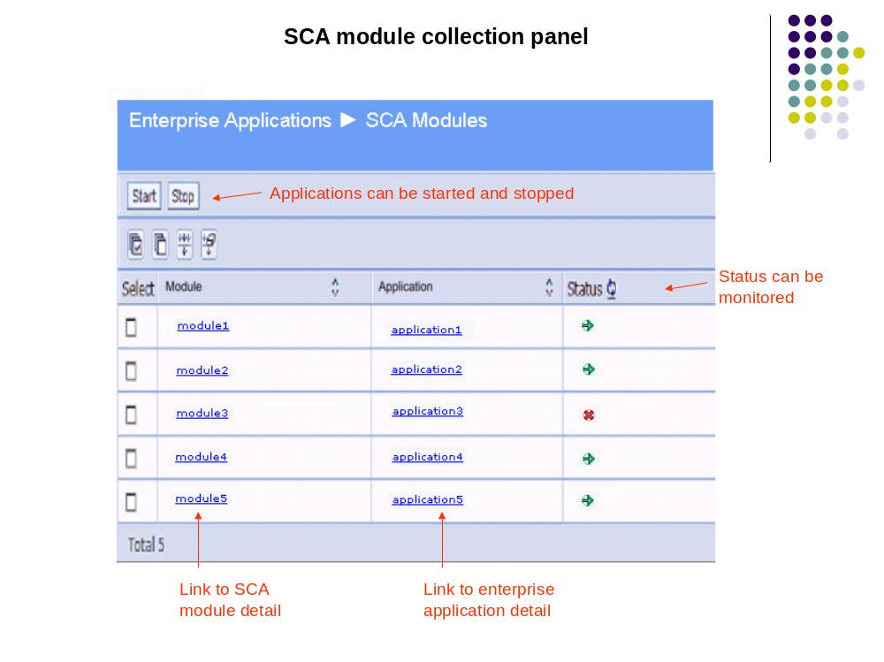
管理控制台 (启动和停止模块)
Solution
Administrator
Notes:
At the operational level, each module maps to a single WebSphere application. Admin panels allow simple navigation to and control of these applications

Slide 32
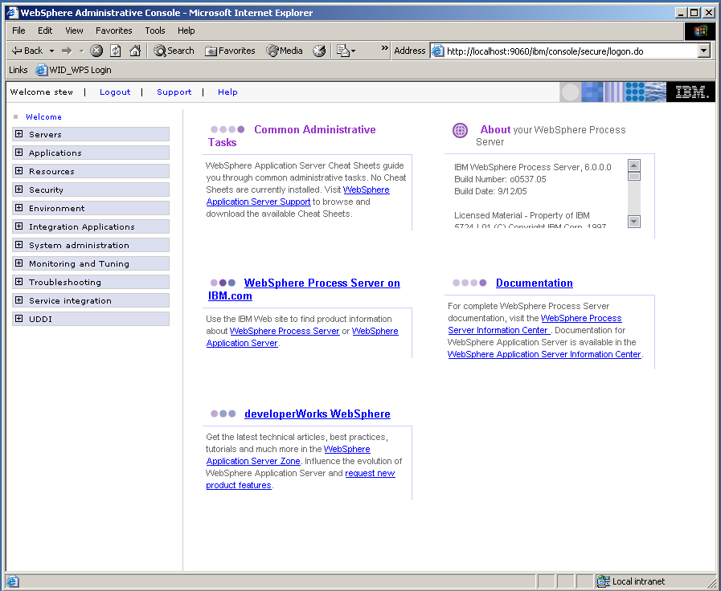

Slide 33
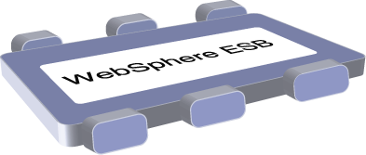

WebSphere ESB案例
面临的挑战: Share Trader Financial Services needed to roll out a new offering that required integration of multiple systems. Share Trader required a responsive Web Services infrastructure. The business also wanted to offer a higher service level to premium customers by providing real time quotes instead of delayed quotes.
JMS or
MQ
Share Trader
Application
SOAP / JMS
Adapter or
WebSphere
Message Broker
Customers
SOAP / HTTP
SOAP / HTTP
SOAP / HTTP
External Web Service Delayed Quotes
Internal Web Service real time quotes
External Web Service real time quotes
Notes:
Scenario 1 demonstrates the capabilities of WebSphere ESB when used alone. It assumes that almost all of the interfaces are services-based (either SOAP/JMS or SOAP/HTTP). It can also talk to WebSphere MQ or WebSphere Message Broker or an adapter if it needs to talk to any system that is not using the Web Services or JMS model.
Solution: Share Trader utilized WebSphere ESB to implement an Enterprise Service Bus that:
Routes incoming requests from the Web site to the appropriate service based on the customer’s status using content based routing
Transforms the request to the appropriate format for the target destination using XSLT and protocol transformation and routes request back to source
Enables Share Trader to seamlessly transition service end points. Share Trader recently moved from an internally provided stock quote service to a more dependable external provider without any impact to the rest of the offering.

Slide 34
高级的企业服务总线
WebSphere Message Broker

Slide 35
Message Broker在业务整合参考架构中的战略地位
WebSphere Modeler
开发平台
Rational Application Developer
业务绩效管理服务
WebSphere Monitor
交互服务
流程服务
信息服务
WebSphere
Portal Server
WebSphere
Process Server
WebSphere Information Integrator
WebSphere MQ
WebSphere ESB
WebSphere Message Broker
企业服务总线
WebSphere Adapters
HATS
DB2 II Classic
业务应用服务
应用和数据访问服务
合作伙伴服务
WebSphere Partner Gateway
WebSphere
Application Server
业务应用和数据服务
企业应用和数据
基础架构服务

Slide 36
Message Broker的产品发展历史
IBM WebSphere Business Integration
Message Broker
Version 6.0
IBM WebSphere Business Integration
Message Broker
Version 5.0
IBM WebSphere MQ
Integrator Broker
Version 2.1
IBM WebSphere MQ
Integrator
Version 2.1
IBM WebSphere Business Integration
Event Broker
Version 5.0
IBM MQSeries
Integrator
Version 2.0
IBM WebSphere MQ
Event Broker
Version 2.1
June 1999
Dec 2001
June 2002
June 2003
Sep 2005

Slide 37
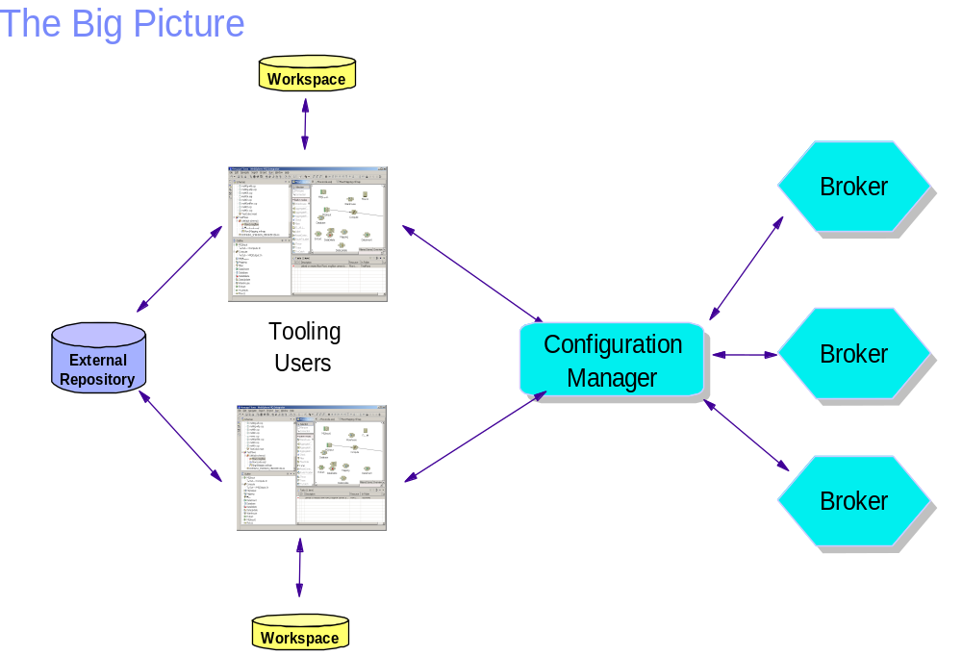
Message Broker的开发和运行构架

Slide 38
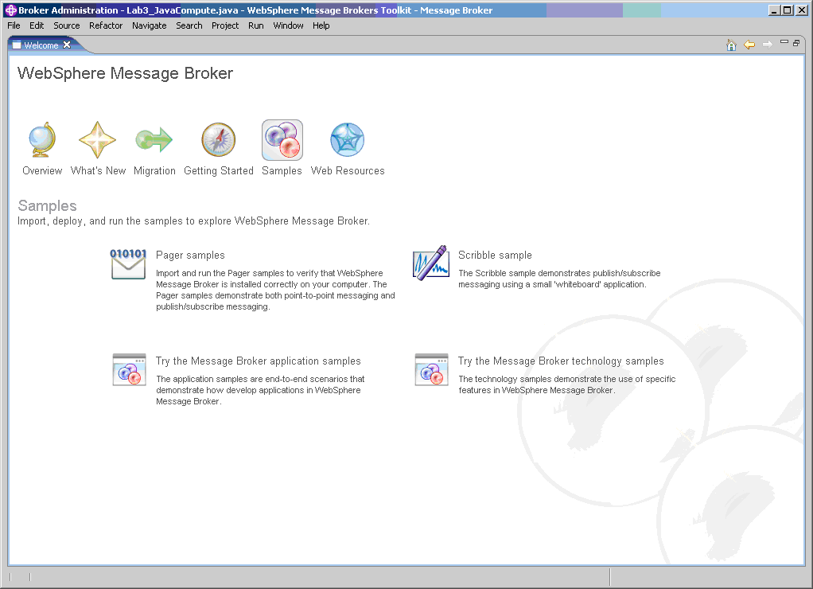
基于Eclipse的开发工具Toolkit

Slide 39
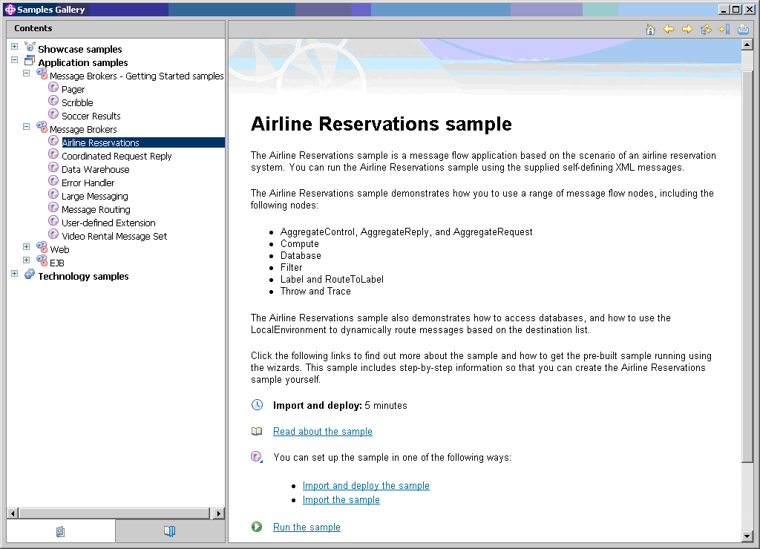
提供已开发的例子

Slide 40
配置管理器 Configuration Manager
User
App
Broker Domain
Config Manager Proxy
User
App
v6 Config Manager
Config Manager Proxy
v5 Config Manager

Slide 41
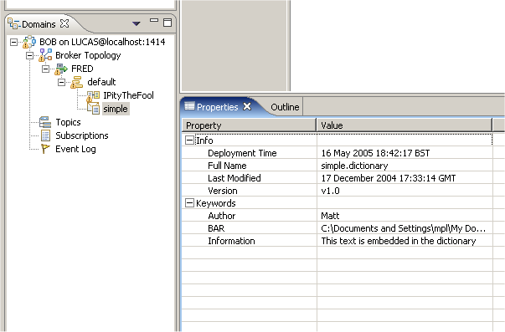
Toolkit Representation – Domain, CM, Broker

Slide 42

Message Broker支持的操作系统
Windows XP Professional – development and test only
Windows Server 2003 Standard Edition
Windows Server 2003 Enterprise Edition
Windows on iSeries Server (using the IBM Integrated xSeries Server card)
AIX 5.2 (plus Maintenance Level 3)
AIX 5.3 (plus Maintenance Level 2)
HP-UX 11i v1 (B.11.11) (plus Dec. 2003 QPK)
Solaris 8 (plus SunSolve recommended Patch Cluster level and patch 111308)
Solaris 9 & 10 (plus SunSolve recommended Patch Cluster level)
Linux Intel (IA32) Red Hat Enterprise Linux AS 3.0 & 4.0(plus Update 2)
Linux Intel (IA32) SuSE LINUX Enterprise Server (SLES) 9
Linux zSeries (31-bit) Red Hat Enterprise Linux AS 3.0 (plus Update 2)
Linux zSeries (31-bit) SuSE LINUX Enterprise Server (SLES) 9
z/OS 1.5
z/OS 1.6
Notes:
Note that Windows 2000 support has been removed!! This is due to Microsoft having dropped support for this platform recently.
Linux on pSeries coming post GA.
Solaris 10 support coming post GA.

Slide 43

Message Broker支持的数据库
IBM DB2® Enterprise Edition, V8.2 (and other IBM DB2 UDB V8.2 editions for production purposes)
IBM DB2® Enterprise Edition, V8.1 Fix Pack 6 or later maintenance (non-XA with 32-bit Broker only) - supported on version 6.0.0.1 or later
Oracle 9i Release 2 Patch Set 4 (9.2.0.5) Oracle Patch 3501955
Oracle 10g Release 1
Sybase Adaptive Server Enterprise (ASE) V12.5 (non-XA only)
Microsoft® SQL Server 2000 (plus Service Pack 3A) - supported on version 6.0.0.1 or later
Informix® Dynamic Server V9.40 with UC7 Fix Pack. Informix Client SDK V2.90 with UC4 Fix Pack (non-XA only, user database only) - supported on version 6.0.0.1 or later

Slide 44

开发工具Toolkit支持的环境
Based on the IBM Eclipse SDK v3.01 (formerly known as the WebSphere Studio Workbench) and RAD v6.0.0.1
Windows
  Windows XP Professional
  Windows Server 2003 Standard Edition
  Windows Server 2003 Enterprise Edition
Linux Intel (IA32)
  Red Hat Enterprise Linux Advanced Server V3.0 (Update 2)
  Red Hat Enterprise Linux Advanced Server V4.0
  SUSE LINUX Enterprise Server (SLES) 9
  GTK Version 2.2.4 or later
  Mozilla version 1.4.2 or later
Notes:
Note that Windows 2000 support is gone!!

Slide 45
其他环境要求
WebSphere MQ v5.3.0.1 or higher
  JMS Real-time support requires WebSphere MQ V5.3 Fix Pack 10.
  Support for JMS MQ Optimized node requires WebSphere MQ V5.3 Fix Pack 10.
  JMS Real-time Multicast PGM support – requires WebSphere MQ V6.0.1.0
  Support for JMS MQ Optimized node requires WebSphere MQ V5.3 Fix Pack 10
  Support for JMS SSL requires WebSphere MQ V5.3 Fix Pack 11
WebSphere MQ v6.0
  JMS Real-time Multicast PGM support – requires WebSphere MQ V6.0.1.0
  Support for 64-Bit requires WebSphere MQ V6.0
  Benefit from NPTL performance gains requires WebSphere MQ V6
IBM JRE 1.4.2 fp2 required for UNIX and z/OS platforms
Notes:
Ships with WebSphere MQ V6 – if V5.3 is not detected then V6 is installed.

Slide 46

Message Broker 强大功能
Any-to-any 消息转换
  XML, SOAP and Web Services
  C records and Cobol copybooks
  EDI, Swift, Fix records, …
基于内容的路由
  过滤
  基于业务规则的路由
  消息合成、拆分
  分发/订阅(pub/sub)
与Database 的无缝集成
基于 Eclipse 的开发平台
  XML Schema 和 Web services Definition Language
  可视化的开发环境实现各种功能：消息定制、消息流定制和部署
扩展性和高性能
与 WBI Adapters的紧密集成
  对各种应用系统的连通性

Slide 47

消息格式服务
提供 Processing Nodes来解析和实现格式传唤
提供的消息解析器有：
  XML 格式
    generic XML， DTD ，Schema
  面向记录的消息格式
    C Headers, COBOL records, JMS Messages
  利用 Message Repository Manager 自定义的消息格式
  SWIFT，IDOC
  透明的
    对消息不进行解析

Slide 48
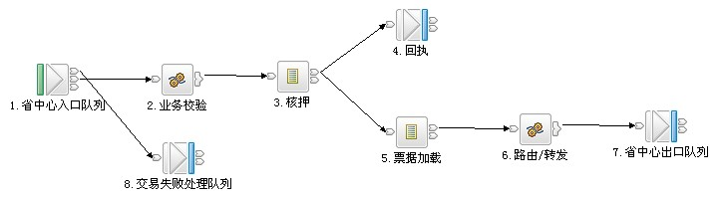
消息处理服务 Message Flow
消息流
  对消息的一系列处理的集合
  通过拖-拽实现
消息流的组成
  开箱既有的处理节点
  第三方节点
  客户化的节点

Slide 49
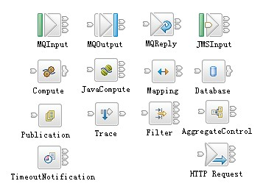
消息流处理节点
众多开箱既有的处理节点
  Check
  Compute
  Database
  Filter
  pass-through
  Subscription
  Throw
  Trace
  TryCatch
  Warehouse
  JMSNode
  ……..
提供开发工具支持客户化节点的开发

Slide 50
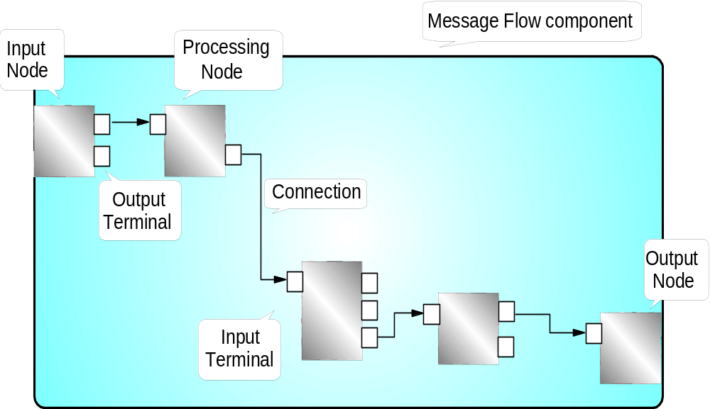
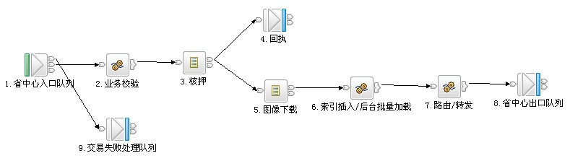
Message Flow 的组成

Slide 51
简单的开发工具
支持ESQL开发语言 － 内嵌SQL语句
提供端到端的开发工具
  开发-管理-测试-部署
  工作组开发
建立在开放开发平台之上
  Eclipse3.01
关注易用性
  开发和配置向导
  丰富的例子程序
目标: 提供业界最全面的开发工具

Slide 52
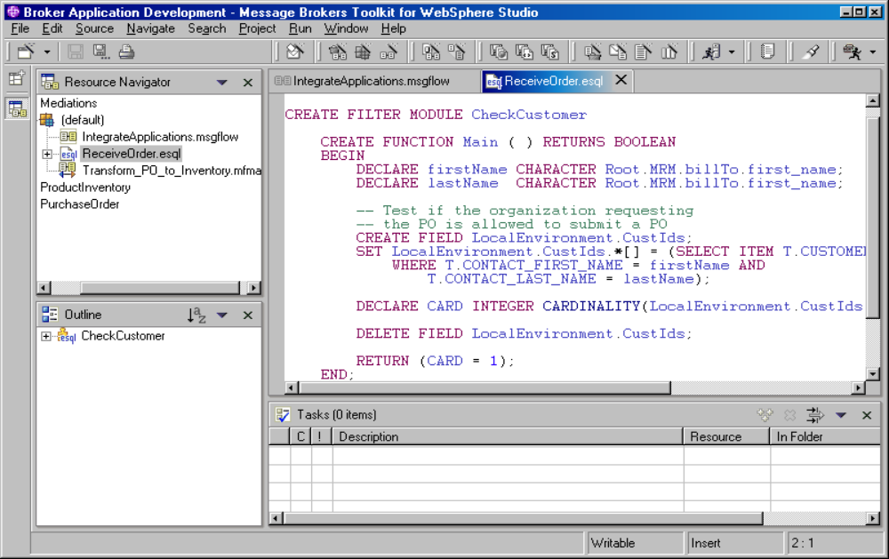
ESQL 编辑器

Slide 53
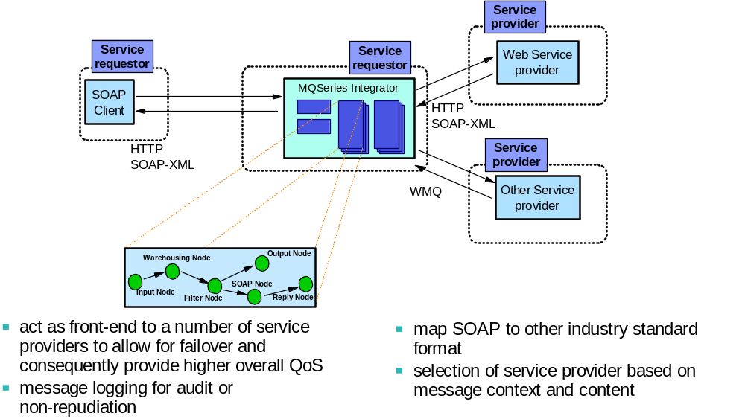
全面支持Web Services

Slide 54
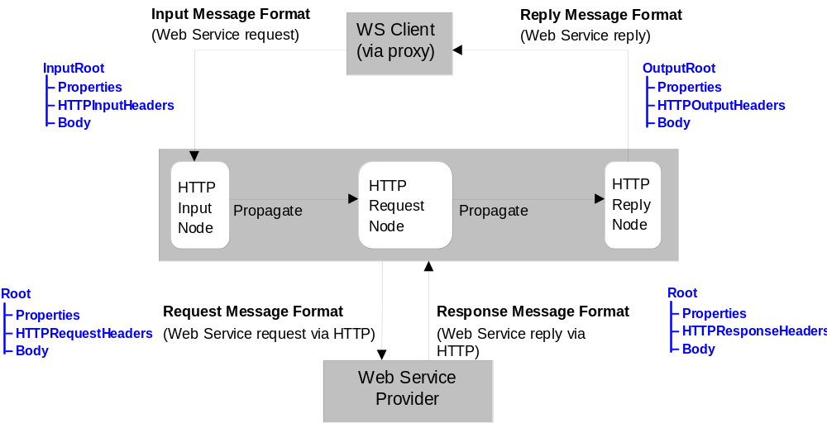
全面支持Web Services

Slide 55
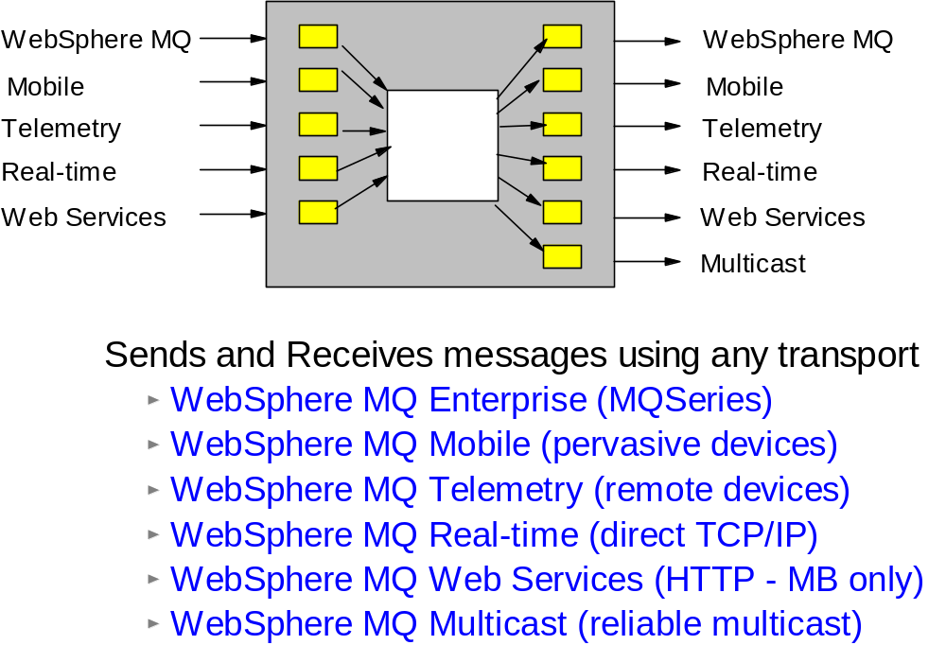
对多协议的支持

Slide 56
IBM ESB的独特优势

Slide 57
为什么不采用传统架构，而是采用ESB总线方案
采用传统架构可以实现系统交互
  自行开发定义系统间数据接口和应用接口
采用总线的优势
利用开放标准，将软件资产展现为服务的结构
面向服务的体系架构
  完全松耦合架构提升系统间的弹性
  采用独立的实现接口描述，单一对外接口，容易实现各种应用整合
  由于明确定义了应用系统间的接口，容易实现应用流程模型－－就象搭积木！
总体性价比
  升级、维护
  易于管理和监控

Slide 58
IBM ESB独特的能力
An ESB 必须提供…
  支持开放的标准
  具有消息中间件的能力
  支持遗留的传统应用
  具有高效的能力，方便的系统管理特点…….
IBM’s ESB产品是唯一满足上述要求的产品
  是开放技术制订和实现的技术领导者
  提供了最好的消息系统，这是ESB的灵魂
    IBM是唯一能够提供传输服务的EAI厂商，因为我们有MQ

Slide 59
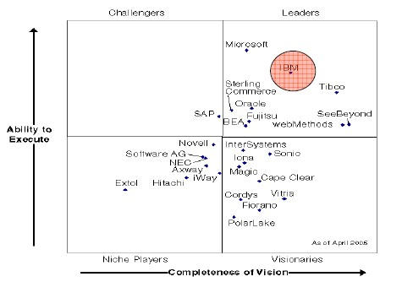
IBM总线方案的强大优势：应用集成/ESB中间件市场比较
2005 by Gartner

Slide 60
IBM ESB独特的能力
可以充分利用各种平台和环境
  利用适配器连接各种应用系统
  提供对传统应用的连接能力，如 CICS, IMS, 等.
优异的处理性能
  在业界同类产品中的性能是无可比拟的，它内部用于数据处理的消息流
  是以多线程方式工作的，同一个消息流还可以分配到不同的执行组，从
  而提高整个系统的运行效率
完善的功能
  消息格式转换，不是一切皆XML

Slide 61
IBM ESB独特优势
交易完整性保证
  支持不同层次的交易完整性要求，例如：可以设定整个消息流为一个完整的交易，当某一环节发生错误时，整个消息流回滚，保证数据一致性；
高可靠性和高扩展性
  单节点：
  多节点：强大的Cluster功能
具有理解和管理各类系统的能力
  支持统一的监控和管理框架：Common Event Infrastructure
  利用Tivoli相关产品进行全面的系统监控和管理
开发简单

Slide 62

IBM ESB独特优势：强大的连接性
先进的企业服务总线
WebSphere Message Broker
提供标准接口和通用连接
HTTP
JMS
WebSphere MQ
Web Services
XML
WebSphere
Adapters
C, C++, C#, Java, .NET, PB, PL/1, ASM, TAL, RPG, VB, COBOL, Perl, SmallTalk, LotusScript, REXX, …
Plus the following:
Weblogic JMS®
Biztalk®
TIBCO Rendezvous®
MQe
Multicast
Tuxedo®
FTP
TIBCO EMS JMS®
COBOL
Copybook
HIPAA
EDI-FACT
HL7
SonicMQ JMS®
ACORD
Real-time IP
AL3
Word/Excel/PDF
SWIFT
FIX
ebXML
EDI-X.12
MQTT
Custom Formats

Slide 63
IBM ESB案例分享

Slide 64
民航航空安全系统整合技术方案

Slide 65

民航信息建设要求
利用现代信息技术建立完整的高速网络交换平台
建立高效、及时、准确、完整、统一的民航安全运行管理信息系统
满足各种应用系统集成的需要
完整的管理机制满足运行和维护的需要

Slide 66
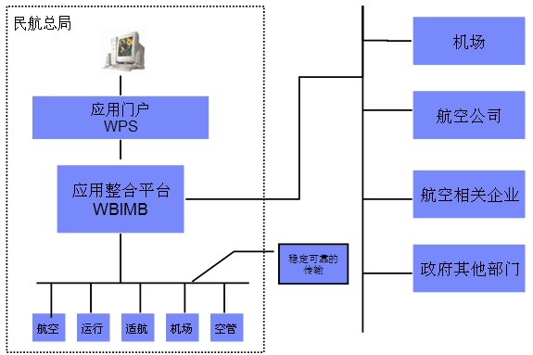
航安系统整合实现框架

Slide 67
方案总结 -民航航空安全系统整合技术方案
首先保证在一个异构的环境中实现信息稳定、可靠的传输
屏蔽掉用户实际中的硬件层、操作系统层、网络层等相对复杂、烦琐的界面，
为用户提供一个统一、标准的信息通道，保证用户的逻辑应用和这些底层平台没有任何关系
提供一个基于application-hub的先进应用整合理念，最大限度地减少应用系统互联所面临的复杂性
基于WBI系统的实现维护都相对简单，保证每一个应用系统的更新和修改都能够实时地实现，
当新的应用系统出现时能够简便的纳入到整个IT环境当中，与其它的应用系统相互协作，共同为用户提供服务，是我们实现企业应用互联和流程管理的最佳实现方案

Slide 68
中国人民银行国库信息处理系统

Slide 69

建设目标
国库信息处理系统 (Treasury Information Processing System)是
一个以国库横行联网的业务流程和工作流程为基础，连接税务、财政、
国库及商业银行等业务部门的信息集成处理系统，用于传递、处理税款
缴纳、划分、入库、退库、对账、业务监管、统计分析等各项业务的电
子信息。
高性能
高可靠
安全
扩展性好
集成平台

Slide 70
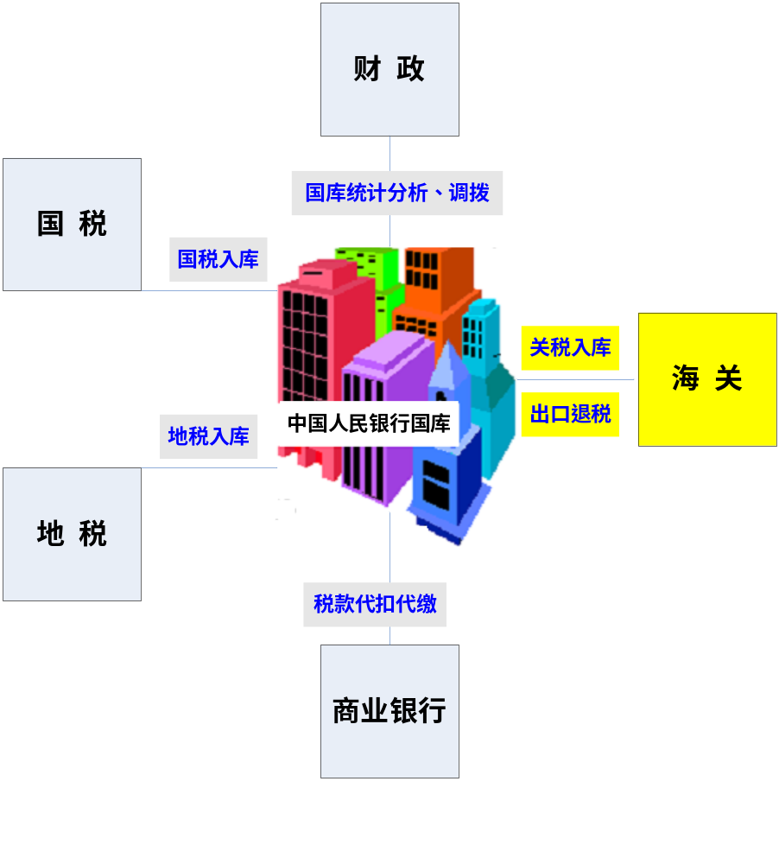

中国人民银行国库信息处理系统
业务关联图

Slide 71
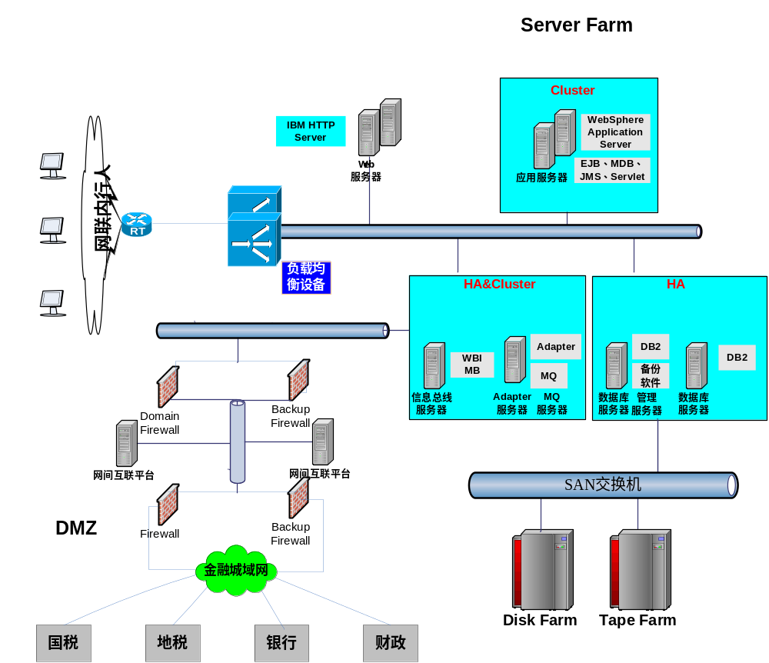
中国人民银行国库信息处理系统

Slide 72
IBM ESB总结
为基础服务和业务服务提供稳定的集中平台
高性能，提供强大的负载均衡功能，提高系统的吞吐率
部署和配置简单，管理界面友好，容易监控
强大的系统连通性，支持多种协议、多种系统接口和多种接入方式
数据传输安全可靠，提供系统的实时响应
灵活的架构，对任何一个接入系统影响都最小
开发简单，开发周期短，降低投资风险

Slide 73









Thai
Traditional Chinese
Gracias
Russian
Spanish
Thank You
English
Merci
Obrigado
French
Arabic
Brazilian Portuguese
Grazie
Danke
Italian
German
Simplified Chinese
Japanese
Notes:
Thank You !

