Slide 1
ESB设计与最佳实践
东风汽车有限公司
陆正武
IBM Certificated SOA Architect
luzw@cn.ibm.com

Slide 2
议程
ESB 、SOA与WebSphere的关系
什么时候需要用到ESB
ESB架构标准实践
ESB设计原则实践
IBM关于建立东风有限统一的ESB的建议方案
IBM ESB的独特优势
IBM ESB案例分享

Slide 3
ESB、SOA和WebSphere的关系

Slide 4

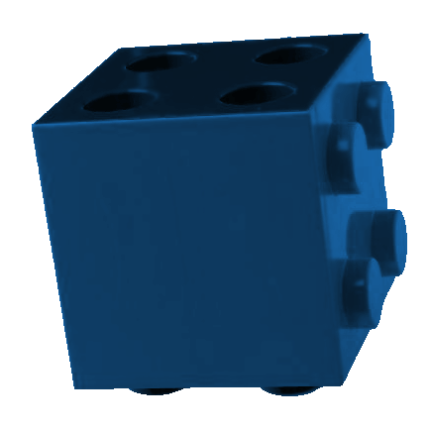

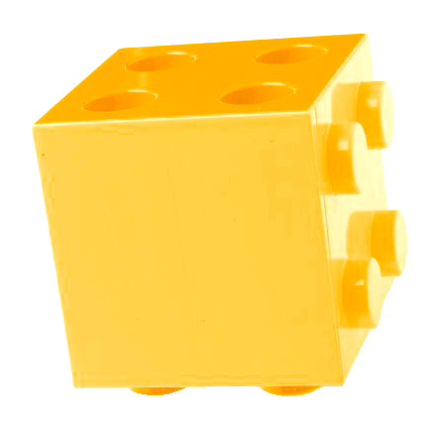
IT构架的演变
The next stage of integration
先进构架
面向服务体系架构
SOA
过渡架构
企业应用整合
传统架构
基于消息传递的模式
通过企业服务总线实现服务的整合集中和流程实现
借助标准的接口灵活地连接，实现真正的随需应变
通过HUB模式实现应用之间的整合
很容易管理大量的连接和系统
应用之间点对点的连接
实现简单、基本的信息交互和数据传递
Flexibility
As Patterns Have Evolved, So Has IBM
Notes:
The desire to make IT more flexible is not new. Indeed, it is as old as the IT industry itself. Each of these integration techniques has its place and is appropriate for handling certain situations.
SOA blends the best of all these concepts into one new architecture. But it’s important to recognize that SOA is not the end of the road either, It’s the next step in the evolution of flexible infrastructures.

Slide 5
什么是SOA？为什么采用SOA？
一种充分利用开放标准，将软件资产展现为服务的结构
提供软件资产标准的展现和交互途径
在开发其他应用的时候，可以将独立的软件资产封装为一个一个的“积木”
更注重应用之间的装配而不是实现细节
封装可以实现重用
采用独立的实现接口描述，容易整合各种应用
由于明确定义了应用系统间的接口，容易实现应用流程模型－－就象搭积木！

Slide 6
关键概念
SOA通过明确的定义和松散藕荷来提升系统间的弹性:
Service：服务
  任何事情都可以是一个服务, 一个实现了唯一功能的自包容的实体
Service 交互
  外部用户调用服务
  服务可以彼此交互，调用操作和交换数据
  Service交互可以是间接的
Service 编排
  通过调用服务, 可以编排实现业务流程
Service 发现
  一个注册的服务可以在构建时或者运行时被发现
Discovery
Service
Discovery
Discovery
Registry
Agency
Agency
Agency
Publish
Publish
Find
Find
Service
Client
Service
Client
Service
Service
Service
Service
Service
Service
Description
Requestor
Description
Requestor
Provider
Interact
Provider
Interact
Notes:
Of all of these dynamic Service Discovery at runtime is probably least used at the moment

Slide 7
Service Interaction
Service
Service
Enterprise Service Bus
Client
Service
Service
企业服务总线(ESB)概念经常用来表示服务互相交互的机制，它提供
了通信的基础架构
企业服务总线应当提供:
  一致的、位置透明的、协议独立的手段来实现交互
  一致的、位置透明的交互意味服务消费者和提供者之间可以是间接的
  无论何种通信服务，应提供端到端的连通保证

Slide 8
什么是Enterprise Service Bus？
An Enterprise Service Bus is a core component of a Services Oriented Architecture …
  它连接和集成企业和组织的IT infrastructure, across many
  locations, 支持不同的transport services, and…
  它可以自动路由消息并且提供系统级的功能，如：消息的格式自动
  转换, and…
  必须是基于标准的规范, and…
  这些必须是安全的、可靠的，并且在高负荷的情况下可管理

Slide 9







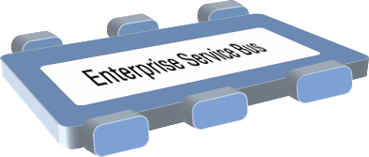













ESB应该有哪些服务？
An Enterprise Service Bus (ESB) is a flexible connectivity infrastructure for integrating applications and services.
An ESB powers your SOA by reducing the number, size, and complexity of interfaces.
传输服务
安全、可靠的数据传输
永久性/非永久性
同步/异步
仲裁服务
路由
格式转换
事件服务
事件发现和发布
Publish / Subscribe
Shape = Protocol
Color = Data type

Slide 10
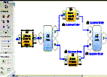
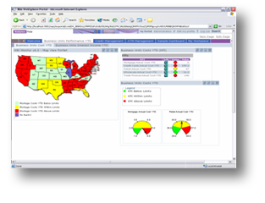

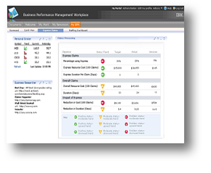
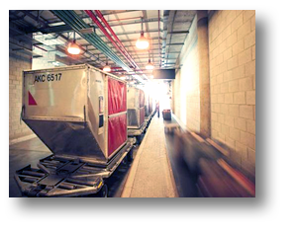
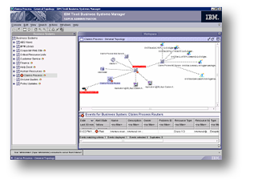
SOA 参考架构
业务用面板
开发服务
业务创新和优化服务
业务创新和优化
交互服务
流程服务
信息服务
门户
联合质询
连接性服务
团体管理器
应用程序 EJB
Oracle
适配器
数据库
访问
SAP
适配器
IT 对流程的支持
数据库
访问
合作伙伴服务
业务应用程序服务
应用程序和信息资产
IT 服务管理
Notes:
And when you deploy this rich set of capabilities along with a Services Oriented approach to your IT Architecture, where do you end up? With composite applications … applications that are made up of multiple services , that
(1) Can be choreographed and designed using modeling tools shared between business & IT
(2) Leverage code artifacts that were automatically generated from those models..
(3) Expose business function to users via any device appropriate
(4) Leverage application function coming from existing, legacy applications
(5 & 6) Tie in data from a variety of datasources with source transparency
(7) Expose the process to business parters, outside the firewall
(8) Reflect process performance on Key-performance-indicators to LOB via dashboards
(9) Create the closed loop environment for process improvement and better business results..
In short… Business Flexibility.. enabled by IT flexibility

Slide 11





IBM软件助您实现整合计算
IT自动化管理平台
信息
流程
人员
软件资产管理和整合开发平台

Slide 12
SOA参考框架下WebSphere产品线
WebSphere
Business Modeler
Rational
开发服务
工具
WebSphere
Integration Developer
Tivoli
WebSphere
Business
Monitor
业务创新和优化服务
工具
交互服务
WebSphere
Process Server
信息服务
WebSphere
流程服务
WebSphere
Information Integrator
Portal
IBM
Workplace
WebSphere
BI Server Foundation
WebSphere
Message Broker
WebSphere
WebSphere
DataPower
连接性服务
ESB
WebSphere
MQ
合作伙伴服务
业务应用程序服务
应用程序和信息资产
Partner Gateway
Application Server
WebSphere
Business Integration
Adapters
WebSphere
WebSphere
WebSphere
Information Integrator
Tivoli
Monitoring
Tivoli
IT 服务管理
Intelligent Orchestrator
Tivoli
Access Manager

Slide 13
什么时候需要用 ESB

Slide 14
什么时候需要用 ESB
  ESB 网关 – recommendation DataPower SOA Appliance – for any external services to protect against XML threats
  中介 between non-standards based systems and standards based systems
  支持动态更改提供者 (routing, replacement, load balancing, protocol changes)
    Including versioning
  Minimize changes to requestors
  支持请求者与提供者之间协议和数据格式不同时的交互
    Adding new requestors who are not an exact match with provider
  Common security, management, monitoring enforcement

Slide 15
ESB架构模式核心原则
ESB
Service Requestor
Service Provider
ESB inter-connects requester and provider
  Interactions are decoupled
  Supports key SOA principle – separation of concerns
ESB provides Service Virtualization of
  Identity via routing
  Interaction via conversion
  Interface via transformation
ESB also enables Aspect Oriented Connectivity
  Security
  Management
  Logging
  Auditing
  …
Described in a whitepaper by Greg Flurry
  http://www-128.ibm.com/developerworks/architecture/library/ar-esbpat1/

Slide 16
ESB架构实践

Slide 17
1. 确定参考架构
ESB涉及多平台，多项目
  Usually spearheaded by a corporate Architecture team or Infrastructure team
  Needs participation and agreement from Networking, Security, Application Development, and Operations
A Reference Architecture is a key document and process for securing this agreement across all stakeholders
  核心架构、设计和管控决策
  可选的技术路线和设计模式
  提供常见场景和使用实践

Slide 18
定义接口和连接标准
ESB功能全面，大多数企业不会使用到所有功能
  You need to decide what connectivity options to allow both internally and externally
确定总线上实现哪些功能及gateways 和 adapters
    Gateways are access points for bridging on and off the bus
      Can be used as policy enforcement points
    Adapters are mechanisms for bringing information onto or off of the bus
确定采用哪种标准路线
  Emphasize industry standards for external (partner) communication
确定所支持的常见数据表示
  Canonical message formats allow for shared transformation mediations

Slide 19
Expanded view of the ESB
Enterprise Service Bus
Mediation Flows
Mediation Patterns
Message Models ：XML
Meta models
Communication Protocols
Interaction Patterns
Notes:
Communication protocols
To enable interaction between service requesters and providers, that is to receive and deliver messages, the ESB must connect to requesters and providers via communication protocols. The ESB can leverage different protocols to support differing qualities of service between requesters and providers, for example, to support best effort or assured delivery. The broader the spectrum of protocols an ESB leverages the broader the spectrum of requesters and providers the ESB can interconnect.
The ESB itself does not actually provide the communication protocols, but instead leverages one or more of the underlying communication fabrics offered by its operating environment (the Infrastructure Services in the SOA Foundation Reference Logical Model). One might say that the ESB itself supplies on-ramps and off-ramps or bindings to enable interaction using various protocols.
Communication protocols inherently support one or more interaction patterns due to characteristics of the underlying communications fabric. For example, some common interaction patterns are synchronous request/reply, one-way (sometimes called event), and publish/subscribe (sometimes called event propagation).
Message models
To interact with service requesters and providers, the ESB must support the message models that define the content of the messages used in interactions. To that end, an ESB must be message model agnostic, and offer the configuration flexibility to support the message models defined by the service requesters and providers.
A message model itself is based on a meta-model, a way of representing message content. An example of a message meta-model is the XML schema definition language; in fact that is the most common meta-model found in ESB products. A message model is a specific application of a meta-model; an example of a content model is a specific XML schema. An ESB must obviously support at least one message meta-model and may support many.
While the architectural pattern is message model agnostic, specific ESB products may provide support for a set of cross-industry or industry-specific “standard” message models such as HL7 in the healthcare industry. Support in this case means built-in recognition of the model in the associated tooling and even optimized runtime transformation capability.
Mediation flows
To support the service virtualization and aspect oriented connectivity necessary in interactions between service requester and providers, the ESB provides mediation flows. A mediation flow, commonly shortened to simply mediation, includes the receiving an inbound request message from a requester via some off-ramp, processing of a request message and sending an outbound request message to the provider via some on-ramp; if applicable, it includes receiving a correlated inbound response message, the processing of a correlated response message and sending the outbound response message to the requester.
The mediation flows in a solution can vary in complexity from very simple to very complex and can vary in reusability from unique to a single interaction to applicable to all interactions in a solution, or even across solutions. Certain types of message processing performed in a mediation flow tend to be highly reusable. These commonly occurring, highly reusable, well-defined types of message processing are called mediation patterns. ESB products can offer one or more pre-built mediation patterns. ESB products that offer more than one pre-built mediation pattern provide a mediation framework that supports creation of mediation flows via composition of mediation patterns.
How do mediation flows implement service? Virtualization of protocol and pattern implies conversion between different communication protocols and interaction patterns. An ESB can only convert between one protocol and another if it has on-ramps and off-ramps, or bindings, for both. Conversion between interaction patterns may be inherent with support for the inbound and outbound protocols, or may require additional processing. For example, converting from an inbound one-way request via SOAP/HTTP to an outbound one-way request via some queue-based protocol where the message model is the same is inherent since a queue-based protocol is inherently one-way. Conversely, converting between an inbound synchronous request/reply via SOAP/HTTP to an outbound asynchronous request/reply via some queue-based one-way request with a one-way reply requires the mediation flow to enable correlation between the queue-based request and reply. Conversion-related mediation patterns include the on and off-ramps and correlation patterns, though correlation is so core to mediation flows it is in many cases implicit in the mediation framework.
Virtualization of interface requires that the ESB support syntactic transformation between the message models defined by the service requesters and providers. Messages inbound from service requesters using one message model might have to be transformed into the specific message model required by the service provider; any responses messages must also be transformed. Transformation-related mediation patterns include those that allow a single meta-model, e.g., XSLT, more generic any-to-any transformation patterns that support multiple meta-models and other forms of message manipulation, such as message enrichment and message filtering (changing syntax, not semantics).
Virtualization of identity requires the ESB to support various forms of routing. Routing allows the ESB to send messages from a service requester to a service provider chosen statically, e.g., at the time of deployment, or dynamically, based on the conditions at the time of the request. Routing mediation flows range from very simple to very complex. For example, a simple routing mediation flow would do nothing but supply a different address for the provider; the address might come from some property set at deployment. A more complex routing mediation flow might: access a service registry to understand the needs of the requester and the offers of the potential providers; use a complex matching algorithm to determine the “correct” provider; and finally perform various conversions and transformations as discussed above. Routing-related mediation patterns allow simple address manipulation, various forms of registry access and various forms of decision making. Larger-grained routing patterns can contribute to differing qualities of service, for example offering request retry and failover, or even dynamic matching of requester and provider based on policies extracted from a service registry. An ESB may support more complex and sophisticated routing patterns such as distribution of a request and correlated aggregation of responses, or even complex event processing.
How do mediation flows implement aspect oriented connectivity? The mediation flow may simply log that a request was passed from requester to provider, or may block requests from unknown or unauthorized requesters, or may block requests based on provider availability. Related mediation patterns include auditing and logging in a manner appropriate for the solution. Other mediation patterns provide direct or indirect access to the security and management policy definition points so the mediation flow can perform the appropriate control.
From the discussion above, it is clear that many mediation flows are likely composed of mediation patterns supporting various forms of service virtualization and aspect oriented connectivity. Individual mediation patterns are placed appropriately in the mediation flow to achieve the goals of the intended interaction as well as enforce management and security policies.

Slide 20
以ESB为中心的逻辑模型
ESB
Application Services
Interaction
Process
Information
Security
Management Services
Development Services
Partner
Business App
Access
Registry
Management
Outside ESB
  Business Logic (Business Services)
    ESB does contain integration logic or connectivity logic
    Criteria: semantics versus syntax; aspects
Loosely coupled to ESB
  Security and Management
    Policy Decision Point outside the ESB
    ESB can be Policy Enforcement Point
Tightly coupled to ESB
  Service Registry
    Registry a Policy Decision Point for ESB
    ESB a Policy Enforcement Point for Registry
    But, Registry has a broader scope in SOA
Tooling required for ESB
  Development
  Administration
  Configures ESB via Service Registry

Slide 21
2. 定义公共术语表
ESB没有统一的术语
  Vendors and clients are variable in their definition of what is part of the ESB and terminology
  IBM has varying terminology in our ESB products
  Patterns work has its own terminology
构建ESB/SOA时非常重要的一点就是建立统一的术语表
Generic Term | Mediation Flow (or simply Mediation) | Mediation Pattern
WMB | Message Flow | Node
WESB | Mediation Module | Mediation primitive
DataPower | Policy | Policy Step

Slide 22
使用规范还是标准？
A specification outlines APIs/data/formats from one or more vendors working together
  Proposed by vendors to address a gap
  Often supported by some vendor’s software
Usually submitted to a standards body
  More companies get involved, specification changes, sometimes merged with competing specifications
  Goes through multiple drafts and reviews
Standard is agreed to by the standards body’s committee members and is declared a ‘version x’ standard
Standards bodies vary by process, rigor, respect and adoption rate
  And specific standards vary wrt to adoption
Notes:
Key standards bodies for SOA: W3C, OASIS
WS-I
Consortium to promote interoperability of web services standards
Most established, proven SOA standards:
XML, XML Schema, SOAP, WSDL, WS-Security
Opinions vary as to whether Java Community Process (JCP) is a standards body
W3C (World Wide Web Consortium) – http://www.w3.org
develops interoperable technologies (specifications, guidelines, software, and tools) to lead the Web to its full potential. Covers HTML, HTTP, XML, SOAP, etc. Founded in 1994 and includes 350 member organizations from around the world. The W3C focuses mostly on interoperable technologies that are more web related (including HTML, HTTP, XML, and SOAP) and for service meta-data – WSDL and WS-Policy
OASIS (Organization for the Advancement of Structured
Information Standards) - http://www.oasis-open.org
drives the development and adoption of Web services, security, e-business, public sector and application-specific standards (BPEL, ebXML, UDDI, WSRP, WS-Security, etc.). Founded in 1993, has more than 3,000 participants from 600 organizations in 100 countries. OASIS focuses on the development/adoption of web services QOS standards (WS-Security, WS-Distributed Management, etc…) along with other application-specified standards like BPEL, UDDI, WSRP, etc…
JCP (Java Community Process) – http://www.jcp.org
holds the responsibility for the development of Java technology. It primarily guides the development and approval of Java technical specifications (JSRs). JCP is controlled by Sun, but is open to everyone. IBM, BEA, Oracle, Novell, JBoss, AOL, ATG, SAS, Sybase, Borland, Macromedia, HP are among many other contributors
WS-I
is an open industry effort to promote Web Services interoperability across platforms, applications, and programming languages. Provides guidance, recommended practices, and supporting resources for developing interoperable Web services (WS Basic Profile). The WS-I organization isn’t meant to focus on the creation of any particular technology standard, but more on promoting interoperability across vendor runtimes (and focuses more on resolving ambiguities and contradictions between specs, as they try and achieve interoperability between different vendors).

Slide 23
3. Apply criteria on whether to use a standard or specification
是否很好地描述了我们的需求?
标准是否覆盖了我们的需求?
是否需要在不同平台上的互操作性和可移植性?
采用的到底是标准还是规范，标准和规范的成熟度如何?
是否支持所有的供应商平台，版本是否具有连续性?
采用的标准是否支持WS-I? 我们的供应商是否也支持?
是否需要采用最新版本的标准?
如果供应商系统不支持现有标准，只支持早期的规范，如何移植?
是否可以增加一层标准的API，以保护你的代码?
采用的标准和规范是否比我们所需要的更复杂?

Slide 24
4. 从企业基础架构中分离出业务逻辑
基本设计原则：需要分离考虑：
  Business logic does not belong in mediations
ESB 架构于业务逻辑之上 - the business logic may put information into headers
  Example: business logic determines whether a customer deserves priority treatment, sets a flag in the header, the ESB routes to highest performing provider
分离业务逻辑和应用程序逻辑
    Use BPEL and choreography for that instead
Notes:
Note that several parts of the are SOA Foundation inter-connected by the ESB, namely the Interaction Services, Process Services, Information Services, Partner Services, Business Application Services and Access Services, have been grouped into a single category labeled Applications Services positioned outside the ESB. The parts of the Foundation grouped as application services are used to implement different forms of service requesters and service providers, i.e., the application or business logic in a solution, targeted at achieving domain-specific business goals. The ESB implements the connectivity or integration logic in a solution, performing service virtualization and aspect oriented connectivity, targeted at achieving on-demand inter-connectivity between application service requesters and providers. In an ideal service oriented solution, separation of application/business logic and connectivity/integration logic is “clean,” meaning that the service requesters and service providers, i.e., the application service contain no connectivity/integration logic, and that the ESB contains no application/business logic. Only by architecting this clean separation can an enterprise achieve the flexibility, agility and reuse sought from SOA.
It is sometimes difficult to distinguish between application/business logic and connectivity/integration logic. There are no strict guidelines, and in fact, the choice may depend on the nature of the enterprise, or even a particular situation within the enterprise. One guideline that often works leverages the distinction between semantics and syntax. If the logic creates, reads, updates or deletes the semantics associated with achieving business goals, it is application/business logic. If the logic only modifies syntax associated with achieving the necessary inter-connectivity, it is connectivity/integration logic. A related guideline leverages interaction characteristics. Application/business logic is active, in that it creates or consumes the messages (requests and responses) used in service interactions; connectivity/integration logic is passive and simply reacts to messages generated by the business logic, basically moving the messages from one participant to another.

Slide 25
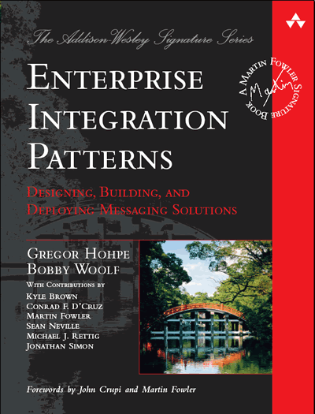
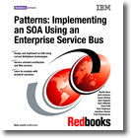
5. 采用基于模式的研究方法
Enterprise Integration Patterns (Hohpe) has a set of 60+ patterns that cover common messaging and EI situations
Includes an abstract notation for representing the patterns
Using this notation allows you to decide on the content and flow of the mediations without having implementation considerations drive the process
  帮助实现多个ESB产品之间耦合的配置
  方便查找应用程序之间的公共部分
  在大多数ESB工具中容易实现 (WMB, WESB, DataPower)
Use the IBM Patterns for e-Business to map out your ESB topologies

Slide 26
EIP Patterns Organization
Chapter 2:
Integration
Styles
Messaging
Chapter 3:
Messaging
Systems
Message
Channel
Message
Pipes and
Filters
Message
Router
Message
Translator
Message
Endpoint
Chapter 4:
Messaging
Channels
Chapter 5:
Message
Construction
Chapter 7:
Message
Routing
Chapter 8:
Message
Transformation
Chapter 10:
Messaging
Endpoints
Chapter 11:
Systems
Management
Message
Routing
Translation
Application
Channel
Application
Endpoint
Systems Management

Slide 27
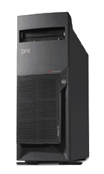

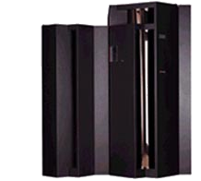
The SOA/ESB Design Pattern (P4eB)
Partner Zone
Inter-Enterprise Zone
Demilitarized
Zone
Enterprise Secure Zone
Enterprise Service Bus
Network Infrastructure
Web Services Gateway
Protocol Firewall
Domain Firewall
Enterprise Service Bus Gateway
Back-end Resource Gateway

Slide 28
6. 确定服务提供者查找方法论– ESB 需要提供者的源头
An ESB must send the message to one or more provider endpoints
  在可选的提供者之间作出选择
Options for managing endpoint lookup
  Not recommended
    No endpoint lookup (fixed addresses)
    Change endpoint administratively on the ESB servers
      Provider must keep track of all ESB servers which can call it
    IP spraying or load balancing between ESB and providers
      Limited to IP, providers maybe outside of your domain
  Endpoint(s) lookup from a registry
    使用Cache，而不是直接向注册库
    Providers update the registry with new endpoints
    Separates ESB from the providers
    允许无缝增加新的providers 和ESB服务器

Slide 29





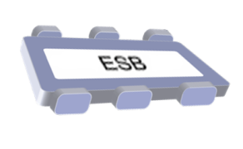

7. 使用 Service 注册表
Dynamic selection
WSRR support
WESB 6.0.2 mediation primitive
  Port Type match
WMB SupportPac
  Port Type match
  General metadata retrieval
DP 3.6.0.8 and higher firmware
WebSphere Service Registry and Repository
Publish
Find
Enrich
Manage
Govern
(3) Retrieve requestor information
(4) Retrieves candidate providers information
Message
Message
ESB
Mediation
Message
Service
(1) A Message is received
(2) Invokes a selection mediation.
(5) Executes matching algorithm to identify the provider service for requestor service
(6) Message is transformed and routed to the selected endpoint.
Notes:
This slide shows a scenario that demonstrates the use of runtime mediations to dynamically access service metadata in the WSRR.
The scenario shows the retrieval of candidate service descriptions and the dynamic selection and late binding to a service.
The provider service is selected dynamically based on message content.
The requester service description is obtained from the Service Registry, including its terms and relationships. The relationships to qualified service providers are wired in the Service Registry. These relationships are used to obtain service descriptions and terms about the wired candidate services. Business rules are used to select the service to invoke form the candidates (business rules are not assumed to be services advertised in the Service Registry).
Discovery – stereotypical ‘find’ either during development (locate services to target consumer request) or runtime (locating services to target consumer request to OR locate hosted service to route inbound message to, for purposes of concealing the actual endpoint, transforming and routing to a newer version, routing based on content (currency, timezone, requester classification). Note that operational efficiency use case deals with using information collected through monitoring to route for reasons of failover, load balancing, operational QoS). Note that at development time discovery is often performed for the purposes of reuse. Asset management processes may govern visibility and reuse of a service.
Selection – involves a human or a selector mediation component or a matchmaking engine to choose the service instance to invoke.
Binding and invocation – executing invocation terms such as logging, auditing, billing and those related to ‘provisioning’ the message (adding things like WS-Security and WS-RM headers to a SOAP message) – applying security policy and reliable messaging policy

Slide 30
8. 确定Services版本方法
Option 1: 利用兼容的schema设计实现
Option 2: 在ESB中实现多版本的.
Option 3: 利用ESB在不同版本之间进行转换

Slide 31
Services Versioning Approaches
Approach | Pros | Cons
Schema Versioning | Enforceable with schema validation | Requires careful planning
Multiple Versions | Simple design and implementation | Expensive to implement
ESB Mediation | Works even when schema evolution not planned | Performance, Complex implementation

Slide 32
9. 设置端到端的 QOS指导方针
在SOA中，性能方面的考虑比其他非SOA的应用复杂得多
  Need to include mediations and transports in performance budgets
  More shared resources to consider
需要了解每个service的负载及应用程序中介的负担
对SOA流程端到端的监控计划
采用可选的技术，如DP 和 WebSphere XD 来管理 QOS

Slide 33
10. 设立公共安全策略
ESB是共享资源，安全策略更为重要
  This is a least-common denominator from which you can expand
  Security must be holistic
    Each enterprise has its own balance of risk and countermeasures but ultimately must support the business model for information protection & user access
定义端到端的安全模型
  Document existing security practices, policies and requirements
  Perform a risk assessment to document vulnerabilities and countermeasures to address known risks
    What are the legal issues involved?
    Are there requirements where policies are(/should be) being enforced?
    Is a manual procedure (code review) for application development the control point?
确定安全策略及策略控制点

Slide 34
11. Determine Ownership of the ESB
The question of who owns the ESB(s) often nearly stops many ESB projects
  网络组?
  核心架构组?
  项目组管理 ESBs?
大多数案例中，中央集权的管理是成功的
  在ESB中只部分需要共享的WEB资源
  If centralization is impossible, then a central team should control federation

Slide 35
ESB设计原则实践

Slide 36
1. 确定规范或不规范消息模型
在ESB中建议采用一致规范的消息模型.
  If any requester or provider does not understand the canonical message ([Hohpe]), then the canonical message is transformed into the message format of the requester or provider.
  This transformation may be done by ESB or one the requester or provider.
如果没有规范的消息模型，ESB就成了点对点的集成
  Which increases cost to add new requestors and providers.

Slide 37
When do you adopt a standard or a specification?
Industry Standards and XML Schema issues
ESB 采用工业标准的规范格式
在需要集成供应商和客户的系统时更需要采用工业标准
不同行业有自己的行业标准
  Some popular ones HL7 for healthcare, ACORD for insurance
有些客户需要扩展某些标准
Many industry schemas leverage XML Schema elements that are not (yet) well supported by Web service environments/tools
  Most common examples are <xsd:group> and xsd:choice>
Vendor support for these complex schema elements is varied in some cases proprietary or not fully supported
  Try to avoid those if you can
  JAX-RPC has limited schema support - JAX-WS 2.0 / JAXB 2.0 will support full set of schema elements
In our products
  JAX-RPC supported by WAS 5.0.2 – 6.1 so limited support
  WAS 6.0 and above, you can plug in JAX-B and/or custom serializers
  Web services feature pack will support JAX-WS and JAX-B
  WebSphere ESB and WPS have limited support
Notes:
Many industry schemas leverage XML Schema elements that are not (yet) well supported by Web service environments/tools
Biggest examples are <xsd:group> and xsd:choice>
Vendor support for these complex schema elements is varied in some cases proprietary or not fully supported
JAX-RPC does not support all schema and implementers may generate SOAPElement to map unsupported types
Try to avoid those if you can
JAX-WS 2.0 / JAXB 2.0 will support full set of schema elements
May require to handcraft industry schemas to make them work
May require to use custom binding support
In our products
JAX-RPC supported by WAS 5.0.2 – 6.1 so limited support
WAS 6.0 and above, you can plug in JAX-B and/or custom serializers
Web services feature pack will support JAX-WS and JAX-B
WebSphere ESB and WPS have limited support

Slide 38
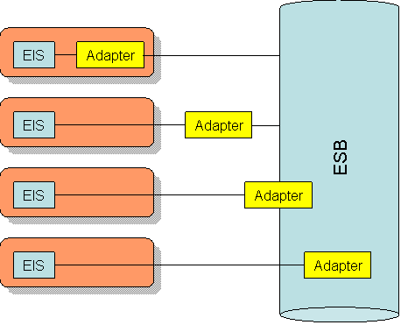
利用Adapters集成现有系统
An ESB must allow access to existing Enterprise Information Systems
Adapters typically used, and may or may not be part of the ESB
  Technology 技术适配器
  Application 应用适配器
  Legacy 遗留系统适配器
适配器与ESB的位置关系:
  Outside of the ESB, and inside the EIS domain
  Outside the ESB, and the EIS domain
  On the boundary of the ESB
  Inside the ESB
Adapters两个关键技术点
  Communication protocol
  Message format

Slide 39
2. 确定哪个应用程序需要适应总线
Who is responsible for building adapters on to the bus is a governance issue. It is frequently driven by ownership, power, and funding considerations.
  It may be influenced by the technical considerations
Options:
  ESB declares canonical messages and all requestors and providers adapt to the canonical format.
  ESB adapts all providers (or a limited set) to a canonical format. Requestors adapt to canonical format.
  ESB adapts requestors (usually legacy requestor) to canonical or provider specific format.
  ESB adapts directly from a provider format to a specific requestor format (basically point to point).

Slide 40
3. 仅当需要的时候才用可靠性和事务处理功能
QoS includes not only performance but reliability measures as well
Use reliable delivery sparingly
  Relatively high performance penalty
  Limited to some transports or standards
少用事务
  利用 services 而不是本地调用

Slide 41
4. 将基本信息放在消息头中，而不是消息体中
Place infrastructure logic such as security, logging levels, client application identify in a header which is separate from the body of a message
ESBs are designed to support separation of infrastructure processing from service logic and are frequently optimized to use headers.
It's better to use headers which are protocol independent to allow header information to seamlessly flow across the various protocols the bus supports.
  No header mapping is required as the bus converts to a new protocol
  Included in SOAP is separation of the header from the body
  When designing your own message formats, have a header section and a body section

Slide 42
5. ESB联邦设计
基本上每个大型ESB项目都会遇到ESB联邦
  Multiple products used for ESB functionality
  Multiple sites dictate multiple product installations
  Organizational, Corporate or political boundaries may dictate the boundary of an ESB
ESB联邦最佳解决方案是采用gateway
  Routing requests to the appropriate ESB (local or remote)
  Handling special security requirements across boundaries
  Providing logging and auditing requirements across boundaries
  Dealing with technology differences in transport or format

Slide 43

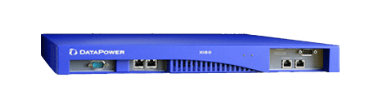
ESB 联邦
站点 1
站点2
MQ Backbone
Transport Security
HTTP Backbone
WS-Security
WMB
WESB
XI50 Gateway
Notes:
Questions Raised by ESB Federation:
How many Registries?
Each site may have its own registry or there may be a single global registry (difficult over a WAN – failover questions across cells)
Monitoring
Complex, multi-product topologies make monitoring challenging but all the more important
Management
Who is responsible for the gateways? Do they belong to one side or the other, or neither?

Slide 44
IBM关于建立东风有限统一的ESB的建议方案

Slide 45
IBM ESB简介
标准的企业服务总线：WebSphere ESB
高级的企业服务总线：WebSphere Message Broker
企业服务总线Gateway：DataPower

Slide 46

WebSphere ESB 架构
Messaging:
Clients:
JMS 1.1
C++
Client
.Net
Client
Java and C/C++
Web Services
Client
MQ
interoperability
Lightweight
Java Client
coming
WebSphere ESB
WebSphere
Integration
Developer
WebSphere
Adapter
Support
XSLT
Message
Logger
Mediation
Function
Message
Router
DB
Lookup
SCA
Programming
Model:
Web
Services:
WebSphere Application Server
Tivoli Access Manager
DB2 Universal Database
Edge Components
SOAP/
HTTP
SCA
SOAP/
JMS
WS-*
UDDI
Registry 3.0
SDO
Notes:
This is a high level architectural view of the WebSphere ESB product. From a messaging perspective we offer support for JMS 1.1 via the WebSphere Messaging support in WAS (native JMS provider), and interoperability with MQ. Clients for C++, .NET, Web Services (Java and C/C++) and a Lightweight Java client (future release). Full support for J2C (JCA adapters), and full support for the SCA programming model which we will discuss in further detail in the subsequent slides. In addition we have a full complement of Web Services offerings including su[pport for SOAP over HTTP or SOAP over JMS transports, WS-*: We have atomic and security, WSRM is planned for future releases but its not yet a standard and full support for UDDI V3.g

Slide 47

WebSphere ESB的位置
Increased capabilities / automation
WebSphere Process Server
Business Process
For customers who want a higher level solution to design, automate and manage composite applications and operational business processes. Built on WebSphere ESB.
Superset
WebSphere ESB
A new product that delivers an Enterprise Service Bus. Provides Web Services connectivity and data transformation. Built on WebSphere Application Server.
ESB
WebSphere Application Server
A world-class J2EE foundation providing industry-leading levels of availability, scalability, and performance.
Subset
Notes:
WebSphere ESB is only one piece of the complete solution that IBM offers for transport, mediation, process, and transformation needs. On the left hand side of this picture, you can see how WebSphere ESB and WebSphere Process Server build on top of one another, WESB to deliver a mediation and connectivity layer, and WPS to deliver a business process management layer. In a similar way, WebSphere Message Broker builds on top of the word class transport within WebSphere MQ to provide transformation and universal connectivity. The stacks interoperate to provide a comprehensive solution.

Slide 48




WebSphere ESB and WebSphere Message Broker
高级版
核心版
ESB:
WebSphere ESB
Advanced ESB:
WebSphere Message Broker
Web Services connectivity
and data transformation
Universal connectivity and data transformation
HTTP
JMS
WebSphere MQ
HTTP
JMS
Web Services
XML
WebSphere
Adapters
Plus the following:
WebSphere MQ
Weblogic JMS®
Biztalk®
TIBCO Rendezvous®
Web Services
XML
MQe
Multicast
Tuxedo®
FTP
TIBCO EMS JMS®
COBOL
Copybook
HIPAA
EDI-FACT
HL7
SonicMQ JMS®
WebSphere Adapters
ACORD
Real-time IP
AL3
Word/Excel/PDF
SWIFT
FIX
ebXML
EDI-X.12
MQTT
Custom Formats
Customers face a range of ESB requirements. As a result, any given project might require an ESB or an Advanced ESB… OR BOTH.
Notes:
The two products work together. WebSphere ESB delivers an Enterprise Service Bus that will connect applications that have standards based interfaces such as HTPP, JMS, and XML data formats.
WebSphere Message Broker is designed for universal connectivity, whether the applications do or do not comply to standards! Therefore it has robust support for data formats such as EDI, SWIFT, FIX, COBOL Copybooks, HIPAA, ACORD, HL7, custom formats, etc. The Broker also handles a multitude of different connection types allowing you to integrate virtually your entire enterprise.

Slide 49
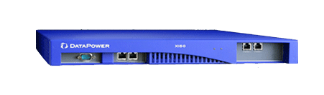
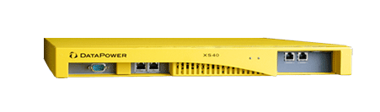
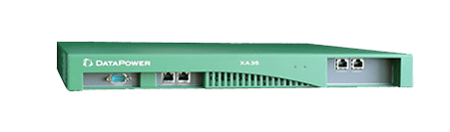
SOA 利器 —— WebSphere DataPower
简化 SOA
  专用的 SOA 设备，部署、管理及维护更加简便，降低成本；
保护 SOA
  集中化管理、丰富的安全策略，更高的可靠性，有力保障系统安全；
加速 SOA
  无与伦比的 XML 处理能力，大幅提高系统处理速度和吞吐量；
IBM 和 DataPower 利用专用的耐久性SOA设备 – 为SOA实施提供优异的性能与硬件安全性 –重新定义了中间件的界限，扩大了SOA的基础。

Slide 50
DataPower 典型应用场景
保护对外的 Web 服务
  支持合作伙伴、客户安全地访问记录的后端系统
传统系统集成
  把大型机或传统应用连接到 Web 服务SOA
HUB 式的中介服务
  在应用和 Web 服务间有效地转换、路由、记录消息
加速动态的 Web 站点
  加快 XML-HTML 渲染，用于动态内容生成

Slide 51
东风汽车有限公司ESB建议方案
企业组ESB
部门/应用级ESB
ESB Gateway

Slide 52


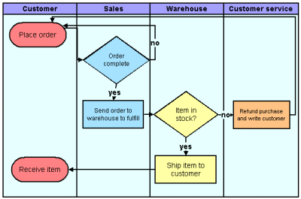
企业级ESB典型方案
SCM系统
WEB展现
交互服务
内部流程服务
Web页面
MQ
MQ
Web页面
Enterprise Service Bus（MB/WESB）
SOAP/JMS/IIOP
SOAP/JMS/IIOP
DataPower
Enterprise Service Bus（MB）
Mediation Chain
格式转换
服务路由
Adapter
SOAP/JMS/IIOP
SOAP/JMS/IIOP
SOAP/JMS/IIOP
SOAP/JMS/IIOP
SAP
DMS
召回系统
OA
新车销售系统
……
……

Slide 53
开发与部署架构
开发
ESB Cluster
WPS Cluster
User
App
Config Manager Proxy
Broker Domain
Broker Domain
Node Agent
Node Agent
v6 Config Manager
User
App
Broker
Broker
WPS
WPS
Config Manager Proxy
Broker
Broker
WPS
WPS
WebSphere Message Broker
WebSphere Message Broker
WebSphere Process Server
WebSphere Process Server
Adapter
MQ
JMS
HTTP/SOAP

Slide 54
IBM ESB的独特优势

Slide 55
为什么不采用传统架构，而是采用ESB总线方案
采用传统架构可以实现系统交互
  自行开发定义系统间数据接口和应用接口
采用总线的优势
利用开放标准，将软件资产展现为服务的结构
面向服务的体系架构
  完全松耦合架构提升系统间的弹性
  采用独立的实现接口描述，单一对外接口，容易实现各种应用整合
  由于明确定义了应用系统间的接口，容易实现应用流程模型－－就象搭积木！
总体性价比
  升级、维护
  易于管理和监控

Slide 56
IBM ESB独特的能力
An ESB 必须提供…
  支持开放的标准
  具有消息中间件的能力
  支持遗留的传统应用
  具有高效的能力，方便的系统管理特点…….
IBM’s ESB产品是唯一满足上述要求的产品
  是开放技术制订和实现的技术领导者
  提供了最好的消息系统，这是ESB的灵魂
    IBM是唯一能够提供传输服务的EAI厂商，因为我们有MQ

Slide 57
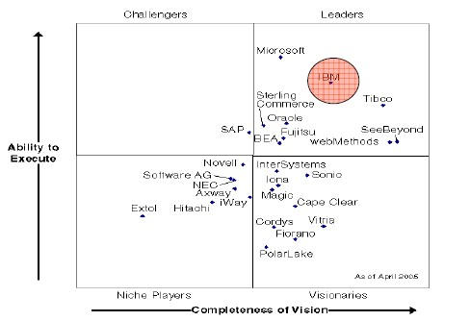
IBM总线方案的强大优势：应用集成/ESB中间件市场比较
2005 by Gartner

Slide 58
IBM ESB独特的能力
可以充分利用各种平台和环境
  利用适配器连接各种应用系统
  提供对传统应用的连接能力，如 CICS, IMS, 等.
优异的处理性能
  在业界同类产品中的性能是无可比拟的，它内部用于数据处理的消息流
  是以多线程方式工作的，同一个消息流还可以分配到不同的执行组，从
  而提高整个系统的运行效率
完善的功能
  消息格式转换，不是一切皆XML
SOA利器——DataPower

Slide 59
IBM ESB独特优势
交易完整性保证
  支持不同层次的交易完整性要求，例如：可以设定整个消息流为一个完整的交易，当某一环节发生错误时，整个消息流回滚，保证数据一致性；
高可靠性和高扩展性
  单节点：
  多节点：强大的Cluster功能
具有理解和管理各类系统的能力
  支持统一的监控和管理框架：Common Event Infrastructure
  利用Tivoli相关产品进行全面的系统监控和管理
开发简单

Slide 60

IBM ESB独特优势：强大的连接性
先进的企业服务总线
WebSphere Message Broker
提供标准接口和通用连接
HTTP
JMS
WebSphere MQ
Web Services
XML
WebSphere
Adapters
C, C++, C#, Java, .NET, PB, PL/1, ASM, TAL, RPG, VB, COBOL, Perl, SmallTalk, LotusScript, REXX, …
Plus the following:
Weblogic JMS®
Biztalk®
TIBCO Rendezvous®
MQe
Multicast
Tuxedo®
FTP
TIBCO EMS JMS®
COBOL
Copybook
HIPAA
EDI-FACT
HL7
SonicMQ JMS®
ACORD
Real-time IP
AL3
Word/Excel/PDF
SWIFT
FIX
ebXML
EDI-X.12
MQTT
Custom Formats

Slide 61
IBM ESB案例分享

Slide 62
民航航空安全系统整合技术方案

Slide 63

民航信息建设要求
利用现代信息技术建立完整的高速网络交换平台
建立高效、及时、准确、完整、统一的民航安全运行管理信息系统
满足各种应用系统集成的需要
完整的管理机制满足运行和维护的需要

Slide 64
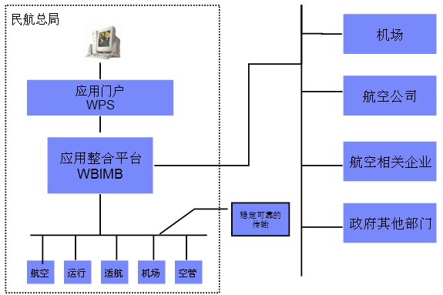
航安系统整合实现框架

Slide 65
方案总结 -民航航空安全系统整合技术方案
首先保证在一个异构的环境中实现信息稳定、可靠的传输
屏蔽掉用户实际中的硬件层、操作系统层、网络层等相对复杂、烦琐的界面，
为用户提供一个统一、标准的信息通道，保证用户的逻辑应用和这些底层平台没有任何关系
提供一个基于application-hub的先进应用整合理念，最大限度地减少应用系统互联所面临的复杂性
基于WBI系统的实现维护都相对简单，保证每一个应用系统的更新和修改都能够实时地实现，
当新的应用系统出现时能够简便的纳入到整个IT环境当中，与其它的应用系统相互协作，共同为用户提供服务，是我们实现企业应用互联和流程管理的最佳实现方案

Slide 66
中国人民银行国库信息处理系统

Slide 67

建设目标
国库信息处理系统 (Treasury Information Processing System)是
一个以国库横行联网的业务流程和工作流程为基础，连接税务、财政、
国库及商业银行等业务部门的信息集成处理系统，用于传递、处理税款
缴纳、划分、入库、退库、对账、业务监管、统计分析等各项业务的电
子信息。
高性能
高可靠
安全
扩展性好
集成平台

Slide 68
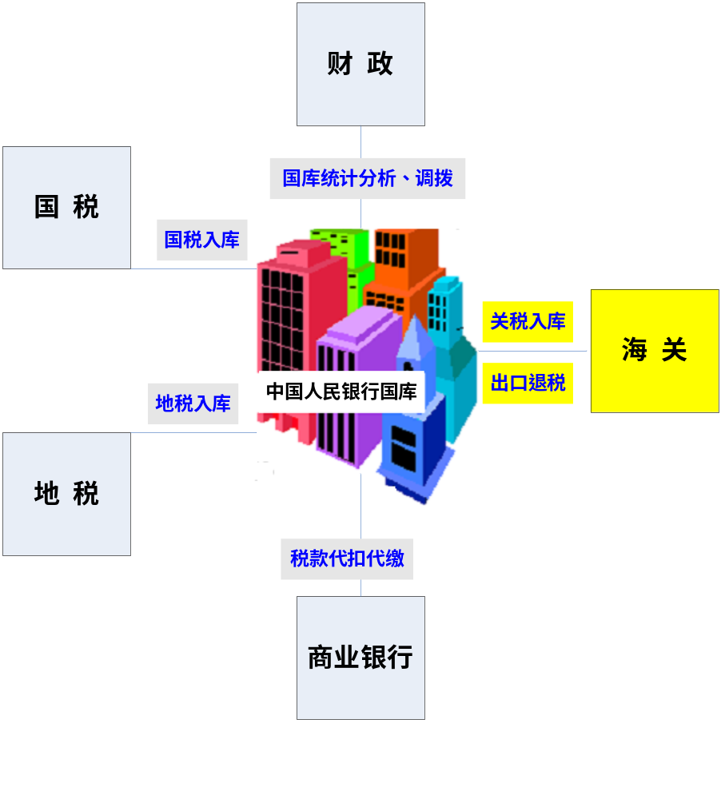

中国人民银行国库信息处理系统
业务关联图

Slide 69
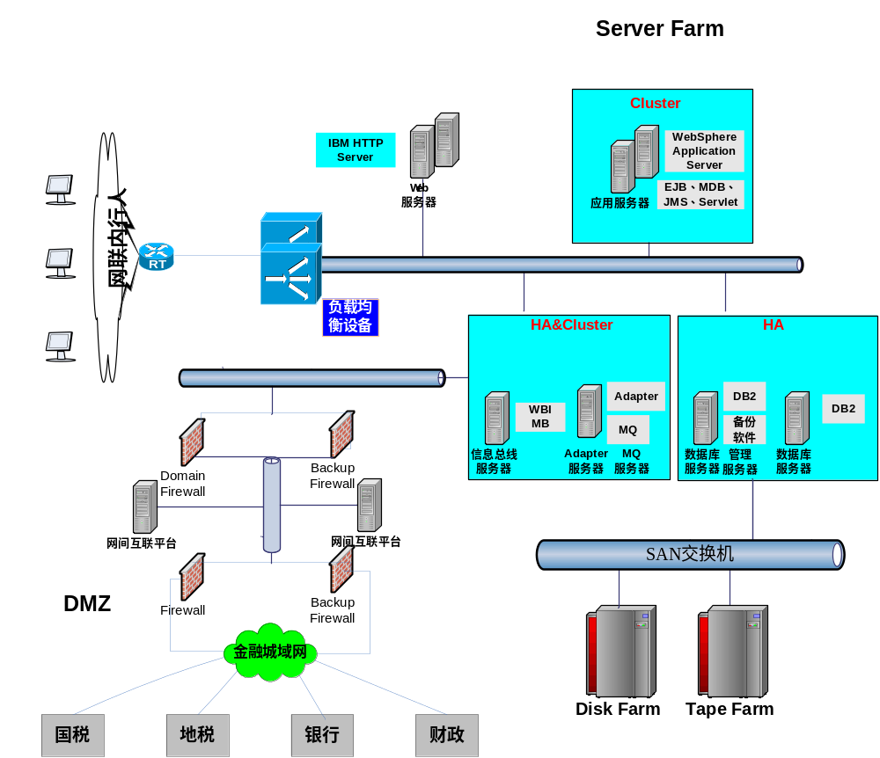
中国人民银行国库信息处理系统

Slide 70
IBM ESB总结
为基础服务和业务服务提供稳定的集中平台
高性能，提供强大的负载均衡功能，提高系统的吞吐率
部署和配置简单，管理界面友好，容易监控
强大的系统连通性，支持多种协议、多种系统接口和多种接入方式
数据传输安全可靠，提供系统的实时响应
灵活的架构，对任何一个接入系统影响都最小
开发简单，开发周期短，降低投资风险

Slide 71









Thai
Traditional Chinese
Gracias
Russian
Spanish
Thank You
English
Merci
Obrigado
French
Arabic
Brazilian Portuguese
Grazie
Danke
Italian
German
Simplified Chinese
Japanese
Notes:
Thank You !

