Slide 1
Schema Design Basics
Roger Bodamer roger@10gen.com
@rogerb

Slide 2
A brief history of Data Modeling
ISAM
  COBOL
Network
Hiearchical
Relational
  1970 E.F.Codd introduces 1st Normal Form (1NF)
  1971 E.F.Codd introduces 2nd and 3rd Normal Form (2NF, 3NF
  1974 Codd & Boyce define Boyce/Codd Normal Form (BCNF)
  2002 Date, Darween, Lorentzos define 6th Normal Form (6NF)
Object

Slide 3

So why model data?

Slide 4
Modeling goals
Goals:
Avoid anomalies when inserting, updating or deleting
Minimize redesign when extending the schema
Make the model informative to users
Avoid bias towards a particular style of query
* source : wikipedia

Slide 5
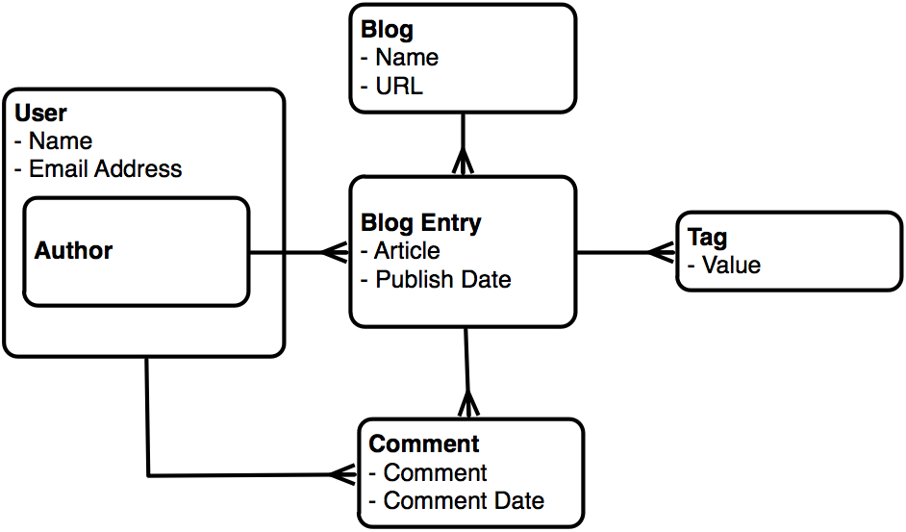
Relational made normalized data look like this

Slide 6
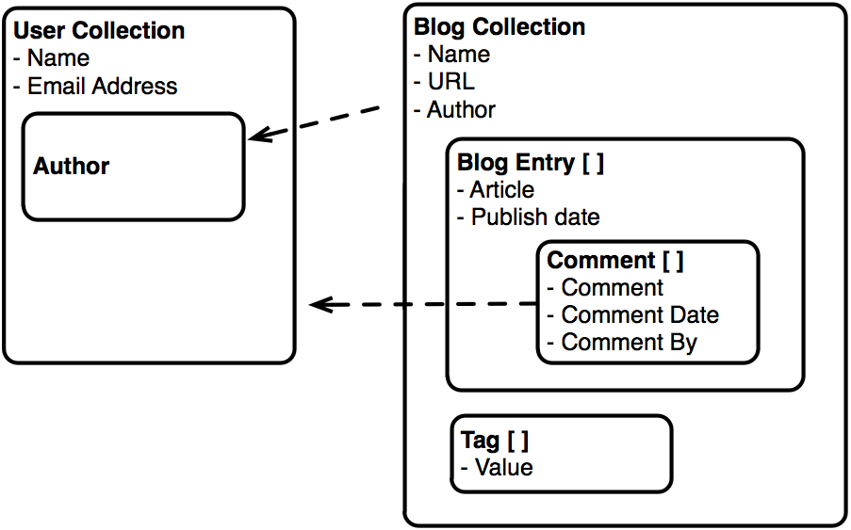
Document databases make normalized data look like this

Slide 7
Some terms before we proceed
RDBMS | Document DBs
Table | Collection
View / Row(s) | JSON Document
Index | Index
Join | Embedding & Linking across documents
Partition | Shard
Partition Key | Shard Key

Slide 8
Recap
Design documents that simply map to your application
post = {author: “roger”,
date: new Date(),
text: “I love J.Biebs...”,
tags: [“rockstar”,“puppy-love”]}

Slide 9
Query operators
Conditional operators:
  $ne, $in, $nin, $mod, $all, $size, $exists, $type, ..
  $lt, $lte, $gt, $gte, $ne,
  // find posts with any tags
  >db.posts.find({tags: {$exists: true}})

Slide 10
Query operators
Conditional operators:
  $ne, $in, $nin, $mod, $all, $size, $exists, $type, ..
  $lt, $lte, $gt, $gte, $ne,
  // find posts with any tags
  >db.posts.find({tags: {$exists: true}})
Regular expressions:
// posts where author starts with k
  >db.posts.find({author: /^r*/i })

Slide 11
Query operators
Conditional operators:
  $ne, $in, $nin, $mod, $all, $size, $exists, $type, ..
  $lt, $lte, $gt, $gte, $ne,
  // find posts with any tags
  >db.posts.find({tags: {$exists: true}})
Regular expressions:
// posts where author starts with k
  >db.posts.find({author: /^r*/i })
  Counting:
  // posts written by mike
>db.posts.find({author: “roger”}).count()

Slide 12
Extending the Schema
new_comment = {author: “Gretchen”,
date: new Date(),
text: “Biebs is Toll!!!!”}
new_info = { ‘$push’: {comments: new_comment},
‘$inc’: {comments_count: 1}}
>db.posts.update({_id: “...” }, new_info)

Slide 13
Extending the Schema
  { _id : ObjectId("4c4ba5c0672c685e5e8aabf3"),
  author : ”roger",
  date : "Sat Jul 24 2010 19:47:11 GMT-0700 (PDT)",
  text : "I love J.Biebs...",
  tags : [ ”rockstar", ”puppy-love" ],
  comments_count: 1,
  comments : [
  {
  author : ”Gretchen",
  date : "Sat Jul 24 2010 20:51:03 GMT-0700 (PDT)",
  text : ” Biebs is Toll!!!!"
  }
  ]}

Slide 14
Extending the Schema
// create index on nested documents:
  >db.posts.ensureIndex({"comments.author": 1})
  >db.posts.find({comments.author:”Gretchen”})
// find last 5 posts:
>db.posts.find().sort({date:-1}).limit(5)
// most commented post:
  >db.posts.find().sort({comments_count:-1}).limit(1)
  When sorting, check if you need an index

Slide 15
Single Table Inheritance
>db.shapes.find()
{ _id: ObjectId("..."), type: "circle", area: 3.14, radius: 1}
{ _id: ObjectId("..."), type: "square", area: 4, d: 2}
{ _id: ObjectId("..."), type: "rect", area: 10, length: 5, width: 2}
// find shapes where radius > 0
>db.shapes.find({radius: {$gt: 0}})
// create index
>db.shapes.ensureIndex({radius: 1})

Slide 16
One to Many
- Embedded Array / Using Array Keys
    - slice operator to return subset of array
    - hard to find latest comments across all documents

Slide 17
One to Many
- Embedded Array / Array Keys
    - slice operator to return subset of array
    - hard to find latest comments across all documents
    - Embedded tree
      - Single document
      - Natural

Slide 18
One to Many
- Embedded Array / Array Keys
    - slice operator to return subset of array
    - hard to find latest comments across all documents
    - Embedded tree
      - Single document
      - Natural
      - Normalized (2 collections)
      - most flexible
      - more queries

Slide 19
Many - Many
  Example:
- Product can be in many categories
- Category can have many products
Products
- product_id
Category
- category_id
Prod_Categories
id
product_id
category_id

Slide 20
Many – Many
products:
  { _id: ObjectId("4c4ca23933fb5941681b912e"),
  name: "Sumatra Dark Roast",
  category_ids: [ ObjectId("4c4ca25433fb5941681b912f"),
  ObjectId("4c4ca25433fb5941681b92af”]}

Slide 21
Many – Many
products:
  { _id: ObjectId("4c4ca23933fb5941681b912e"),
  name: "Sumatra Dark Roast",
  category_ids: [ ObjectId("4c4ca25433fb5941681b912f"),
  ObjectId("4c4ca25433fb5941681b92af”]}
categories:
{ _id: ObjectId("4c4ca25433fb5941681b912f"),
name: "Indonesia",
product_ids: [ ObjectId("4c4ca23933fb5941681b912e"),
ObjectId("4c4ca30433fb5941681b9130"),
ObjectId("4c4ca30433fb5941681b913a"]}

Slide 22
Many - Many
products:
  { _id: ObjectId("4c4ca23933fb5941681b912e"),
  name: "Sumatra Dark Roast",
  category_ids: [ ObjectId("4c4ca25433fb5941681b912f"),
  ObjectId("4c4ca25433fb5941681b92af”]}
categories:
{ _id: ObjectId("4c4ca25433fb5941681b912f"),
name: "Indonesia",
product_ids: [ ObjectId("4c4ca23933fb5941681b912e"),
ObjectId("4c4ca30433fb5941681b9130"),
ObjectId("4c4ca30433fb5941681b913a"]}
//All categories for a given product
>db.categories.find({product_ids: ObjectId("4c4ca23933fb5941681b912e")})

Slide 23
Many - Many
products:
  { _id: ObjectId("4c4ca23933fb5941681b912e"),
  name: "Sumatra Dark Roast",
  category_ids: [ ObjectId("4c4ca25433fb5941681b912f"),
  ObjectId("4c4ca25433fb5941681b92af”]}
categories:
{ _id: ObjectId("4c4ca25433fb5941681b912f"),
name: "Indonesia",
product_ids: [ ObjectId("4c4ca23933fb5941681b912e"),
ObjectId("4c4ca30433fb5941681b9130"),
ObjectId("4c4ca30433fb5941681b913a"]}
//All categories for a given product
>db.categories.find({product_ids: ObjectId("4c4ca23933fb5941681b912e")})
//All products for a given category
>db.products.find({category_ids: ObjectId("4c4ca25433fb5941681b912f")})

Slide 24
Alternative
products:
  { _id: ObjectId("4c4ca23933fb5941681b912e"),
  name: "Sumatra Dark Roast",
  category_ids: [ ObjectId("4c4ca25433fb5941681b912f"),
  ObjectId("4c4ca25433fb5941681b92af”]}
categories:
{ _id: ObjectId("4c4ca25433fb5941681b912f"),
name: "Indonesia"}

Slide 25
Alternative
products:
  { _id: ObjectId("4c4ca23933fb5941681b912e"),
  name: "Sumatra Dark Roast",
  category_ids: [ ObjectId("4c4ca25433fb5941681b912f"),
  ObjectId("4c4ca25433fb5941681b92af”]}
categories:
{ _id: ObjectId("4c4ca25433fb5941681b912f"),
name: "Indonesia"}
// All products for a given category
>db.products.find({category_ids: ObjectId("4c4ca25433fb5941681b912f")})

Slide 26
Alternative
products:
  { _id: ObjectId("4c4ca23933fb5941681b912e"),
  name: "Sumatra Dark Roast",
  category_ids: [ ObjectId("4c4ca25433fb5941681b912f"),
  ObjectId("4c4ca25433fb5941681b92af”]}
categories:
{ _id: ObjectId("4c4ca25433fb5941681b912f"),
name: "Indonesia"}
// All products for a given category
>db.products.find({category_ids: ObjectId("4c4ca25433fb5941681b912f")})
// All categories for a given product
product = db.products.find(_id : some_id)
>db.categories.find({_id : {$in : product.category_ids}})

Slide 27
Trees
Full Tree in Document
{ comments: [
{ author: “rpb”, text: “...”,
replies: [
{author: “Fred”, text: “...”,
replies: []}
]}
]}
  Pros: Single Document, Performance, Intuitive
  Cons: Hard to search, 4MB limit

Slide 28
Trees - continued
Parent Links
- Each node is stored as a document
- Contains the id of the parent
Child Links
- Each node contains the id’s of the children
- Can support graphs (multiple parents / child)

Slide 29
Array of Ancestors
- Store Ancestors of a node
{ _id: "a" }
{ _id: "b", ancestors: [ "a" ], parent: "a" }
{ _id: "c", ancestors: [ "a", "b" ], parent: "b" }
{ _id: "d", ancestors: [ "a", "b" ], parent: "b" }
{ _id: "e", ancestors: [ "a" ], parent: "a" }
{ _id: "f", ancestors: [ "a", "e" ], parent: "e" }
{ _id: "g", ancestors: [ "a", "b", "d" ], parent: "d" }

Slide 30
Array of Ancestors
- Store Ancestors of a node
{ _id: "a" }
{ _id: "b", ancestors: [ "a" ], parent: "a" }
{ _id: "c", ancestors: [ "a", "b" ], parent: "b" }
{ _id: "d", ancestors: [ "a", "b" ], parent: "b" }
{ _id: "e", ancestors: [ "a" ], parent: "a" }
{ _id: "f", ancestors: [ "a", "e" ], parent: "e" }
{ _id: "g", ancestors: [ "a", "b", "d" ], parent: "d" }
//find all descendants of b:
>db.tree2.find({ancestors: ‘b’})

Slide 31
Array of Ancestors
- Store Ancestors of a node
{ _id: "a" }
{ _id: "b", ancestors: [ "a" ], parent: "a" }
{ _id: "c", ancestors: [ "a", "b" ], parent: "b" }
{ _id: "d", ancestors: [ "a", "b" ], parent: "b" }
{ _id: "e", ancestors: [ "a" ], parent: "a" }
{ _id: "f", ancestors: [ "a", "e" ], parent: "e" }
{ _id: "g", ancestors: [ "a", "b", "d" ], parent: "d" }
//find all descendants of b:
>db.tree2.find({ancestors: ‘b’})
//find all ancestors of f:
>ancestors = db.tree2.findOne({_id:’f’}).ancestors
>db.tree2.find({_id: { $in : ancestors})

Slide 32
Variable Keys
How to index ?
{ "_id" : "uuid1",
"field1" : { "ctx1" : { "ctx3" : 5, … },
"ctx8" : { "ctx3" : 5, … } }}
db.MyCollection.find({ "field1.ctx1.ctx3" : { $exists : true} })
Rewrite:
{ "_id" : "uuid1",
"field1" : { key: "ctx1”, value : { k:"ctx3”, v : 5, … },
key: "ctx8”, value : { k: "ctx3”, v : 5, … } }}
db.x.ensureIndex({“field1.key.k”, 1})

Slide 33
findAndModify
Queue example
//Example: find highest priority job and mark
job = db.jobs.findAndModify({
query: {inprogress: false},
sort: {priority: -1),
update: {$set: {inprogress: true,
started: new Date()}},
new: true})

Slide 34
Learn More
Kyle’s presentation + video:
http://www.slideshare.net/kbanker/mongodb-schema-design
http://www.blip.tv/file/3704083
Dwight’s presentation
http://www.slideshare.net/mongosf/schema-design-with-mongodb-dwight-merriman
Documentation
Trees: http://www.mongodb.org/display/DOCS/Trees+in+MongoDB
Queues: http://www.mongodb.org/display/DOCS/findandmodify+Command
Aggregration: http://www.mongodb.org/display/DOCS/Aggregation
Capped Col. : http://www.mongodb.org/display/DOCS/Capped+Collections
Geo: http://www.mongodb.org/display/DOCS/Geospatial+Indexing
GridFS: http://www.mongodb.org/display/DOCS/GridFS+Specification

Slide 35
Thank You :-)

Slide 36
Download MongoDB
and let us know what you think
@mongodb
http://www.mongodb.org
Notes:
blog post
twitter

Slide 37
DBRef
DBRef
{$ref: collection, $id: id_value}
- Think URL
- YDSMV: your driver support may vary
Sample Schema:
nr = {note_refs: [{"$ref" : "notes", "$id" : 5}, ... ]}
Dereferencing:
nr.forEach(function(r) {
printjson(db[r.$ref].findOne({_id: r.$id}));
}

Slide 38
BSON
Mongodb stores data in BSON internally
  Lightweight, Traversable, Efficient encoding
  Typed
boolean, integer, float, date, string, binary, array...

