Slide 1
DVSA Vulnerability Discovery
and Remediation
ICS-344 Course Project | OWASP Damn Vulnerable Serverless Application
ICS-344: Information Security | KFUPM | Term 252

Slide 2
Agenda
Project Overview & Architecture
10 Official Vulnerability Lessons (Lessons #1–#10)
Bonus Vulnerabilities: B1–B7
Summary Table & Key Takeaways
Each lesson covers: Exploit → Evidence → Fix → Verification

Slide 3
DVSA — AWS Serverless Architecture
Frontend:
Static website hosted on Amazon S3
Entry Point:
Amazon API Gateway — routes HTTP requests to Lambda
Compute Layer:
AWS Lambda functions — business logic, auth, processing
Data Layer:
DynamoDB (orders/users), S3 (receipts), SQS (messaging)
Identity:
Amazon Cognito — user auth and JWT issuance

Slide 4
All 10 Vulnerabilities — Summary
# | Vulnerability | Affected Component | CVSS Impact | Fixed?
#1 | Event Injection (RCE) | Lambda / node-serialize | Critical | ✓
#2 | Broken Authentication | Lambda / JWT validation | Critical | ✓
#3 | Sensitive Data Exposure | Lambda / S3 receipts | High | ✓
#4 | Insecure Cloud Config | S3 bucket policy | High | ✓
#5 | Broken Access Control | Lambda / admin function | Critical | ✓
#6 | Denial of Service | Lambda concurrency | High | ✓
#7 | Over-Privileged Function | IAM execution role | Critical | ✓
#8 | Logic Vulnerabilities | Lambda / race condition | High | ✓
#9 | Vulnerable Dependencies | node-serialize package | Critical | ✓
#10 | Unhandled Exceptions | Lambda error handling | Medium | ✓

Slide 5
Lesson #1
Event Injection (RCE)

Slide 6
Lesson #1: Event Injection — How It Works
🔴 The Attack
🟢 The Fix
POST to /order with $$ND_FUNC$$ payload
node-serialize evaluates embedded JS function
Code executes inside Lambda environment
Attacker writes/reads /tmp/pwned.txt
Evidence: CloudWatch log shows FILE READ SUCCESS
Remove node-serialize from package.json
Replace unserialize() with JSON.parse()
Add input schema validation (allowlist)
Deploy fixed Lambda
Verify: $$ND_FUNC$$ no longer executes

Slide 7
Lesson #1 — Evidence

Slide 8
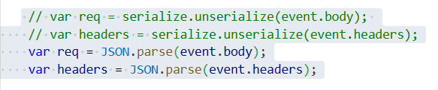
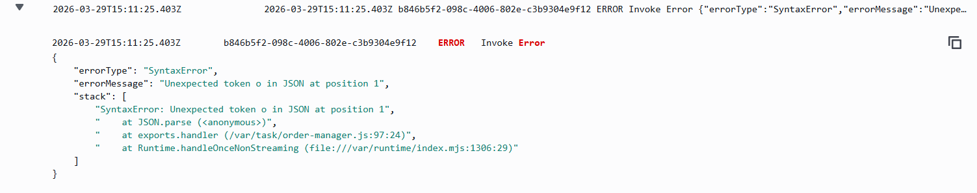
Lesson #1 — Post-Fix Verification

Slide 9
Lesson #2
Broken Authentication

Slide 10
Lesson #2: Broken Authentication — How It Works
🔴 The Attack
🟢 The Fix
Capture TOKEN_B (attacker) from DevTools
Decode JWT payload — extract username & sub
Replace username/sub with victim (User C) identity
Re-encode payload, keep original signature
Send forged token → receive victim's orders
Add verifyCognitoJwt() helper in order-manager.js
Fetch Cognito JWKS public keys
Verify JWT signature using node-jose
Check issuer and expiration claims
Return 401 on any verification failure

Slide 11
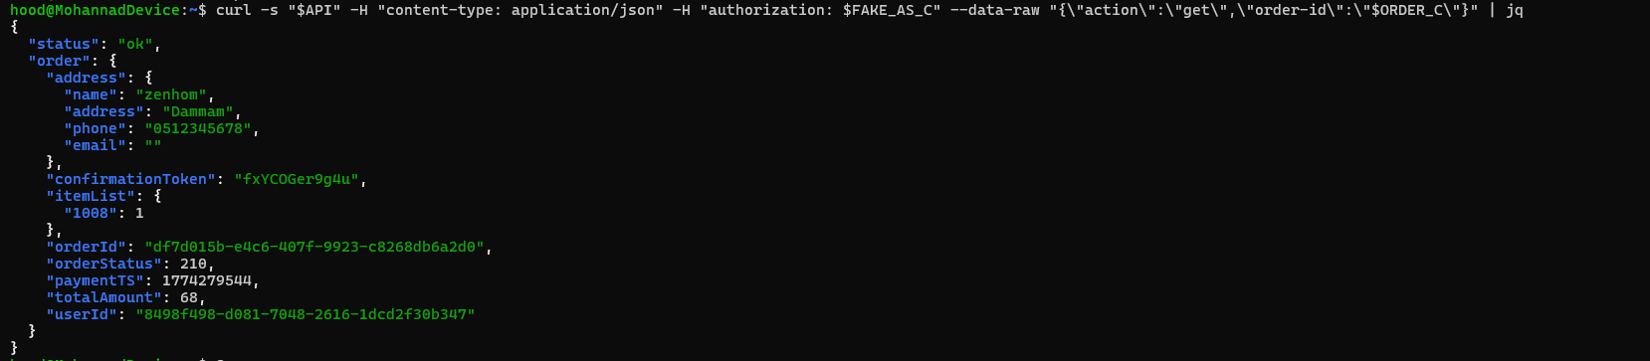
Lesson #2 — Evidence: Forged Token Returns Victim's Orders

Slide 12
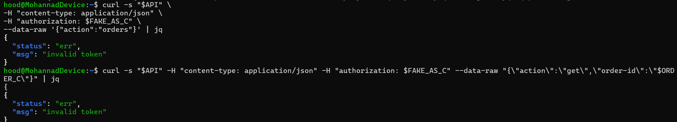
Lesson #2 — Post-Fix: Forged Token Rejected

Slide 13
Lesson #3
Sensitive Information Disclosure

Slide 14
Lesson #3: Sensitive Data Exposure — How It Works
🔴 The Attack
🟢 The Fix
Authenticated attacker sends action='receipt'
Provides a victim's order-id in the request
DVSA-ADMIN-GET-RECEIPT generates signed URL
No ownership check — any user's receipt accessible
Attacker downloads victim's financial receipt from S3
Add DynamoDB ownership check in receipt Lambda
Verify requesting user owns the order
Return 403 Forbidden if ownership mismatch
Reduce signed URL expiry duration
Log all receipt access events to CloudWatch

Slide 15
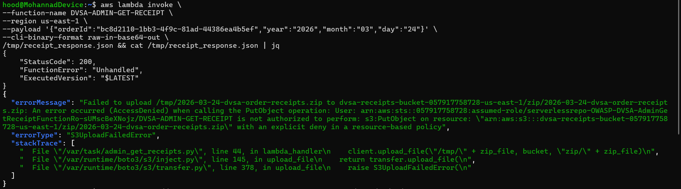
Lesson #3 — Post-Fix Verification

Slide 16
Lesson #4
Insecure Cloud Configuration

Slide 17
Lesson #4: Insecure Cloud Config — How It Works
🔴 The Attack
🟢 The Fix
Identify DVSA receipts S3 bucket name
Upload arbitrary file without app credentials
Upload succeeds → overly permissive bucket
Upload maliciously-named file
Triggered Lambda processes unsafe filename
Restrict S3 bucket policy to Lambda roles only
Remove public write ACL
Add filename allowlist validation in Lambda
Reject keys with path traversal or special chars
Verify: unauthorized upload returns Access Denied

Slide 18
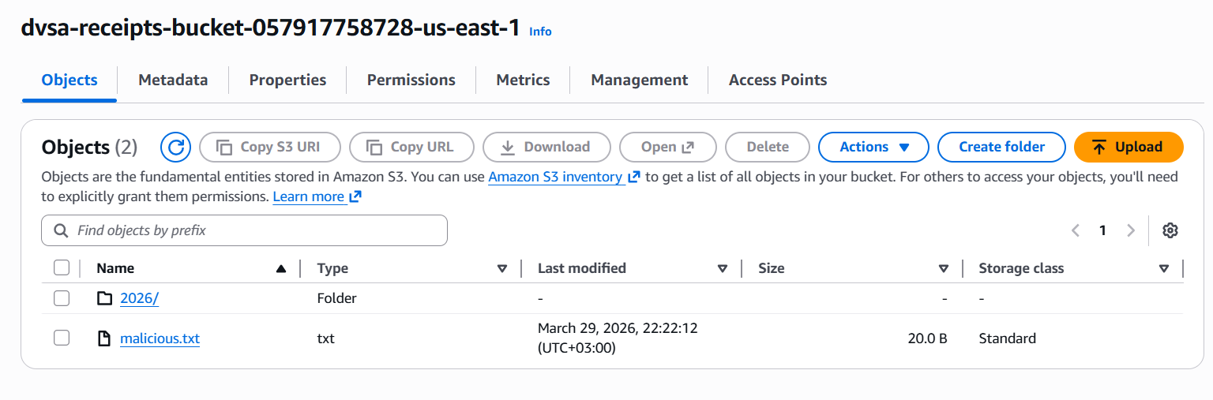
Lesson #4 — Evidence

Slide 19
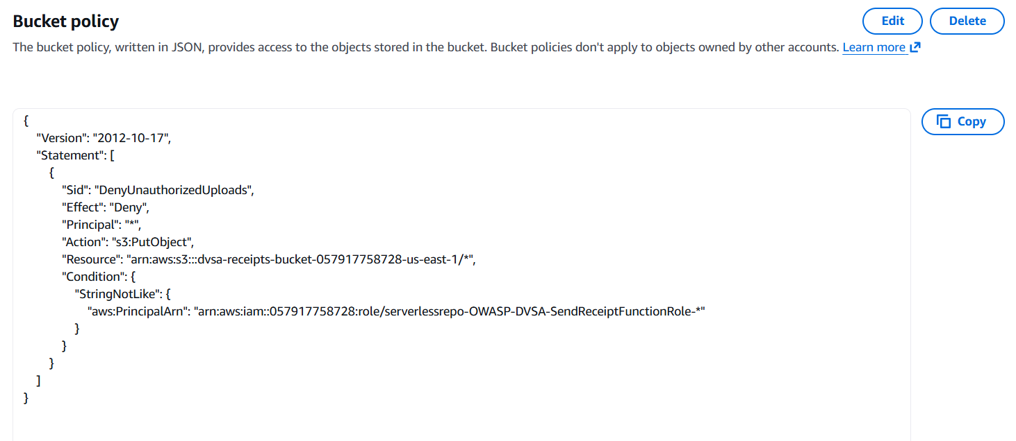
Lesson #4 — Post-Fix Verification

Slide 20
Lesson #5
Broken Access Control

Slide 21
Lesson #5: Broken Access Control — How It Works
🔴 The Attack
🟢 The Fix
Regular user creates an order
Sends action='update' with own valid JWT
Sets order status to 'paid' — no admin check
Order appears paid without completing checkout
DynamoDB confirms unauthorized status change
Add Cognito group check in order-manager.js
Verify cognito:groups includes 'admin' for update action
Return 403 Forbidden for non-admin update attempts
Add server-side order state transition validation
Verify: regular user update returns 403

Slide 22
Lesson #5 — Post-Fix Verification

Slide 23
Lesson #6
Denial of Service (DoS)

Slide 24
Lesson #6: Denial of Service — How It Works
🔴 The Attack
🟢 The Fix
Create order, advance to shipping state
Send 50+ concurrent billing requests via bash loop
Lambda concurrency limit exhausted
Legitimate billing request returns 429/500
CloudWatch shows Lambda throttle spike
Configure API Gateway throttling on billing route
Set burst/rate limits per user
Add DynamoDB conditional write (billing lock)
Only first valid billing per order succeeds
Verify: flood throttled; legitimate billing works

Slide 25
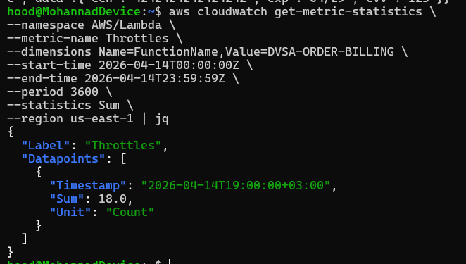
Lesson #6 — Evidence

Slide 26
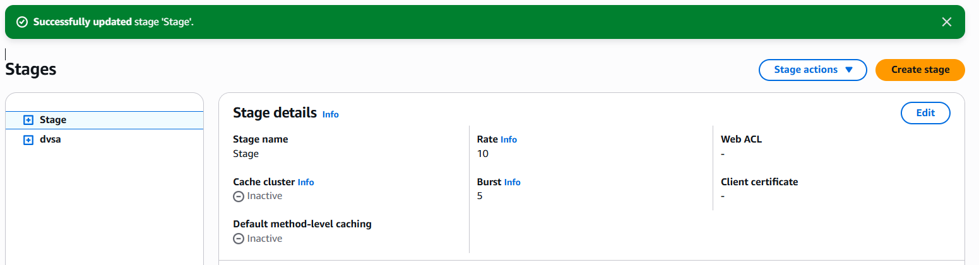
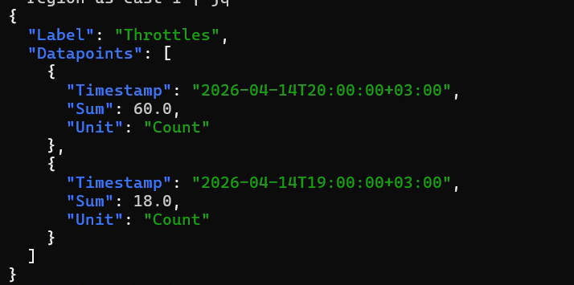
Lesson #6 — Post-Fix Verification

Slide 27
Lesson #7
Over-Privileged Function

Slide 28
Lesson #7: Over-Privileged Function — How It Works
🔴 The Finding
🟢 The Fix
DVSA-SEND-RECEIPT-EMAIL has wildcard IAM policies
S3: GetObject/PutObject on arn:aws:s3:::* (all buckets)
DynamoDB: Scan/Get/Put/Delete on table/* (all tables)
AmazonSESFullAccess — far beyond needed
IAM Simulator confirms: all actions ALLOWED
Restrict S3 to receipts bucket key prefix only
Restrict DynamoDB to DVSA-ORDERS-DB + GetItem only
Replace SESFullAccess with ses:SendEmail on one identity
Remove all wildcard resource ARNs
Verify: non-DVSA resources now show DENIED in Simulator

Slide 29
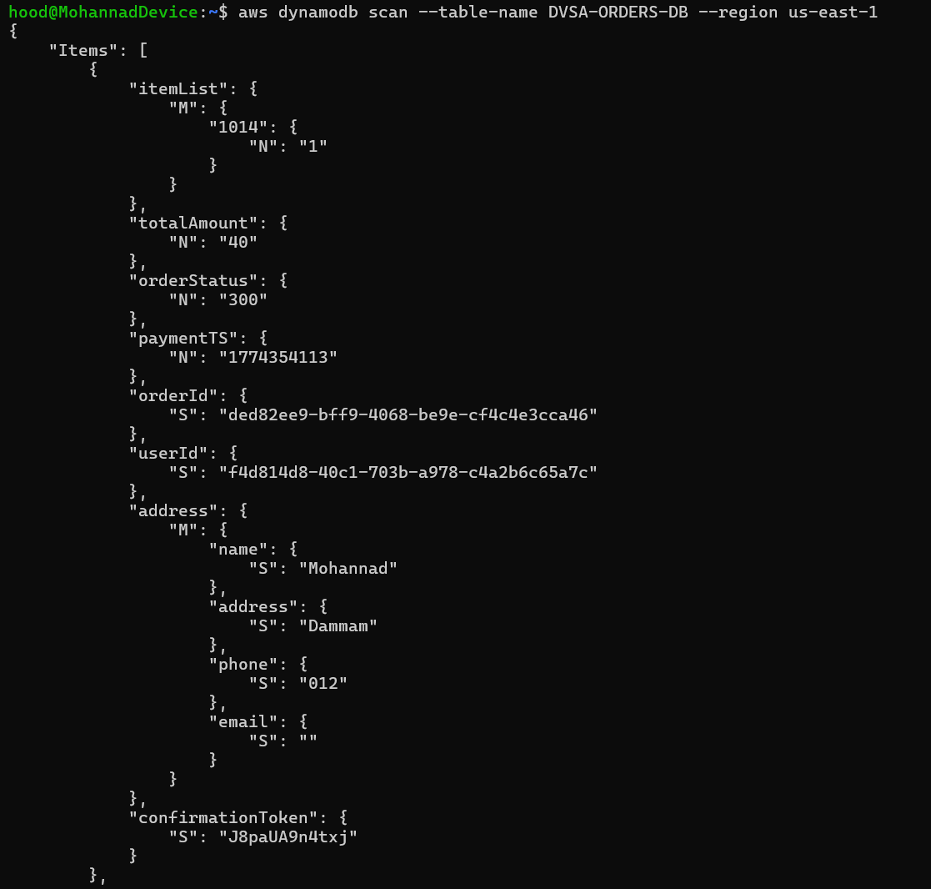
Lesson #7 — Evidence: IAM Policy Simulator

Slide 30
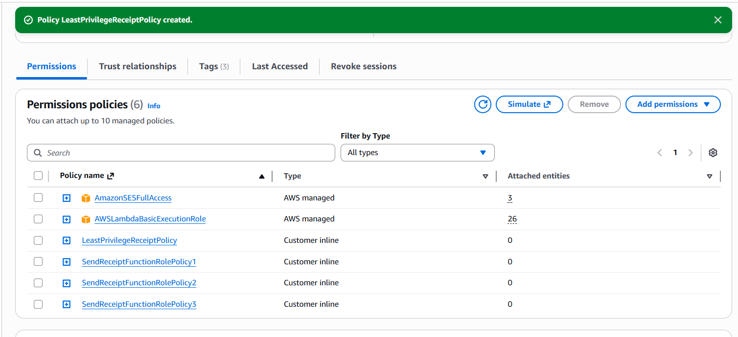
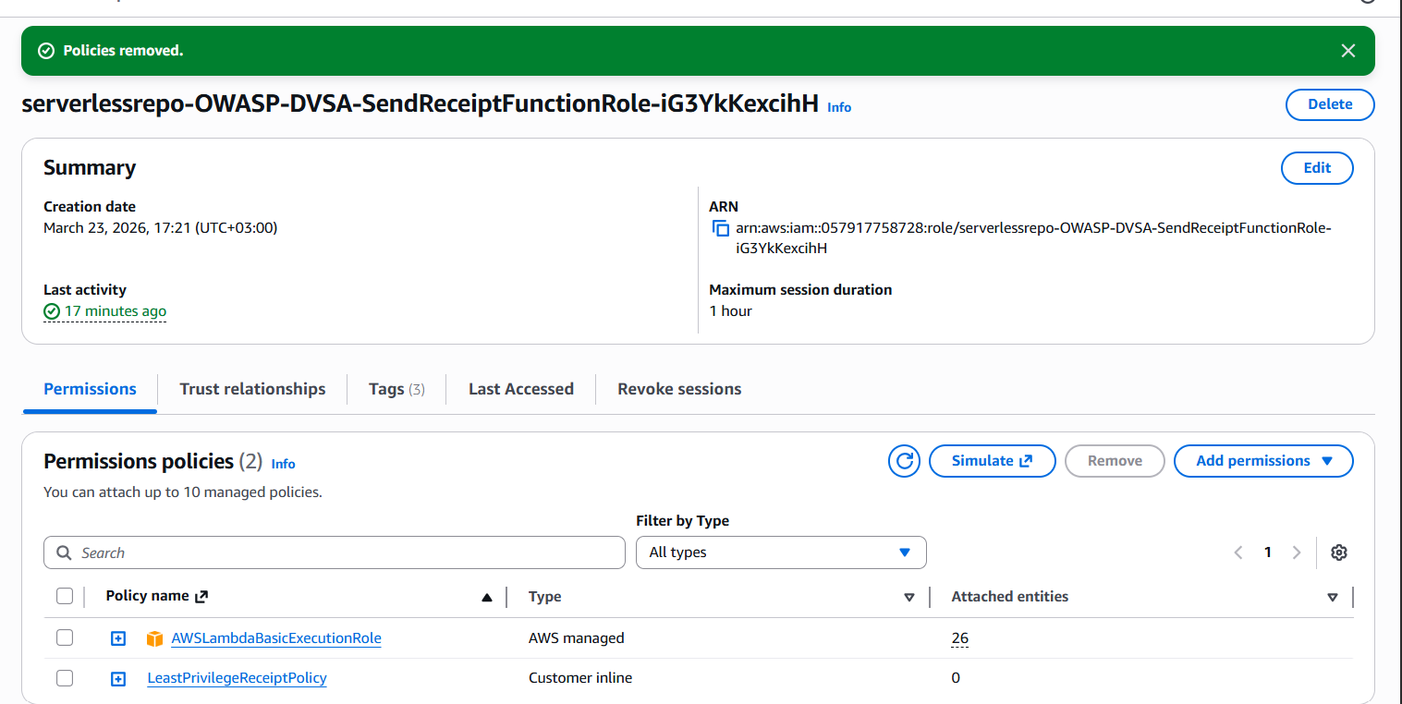
Lesson #7 — Post-Fix: Simulator Shows Denied

Slide 31
Lesson #8
Logic Vulnerabilities (Race Condition)

Slide 32
Lesson #8: Race Condition — How It Works
🔴 The Attack
🟢 The Fix
Create order with 1 item, advance to shipping
T=1: Send billing request for 1-item order
T=2: Immediately send update — change qty to 5
Backend processes update AFTER billing commits
Final order: 5 items, charged for 1 item only
Billing handler: DynamoDB ConditionExpression
Only proceed if status = 'shipping' (atomic lock)
Update handler: reject if status = 'billing' or later
Return 409 Conflict for concurrent modification
Verify: race condition attempt fails with 409

Slide 33
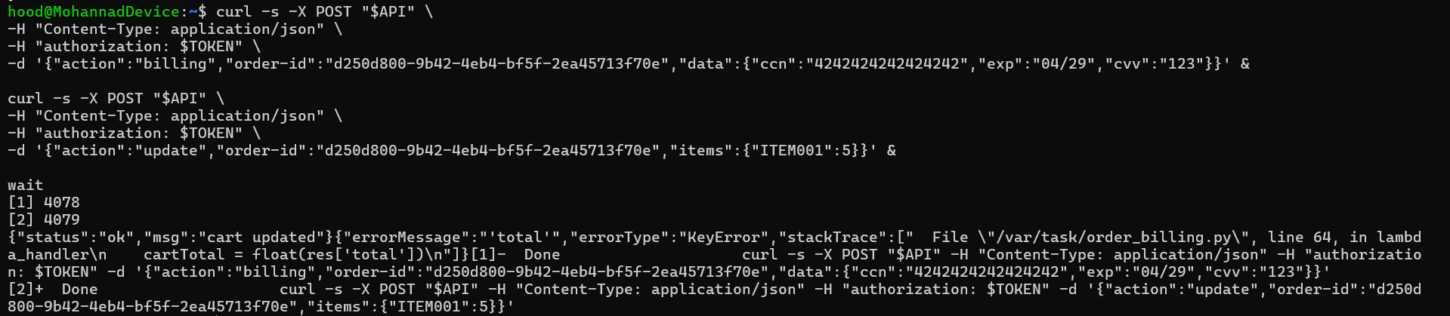
Lesson #8 — Evidence

Slide 34
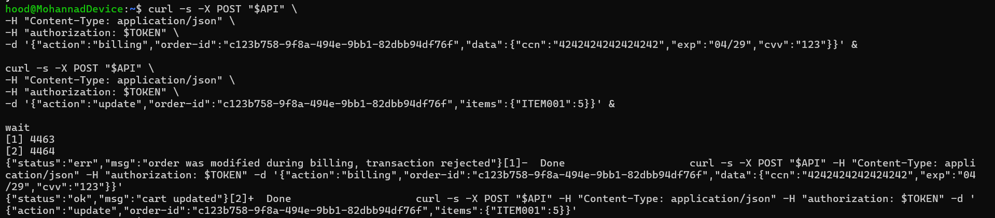
Lesson #8 — Post-Fix Verification

Slide 35
Lesson #9
Vulnerable Dependencies

Slide 36
Lesson #9: Vulnerable Dependencies — How It Works
🔴 The Finding
🟢 The Fix
Lambda code uses: require('node-serialize')
node-serialize v0.0.4 — known critical CVE
Allows arbitrary JS execution via $$ND_FUNC$$
npm audit confirms: critical severity
This is the root cause of Lesson #1 RCE
Remove node-serialize from package.json
Replace unserialize() with JSON.parse()
Run npm audit — confirm no critical findings
Pin all remaining dependencies to reviewed versions
Integrate npm audit into CI/CD pipeline

Slide 37
Lesson #9 — Post-Fix Verification

Slide 38
Lesson #10
Unhandled Exceptions

Slide 39
Lesson #10: Unhandled Exceptions — How It Works
🔴 The Attack
🟢 The Fix
Send malformed POST — omit required fields
Lambda crashes with unhandled runtime exception
Full stack trace returned in API response
Reveals: file paths, code structure, library names
Attacker uses info for targeted follow-up attacks
Wrap handler in try-catch block
Add input validation at entry point (check required fields)
Return generic 500: 'An unexpected error occurred'
Log full stack trace ONLY to CloudWatch
Verify: malformed request returns generic error only

Slide 40
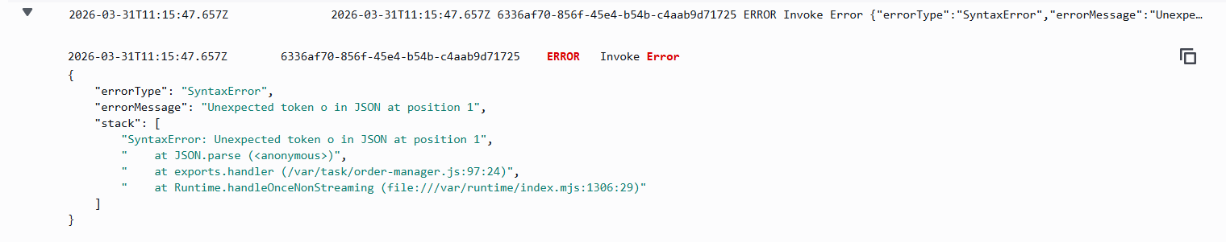
Lesson #10 — Evidence

Slide 41
Lesson #10 — Post-Fix Verification

Slide 42
Bonus #B1
Admin Email Exposed in CloudFormation

Slide 43
Bonus #B1: Admin Email Exposed in CloudFormation — How It Works
🔴 The Attack
🟢 The Fix
Open CloudFormation → Stack → Parameters tab
AdminEmail visible in plain text to any IAM user with read access
Retrievable via CLI: aws cloudformation describe-stacks
Only requires cloudformation:DescribeStacks — no special privileges
Email used for phishing, credential stuffing, or brute-force attacks
Create AWS Secrets Manager secret: dvsa/admin-email
Store real admin email value securely in the secret
Update CloudFormation parameter to: REDACTED-SEE-SECRETS-MANAGER
Real email now requires secretsmanager:GetSecretValue to access
Verify: describe-stacks shows REDACTED — not the real email

Slide 44
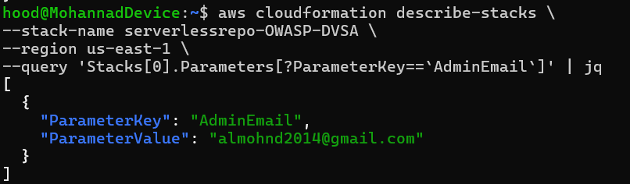
Bonus #B1: Admin Email Exposed in CloudFormation — Evidence

Slide 45
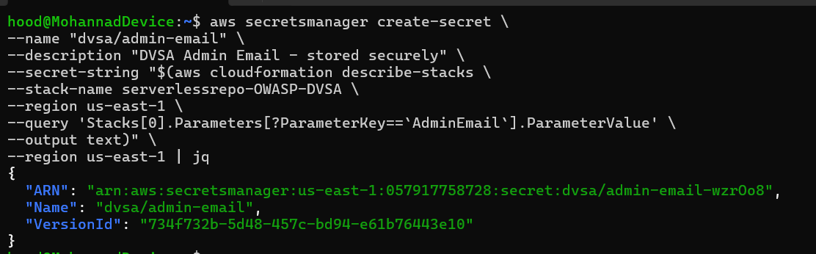
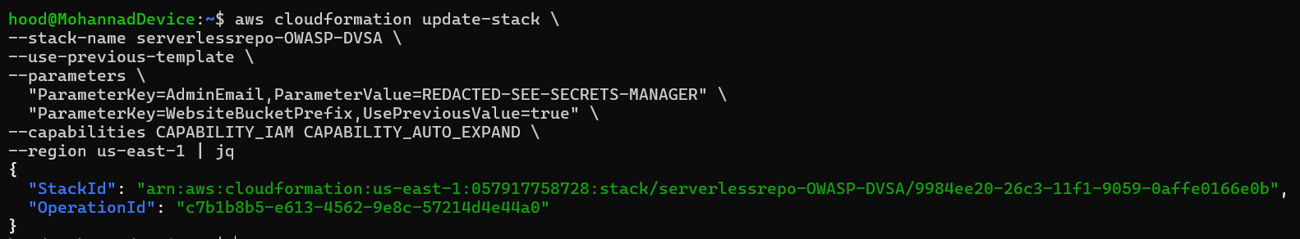
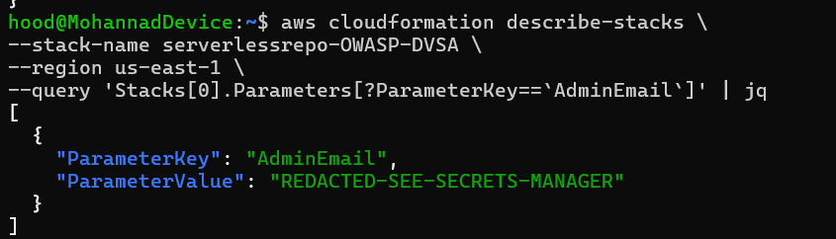
Bonus #B1: Admin Email Exposed in CloudFormation — Post-Fix Verification

Slide 46
Bonus #B2
User Enumeration via Cognito

Slide 47
Bonus #B2: User Enumeration via Cognito — How It Works
🔴 The Attack
🟢 The Fix
Send auth with non-existent username: UserNotFoundException returned
Send auth with valid username + wrong password: NotAuthorizedException
Different errors reveal which accounts exist in the Cognito pool
Attacker builds list of valid accounts for brute-force or phishing
No admin credentials needed — only a Cognito client ID required
Enable PreventUserExistenceErrors on Cognito App Client
aws cognito-idp update-user-pool-client --prevent-user-existence-errors ENABLED
Both cases now return: Incorrect username or password
No longer possible to distinguish valid from invalid accounts
Verify: both responses identical — enumeration blocked

Slide 48
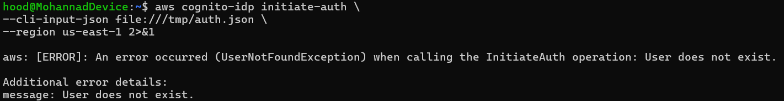
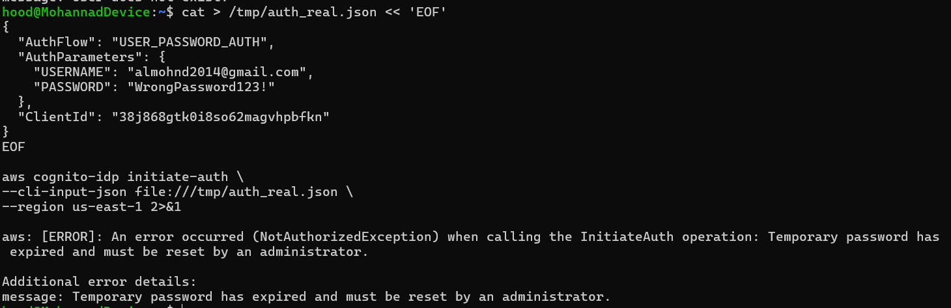
Bonus #B2: User Enumeration via Cognito — Evidence

Slide 49
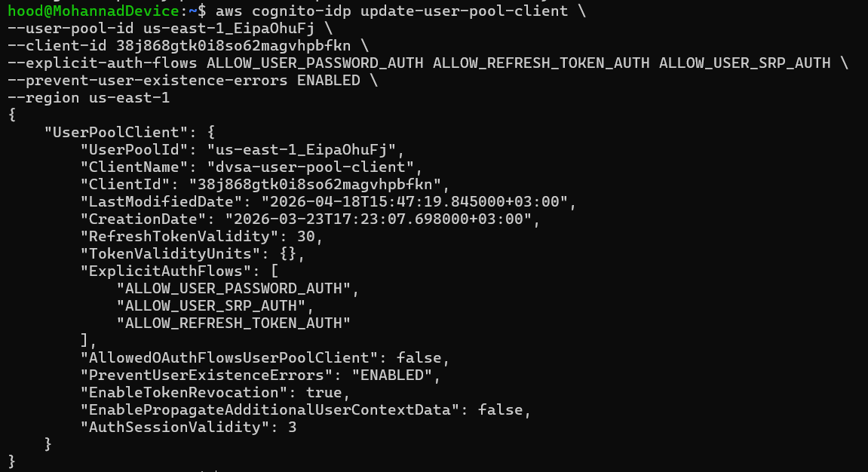
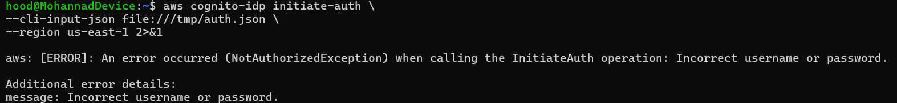
Bonus #B2: User Enumeration via Cognito — Post-Fix Verification

Slide 50
Bonus #B3
Missing Rate Limiting on Authentication

Slide 51
Bonus #B3: Missing Rate Limiting on Authentication — How It Works
🔴 The Attack
🟢 The Fix
Send 20 consecutive failed login attempts against a valid account
All 20 return NotAuthorizedException — no lockout ever triggered
No CAPTCHA, no throttling, no account lockout at any point
Attacker can attempt thousands of passwords with no restriction
Cognito Advanced Security not enabled — attacks go undetected
Create DynamoDB table: dvsa-auth-attempts (tracks attempts per user)
Deploy Pre-Authentication Lambda trigger: dvsa-rate-limiter
Lambda blocks after 5 failed attempts within a 5-minute window
Attempt 6+ returns: UserLambdaValidationException: Too many attempts
Verify: 7 attempts — blocked on attempt 6 with rate limit error

Slide 52
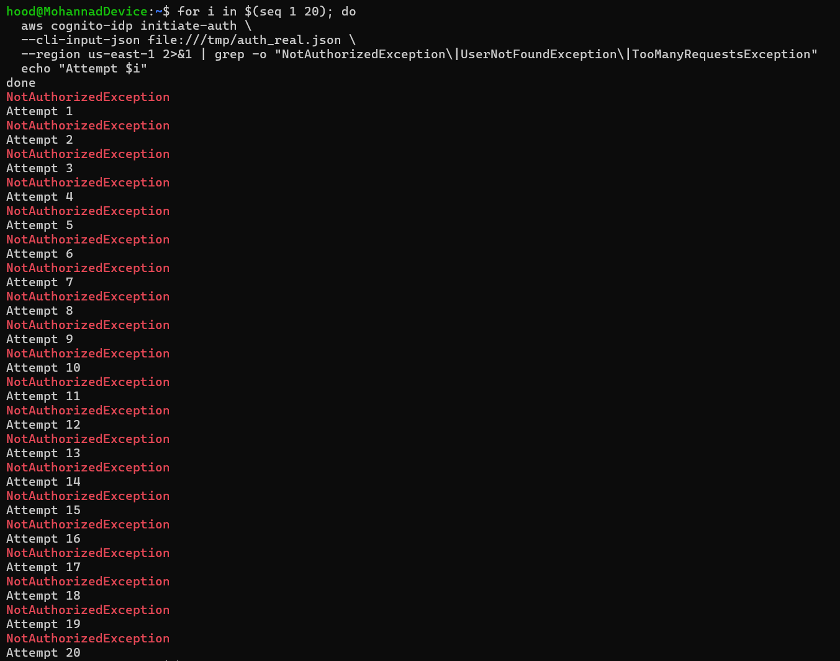
Bonus #B3: Missing Rate Limiting on Authentication — Evidence

Slide 53
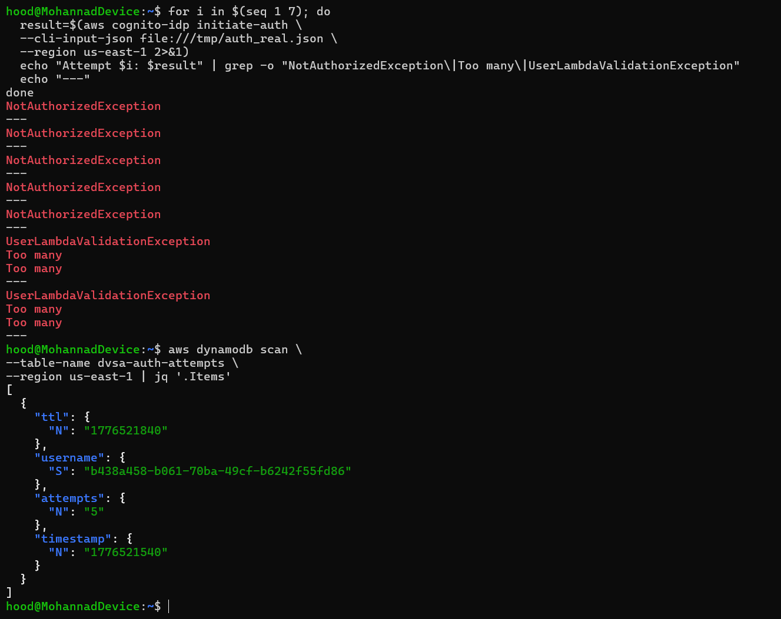
Bonus #B3: Missing Rate Limiting on Authentication — Post-Fix Verification

Slide 54
Bonus #B5
Mass Assignment

Slide 55
Bonus #B5: Mass Assignment on Order Update — How It Works
🔴 The Attack
🟢 The Fix
Send order update with injected extra fields in the payload
Include: orderStatus: 120, totalAmount: 0, confirmationToken: hacked
DVSA-ORDER-UPDATE passes raw payload to DynamoDB — no validation
Protected fields like totalAmount overwritten without billing
Financial data manipulated — order shows $0 without any payment
Implement server-side field allowlist in DVSA-ORDER-UPDATE Lambda
Only extract itemList from payload — all other fields silently ignored
Validate each item key is numeric — reject non-numeric keys
Invalid item key returns: Invalid item format
Verify: injected orderStatus and totalAmount ignored in DynamoDB

Slide 56
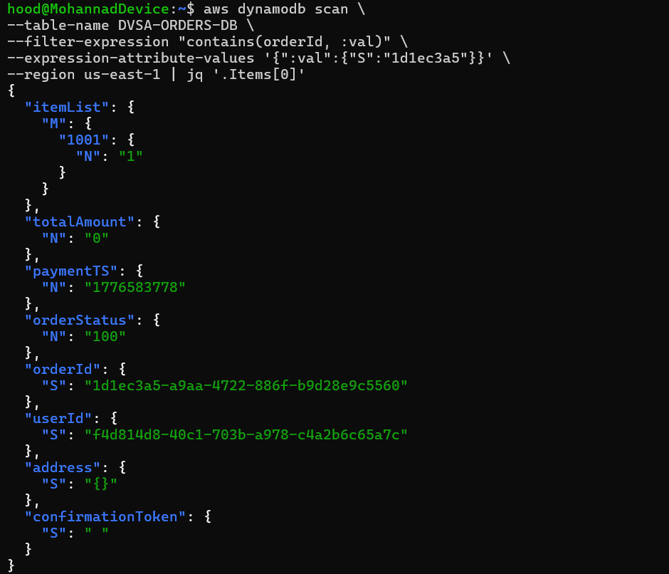
Bonus #B5: Mass Assignment on Order Update — Evidence

Slide 57
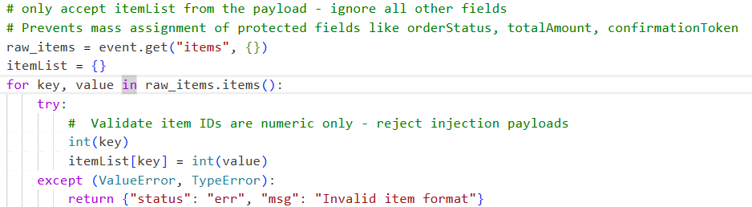
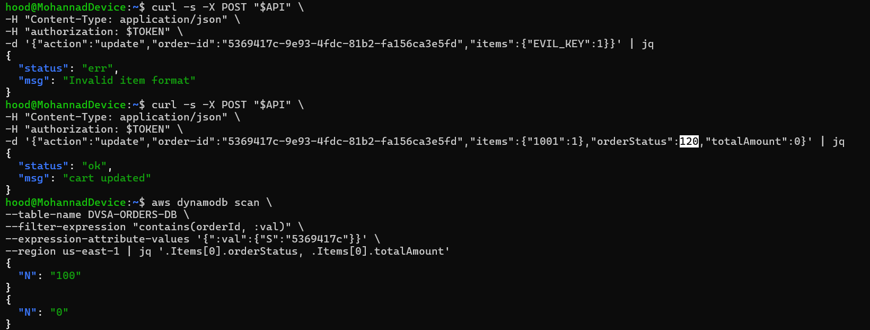
Bonus #B5: Mass Assignment on Order Update — Post-Fix Verification

Slide 58
Bonus #B6
Verbose Errors Leaking Internal Paths

Slide 59
Bonus #B6: Verbose Errors Leaking Internal Paths — How It Works
🔴 The Attack
🟢 The Fix
Send action=shipping without order-id — KeyError stack trace returned
Stack trace reveals: order_shipping.py line 18, path /var/task/
Send action=complete — reveals order_complete.py line 33
Send action=cancel — reveals cancel_order.py line 18
Internal file paths and code structure exposed to any caller
Wrap all three Lambda handlers in try-catch blocks
Log full error details to CloudWatch only — never to client
Return only generic message: {status: err, msg: An error occurred}
Applied to: DVSA-ORDER-SHIPPING, DVSA-ORDER-COMPLETE, DVSA-ORDER-CANCEL
Verify: malformed requests return generic error — no paths or line numbers

Slide 60
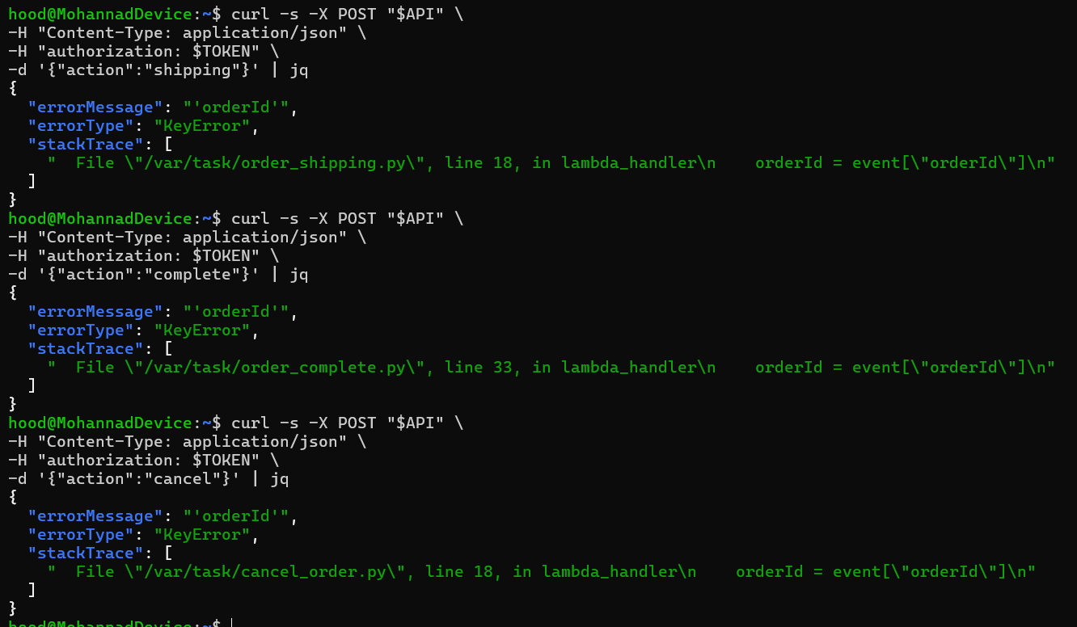
Bonus #B6: Verbose Errors Leaking Internal Paths — Evidence

Slide 61
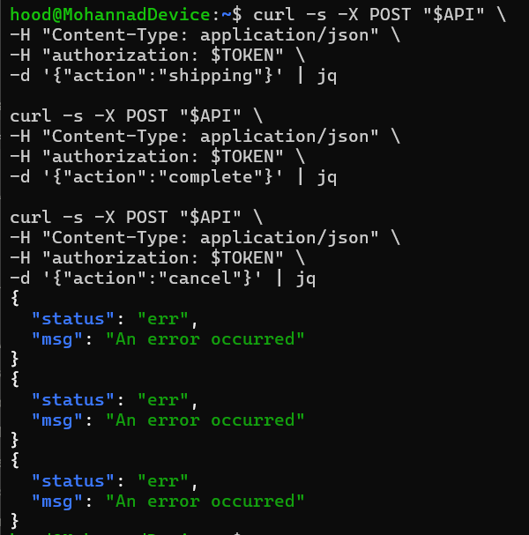
Bonus #B6: Verbose Errors Leaking Internal Paths — Post-Fix Verification

Slide 62
Bonus #B7
Unauthenticated File Upload

Slide 63
Bonus #B7: Unauthenticated File Upload — How It Works
🔴 The Attack
🟢 The Fix
Invoke DVSA-FEEDBACK-UPLOADS Lambda directly — no JWT required
Lambda returns pre-signed S3 upload URL without any authentication
Upload arbitrary file using the URL — HTTP 204 confirms success
File appears in feedback S3 bucket with no authorization check
is_safe() filename validation was disabled (logic commented out)
Add file extension allowlist: txt, pdf, png, jpg, jpeg only
Validate filename length (max 100 characters)
Sanitize filename: remove dangerous characters before S3 key
Re-enable is_safe() to reject semicolons, pipes, and quotes
Verify: .exe and other disallowed types return: File type not allowed

Slide 64
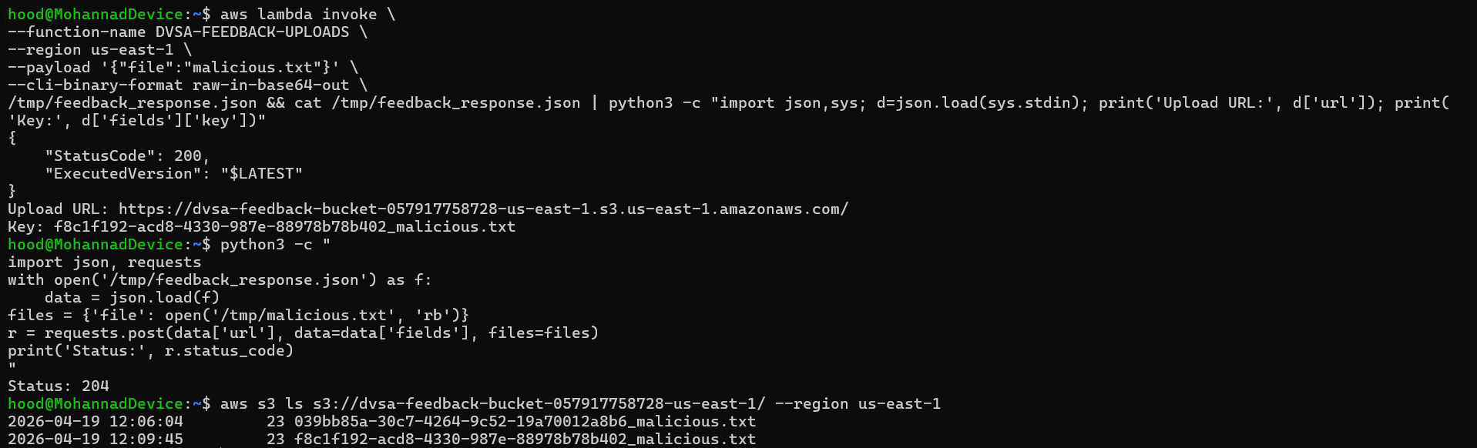
Bonus #B7: Unauthenticated File Upload — Evidence

Slide 65
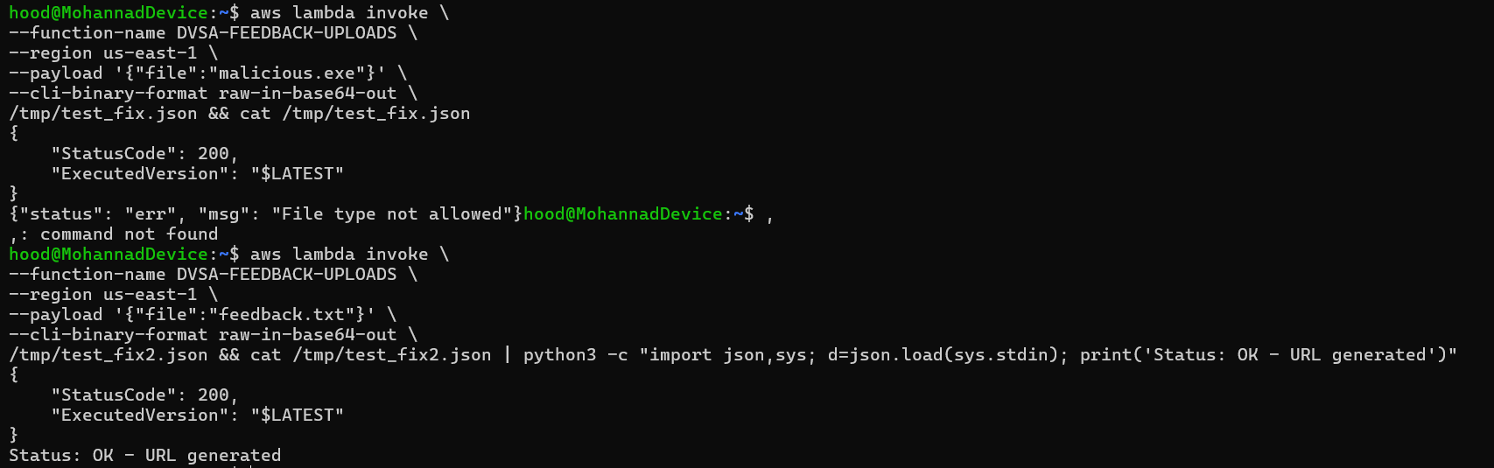
Bonus #B7: Unauthenticated File Upload — Post-Fix Verification

Slide 66
Key Security Takeaways
🔑 Never trust unverified JWT claims Always verify signatures using JWKS before trusting identity fields.
🔑 Validate all input — at every stage Second-order injections prove entry-point validation is not enough.
🔑 Least privilege is mandatory in serverless Function roles define blast radius. Over-privilege = account-wide risk.
🔑 Audit your dependencies One abandoned npm package can invalidate all other security controls.
🔑 Lock state transitions atomically Race conditions bypass business logic. Use DynamoDB conditional writes.

Slide 67
Thank You
Questions?
ICS-344: Information Security | KFUPM | Term 252

