Slide 1
Clean Code Workshop
first day

Slide 2
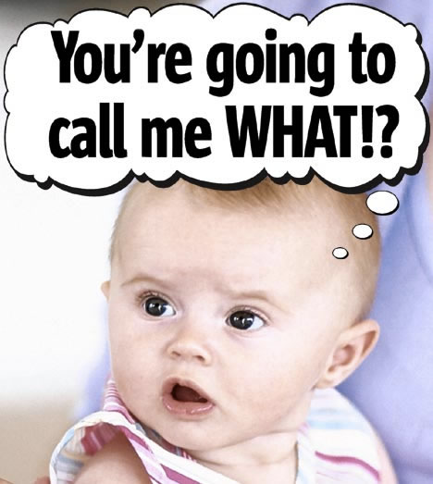
Naming
name and conquer

Slide 3
Tim Ottinger
Ottinger's Rules for Variable and Class Naming
1997
Most downloaded OO-paper

Slide 4
Reveal Intent

Slide 5
Reveal Intent
int r; // remaining days in month
int y; // elapsed years since World War ||
void copy(int[] a1, int[] a2); //Copy numbers from a1 to a2

Slide 6
Reveal Intent
int remainDaysInMonth;
int elapsedYearsSinceWorldWar2;
void copy(int[] source, int[] destination);

Slide 7
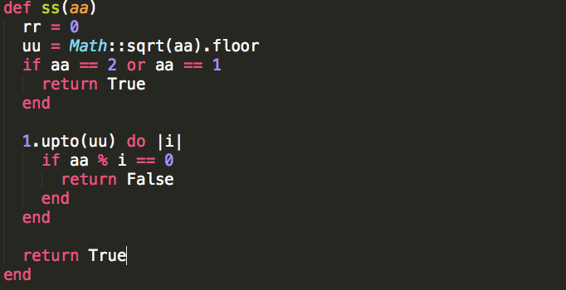
Reveal Intent

Slide 8
Avoid Disinformation

Slide 9
Avoid disinformation
Avoid meaning collision
XXXList
YYYTree
ZZZMap
Avoid visually similar names in same namespace
thisIsAMethod
thisIsAMethod

Slide 10
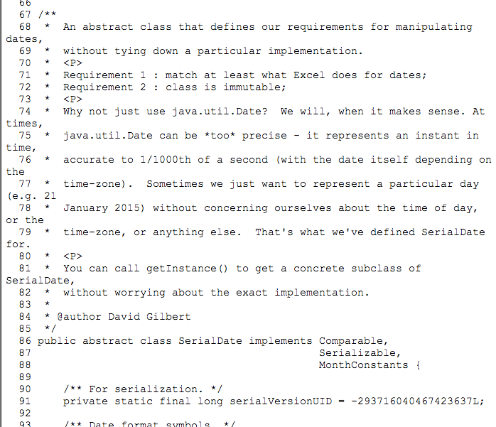
Reveal Intent

Slide 11
Use Problem Domain Names

Slide 12
Use Problem Domain Names
int off_first_off_second = 0;
int off_first_on_second = 1;
int on_first_off_second = 2;
int on_first_on_second = 3;

Slide 13
Use Problem Domain Names
int open_interval = 0;
int left_open_interval = 1;
int right_open_interval = 2;
int closed_interval= 3;

Slide 14
Use Problem Domain Names
enum {open_interval, left_open_interval, right_open_interval, closed_interval}

Slide 15
Use Problem Domain Names
enum {open_interval, left_open_interval, right_open_interval, closed_interval}
Add context

Slide 16
Class & Methods
Class
Nouns
Noun Phrases
Methods
Verbs
Verb Phrases
boolean isXXX()

Slide 17
Variable Names in method
The bigger the scope
the longer the name
The smaller the scope
the shorter the name

Slide 18
Parameters names in methods
The longer the better
Only write once
Kinda of documentation

Slide 19
Class variable names
The longer the better
Only visible in current class
Long scope
Kinda of documentation

Slide 20
Method names in class
The Public API (Bigger scope)
The shorter the better
The Private Methods (Smaller scope)
As long as necessary

Slide 21
Naming Wrap Up
Reveal intent
Avoid disinformation
Use Problem Domain Names
Add Meaningful Context
Names in methods
Names in classes

Slide 22
Functions

Slide 23
How long should it be?
Not longer than screen
Ideal
4 or 5 lines
Bottom Line
<= 10 lines

Slide 24
Why so short?
No space for nested indentation
No space for nested if, while, for
You must use separate function
with meaningful name
No space for bugs

Slide 25
A Function works at one abstraction level
def check_out():
amounts = calculate_amounts()
discounts = calculate_discounts()
if (amounts > 1000)
discounts *= 1.2
shippings = 0
else
shippings = amounts * 0.05
end
amounts - discounts + shippings
end

Slide 26
A function does one thing
Single responsibility
One abstraction level

Slide 27
How?
Extract functions until you can’t
Wait for testableHtml refactoring demo

Slide 28
Function Arguments
Ask explicitly, do not dig!
para1.getXXX().getYYY().getZZZ()
Ask instead
def function(zzz)

Slide 29
Function Arguments
Boolean Arguments
Is it two functions?
Maybe you should write two functions
void checkOut(boolean isVIP)

Slide 30
Function Arguments
Different types whenever possible
String encodeDate(int year, int month, int day)
String encodeDate(Year year, Month month, Day day)

Slide 31
Function Arguments
Number of arguments
<= 3
What about more?
object?
Too much responsibilities?

Slide 32
Command-Query
Command
side-effect
never return value
Query
No side-effect
Return values

Slide 33
Output Argument
void appendLastName(StringBuffer name) {
name.append(“Last name”);
}

Slide 34
Exception Handling
Never mix exception handling with normal execution flow
inconsistency
A function may raise exception must be wholly wrapped

Slide 35
Function Wrap Up
How long should it be?
One abstraction level
Single Responsibility
Function Arguments?

Slide 36
What’s missing?
Switch?
Comments?
Formatting?

Slide 37
Now, Demo Time!

