Slide 1
Digital portfolio
Student Name : Kisok . C
Register Number : 24134080500121023
Nuid: 6E66EA949574400AAC94C16E31239CA4
Department : BCA Department of Computer Science
College : TBML College , Annamalai University

Slide 2
Project Title
Smart Digital Portfolio with Skill Analytics & Recommendation

Slide 3
Agenda
Problem Statement
Project Overview
End Users
Tools & Technologie
Design & Layout
Features & Functionality
Results
Sample Output Images
Conclusion
GitHub Link

Slide 4
Problem Statement
Students struggle to effectively maintain and organize their academic and personal projects.
Traditional resumes are static and fail to showcase the depth of a student's work.
There is a gap between showcasing projects and getting actionable feedback on skill development.
Recruiters find it time-consuming to manually assess a candidate's entire skillset from a PDF

Slide 5
Project Overview
This project involves creating an intelligent, personalized digital portfolio web application. It goes beyond a simple showcase by integrating analytics to track visitor engagement and a recommendation system that suggests skills to learn based on the user's existing projects and career goals. It is designed to be user-friendly, fully responsive, and data-driven.

Slide 6
End Users
Students & Graduates: Primary users who can showcase their work, track portfolio visibility, and receive personalized learning paths.
Recruiters & HR Professionals: Benefit from a standardized, comprehensive view of a candidate's abilities, including project demos and verified skill analytics.
Academic Institutions & Mentors: Can use the platform to track student progress over time and guide them based on data-driven skill recommendations.

Slide 7
Tools & Technologies
Frontend: HTML5, CSS3, JavaScript (React.js / Next.js)
Backend: Node.js with Express.js
Database: MongoDB (for flexible data storage)
Analytics Engine: Python (Pandas, NumPy) for processing visitor data
Recommendation System: A machine learning model (e.g., collaborative filtering) or a rules-based engine integrated via API.
Version Control & Deployment: GitHub, Vercel/Netlify/Heroku

Slide 8
Design & Layout
Modern & Minimalist Design: Focus on content with clean typography and ample white space.
Fully Responsive: Seamless experience on desktop, tablet, and mobile.
Key Sections:
Hero Section: Name, title, and brief intro.
About Me: Detailed bio and passion.
Skills & Analytics: Visual charts (e.g., bar charts for skill proficiency, line charts for portfolio views).
Project Showcase: Filterable grid of projects with details and links.
Recommendations: A dedicated section for suggested skills and courses.
Contact Form: With integrated validation.

Slide 9
Features & Functionality
Dynamic Skill Analytics Dashboard: Charts showing portfolio view counts, visitor geographic location, and popular projects.
Personalized Skill Recommendations: Suggests relevant skills to learn next based on the user's current profile and trending skills in their field.
Interactive Project Gallery: Filter projects by technology used (e.g., show all "Python" projects).
Resume/CV Download: Option for visitors to download a PDF resume directly.
Secure Contact Form: Backend API to receive and manage messages without revealing personal email.
Dark/Light Mode Toggle: For user preference and reduced eye strain

Slide 10
Results
Successfully developed a fully functional, responsive, and secure web application.
Implemented a data-driven approach to portfolio management, moving beyond static presentation.
Provides tangible value to students by not just showcasing skills, but also guiding their learning journey.
Improves visibility and accessibility for academic and professional opportunities by offering a centralized, insightful platform.

Slide 11
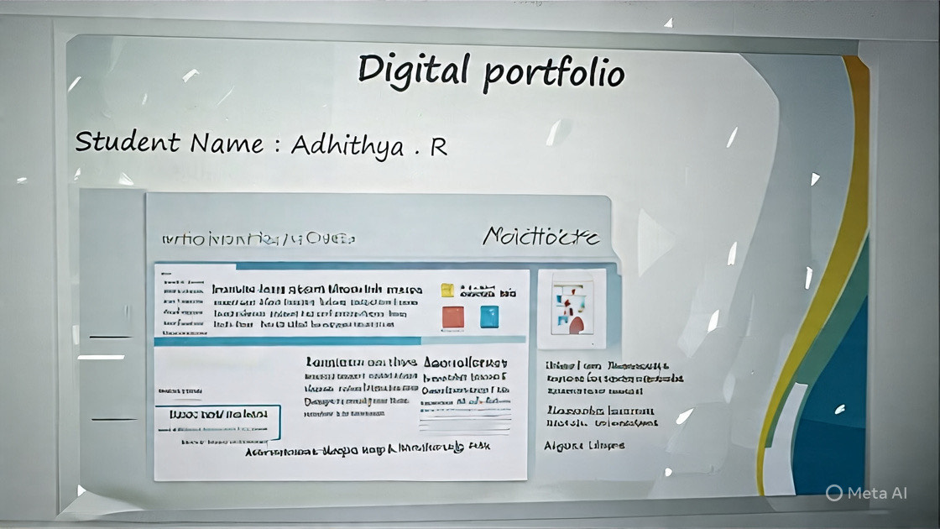
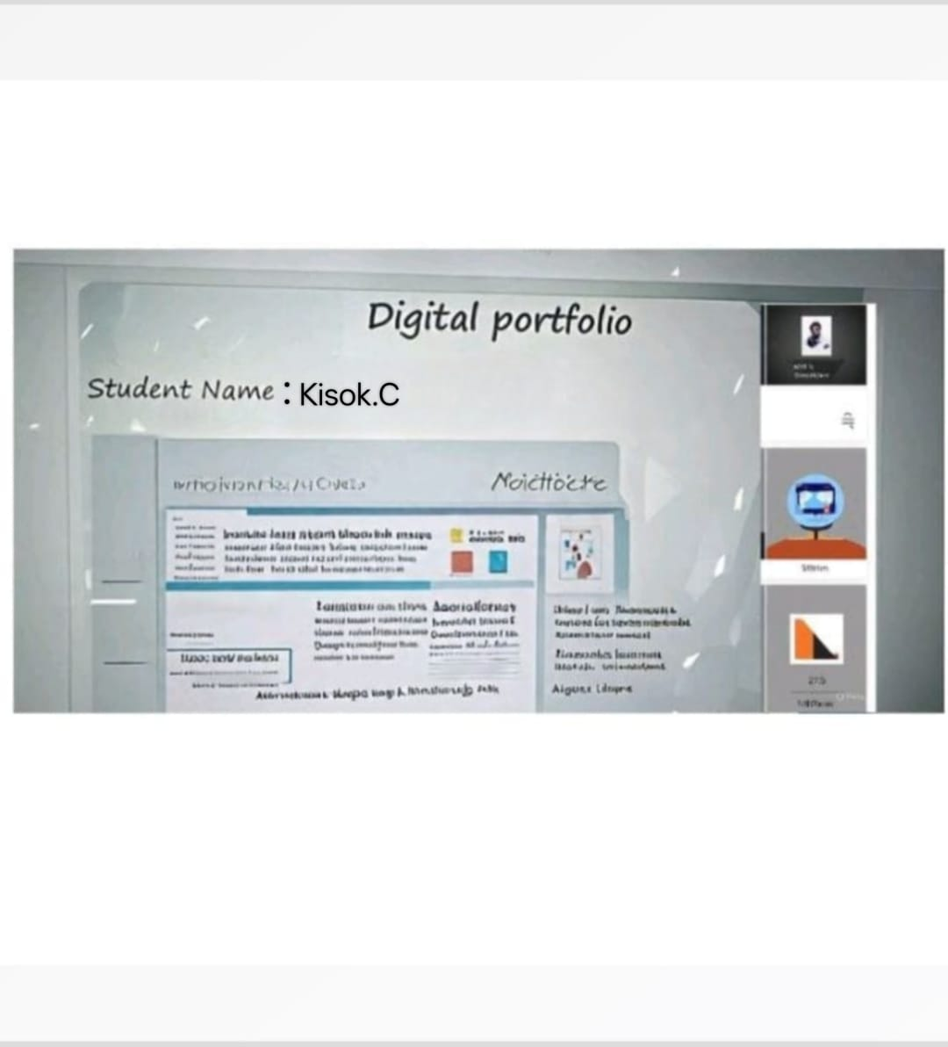
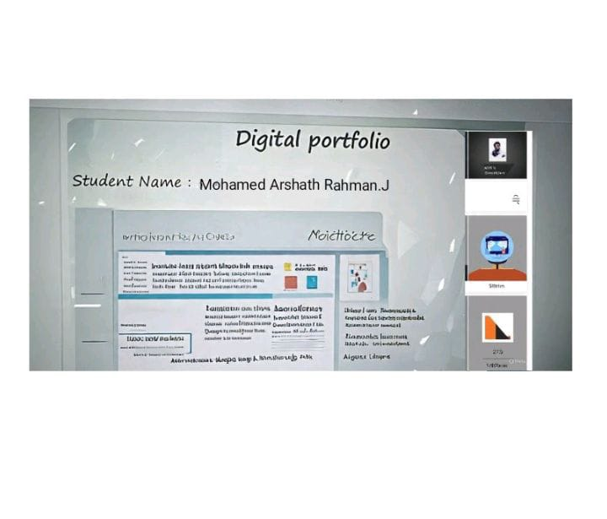

Slide 12
https://github.com/zenintoji078-blip/Kisok_TNSDC_FWD_DP.git

Slide 13
