Slide 1
ME 647 : Vapor Liquid Phase Change Phenomena
Transient Filmwise
Condensation &
Interfacial Shear Effects
Project Code: Filmwise Condensation
Project Mentor: Mondeep Gohain
Shrishti Mishra (22110246) Hari Balaji (22110092) Diya Mehta (22110078)

Slide 2
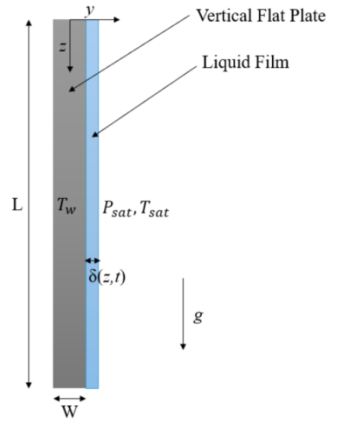
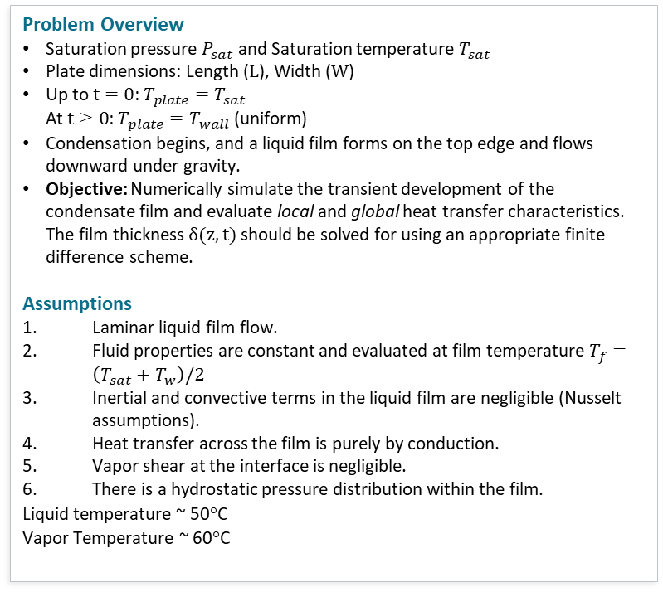
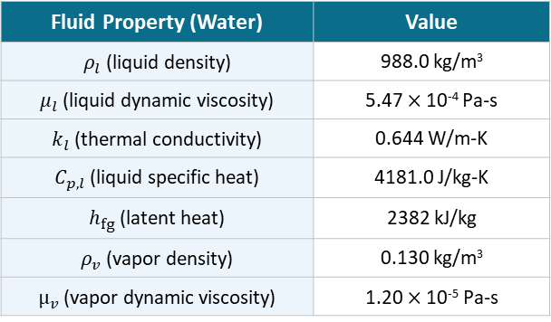
Part (a) - Transient Gravity-Driven Filmwise Condensation
Problem Overview
Saturation pressure $P_{sat}$ and Saturation temperature $T_{sat}$
Plate dimensions: Length ($L$), Width ($W$)
Up to $t=0$: $T_{plate}=T_{sat}$ At $t≥0$: $T_{plate}=T_{wall}$ (uniform)
Condensation begins, and a liquid film forms on the top edge and flows downward under gravity.
Objective: Numerically simulate the transient development of the condensate film and evaluate local and global heat transfer characteristics. The film thickness $δ(z,t)$ should be solved for using an appropriate finite difference scheme.
Assumptions
Laminar liquid film flow.
Fluid properties are constant and evaluated at film temperature $T_{f}=\left(T_{sat}+T_{w}\right)/2$
Inertial and convective terms in the liquid film are negligible (Nusselt assumptions).
Heat transfer across the film is purely by conduction.
Vapor shear at the interface is negligible.
There is a hydrostatic pressure distribution within the film.
Liquid temperature ~ 50$°$C
Vapor Temperature ~ 60$°$C
Fluid Property (Water) | Value
$ρ_{l}$ (liquid density) | 988.0 kg/m³
$μ_{l}$ (liquid dynamic viscosity) | 5.47 $×$ 10⁻⁴ Pa-s
$k_{l}$ (thermal conductivity) | 0.644 W/m-K
$C_{p,l}$ (liquid specific heat) | 4181.0 J/kg-K
$h_{fg}$ (latent heat) | 2382 kJ/kg
$ρ_{v}$ (vapor density) | 0.130 kg/m³
$μ_{v}$ (vapor dynamic viscosity) | 1.20 $×$ 10⁻⁵ Pa-s

Slide 3
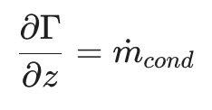
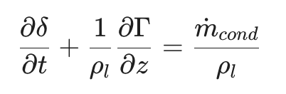
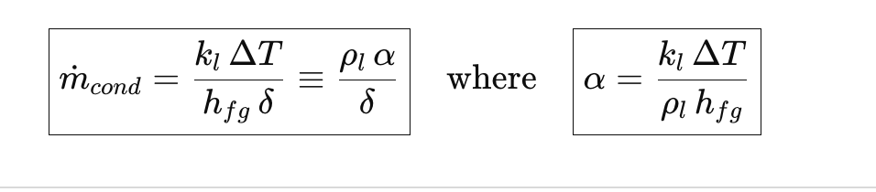
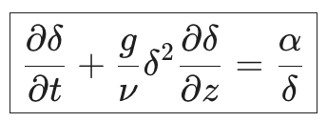

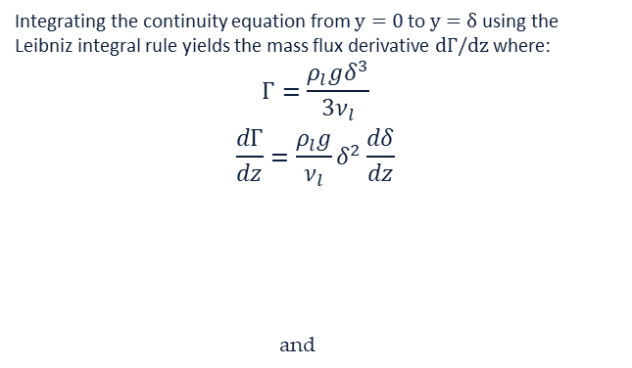

Part (a) - Governing PDE for Film Thickness δ(z,t)
1
Step 1: Momentum Equation → Velocity Profile
2
Step 2: Integrate Continuity Across Film (Leibniz Rule)
Under Nusselt assumptions (no inertia, quasi-steady), the balance of gravity and viscous forces gives a parabolic velocity profile:
$$u\left(y\right)=\frac{ρ_{l}g}{μ_{l}}\left(δy−\frac{y^{2}}{2}\right)$$
Integrating the continuity equation from $y=0$ to $y=δ$ using the Leibniz integral rule yields the mass flux derivative $dΓ/dz$ where:
$$Γ=\frac{ρ_{l}gδ^{3}}{3ν_{l}}$$
$$\frac{dΓ}{dz}=\frac{ρ_{l}g}{ν_{l}}δ^{2}\frac{dδ}{dz}$$
and
3
Step 3: Interface Energy Balance
4
Step 4: Final Governing PDE
Latent heat released by condensation = conductive heat flux through film (Chung 1963):
Combining Steps 1, 2, 3, eliminating velocity and combining mass/energy:
The unsteady term gets added to the mass conservation here.
Final non-linear hyperbolic PDE with stiff source term
$$⟹$$

Slide 4
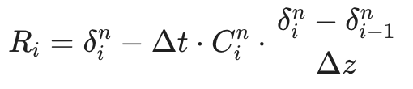
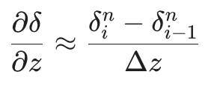
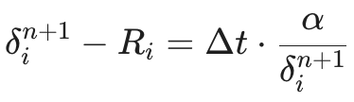
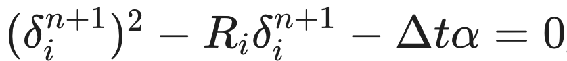

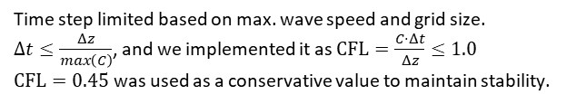

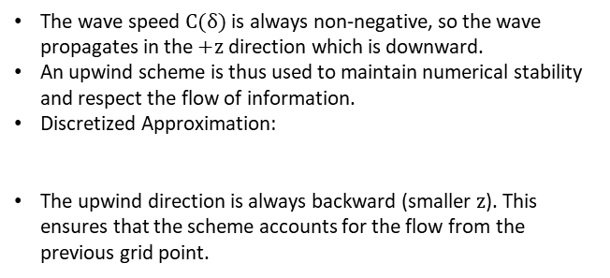
Part (a) - Numerical Finite-Difference Scheme
PDE: $\frac{∂δ}{∂t}+C\left(δ\right)⋅\frac{∂δ}{∂z}=S\left(δ\right)$ $C\left(δ\right)=gδ^{2}/ν$ (wave speed) $S(δ)=α/δ$ (source term)
Spatial Discretization: Backward Difference
Temporal Discretization and Source Term
The wave speed $C(δ)$ is always non-negative, so the wave propagates in the $+z$ direction which is downward.
An upwind scheme is thus used to maintain numerical stability and respect the flow of information.
Discretized Approximation:
The upwind direction is always backward (smaller $z$). This ensures that the scheme accounts for the flow from the previous grid point.
A hybrid implicit-explicit approach is used to handle the source term $S(δ)$ as $δ→0$.
Explicit convection: Calculated using Forward Euler
Implicit source: Calculated using Backward Euler (so that$δ$ remains positive)
We get a quadratic solution, and solve for the positive root:
Stability: Courant-Friedrichs-Lewy (CFL) Condition
Initial & Boundary Conditions
Time step limited based on max. wave speed and grid size.
$Δt≤\frac{Δz}{max\left(C\right)}$, and we implemented it as $\text{CFL}=\frac{C⋅Δt}{Δz}≤1.0$
$\text{CFL}=0.45$ was used as a conservative value to maintain stability.
BC: $δ(0,t)=0$, Film starts at the leading edge ($z=0$)
IC: $δ(z,0)≈0$, The plate is dry at $t=0$

Slide 5
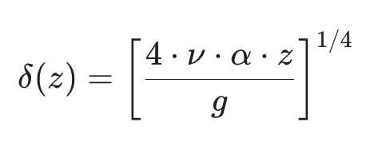
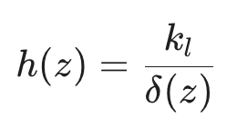
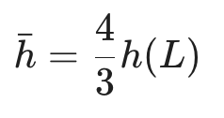
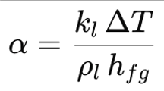
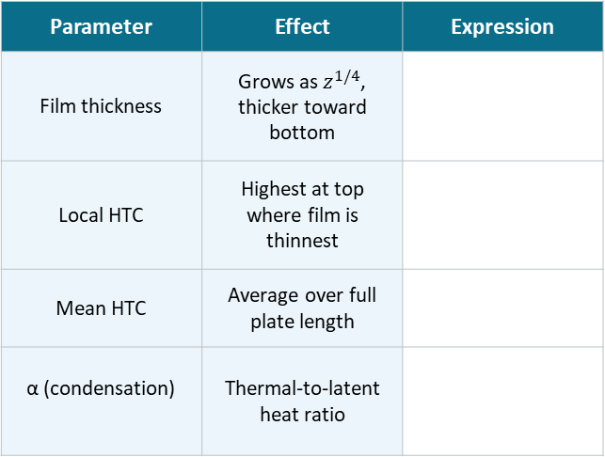
Part (a) - Nusselt Analytical Solution - Validation Baseline
Classical steady-state theory against which our numerical model validated
Key Analytical Expressions
Parameter | Effect | Expression
Film thickness | Grows as $z^{1/4}$, thicker toward bottom
Local HTC | Highest at top where film is thinnest
Mean HTC | Average over full plate length
α (condensation) | Thermal-to-latent heat ratio
What is the Nusselt Solution?
The Nusselt condensation theory gives a closed-form steady-state solution for a laminar liquid film on an isothermal vertical plate, assuming pure gravity drainage, conduction-only heat transfer, and negligible vapor shear.
Underlying Assumptions
Laminar, steady-state liquid film flow
Heat transfer by pure conduction across the film
Inertia and convective terms in the film are negligible
Vapor shear at the liquid-vapor interface is zero
Fluid properties constant at film temperature T_{f} = (T_{sat} + T_{w})/2
The Nusselt solution assumes gravity only drainage and zero vapor shear, Part(a) of our simulation reproduces this analytically

Slide 6
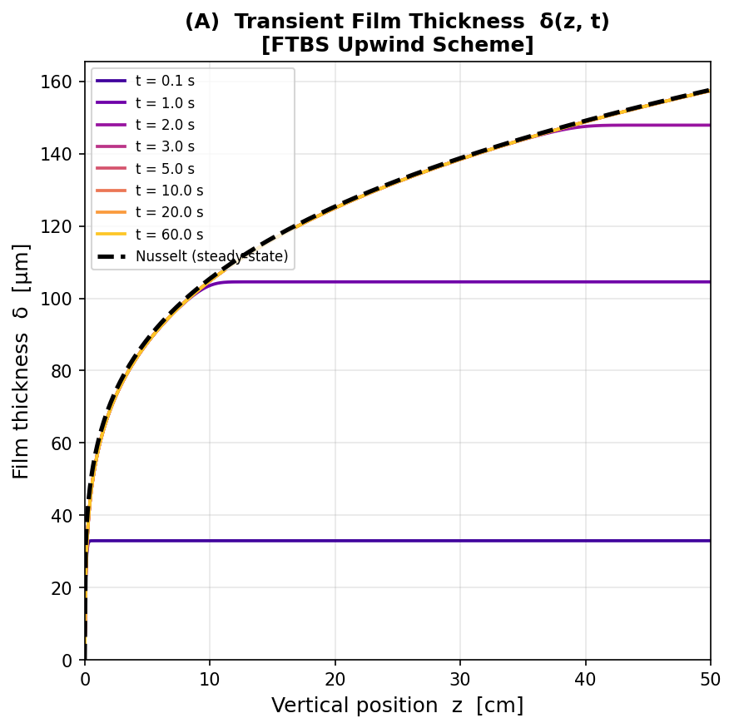
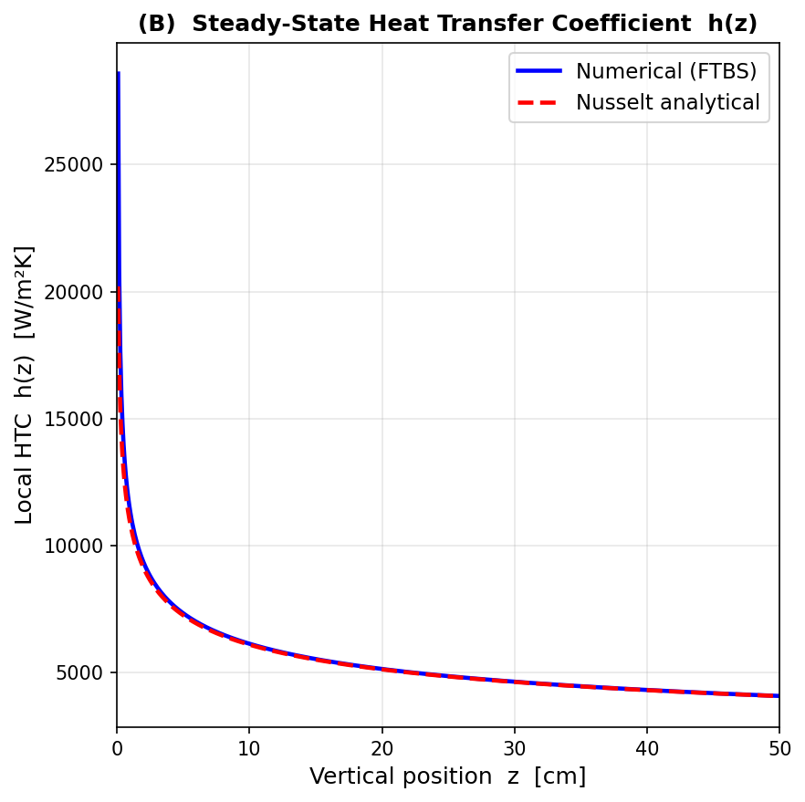
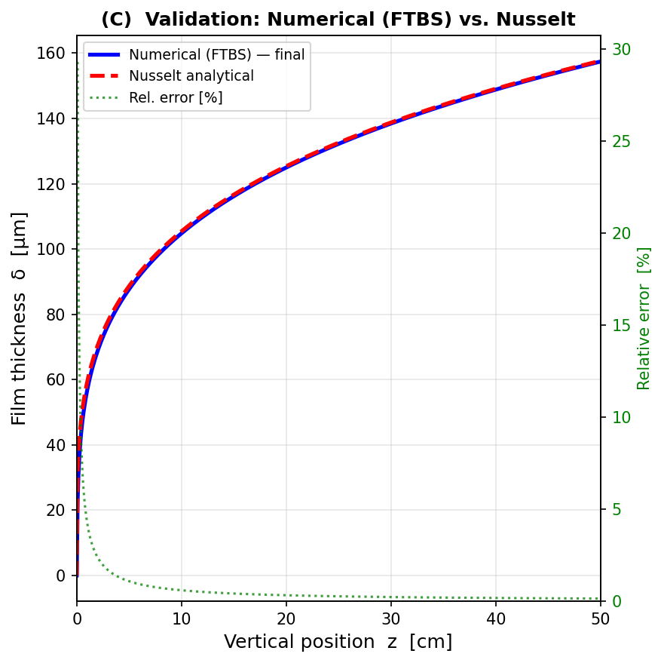
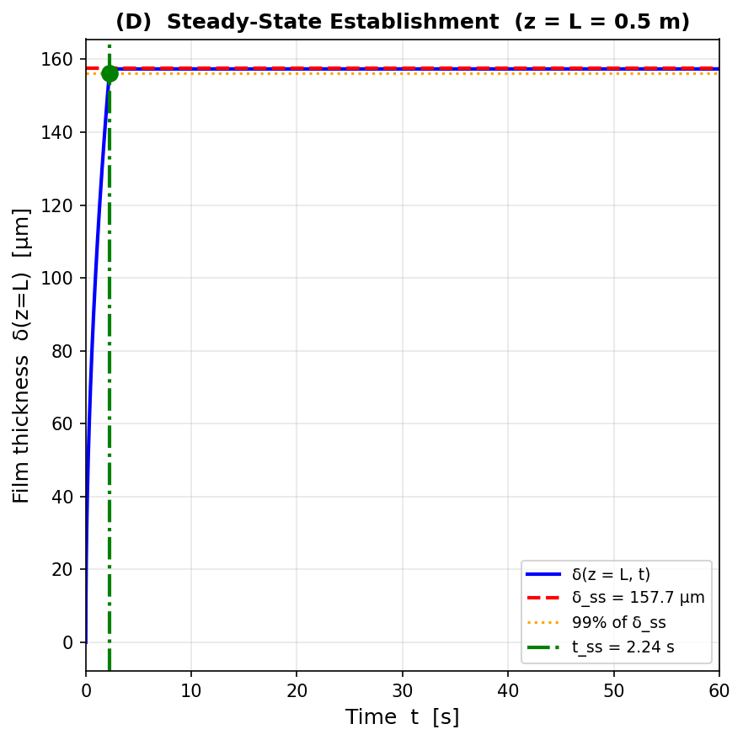
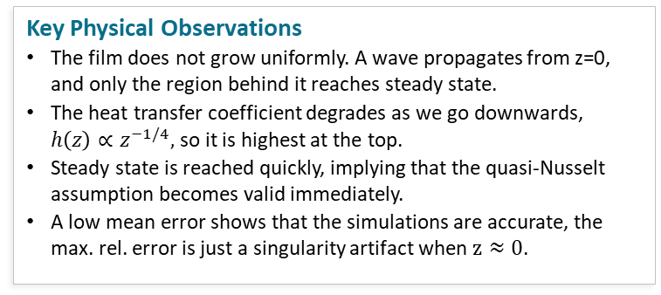
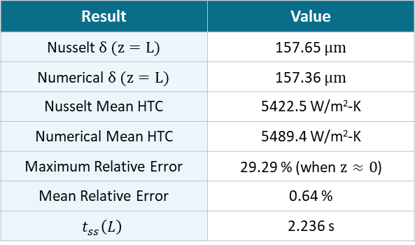
Part (a) - Simulation Results
Result | Value
Nusselt $δ (z=L)$ | 157.65 $μm$
Numerical $δ (z=L)$ | 157.36 $μm$
Nusselt Mean HTC | 5422.5 W/m²-K
Numerical Mean HTC | 5489.4 W/m²-K
Maximum Relative Error | 29.29 % (when $z≈0$)
Mean Relative Error | 0.64 %
$$t_{ss}\left(L\right)$$ | 2.236 s
Key Physical Observations
The film does not grow uniformly. A wave propagates from z=0, and only the region behind it reaches steady state.
The heat transfer coefficient degrades as we go downwards, $h\left(z\right)∝z^{−1/4},$ so it is highest at the top.
Steady state is reached quickly, implying that the quasi-Nusselt assumption becomes valid immediately.
A low mean error shows that the simulations are accurate, the max. rel. error is just a singularity artifact when $z≈0$.

Slide 7
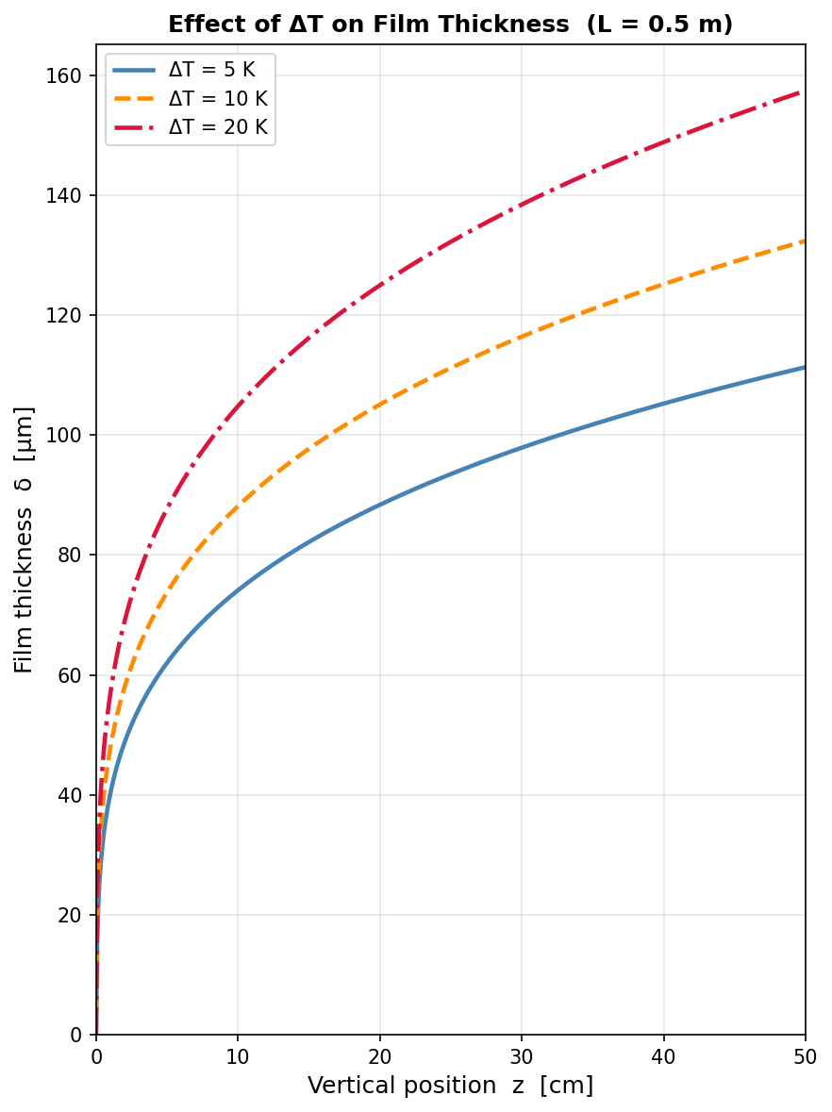
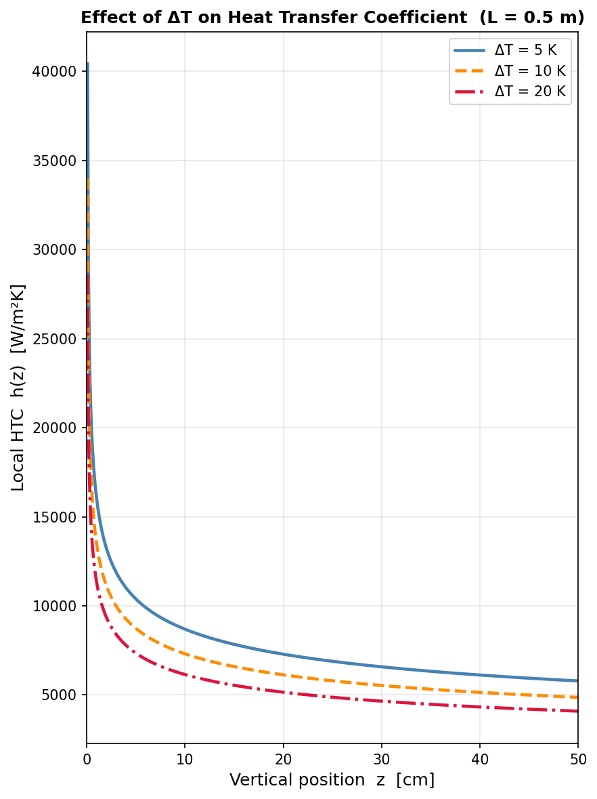
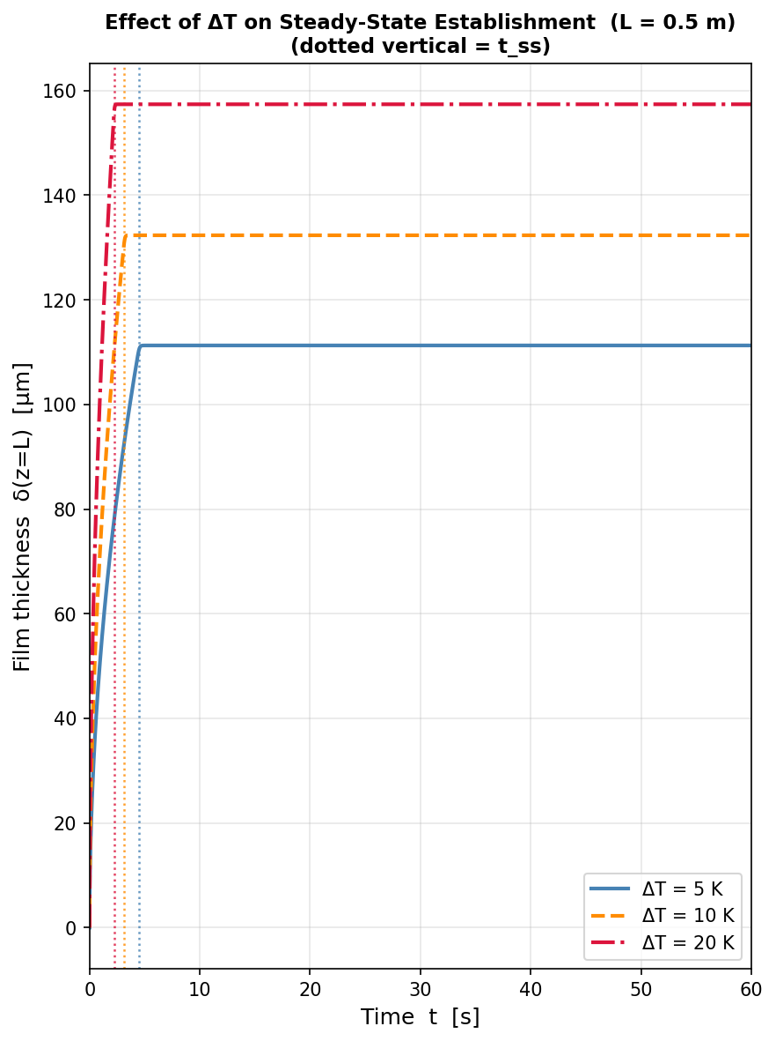
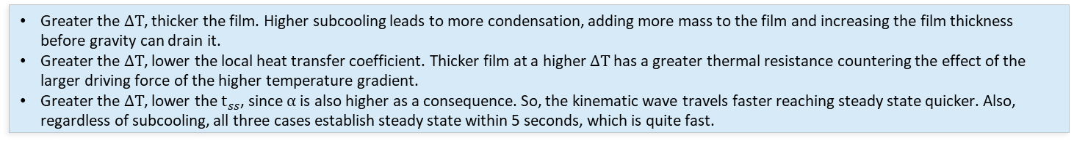
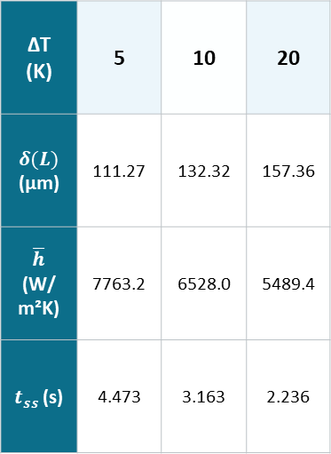
Part (a) - Parametric Study: Effect of ΔT and L
Effect of Wall Subcooling ΔT (L = 0.5 m)
ΔT (K) | 5 | 10 | 20
$δ(L)$ (µm) | 111.27 | 132.32 | 157.36
$\overline{h}$ (W/m²K) | 7763.2 | 6528.0 | 5489.4
$t_{ss}$ (s) | 4.473 | 3.163 | 2.236
Greater the $ΔT$, thicker the film. Higher subcooling leads to more condensation, adding more mass to the film and increasing the film thickness before gravity can drain it.
Greater the $ΔT$, lower the local heat transfer coefficient. Thicker film at a higher $ΔT$ has a greater thermal resistance countering the effect of the larger driving force of the higher temperature gradient.
Greater the $ΔT$, lower the $t_{ss}$, since $α$ is also higher as a consequence. So, the kinematic wave travels faster reaching steady state quicker. Also, regardless of subcooling, all three cases establish steady state within 5 seconds, which is quite fast.

Slide 8
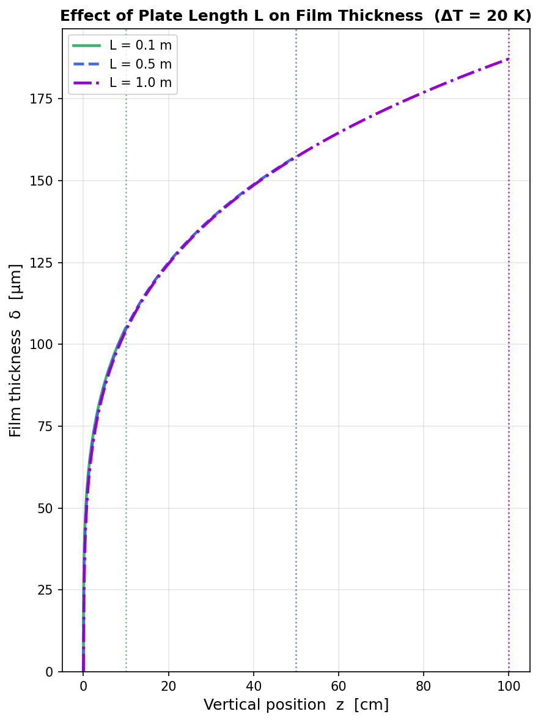
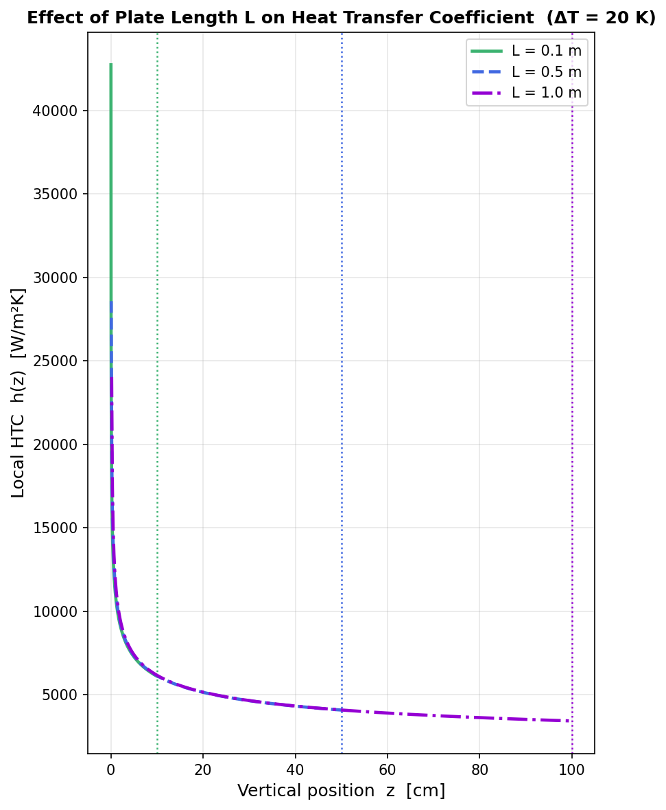
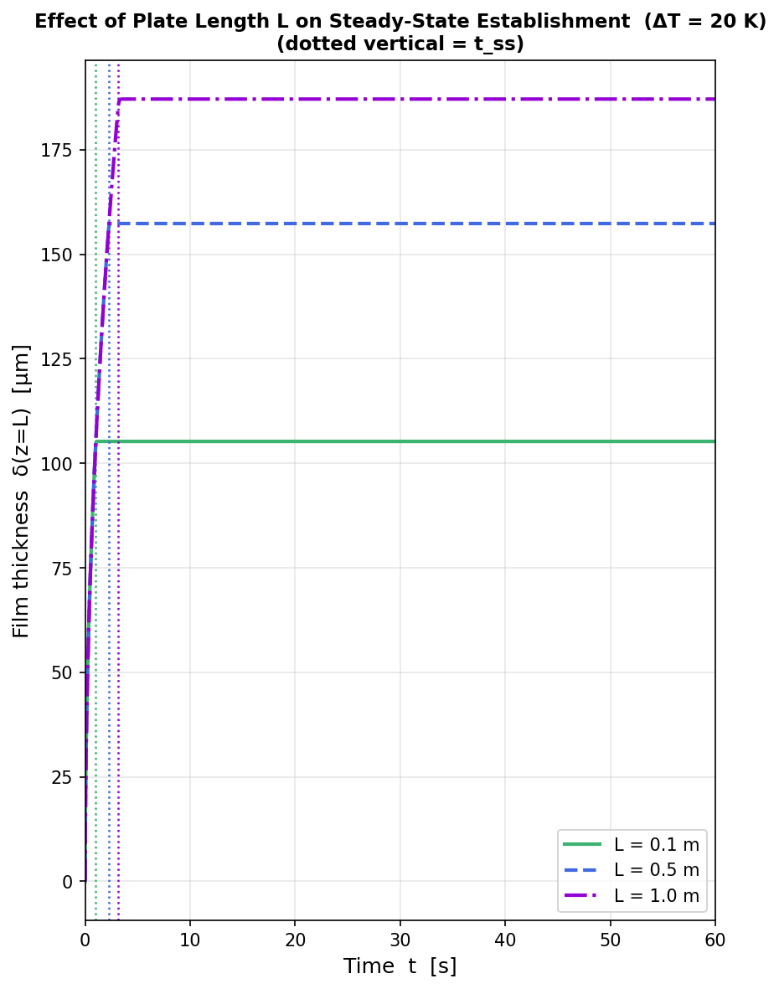
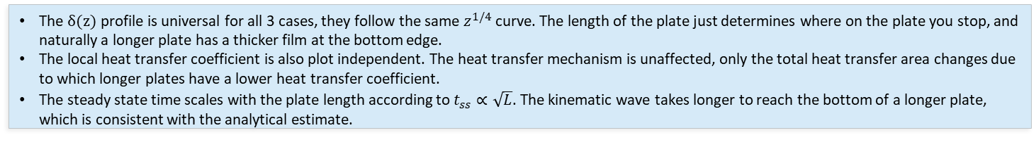
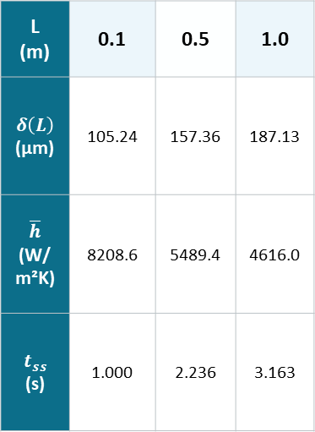
Part (a) - Parametric Study: Effect of ΔT and L
Effect of Plate Length L (ΔT = 20 K)
L (m) | 0.1 | 0.5 | 1.0
$$δ\left(L\right)$$ (µm) | 105.24 | 157.36 | 187.13
$$\overline{h}$$ (W/m²K) | 8208.6 | 5489.4 | 4616.0
$$t_{ss}$$ (s) | 1.000 | 2.236 | 3.163
The $δ(z)$ profile is universal for all 3 cases, they follow the same $z^{1/4}$ curve. The length of the plate just determines where on the plate you stop, and naturally a longer plate has a thicker film at the bottom edge.
The local heat transfer coefficient is also plot independent. The heat transfer mechanism is unaffected, only the total heat transfer area changes due to which longer plates have a lower heat transfer coefficient.
The steady state time scales with the plate length according to $t_{ss}∝\sqrt{L}$. The kinematic wave takes longer to reach the bottom of a longer plate, which is consistent with the analytical estimate.

Slide 9
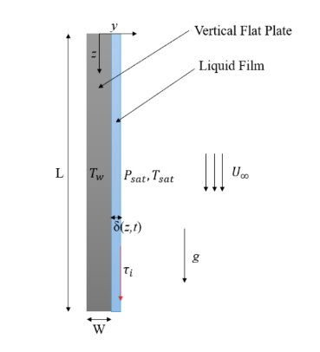
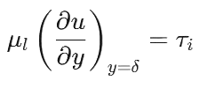
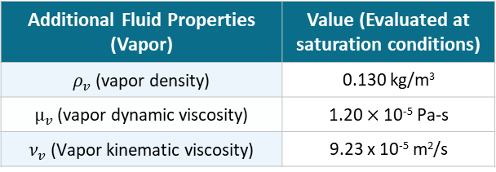
Part (b) - Steady-State Film Condensation with Interfacial Vapor Shear
Problem Overview
In Part (a), vapor was stagnant. Now vapor flows downward at free-stream velocity U∞, exerting a friction force at the liquid-vapor interface called interfacial shear stress τᵢ.
Shear adds a second drainage force on top of gravity → film drains faster
Faster drainage → thinner film → lower thermal resistance → better heat transfer
What we solve: Steady-state film thickness δ(z) under combined gravity + vapor shear, for U∞ = 1, 5, 15, 30 m/s.
New boundary condition at the interface (replaces the zero-shear BC from Part (a)):
Objective: Incorporate vapor shear into condensation model and analyze effect of vapor velocity on film behavior.
Assumptions (In addition to part (a))
Steady-State: The film has reached its stable profile.
Downward Vapor Flow: At a constant velocity U∞.
Interfacial Shear (tau_i): The flowing vapor exerts a downward stress.
Laminar Boundary Layer: Vapor shear is calculated using the Blasius friction factor for laminar flow.
Negligible Pressure Gradient: Fluid motion is driven solely by gravity and interfacial shear.
Additional Fluid Properties (Vapor) | Value (Evaluated at saturation conditions)
$ρ_{v}$ (vapor density) | 0.130 kg/m³
$μ_{v}$ (vapor dynamic viscosity) | 1.20 $×$ 10⁻⁵ Pa-s
$ν_{v}$ (Vapor kinematic viscosity) | 9.23 x 10⁻⁵ m²/s
Vapor Velocities to Test: 1, 5, 15, 30 m/s
Liquid temperature ~ 50 deg C
Vapor temperature ~ 60 deg C

Slide 10
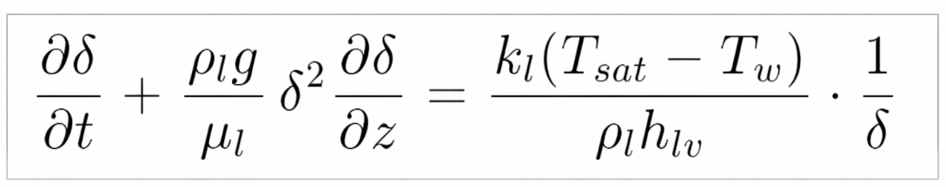
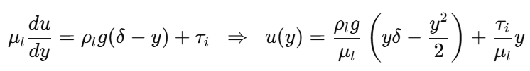
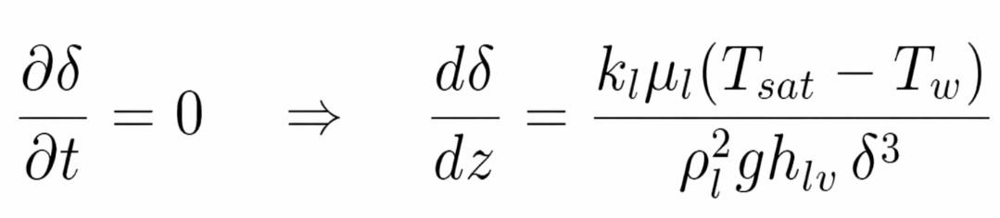
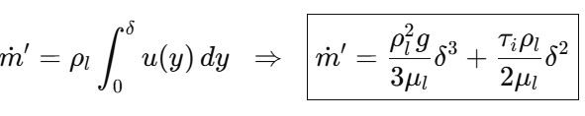





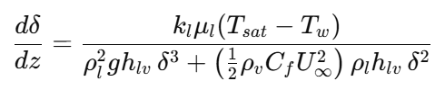
Part (b) - Derivation of Modified Steady-State ODE
1
Step 1 — Steady State Equation
2
Step 2 — Momentum Equation
From part (a) applying steady-state condition:
Momentum Balance and Velocity Profile with Interfacial Shear:
Mass flow rate:
3
Step 3 — Continuity + Energy Balance
4
Step 4 — Final ODE & Shear Correlation
Energy Balance:
Mass conservation:
ODE:
Vapor Reynolds Number: Friction Factor (Laminar): Shear Stress:
Final ODE:

Slide 11



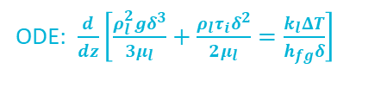
Part (b) - Numerical Solution of the Modified ODE
ODE: $\frac{d}{dz}\left[\frac{ρ_{l}^{2}gδ^{3}}{3μ_{l}}+\frac{ρ_{l}τ_{i}δ^{2}}{2μ_{l}}=\frac{k_{l}ΔT}{h_{fg}δ}\right]$
Spatial Discretization: Forward Euler
Stability and Step Size (Δz)
Methodology: Since the film growth is driven by the condensation from the top downward, we step through the plate length L in the +z direction.
Scheme Selection: A first-order Forward Euler scheme is used for simplicity and direct integration of the derived ODE.
Discretized Approximation:
Gradient Function:
Grid Independence: Unlike Part (A) which relies on a CFL condition for time steps, Part (B) requires grid convergence.
Step Size Control: A sufficiently small Δz (L/1000) is chosen to capture the steep thickness gradient near the leading edge (z → 0).
Convergence Metric: Solutions at N = 500 and N = 1000 agreed to within 0.5%, confirming the scheme is within the stable and convergent regime.
Initial Condition
Since 𝛿 = 0 at z = 0, the gradient function becomes undefined (division by zero). To bypass this, we "seed" the first node $z_{1}$ using the pure-gravity Nusselt analytical solution.

Slide 12
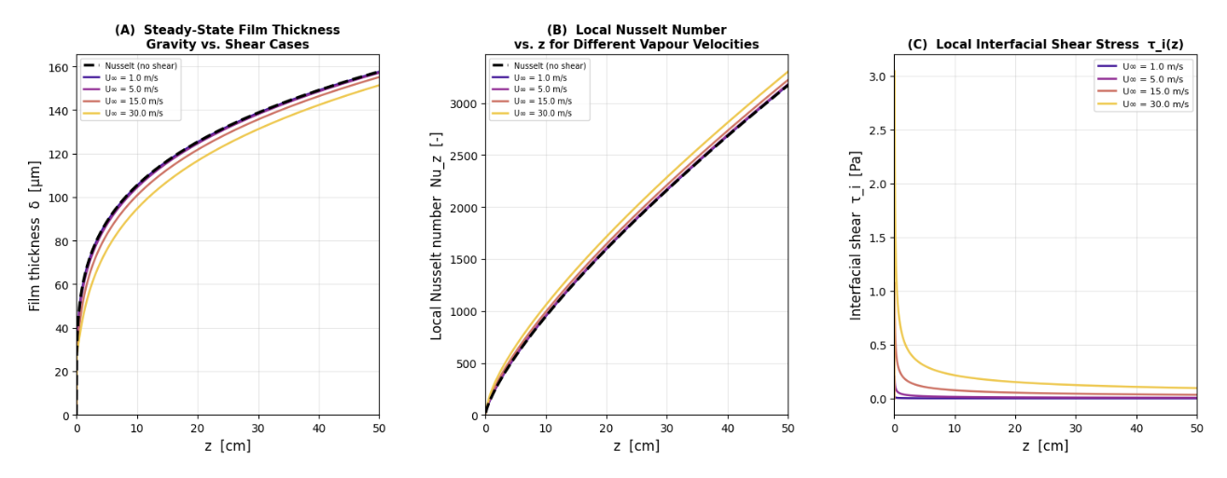
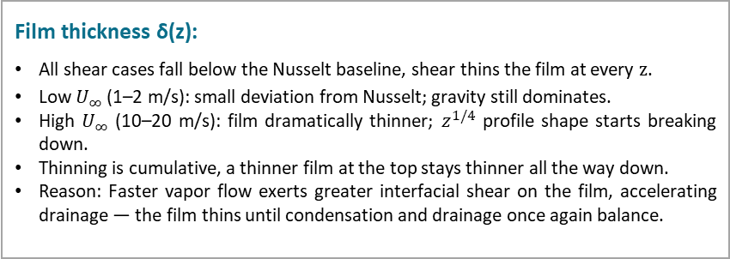
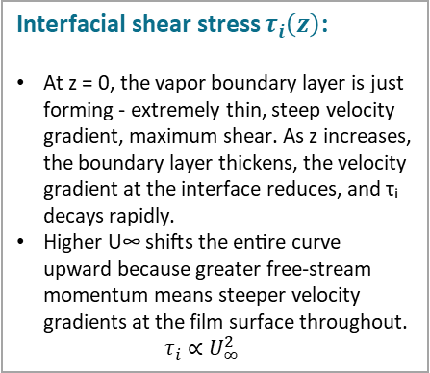
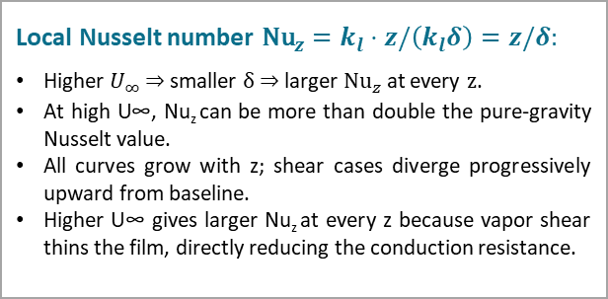
Part (b) – Simulation Results
Interfacial shear stress $τ_{i}\left(z\right)$:
At z = 0, the vapor boundary layer is just forming - extremely thin, steep velocity gradient, maximum shear. As z increases, the boundary layer thickens, the velocity gradient at the interface reduces, and τᵢ decays rapidly.
Higher U∞ shifts the entire curve upward because greater free-stream momentum means steeper velocity gradients at the film surface throughout. $τ_{i}∝U_{∞}^{2}$
Film thickness δ(z):
All shear cases fall below the Nusselt baseline, shear thins the film at every $z$.
Low $U_{∞}$ (1–2 m/s): small deviation from Nusselt; gravity still dominates.
High $U_{∞}$ (10–20 m/s): film dramatically thinner; $z^{1/4}$ profile shape starts breaking down.
Thinning is cumulative, a thinner film at the top stays thinner all the way down.
Reason: Faster vapor flow exerts greater interfacial shear on the film, accelerating drainage — the film thins until condensation and drainage once again balance.
Local Nusselt number ${\text{Nu}}_{z}=k_{l}⋅z/\left(k_{l}δ\right)=z/δ:$
Higher $U_{∞}$ $⇒$ smaller $δ$ $⇒$ larger ${\text{Nu}}_{z}$ at every $z$.
At high U∞, Nu_{z} can be more than double the pure-gravity Nusselt value.
All curves grow with z; shear cases diverge progressively upward from baseline.
Higher U∞ gives larger Nu_{z} at every z because vapor shear thins the film, directly reducing the conduction resistance.

Slide 13




Part (b) - Key Results: Vapor Velocity Effects
Effect of Downward Vapor Velocity $U_{∞}$ on Film Thickness and Heat Transfer
Laminar since Re < 5×10⁵
U∞ [m/s] | Re_v(L) | τ_i(L) [Pa] | δ(L) [µm] | Δδ vs Nusselt | h̄ [W/m²K] (confirm)
0 (Nusselt) | — | — | 157.65 | Baseline | 5430
1 | 5420 | 0.0006 | 157.60 | −0.03% | 5432
5 | 27100 | 0.0066 | 157.12 | −0.34% | 5489
15 | 81200 | 0.0341 | 155.15 | −1.58% | 5685
30 | 162000 | 0.0964 | 151.40 | −3.96% | 6020
δ(L) decreases with $U_{∞}$: Higher vapor velocity imposes greater interfacial shear. The film equilibrates at a smaller thickness where the now-higher drainage rate is balanced by condensation.
Δδ vs Nusselt is small even at $U_{∞}$ = 30 m/s (only −3.96%): Steam at 60°C has very low vapor density (ρᵥ = 0.13 kg/m³), so even at 30 m/s, the dynamic pressure ½ρᵥ $U_{∞}^{2}$ and therefore τᵢ remain small relative to the gravitational body force ρₗgδ acting on the much denser liquid film.
h̄ increases with $U_{∞}$: Since h̄ = kₗ/δ̄, any reduction in mean film thickness directly increases the average heat transfer coefficient — thinner film, lower conduction resistance.
U ≈ 69.13 m/s is very high:* This confirms that for low-pressure steam (low ρᵥ), vapor shear becomes dynamically comparable to gravity only at very high velocities.
Criterion: The ODE denominator has two competing terms. They are equal when:
R is the plate-averaged shear-to-gravity ratio. U* is the velocity where R crosses 1.
Method: $U_{∞}$scanned from 0.01 to 100 m/s (500 log-spaced values). Forward Euler ODE solved at each. R computed and plotted vs U∞.
Result: U ≈ 69.13 m/s*
$U_{∞}$<< U*: gravity dominates, film ≈ Nusselt solution.
$U_{∞}$>> U*: shear dominates, film substantially thinner, heat transfer significantly enhanced.

Slide 14
Appendix
Symbol | Meaning | Units
δ(z,t) | Local film thickness | µm
z | Vertical position from top of plate | m
t | Time | s
L | Plate length | m
W | Plate width | m
ΔT = Tsat − Tw | Wall subcooling | K
Tsat | Saturation temperature | K
Tw | Wall temperature | K
Tf = (Tsat + Tw)/2 | Film temperature | K
α = kₗΔT/ρₗhfg | Condensation coefficient | m²/s
C(δ) = gδ²/ν | Kinematic wave speed | m/s
S(δ) = α/δ | Condensation source term | m/s
hfg | Latent heat of vaporization | J/kg
kₗ | Liquid thermal conductivity | W/m·K
ρₗ | Liquid density | kg/m³
ρᵥ | Vapor density | kg/m³
μₗ | Liquid dynamic viscosity | Pa·s
μᵥ | Vapor dynamic viscosity | Pa·s
νₗ = μₗ/ρₗ | Liquid kinematic viscosity | m²/s
νᵥ = μᵥ/ρᵥ | Vapor kinematic viscosity | m²/s
g | Gravitational acceleration | m/s²
u(y) | Liquid velocity at depth y | m/s
y | Cross-film coordinate (wall to interface) | m
Γ | Film mass flow rate per unit width | kg/m·s
ṁ_cond | Condensation mass flux | kg/m²·s
hᵤ = kₗ/δ | Local heat transfer coefficient | W/m²K
h̄ | Average heat transfer coefficient | W/m²K
Nu_z = z/δ | Local Nusselt number | —
tss | Steady-state establishment time | s
τᵢ | Interfacial shear stress | Pa
Cf | Blasius friction factor | —
U∞ | Vapor free-stream velocity | m/s
Re_v,z = U∞z/νᵥ | Local vapor Reynolds number | —
U* | Critical velocity — shear equals gravity | m/s
R = ⟨τᵢ/ρₗgδ⟩ | Plate-averaged shear-to-gravity ratio | —
Cp,l | Liquid specific heat | J/kg·K
Pr | Prandtl number | —

Slide 15
Contributions
Acknowledgements
We would like to thank Prof. Soumyadip Sett for his guidance and teaching.
We would also like to thank Mondeep Gohain for always providing us timely answers to our queries and helping us through this project.
Contributions
Shrishti Mishra –
Derivation of governing PDE for Part (a) momentum equation, mass balance, energy balance, final PDE formulation
Nusselt analytical steady-state solution derivation and validation baseline
Validation of numerical results against Nusselt analytical solution and error analysis
Hari Balaji –
Numerical scheme design for Part (a) FTBS upwind discretization, implicit source treatment, CFL stability condition, IC and BC implementation,
Code development and simulation execution for Part (a)
Parametric study: effect of ΔT and L on film thickness, HTC, and tss
Diya Mehta –
Derivation of modified steady-state ODE for Part (b) momentum equation with interfacial shear BC, mass flow rate.
Blasius shear stress model implementation, τᵢ(z) computation and Forward Euler numerical solution
Critical velocity U* analysis, and results and discussion for Part (b)
References
P. M. Chung, "Unsteady laminar film condensation on vertical plate," Journal of Heat Transfer, vol. 85, no. 1, pp. 63–70, Feb. 1963.
E. M. Sparrow and R. Siegel, "Transient film condensation," Journal of Applied Mechanics, vol. 26, no. 1, pp. 120–121, Mar. 1959.
V. P. Carey, Liquid-Vapor Phase-Change Phenomena: An Introduction to the Thermophysics of Vaporization and Condensation Processes in Heat Transfer Equipment, 2nd ed. New York, NY, USA: Taylor & Francis, 2008.

