Slide 1


HABITABLE
EXOPLANET EXPLORER
Group Members
Muhammad Ahmed Raza (19P-0070)
Project Supervisor
Dr. Omer Usman Khan

Slide 2
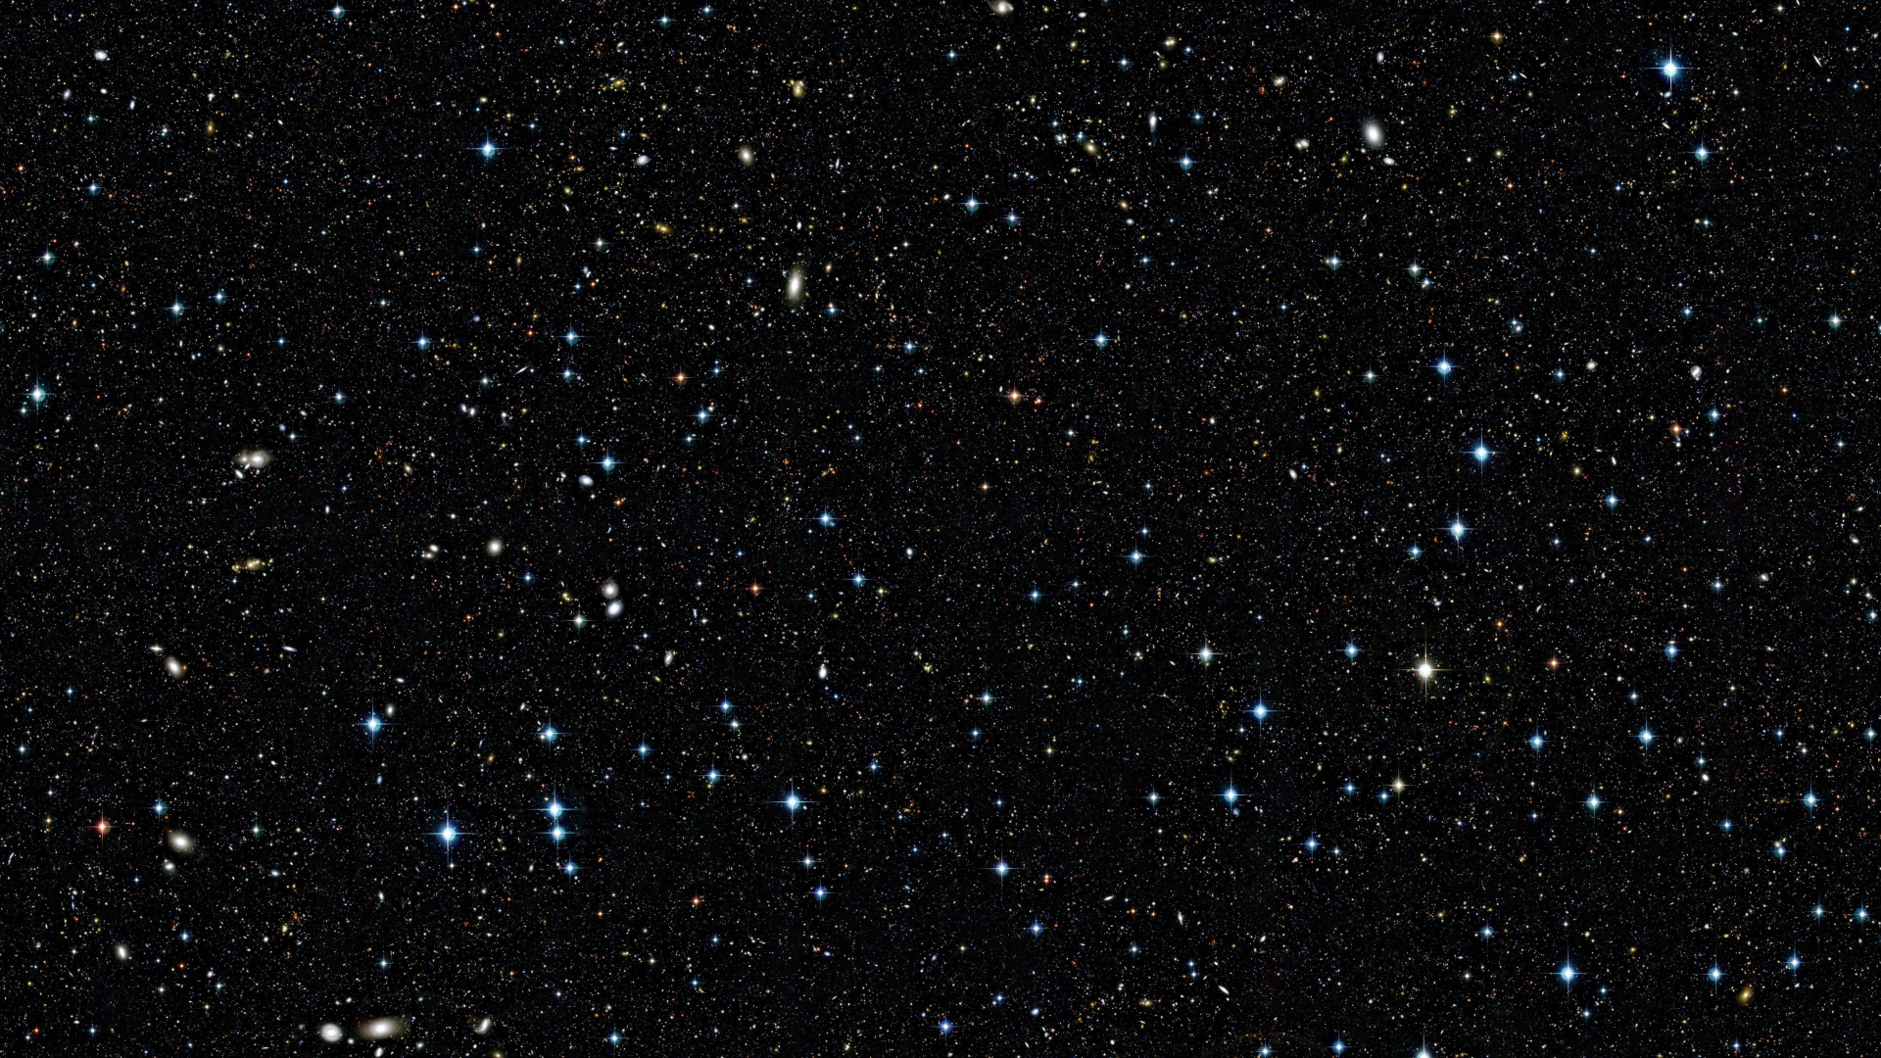
Introduction
Embark on a journey to explore the possibilities of habitable exoplanets, where science and technology converge to reveal cosmic wonders.
This project seamlessly integrates astronomy with cutting-edge technology, offering a glimpse into the vast universe. it aims to inspire curiosity about our cosmic surroundings. As we delve into this cosmic exploration
Unveiling the mysteries of habitable exoplanets
Scientific synergy of astronomy and technology
Inspiring curiosity and interest in space science
Ethical considerations embedded in cosmic exploration

Slide 3
Motivation
The motivation behind this project lies in the desire to expand our understanding of the universe and potentially answer the age-old question: Are we alone? By identifying habitable exoplanets, we pave the way for future space exploration and contribute to astrobiology research. The project is not just about scientific discovery; it's a catalyst for inspiring wonder and questioning our place in the cosmos.
Expanding our understanding of the universe
Seeking answers to the question of extraterrestrial life
Guiding future space exploration
Inspiring curiosity and wonder about our cosmic existence

Slide 4
Motivation
Consequences of Not Undertaking the Project:
Without embarking on this project, we risk missing crucial opportunities for scientific exploration and discovery. The absence of this initiative means:
Limited Understanding: We miss the chance to deepen our comprehension of habitable exoplanets and their potential implications for life beyond Earth.
Stagnation in Space Exploration: The project's absence hinders advancements in space exploration, limiting our ability to identify potential destinations for future missions.

Slide 5
Problem Statement
The exploration of habitable exoplanets poses a multifaceted challenge.:
Current data sources, while rich, lack a unified platform for comprehensive analysis and prediction of habitability.
Existing methods for exoplanet characterization and habitable zone calculation require refinement.
The absence of a sophisticated machine learning model limits our ability to predict habitability accurately.
Additionally, the lack of an interactive visualization tool hampers public engagement and understanding.

Slide 6
Solution Statement
This project aims to revolutionize the exploration of habitable exoplanets by:
1. Unified Data Platform: Integrate diverse data sources into a unified platform for comprehensive analysis.
2. Advanced Characterization Algorithms: Develop sophisticated algorithms for precise exoplanet characterization and habitable zone calculations.
3. Machine Learning Model: Implement a state-of-the-art machine learning model for accurate habitability predictions.
4. Interactive Visualization Tool: Create an intuitive web application for public engagement, allowing users to explore habitable exoplanets.
5. Ethical Framework: Embed ethical considerations in the project, ensuring responsible exploration and potential discoveries.

Slide 7
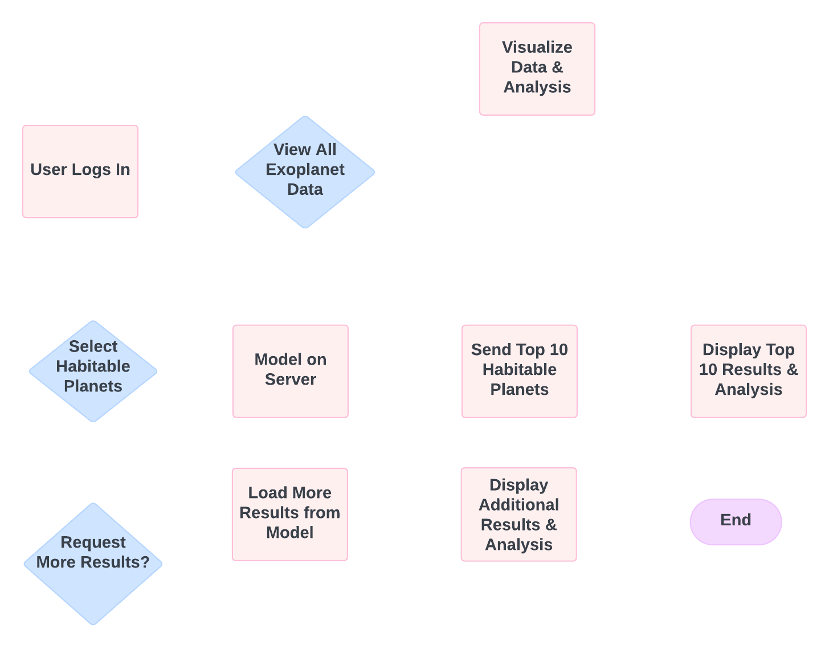
Project Workflow

Slide 8
Scope of project
This ambitious project encompasses a multi-phase exploration, aiming to:
1. Data Integration: Gather comprehensive exoplanet data from esteemed sources like NASA's Kepler, TESS, and relevant space missions.
2. Data Processing: Employ Python, utilizing Pandas and NumPy, to clean and preprocess the data, ensuring consistency for subsequent analysis.
3. Visual Analysis: Leverage Python libraries such as Matplotlib and Seaborn for in-depth data analysis and visualization, uncovering patterns crucial for habitability assessment.
4. Stellar Classification and Habitable Zone Calculation: (Optional)
- Implement spectral analysis tools for categorizing host stars based on their properties.
- Utilize stellar modeling software and Python for precise habitable zone calculations, outlining regions conducive to liquid water.

Slide 9
Scope of project
5. Exoplanet Characterization:
- Enhance algorithms, incorporating Bayesian inference and MCMC methods for improved accuracy in estimating key exoplanet properties.
- Consider atmospheric conditions through atmospheric modeling software and climate modeling tools. (optional)
6. Machine Learning Model Development: Train a robust machine learning model using Python, Scikit-learn, and TensorFlow to predict habitability based on a combination of stellar and exoplanet features.
7. Model Evaluation and Fine-Tuning: Rigorously evaluate the model's performance, fine-tune parameters, and address overfitting or biases using cross-validation techniques and hyperparameter tuning.
8. Interactive Visualization Tool: Develop a user-friendly web interface using web development tools like D3.js and Plotly, allowing intuitive exploration of habitable exoplanets.

Slide 10
Data Acquisition & Preprocessing
Dataset: Planetary Systems Composite Parameters (NASA Exoplanet Archive)
Key Features: Planet radius, mass, orbital period, star temperature, etc.
Filtering: Selected confirmed exoplanets (default_flag = 1)
Cleaning: Removed duplicates, filled missing values with medians

Slide 11
Data Acquisition & Preprocessing
Key features (planetary_dataset)
pl_name: Planet name (unique identifier)
hostname: Host star name (context for the planetary system)
pl_rade: Planet radius (Earth radii) – A fundamental parameter for understanding a planet's size and potential composition.
pl_masse: Planet mass (Earth masses) – Crucial for understanding a planet's gravity, density, and potential for retaining an atmosphere.
pl_orbper: Orbital period (days) – The time it takes for a planet to complete one orbit around its star, influencing its temperature and potential for seasons.
pl_orbsmax: Orbital semi-major axis (AU) – The average distance between the planet and its star, a key factor in determining its temperature and potential for liquid water.
st_teff: Stellar effective temperature (K) – The temperature of the star's surface, which directly affects the habitable zone location and planet's climate.
st_rad: Stellar radius (solar radii) – The size of the star, influencing its luminosity and habitable zone.
pl_dens: Planet density (g/cm³) – Provides insights into a planet's composition (rocky, gaseous, etc.).
st_met: Stellar metallicity (dex) – The abundance of elements heavier than hydrogen and helium in the star, potentially correlated with planet formation.

Slide 12
Data Acquisition & Preprocessing
Reasoning for selection
These features are essential for characterizing exoplanets and their host stars, providing information about their physical properties and potential for habitability.
They are commonly used in exoplanet research and have been extensively studied in the literature.
The features align with the core goals of your analysis: identifying potentially habitable exoplanets and exploring their characteristics.
Sources
NASA Exoplanet Archive: The primary source of the dataset, providing detailed documentation of the features and their significance in exoplanet studies.
Exoplanet Science: Numerous scientific papers and textbooks on exoplanet science discuss the importance of these parameters in understanding planetary systems and habitability.

Slide 13
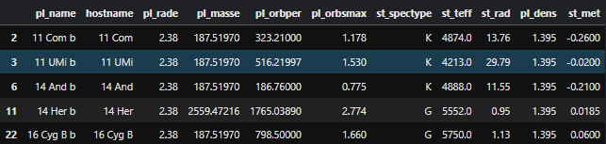
Data Acquisition & Preprocessing
Planetary_dataset

Slide 14
Data Acquisition & Preprocessing
Key features (direct_imaging)
plntname: Planet name (to link with the NASA archive)
impltemp: Inferred planet temperature (K) – Directly relevant to habitability.
implradius: Inferred planet radius (Jupiter radii) – Indicates the size of the planet.
implmass: Inferred planet mass (Jupiter masses) – Provides information about the planet's gravitational influence.
Reasoning for selection
These features are specific to directly imaged exoplanets and provide valuable information about their properties, complementing the data from the NASA Exoplanet Archive.
The temperature is particularly crucial in assessing habitability, as it determines the potential for liquid water
Radius and mass provide context about the planet's overall nature (e.g., gas giant vs. terrestrial).

Slide 15
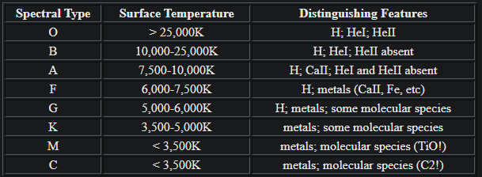
Spectral Analysis

Slide 16
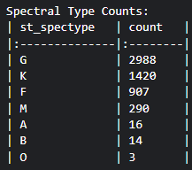
Spectral Analysis

Slide 17
Habitable Zone Calculation
Habitable Zone (HZ): The region around a star where liquid water could exist on a planet's surface
Traditional Calculation: Based on stellar luminosity (simplified)
Refinement:
Effective Stellar Flux (s_eff): More precise measure of radiation received by the planet
df_filtered['s_eff'] = (df_filtered['luminosity'] / (4 * np.pi * df_filtered['pl_orbsmax']**2)).abs()
Albedo: Planet's reflectivity (0.3 for Earth-like)
Greenhouse Effect: Estimated based on size and density (crude but illustrative)
Formula:
equilibrium_temp = ((1 - albedo) * s_eff / (4 * sigma))**(1/4)
Sigma: Stefan-Boltzmann constant (5.67e-8), fundamental physical constant relating object's temperature to its emitted radiation

Slide 18
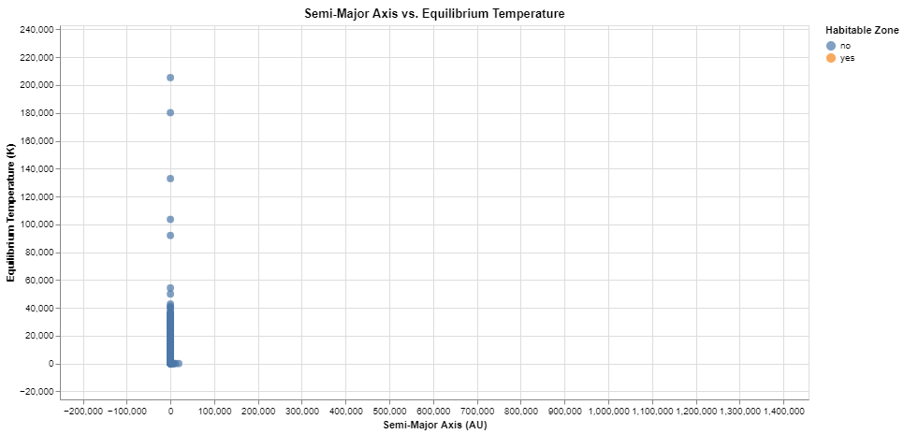
Habitable Zone Calculation

Slide 19
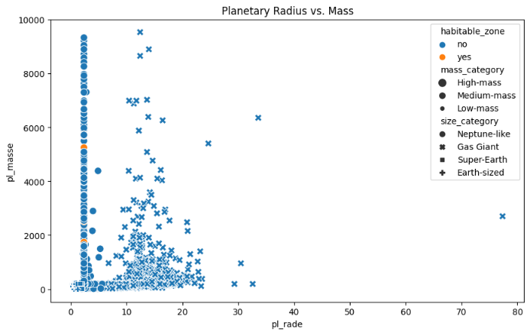
Habitable Zone Calculation

Slide 20
Earth Similarity Index (ESI)
ESI: Measure of how similar an exoplanet is to Earth
Simplified Formula: Focuses on radius and temperature
esi = max(0, min(1, (radius_factor * temp_factor)**0.5))
Interpretation: Higher ESI indicates greater Earth-likeness

Slide 21
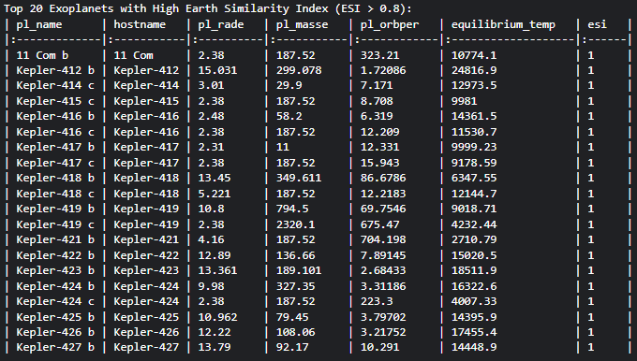
High ESI Exoplanets
Top Candidates: [Table showing top 20 exoplanets with ESI > 0.8]

Slide 22
High ESI Exoplanets
Noteworthy Characteristics:
Giant Planets Dominance: The majority of these exoplanets are significantly larger than Earth, falling into the categories of gas giants or ice giants. This suggests that our current simplified ESI, based mainly on radius and temperature, might not be the most accurate representation of Earth-likeness.
Extremely High Temperatures: Most of these planets exhibit equilibrium temperatures far exceeding Earth's comfortable 288 K. This indicates that while they may have a similar size to Earth, their proximity to their host stars results in scorching conditions unlikely to support life as we know it.
Potential for Deep Oceans or Ice Layers: The high masses and densities of some of these planets, combined with their high temperatures, raise the possibility of them harboring deep oceans or thick layers of exotic ices (e.g., water ice under high pressure).
Diversity in Orbital Periods: The orbital periods of these planets range from just a few days to several hundred days, indicating diverse planetary system architectures.

Slide 23
High ESI Exoplanets
Specific Examples:
Kepler-421 b: This exoplanet has a relatively long orbital period of over 700 days and a cooler temperature compared to others in the list, potentially placing it in a more moderate zone for habitability.
Kepler-417 c: This planet stands out due to its slightly lower mass compared to the other gas giants in the list, possibly hinting at a different composition or formation history.
NOTE: The ESI, as calculated here, is a simplified metric and doesn't capture the full complexity of habitability. Factors like atmospheric composition, presence of a magnetic field, and geological activity are also crucial in determining a planet's potential for life.

Slide 24
Direct Imaging Analysis
Direct Imaging: Challenging technique to directly observe exoplanets
Merged with planetary_dataset by planet name

Slide 25
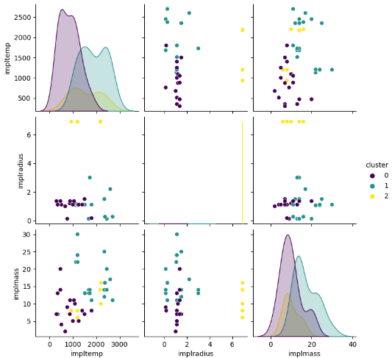
Direct Imaging Analysis (cont.)
Cluster Analysis (K-means): Grouping planets based on temperature, radius, and mass

Slide 26
Direct Imaging Analysis (cont.)
Cluster Analysis (K-means): Grouping planets based on temperature, radius, and mass
Temperature vs. Temperature (Diagonal):
Key Insight: Reveals three distinct temperature groups.
Cluster 0: Mostly cooler planets (below 1000K).
Cluster 1: Intermediate temperatures (1000K-2000K).
Cluster 2: Hottest planets (above 2000K).
Temperature vs. Radius:
Key Insight: Suggests larger planets may be slightly cooler.
Most planets in Cluster 2 (hottest) have small radii.
Some overlap exists between clusters, indicating temperature isn't solely determined by size.
Temperature vs. Mass:
Key Insight: No clear trend between mass and temperature.
Points are scattered, suggesting complex relationships with other factors like composition and age.

Slide 27
Direct Imaging Analysis (cont.)
Cluster Analysis (K-means): Grouping planets based on temperature, radius, and mass
Radius vs. Radius (Diagonal):
Key Insight: Displays the size distribution across clusters.
Cluster 0: Predominantly small planets.
Clusters 1 & 2: Mix of small and large planets, with cluster 2 skewed slightly larger.
Radius vs. Mass:
Key Insight: Larger planets tend to be more massive.
Cluster 2 (hottest) has the most massive planets.
Some smaller planets in clusters 1 & 2 are relatively massive, suggesting higher densities.
Mass vs. Mass (Diagonal):
Key Insight: Shows the distribution of masses in each cluster.
Cluster 0: Mostly low-mass planets.
Cluster 1: Intermediate mass range.
Cluster 2: Wide mass distribution, including the most massive planets.

Slide 28
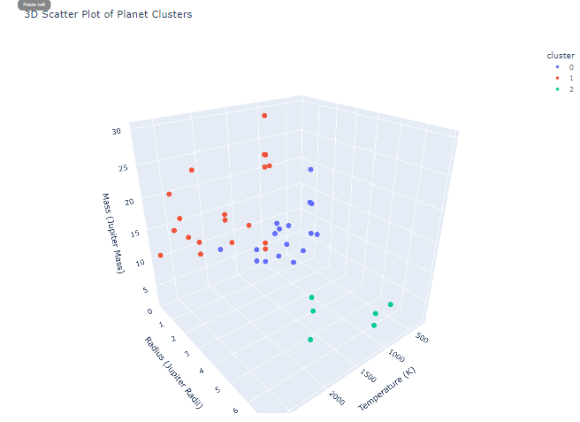
Direct Imaging Analysis (cont.)
3dScattor Plot of Clusters

Slide 29
Key Findings and Future Directions
Key Findings:
Potential Habitable Worlds: A subset of exoplanets exhibit characteristics that place them within the habitable zone, suggesting the possibility of liquid water and conditions suitable for life as we know it.
Earth Similarity Index (ESI): The ESI distribution highlights a few exoplanets with relatively high similarity to Earth, although these simplified calculations should be interpreted with caution.
Direct Imaging Challenges: Directly imaged exoplanets tend to be large and hot, suggesting biases in our current detection methods.
Cluster Analysis Insights: Clustering reveals distinct groups of exoplanets based on size, mass, and temperature, suggesting potential patterns in planetary formation and evolution.

Slide 30
Key Findings and Future Directions
Limitations:
Crude Greenhouse Effect Estimation: The greenhouse factor is estimated based on basic properties like size and density, and may not accurately reflect the complex atmospheric processes that influence a planet's temperature.
Small Sample Size for Direct Imaging: Directly imaged exoplanets constitute a small fraction of the known exoplanet population, limiting our ability to generalize findings about their characteristics.

Slide 31
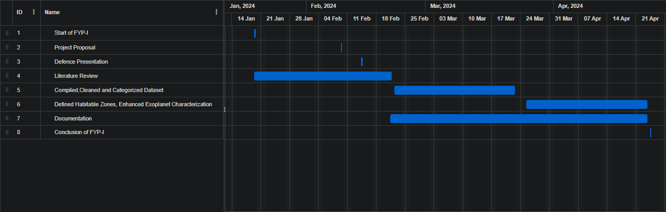
Objectives
FYP-I Timeline:

Slide 32
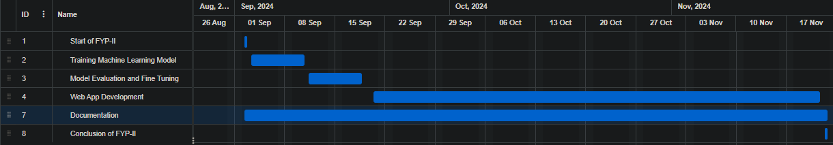
Objectives
FYP-II Timeline:

Slide 33
Expected Result
Unified platform with comprehensive exoplanet data
Refined and consistent dataset for advanced analysis
Visual representation of key exoplanet properties
Accurate stellar classification and habitable zone calculations
Enhanced exoplanet characterization algorithms
Trained machine learning model for precise habitability prediction

Slide 34
Team Work
Given the solo nature of this project, all phases, from requirements to implementation, are led and executed by me. The effectiveness of work distribution is inherently streamlined, ensuring focused and consistent progress throughout each major phase. This approach allows for a seamless transition between project stages, eliminating the need for coordination among group members and providing an efficient and cohesive workflow.

Slide 35
References
Evolution of a Habitable Planet: Annual Review of Astronomy and Astrophysics
https://www.annualreviews.org/doi/full/10.1146/annurev.astro.41.071601.170049#_i4
Habitable planets around the star Gliese 581?
https://www.aanda.org/articles/aa/abs/2007/48/aa8091-07/aa8091-07.html
What makes a planet Habitable?
https://link.springer.com/article/10.1007/s00159-009-0019-z
Extrasolar Planets: Formation, Detection and Dynamics:
https://onlinelibrary.wiley.com/doi/book/10.1002/9783527621361#page=16

Slide 36
References
The Occurrence of Rocky Habitable-zone Planets around Solar-like Stars from Kepler Data: https://iopscience.iop.org/article/10.3847/1538-3881/abc418/meta
Multiverse Predictions for Habitability: Number of Potentially Habitable Planets: https://www.mdpi.com/2218-1997/5/6/157https://www.mdpi.com/2218-1997/5/6/157

