Slide 1


HABITABLE
EXOPLANET EXPLORER
Group Members
Muhammad Ahmed Raza (19P-0070)
Project Supervisor
Dr. Omer Usman Khan

Slide 2
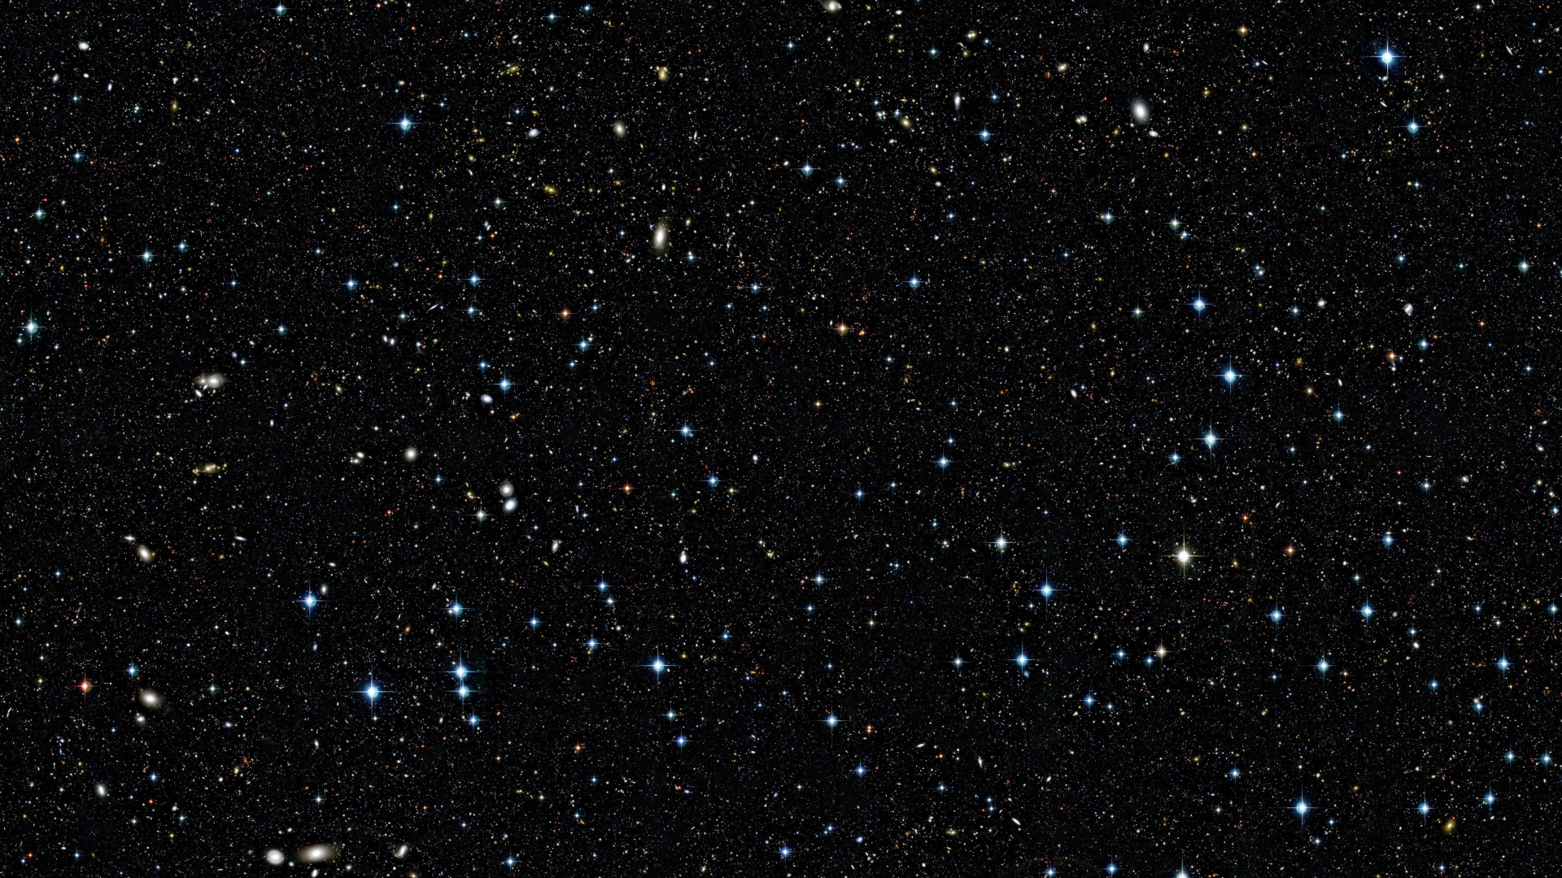
Introduction
Embark on a journey to explore the possibilities of habitable exoplanets, where science and technology converge to reveal cosmic wonders.
This project seamlessly integrates astronomy with cutting-edge technology, offering a glimpse into the vast universe. it aims to inspire curiosity about our cosmic surroundings. As we delve into this cosmic exploration
Unveiling the mysteries of habitable exoplanets
Scientific synergy of astronomy and technology
Inspiring curiosity and interest in space science
Ethical considerations embedded in cosmic exploration

Slide 3
Motivation
The motivation behind this project lies in the desire to expand our understanding of the universe and potentially answer the age-old question: Are we alone? By identifying habitable exoplanets, we pave the way for future space exploration and contribute to astrobiology research. The project is not just about scientific discovery; it's a catalyst for inspiring wonder and questioning our place in the cosmos.
Expanding our understanding of the universe
Seeking answers to the question of extraterrestrial life
Guiding future space exploration
Inspiring curiosity and wonder about our cosmic existence

Slide 4
Motivation
Consequences of Not Undertaking the Project:
Without embarking on this project, we risk missing crucial opportunities for scientific exploration and discovery. The absence of this initiative means:
Limited Understanding: We miss the chance to deepen our comprehension of habitable exoplanets and their potential implications for life beyond Earth.
Stagnation in Space Exploration: The project's absence hinders advancements in space exploration, limiting our ability to identify potential destinations for future missions.

Slide 5
Problem Statement
The exploration of habitable exoplanets poses a multifaceted challenge.:
Current data sources, while rich, lack a unified platform for comprehensive analysis and prediction of habitability.
Existing methods for exoplanet characterization and habitable zone calculation require refinement.
The absence of a sophisticated machine learning model limits our ability to predict habitability accurately.
Additionally, the lack of an interactive visualization tool hampers public engagement and understanding.

Slide 6
Solution Statement
This project aims to revolutionize the exploration of habitable exoplanets by:
1. Unified Data Platform: Integrate diverse data sources into a unified platform for comprehensive analysis.
2. Advanced Characterization Algorithms: Develop sophisticated algorithms for precise exoplanet characterization and habitable zone calculations.
3. Machine Learning Model: Implement a state-of-the-art machine learning model for accurate habitability predictions.
4. Interactive Visualization Tool: Create an intuitive web application for public engagement, allowing users to explore habitable exoplanets.
5. Ethical Framework: Embed ethical considerations in the project, ensuring responsible exploration and potential discoveries.

Slide 7
Paper Name | Key Points | Important Formulas or Discoveries | Limitations
Bryson et al. (2021) | The Occurrence of Rocky Habitable-zone Planets around Solar-like Stars from Kepler Data | η⊕ for the conservative HZ is between 0.21+0.37−0.21 and 0.51+0.88−0.33 planets per star | Large uncertainties due to small sample size
Dyck et al. (2021) | Core mass fraction, crust composition, habitability | Petrological modeling | Simplified model assumptions
Dvorak et al. (2015) | Planet formation, water delivery, collisions | N-body and SPH simulations | Simplified collisions and initial conditions
Thebault et al. (2009) | Alpha Centauri B, habitable zone, planet formation | Numerical simulations | Simplified simulations, uncertain initial conditions
Broecker (1985) | Earth's history, habitability factors, geological processes | Radioactive decay, plate tectonics, carbon cycle | Outdated information (1985)
Selsis et al. (2007) | Gliese 581, habitable zone, planet habitability | HZ boundaries based on stellar properties | Uncertainties in HZ boundaries and atmospheric properties
Haghighipour and Raymond (2007) | Binary stars, planet formation, habitable zone | Stability criterion for giant planets | Assumes terrestrial planet formation similar to single stars
Clement et al. (2022) | M dwarfs, volatile delivery, giant planets | Water-ice snow line location | Simplified models, no gas-disk interactions

Slide 8
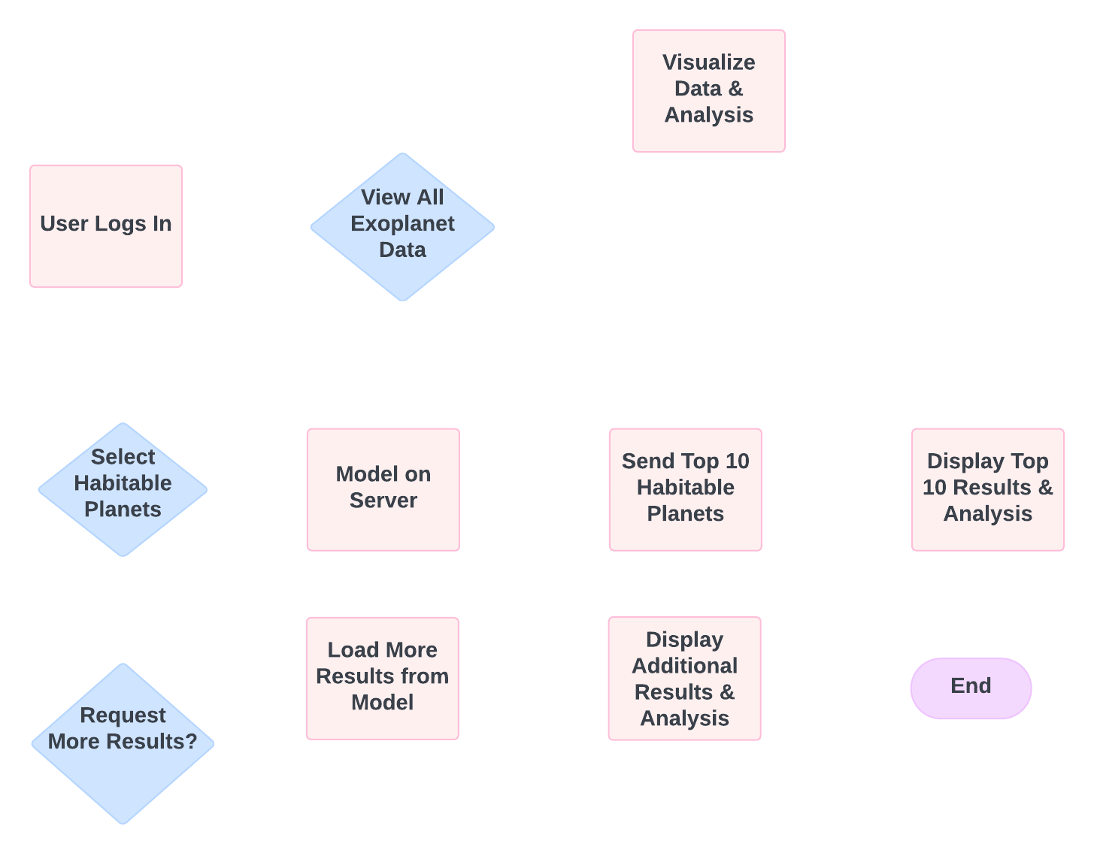
Project Workflow

Slide 9
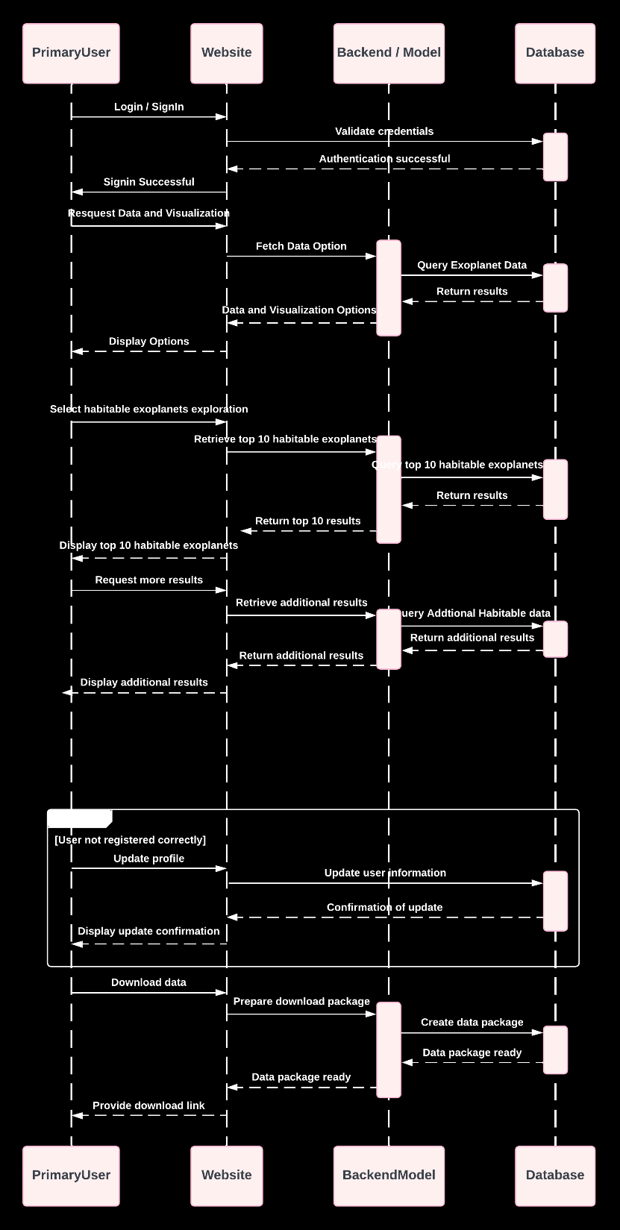
Sequence Diagram

Slide 10
Sequence Diagram
Query
Q

Slide 11
Sequence Diagram
Alternative

Slide 12
Scope of project
This ambitious project encompasses a multi-phase exploration, aiming to:
1. Data Integration: Gather comprehensive exoplanet data from esteemed sources like NASA's Kepler, TESS, and relevant space missions.
2. Data Processing: Employ Python, utilizing Pandas and NumPy, to clean and preprocess the data, ensuring consistency for subsequent analysis.
3. Visual Analysis: Leverage Python libraries such as Matplotlib and Seaborn for in-depth data analysis and visualization, uncovering patterns crucial for habitability assessment.
4. Stellar Classification and Habitable Zone Calculation: (Optional)
- Implement spectral analysis tools for categorizing host stars based on their properties.
- Utilize stellar modeling software and Python for precise habitable zone calculations, outlining regions conducive to liquid water.

Slide 13
Scope of project
5. Exoplanet Characterization:
- Enhance algorithms, incorporating Bayesian inference and MCMC methods for improved accuracy in estimating key exoplanet properties.
- Consider atmospheric conditions through atmospheric modeling software and climate modeling tools. (optional)
6. Machine Learning Model Development: Train a robust machine learning model using Python, Scikit-learn, and TensorFlow to predict habitability based on a combination of stellar and exoplanet features.
7. Model Evaluation and Fine-Tuning: Rigorously evaluate the model's performance, fine-tune parameters, and address overfitting or biases using cross-validation techniques and hyperparameter tuning.
8. Interactive Visualization Tool: Develop a user-friendly web interface using web development tools like D3.js and Plotly, allowing intuitive exploration of habitable exoplanets.

Slide 14
Research steps:
Data Acquisition and Prep: Gather exoplanet data (e.g., NASA's Kepler). Clean and preprocess data for a refined dataset.
Stellar Analysis:
Spectral Analysis.
Stellar Luminosity
3. Habitable Zone Identification: Categorize stars by spectral type. Calculate habitable zones based on stellar properties.
Calculate semi-major axis using Kepler's Third Law
Calculate Effective Stellar Flux
Estimate equilibrium temperature with albedo consideration
Approximate Greenhouse Factor
4. Exoplanet Characterization: Categorize planets based on their mass and radius. Analyze various relationships and distributions of the planets. Incorporate Direct Imaging.

Slide 15
1. Data Acquisition & Preprocessing
Dataset: Planetary Systems Composite Parameters (NASA Exoplanet Archive)
Key Features: Planet radius, mass, orbital period, star temperature, etc.
Filtering: Selected confirmed exoplanets (default_flag = 1)
Cleaning: Removed duplicates, filled missing values with medians

Slide 16
1. Data Acquisition & Preprocessing
Key features (planetary_dataset)
pl_name: Planet name (unique identifier)
hostname: Host star name (context for the planetary system)
pl_rade: Planet radius (Earth radii) – A fundamental parameter for understanding a planet's size and potential composition.
pl_masse: Planet mass (Earth masses) – Crucial for understanding a planet's gravity, density, and potential for retaining an atmosphere.
pl_orbper: Orbital period (days) – The time it takes for a planet to complete one orbit around its star, influencing its temperature and potential for seasons.
pl_orbsmax: Orbital semi-major axis (AU) – The average distance between the planet and its star, a key factor in determining its temperature and potential for liquid water.
st_teff: Stellar effective temperature (K) – The temperature of the star's surface, which directly affects the habitable zone location and planet's climate.
st_rad: Stellar radius (solar radii) – The size of the star, influencing its luminosity and habitable zone.
pl_dens: Planet density (g/cm³) – Provides insights into a planet's composition (rocky, gaseous, etc.).
st_met: Stellar metallicity (dex) – The abundance of elements heavier than hydrogen and helium in the star, potentially correlated with planet formation.

Slide 17
1. Data Acquisition & Preprocessing
Reasoning for selection
These features are essential for characterizing exoplanets and their host stars, providing information about their physical properties and potential for habitability.
They are commonly used in exoplanet research and have been extensively studied in the literature.
The features align with the core goals of your analysis: identifying potentially habitable exoplanets and exploring their characteristics.
Sources
NASA Exoplanet Archive: The primary source of the dataset, providing detailed documentation of the features and their significance in exoplanet studies.
Exoplanet Science: Numerous scientific papers and textbooks on exoplanet science discuss the importance of these parameters in understanding planetary systems and habitability.

Slide 18
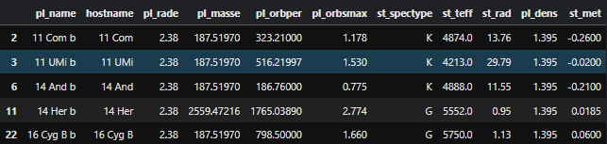
1. Data Acquisition & Preprocessing
Planetary_dataset

Slide 19
1. Data Acquisition & Preprocessing
Key features (direct_imaging)
plntname: Planet name (to link with the NASA archive)
impltemp: Inferred planet temperature (K) – Directly relevant to habitability.
implradius: Inferred planet radius (Jupiter radii) – Indicates the size of the planet.
implmass: Inferred planet mass (Jupiter masses) – Provides information about the planet's gravitational influence.
Reasoning for selection
These features are specific to directly imaged exoplanets and provide valuable information about their properties, complementing the data from the NASA Exoplanet Archive.
The temperature is particularly crucial in assessing habitability, as it determines the potential for liquid water
Radius and mass provide context about the planet's overall nature (e.g., gas giant vs. terrestrial).

Slide 20
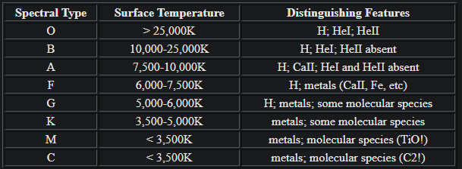
2. Spectral Analysis
Spectral Analysis

Slide 21
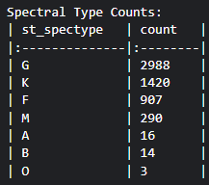
2. Spectral Analysis

Slide 22
2. Stellar Analysis
Stellar Luminosity
Luminosity (L) is the total amount of energy emitted by a star per unit of time. It's a measure of the star's intrinsic brightness and is typically expressed in units of solar luminosity (L☉), where 1 L☉ is the luminosity of our Sun.
Formula:
Stefan-Boltzmann law, tailored for calculating stellar luminosity:
L = 4πR²σT⁴
4πR² calculates the surface area of each star. The radius is squared because the surface area of a sphere is 4πr².
L is the star's luminosity (in watts).
R is the star's radius (in meters).
σ is the Stefan-Boltzmann constant.
T is the star's effective temperature (in Kelvin).

Slide 23
2. Stellar Analysis
Stellar Luminosity (cont…)
What is Stefan-Boltzmann constant?
The Stefan-Boltzmann constant (sigma) is a fundamental physical constant that relates the temperature of an object to the amount of energy it radiates per unit surface area. Its value is approximately 5.67 x 10^-8 watts per square meter per Kelvin to the fourth power (W/m²K⁴).

Slide 24
2. Stellar Analysis
Stellar Luminosity (cont…)
Why calculate Luminosity in the first place?
Habitability: A star's luminosity directly impacts the location and size of its habitable zone, where liquid water could exist on a planet's surface. Hotter, more luminous stars have habitable zones farther out, while cooler, less luminous stars have habitable zones closer in.
Planetary Climate: The amount of energy a planet receives from its star (which depends on the star's luminosity and the planet's distance) is the primary factor determining its climate and potential habitability.
Stellar Evolution: Luminosity is a key indicator of a star's stage in its life cycle. Stars tend to become more luminous as they age.

Slide 25
3. Habitable Zone (HZ) – A More Refined Approach
Habitable Zone (HZ): The habitable zone is the region around a star where conditions might be right for liquid water to exist on the surface of a planet. This is considered a crucial factor for the potential of life as we know it.
Traditional Calculation: Based on stellar luminosity (simplified)
Refinement:
Calculate semi-major axis using Kepler's Third Law
Calculate Effective Stellar Flux
Estimate equilibrium temperature with albedo consideration
Approximate Greenhouse Factor

Slide 26
3. Habitable Zone (HZ) – A More Refined Approach
1. Calculating Semi-Major Axis (a) Using Kepler's Third Law:
Purpose: To determine the average distance of the planet from its host star.
Formula:
a³ = (P² * G * M) / (4 * π²)
a is the semi-major axis (in AU)
P is the orbital period (in days)
G is the gravitational constant (6.67430e-11 m³ kg⁻¹ s⁻²)
M is the star's mass (in solar masses)
Why: The semi-major axis is a crucial factor in determining the amount of energy a planet receives from its star.

Slide 27
3. Habitable Zone (HZ) – A More Refined Approach
2. Calculate Effective Stellar Flux (S_eff):
Purpose: To measure the amount of energy per unit area that the planet receives from its star.
Formula:
S_eff = L / (4πa²)
S_eff is the effective stellar flux (in W/m²)
L is the star's luminosity (in Watts)
a is the semi-major axis (in meters)
Why: S_eff is the primary driver of a planet's equilibrium temperature, which is a good starting point for assessing habitability.

Slide 28
3. Habitable Zone (HZ) – A More Refined Approach
3. Estimate Equilibrium Temperature (T_eq):
Purpose: To get a first-order approximation of the planet's temperature without an atmosphere.
Formula:
T_eq = ((1 - albedo) * S_eff / (4σ))^(1/4)
T_eq is the equilibrium temperature (in Kelvin)
albedo is the planet's reflectivity (0.3 is a typical value for Earth-like planets)
Why: While not the final temperature, T_eq provides a useful baseline for comparison and further analysis.

Slide 29
3. Habitable Zone (HZ) – A More Refined Approach
4. Approximate Greenhouse Factor:
Purpose: To account for the potential warming effect of the planet's atmosphere.
Approach: A simplified approach is used based on the planet's radius and density, assigning a greenhouse factor to categorize it as a gas giant, mini-Neptune, or Earth-like.
Why: This is a crude estimate, but it allows us to adjust the habitable zone boundaries to account for potential atmospheric warming, which is a critical factor for habitability.

Slide 30
3. Habitable Zone (HZ) – A More Refined Approach
How many exoplanets lie in the habitable zone?
12
How many exoplanets don’t lie in the habitable zone?
5626

Slide 31
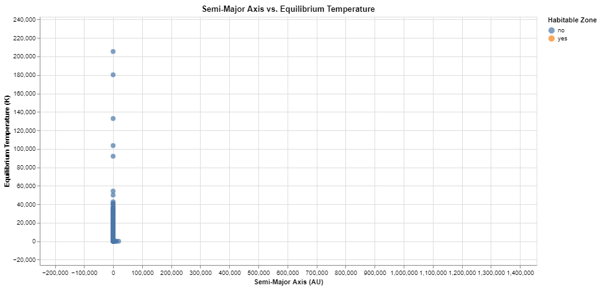
3. Habitable Zone (HZ) – A More Refined Approach

Slide 32
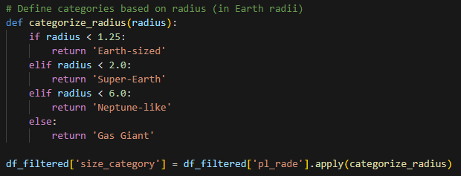
4. Exoplanet Characterization:
Categorize Exoplanets by key properties
Categorize Exoplanets by radius

Slide 33
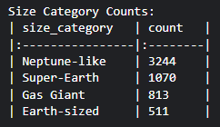
4. Exoplanet Characterization:
Categorize Exoplanets by key properties
Categorize Exoplanets by radius (output)

Slide 34
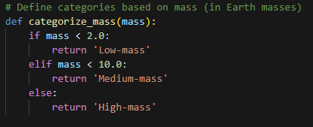
4. Exoplanet Characterization:
Categorize Exoplanets by key properties
Categorize Exoplanets by mass

Slide 35
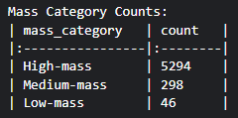
4. Exoplanet Characterization:
Categorize Exoplanets by key properties
Categorize Exoplanets by mass (output)

Slide 36
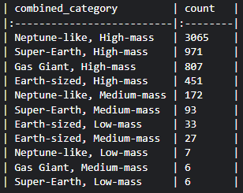
4. Exoplanet Characterization:
Categorize Exoplanets by key properties

Slide 37
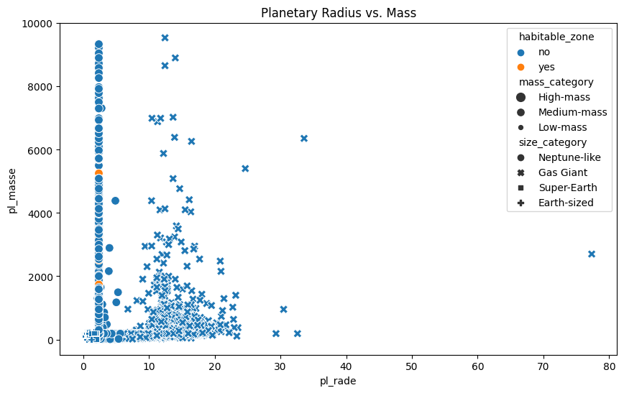
4. Exoplanet Characterization:
Visualize Relationships and Distributions:

Slide 38
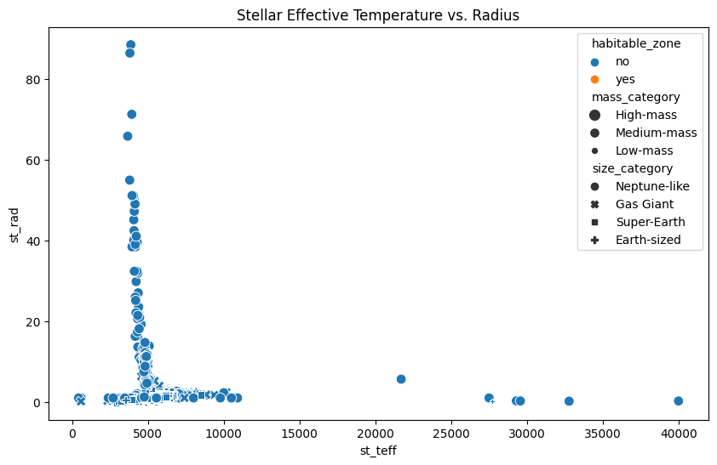
4. Exoplanet Characterization:
Visualize Relationships and Distributions:

Slide 39
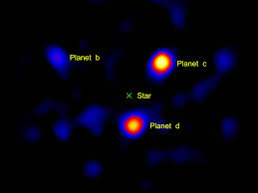
Direct Imaging Analysis
Direct Imaging: Challenging technique to directly observe exoplanets
Merged with planetary_dataset by planet name
Average Temperature of Directly Imaged Planets: 1369.74 K

Slide 40
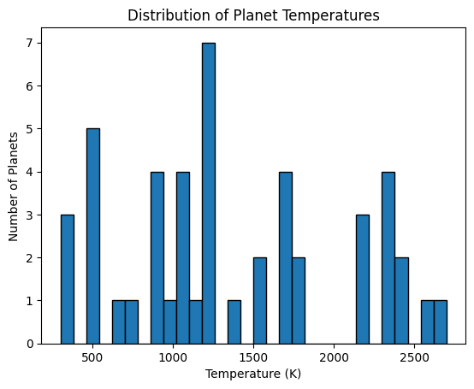
Direct Imaging Analysis

Slide 41
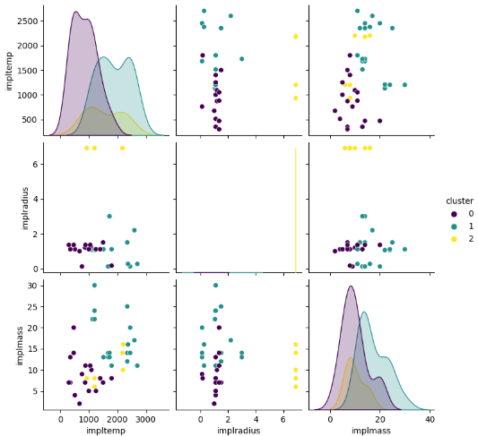
Direct Imaging Analysis (cont.)
Cluster Analysis (K-means): Grouping planets based on temperature, radius, and mass

Slide 42
Direct Imaging Analysis (cont.)
Cluster Analysis (K-means): Grouping planets based on temperature, radius, and mass
Temperature vs. Temperature (Diagonal):
Key Insight: Reveals three distinct temperature groups.
Cluster 0: Mostly cooler planets (below 1000K).
Cluster 1: Intermediate temperatures (1000K-2000K).
Cluster 2: Hottest planets (above 2000K).
Temperature vs. Radius:
Key Insight: Suggests larger planets may be slightly cooler.
Most planets in Cluster 2 (hottest) have small radii.
Some overlap exists between clusters, indicating temperature isn't solely determined by size.
Temperature vs. Mass:
Key Insight: No clear trend between mass and temperature.
Points are scattered, suggesting complex relationships with other factors like composition and age.

Slide 43
Direct Imaging Analysis (cont.)
Cluster Analysis (K-means): Grouping planets based on temperature, radius, and mass
Radius vs. Radius (Diagonal):
Key Insight: Displays the size distribution across clusters.
Cluster 0: Predominantly small planets.
Clusters 1 & 2: Mix of small and large planets, with cluster 2 skewed slightly larger.
Radius vs. Mass:
Key Insight: Larger planets tend to be more massive.
Cluster 2 (hottest) has the most massive planets.
Some smaller planets in clusters 1 & 2 are relatively massive, suggesting higher densities.
Mass vs. Mass (Diagonal):
Key Insight: Shows the distribution of masses in each cluster.
Cluster 0: Mostly low-mass planets.
Cluster 1: Intermediate mass range.
Cluster 2: Wide mass distribution, including the most massive planets.

Slide 44
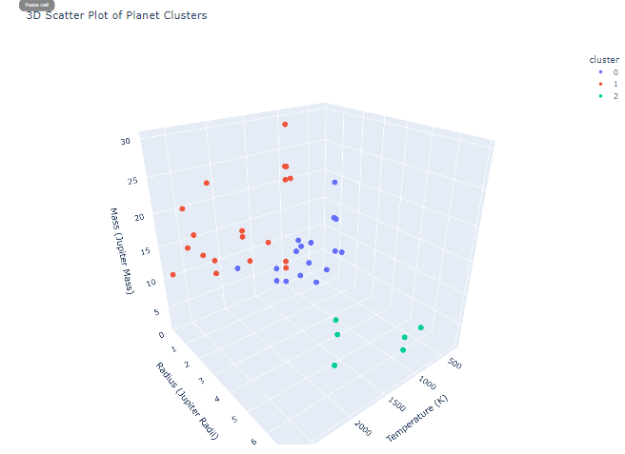
Direct Imaging Analysis (cont.)
3dScattor Plot of Clusters

Slide 45
Key Findings and Future Directions
Key Findings:
Potential Habitable Worlds: A subset of exoplanets exhibit characteristics that place them within the habitable zone, suggesting the possibility of liquid water and conditions suitable for life as we know it.
Direct Imaging Challenges: Directly imaged exoplanets tend to be large and hot, suggesting biases in our current detection methods.
Cluster Analysis Insights: Clustering reveals distinct groups of exoplanets based on size, mass, and temperature, suggesting potential patterns in planetary formation and evolution.

Slide 46
Key Findings and Future Directions
Limitations:
Crude Greenhouse Effect Estimation: The greenhouse factor is estimated based on basic properties like size and density, and may not accurately reflect the complex atmospheric processes that influence a planet's temperature.
Small Sample Size for Direct Imaging: Directly imaged exoplanets constitute a small fraction of the known exoplanet population, limiting our ability to generalize findings about their characteristics.

Slide 47
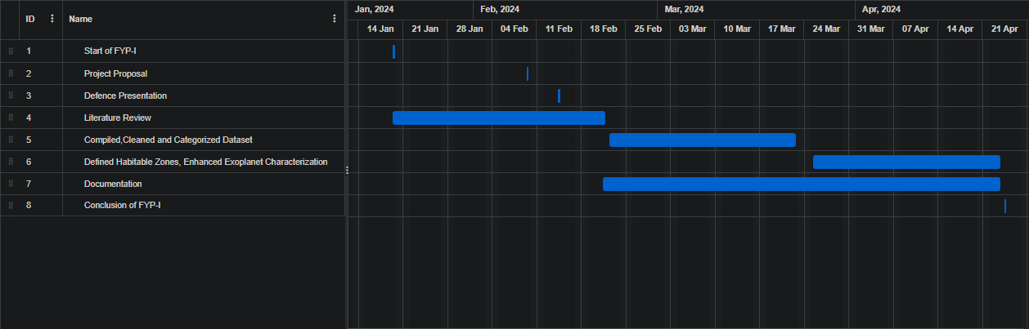
Objectives
FYP-I Timeline:

Slide 48
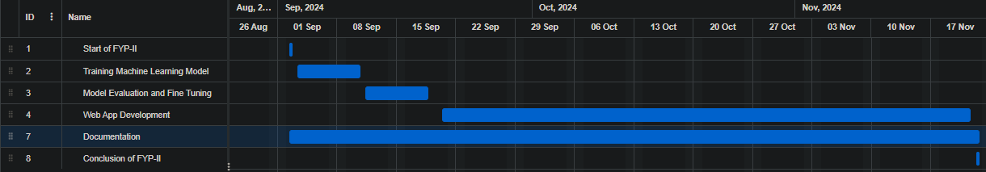
Objectives
FYP-II Timeline:

Slide 49
Expected Result
Unified platform with comprehensive exoplanet data
Refined and consistent dataset for advanced analysis
Visual representation of key exoplanet properties
Accurate stellar classification and habitable zone calculations
Enhanced exoplanet characterization algorithms
Trained machine learning model for precise habitability prediction

Slide 50
Team Work
Given the solo nature of this project, all phases, from requirements to implementation, are led and executed by me. The effectiveness of work distribution is inherently streamlined, ensuring focused and consistent progress throughout each major phase. This approach allows for a seamless transition between project stages, eliminating the need for coordination among group members and providing an efficient and cohesive workflow.

Slide 51
References
Habitable planets around the star Gliese 581?
https://www.aanda.org/articles/aa/abs/2007/48/aa8091-07/aa8091-07.html
The Occurrence of Rocky Habitable-zone Planets around Solar-like Stars from Kepler Data: https://iopscience.iop.org/article/10.3847/1538-3881/abc418/meta

