Slide 1

Artificial Intelligence
Machine Learning
Autonomous Action
sentientlabs.co

Slide 2
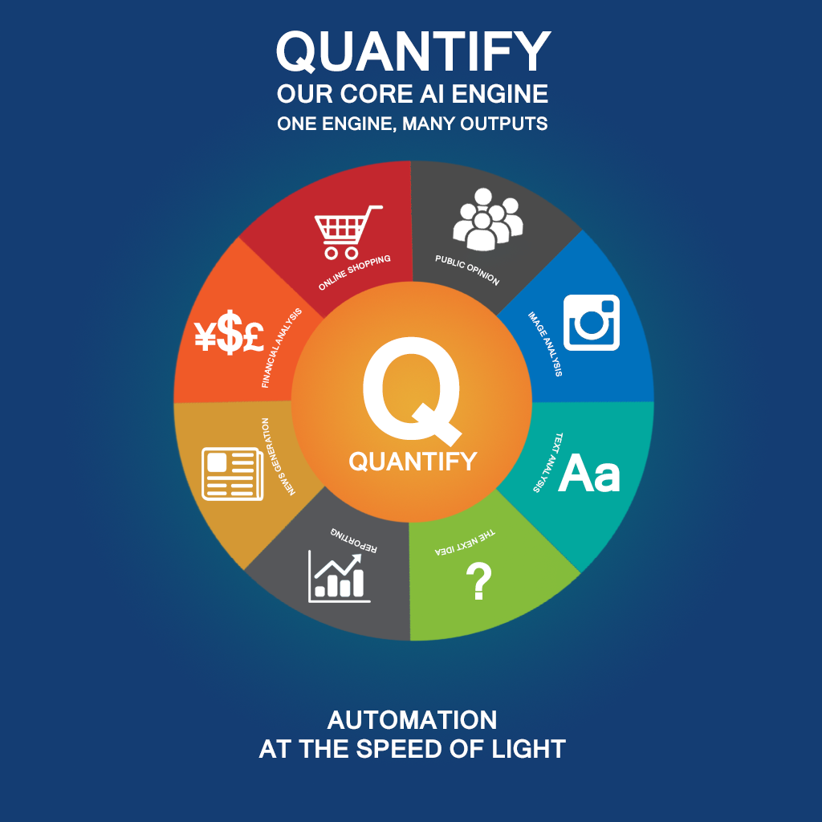

Slide 3
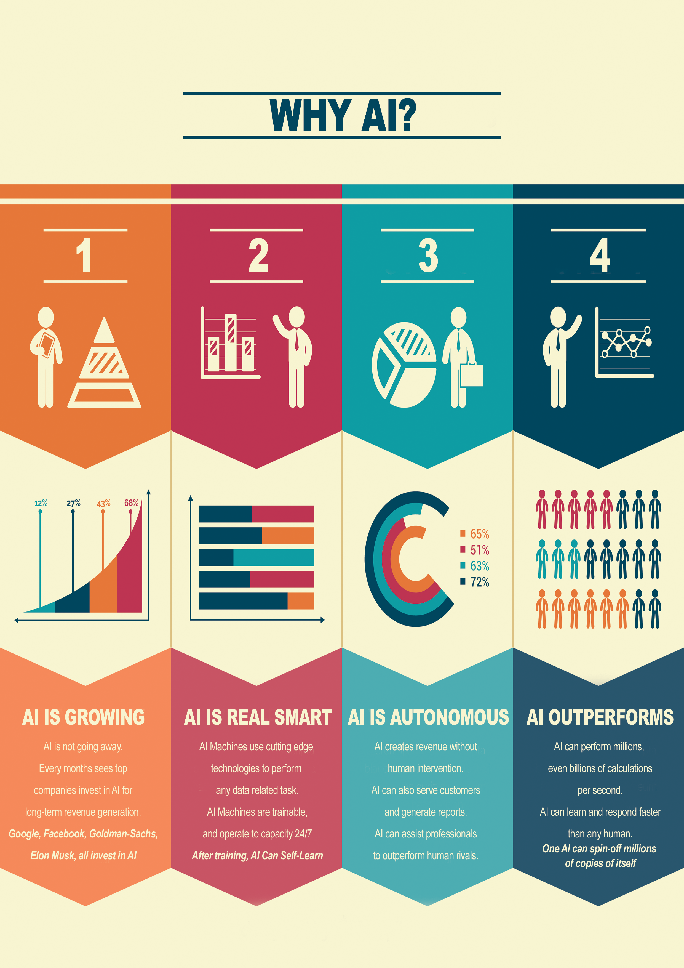

WHY A.I.
AI is not going away
Artificial Intelligence can discover new strategies faster than an analyst
AI Systems are trainable and can operate autonomously
AI data is cross-domain, giving each system unprecedented insight
AI is the most exciting tech innovation since social media.
AI never sleeps
AI operates at the speed of light

Slide 4
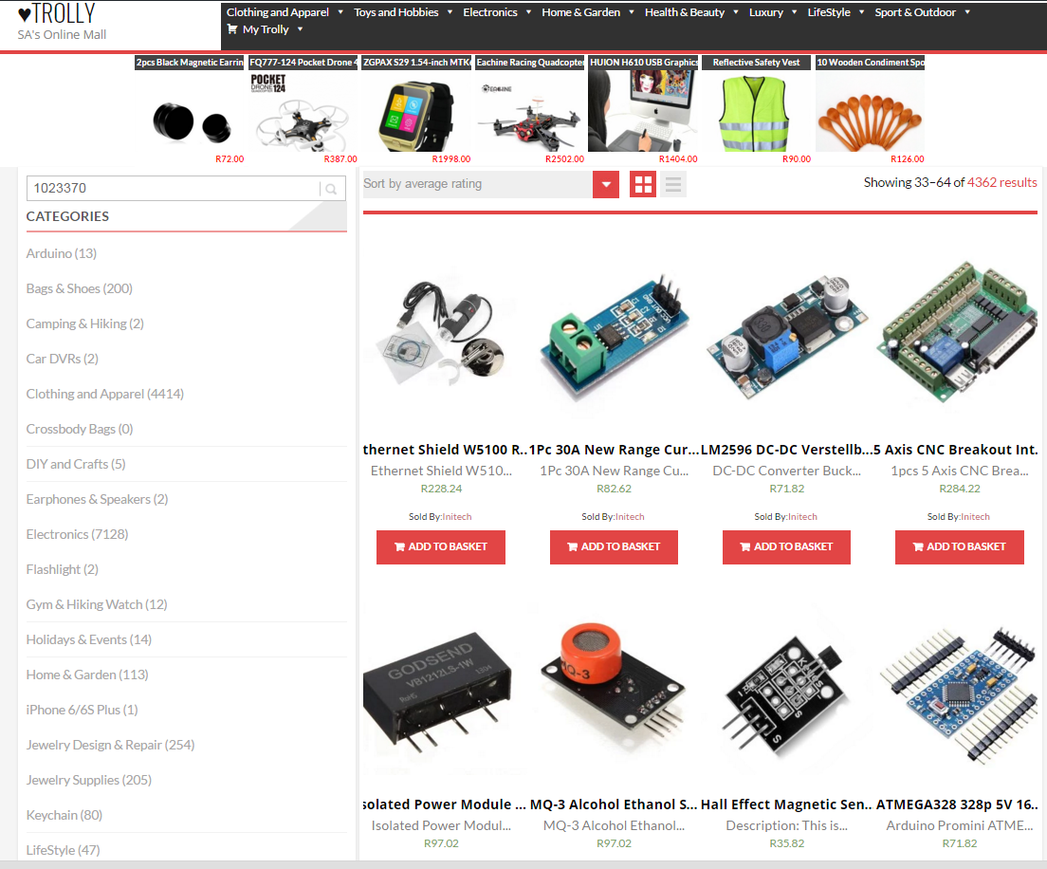
SENTIENT LIVE TEST CASE TROLLY.CO.ZA
AI Managed online shop
TROLLY.CO.ZA operates autonomously
The TROLLY AI (Running Q Engine) also sells on Twitter
Data mining of browsing habits is used to feed further advertising, automatically
TROLLY.CO.ZA has no operating costs, has never been in the red, makes a small but steady profit, growing at 10% per month since 2015. Imagine what scaling can achieve.

Slide 5
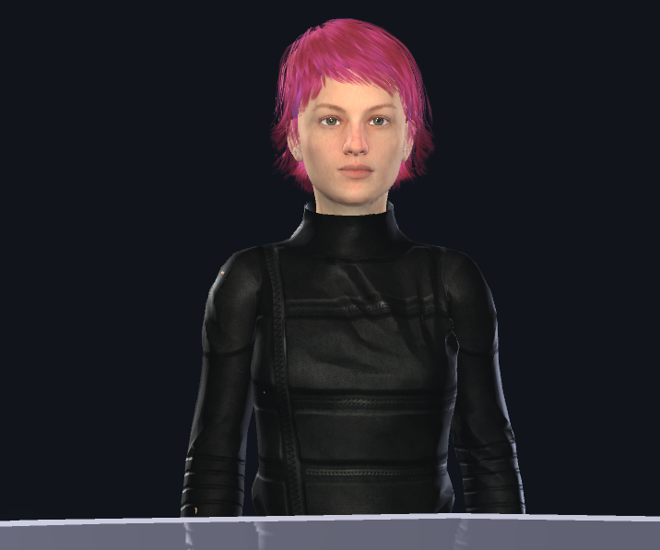
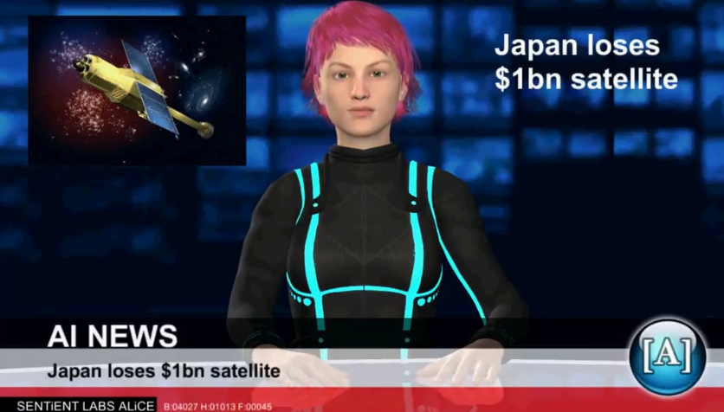
Sentient Live Test Case
AI NEWS NETWORK
Sentient's Q Engine drives live news gathering and semi-automated news report generation.
Our main target is news agencies who want content and see the value in data-generated news, like weather, current affairs reports and earnings reports.
Content is delivered in text, audio (automatically generated with our realistic news reader), or even automatically generated video (an experimental project)
To demonstrate the possibilites of data-drive news we created ALiCE.
ALiCE is the hardest working member of our staff. She tirelessly searches for news, weather, sport, and stock market insight, 24/7.
ALiCE also processes and delivers the news in natural language.
She speaks 5 languages and is emotionally aware of the content of whatever she is reading.
AliCE will soon be joined by AleX, an A.I. with his own opinions about sport and financial markets. Their on-air conversations should be interesting to watch.
AliCE and AleX can run multiple instances simultaneously, creating an unprecedented amount of content in English, French, Spanish, Chinese, and Japanese.

Slide 6

OUR FUTURE
We are expanding our core engine 'Q' to operate in financial markets
Q can offer deep insight into marketing campaigns no human can compete with
Q's image recognition and categorisation component is usable in everything from security, social tagging, even fashion!
AI needs lots of electricity to power servers. We are already working on alternative energy solutions to drive our future scaling needs.

Slide 7
WHY SENTIENT
AI is Tech Heavy.
Sentient is run by tech-centric leadership "Quants" with far-reaching vision and proven business acumen.
Sentient's IP generates autonomous income
We are leading the way in our sector, long tail IP licensing to later startups can generate extra revenue.
We have big ideas and are not afraid to disrupt markets. Our tech is cross-domain, hedging our development strategies.
We convert Tech mumbo jumbo into real world data and AUGMENTED INTELLIGENCE everyone can use

Slide 8
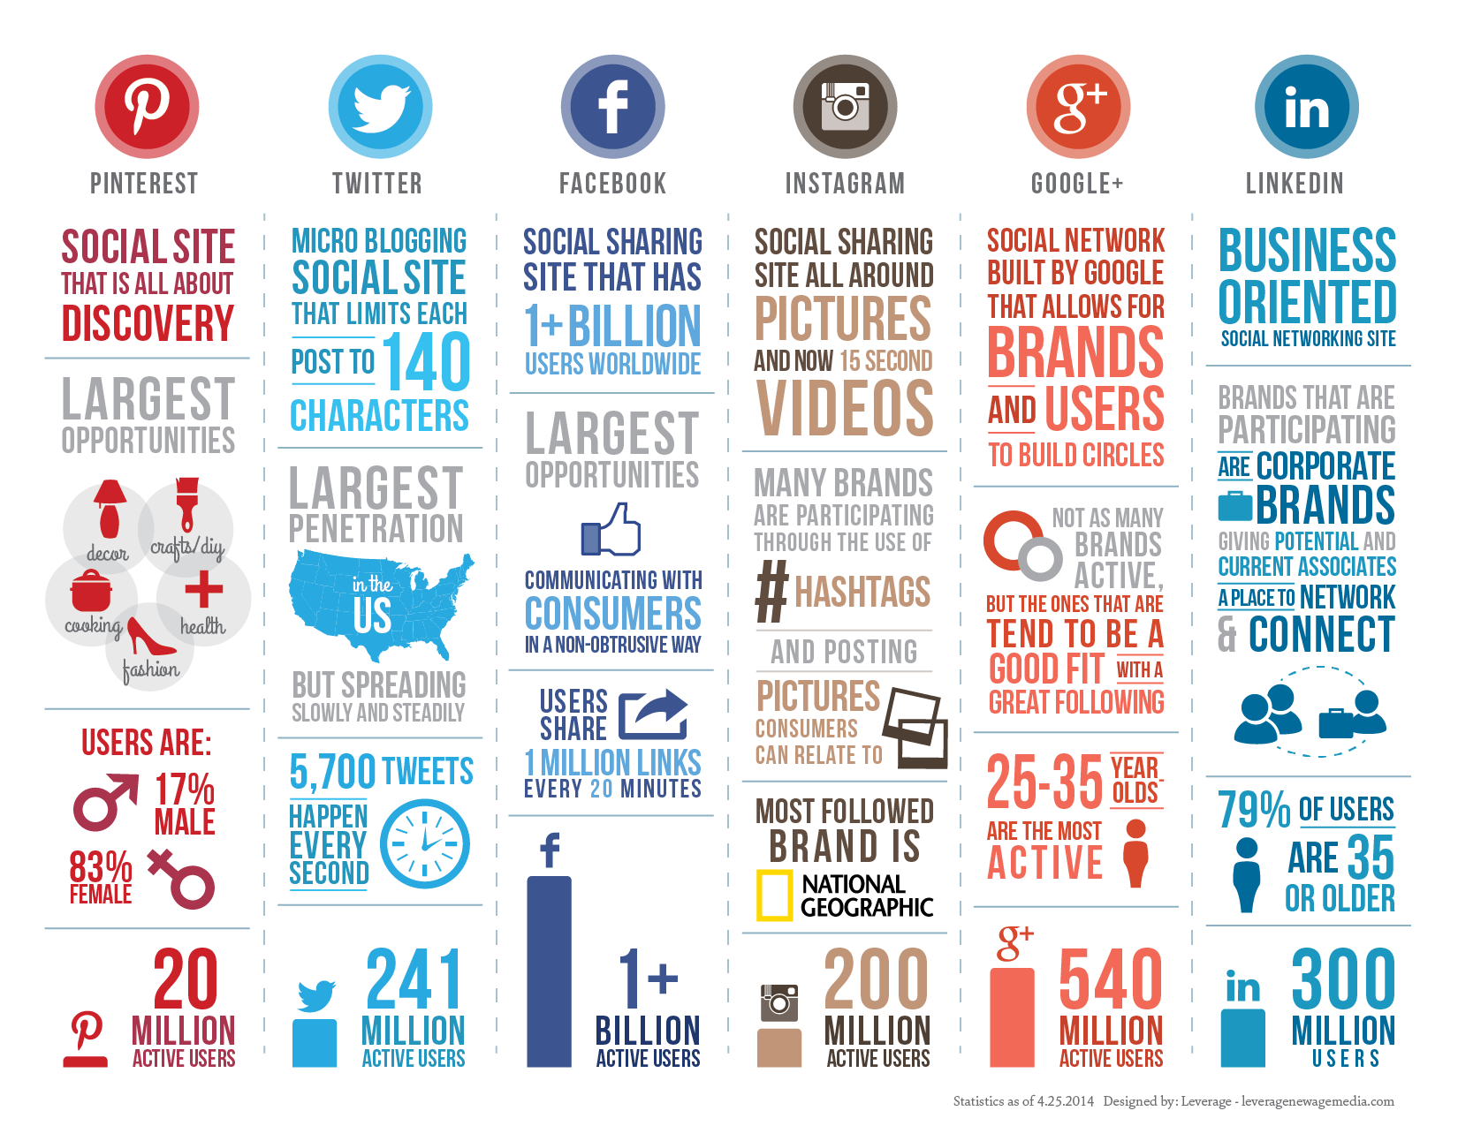
AI TRANSFORMS BIG DATA
INTO QUANTIFIABLE STRATEGY
A major aspect of Sentient's technology stack is big data transformation and filtering, turning mundane lists into human readable, and human enjoyable, content. In a data-rich environment our challenge is to find relevant data and present it in a compelling form, without human interaction.
We transform weather data into weather reports, stock market movements into reports and blog posts, and integrate seamlessly into our client's media pipeline. Our current focus is transforming quantitative news data into high quality, high trust news reports, turning numbers into meaning.
Analysing the data is a natural evolution of the process. Our Data Dragon software can compare books, for example, and give new insight into the emotional content of popular novels compared to classics.
Of course we compare social media brands, information, filtering newsworthy items to bring fresh insight cross-referenced with stock market quotes, trends, news, and even trending memes.

Slide 9
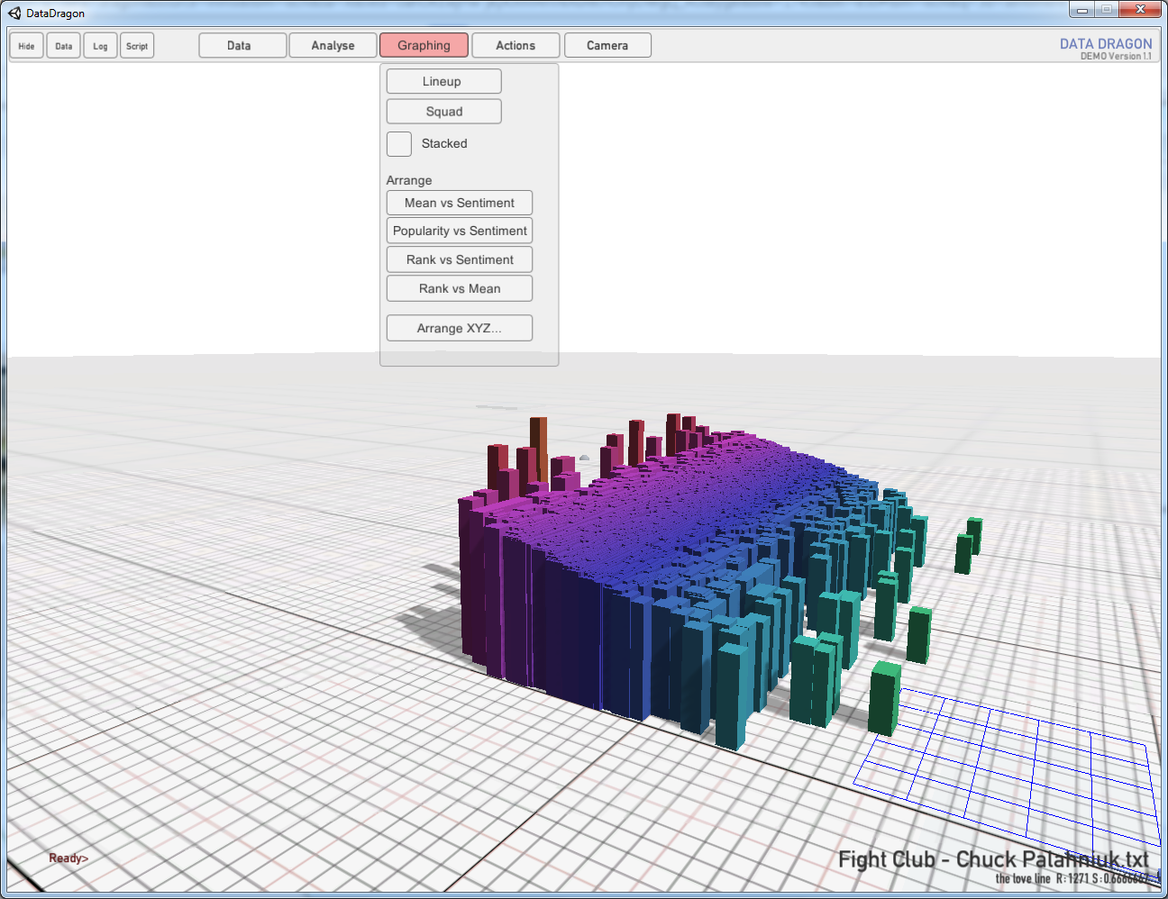
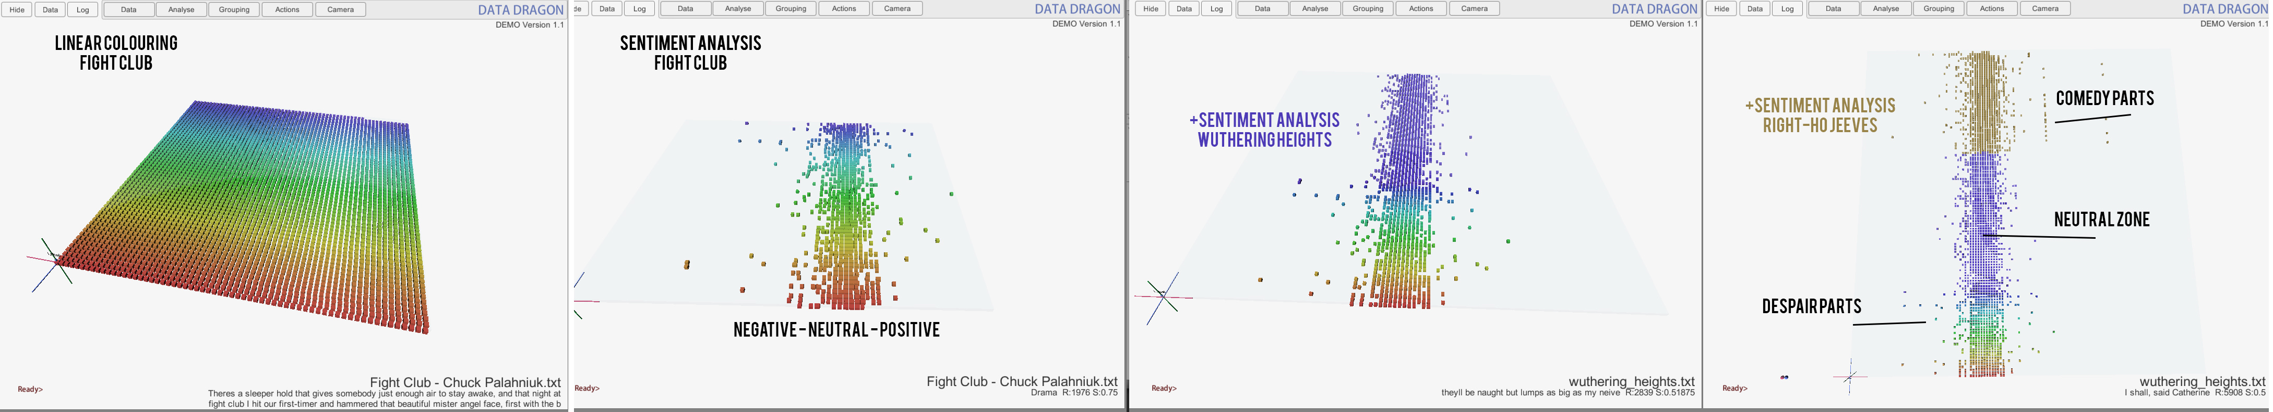
DATA VISUALISATION AND INSTRUMENTATION
SENTiENT LAB's Data Dragon is our Stand-alone sentiment-aware processor for text and social media. The Dragon can also visualize and compare data in 3D, giving unprecedented insight into traditionally obscure data, find outliers and trends.
See at a glance which book or marketing campaign has the strongest emotional content, the most used words and phrases, and cross-reference this information with current trends across social media.
Analyse stock trends and brand opinion by mining sentiment in specific geographic regions to watch the spread of an ad campaign in real time.

Slide 10
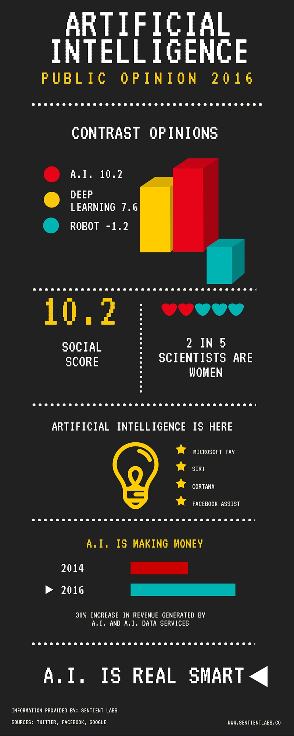
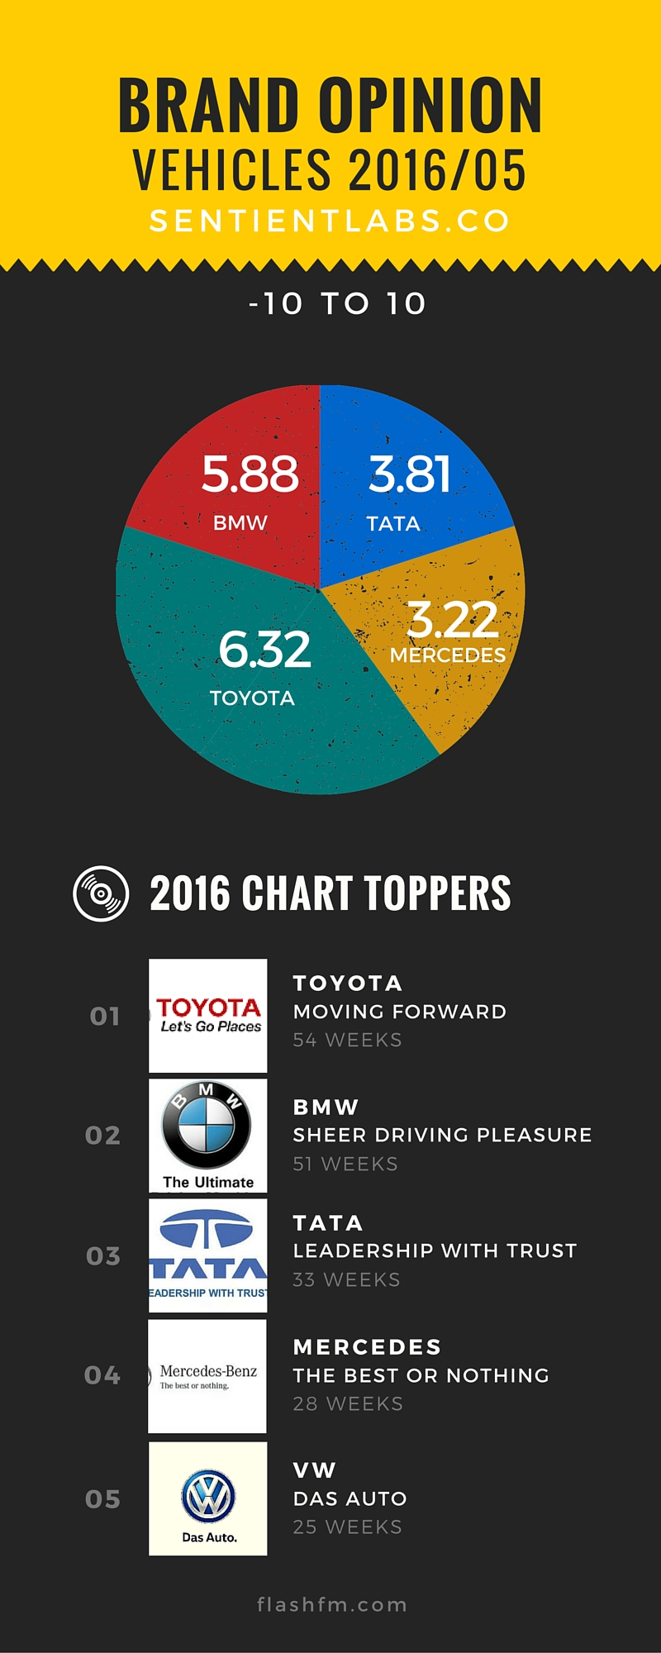
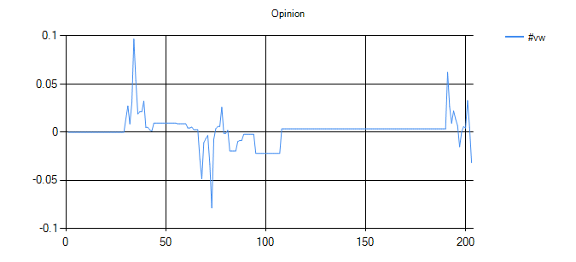
SAMPLE AI
Each customer is assigned a unique AI to manage their portfolio, or campaign
Welcome to Quantify. I am SAM-8, an artificial intelligence assigned to manage your data. Over the next 7 months I will assist you in making better choices.
I am available to you 24/7. I can also generate written reports, graphs, and infographics for your presentations.
Ask me anything in plain English here: sentientlabs.co/ai/sam-8
EMISSIONS
SCANDAL
SENT VW
STOCK PLUMMETING, SHOWS SIGNS OF RECOVERY
On 18 September 2015, the United States Environmental Protection Agency (EPA) issued a notice of violation of the Clean Air Act to German automaker Volkswagen Group after it was found that Volkswagen had intentionally programmed turbocharged direct injection (TDI) diesel engines to activate certain emissions controls only during laboratory emissions testing. The programming caused the vehicles' nitrogen oxide (NOx) output to meet US standards during regulatory testing but emit up to 40 times more NOx in real-world driving.[11] Volkswagen put this programming in about eleven million cars worldwide, and in 500,000 in the United States, during model years 2009 through 2015

Slide 11
SENTiENT LABS started as a Meetup group in 2016, we immediately became excited to join forces and jump-start Africa's AI revolution.
We are working tirelessly to be the first and foremost AI provider to Africa, and to larger markets by 2017.
We are 5 top-of-their-game industry professionals leading the way in this new era of computing and data analysis.
For more information, please visit sentientlabs.co
Contact:
CTO and Software Architect
Karl Lilje, Cape Town
karl@sentientlabs.co
Marketing and Strategy
Chantal Louw, Cape Town
chantal@sentientlabs.co
Software, Networking, Power Management
Adrian Dukhan, Cape Town
adrian@sentientlabs.co
3D and Animation
Lyndon Daniels, Cape Town
lyndon@sentientlabs.co
Writing and Language
Roger Minnaar, Johannesburg
roger@sentientlabs.co

