Slide 1
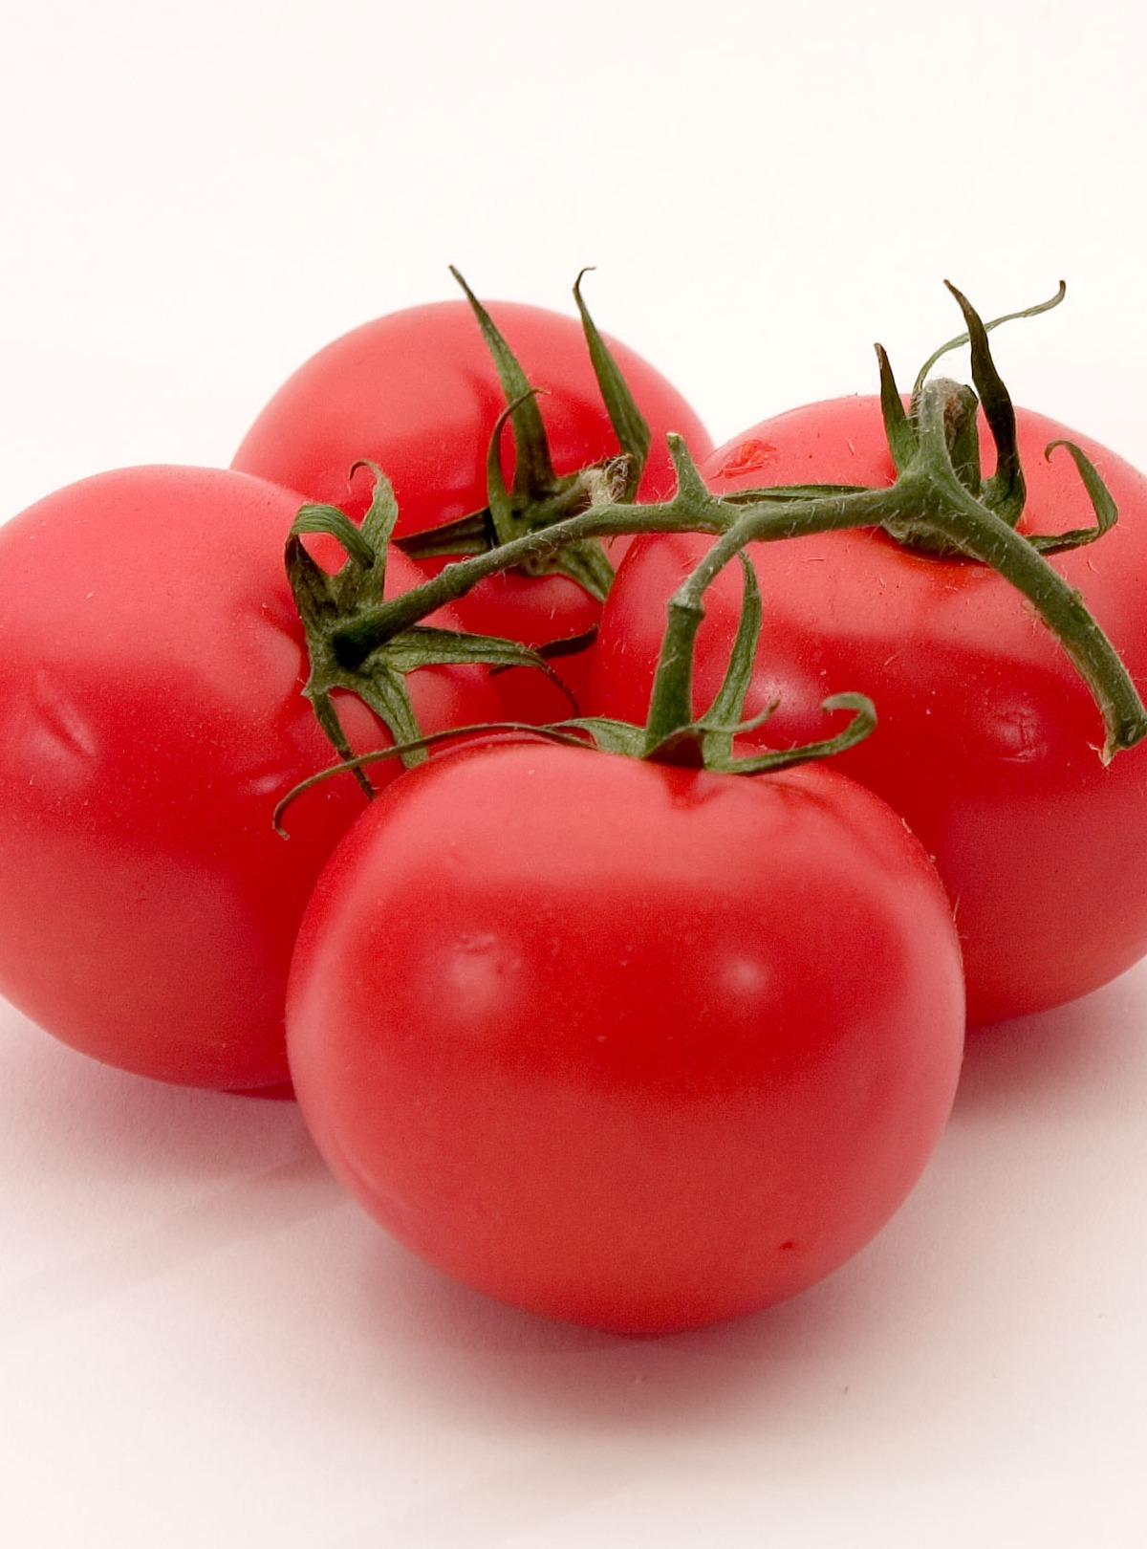
14
TEN MINUTES · THEN PAST WORK
Thorn & Furrow
A live heirloom-seed catalog
on Next.js and Sanity.
Product. Content model. Publish loop.
Next.js · Sanity · Vercel
Notes:
0:00–0:50 · 1 · Title
DO: Deck on the projector: Thorn-and-Furrow-Portfolio.pptx. Catalog open at localhost:3000. Studio logged in on a second screen. Do not demo yet. There is no SaaS slide and no stack slide — say both here.
SAY:
I am presenting a marketing website — not a SaaS product. Next.js is the site. Sanity is the CMS. Vercel is where it deploys. This catalog is Thorn and Furrow. I can open it. Two other live sites come after the close. I will not open their studios.

Slide 2
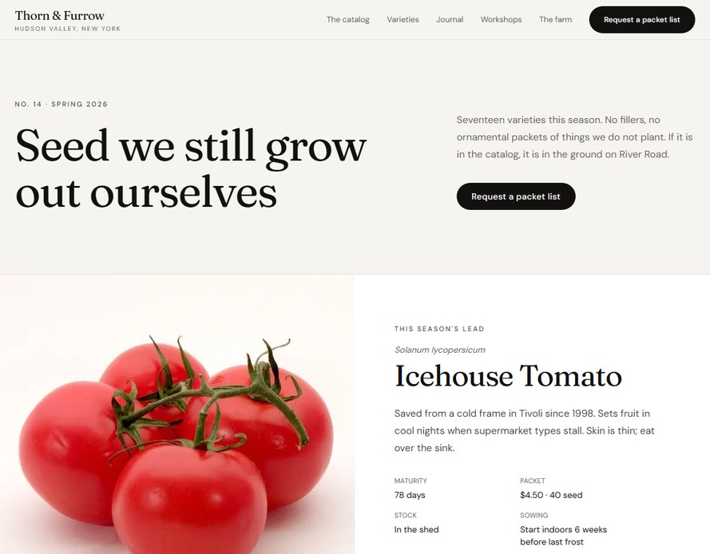
I own the types. They own the catalog.
The farm packs seed March through June. Catalog No. 14 — if a variety is listed, they grow it.
Marketing does not wait on engineering for a new heading or a sold-out packet. Those are fields. I own the types. They own the weekly catalog.
localhost:3000 · live catalog
No. 14
Spring 2026. The season is a document, not a deploy.
17
Packets still grown out. No ornamental fillers.
Mar–Jun
Packed the week they ship. Zone 6a, Tivoli.
Thorn & Furrow
02 / 15
Notes:
0:50–1:30 · 2 · I own the types. They own the catalog.
DO: Stay on this slide. Do not click the site yet. Point at Catalog No. 14 and the live homepage screenshot.
SAY:
The farm packs seed March through June. This season is Catalog Number 14. If a variety is listed, they grow it. Marketing does not wait on engineering for a new heading or a sold-out packet. Those are fields. I own the types. They own the weekly catalog. That is the same contract as any marketing site: structured content, page composition, caching, SEO, and analytics that survive a copy change.

Slide 3
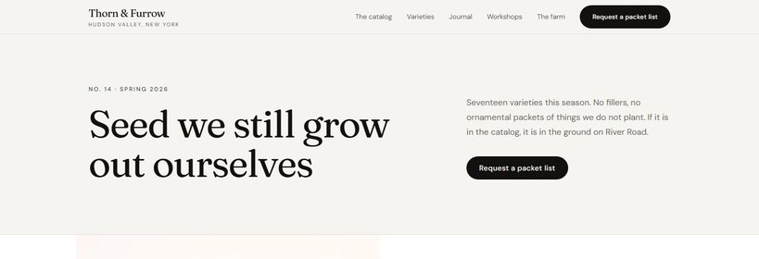
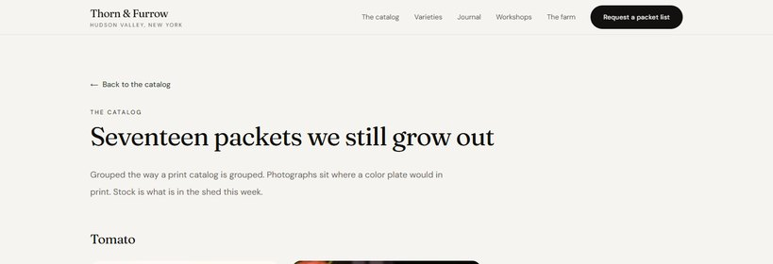
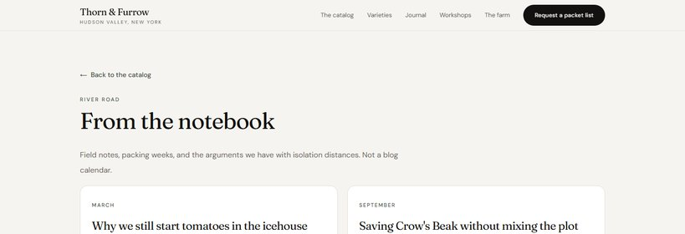
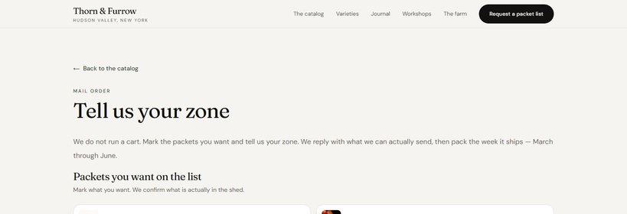
What visitors see
Four public surfaces. Studio lives at /studio and is not linked on the storefront — the catalog should feel live, not like a CMS demo.
01
Homepage
/
02
Catalog
/varieties
Ordered CMS sections: masthead, featured packet, sowing table, spring list.
Seventeen packets grouped by family, the way a print catalog is grouped.
03
Notebook
/journal
04
Mail order
/order
Seasonal field notes. Not a blog calendar.
A letter, not a cart. Mark packets, tell us your zone, we write back.
Thorn & Furrow
03 / 15
Notes:
1:30–2:05 · 3 · What visitors see
DO: Point at the four cards, then glance at the live homepage if it is visible.
SAY:
Visitors land on a homepage composed from Sanity sections — masthead, featured packet, sowing table, the spring list. Varieties is the catalog: seventeen packets grouped by family, the way a print catalog is grouped. Journal is the seasonal notebook. Mail order is a letter, not a cart: mark packets, tell us your zone, we write back. Studio exists at /studio for editors. It is not linked on the public site. The storefront should feel live, not like a CMS demo.

Slide 4
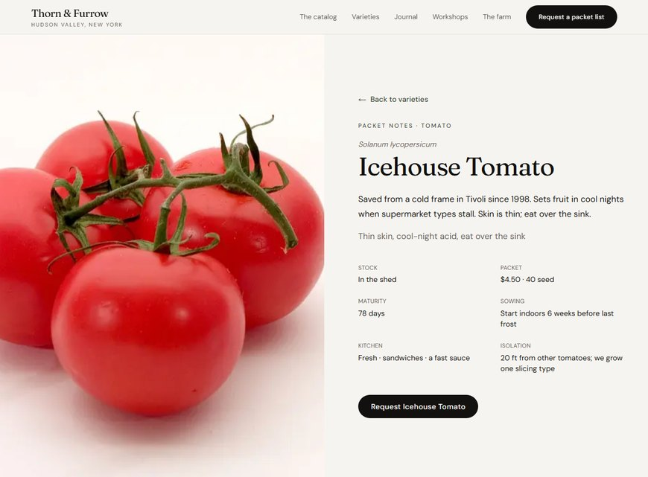
Why this shape
01
Documents
Same Icehouse document — packet page
Icehouse Tomato is one record. Home, the index, the packet page, and the order form all reference it. Change stock once — every surface updates.
/varieties/icehouse-tomato
02
Composition
The homepage is an ordered section array: masthead, featured packet, sowing table, spring list. Editors reorder blocks without a deploy.
03
Editor fields
Stock, packet price, sowing, isolation, photographs. Marketing edits fields. Engineering owns the types.
04
Stable tracking
GTM keys off eventId (hero_order, nav_order), not the words on the button. Copy can change. Measurement does not.
Thorn & Furrow
04 / 15
Notes:
2:05–2:40 · 4 · Why this shape
SAY:
I did not build a hero, a two-by-three feature grid, and a logo wall. That would look like homework. A catalog needs four things a marketing site actually needs. Documents: Icehouse Tomato is one record, reused on home, the index, the packet page, and the order form. Composition: the homepage is an ordered list of blocks. Editors reorder it without a deploy. Editor-safe fields: stock, packet price, sowing, isolation, photographs. Stable tracking: GTM keys off event IDs, not the words on the button.

Slide 5
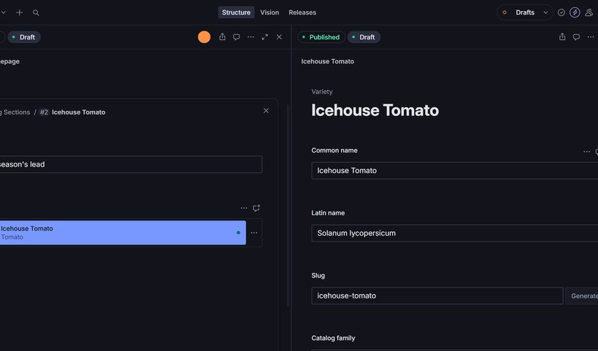
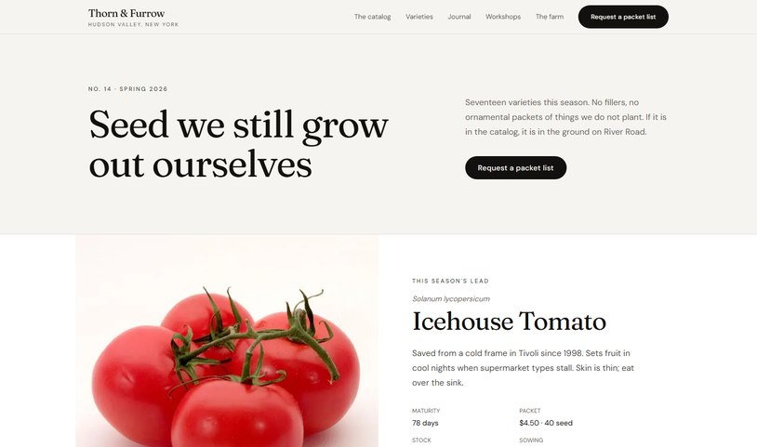
Editor to production
1
Studio
2
GROQ
3
Next.js
4
ISR
5
Catalog
Editor publishes in Studio. Next.js pulls with GROQ. RSC pages. ISR every 60s, plus a signed revalidate API after publish. If Sanity is down, local seed still renders.
Studio · homepage section + Icehouse document
Storefront · the same heading, live
/studio · featured section
/
Thorn & Furrow
05 / 15
Notes:
2:40–3:30 · 5 · Editor to production
DO: Walk the five boxes left to right. Do not open code unless asked.
SAY:
The path is simple. An editor publishes in Sanity Studio. Next.js pulls the page with GROQ through next-sanity. Pages are React Server Components in the App Router. Production uses ISR — pages revalidate about every sixty seconds — plus a signed revalidate API after publish, so we do not wait a full minute. If Sanity is down, a local seed still renders the catalog. That is resilience, and it is also how a demo does not die. Photographs come from Sanity assets, with a local file fallback per slug.

Slide 6
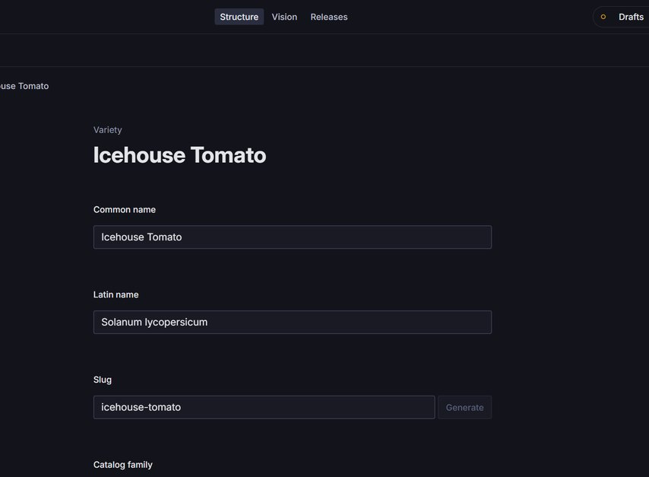
Five documents
Farm settings
Icehouse Tomato open in Studio — common name, latin, slug. Change it once; home, packet page, and order form all follow.
01
Site name, nav, primary CTA, footer, default SEO — the chrome of the catalog.
/studio · Variety document
Catalog homepage
02
SEO plus an ordered section array. Editors compose the front page.
Variety
03
The product object: latin name, family, days, packet, stock, photo, story.
Journal note
04
Season, excerpt, body. Field notes, not a blog calendar.
Workshop
05
Date, place, seats. Seasonal, same desk as the packets.
Thorn & Furrow
06 / 15
Notes:
3:30–4:05 · 6 · Five documents
DO: Name the five documents. Mention the Studio desk is labeled The farm.
SAY:
Five document types. Farm settings: name, nav, primary CTA, footer, default SEO. Catalog homepage: SEO plus an ordered section array. Variety: latin name, family, days, packet, stock, photo, story. That is the product object. Journal note and workshop are seasonal content. The Studio desk is labeled The farm so editors see a catalog, not a generic CMS. Change Icehouse Tomato once. Home, packet page, and order form all update, because they reference the same document.

Slide 7
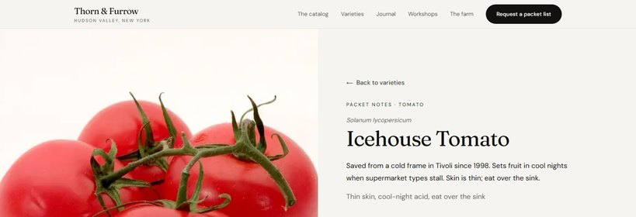
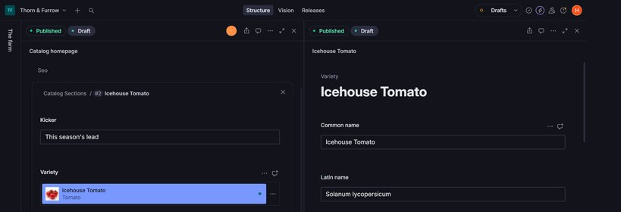
Live demo — this is the talk
Switch to the browser. Four clicks: home, Icehouse, publish a heading, then the CTA event ID.
1
Homepage
2
Packet page
Masthead is a section. Featured packet is a document — not a widget.
Same Icehouse record. App Router, static params, ISR.
3
Publish
4
Tracking
Studio → Catalog homepage → masthead → Publish → reload /.
“Request a packet list” is copy. eventId is the contract.
Thorn & Furrow
07 / 15
Notes:
4:05–6:45 · 7 · Live demo
DO: Switch to the browser. (1) Homepage: masthead, Icehouse feature, sowing table, packet grid. (2) Click Icehouse Tomato. (3) Studio → Catalog homepage → Catalog sections → Catalog masthead → Heading → Publish → reload /. (4) Hover Request a packet list and say the event ID.
SAY:
This is the site. Catalog Number 14, Spring 2026. The masthead is a section. The featured packet is a document — latin name, story, maturity, stock — not a dashboard widget. The sowing table is editorial and dated for zone 6a. The spring list is seventeen references to variety documents. Marketing reorders this list. I own the types. Icehouse Tomato: same document you just saw featured. App Router, static params, ISR. In Studio, Catalog homepage, Catalog sections, Catalog masthead: I change the Heading and publish. Reload. The heading is live. That publish loop is the work. Request a packet list: the label is copy. The contract is eventId — hero_order, nav_order. Copy can change. GTM does not.

Slide 8
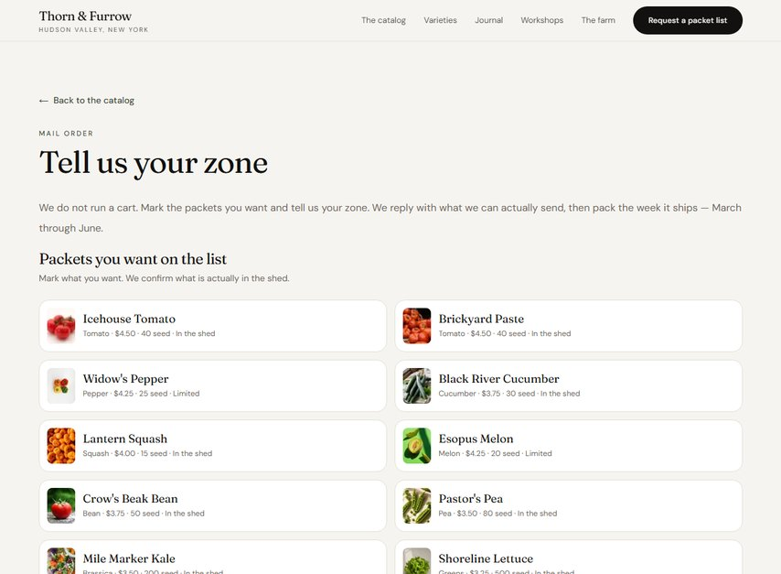
What I would defend
RSC + GROQ
We do not run a cart. Mark packets, tell us your zone, we write back — then pack the week it ships.
01
Pages fetch on the server. Not a client-side CMS call on every view.
/order · eventId on the CTA
References
02
One variety document. Home, packet, and order form share it.
eventId
03
GTM keys off hero_order / nav_order. A rewrite of the button does not break measurement.
ISR + webhook
04
Revalidate about every 60s, or immediately after publish via a signed API.
No cart
05
A qualified packet-list request — a marketing lead, not a fake checkout.
Thorn & Furrow
08 / 15
Notes:
6:45–7:25 · 8 · What I would defend
DO: Back to the deck. If Studio failed, say: seed fallback still rendered the catalog. Skip this slide if you are over time.
SAY:
Five decisions I would make again. Server components and GROQ, not a client-side CMS fetch on every page. References over duplication. Event IDs on every CTA so measurement survives a rewrite. ISR plus a signed revalidate webhook. No cart. The conversion is a qualified packet-list request — closer to a real marketing funnel than a fake checkout.

Slide 9
CLOSE
The catalog is the product.
The CMS is how it changes
without a deploy.
Two more live sites next. Public business only.
Then questions
09 / 15
Notes:
7:25–7:55 · 9 · Close
DO: One line. If they only have ten minutes, stop and take questions. Otherwise go to slide 10.
SAY:
The catalog is the product. The CMS is how it changes without a deploy.

Slide 10
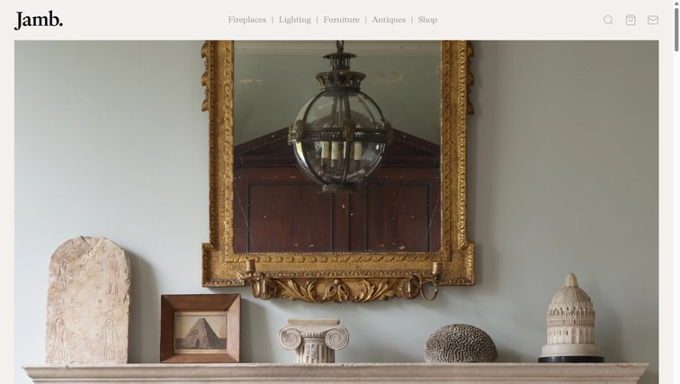

Work I cannot open
Same as an ads business: who buys, what is inventory, how a visit becomes a sale. Then where Sanity sits. No Studio, schemas, or fields.
Jamb · jamb.co.uk
Slingshot Bio · slingshotbio.com
jamb.co.uk · public catalog
slingshotbio.com · public catalog
Pimlico dealer. Designers and collectors. Antiques plus reproductions.
Next: who buys, inventory, the four collections.
Reagents for flow cytometry labs. Cell mimics, not donor cells.
Next: the problem, the product, the shop.
Thorn & Furrow
10 / 15
Notes:
7:55–8:10 · 10 · Work I cannot open
DO: Point at both public homepages. Do not open Studio. Then Jamb, then Slingshot.
SAY:
Same pattern as an ads business: who buys, what is inventory, how a visit becomes a sale. Then where the CMS sits. Jamb is a Pimlico dealer. Slingshot Bio sells reagents to flow cytometry labs. I will not open Studio, schemas, or fields. Public surfaces only.

Slide 11
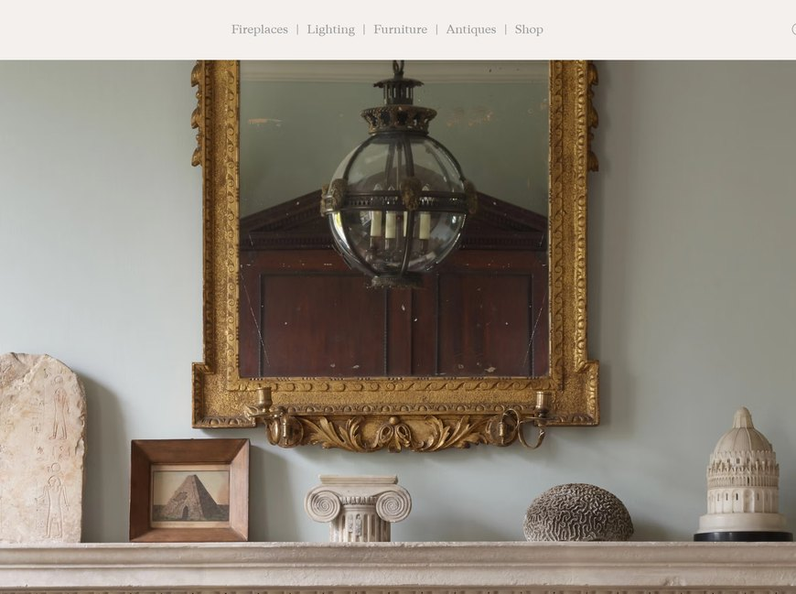
Jamb — who buys, what sells
Who
Public homepage — not Studio
Interior designers, collectors, country-house clients. Flagship on Pimlico Road; showrooms in Los Angeles, Chicago, Dallas, Atlanta, Palm Beach.
jamb.co.uk
Inventory
Unique antiques — chimneypieces, lighting, furniture — and handmade reproductions from the south London workshop, so a design stays available after the antique sells.
Sale
High-ticket, consultative. The site is the catalog for the showroom. A designer specs a piece; enquiry closes it. Not a cart.
CMS
Sanity owns collections and journal stories. Next.js is the storefront. I cannot open the desk.
Thorn & Furrow
11 / 15
Notes:
8:10–8:45 · 11 · Jamb — who buys, what sells
DO: Walk who, inventory, sale. Screenshot is the public homepage. No Studio.
SAY:
Jamb opened on Pimlico Road in 2001. The buyer is an interior designer, a collector, a country-house client — London, then Los Angeles, Chicago, Dallas, Atlanta, Palm Beach. Inventory is two things at once. Unique antiques: chimneypieces from the seventeenth century on, furniture, lighting. And handmade reproductions from the south London workshop, so a design stays available after the antique sells — that is the original business idea. The sale is high-ticket and consultative. A designer specs a piece from the catalog. The showroom closes it. Enquiry, not Amazon checkout. Sanity owns collections and journal stories. Next.js is the storefront.

Slide 12
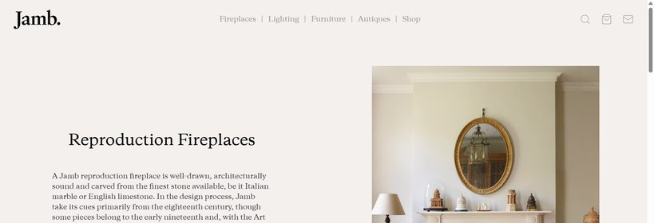
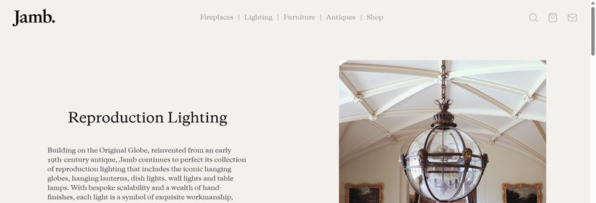
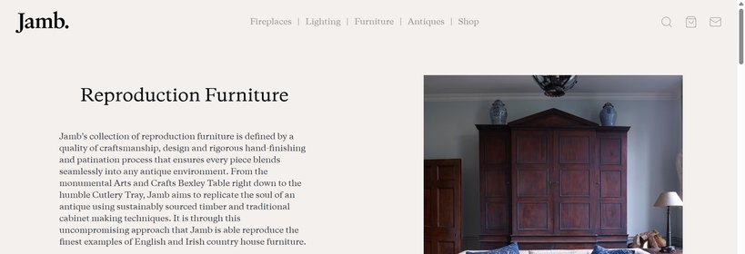
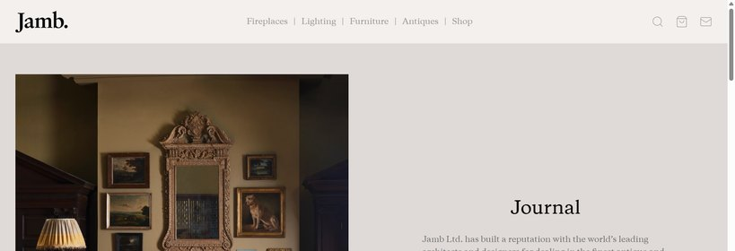
Jamb — four public collections
Same contract as any marketing catalog: collections and stories in the CMS, storefront in Next.js. I will not name schemas or fields.
01
Fireplaces
/fireplaces
02
Lighting
/lighting
Antique chimneypieces and stone or marble reproductions. Bespoke when the room needs a scale that is not in stock.
Hanging globes, lanterns, wall lights. The Original Globe is the story that started the reproduction line.
03
Furniture
/furniture
04
Journal
/journal
English country-house seating and tables — antique and made. Same aesthetic as the chimneypieces.
Stories for architects and designers. Not a blog calendar. Sanity owns the stories.
Thorn & Furrow
12 / 15
Notes:
8:45–9:15 · 12 · Jamb — four public collections
DO: Name the four public collections. Do not invent schemas.
SAY:
Four public surfaces, same contract as any marketing catalog. Fireplaces: antique chimneypieces and stone or marble reproductions, plus a bespoke service. Lighting: hanging globes, lanterns, wall lights — the Original Globe is the story that started the reproduction line. Furniture: English country-house seating and tables, antique and made. Journal: stories for architects and designers, not a blog calendar. Editors change stock and stories. Engineering owns the types.

Slide 13
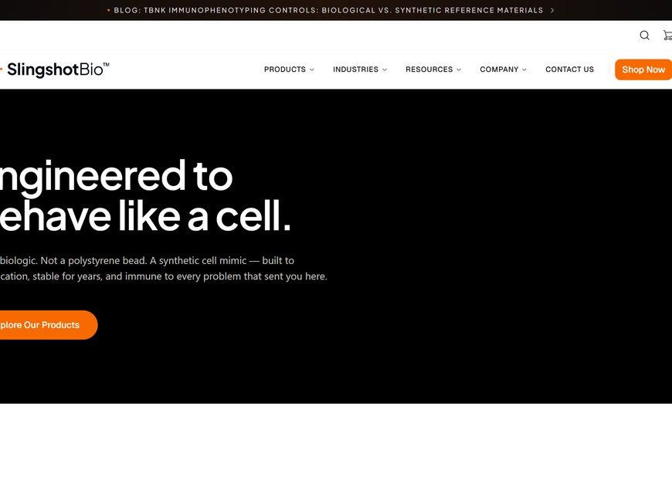
Slingshot — the control problem
Who
How Mimics Work — public argument
Flow cytometry labs: biopharma, CROs, academic cores, cell therapy, instrument makers.
slingshotbio.com/how-mimics-work
Problem
Donor cells expire and drift lot to lot. Polystyrene beads have the wrong scatter. The control is the weak point in the assay.
Product
Shelf-stable synthetic cell mimics — polymer particles that scatter, fluoresce, and stain like real cells. Catalog SKUs plus custom mimics.
Sale
A scientist finds a control, reads a protocol, orders a reagent. Repeat purchases. Sanity owns product and resource documents.
Thorn & Furrow
13 / 15
Notes:
9:15–9:50 · 13 · Slingshot — the control problem
DO: Walk the problem, then the product, then who pays. Screenshot is How Mimics Work. No Studio.
SAY:
Slingshot Bio sells to flow cytometry labs: biopharma, CROs, academic cores, cell therapy, instrument makers. The problem is the control. Donor cells expire and drift lot to lot. Polystyrene beads have the wrong scatter. They sell shelf-stable synthetic cell mimics — polymer particles engineered to scatter, fluoresce, and stain like real cells. Compensation, unmixing, viability, immunophenotyping, instrument setup. Catalog SKUs plus custom mimics on request. A scientist finds a control, reads a protocol, orders a reagent. Repeat purchases. Sanity owns product and resource documents. Next.js is the catalog and shop.

Slide 14

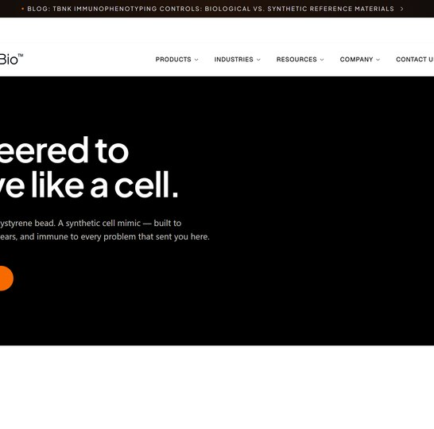
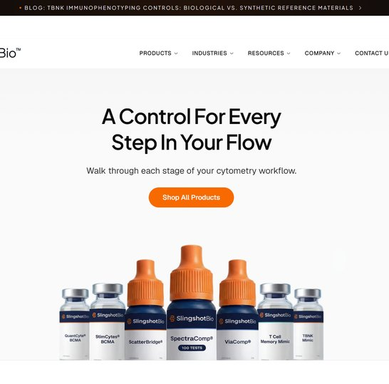
Slingshot — catalog, argument, shop
Public surfaces only. Products and resources live in Sanity. Next.js is the catalog and shop. I will not open Studio.
01
Homepage
02
Argument
03
Shop
/ · Catalog of controls: compensation, unmixing, viability, immunophenotyping.
/how-mimics-work · Not a biologic. Not a bead. The page that sells the category.
/shop · SKUs by purpose, then a cart. Custom mimics on request. Repeat reagent purchases.
Thorn & Furrow
14 / 15
Notes:
9:50–10:20 · 14 · Slingshot — catalog, argument, shop
DO: Home, how it works, shop. Name public surfaces only.
SAY:
Three public surfaces. Homepage is the catalog of controls. How Mimics Work is the argument: not a biologic, not a bead. Shop is the conversion: SKUs grouped by purpose — unmixing, immunophenotyping, CAR-T, custom — then a cart. Resources sit beside the shop: application notes, data sheets, protocols. That is the education that sells a reagent. Same rule: I cannot open the desk.

Slide 15
STOP
I cannot open those desks.
This catalog I can.
Schema, caching, and the order form — here, on Thorn & Furrow.
Questions
15 / 15
Notes:
10:20–10:35 · 15 · Stop
DO: Stop. Invite questions on Thorn and Furrow, not on those studios.
SAY:
I cannot open those desks. This catalog I can. Happy to go into schema, caching, or the order form — here.

