Slide 1
CONTOSO GROUP
Data and AI Analytics KPI Overview
June 2026 Data

Slide 2
Read Me
Data scope, freshness, and update rhythm
This dashboard combines multiple data sources with different reporting cycles. Please consider the source date and update frequency when interpreting KPI results.
People data
Databricks data
Data & AI data
PlanTrack data
Employee numbers
Databricks trainings
Data & AI Community
PlanTrack trainings
Current basis: 2025 Q4
Current data until 2026.06
Current data until 2026.06
Shows completions only
Will be updated once new employee data is available.
Sourced from Beacon and the Group Portal. Training figures include registrations.
Sourced from Beacon and the Group Portal. Community figures include registrations.
Completion data will be received on a quarterly basis.
Update: when new data is released
Update: monthly
Update: monthly
Update: quarterly
Important interpretation notes
Some views show Teams listings / current members, while others show registrations for Community or Databricks trainings. These numbers can differ when people leave a community, duplicate entries are cleaned, or registrations do not equal active membership.
Source refresh
Not all KPIs may reflect the exact same reporting period because source systems are refreshed at different intervals.
Teams members vs. registrations
Contoso Group · demo data

Slide 3

Activating Data & AI communities
at scale
Connect Channel
general
  Data & AI Community reached 766 members from 30 companies across 22 countries​
  Lakehouse Guild launched to enable platform use
  4 community events delivered, each engaging 185–238 participants across the Group​
Data & AI Community
Databricks
Guild
AI Governance
Guild
Data Governance Guild
specifc
Coming soon
Use Case Working Groups
AI Responsible Person Network
Contoso Group · demo data

Slide 4
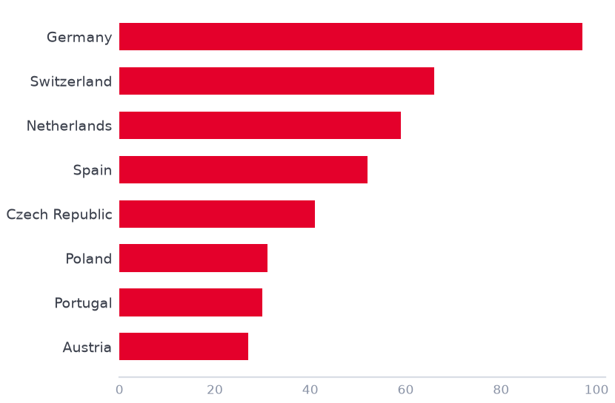
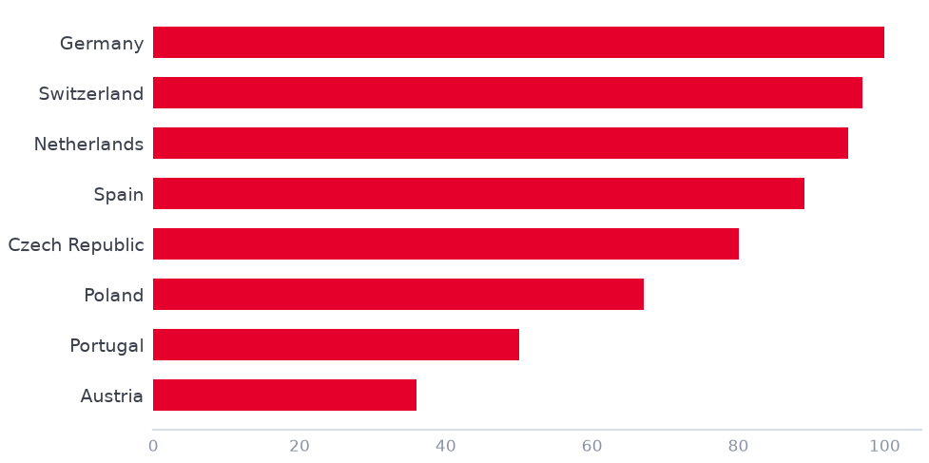
Demo data
Learning continues to grow across countries
Growth is accelerating across the Group
Learning By Country
Learning By Module
8
160
Enrolled
In Progress
Strong engagement creates a solid base to expand learning further.
4
Contoso template
Contoso Group · demo data

Slide 5
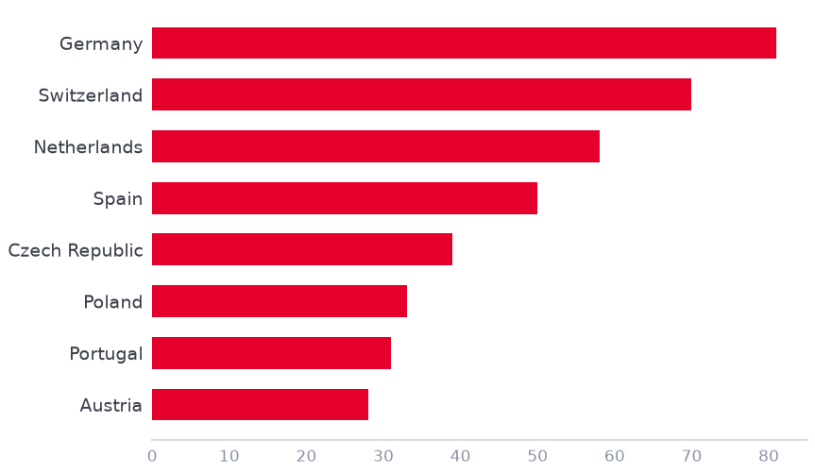
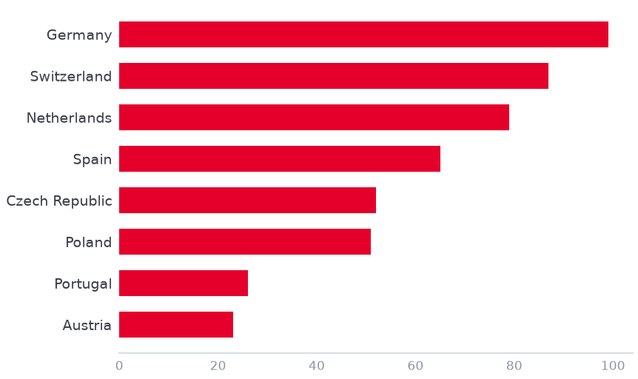
Demo data
Learning continues to grow across countries
Employee engagement by country and learning module
Learning By Country
Learning By Module
8
192
Enrolled
In Progress
Strong engagement creates a solid base to expand learning further.
5
Contoso template
Contoso Group · demo data

Slide 6
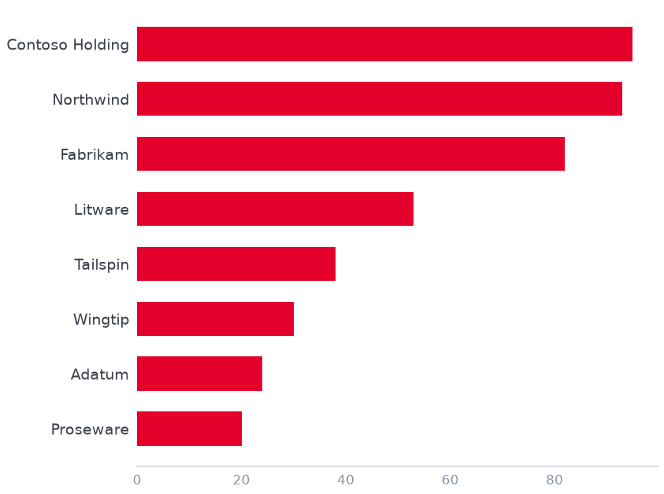

Demo data
Databricks Trainings Across the Group
Shows that interest is converting into completed learning
139
Completions By Company
participants
24
companies involved
8
countries involved
Ignite & Learn levels completions across 24 companies show scalable Data & AI capability building.
6
Contoso template
Contoso Group · demo data

Slide 7
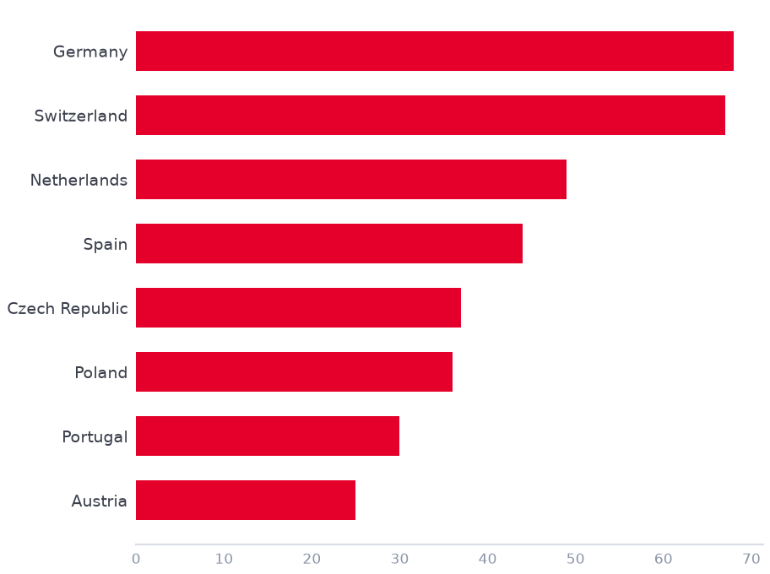
Demo data
Databricks Trainings Across the Group
Current status of learning, adoption, and company participation
Ignite
Learn
Mapping of Databricks Training Completions
46
97
participants
participants
10
11
countries
countries
23
19
companies
companies
Databricks learning has established a Group-wide presence
7
Contoso template
Contoso Group · demo data

Slide 8
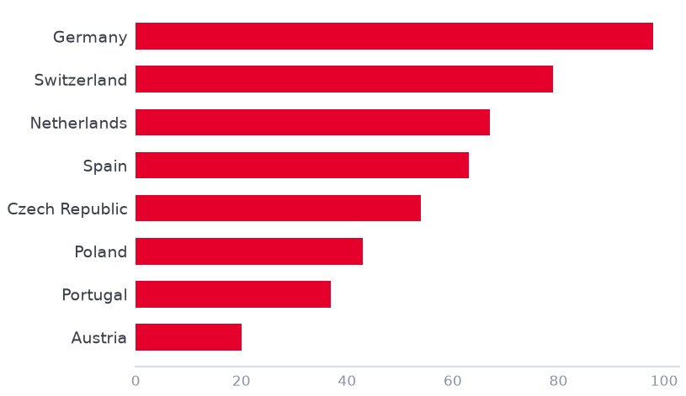
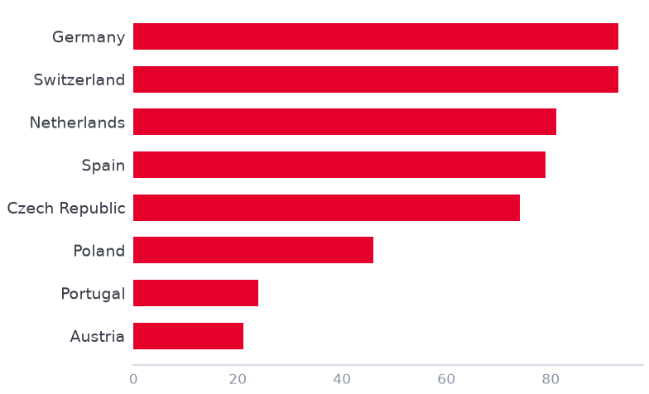
Demo data
Databricks Training and Community Engagement
Country Overview
154
0.49%
0.53%
Lakehouse Guild Members
Training Coverage
(of Group Headcount)
Guild Members
(of Group Headcount)
Training Participation % by Country (vs HC)
Lakehouse Guild Participation % by Country (vs HC)
Lakehouse Guild = Teams community
Guild members are the current Teams member listing for the Databricks community.
This is different from training registrations or completions.
Community engagement is translating into completed learning across the Group.
8
Contoso template
Contoso Group · demo data

Slide 9
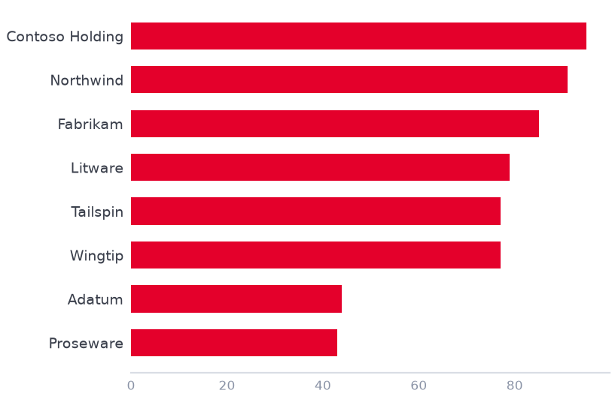
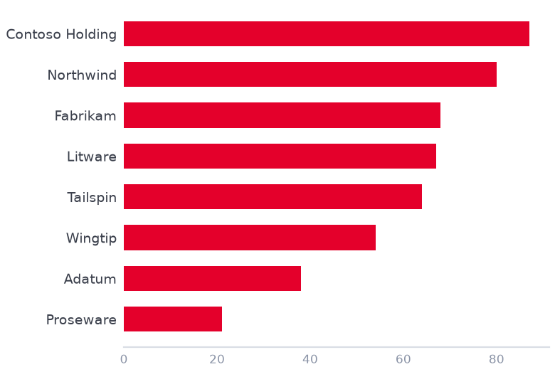
Demo data
Databricks Training and Community Engagement
Company Overview
249
0.39%
0.46%
Lakehouse Guild Members
Training Coverage
(of Group Headcount)
Guild Members
(of Group Headcount)
Training Participation % by Company (vs HC)
Lakehouse Guild Participation % by Company (vs HC)
Lakehouse Guild = Teams community
Guild members are the current Teams member listing for the Databricks community.
This is different from training registrations or completions.
Adoption is progressing across the Group, with several companies leading both training participation and community engagement.
9
Contoso template
Contoso Group · demo data

Slide 10
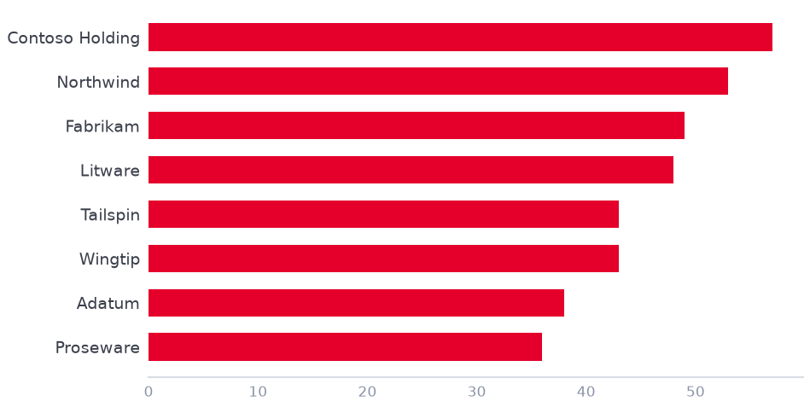
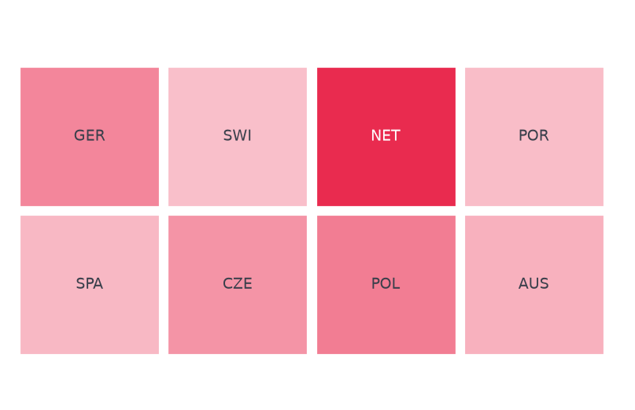

Group-Wide Data & AI Community connects colleagues across entities
1156
66
19
Total registrations
Companies Represented
Countries Represented
Community Geographic Footprint
Top Entities In Community
Germany is the strongest base, while participation already extends across the European region and multiple Group companies
10
Data & AI @ Contoso
Contoso Group · demo data

Slide 11
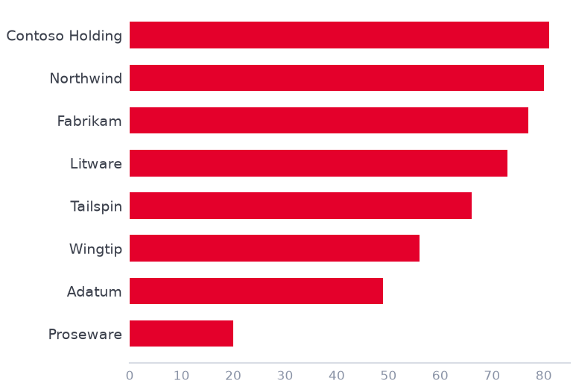
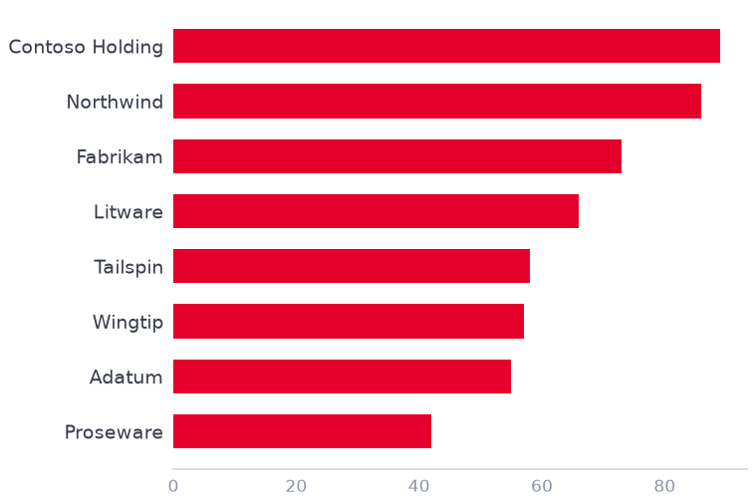
Data & AI Community Overview - Company
Total registrations
TEAMS members
Countries
Companies
Top registration reach
Top TEAMS reach
569
799
22 / 15
70 / 66
Contoso Holding
Contoso Holding
Registration list
Current Teams listing
Registrations / TEAMS
Registrations / TEAMS
33.78% of country HC
79.5% of country HC
Top Registrations Reach % by Company
Top TEAMS Members Reach % by Company
Registrations show how many people registered for the Data & AI Community. TEAMS members show the current member listing. The numbers can differ if people leave, duplicates are cleaned, or registrations are not active members.
11
Data & AI @ Contoso
Contoso Group · demo data

Slide 12
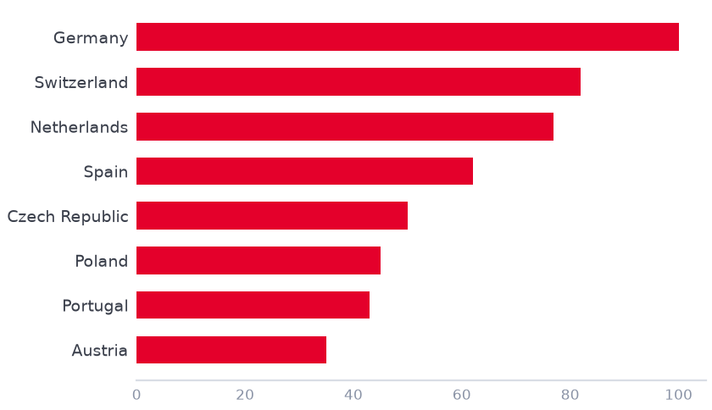
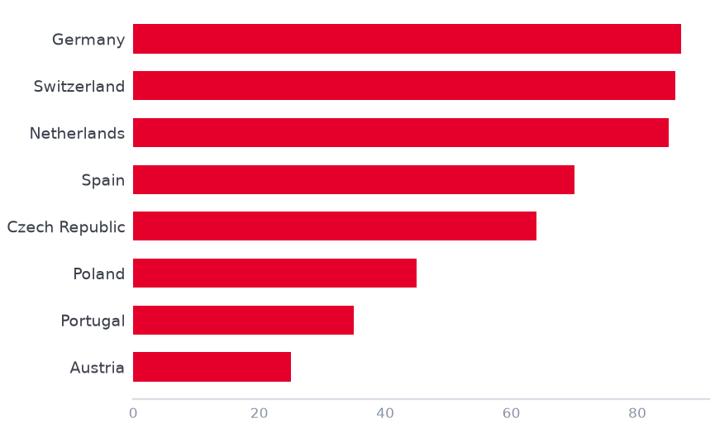
Data & AI Community Overview - Country
Total registrations
TEAMS members
Countries
Companies
Top registration reach
Top TEAMS reach
590
993
13 / 30
80 / 54
Germany
Germany
Registration list
Current Teams listing
Registrations / TEAMS
Registrations / TEAMS
9.64% of country HC
8.39% of country HC
Top Registrations Reach % by Country
Top TEAMS Members Reach % by Country
Registrations show how many people registered for the Data & AI Community. TEAMS members show the current member listing. The numbers can differ if people leave, duplicates are cleaned, or registrations are not active members.
12
Data & AI @ Contoso
Contoso Group · demo data

Slide 13
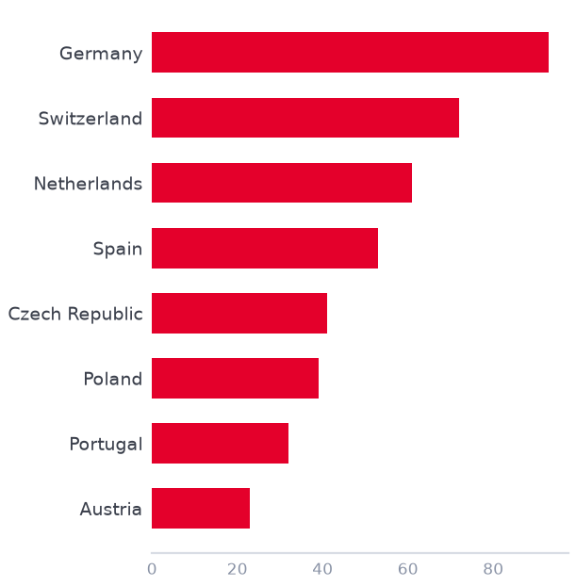
Demo data
AI demand is broad, practical and business-driven
Interest spans general AI awareness, business use cases, automation and analytics
Interest Distribution
29.36% General AI Interest — strong demand for awareness and orientation
Business use cases
Automation & efficiency
Analytics & BI
GenAI & LLMs
Demand is not purely technical — it is coming from business functions looking for practical value.
Position the community as a bridge between AI awareness, business value and hands-on enablement.
13
Contoso template
Contoso Group · demo data

Slide 14
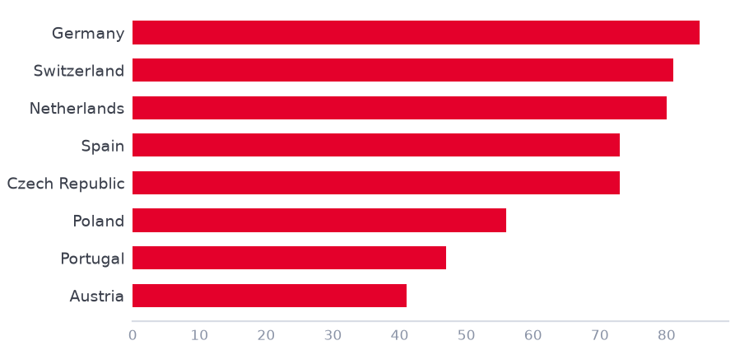
Data & AI Community Events
Strong engagement across four Data & AI community events
4
1.45K
722
11
Events
Total participants
Unique participants
Speakers
Focus on strategy, governance, academy, platform, and AI use cases
Showcased practical use cases: Fraud Detection, Underwriting Assistant, Sales Call Assistant, Contract Review Tool, Data Wiki
Included speakers from Contoso, LITWARE, WOODGROVE, ADATUM, and Databricks
Participants per event
Community Events Topics
Consistent event engagement shows that Data & AI topics are relevant beyond group
14
Data & AI @ Contoso
Contoso Group · demo data

Slide 15
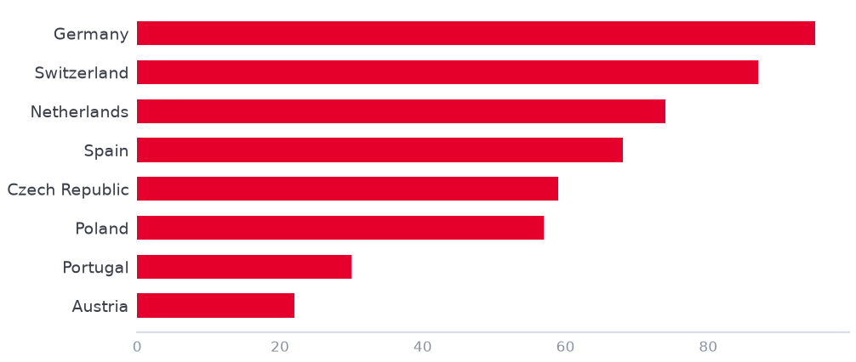
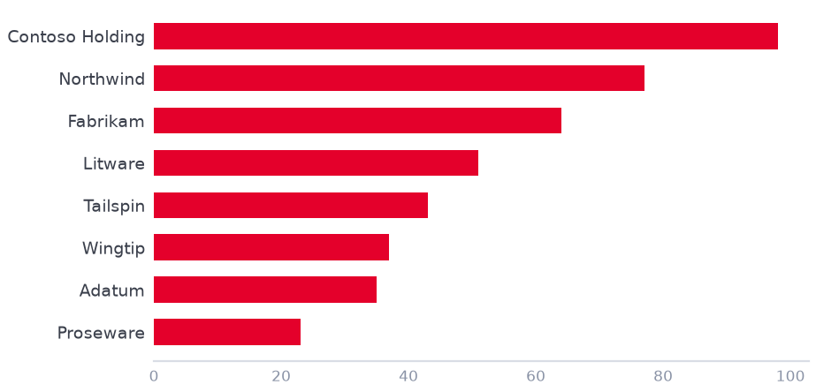
Data & AI Events Participation Overview
Shown as % of total headcount to compare reach across countries and companies
Country leader
Company leader
Overall Rate
Germany
Contoso Holding
2.20%
11.34% participation
64.89% participation
Of total employee participation
Participation % of Total Headcount by Country
Top Companies by Participation %
Broad participation demonstrates strong interest in Data & AI events.
15
Data & AI @ Contoso
Contoso Group · demo data

Slide 16
Cross-Participation Across Learning
Cross participation and capability development across the Group
Contoso Group · demo data

Slide 17
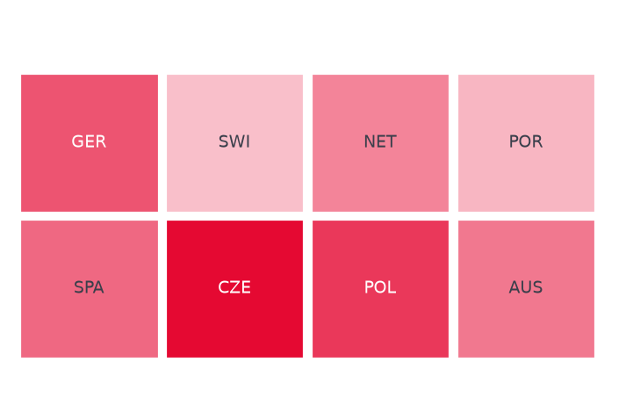
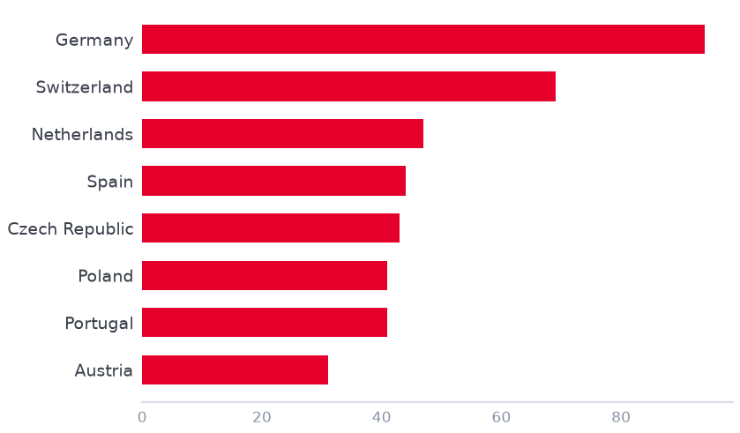
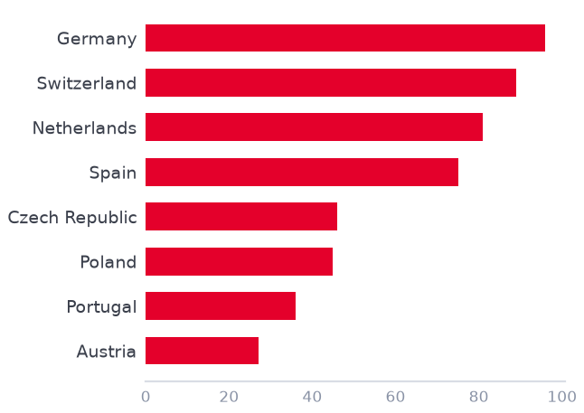
Data & AI Program Reach Overview
Combined participation across Data & AI learning and community initiatives
Demo data
18
29.6%
58
3.1%
Involved Countries
Cross Paritcipation Rate
Involved Companies
Overall % of Group Headcount
Country Headcount % – All Programs (Map)
Top 5 Countries – Cross-Programs Reach
Top 5 Companies – Cross-Program Reach
Cross-program view combining 5 programs: Data & AI Literacy (Beacont/ITP/PlanTrack), Databricks Completions, Lakehouse Guild, and Data & AI Community
17
Data & AI @ Contoso
Contoso Group · demo data

Slide 18
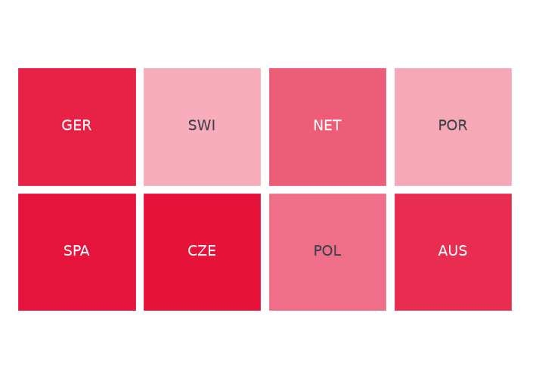
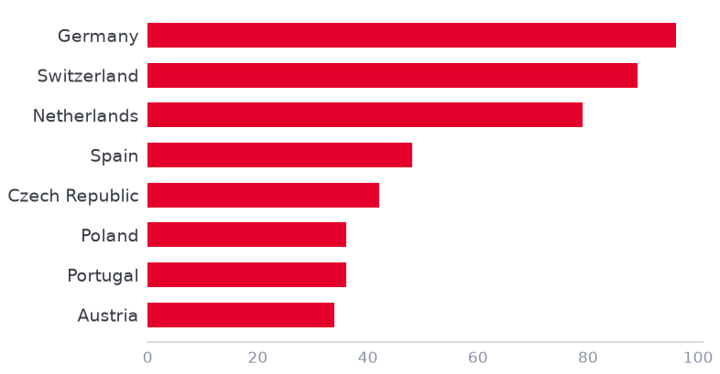
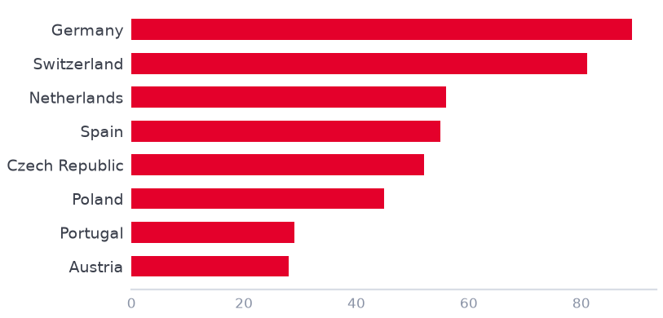
Demo data
Data & AI Program Training Overview
Combined participation across Data & AI and Databricks learning
12
39.4%
10
1.3%
Companies with Dual Participation
Dual Participation Rate
Countries with Dual Participation
Overall % of Group Headcount
Country Headcount % – Cross-Program Training
Top 5 Countries – Cross-Program Reach
(Data Literacy + Databricks Training)
Top 5 Companies – Cross-Program Reach
(Data Literacy + Databricks Training)
Employees participated in both Data Literacy programs (Beacont/ITP/PlanTrack) and completed Databricks training — showing breadth of engagement across Contoso's data upskilling initiatives.
18
Data & AI @ Contoso
Contoso Group · demo data

Slide 19
PlanTrack Appendix
Group License Usage Across the Group
Demo data
Contoso Group · demo data

Slide 20
Read Me
License Utilization
Demo data
This view explains how license utilization is calculated and what to consider before comparing entities. The exact numbers and rankings are shown on thedetailed utilization slides
License Base
Completion Data
Utilization KPI
Detailed View
Active licenses
Course completions
Usage ratio
Entity-level split
Denominator
Numerator
Total available PlanTrack licenses assigned to the entity or group. Used as the base for the utilization calculation.
Recorded Data & AI course completions. Completion counts can be split more granularly than the license base.
Calculation logic
Granular perspective
Utilization shows the share of assigned licenses that resulted in a recorded Data & AI course completion.
Sub-entities are shown separately where available, so per-country views may differ from grouped license ownership.
Base: active licenses
Metric: completions
Formula: completions ÷ licenses
Use: interpret trends carefully
Important data limitations
NL / PT / ES share one grouped license count, while course completions are reported separately by country.
Only a general Adatum entry is available; the data does not distinguish Property separately.
Some users have no assigned company. Known cases include Proseware (DE), Lucerne Life (TR), and a few non-insurance users without an admin.
Woodgrove Benelux
Adatum
NULL companies
Reading the detailed chart: Utilization % = Course Completions ÷ Active Licenses × 129. Companies with 0% have licenses assigned but no recorded completions. More detailed mapping is currently unavailable.
20
Data & AI @ Contoso
Contoso Group · demo data

Slide 21
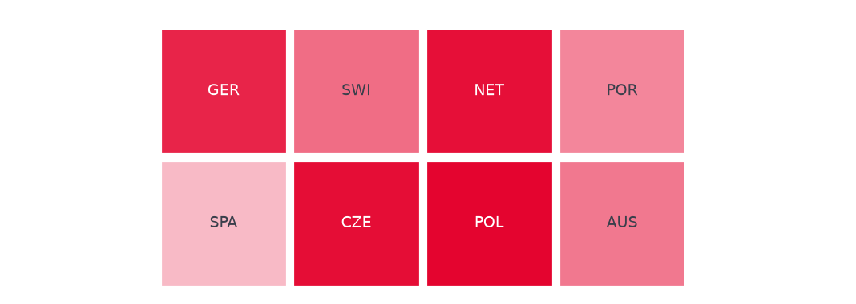
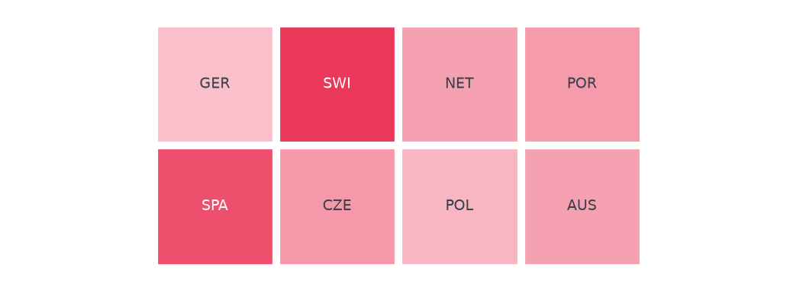
Demo data
License Utilization & Engagement
How effectively entities convert licenses into training activity
2065
108
31
39
Total Active Licenses
Total Completions
Utilization %
Companies With Licenses
License Utilization by Company (Grouped)
License Utilization by Company (Detailed)
21
Data & AI @ Contoso
Contoso Group · demo data

Slide 22
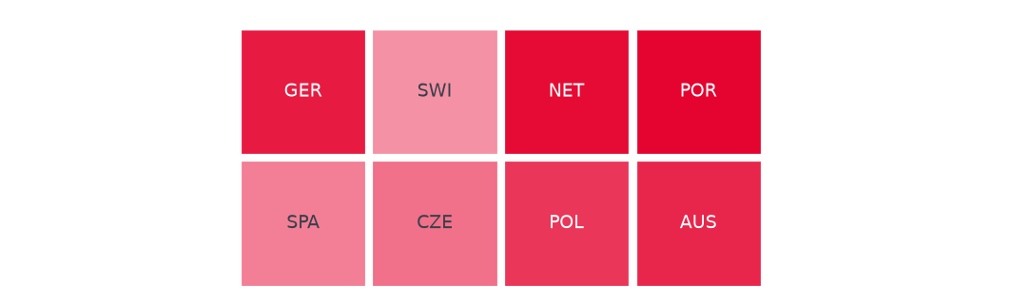
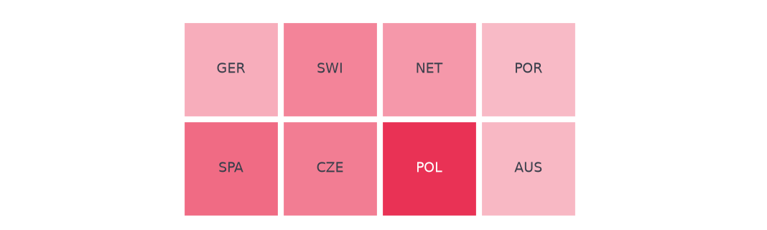
Demo data
License Allocation & Coverage
Active license pool distribution across entities and countries
17
19
56
568
Companies with 0 Completions
Companies with Completions
Avg License Per Company
Largest License Pool
Active Licenses by Company
Active Licenses by Country
22
Data & AI @ Contoso
Contoso Group · demo data

Slide 23
Key Findings
Demo data
The story is not one simple ranking. Licenses are concentrated in large pools, while meaningful learning activity is driven by fewer engaged entities. Read utilization together with license pool size, other learning channels such as Beacon, and data-quality gaps.
🎯
License concentration is extreme
⚡
Utilization paradox: small = active
🏆
Fabrikam is the scalable champion
Top-heavy seat allocation
High rates can come from tiny pools
One entity drives the program
54% in top 3
64% with 6 seats
31 of 137 completions
Contoso DE, Northwind DE and Fabrikam ES hold 54% of all licenses. Germany alone accounts for 492 active PlanTrack seats — 38% of the total pool.
Litware PL leads by percentage, but from a very small base. The top 5 by utilization average only around 64 licenses each.
Fabrikam combines scale and activity: 235 licenses, 31 completions, 23 unique learners and 30.5% utilization. Without Fabrikam, utilization drops to 4.2%.
⏸
Half the companies show zero activity
🔍
Ghost completions need follow-up
🌍
Geographic disparity is visible
Large pools still need activation
Completion exists without license match
Country-level adoption differs sharply
13 of 38 at 0%
5 entities
ES 30.5% vs PL 0%
Zero-completion entities include Tailspin CZ, Contoso IT DE, Wingtip PL and Adatum PL. Czech Republic shows 182 licenses and 0 completions.
Contoso PL, Contoso Armenia AM, Proseware DE, Woodgrove NL and Margie PT show completions with 0 mapped licenses, suggesting admin-data gaps.
Spain reaches 30.5% utilization. Germany has the largest PlanTrack pool but learners may also train via Beacon / other channels, so read PlanTrack utilization as one signal only. Poland has 171 licenses and no recorded completions.
23
Data & AI @ Contoso
Contoso Group · demo data

Slide 24

Upcoming Event
Contoso Group · demo data

Slide 25
Demo data
Links for Internal Databricks Sources
Dashboards
Data and AI Community
Learnings/Trainings
Community Events
Databricks Trainings and Community
Genie Space – Ask Questions
Analytics Genie Space
Access to these links is restricted to the Analytics Team only
25
Data & AI @ Contoso
Contoso Group · demo data

