Slide 1
Analytics KPI Overview
Fictional demo deck — Contoso Group
June 2026 Data

Slide 2
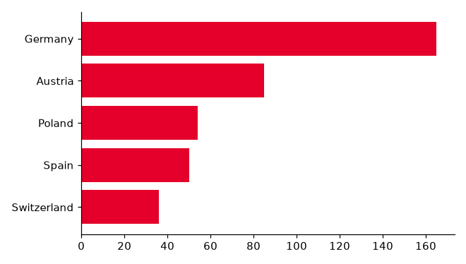
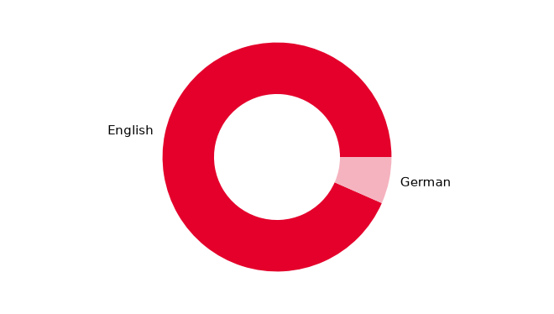
Analytics Academy
Total learners
Countries
Companies
100
5
9

Slide 3
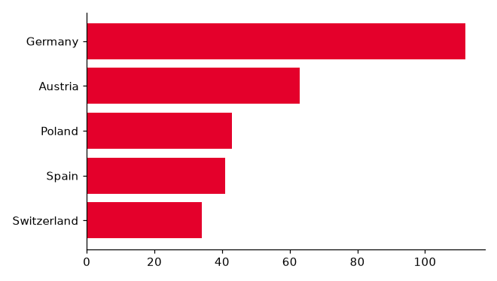
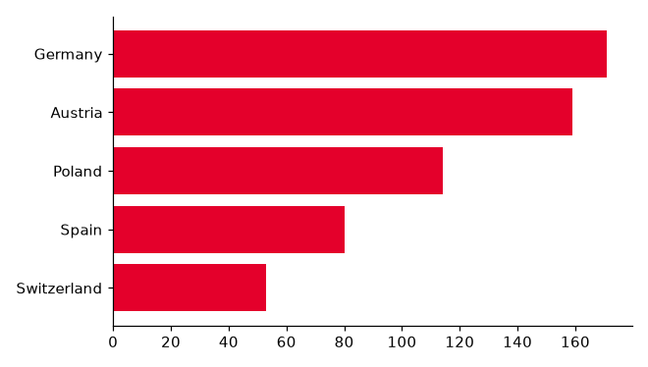
Databricks Trainings and Lakehouse Guild
Training participants
Guild members
Training coverage
110
120
0.30%

Slide 4
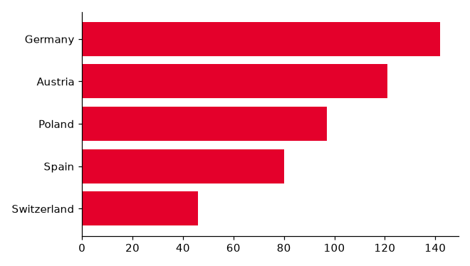
Analytics Community
Total registrations
Teams members
Countries
130
140
6

Slide 5
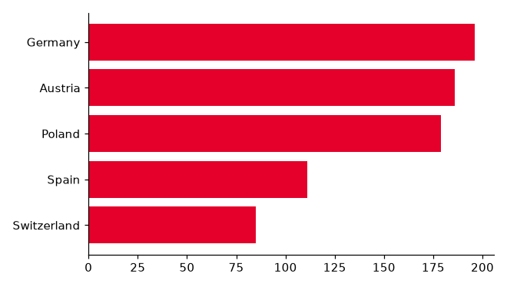
Community Events
Events
Total participants
Unique participants
2
150
160

Slide 6
Notes (maintained by hand)
This slide is listed under manual_slides in config/deck_layout.json,
so even its tagged shapes are never refreshed.
Edited by hand

