Slide 1
Preference Consistency Relies on Hippocampal Function: Evidence from Mediotemporal Lobe Epilepsy
A. Zeynep Enkavi, Bernd Weber, Iris Zweyer, Jan Wagner, Christian Elger, Elke Weber, Eric. J. Johnson
Notes:
First, thank you very much for having me here and still being here in the last session! It is my first conference talk and I am rather nervous. But I am also very excited to tell you about this simple experiment we did, which we believe has important implications. The title of the talk as you can see is a mouthful: [read title]. And I actually didn’t even know that this was going to be a recurring theme when I wrote this talk but

Slide 2
Memory
Preference
Notes:
Let me take a step back. This last session is titled consumer neuroscience and in line with that I will be talking about preferences. Preferences and their reliance on memory. Now, if I were a properly a trained economist I would probably talk about revealed preferences with respect to expected utility theory. But keeping in mind the last four decades of research and the idea of constructed preferences in mind it’s probably not surprising to anyone for me to casually draw this arrow from memory to preferences. And I mean it sounds it sounds obvious right? For example

Slide 3
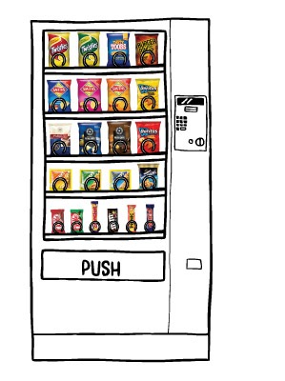
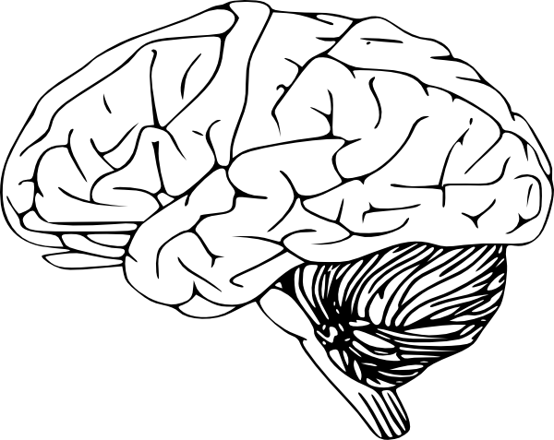
Notes:
If you’re in front of a vending machine and thinking about what you’re going to get you think about the previous times you had a Snickers bar or something else and the memory of how much you liked it.
One can easily imagine how such a process could be crucial for survival skills.
But just how the preference relies on memory, is difficult to measure and mathematically specify.
Especially when preferences are thought of as primitives in axiomatic models of risky choice as they often are in economics. Ignoring the whole brain part of this schematic.
What cognitive neuroescience can bring to the table is very tangible evidence regarding preferences and how they are constructed.
So the purpose of this talk is to present evidence that points to a necessary region in our brains behind this intuition that our preferences rely on our memories.
Of course there is a wealth of behavioral evidence supporting this intuition. For example

Slide 4
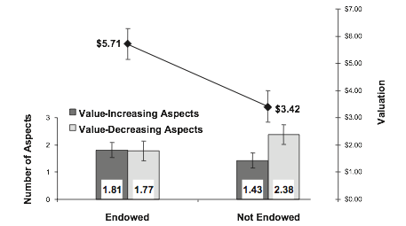
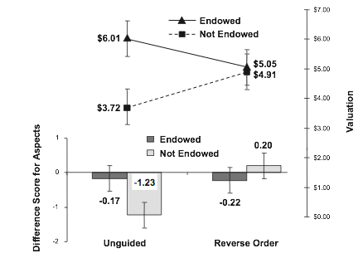
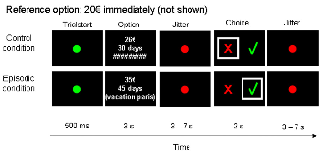
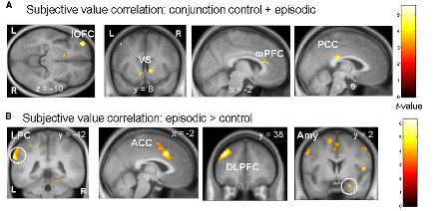
Johnson, Häubl, Keinan (2007)
Peters and Büchel (2010)
Notes:
We know that endowment changes the order of aspects of the products buyers and sellers recall in evaluation (buyers recall memories of things that would decrease the value of a product while sellers recall memories of things that would increase its value), and manipulating this order of aspects they consider removes the effect.
This also applies to decisions across time. Changes in preferences resulting from framing them either as a decision to speed up consumption versus delaying consumption is mediated also by the order of thoughts that comes to mind.
There is also neural evidence showing that thinking about concrete future events can change our intertemporal preferences. So thinking about a concrete event like a vacation in the future increases patience. Neurally, the proposed mechanism for this effect suggests that hippocampal episodic predictions influence preferences and valuation through modulating information processing in prefrontal regions such as the ACC. Moreover..

Slide 5
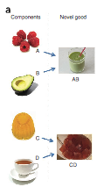

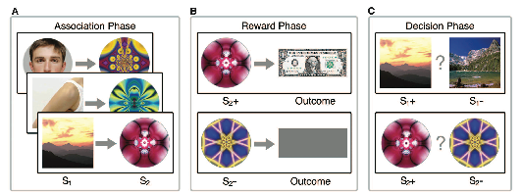
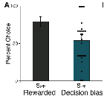
Barron, Dolan, Behrens (2013)
Wimmer and Shohamy (2012)
Notes:
Even if we haven’t experienced something directly our brains response to it is informed by its representation of its components. So you may have never had tea flavored jelly but your representation of tea and jelly inform your valuation and preference of tea-jelly (so that the signals show repetition suppression to it).
People have also in a way reverse engineered how our memories inform our preferences. In a clever design Wimmer and Shohamy showed that preferences were biased towards non-rewarded stimuli that are associated with rewarded stimuli compared to non-rewarded stimuli that are associated with non-rewarded stimuli. And this was modulated by the hippocampal response.
So these results already imply a role of memories in preferences. And neurally they also point to a specific region in the brain

Slide 6
Notes:
Namely the hippocampus and the medial temporal lobe. This of course is informed by decades of cognitive psychology research focusing on this exact region (which I won’t go over now) but it is worth mentioning that seminal studies establishing this role for this region involved lesion patients.
Why? Because the cognitive neuroscience gold standard to establish the necessity of a region is lesion studies. They harder to collect data for and often less controlled but necessary for a complete understanding of how preferences are constructed in the brain. The handful of studies focusing on deficits in value-based decisions as a result of lesions are therefore instrumental.

Slide 7
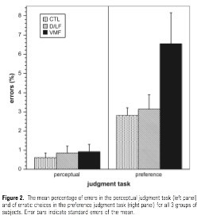
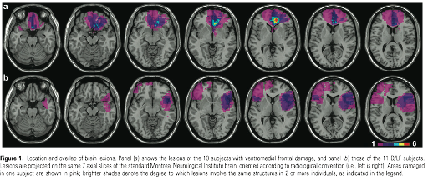
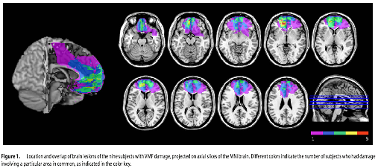
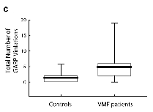
Fellows and Farah (2007)
Camille, et al. (2011)
Notes:
These studies have mostly focused on frontal regions and specifically to the vmPFC for its well-documented role in value-based decisions and preferences. And they have indeed established a necessary role for this region by showing that preference performance (and I’ll explain what I mean by this in a minute) suffers when you have lesions in these regions.
So we know that these regions play a crucial role for value representations but as the intuition I’ve been talking about also implies we also know that it is unlikely that it is the only necessary region for these decisions. In fact if we are interested in seeing whether regions associated with memory retrieval are necessary for these decisions then we should look at how performance changes when you have hippocampal lesions. So that is exactly what we did:

Slide 8
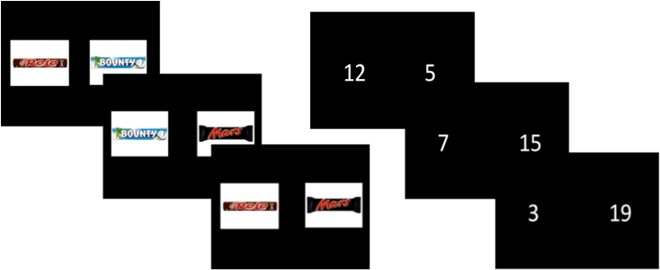
Experiment
Test
Control
N = 91 (C = 30, ETL= 30, MTL = 31)
Notes:
We had 31 mediotemporal lobe epilepsy patients going through surgery and we asked them to indicate their preferences between candy bars. There were 20 candy bars (so a 190 binary choices) and they were all familiar to the subjects. (ejj> before going through surgery?)
We also had two control groups: one healthy group and another extra-temporal lesion group that had lesions elsewhere in their brain but their MTL’s were intact.
We also had a control task (similar to other lesion studies) where they indicated which number was larger. Because we wanted to make sure that this was indeed a deficit related to value-based decisions.
So if the regions associated with memory encoding and retrieval are necessary for value-based decision then the MTL group should do worse in the test task and do the same in the control task compared to the two other control groups. So we’re looking for a task by group interaction.
Now what do I mean by their performance:
[uni- (left:n=14;right:n=8) or bilateral (n=9) hippocampal sclerosis]

Slide 9



Transitivity
>
>
>
Notes:
What is our dependent measure? It is preference transitivity. This is similar to previous lesions studies. It is the idea that if you prefer Mars over Bounty and Bounty over Rolo you should prefer Mars over Rolo. This simple principle is crucial because it is both a necessary and sufficient condition of value maximization. Furthermore it is something people at least strive for: when intransitivities in preferences are pointed out to people they change to transitive choice patterns. So what did we find?

Slide 10
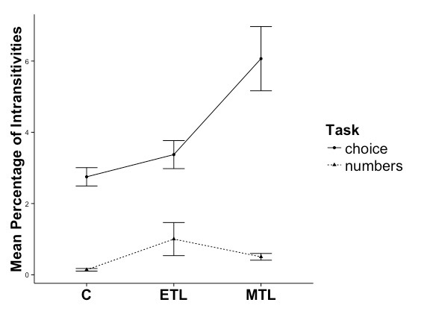
Results
Increased intransitivity in MTL patients
Notes:
We found indeed a significant interaction between the tasks and the groups. The performance of the MTL group was significantly worse in the preference task but not the numbers task. Even more strikingly

Slide 11
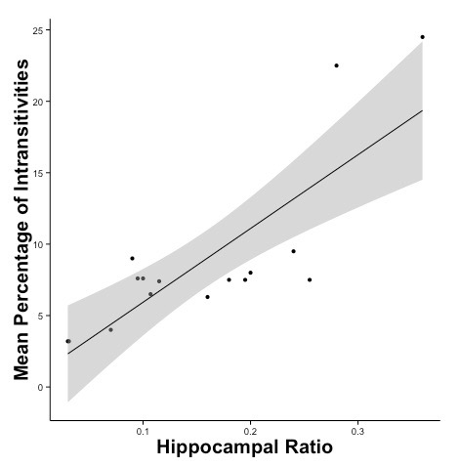
Results
Increased intransitivity with lesion size
Notes:
The larger their lesions the more intransitivities they made. So this showed us that these regions were indeed very important for these decisions. But it was a little hard to understand how large this effect was.
To contextualize the effect size we ran simulations to see how noisy the value estimations of the MTL group were

Slide 12
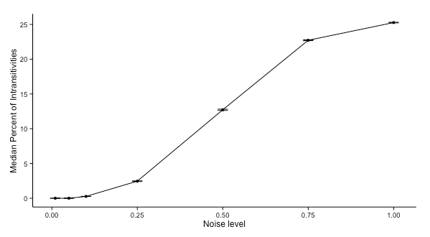
Results
Simulations contextualize the size of the deficit
Notes:
The simulations show that increasing the noise level has a non-linear effect on intransitivities. And the MTL groups intransitivities tend to fall between noise levels of 25 and 50%.
So these two pieces of evidence combined provide strong support for a role of the hippocampus in value construction. And as behavioral economists trying to strengthen our research with cognitive neuroscience methods this was a very encouraging result.
Still there were some alternative hypotheses that we could test for.
One can imagine for example that explicit memory of prior choices involving one of the candy bars facilitates subsequent choices. If that were the case we would expect a general decrease in intransitivities throughout the task

Slide 13
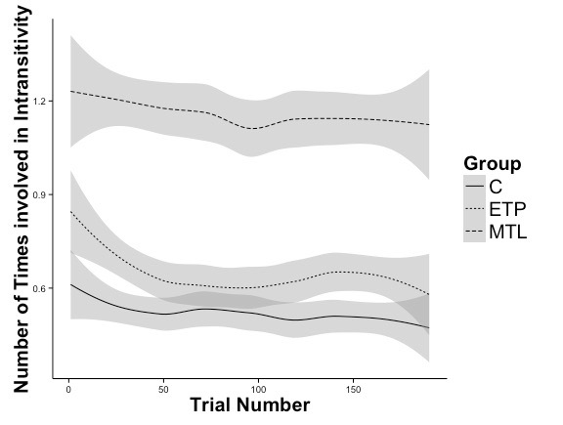
Alternative Explanations
The effect is not due impairment in explicit declarative memory
Notes:
This, however, does not seem to be the case. So on the x-axis here we’re seeing time and on the y-axis the average number of times each trial was involved in an intransitive choice. We can see that each trial is equally likely to be involved in an intransitivity throughout the task and always higher for the MTL group. Another alternative hypothesis could involve a speed accuracy trade-off. If this were the case then faster trials should have more error but what we see instead
ejj> Just looking at the graph shows what appears to be a decrease for the C and ETP groups, particularly the latter. You may need to describe that there is no difference in the slope of these lines by group, even when we include a quadratic term.

Slide 14
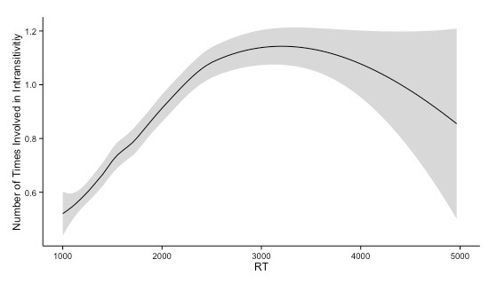
Alternative Explanations
It is also not due to a speed-accuracy trade-off
Notes:
is that slower, more effortful trials (not faster ones) are involved in more intransitivities and…

Slide 15
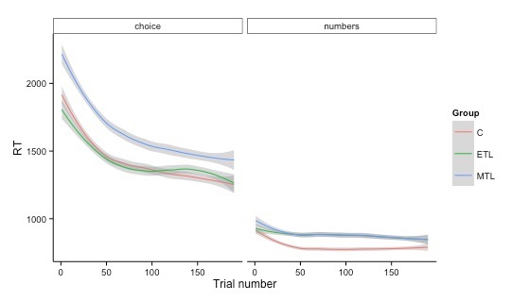
Alternative Explanations
It is also not due to a speed-accuracy trade-off
Notes:
the MTL group is always slower compared to the control groups. So together these rule out a speed-accuracy tradeoff possibility as well.

Slide 16
Summary and Implications
Hippocampal lesions lead to increased inconsistencies in preferences
The effects cannot be explained by random choosing, explicit declarative memory deficits or speed-accuracy trade-offs
They point to the necessity of certain cortical regions other than frontal regions, namely the MTL, in value-based decisions supporting the intuition that preferences rely on memories
Further research will show the exact mechanisms of how the MTL interacts with PFC in value-based decisions

Slide 17



Thank You!
Bernd Weber
Eric Johnson
Elke Weber
Iris Zweyer
Jan Wagner
Christian E. Elger
Notes:
Thank you very much for your attention. And of course to Bernd Weber at Bonn, where this study was completed and to my incredible mentors Eric Johnson and Elke Weber, to whom I owe the chance to be speaking to you today.

Slide 18
Outline
What is transitivity?
What is the MTL?
Experiment and results
Implications
Preference Consistency Relies on Hippocampal Function: Evidence from
Mediotemporal Lobe Epilepsy
Notes:
But I will hopefully break it down bit by bit. First I’ll explain what I mean by preference consistency and transitivity

Slide 19
Outline
What is transitivity?
What is the MTL?
Experiment and results
Implications
Preference Consistency Relies on Hippocampal Function: Evidence from
Mediotemporal Lobe Epilepsy
Notes:
Then we’ll talk a little about where the mediotemporal lobe and hippocampus is and our understanding of how it might be working

Slide 20
Outline
What is transitivity?
What is the MTL?
Experiment and results
Implications
Preference Consistency Relies on Hippocampal Function: Evidence from
Mediotemporal Lobe Epilepsy
Notes:
Then I’ll tell you about our experiment and results from patients with MTL lesions

Slide 21
Outline
What is transitivity?
What is the MTL?
Experiment and results
Implications
Preference Consistency Relies on Hippocampal Function: Evidence from
Mediotemporal Lobe Epilepsy
Notes:
And finally a few words on the implications. Ok let’s begin.

Slide 22
