Slide 1
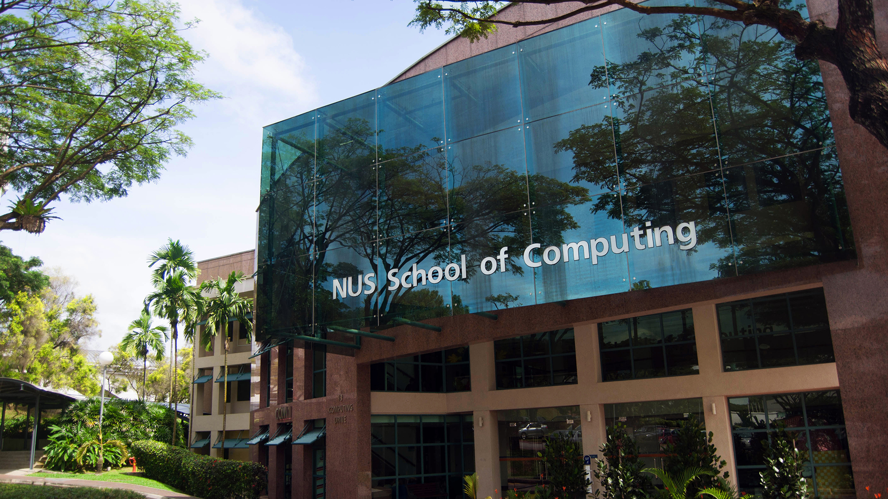








PlanNUS
Zen Lee Yi Jie
Lim Zi Qiang Marcus
Tech Stack
Problem:
A forgetful student with poor time management
Solution:
A website that designs a personalized study plan for students
Features:
Automated schedule planning
Weekly progress tracking (diary)
Telegram bot notifications for reminder

