Slide 1
Django / MVC

Slide 2
Table of Contents
Introduction
Detailed Presentation
Hands-on
Q&A

Slide 3
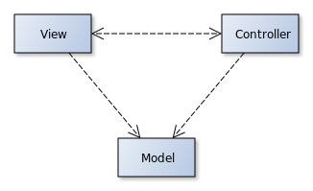

Introduction
What is MVC?
What is it for?
What is Django?
What is it for?

Slide 4
Model View Controller
What is it?
Architectural Design Pattern
What is it for?
Produce Better Code

Slide 5
Django
What is it?
Web Framework
Free
What is it for?
Developing Web Apps
In Python

Slide 6
Detailed Presentation
MVC
Explanation
Pros / Cons
Django
Explanation
Differences in Implementation of MVC
Key Features

Slide 7
MVC – Explanation

Slide 8
MVC – Pros / Cons
Pros
Cons

Slide 9
Django – Explanation

Slide 10
Django – Differences to MVC

Slide 11
Django – Key Features

Slide 12
Hands-on
Web Application
Memegenerator

Slide 13
Question & Answer

