Slide 1

Data Insights on Seasonal Trends in “Affordable” Airbnb Listings
Team Members: Bryan, Jazmin, & Nebiat

Slide 2

Project Overview
Objective: Analyze how seasonal trends affect Airbnb metrics such as price, number of reviews, reviews per month, and availability.
Goal: Provide insights for hosts and guests to optimize rental strategies.

Slide 3

Research Questions
How do average nightly rental prices for Airbnb properties vary by season?
How do the number of reviews, reviews per month, and availability change with the seasons?
What is the correlation between average nightly rental prices and other metrics across different seasons?

Slide 4

Datasets
Airbnb Listings Data: Key metrics such as price, number of reviews, reviews per month, and availability.
Seasonal Information: Derived from listings review dates

Slide 5

Data Preparation
Outlier Removal: Excluded extreme values
Handling Missing Values: Addressed missing data
Feature Engineering: Added a 'season’ column
Data Aggregation: Grouped data by season and calculated average metrics
Correlation Analysis: Identified significant relationships between metrics (e.g., price and availability).
Data Validation: Ensured data integrity and accuracy through validation checks.

Slide 6
Data Analysis Methods
Seasonal analysis: Categorized data by seasons
Early Spring/Late Spring
Early Summer/Late Summer
Early Fall/Late Fall
Early Winter/Late Winter
Aggregation: Calculated average metrics for each season.
Statistical Testing: ANOVA was used to test the following hypotheses:
Null Hypothesis (H0): There are no significant differences in the means of the metrics across seasons
Alternative Hypothesis (H1): There are significant differences in the means of the metrics across seasons

Slide 7
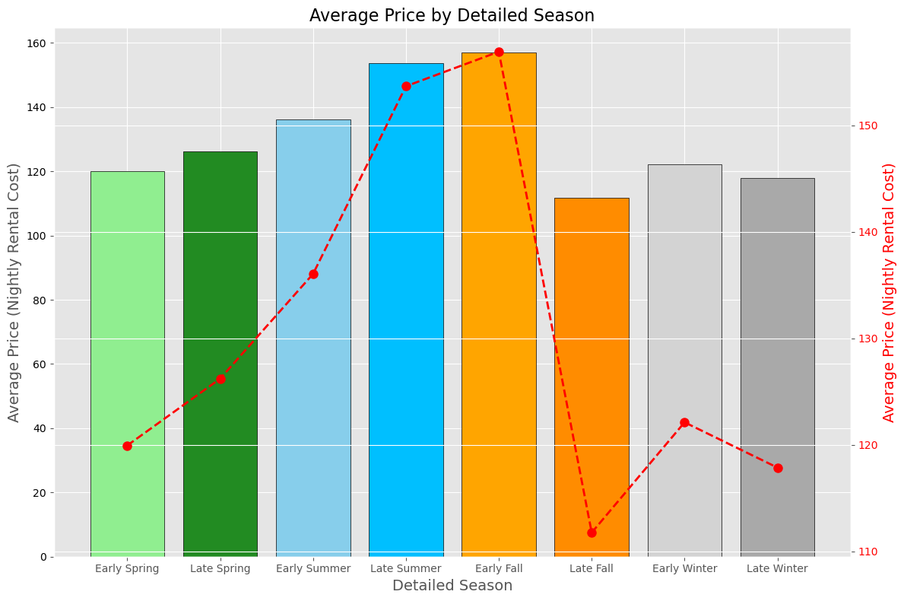
Average Price by Season
Early Summer has peak availability, Late Summer has highest prices.
Hosts should adjust prices for peak seasons and ensure availability during high-demand periods.

Slide 8
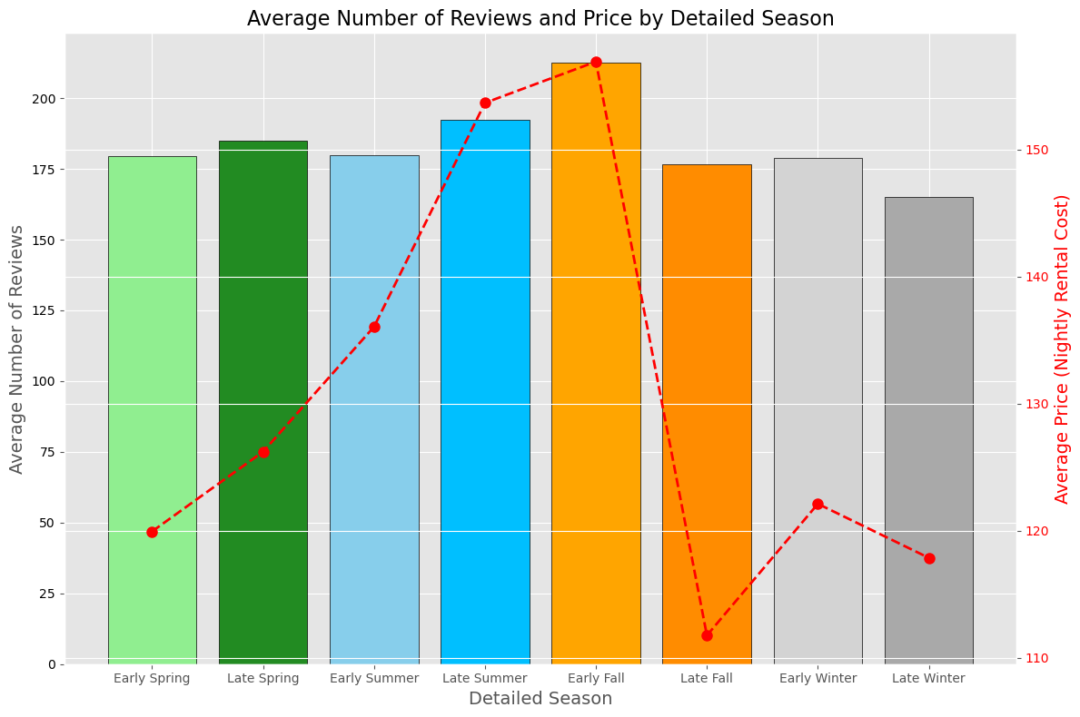
Average Number of Reviews and Price by Season
Reviews peak in Late Summer/Early Fall, indicating higher guest activity

Slide 9
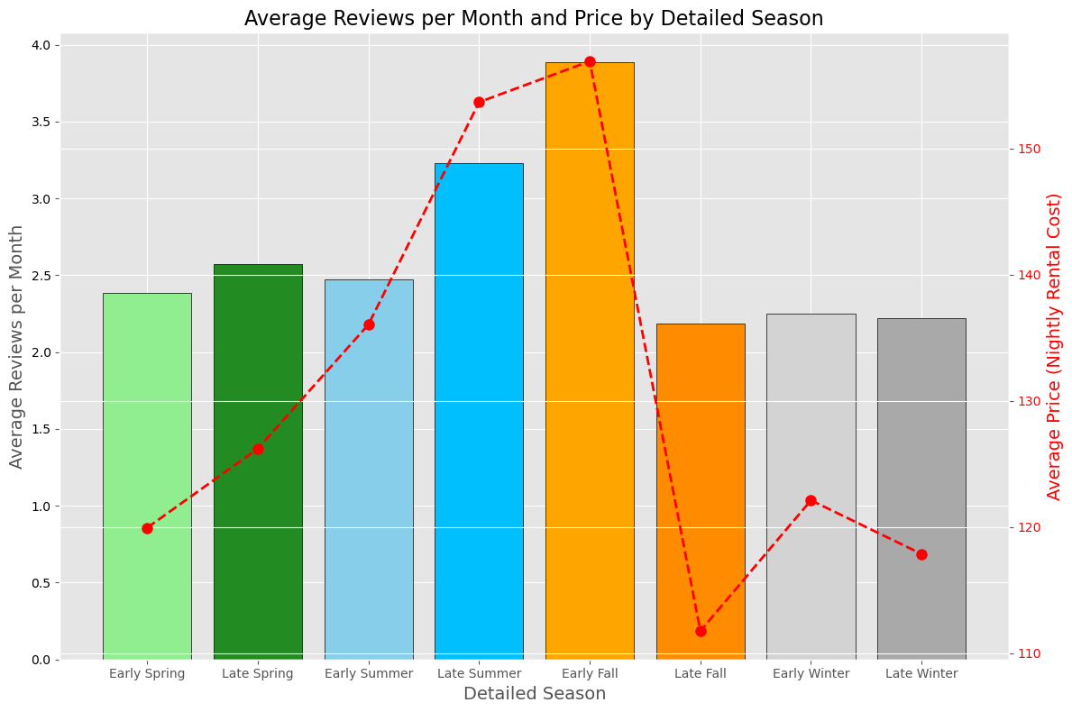
Average Reviews per Month and Price by Season
Reviews per month peak in Early Fall, indicating higher guest feedback

Slide 10
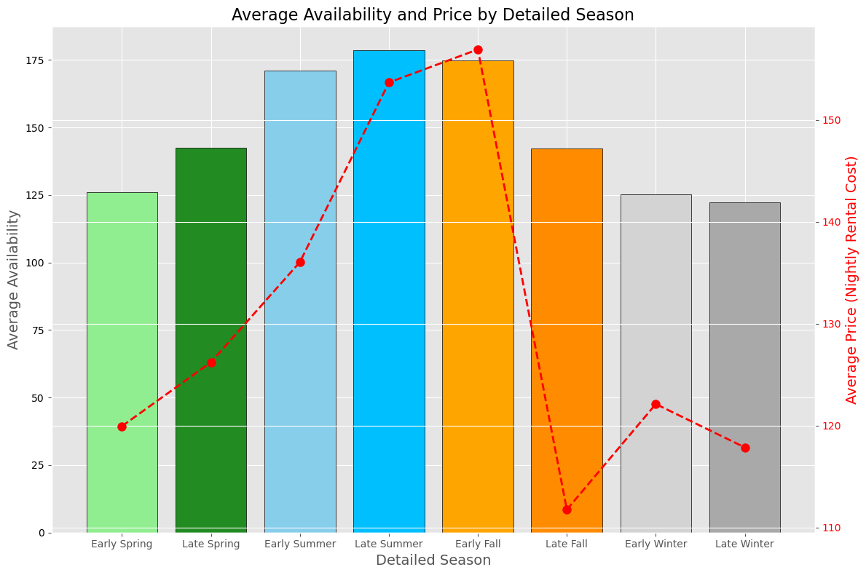
Average Availability and Price by Season
Early Summer has peak availability, Late Summer has highest prices.
Hosts should adjust prices for peak seasons and ensure availability during high-demand periods.

Slide 11
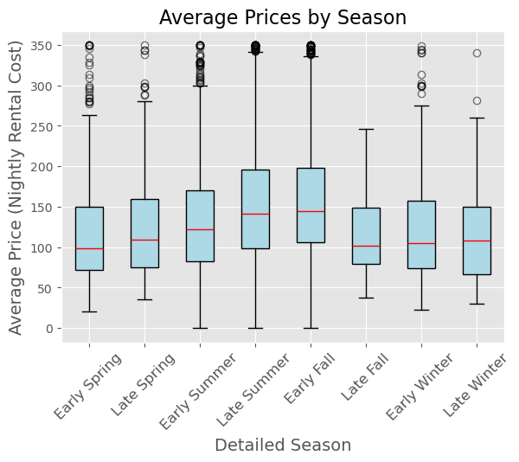
Box Plot of Average Prices by Season
Summer: Highest Median prices, most variability
Spring & Fall: Moderate Prices, slight peaks in Late Spring/Early Fall
Winter: Lowest Prices, less variability
Outliers* indicate luxury listings
*Note: excluded bookings above $350/night to focus on affordable listings

Slide 12
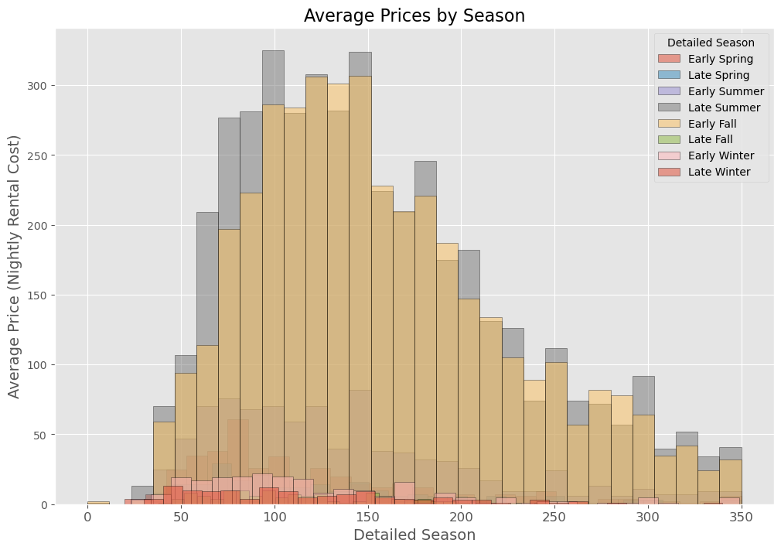
Histogram of Average Prices
Most rentals priced $100-$200 per night
Peaks in summer suggest higher demand and prices
Lower Prices in winter due to reduced demand
Exclusion of high-priced outliers ensures focus on more common price ranges

Slide 13
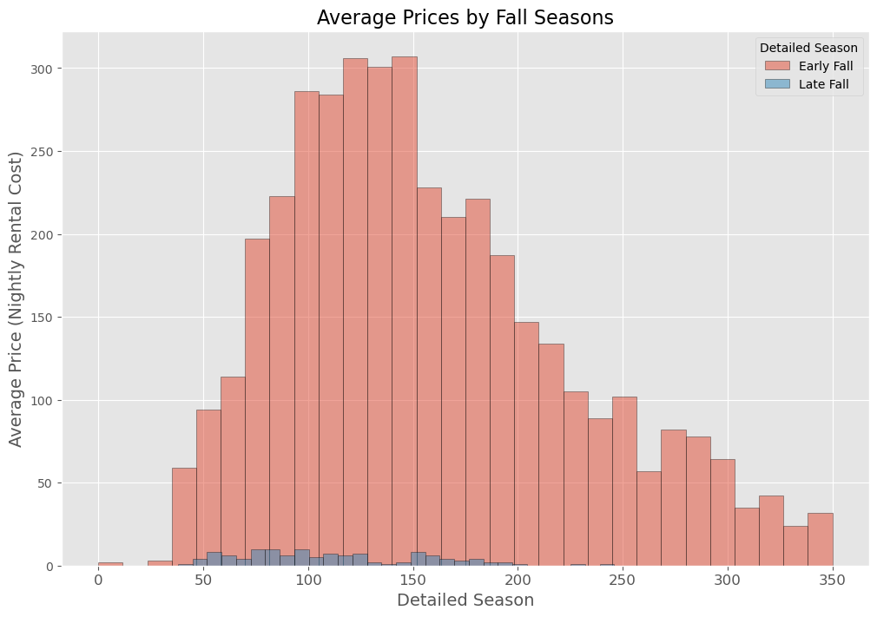
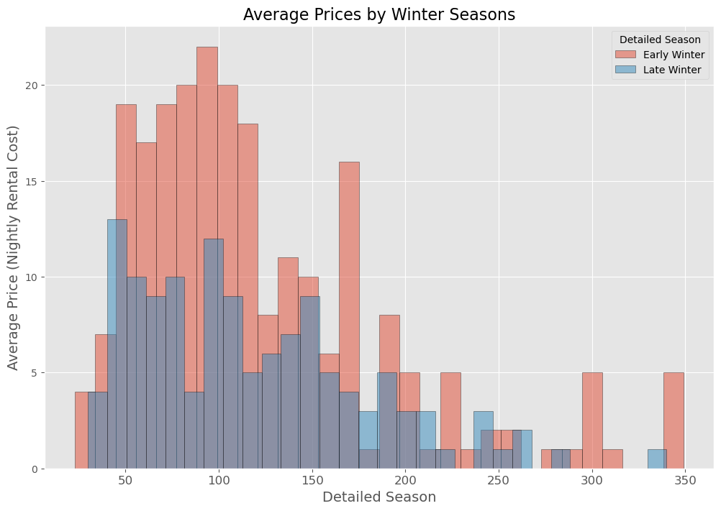
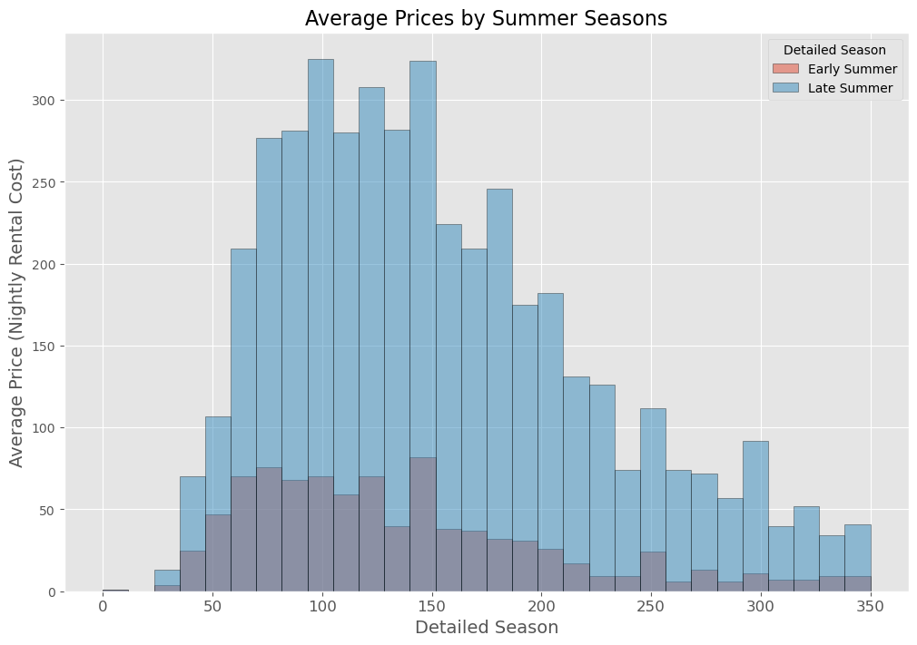
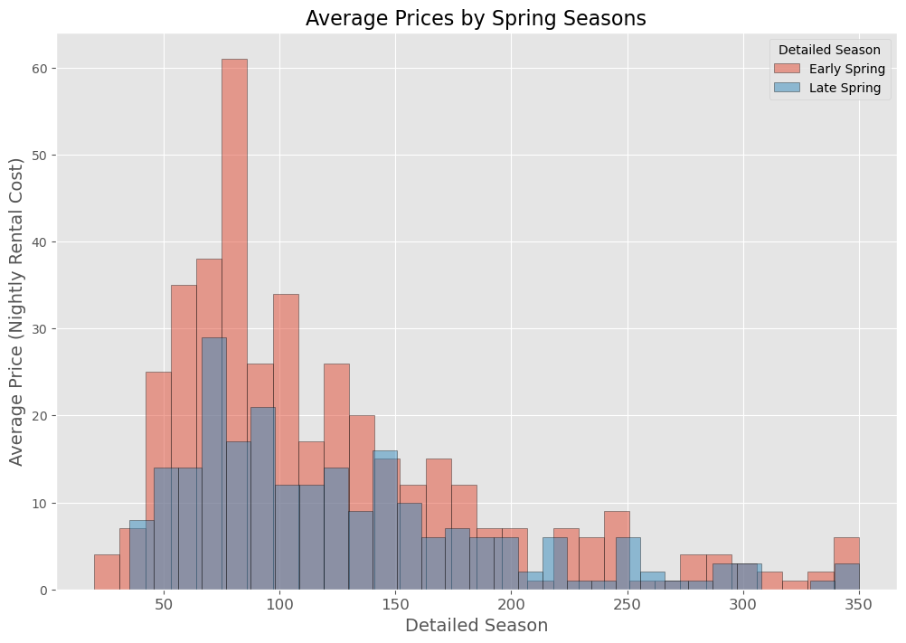

Slide 14
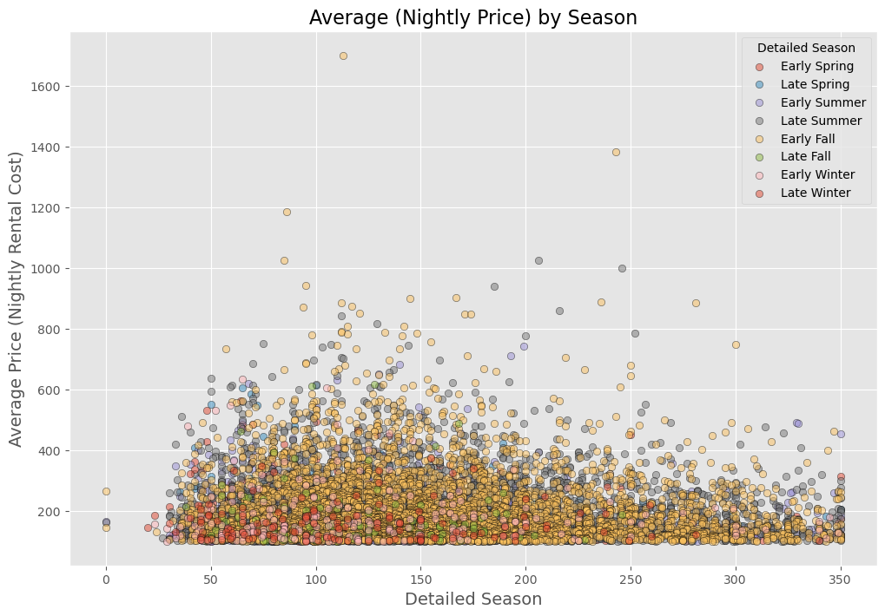
Scatter plot of Price vs. Number of Reviews
Price Distribution: Most listings are priced between $50 and $200 per night.
Review Counts: Late Summer and Early Fall show higher review counts, indicating increased guest activity.
Winter Seasons: Lower review counts in Early and Late Winter suggest lower demand.
No Clear Correlation
Seasonal Impact: Late Summer and Early Fall are peak seasons with more guest interactions.

Slide 15
Key Findings and Implications
Significant seasonal variations in Airbnb metrics
Hosts: Adjust prices, manage availability seasonally, and encourage reviews
Guests: Book off-peak for better deals, leave reviews.

