Slide 1

Singapore HDB Resale Price Analysis
Capstone 2 Project - Data Analytics with AI
By Ong Bee Yian

Slide 2
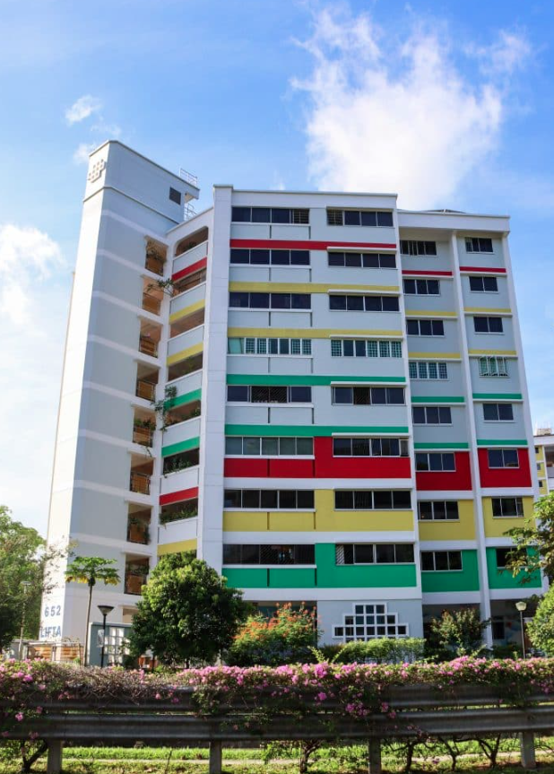

Background
Context
Over 80% of Singapore residents live in HDB flats. Rising costs make housing a top national concern.
Stakeholder Needs :
Home Buyers and Property valuer : Want to know if they are paying a fair price.
Ministry of National Development (MND) policy maker :
Need to track long-term affordability and intervene when necessary.
Property Investors/Agents: Seek price forecasting for decision-making.
Proposed Solution :
Streamlit Data Product for Singapore HDB Resale Flat Analysis

Slide 3
Problem statements
Complex Pricing Dynamics
  Resale flat prices vary widely by location, flat type, age, and storey level.
  Buyers and sellers lack transparent tools to assess fair value beyond historical averages.
Decision-Making Gaps
  Home buyers: Unsure whether a unit is overpriced or underpriced.
  MND Policymakers: Need systematic insights to monitor housing affordability and guide policy.
  Property Agents/Investors: Require reliable forecasts of future price movements to reduce risks.
3. Current Limitations
  Market information is fragmented (reports, word-of-mouth, property listings).

Slide 4
Solution Proposal
Streamlit-powered solution featuring three AI/ML-driven solutions
Feature | Price Estimator | Market Segmentation | Trend Forecasting
Business Need | Home buyers need fair valuation. Property Valuer need tool for valuation | MND Policymakers & Property analysts need to understand affordability segments. | Property investors & Property analysts want to anticipate price trends.
Approach | Model: XGBoost / Random Forest Regressor Reason : Support Non-linearity Robust to outliers Handles categorical data with One-Hot Encoding and Mean Encoding | Model: K-Means Clustering (unsupervised) Groups flats into affordability categories (e.g., low, medium, high). Reason : Interpretable each segment Balance of accuracy, scalability, and interpretability. | Model: Prophet / LSTM (time series). Forecast price by town or flat type. Reason : Prophet : Ease of use, interpretability, and business-ready forecasts. LSTM : Capture complex, non-linear time patterns when high accuracy is critical.
Evaluation Metrics | RMSE, MAE, R² | Silhouette score, cluster interpretability. | RMSE, MAPE
UI | Interactive form User input : Flat type, floor area, town, storey, age. Output: Predicted resale price. | Interactive form User input : Town, flat type Output: Market Segments Overview Geographic Distribution Price Distribution by Flat Type | Interactive trend chart User input : Town, flat type Forecast Horizon (Months) Output : Price Forecast

Slide 5
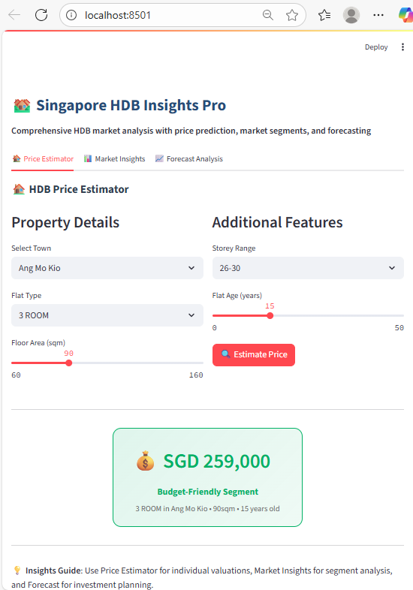
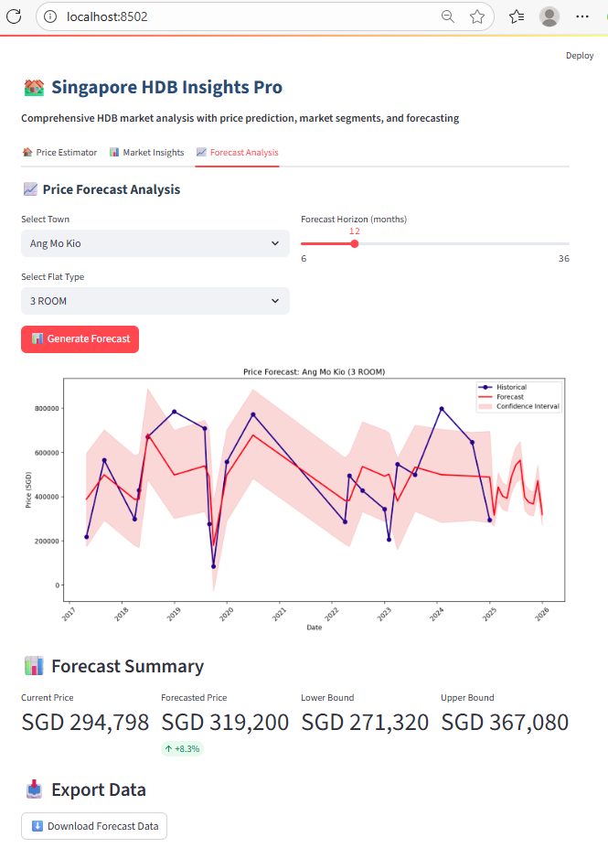
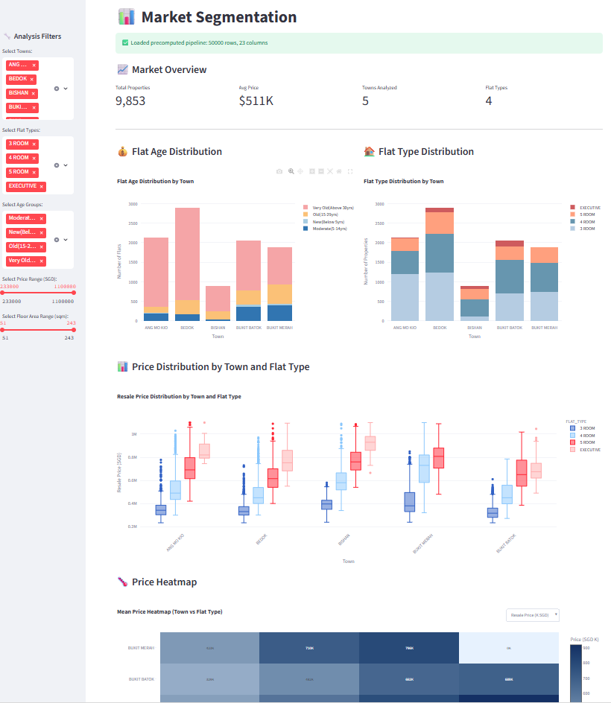
Data Product Design (Prototype)
Price Estimator
Trend Forecasting
Market Insights

Slide 6
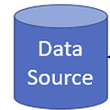




System Architecture
Local Environment
Data Source
Data Lake
Data Warehouse
Development
Service Layer
Data Product
Data Modelling
EDA
Data
Transformation
App Development
Data models
Conceptual
Logical
Physical
Perform Exploratory
Data Analysis
to understand trends
and outliers.
Clean, format, and restructure data for analytics.
Version Control : NYP GitLab

Slide 7
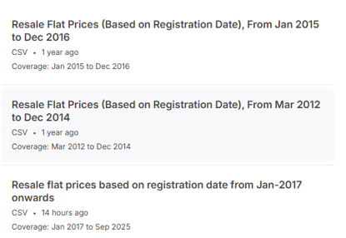
Data Source
  HDB data obtained from Resale Flat Prices | HDB | data.gov.sg
  To get HDB data from 2012 to 2025 from the 3 files.

Slide 8
Data Preprocessing
Data Preprocessing
Step | Category | Detail Description
1 | Load Data | Load CSV files from a Snowflake stage into pandas DataFrames
2 | New Field | Derive AGE column from REMAINING_LEASE or LEASE_COMMENCE_DATE Split 'MONTH' column into 'YEAR' and 'MONTH_NUM'
3 | Clean Data | Clean text columns (uppercase conversion and NaN handling)
4 | Filtering | Filter unnecessary columns and ensure column consistency
5 | Combine Data | Combine all cleaned CSV files into a single DataFrame
7 | Remove Duplicate | Check for and remove duplicate rows
8 | Create Silver table | Save the final cleaned dataset to a Snowflake table (default: HDB_SILVER)

Slide 9
Data Transformation
Data Transformation
Step | Category | Detail Description
1 | Clean Data | Remove rows with FLAT_TYPE = ['MULTI GENERATION', '1 ROOM', '2 ROOM'] and Remove FLAT_MODEL column |
2 | Outlier Handling | Caps RESALE_PRICE values at 0.5th and 99.5th percentiles Create new field IS_OUTLIERS to identify outliers. To use this field for forecasting feature
3 | Feature Engineering | Creates new derived features: - AGE_GROUP: Bucketized age bins - PRICE_TIER: Quantile-based price segmentation - SEASON: Quarter (Q1–Q4) from MONTH_NUM - STOREY_NUMERIC: Midpoint of STOREY_RANGE - PRICE_PER_SQM: Price per square meter
4 | Create Gold table | Save the final dataset to a GOLD table

Slide 10
ML training – Price Estimator
Strategy
1 ) Train with 20K data for different model with hyperparameter tuning via GridSearch
2 ) Try Data Transformation with Bayesian Optimization to obtain best parameter
3 ) Filtering Outiners and varying column ( i.e include AGE column)
Model | Random Forest | XGBoost | LightGBM | CatBoost | Weighted Ensemble Evaluation for XGB, LightGBM, CatBoost
Metrics R² | R²: 0.8573 | R²: 0.8897 | R²: 0.8853 | R²: 0.8944 | 0.7 * pred_cat + 0.2 * pred_xgb + 0.1 * pred_lgb R²: 0.9079
Model | Box-Cox | Yeo-Johnson | Inverse Transformation (Current)
Metrics R² | R²: 0.9276 | R²: 0.9277 | R²: 0.9284
Split | Proportion
Training | 60%
Validation | 20%
Testing | 20%
Model | 20K record | Complete data 295K record Training 60%, Validation 20%, Testing 20%
Metrics R² | R²: 0.936 | R²: 0.954

Slide 11
ML training – Market Segmentation (1/3)
Strategy
1 ) Train with 20K data for different model
Model | K-Means Clustering | GMM Clustering | DBSCAN Clustering | HDBSCAN Clustering
Metrics Silhouette Score | 1. Initial run : 0.2242 2. Dimensionality reduction and best K mean : 0.3265 3. 2 and include feature ‘AGE_GROUP’ : 0.3359 4. Hyperparameter fine-tuning : 0.3513 5. With Bayesian Optimization : 0.3888 6. Remove Outliners, combine features : 0.3625 | Initial run with Bayesian Optimization : 0.0063 | 1. Initial run with Bayesian Optimization : 0.4530 2. Found duplicate regressor used AGE and AGE_GROUP. Update and score < 0.3 3. + UMAP | 1. Initial run with Bayesian Optimization : 0.437 2. Umap : 0.4373 > High imbalance of cluster. 1 big many small. 3. Reduced cluster count from 68 to 18
Cluster count | Sihouette Score
68 | 0.4366
8 | 0.0085 - 0.1733
Cluster count | Sihouette Score
420 | 0.872

Slide 12
ML training – Market Segmentation (2/3)
Strategy
2 ) Scaler Comparison
3 ) Vary feature combination (AGE, PRICE_PER_SQM, MEAN RESALE_PRICE, MEAN FLOOR_AREA_SQM etc)
4 ) Hybrid (HDBSCAN + K-Mean)
 | Scaler Comparison | Silhouette | Davies_bouldin | Noise_rate | N_clusters
0 | Standard | 0.421557 | 0.946168 | 0.7103 | 4
1 | Power | 0.338788 | 1.223549 | 0.7128 | 7
2 | Quantile | 0.234283 | 1.661894 | 0.5965 | 10
3 | Robust | 0.16573 | 1.666164 | 0.4536 | 12
Hybrid | Iteration x | Final (50K record)
Metrics Silhouette Score (to be maximized) Davies–Bouldin Index (to be minimized) | HDBSCAN clustering on combined features. UMAP after clustering for dimensionality reduction KMeans for final clustering. Map noise points to nearest | HDBSCAN as pre-filter to filter noise Feature weighting (Optimized) SVD for Numeric, UMAP for categorical (Optimized) Multi-metric scoring (2×Silhouette−Davies–Bouldin) Noise handling (Penalized, integrated during each optimization and evaluated) Silhouette score: 0.5847 Davies–Bouldin score: 0.7197 Number of clusters: 5

Slide 13
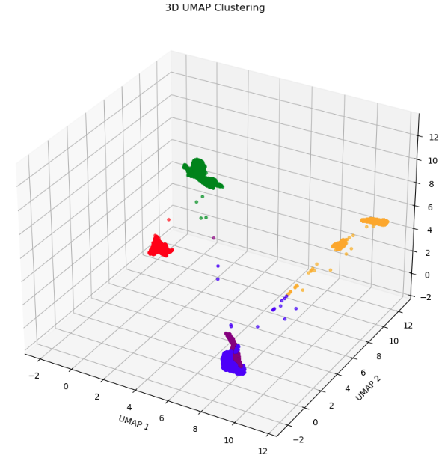
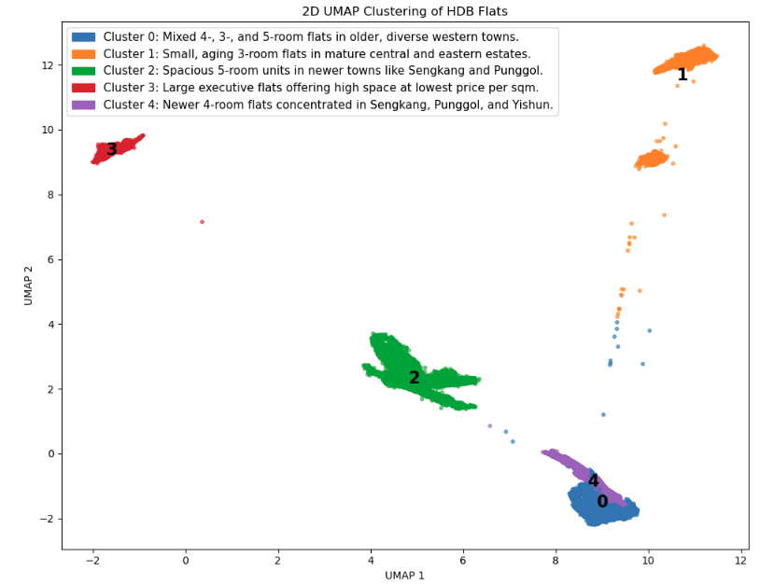
ML training – Market Segmentation (3/3)
Silhouette score: 0.5847
Davies–Bouldin score: 0.7197
Number of clusters: 5
Cluster distribution: -
Cluster 0: 11155 points (22.3%)
Cluster 1: 12497 points (25.0%)
Cluster 2: 12479 points (25.0%)
Cluster 3: 3702 points (7.4%)
Cluster 4: 10167 points (20.3%)

Slide 14
ML training – Forecasting (1/3)
Strategy
1 ) Train with split time of all dataset for different model with hyperparameter tuning with Bayesian Optimization
2 ) Use CatBoost via Bayesian Optimization to obtain best parameter
Backtesting :MAPE 1.788471 , MAPE : 1.33%
Model | LSTM | Prophet
Metrics MAPE | Numeric_features = [ 'price', 'price_volatility', 'transaction_volume', 'avg_floor_area', 'avg_age', 'avg_storey', 'outlier_count', 'outlier_ratio', 'market_stress', 'price_ma_3', 'price_ma_6', 'price_ma_12', 'price_trend', 'price_change_pct', 'year', 'month', 'quarter', 'is_year_end’] Categorical_features = ['TOWN', 'FLAT_TYPE', 'AGE_GROUP', 'PRICE_TIER', 'SEASON’] 3.42% ( Data : Train 75% , Validate 15%, Testing 15%) | 1. Same regressors as LSTM > 2.03% 2. Derived_regressors = ['price_volatility', 'transaction_volume', 'avg_floor_area', 'avg_age', 'avg_storey', 'outlier_count', 'outlier_ratio', 'market_stress’] Explicit_regressors = ['TOWN_encoded', 'FLAT_TYPE_encoded', 'AGE', 'STOREY_NUMERIC', 'FLOOR_AREA_SQM’] 1.33% ( Data : Train 75% , Validate 15%, Testing 15%) 0.63%( Data : Train 80% , Validate 10%, Testing 10%) Streamlit App forecasting give flat line, Could be due to Missing or incorrect regressor values. Prophet model is being overly conservative due to hyperparameters or regressor handling.

Slide 15
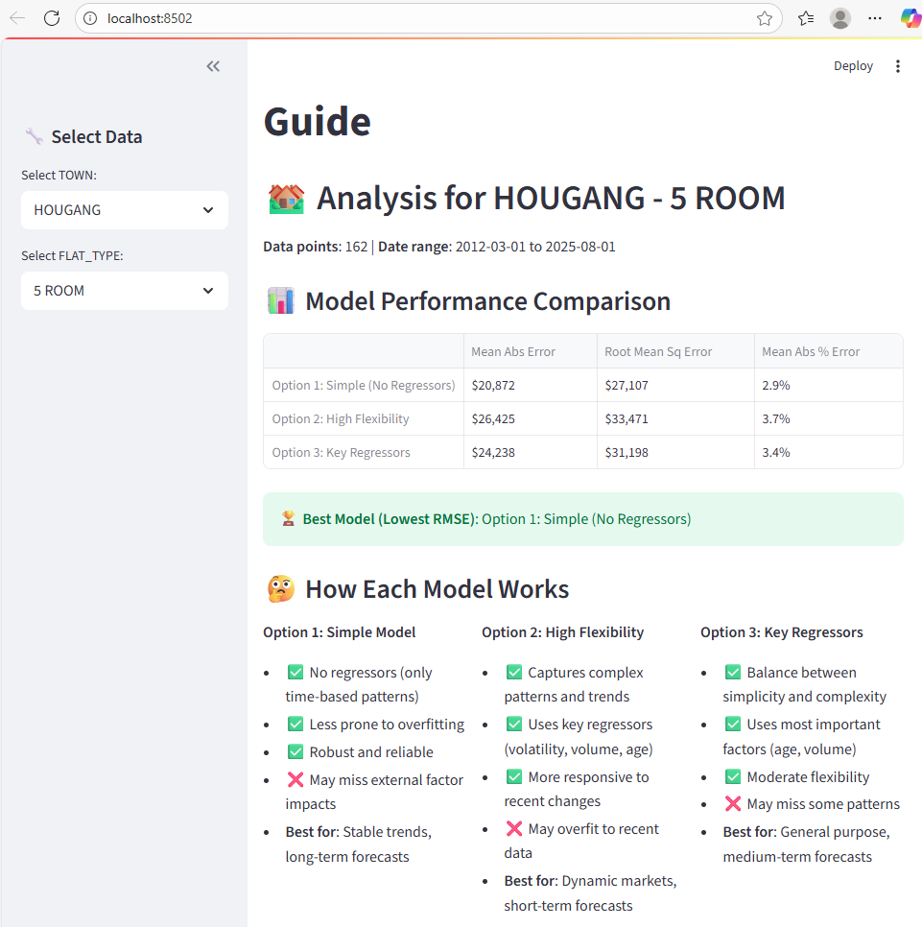
ML training – Forecasting (2/3)
Strategy
2 ) Vary different regressor
Final Prophet model with 8 regressors.
‘price_volatility', 'transaction_volume', 'avg_floor_area', 'avg_age', 'avg_storey', 'market_stress’,
'price_ma_3', 'price_ma_6']
MAPE = 2.69%
Option | Regressors Used | Remark
Simple | None | Lowest RMSE for most Town/Flat_type
High Flexibity | Volatility, Volume, Avg Age | Similar result
Key Regressors | Avg Age, Volume

Slide 16
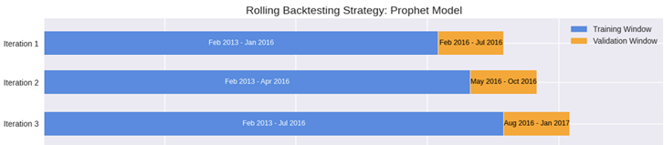

ML training – Forecasting (3/3)
Backtesting Strategy
Backtesting and Final Test
Description | Backtesting | Final Test
Purpose | Stability, drift, robustness | Final performance snapshot
Initial Training | 36 months | Entire dataset except last 6 months (Feb 2013 – Feb 2025)
Validation | 6 months/training
Testing |  | Final 6 months (Mar 2025 – Aug 2025)
Rolling Step | 3 months forward per cycle
Total Iterations | 37
Final Training Window | Feb 2013 – Oct 2024 (141M)
Final Validation Window | Nov 2024 – Apr 2025 (6M)
MAPE | 2.17% | 1.31%

Slide 17
Lesson learn
1 ) ML model used
Supervised Learning (XGBoost/Random Forest/XGBBoost/LightGBM,CatBoost, LSTM, Prophet, Weighted Ensemble for multiple model)
Unsupervised Learning (K-Means, GMM, DBSCAN, HDBSCAN)
2 ) Data Leak, Feature Redundancy, Overfitting
3 ) Testing Strategy (Sampling, Time series testing)

