Slide 1
INVESTMENT COMMITTEE · FEASIBILITY BRIEF
Biotech Clinical-Catalyst Strategy
Trading the stock reaction to clinical-trial & FDA outcomes — market-neutral.
Perfect-foresight backtest (README Step 2) — the payoff ceiling and its honest, deployable haircut.
$10M
2016–2019
Small-cap
Market-neutral
starting capital
test window
tradeable universe
beta-hedged
July 2026
Notes:
Objective: establish the ceiling of a trial-outcome trading strategy assuming a perfect model, then haircut to what is actually executable. Everything here is small-molecule biotech, 2016-2019, market-neutral.

Slide 2
1
What we set out to test
The ceiling first, then the honest, deployable number
Assume a 100%-accurate outcome model (the fantasy ceiling), backtest a $10M book over 2016–2019, then progressively haircut for the constraints that actually bind a biotech book: borrow supply, short executability, sector beta, path risk.
1
What is the ceiling?
If the model were perfect, how much could the strategy make?
2
What survives reality?
After borrow limits, executability and costs — what is left to deploy?
Bottom line. The strategy works and is market-neutral — but it is a capacity-limited sleeve, not a scalable flagship.
Data: BioPharmCatalyst small-molecule Approved/CRL + parsed Phase 2/3 · market-model CAR vs XBI · sample 320 small-cap events 2016–2019 (217 successes / 103 failures).
02
Notes:
We are not claiming to have a model yet. Step 2 is the perfect-foresight ceiling. The value of this exercise is the haircut path — showing what a real, executable version keeps.

Slide 3
2
The finding: only failure moves the stock
Approvals are priced in advance — the information event is failure, and only in small-caps
~0%
−11% to −18%
~0%
Approval-day reaction
(priced in advance)
Small-cap failure
(single-day drop)
Big-pharma failure
(non-event)
The tradeable signal lives only in small-caps. A large-cap failure barely moves a diversified pipeline; a small-cap’s whole value is the one drug. That asymmetry is the entire edge — and it is why the universe is deliberately small-cap-only.
Why the crowd is there: ~90% of trials fail, so shorting biotech into a catalyst is the consensus trade — which is exactly what makes the borrow rich when the model is right.
03
Notes:
Key insight for the committee: you do not get paid for predicting approvals — the market already knows. You get paid on failures, and only small-caps actually move. This narrows the whole strategy.

Slide 4
Where the money is
The profit is on the long side — the failure signal is what makes the shorts crowded, and the lending rich.
1
~90% of trials fail
So the crowd systematically shorts biotech names into their catalysts.
2
Borrow fees spike
Heavy short demand drives securities-lending rates sky-high on these names.
3
Our model picks the winners
We go long the names that will actually succeed — against the consensus short.
4
We lend to the shorts
Collecting their borrow fees as they are proven wrong, on top of the price jump.
04
Notes:
This is the counter-consensus core: the crowd shorts because most trials fail; when our model finds the exceptions, we are long AND we rent our shares to the very shorts who are wrong. Two income streams from one position.

Slide 5
3
The strategy — deployed = long + lend
Money comes from long price + lending fees; the short leg was tested and dropped
1
Long + lend
2
Short / puts
3
Hedge beta
Buy known successes ~1 month out, hold ~3 months, and lend the shares to the crowded shorts for borrow-fee income. The engine.
Short — or buy puts on — known failures. After honest borrow limits it nets flat-to-negative; only pays in the bull regime. Not deployed.
Net biotech-sector exposure hedged with XBI, so returns are alpha, not market direction. Cost return this window.
DEPLOYED — THE ENGINE
TESTED & DROPPED
OPTIONAL — MANDATE / TAIL
Long price + lending is the whole engine. The short leg loses money after honest borrow limits (see next slide) and isn't needed for neutrality — the XBI hedge already provides that — so it is dropped.
05
Notes:
Three legs, but do not let the symmetry mislead: the long+lend leg is the profit engine. Short and hedge are risk-control, not return generators.

Slide 6
4
Mechanics & the lending engine
The levers a reviewer should interrogate — with a worked example
Portfolio
Lending income (per position)
5% per position · 10% max per company · 150% gross cap → ~30 positions open; new events queue when full.
notional × rate × utilization × days/252 × multiplier
Timing (from our data)
pre-catalyst (20d): full rate × 1.0
post-catalyst (63d): collapsed
× 0.10
Long: enter T−20, hold to T+63 (~3 mo). Short: enter T−10, cover T+5 (a one-day gap).
Executability gate
Worked example — one $1M position (rate 100%/yr, util 40%)
Keep only 60% of failures as shortable — the biggest drops are the hardest to borrow. This is why the short leg barely earns.
pre = 1M × 1.00 × 0.40 × 20/252 × 1.00 = $31,700 post = 1M × 1.00 × 0.40 × 63/252 × 0.10 = $10,000
Costs
80 bps market impact + 5 bps commission, round trip (small caps move on your trades).
total lending = $41,700 (4.2% of the position)
06
Notes:
The lending fee is a daily flow, not an upfront payment, and it collapses after the catalyst because shorts cover. That time-shape is why we model pre- and post- separately. 4.2% per position from lending alone, before the price move.

Slide 7
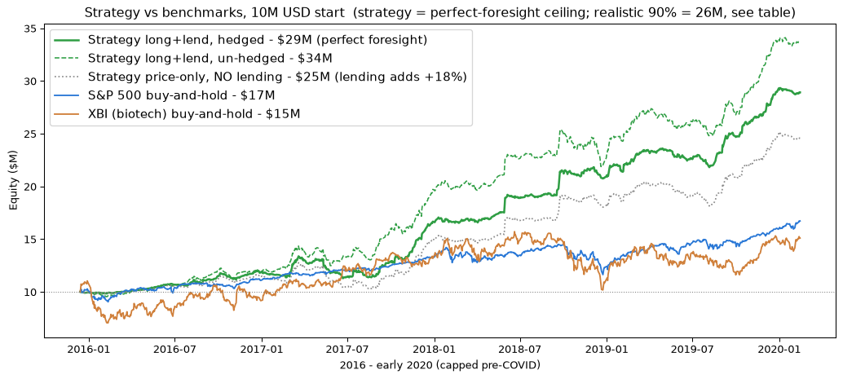
5
Results — deployed long+lend vs the market
2016–2019, small-cap, capped pre-COVID · headline = realistic 90% model; perfect-foresight ceiling $28.9M
$26.3M
27%
1.47
−18%
$10M grows to (90% model)
CAGR
Sharpe
max drawdown
$10M → | Total | CAGR | Sharpe | Max DD
Strategy (perfect foresight) | $28.9M | 29% | 1.65 | −16%
Strategy @ 90% model (fair) | $26.3M | ~27% | 1.47 | −18%
S&P 500 buy-and-hold | $16.7M | 13% | 1.11 | −20%
XBI (biotech) buy-and-hold | $15.1M | 10% | 0.42 | −36%
Not apples-to-apples at the top — the strategy line is perfect-foresight. The 90%-model row ($26.1M, +161%) is the fair comparison, still well above the S&P's +67% with a smaller drawdown. Window capped 2020-02-14 so the COVID crash doesn't distort either side.
07
Notes:
Lead with $28.9M perfect-foresight, but be upfront it's a ceiling; the fair line is the 90% model at $26.1M / +161%, which still beats the S&P's +67% with a smaller drawdown. Benchmarks capped pre-COVID so the 2020 crash doesn't flatter us.

Slide 8
6
P&L by leg — why we drop the short
Universe: 320 small-cap events = 217 successes (longs) + 103 failures · short gate keeps 60% = 62 names · 100% model
Scenario (assumptions) | L-price | L-lend | Short net | Frict | Gross
BEAR — borrow 30%, 30% short, 150bps | +$15.2M | +$0.6M | −$1.6M | −$1.8M | +$12.3M
BASE — borrow 100%, 60% short, 80bps | +$14.7M | +$4.3M | −$0.6M | −$1.1M | +$17.3M
BULL — borrow 200%, 70% short, 50bps | +$14.7M | +$17.4M | +$0.1M | −$0.8M | +$31.5M
Short is negative except in BULL. Of 103 failures we can borrow only ~60% (62) — the biggest drops are un-borrowable — so what's left barely covers borrow cost. Loses in BEAR/BASE; dropped.
Lending is the swing factor. Long price is stable (~$15M); lending income runs $0.6M → $4.3M → $17.4M across regimes. It adds +18% over price-only.
The real risk is not the short leg — it is misclassifying a failure as a winner. A wrong long buys a landmine that gaps −15%. Failure-class precision, not raw accuracy, is the number that matters.
08
Notes:
Held at 100% model so the columns isolate the cost assumptions. Short is a drag everywhere except bull, and doesn't help neutrality (the XBI hedge does that) — so it's dropped. Long price is steady; lending is what swings the result.

Slide 9
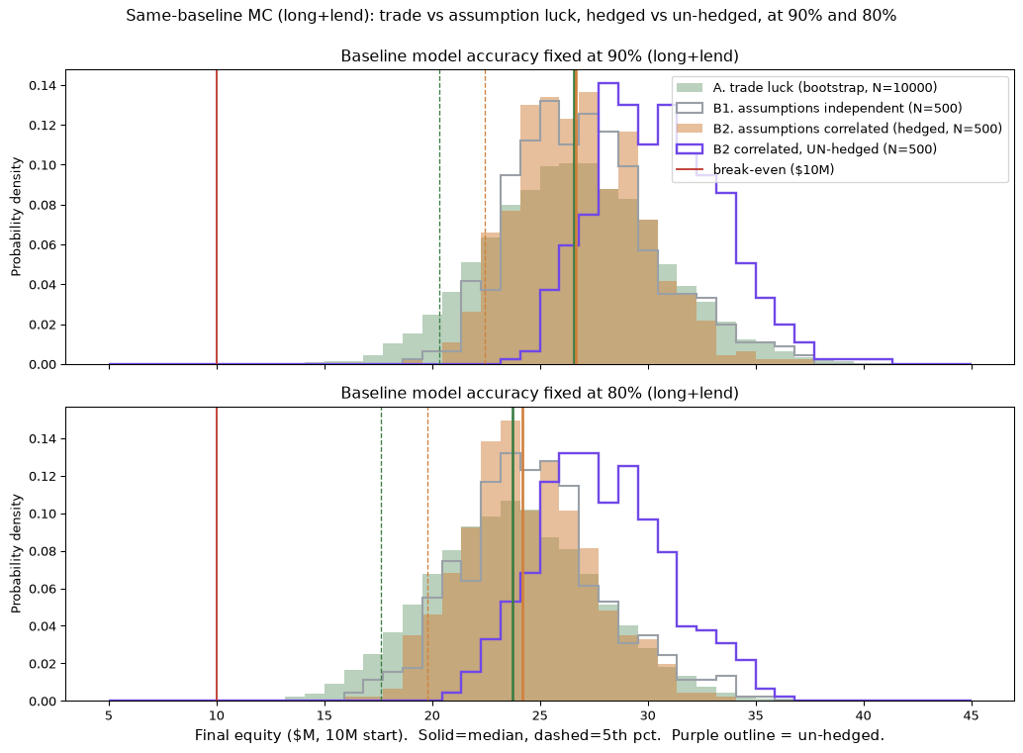
7
Robustness — Monte Carlo
Accuracy held fixed (90% & 80%) so trade-luck vs assumption-luck is like-for-like
What varies (accuracy fixed) | 90% model | 80% model
A. Trade luck (bootstrap) | $26.6M | $23.8M
B1. Assumptions, independent | $26.9M | $24.5M
B2. Assumptions, correlated — hedged | $26.7M | $24.2M
B2 correlated — un-hedged | $30.4M | $27.6M
P(lose money over 4yr) | 0% in every cell
At a fixed accuracy, trade luck ≈ assumption luck — not a few lucky deals nor lucky cost guesses. Dropping the short leg removed the downside: P(loss) is 0% everywhere. Un-hedged sits ~$3–4M higher (the hedge cost return here). The lever that dominates is model accuracy.
Density-normalized so all curves compare despite different sample counts. 90% (top) / 80% (bottom); purple = un-hedged.
09
Notes:
Accuracy pinned at a common baseline so trade-luck and assumption-luck are comparable — they land in the same place. Dropping the short leg removed the loss scenarios (P(loss)=0%). Un-hedged is higher; the hedge is a mandate choice. Borrow rate (cost of lending) is the single biggest input — the one-at-a-time MC in the brief shows that.

Slide 10
8
What could break it
Honest confidence on every assumption
Assumption | Value | Confidence
Entry / exit timing | T−20/T+63 · T−10/T+5 | grounded in data
Costs | 80 + 5 bps | market convention
Sizing / caps | 5% / 10% / 150% | reasonable, swept
Borrow rate + utilization | 100%/yr · 40% | assumed — no data
Model accuracy | 100% (Step 2 ceiling) | ceiling only — 90/80% in MC
XBI hedge | on | optional — cost return here
The real uncertainty is borrow economics and model accuracy. Both are swept in the one-at-a-time and joint Monte Carlo; neither breaks the strategy, but the borrow rate is un-measured until we trade, and accuracy is what Step 3/4 must deliver. Note P(loss)=0% is conditional — every MC path is from 2016-2019, so it does NOT test a different market regime (that's what the hedge is for).
10
Notes:
I am flagging my own weak points. Timing and costs are solid. Borrow economics and executability are assumed and could be wrong — but they are stress-tested and the strategy survives. The honest gap is a real model.

Slide 11
Recommendation
Does the strategy actually add profit?
$24.6M
$28.9M
price-trading alone
with lending overlay (+18%)
Yes — the deployed long+lend book; the short leg was tested and dropped. Lending is the differentiator, not decoration.
Next step
Proceed to Steps 3 / 4 — build the real predictive model and measure its true accuracy. We have stress-tested a 70–100% accuracy range; we have not built the model. The one number that decides everything is how well it separates winners from landmines.
11
Notes:
Ask: approval to proceed to Step 3/4 — building and validating the model. The economics work if the model is real; everything hinges on failure-class precision. This is a capacity-limited uncorrelated sleeve, not a flagship.

