Slide 1
INVESTMENT COMMITTEE · FEASIBILITY REVIEW
Biotech Clinical-Catalyst Strategy
Go long the clinical winners the crowd is busy shorting - and rent them the shares. Market-neutral.
This study ASSUMES a predictive model ("Alpha Forge") and sizes the prize. Building that model is the next step.
$10M
2016-2019
Long + lend
~$100M
assumed capital
320 catalysts
the strategy
capacity
Notes:
Quick intro. This is a feasibility study for a biotech trading strategy - we're NOT presenting a finished fund. One naming thing: the STRATEGY is what I'll walk through; 'Alpha Forge' is the name of the predictive MODEL we'd build to drive it - and we haven't built that yet. This study assumes such a model exists and asks 'if it did, is this worth doing?' The idea in one line: about 90% of biotech trials fail, so everyone shorts these stocks - we do the opposite, go long the ones we think win, and rent our shares to the shorts for a fee. I'll cover what a hedge fund is, our assumptions, the strategy, results, and where it breaks.

Slide 2
1
Motivation - why biotech, why now
Everyone shorts biotech into a catalyst. We take the educated opposite side.
1
~90% of trials never reach approval
So shorting a biotech into its trial readout is the consensus, crowded trade.
2
Crowded shorts = rich borrow fees
When everyone shorts a name, the fee to borrow its shares to short goes sky-high.
3
We flip it
Go LONG the ones our model says will succeed - and LEND our shares to the crowd shorting them.
4
Two ways to win on one position
The stock re-rates up, AND we collect the borrow fee the whole time we hold.
Source: Clinical-trial success ~10% overall (Phase 1 -> approval): Wong, Siah & Lo, Biostatistics 2019; BIO/Informa 2021.
02
Notes:
The main point: we bet against the crowd on purpose. The chain is simple. Roughly 9 in 10 drugs entering trials never get approved - that's a well-documented number, it's cited on the slide. So the default trade is to short these stocks into a readout. When everyone's short, the cost to borrow the shares spikes. That's our opening: if our model can find the winners in that pile, we go long them, and because they're so heavily shorted we rent our shares to those short-sellers and collect the fee. So each position pays us twice - the stock goes up, and we earn rent while we hold. That rent is the piece most people overlook.

Slide 3
2
What is a hedge fund? (the 30-second version)
A pooled fund that tries to make money in any market - by 'hedging' out what it can't predict.
It pools investors' money and runs an active strategy. "Hedging" means cancelling out a risk you don't want - here, we short the biotech ETF to remove "did the whole sector move," leaving just our stock-picking.
Average hedge fund
Top-tier funds
What makes one 'good'
~8% / yr
~20-40% / yr
return per unit of risk
the typical fund; many barely beat a plain index after fees
the best quant shops - rare, and hard to sustain
steady, uncorrelated to the market, survives bad years
Where this sits: a small, market-neutral, uncorrelated sleeve - not the next multi-billion flagship (see capacity slide).
Source: Return ranges are industry estimates (HFR composite ~mid-single digits; top funds per press) - illustrative, verify before external use.
03
Notes:
This is just so nobody's lost, since the audience may not be finance people. A hedge fund pools money and runs an active bet to beat the market. The word 'hedge' is key - it means cancelling a risk you don't want. In our case we short the biotech ETF so that whether the whole sector rises or falls doesn't matter - we're left with just our own stock-picking. That's 'market-neutral.' For context on the bars: the average hedge fund makes about 8% a year, honestly not amazing; superstars do 20 to 40% but that's rare. And 'good' isn't just high return - it's high return for the risk, steady, survives bad years. Those return numbers are industry estimates, so treat them as illustrative.

Slide 4
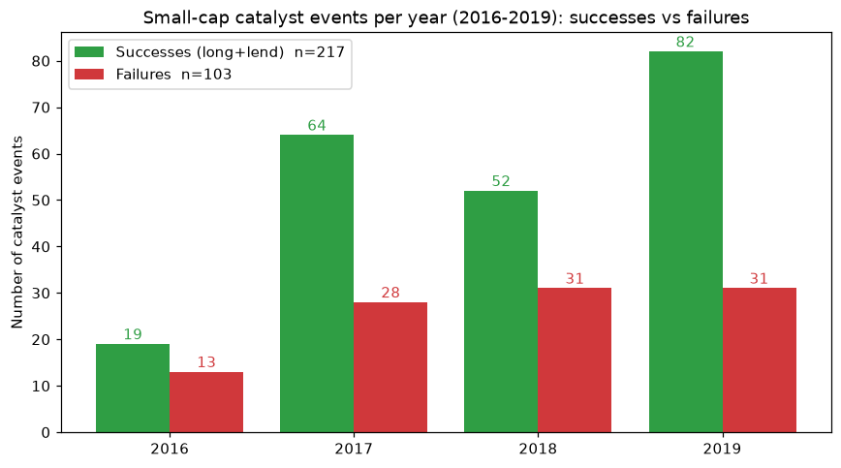
3
What we're assuming (and the dataset)
Plain-English assumptions - plus the one honesty adjustment that matters most.
Why only small companies?
A big drugmaker has 20 drugs, so one trial barely moves its stock. A small biotech IS its one drug - so the price reaction is huge and tradeable. We only trade small-caps.
We assume:
· Start with $10M (a test size). · Put ~$500k (5%) in each name -> about 30 held at once. · Trading + borrow costs (borrow fee has no public data, so we test a wide range). · A model of some accuracy - we don't have it yet, so we test 100% / 90% / 80%.
The honesty adjustment (important)
Our data is 68% winners - flattering (datasets over-capture notable, positive events). The real success rates for the readouts we trade are ~32% / 58% / 87% for Phase 2 / 3 / FDA. Blended by our mix = ~56%. We re-run everything at 56% too.
Source: Phase success rates: Wong, Siah & Lo 2019; BIO/Informa 2021 (Phase 2 ~28-35%, Phase 3 ~55-60%, regulatory ~85-90%).
04
Notes:
Let me lay out the assumptions plainly, this matters. First, why only small companies, top right - a big drugmaker has twenty drugs so one trial barely moves it, but a small biotech IS its one drug, so the stock reaction is huge and worth trading. Deliberate choice. Then: we start with $10M as a test size; put about $500k, which is 5%, into each name, so we hold roughly 30; we assume trading and borrow costs, and since there's no public data on borrow fees we test a wide range; and critically we assume a model of some accuracy - we don't have it, so we test perfect, 90%, and 80%. Now the gold box, the most important honesty point: our data is 68% winners, which is too high - datasets over-capture the notable positive events. The real blended success rate for the Phase 2, 3 and FDA readouts we trade is about 56%. So we re-run every number at 56% too - I'll always show both.

Slide 5
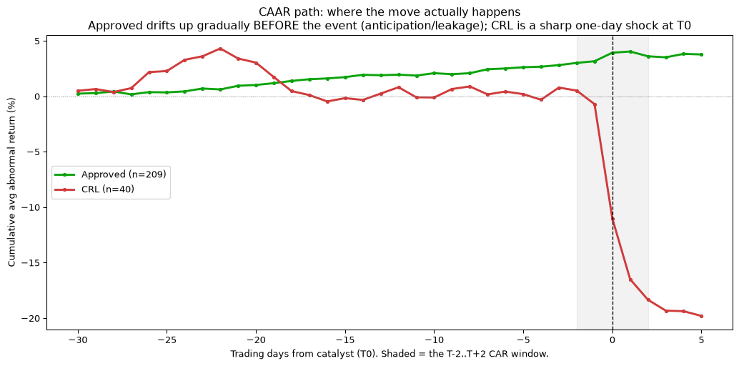
4
The finding - where the money actually is
Approvals are mostly priced in early; the big move is on failure. We go long + hedge.
Approvals are mostly priced in
winners drift up only ~+4% over our hold (median) - the market front-runs the good news
Failures crash hard
a small-cap that misses drops ~-14% to -17% in a day - that's the real, sharp move
Only in small-caps
a big-pharma readout barely moves the stock; a small-cap's whole value is one drug
Success != stock up
even a real winner can drift down over 3 months - which is why we hedge and lend
05
Notes:
The core insight, a little counter-intuitive. Look at the price path. By the time an approval is announced, the stock has usually already drifted up - winners only rise about 4% over our whole hold, because the market front-runs the good news. The BIG, sharp moves happen on failure: a small-cap that misses its trial drops 14 to 17% in a single day. So the information is really in the surprise, and it's concentrated in small-caps - a big pharma company has twenty drugs so one readout is noise, but a small biotech is that one drug. Last point, and it's why we don't just bet on price: even a real winner can drift DOWN over three months. So we hedge out the market and lend the shares for steady income, rather than relying on the stock always going up.

Slide 6
5
The strategy - what we run, and what we cut
We'll cover the deployed strategy (long + lend) first, then why we tested and dropped shorting.
1
Long + lend
2
Short the failures
3
Hedge with XBI
DEPLOYED - the engine
TESTED & DROPPED
OPTIONAL - insurance
Buy the predicted winners ~1 month out, hold ~3 months, and rent the shares to the crowd shorting them. This is where the money is.
We tried shorting the losers too. But the biggest-drop names are impossible to borrow, so after honest limits it loses money except in the best regime - cut. (Next slide: the proof.)
Short the biotech ETF to cancel sector-wide moves (hedge against a broad biotech selloff). Costs a little; it's crash insurance, not profit.
Money comes from the stock re-rating + the lending fee. Short and hedge are risk controls, not return drivers.
06
Notes:
Here's the roadmap for this slide: I'll explain the strategy we actually run - box one - then the next slide shows the short leg we tested and dropped, with the proof. So box one, long and lend: buy the winners about a month before the catalyst, hold three months, rent the shares out. That's the engine. Box two - we DID test shorting the losers, which sounds obvious since most fail. The problem: the juiciest shorts, the ones that crash hardest, are impossible to borrow, so once realistic that leg loses money except in the best case. Box three, the hedge - short the biotech ETF to cancel sector-wide swings, so we're hedged against a broad biotech selloff. Costs a bit, so it's crash insurance, not profit. Bottom line: profit is long + lend; the other two keep us safe.

Slide 7
6
Why we drop the short leg
The proof: split every scenario by leg (100% model). Short only pays in the best case.
Scenario (cost regime) | Long: price | Long: lend | SHORT net | Frictions | Total
BEAR - cheap borrow, hard to short | +$11.9M | +$0.5M | -$2.2M | -$1.6M | +$8.6M
BASE - realistic | +$12.0M | +$3.6M | -$0.9M | -$1.0M | +$13.6M
BULL - rich borrow, easy to short | +$11.9M | +$14.7M | +$0.1M | -$0.7M | +$26.0M
Short loses in BEAR (-$2.2M) and BASE (-$0.9M), and only squeaks positive (+$0.1M) in the best regime. Of the failures, only ~60% can even be borrowed - the biggest drops are the hardest to short.
Lending is the swing factor. Long price is steady (~$12M); lending income runs $0.5M -> $3.6M -> $14.7M across regimes. So we keep long+lend, drop the short.
Numbers on the selection-bias-adjusted 56% universe, at a perfect model, so columns differ only by the cost assumptions.
07
Notes:
This is the proof for dropping the short leg. We split the P&L by leg across three cost regimes - bear, base, bull - holding the model perfect so the only thing changing is the borrow economics. Look at the SHORT column: it loses $2.2M in bear, loses $0.9M in our base case, and only barely turns positive, plus $0.1M, in the best-case bull regime. The reason is on the slide - of all the failures, only about 60% can even be borrowed to short, and it's the biggest-drop names, the ones you'd most want, that are impossible to borrow. Meanwhile look at the two long columns: long price is steady around $12M, and lending swings from half a million to nearly $15M depending on the regime. So the money is long and lend; the short just doesn't pay after honest limits. That's why we cut it.

Slide 8
7
How the lending money is made
A daily rent that's richest before the catalyst, then fades.
Position sizing
5% of capital per name, max 10% per company -> ~30 names at once.
Lending income (per position)
position x borrow rate x utilization x time
Timing
Utilization = the share of your holding actually out on loan (the rest earns nothing).
enter ~1 month before the readout, exit ~3 months after.
Why hold through
Example - $1M position, 100%/yr rate, 40% on loan
you must hold the shares to rent them - the fee is richest while shorts pile in pre-catalyst.
before the event (full rate) = $31,700 after (rate fades) = $10,000
total lending = $41,700 (4.2% of the position, on top of the stock move)
08
Notes:
Quick on mechanics so the lending number feels real. We put 5% in each name, hold about 30, enter a month before, exit three months after. Why hold the whole time even if it wobbles? Two reasons - you literally have to hold the shares to rent them out, and the rent is richest right before the catalyst when the shorts pile in. The formula is your position times the borrow rate times 'utilization' - the fraction actually on loan - times time. In the example, a $1M position earns about $31k before and $10k after, so roughly $42k, about 4.2% - and that's ON TOP of whatever the stock does. Don't sweat the formula; the point is lending adds a few percent of steady income to every trade.

Slide 9
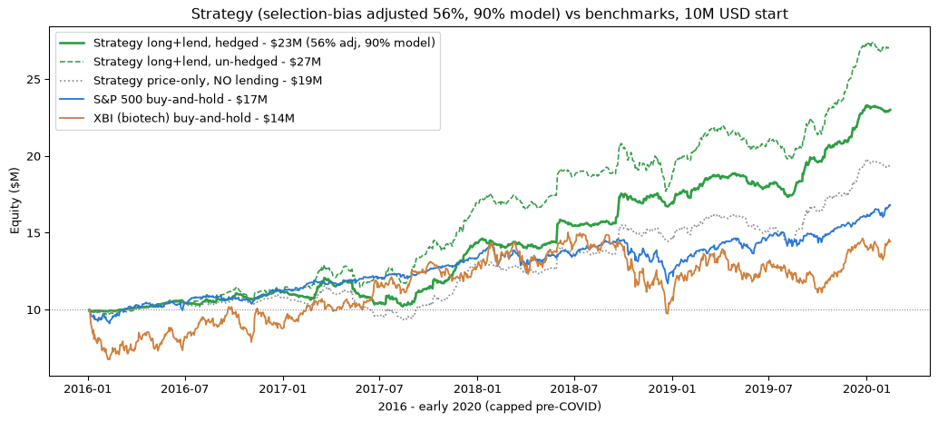
8
Results - over the 4 years, 2016-2019
Raw backtest vs the honest 56%-adjusted number we'd plan around.
$26.3M
$22.3M
~1.5
-18%
backtest (68% data)
adjusted (56% real)
Sharpe (risk-adj.)
worst dip (max DD)
vs market (56% adj) | $10M-> | per yr
Strategy (hedged) | $23M | 22%
Strategy (un-hedged) | $27M | 28%
S&P 500 buy & hold | $17M | 13%
XBI biotech buy & hold | $14M | 10%
Sharpe ~1.5 = solid (above 1 is good) return for the risk. Max dip -18% = the worst peak-to-trough along the way. Never a losing 4-year run in the sims.
09
Notes:
Here's the headline, over the full four years, 2016 to 2019. The raw backtest turns $10M into $26.3M. But remember our honesty fix - adjust to the realistic 56% success rate and it's $22.3M. I'd lead with both. Two risk numbers in plain English: Sharpe of about 1.5 - return per unit of risk, and above 1 is good, so solid. And max drawdown of minus 18% - the worst dip from a peak along the way. The chart shows the adjusted strategy against the market: we end around $23M hedged, $27M un-hedged, versus the S&P at $17M and biotech at $14M. So even after haircutting ourselves we beat the market, and never have a losing four-year run in the simulations. One honest note next slide - a lot of that edge is the lending, not just stock-picking.

Slide 10
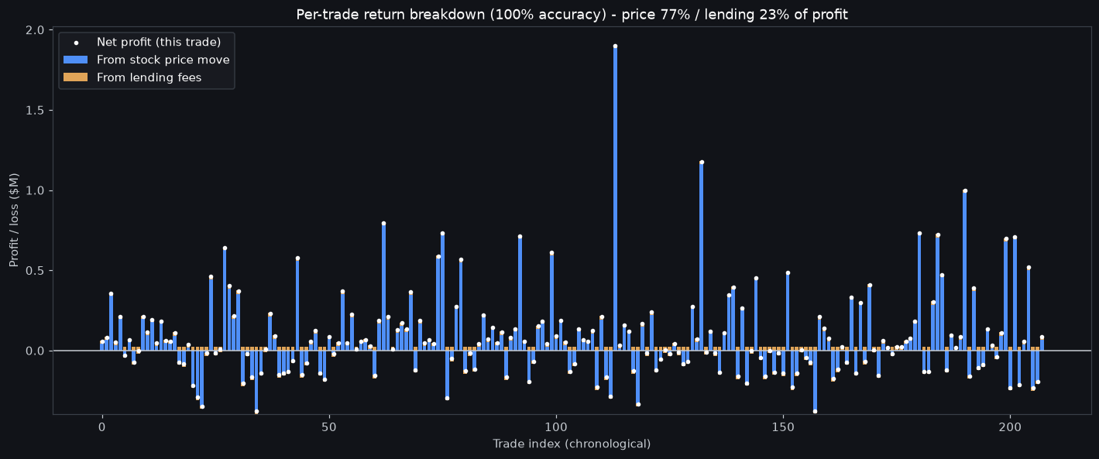
9
Is the profit the stock, or the lending? Every trade
Answer: ~77% from the stock going up, ~23% from lending fees - and we don't win them all.
Trades ($M) | Stock | Lend | Net
118 winners | +26.4 | +2.5 | +28.4
90 losers | -11.9 | +1.9 | -10.4
All 208 taken | +14.6 | +4.3 | +18.0
Stock ~77%, lending ~23%. 90 of 208 trades still LOST on price (winners that drifted down) - lending pays on every one, cushioning them.
208 traded of the 217 winners - ~9 were skipped when the book was already full (30-name cap).
10
Notes:
The question here is: where does the profit come from - stock picking or the lending gimmick? Each bar is one real trade - blue is what the stock did, gold is the lending fee. Add it up: about 77% is the stock going up, 23% is lending. So mostly stock-picking, but lending is a real chunk. Now the honest part in the table: 118 trades won, but 90 LOST money on the stock - cases where the trial succeeded but the stock still drifted down. We don't win them all. Why lending matters beyond the 23%: it pays on every single trade no matter what the stock does, so it steadily cushions those 90 losers. One reconciliation, since someone will ask - earlier I said 217 winners, here it's 208 because about 9 got skipped when we already had 30 positions full.

Slide 11
10
Does it even need a model?
Yes - the model roughly adds 40%, and (more importantly) it protects you.
$16.3M
->
$22.3M
+40%
NO model (long everything)
WITH a 90% model
the model's value
At the realistic 56% rate, winners still slightly outnumber losers (~1.3 to 1) and lending pays - so even buying EVERYTHING makes money in this backtest. But that floor is fragile: it leans on this being a friendly 2016-2019 market. The model's job is to lift the return AND keep it standing when winners get rarer (next slide).
Floor $16.3M (no skill) · Realistic $22.3M (90% model) · Ceiling $24.9M (perfect model). The model is what turns 'positive in a good market' into 'robust.'
11
Notes:
Fair challenge: do you even need a model, or are you just riding a good biotech market? So we tested the dumbest version - no model, buy EVERY catalyst and lend. Even that makes $16M at the realistic 56% rate, because winners still slightly outnumber losers - about 1.3 to 1, not a huge edge - and lending pays on all. Add a 90% model and you get $22M, so the model is worth about 40% more. BUT - and someone will push on this - that no-model floor is fragile. It only works because 2016 to 2019 was friendly; in a worse market or with more failures, buying everything would lose. So I would NOT promise 'you can't lose by buying everything.' The real value of the model is two things: it lifts the return, and it keeps the whole thing standing when winners get rare - which is the next slide.

Slide 12
11
Monte Carlo - do our assumption-guesses break it?
Hold model accuracy fixed; roll the uncertain cost assumptions 500 times (56% universe).
HELD FIXED (the baseline)
DRAWN AT RANDOM each run
Model accuracy 90% (then 80%)
Position size 5%, ~30 names, timing
(our design choices)
Borrow rate 25-250%/yr · Utilization 20-60%
Post-event fade 5-25% · Trading cost 40-150 bps
(the 4 market unknowns)
What varies (accuracy fixed) | 90% model - precision 92% | 80% model - precision 84%
Assumptions drawn independently | $21.9M [18.0, 27.8] | $19.8M [15.7, 25.6]
Assumptions correlated (all hit at once) | $21.7M [18.4, 26.6] | $19.5M [15.4, 24.3]
Chance of losing money (in the sims) | 0% | 0%
Read: a typical run makes ~$22M; even the unlucky 5% stays ~$18M, above the $10M start. Correlating the assumptions barely trims it - the cost guesses don't break it. Caveat: every run uses 2016-2019 prices, so "0% loss" means in a market like that one.
Precision (in the header) = when the model says "success," how often it's right; 92% here because we're at the realistic 56% base rate (next slide).
12
Notes:
Some of our inputs are genuine guesses - we don't know the exact borrow rate, how much of the position actually gets lent out, or the trading cost. So the fair question is: if those guesses are off, does the whole thing fall apart? That's what this slide tests. Here's how. We KEEP the model accuracy fixed - at 90%, then 80% - and keep our own choices fixed, like sizing and timing. Then we take the four things we genuinely don't know - borrow rate, utilization, the post-event fade, and trading cost - and instead of guessing once, we draw them at random over a wide range and re-run the whole strategy, 500 times. That's the table. At a 90% model, a typical run makes about $22M, and 90% of all runs land between $18M and $27M; drop to an 80% model and it's around $19.5M. We even drew the assumptions two ways - each on its own, and all going wrong together like a liquidity crunch - and even that barely moves it. The bottom line: not a single run lost money, so our cost guesses don't break the strategy. Two honest flags to close. One - you'll notice 'precision' in the headers; that's the real risk and it's the very next slide, so hold that thought. Two - this test only shuffles the COST guesses; every run still uses the actual 2016-to-2019 prices, so 'zero losses' means in a market like that one, not a promise for a future crash.

Slide 13
12
Why we adjusted to 56% - it's all about precision
Remember the 56% honesty cut? Here's why: a '90% accurate' model can still be wrong half the time.
Imagine 1,000 companies where only 10% succeed. Even a 90%-accurate model:
 | Model says SUCCESS | Model says fail
100 real winners | 90 caught | 10 missed
900 real failures | 90 LANDMINES | 810 avoided
We'd buy 180, only 90 are real
= precision 50%. Half the book is landmines that crash - even though the model is '90% accurate.'
So why is 56% the whole game? The rarer the winners, the more failures sneak in as "landmines." At a 10% success rate a 90% model is only 50% precise. At OUR realistic 56%, that same model is 92% precise - it holds up. That's exactly why we insisted on 56% instead of a made-up rosy number.
Precision = when the model says "success," how often it's actually right. A wrong pick gets bought and crashes ~15%.
13
Notes:
This ties back to that 56% adjustment - here's WHY it mattered so much. 'Accuracy' can fool you. Picture 1,000 companies where only 10% win. Even a 90%-accurate model catches 90 of the 100 winners, but it also wrongly flags 90 of the 900 losers as winners. So it says 'success' to 180 names and only half are real - precision of 50%. Half your book would be landmines that crash, even though the model is technically 90% accurate. That's the base-rate trap. Now connect it: the rarer winners are, the worse precision gets. That's the entire reason we refused to use our flattering 68% and adjusted to the realistic 56% - because at 56% that same 90% model is 92% precise and holds up, whereas in a 10% world it falls apart. Message to whoever builds the model: chase precision, not just accuracy.

Slide 14
13
What could break it
The honest list - what we assumed, and what we can't yet know.
Assumption | What we used | Confidence
Model precision | 90% acc -> 92% precision at 56% | the big unknown
Borrow rate / utilization | 100%/yr, 40% (assumed) | no data - swept
Timing & costs | ~1mo before / 3mo after, ~0.85% | grounded
Market regime | all sims use 2016-2019 prices | not stress-tested
The hedge | on (optional) | cost return here
Biggest caveat: 'never loses' is conditional on a 2016-2019-like market - every simulated path comes from that window. A broad sector crash is a separate risk, which is what the optional hedge is insurance against.
14
Notes:
I'd rather flag our own weak spots than have someone find them. Top of the list in red: model precision - we don't have the model yet, so 92% is a target, not a fact, and everything hinges on it. Borrow economics we assumed with no hard data, though we stress-tested a wide range. Timing and costs are solid. Two amber ones people miss: first, every simulation uses 2016-to-2019 prices, so 'never loses' means never loses IN a market like that - a real sector crash is a separate risk, which the optional hedge insures against. Second, the hedge itself cost us return in this friendly window. None of these are dealbreakers, but that's the honest fine print, and I wanted you to hear it from us.

Slide 15
14
How big can it get? ~$100M
Small-cap liquidity caps it - a boutique sleeve, not a mega-fund.
1
You can safely trade ~10-20% of a stock's daily volume
push past that in a day and your own buying visibly moves the price against you
2
Over our ~1-month entry window, that's roughly one full day's volume per position
the median name we trade only turns over ~$3.3M a day - so a position tops out around $3-5M
3
A $3-5M position is our 5% slice
so the fund can be about 20x that - roughly $67M to $134M -> call it ~$100M
Deployable ~$50-150M, call it ~$100M. Push past that and you either skip the thinnest names or pay far more to trade - the edge erodes. A high-return niche sleeve, not a flagship.
Source: Median daily $ volume from 2016-2019 trading data for 88 of the 91 names we traded.
15
Notes:
How much money can this hold? About $100M, built up properly. Start with the real constraint: to avoid moving the price you can only safely trade about 10 to 20% of a stock's daily volume in a day - trade more and everyone sees a big buyer and the price runs away. We build a position gradually over our roughly one-month entry window, and that safely lets you accumulate about one full day's volume per name. The stocks are tiny - the typical one trades only about $3.3M a day - so a position tops out around $3 to $5M. THAT position is our 5% slice, so the fund can be roughly 20 times that, landing at $67 to $134M - call it $100M. Past that you skip the smallest names or pay up, and the edge bleeds away. A sharp niche fund, not a giant - fine for an uncorrelated sleeve.

Slide 16
Recommendation
The economics work. The whole bet now rides on one thing: can we build a precise enough model?
PROVEN
Long+lend beats the market even after the honest 56% haircut ($22M, 22%/yr, never a losing 4-year run in the sims). Lending adds ~19%. There's a positive floor even with zero skill in a normal market.
THE CATCH
It all hinges on model precision - at a realistic base rate a 90% model works, but precision (not raw accuracy) is what keeps landmines out of the book.
NEXT STEPS
1) Build & validate the model ('Alpha Forge') - measure its precision. 2) Add a stop-loss to cut drifters and misclassified landmines. 3) Confirm borrow economics with a prime broker. Run it as a capacity-limited (~$100M) uncorrelated sleeve.
16
Notes:
To wrap up - the ask. The economics work: even after we haircut to the realistic 56%, long+lend makes about $22M, 22% a year, never has a losing four-year run in the sims, and beats the market, with lending adding about a fifth of the profit. And there's a positive floor even with no skill in a normal market. The catch - the whole thing now hinges on one question: can we build a model that's not just accurate but PRECISE, so we keep landmines out. Next steps are concrete: build and validate the model - the 'Alpha Forge' piece - and measure its precision; add a stop-loss to cut losers and landmines; and confirm borrow economics with a real prime broker. We'd run it as roughly a $100M uncorrelated sleeve. Recommendation: proceed to build the model.

Slide 17
Appendix
Supporting detail for Q&A: one-at-a-time sensitivity, hedge methodology, and the 68% -> 56% adjustment visualized.
17
Notes:
Everything from here is backup for questions - not part of the main pitch.

Slide 18
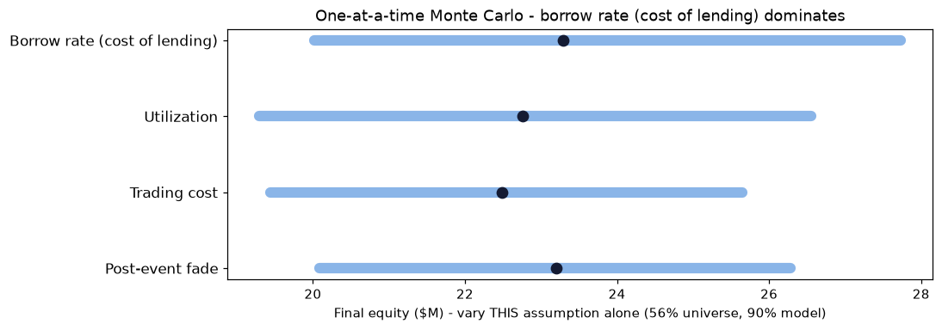
A1
One-at-a-time sensitivity
Vary ONE assumption at a time - which single input matters most? (56%, 90% model)
Vary this alone | Typical [90% range]
Borrow rate (cost of lending) | $23.3M [20.0, 27.7]
Post-event fade | $23.2M [20.1, 26.3]
Utilization | $22.8M [19.3, 26.5]
Trading cost | $22.5M [19.4, 25.6]
Borrow rate - the cost of lending - is the single most important input (widest bar). It's exactly the assumption to nail down with a prime broker. Even so, the worst single-variable case still ends around $20M.
18
Notes:
This is the Stylianos ask - vary one assumption at a time and see which matters most. Each bar holds everything else fixed and sweeps just that one input. The clear winner is borrow rate, the cost of lending - the widest bar - so that's the number to pin down with a prime broker. But even in the worst single-variable case it still lands around $20M, so nothing here is a dealbreaker.

Slide 19
A2
Hedge methodology (how, and against what)
We short the biotech ETF, sized by each stock's beta.
What we short
the XBI biotech ETF - a basket of biotech stocks - so we're not betting on the whole sector's direction
How much (beta-sized)
for each stock, we estimate its 'beta' to XBI (a regression on pre-event returns) and short beta x the position - a jumpier stock gets a bigger hedge
Against what
a broad biotech selloff. If the whole sector drops, the short gains and offsets our longs
The honest cost
in 2016-2019 biotech mostly rose, so the hedge cost return. It helped in the Q4-2018 selloff (-5% vs -14%) but hurt in the 2017 rally
19
Notes:
For anyone who asks how the hedge works. We short the biotech ETF, XBI - a basket of biotech names - so we're not exposed to whether the whole sector goes up or down. We size it by beta: each stock's sensitivity to the ETF, from a regression on its returns before the event, and we short beta times the position, so a jumpier stock gets a bigger hedge. What it protects against is a broad biotech selloff - if the sector craters, the short gains and offsets our longs. And honestly: in 2016-2019 biotech mostly rose, so the hedge cost us return; it did help in the late-2018 selloff, cutting the drawdown from about 14% to 5%, but it hurt during the 2017 rally. That's why we call it optional insurance.

Slide 20
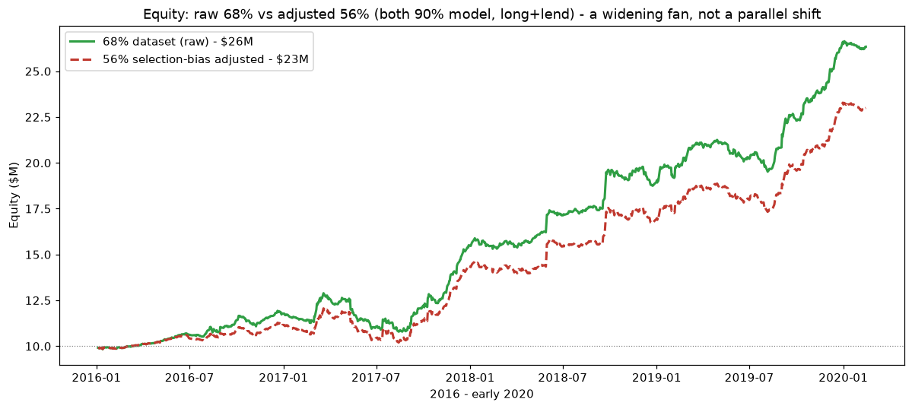
A3
The 68% -> 56% adjustment, visualized
Adjusting to the realistic success rate lowers the growth rate - a widening fan, not a flat drop.
20
Notes:
This shows what the honesty adjustment does to the equity curve. Green is our raw 68% dataset, red is the realistic 56%. Notice they start together and the gap WIDENS over time - it's a fan, not a parallel drop. That's because the extra failures in the 56% version crash at their own scattered dates, so the drag builds up as the strategy runs. The 56% line still climbs steadily, just at a shallower rate, ending around $23M instead of $26M. Same shape, lower slope.

