Slide 1
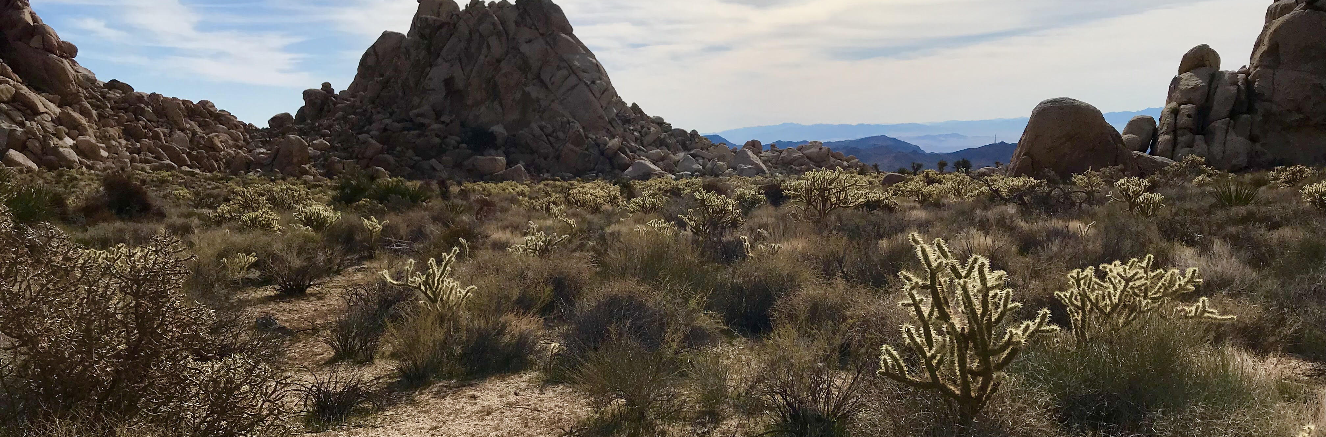
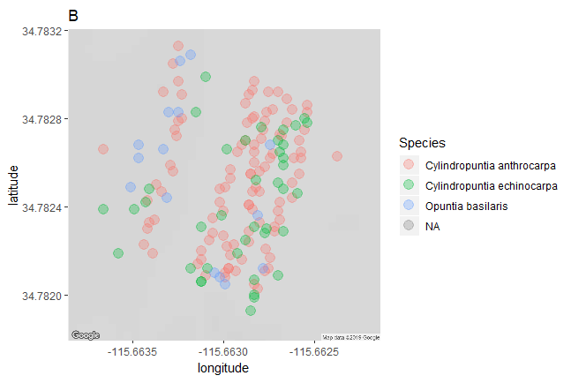




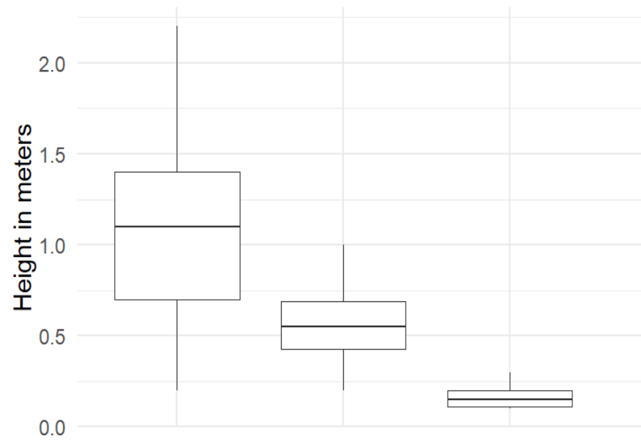

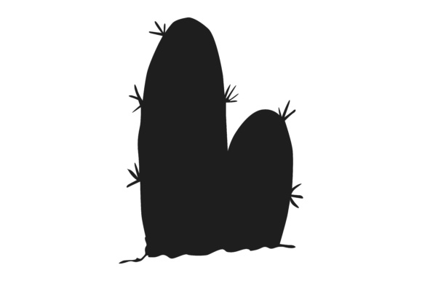





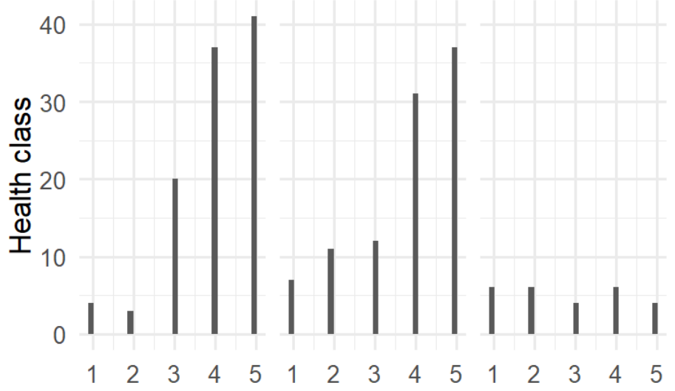
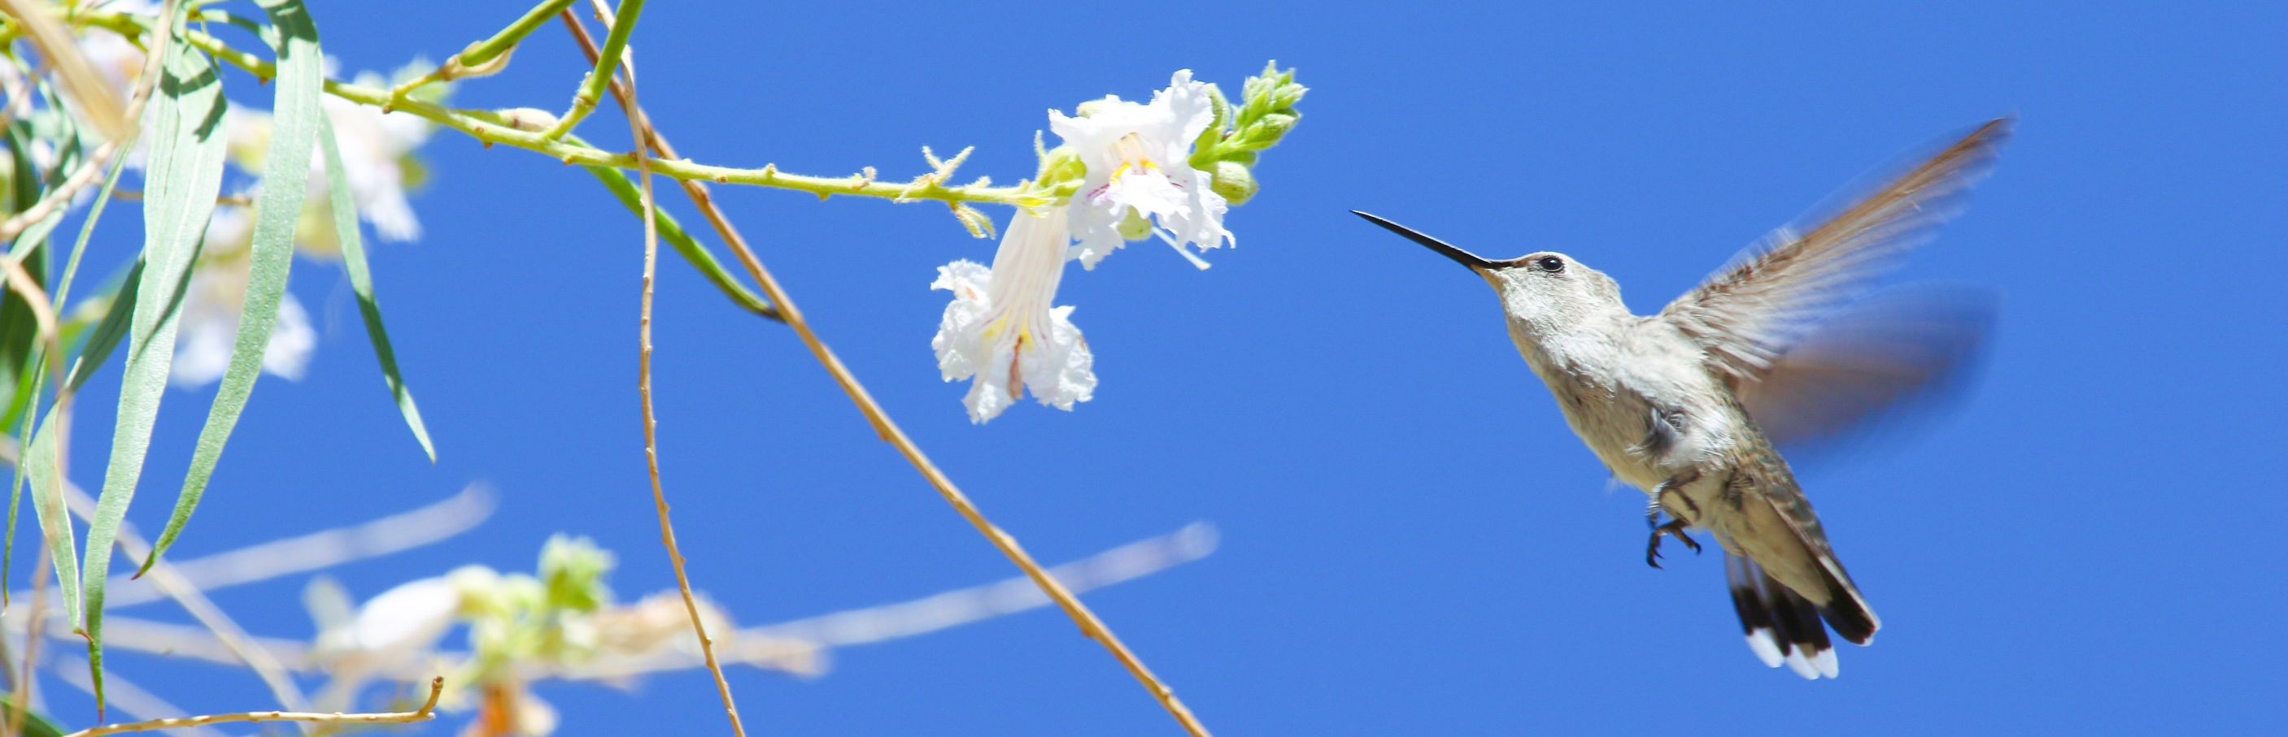



A Prickly Situation: Contrasting ecological functionality in three cactus species
Malory Owen¹ | Dr. Chris Lortie¹ | York University¹ | www.ecoblender.org¹
34.7832
www.ecoblender.org
Question
Methods
What physiological characteristics determine ecologically functional differences in three species of cacti?
Transects or haphazard sampling
Major axis, minor axis, vertical axis
Health index 1-5
Scarification, rot, branch death
34.7828
latitude
Cylindropuntia acanthocarpa
Cylindropuntia echinocarpa
Opuntia basilaris
34.7824
Double Mutualism & Facilitation
Results
34.7820
Positive interactions drive ecosystem infrastructure¹
Birds are nectarivores and frugivores of cacti^{2, 3}
Double mutualism: two positive interactions between interspecifics⁴
Harsh environments promote double mutualism⁵
Cacti are desert foundational species⁶
-115.6635
-115.6630
-115.6625
longitude
Figure 3: A map of three cactus species’ locations and overlap.
Conclusions
These cacti are geographically overlapping, have varying heights, and have unique health. Therefore, they likely provide functionally different niches for nectarivorous and frugivorous birds.
Cylindropuntia Cylindropuntia Opuntia
acanthocarpa echinocarpa basilaris
Future Research
Figure 4: C. acanthocarpa (1.04 m) > C. echinocarpa (0.55 m) > O. basilaris (0.17 m)
Survey reproductive outputs against morphological characteristics
Monitor bird interaction frequency and magnitude at different phenological stages
Determine foundational cacti’s seed shadows facilitation
Figure 1: Birds pollinate and disperse seeds of foundational
plants.
Hypotheses and Predictions
Different species of cacti occupy different ecological and facilitating niches.
Different cactuses will have different sizes and health which will impact interactor visitation at different phenological life stages.
Number of individuals in each health class
Health Class
Figure 5: C. acanthocarpa and C. echinocarpa had more individuals with health scores of 4 or 5, whereas O. basilaris had a even distribution of health scores.
References
Species 2
Each cactus species had significantly different mean heights (Kruskal-Wallis, Chi-square = 3.71, p > 0.0001, df = 52).
C. acanthocarpa and C. echinocarpa are healthier than O. basilaris (Pearson’s Chi-squared Test, X-squared = 27.325, df = 8, p > 0.001).
Callaway, Ragan M. 1997. “Positive interactions in plant communities and the individualistic-continuum concept.” Oecologia 112: 143–49.
Montiel, Salvador, and Carlos Montaña. 2000. “Vertebrate Frugivory and Seed Dispersal of a Chihuahuan Desert Cactus” 146 (2): 221–29.
Gorostiague, P., and P. Ortega-Baes. 2016. “How specialised is bird pollination in the Cactaceae?” Plant Biology 18 (1): 63–72. doi:10.1111/plb.12297.
Kelly, Dave, Jenny J Ladley, Alastair W Robertson, and Jenny J Ladley. 2004. “Is dispersal easier than pollination ? Two tests in New Zealand Loranthaceae.” New Zealand Journal of Botany 42: 89–103. doi:10.1080/0028825X.2004.9512892.
Garcia, Maria B., Xavier Espadaler, and Jens M. Olesen. 2012. “Extreme Reproduction and Survival of a True Cliffhanger : The Endangered Plant Borderea chouardii.” PLOS One 7 (9): 1–7. doi:10.1371/journal.pone.0044657.
Filazzola, A., Lortie, C. J. 2014. “A systematic review and conceptual framework for the mechanistic pathways of nurse plants.” Global Ecology and Biogeography 23 (12): 1335-1345.
Wolf, L. L., and Hainsworth, A.R. 1990. “Non-Random Foraging by Hummingbirds : Patterns of Movement Between Ipomopsis.” Functional Ecology 4 (2): 149–57.
Species 1
Species 3
Figure 2: Avian interactors visit higher and showier reproductive
displays.⁷ Do these characteristics differ between cactus species?
Notes:
Hi I’m Malory Owen, I’m a first year Master’s student here at York, and I’m interested in how different cactus species fulfill different ecological niches.
First off, I just want to clear up that deserts aren’t these bare wastelands we see in movies; they’re full of life and diversity with fascinating unique adaptions to a harsh arid environment.
We’ve seen how important positive interactions are for driving and ecosystem’s infrastructure. Just like a city, we need buildings and roads and sidewalks for people to live in the city. And we, as humans, use all these different structures in different ways. We could measure the width of a sidewalk and a road, and indeed see that they likely fulfill different niches due to their size. I wanted to know, can we pick up on similar differences in a cactus species’s physical characteristics that will influence how they, as foundational keystone species in desert habitats, fulfill different niches. Particularly, niches for positive interactions with flying nectarivores and frugivores (aka birds). And I wanted to do so with fast, reproducible, practical methodology.
We know that flying nectarivores and frugivores tend to visit individuals with showier displays more frequently. Showiness is impacted by the number of inflorsences and the height of those inflorences. These two features would be easy to determine by measuring height and health of an individual (cacti flower at their terminal nodes and healthier individuals are more likely to produce more flowers/fruits). So we set out and measured three different species of cacti: Cylindropuntia acanthocarpa, Cylindropuntia echinocarpa, and Opuntia basilaris. These are three common species in the Mojave Desert.
And we did indeed find significant differences! Mean heights were different for all three cactus species with C. acanthocarpa being the tallest and O. basilaris being the shortest. C. acanthocarpa and C. echinocarpa both had more healthy indivdiuals than O. basilaris, which had an even distribution of health across individuals. We also see that C. acanthocarpa is the most abundant of the species from this map, but perhaps more importantly, we see that they geographically overlap. All these measurements give us opportunity to see physical differences of cacti that could lead to different niche fulfillment.
But next steps must be taken. In Spring, I’ll be returning to the field to test our first two ideas. Of course, we need to see how strongly reproductive output is related to size and health in our cacti. Next, we need evidence that these traits do indeed results in different niche fulfill by monitoring bird visitation. (This poster is actually a story based on my preliminary dataset that I collected in preparation for my spring and summer field seasons coming up). And finally, I’d love for us to take this a step further, and see how different interactions with pollinators and seed dispersers influence a mother plant’s seed shadow (that is, are seeds deposited in favorable conditions for germinations).
If you are interested in keeping up with our labs future projects, you can follow our lab’s blog at ecoblender.org or scan this QR code. And of course I’d like to thank NSERC, York University, and (since this poster was printed) the Paul Jorgensen Research Grant for supporting our work. Thank you so much for listening!

