Slide 1
HR Data Analysis for Workforce Insights
Student: ZENUS DASH
Reg. No.: 2201289227
Guide: SASHI BHUSAN PARIDA

Slide 2
Agenda
Project statement
Objectives
Functionality & features
Methodology / Architechture
Results
Conclusion & Future work
Use-case diagram / requirement analysis

Slide 3
Project Statement & Motivation
PROBLEMS
MOTIVATION
Data driven insights
Identify Trends
Decision Making
Organizations collect large HR datasets, but extracting actionable insights is difficult.
Raw HR data often contains inconsistencies (missing values, duplicate entries, wrong date formats).

Slide 4
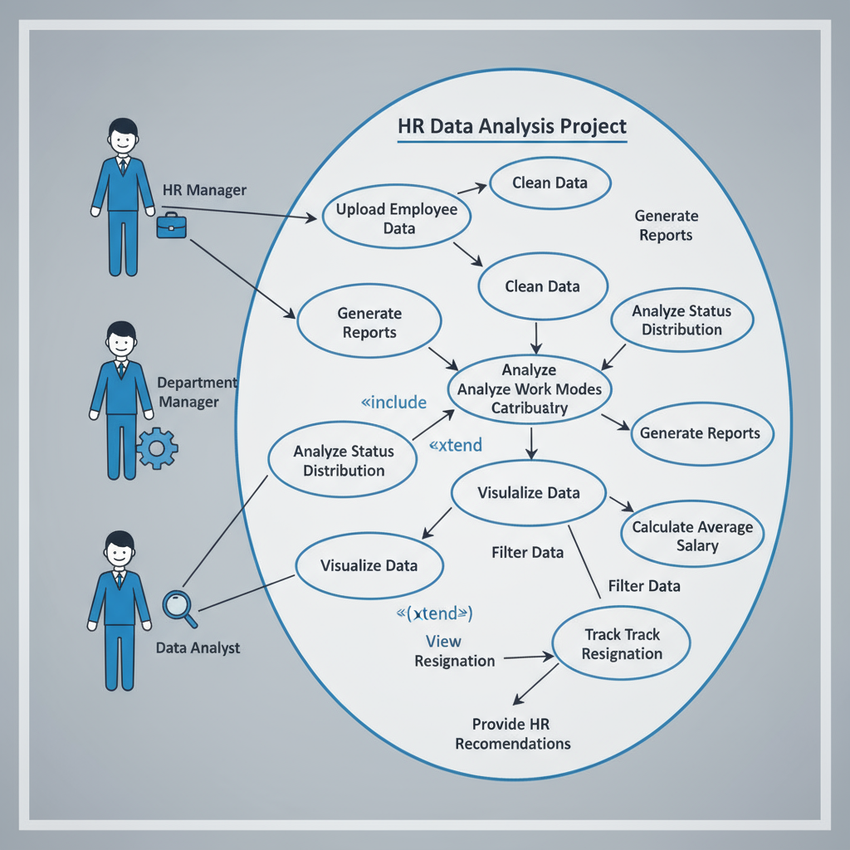
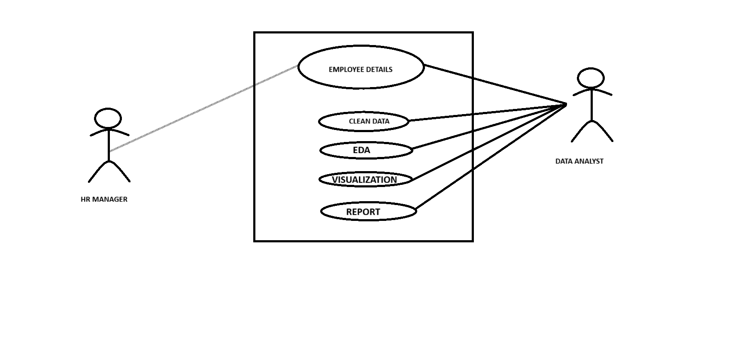
Use-case diagram

Slide 5
Requirement Analysis
Functional Requirement
Upload and Manage Employee Data: The system shall allow HR managers to upload, add, edit, and manage employee information including personal, job, and salary details.
Data Analysis and Reporting: The system shall analyze employee data distributions (status, work modes, departments) and generate customized reports based on filters.
Visualization and Insights: The system shall provide graphical visualizations such as charts and graphs to present trends like average salaries, performance ratings, and attrition.
Employee Retention Tracking: The system shall track employee retention/resignation rates and support decision-making for workforce management.
Non-Functional Requirement
Performance: The system shall efficiently handle large datasets ensuring timely response for analysis and report generation.
Scalability: The system shall scale to handle growing volumes of employee data and users without degrading performance.
Security and Privacy: The system shall ensure secure data access, encryption, and compliance with regulations such as GDPR.
Usability: The system shall have an intuitive interface, enabling HR staff and analysts to easily use features without extensive training.

Slide 6
Objectives
DATA
Validation
Exploratory Data Analysis
PROCESSING
Preprocess raw data
TRENDS
Analysis
Visualization
Data cleaning
DISTRIBUTION
Analyse salary
Experience
Decision making
Provide insights

Slide 7
Functionalities / Features
Data Handlling
Handles missing values, duplicates, and incorrect formats.
Employee status
Identifies workforce distribution across categories: Active, Resigned, Retired, Terminated.
Converts dates, standardizes columns, and removes irrelevant fields.
Helps HR understand attrition and stability levels.
Work mode analysis
Breaks down employees into On-site, Hybrid, or Remote categories.
Useful for workforce planning and hybrid policy decisions.
Department Distribution
Shows headcount per department (HR, Sales, IT, Finance, etc.).
Salary and Experience
Analyzes salary trends across job roles and experience levels.
Highlights overstaffed/understaffed areas.
Helps HR evaluate pay gaps and fairness.
Visualization & Reporting
Generates charts (pie, bar, histogram) for easy understanding.
Converts raw data into meaningful HR insights for decision-making.

Slide 8
Methodology / Architecture
Data collection
Gathered HR dataset which includes employee details
Data processing
Cleaned missing values, removed duplicates.
EDA
Performed statistical analysis to find patterns.
Standardized date formats, dropped irrelevant columns.
Checked employee distribution across status, work mode, and departments.
VISUALIZATION
Used charts (bar, pie, histograms) for employee trends.
Made insights easy to interpret for HR managers.
Insight Generation
Discovered patterns in employee attrition, pay scale, and workforce structure.
Provided actionable takeaways for HR decision-making.

Slide 9
Results
Achievements
Employee status distribution analyzed (Active, Resigned, Retired, Terminated).
Issues
Missing values and incomplete employee records.
Solutions
Data cleaning & preprocessing (drop, fill, convert).
Work mode split (On-site, Hybrid, Remote) clearly identified.
Department-wise headcount visualized.
Salary & experience distribution explored with charts.
Clean and structured dataset ready for HR insights.
Inconsistent date formats and duplicate entries.
Unnecessary or irrelevant columns in dataset.
Standardized formatting for consistency.
Removed noise and irrelevant features for clarity.

Slide 10
Conclusion & Future Work
Conclusion
HR data analysis successfully revealed key workforce trends (status, work modes, departments).
Visualizations provided clear and actionable insights for HR decision-making.
Data preprocessing improved dataset quality, enabling reliable analysis.
Project demonstrated the value of data-driven HR management.
Future Work
Build predictive models for attrition, promotions, and performance.Create interactive dashboards using Tableau/Power BI.
Incorporate real-time HR data streams for live insights.Extend analysis with machine learning for employee satisfaction and retention forecasting.

Slide 11

Thank you

