Slide 1
Information Technology Project Management – Fifth Edition
By Jack T. Marchewka
Northern Illinois University
7-1
Copyright 2015 John Wiley & Sons, Inc.

Slide 2
Managing Project Risk
Chapter 7
7-<number>
Copyright 2015 John Wiley & Sons, Inc.

Slide 3
Learning Objectives
Describe the project risk management planning framework introduced in this chapter.
Apply risk identification tools and understand the causes, effects, and the integrative nature of project risks.
Apply several qualitative and quantitative analysis techniques that can be used to prioritize and analyze various project risks.
Describe the various risk strategies, such as insurance, avoidance, or mitigation.
Describe risk monitoring and control.
Describe risk evaluation in terms of how the entire risk management process should be evaluated in order to learn from experience and to identify best practices.
7-<number>
Copyright 2015 John Wiley & Sons, Inc.

Slide 4
Common Mistakes in Managing Project Risk
Not understanding the benefits of risk management
Not providing adequate time for risk management
Not identifying and assessing risk using a standardized approach
7-<number>
Copyright 2015 John Wiley & Sons, Inc.

Slide 5
Effective & Successful Risk Management Requires
Commitment by all stakeholders
Stakeholder responsibility
Different risks for different types of projects
7-<number>
Copyright 2015 John Wiley & Sons, Inc.

Slide 6
Definition of Risk (PMBOK® Guide)
  An uncertain event or condition that, if occurs, has a positive or negative effect on one or more of the project objectives such as scope, schedule, cost, and quality.
7-<number>
Copyright 2015 John Wiley & Sons, Inc.

Slide 7
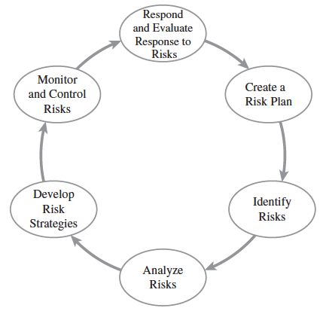
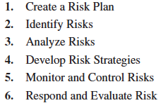
Project Risk Management Processes
7-<number>
Copyright 2015 John Wiley & Sons, Inc.

Slide 8
Step 1 – Create A Risk Plan
Requires firm commitment by all stakeholders to the entire Risk Management (RM) approach
  RM should align throughout the organization
Risk Planning focuses on preparation
  Systematic preparation and planning can help minimize adverse effects on the project while taking advantage of opportunities as they arise
7-<number>
Copyright 2015 John Wiley & Sons, Inc.

Slide 9
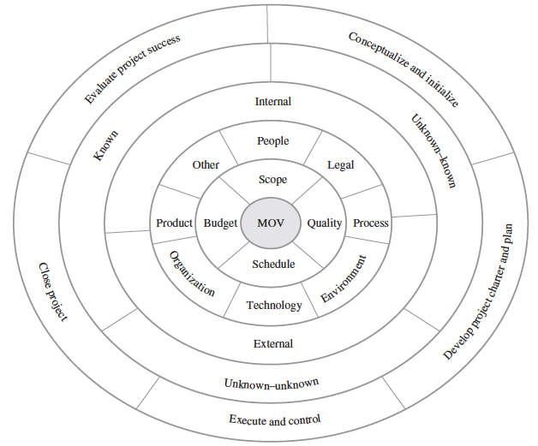
STEP 2 – Identify Risks through a Project Risk Identification Framework
Risk Identification
Framework
7-<number>
Copyright 2015 John Wiley & Sons, Inc.

Slide 10
STEP 2 – Identify Risks through Risk Identification Tools & Techniques
Learning Cycles
Brainstorming
Nominal Group Technique
Delphi Technique
Interviews
Checklists
SWOT Analysis
Cause & Effect (a.k.a. Fishbone/Ishikawa)
Past Projects
7-<number>
Copyright 2015 John Wiley & Sons, Inc.

Slide 11
STEP 2 – Identify Risks through Risk Identification Tools & Techniques – Nominal Group Technique (NGT)
Each individual silently writes their ideas on a piece of paper
Each idea is then written on a board or flip chart one at a time
in a round-robin fashion until each individual has listed all of his or her
ideas
The group then discusses and clarifies each of the ideas
Each individual then silently ranks and prioritizes the ideas
The group then discusses the rankings and priorities
Each individual ranks and prioritizes the ideas again
The rankings and prioritizations are then summarized for the group
7-<number>
Copyright 2015 John Wiley & Sons, Inc.

Slide 12
STEP 2 – Identify Risks through Risk Identification Tools & Techniques – Risk Check List
Funding for the project has been secured
Funding for the project is sufficient
Funding for the project has been approved by senior management
The project team has the requisite skills to complete the project
The project has adequate manpower to complete the project
The project charter and project plan have been approved by senior management or the project sponsor
The project’s goal is realistic and achievable
The project’s schedule is realistic and achievable
The project’s scope has been clearly defined
Processes for scope changes have been clearly defined
7-<number>
Copyright 2015 John Wiley & Sons, Inc.

Slide 13

STEP 2 – Identify Risks through Risk Identification Tools & Techniques – SWOT Analysis
7-<number>
Copyright 2015 John Wiley & Sons, Inc.

Slide 14
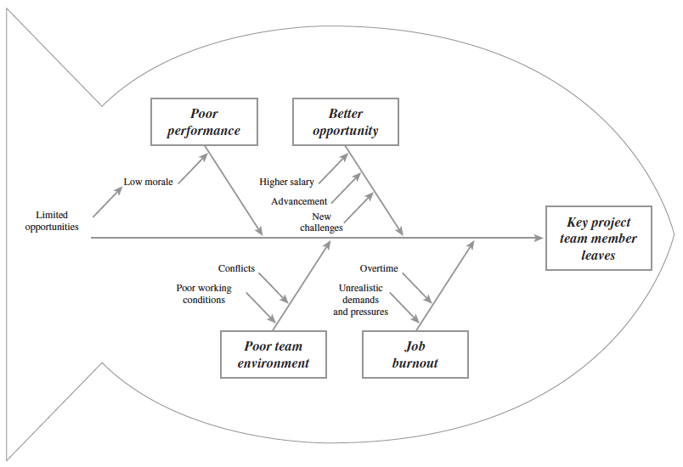
STEP 2 – Identify Risks through Risk Identification Tools & Techniques – Cause & Effect Diagram
7-<number>
Copyright 2015 John Wiley & Sons, Inc.

Slide 15
STEP 3 – Analyze Risks
Risk = f(Probability * Impact)
Risk assessment focuses on prioritizing risks so that
an effective strategy can be formulated for those risks
that require a response.
Can’t respond to all risks!
Depends on Stakeholder risk tolerances
7-<number>
Copyright 2015 John Wiley & Sons, Inc.

Slide 16
STEP 3 – Analyze Risks
Qualitative Approaches
Expected Value & Payoff Tables
Decision Trees
Risk Impact Table & Ranking
Tusler’s Risk Classification
Which risks require a response?
7-<number>
Copyright 2015 John Wiley & Sons, Inc.

Slide 17
Payoff Table
A
B
A*B
Schedule Risk
Probability
Payoff
(In thousands)
Prob * Payoff
(In thousands)
Project completed 20 days early
5%
$ 200
$10
Project completed 10 days early
20%
$ 150
$30
The
Expected
Value
Project completed on Schedule
50%
$ 100
$50
Project completed 10 days late
20%
$ -
$0
Project completed 20 days late
5%
$ (40)
($2)
100%
$88
7-<number>
Copyright 2015 John Wiley & Sons, Inc.

Slide 18
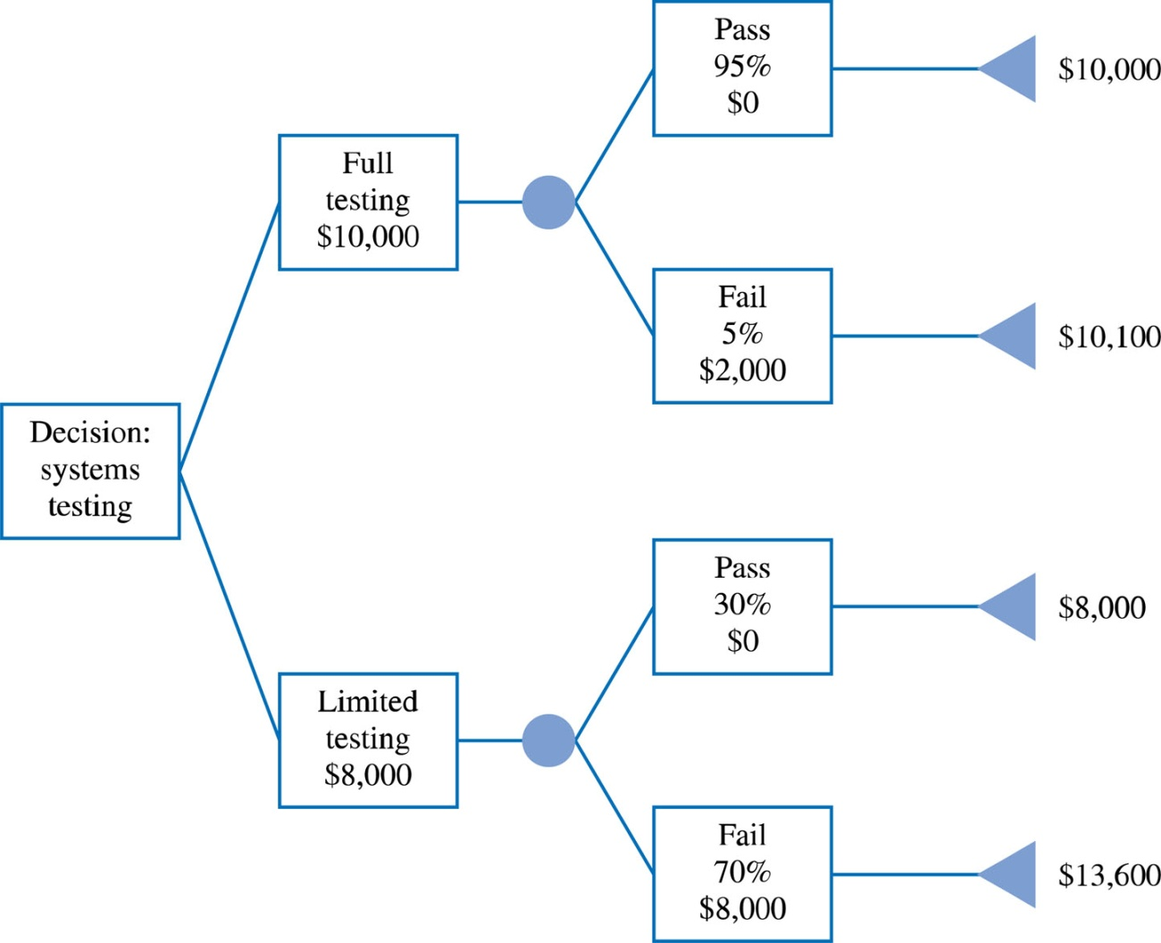
Decision Tree Analysis
7-<number>
Copyright 2015 John Wiley & Sons, Inc.

Slide 19
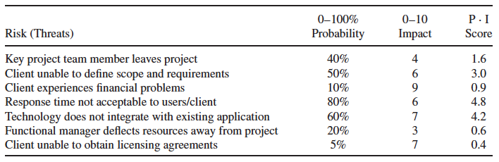
STEP 3 – Analyze Risks – Risk Impact Table
IT Project Risk Impact Analysis
7-<number>
Copyright 2015 John Wiley & Sons, Inc.

Slide 20
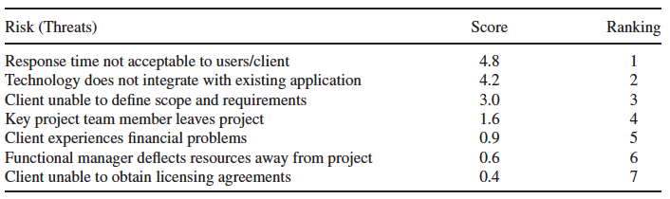
Risk Rankings
7-<number>
Copyright 2015 John Wiley & Sons, Inc.

Slide 21
STEP 3 – Analyze Risks
Quantitative Approaches
Quantitative Probability Distributions
  Discrete
    Binomial
  Continuous
    Normal
    PERT
    TRIANG
7-<number>
Copyright 2015 John Wiley & Sons, Inc.

Slide 22
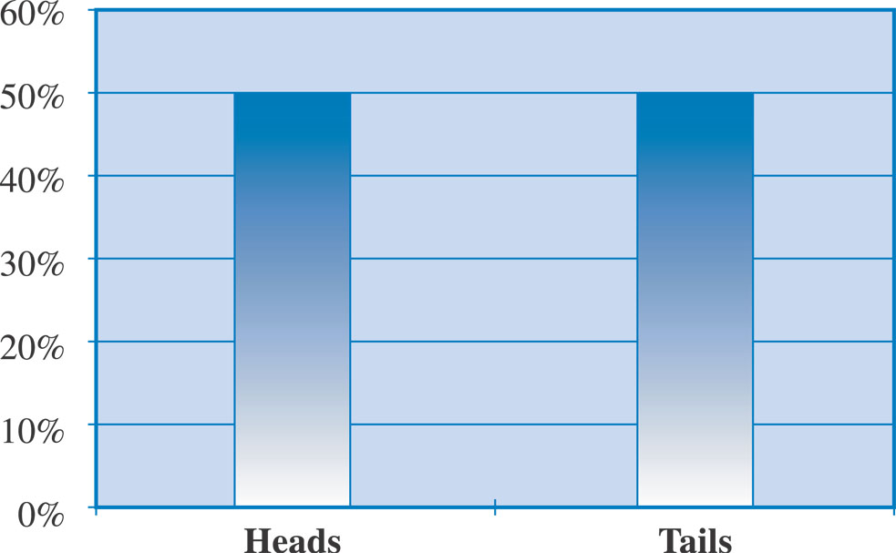
Binomial Probability Distribution
7-<number>
Copyright 2015 John Wiley & Sons, Inc.

Slide 23
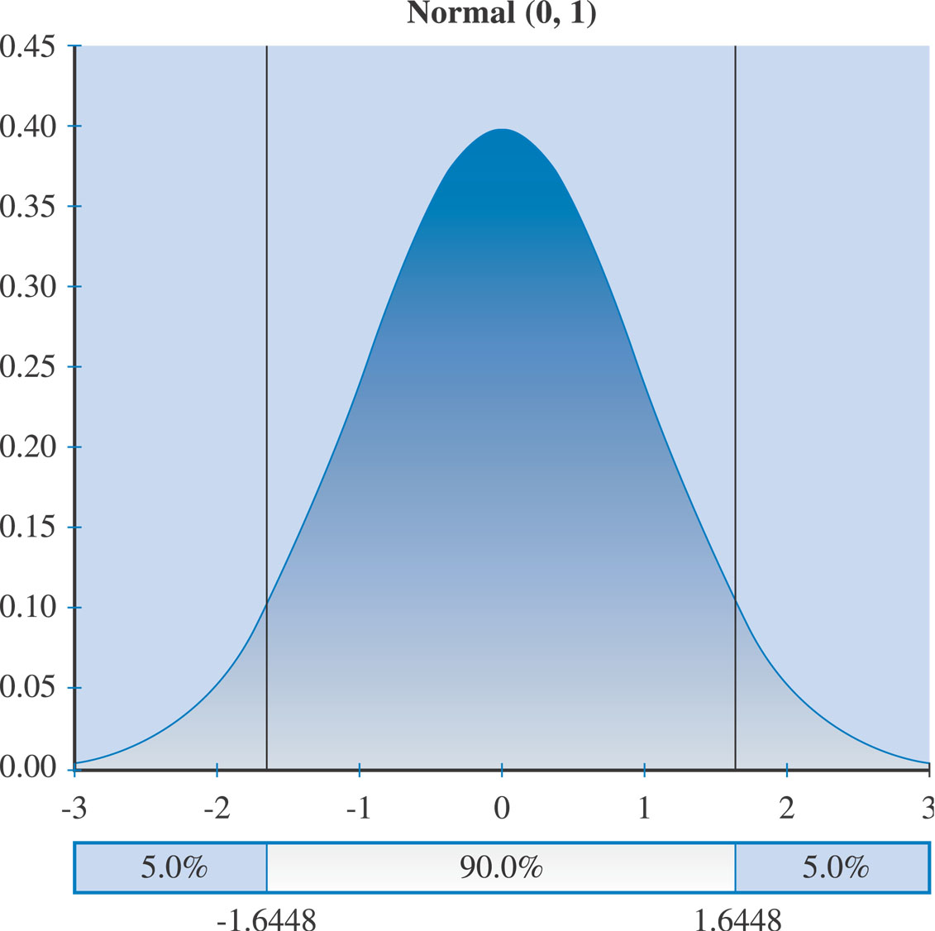
Normal Distribution
7-<number>
Copyright 2015 John Wiley & Sons, Inc.

Slide 24
Normal Distribution
Rules of thumb with respect to observations
Approximately….
68% + 1 standard deviations of mean
95% + 2 standard deviations of the mean
99% + 3 standard deviations of the mean
7-<number>
Copyright 2015 John Wiley & Sons, Inc.

Slide 25
PERT Distribution
PERT MEAN = (a + 4b + c)/6
Where:
a = optimistic estimate
b = most likely
c = pessimistic
7-<number>
Copyright 2015 John Wiley & Sons, Inc.

Slide 26
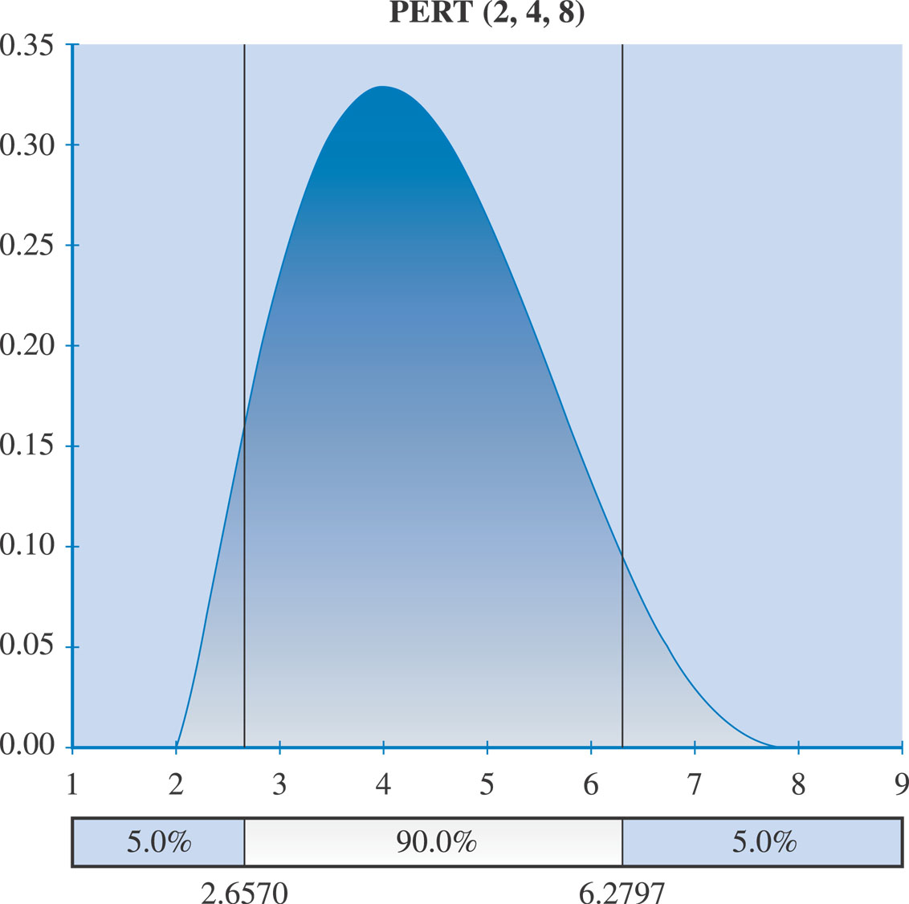
PERT Distribution
7-<number>
Copyright 2015 John Wiley & Sons, Inc.

Slide 27
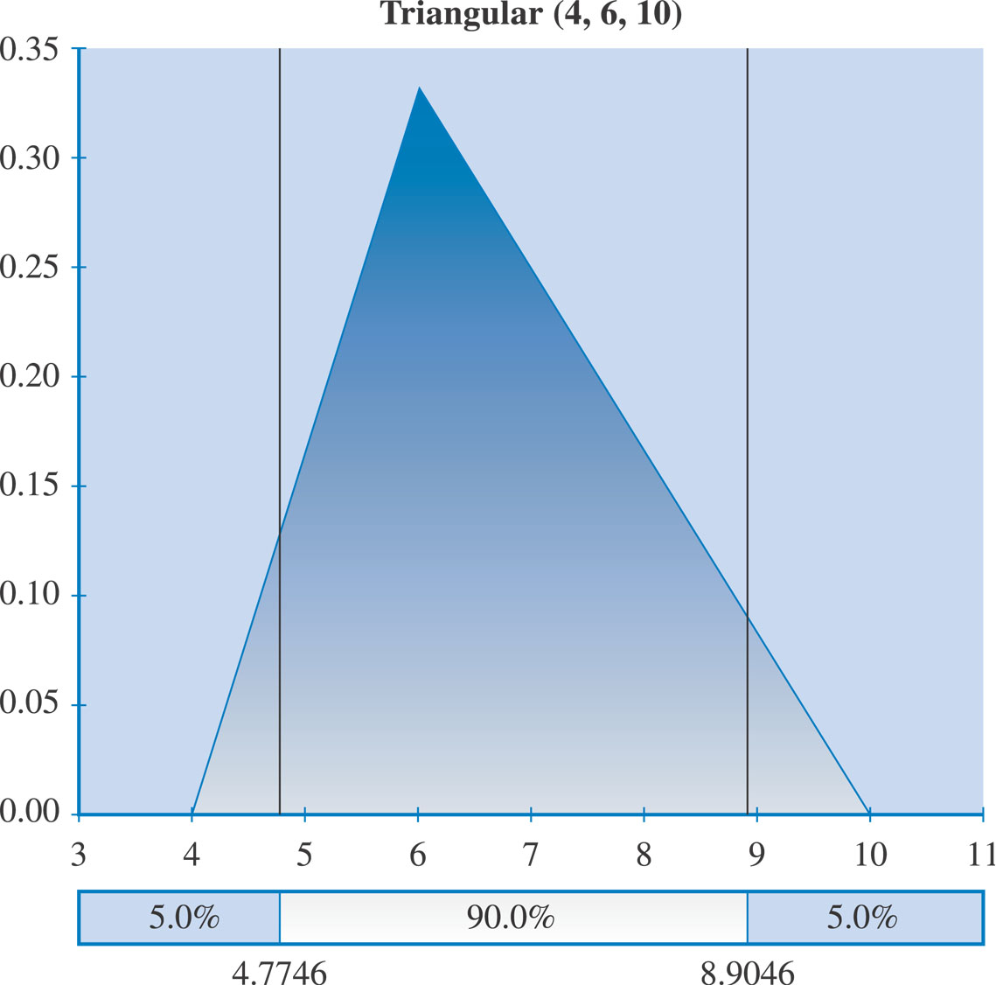
Triangular Distribution
7-<number>
Copyright 2015 John Wiley & Sons, Inc.

Slide 28
Simulations
Monte Carlo
  Technique that randomly generates specific values for a variable with a specific probability distribution
  Goes through a number of trials or iterations and records the outcome
  @RISK6®
    An MS Project® add in that provides a useful tool for conducting risk analysis of your project plan
    http://www.palisade.com/risk/
7-<number>
Copyright 2015 John Wiley & Sons, Inc.

Slide 29
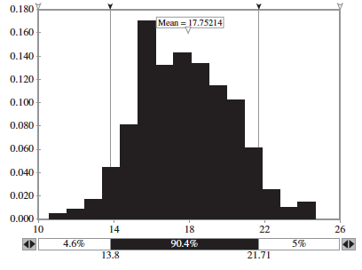
Monte Carlo Simulation
7-<number>
Copyright 2015 John Wiley & Sons, Inc.

Slide 30
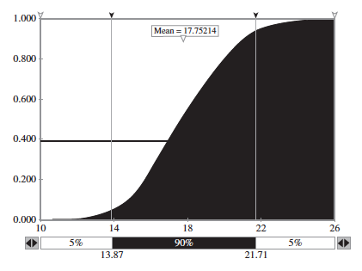
Cumulative Probability Distribution
7-<number>
Copyright 2015 John Wiley & Sons, Inc.

Slide 31
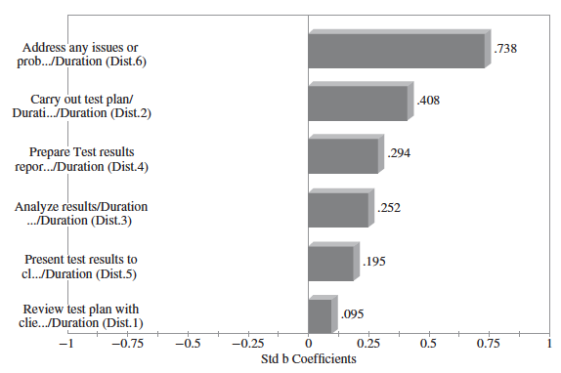
Sensitivity Analysis Using a Tornado Graph
Tornado
Graph
7-<number>
Copyright 2015 John Wiley & Sons, Inc.

Slide 32
STEP 4 – Develop Risk Strategies –Risk Strategies Depend On
The nature of the risk itself
  Really an opportunity or threat?
Impact of the risk on the project’s MOV and objectives
  Likelihood? Impact?
The project’s constraints in terms of scope, schedule, budget, and quality requirements
  Successful response possible with available resources?
Risk tolerances or preferences of the project stakeholders
7-<number>
Copyright 2015 John Wiley & Sons, Inc.

Slide 33
STEP 4 – Develop Risk Strategies – Strategies to respond to opportunities with potential positive impacts on the project goal and objectives
Exploitation – attempt to take advantage of the situation
Sharing of Ownership – e.g. joint partnerships or joint ventures with customers or vendors
Acceptance – PM and project team members’ minds are open in order to take advantage of opportunities as they arise
7-<number>
Copyright 2015 John Wiley & Sons, Inc.

Slide 34
STEP 4 – Develop Risk Strategies
Accept or Ignore
  Management Reserves
    Released by senior management
  Contingency Reserves
    Part of project’s budget
  Contingency Plans
Avoidance
Mitigate
  Reduce the likelihood or impact (or both)
Transfer
  E.g. insurance
7-<number>
Copyright 2015 John Wiley & Sons, Inc.

Slide 35
STEP 5 – Monitor and Control Risk
Risk Audits
  External to project team
Risk Reviews
  Internal
Risk Status Meetings & Reports
7-<number>
Copyright 2015 John Wiley & Sons, Inc.

Slide 36
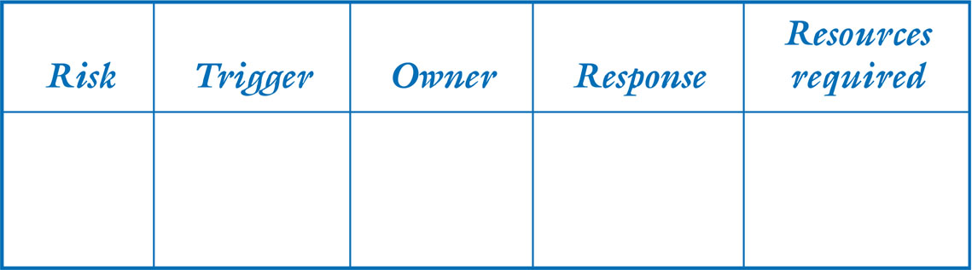
STEP 5 – Respond and Evaluate Response to Risk through a Risk Response Plan that includes:
A trigger which flags that the risk has occurred
An owner of the risk (i.e., the person or group responsible for monitoring the risk and ensuring that the appropriate risk response is carried out)
A response based on one of the four basic risk strategies
Adequate resources
7-<number>
Copyright 2015 John Wiley & Sons, Inc.

Slide 37
STEP 5 – Respond and Evaluate Response to Risk through Risk Evaluation
Lessons learned and best practices help us to:
  Increase our understanding of IT project risk in general.
  Understand what information was available to managing risks and for making risk-related decisions.
  Understand how and why a particular decision was made.
  Understand the implications not only of the risks, but also the decisions that were made.
  Learn from our experience so that others may not have to repeat our mistakes.
7-<number>
Copyright 2015 John Wiley & Sons, Inc.

