Slide 1
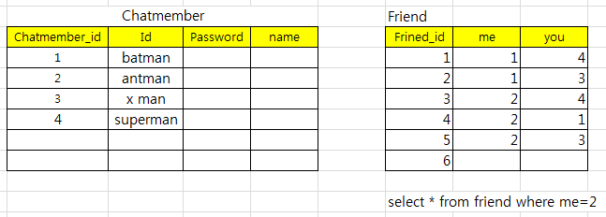
ERD 엔터티 -> 테이블
Chatmembe(엔터티)
Chatmember_id
Id
Password
Name
Profile
status
릴레이션
Friend
Friend_id
me
you
테이블

