Slide 1
repeataly
predicting repeat customers with sales data
Zen Yui | 2016-03-07

Slide 2
Eataly needs to better analyze its customers
What drives repeat business?
Need to understand and segment customers
Need more KPI’s beyond sales and cost metrics
problem
dataset
progress
Notes:
Cashier
Sea of Data
Gut feelings vs historical data
Combine a more scientific approach to our information with the gut decisions made by seasoned ops professionals
KYC – complex bc of diversity of products
Many tourists who won’t return in a year
How do you capture those who might?
Cashier
Sea of Data
Gut feelings vs historical data
Combine a more scientific approach to our information with the gut decisions made by seasoned ops professionals
KYC – complex bc of diversity of products
Many tourists who won’t return in a year
How do you capture those who might?

Slide 3
The POS should contain enough data to make predictions
Question:
What features and values from Eataly’s POS transaction data will best predict the likelihood of a repeat visit within 90 days?
Hypothesis:
Prior visit count will likely prove to be the most important feature, but other features from “domain knowledge” should give an interesting perspective on customer behavior.
problem
dataset
progress

Slide 4
The project followed a 3-step process
Extract raw information from POS SQL Server
Engineer features and conduct EDA
Test performance & brainstorm features
problem
dataset
progress

Slide 5
Raw data came from two queries of different grains
Query 1:
Ticket-specific features that, in 1 row, summarize the retail as many customer behavior concepts as possible. This data is meant for clustering.
Query 2:
Hourly Ticket count per day to summarize how busy the store is, as Eataly has a negative reputation for traffic in peak hours
problem
dataset
progress

Slide 6
EDA was difficult given feature correlation
data dictionary
Feature | Type | Description
TicketDate | datetime | Date of purchase
TicketTime | float | Decimal representation of hour of checkout
PriorVisits | int | Number of visits prior to current ticket
GiftCardLines | int | Lines of gift cards in basket
OilLines | int | Lines of oil products in basket
RotisserieLines | int | Lines of rotisserie products in basket
NetAmount | float | Net spend in dollars
DiscountAmount | float | Net discount in dollars
UniqueItems | int | Count of unique products in basket
UniqueCategories | int | Count of unique categories in basket
ReturnedBags | boolean | Boolean indicator of bag return for refund
TopItemLines | int | Count of top 100 repeat-customer products
RepeatProducts | int | Count of items purchased both last and current visit
TicketMonthDecimal | float | Decimal representation of month and day
WeekdayNumber | int | Integer weekday (1=Monday…7=Sunday)
IsFrontEnd | boolean | True/False indicator that customer used main exit
FreshLines | int | Count of fresh prodcut lines in basket
RetailSpendCnt | float | Locally centered spend on retail products
QsrSpendCnt | float | Locally centered spend on QSR products
Ticketcount | int | Count of tickets happing in that hour
TotalLines | int | Total sale lines and return lines in ticket
ProductVariety | float | Unique products divdied by whole basket
BizHours | boolean | True/False indicator of shopping weekdays before 5pm
WillReturn | boolean | True/False prediction class for repeat visit
problem
dataset
progress

Slide 7
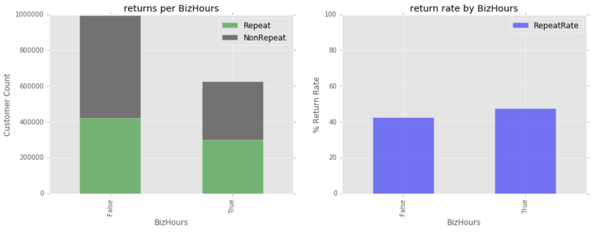
BizHours was not a clear predictor!

Slide 8
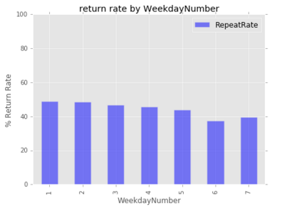
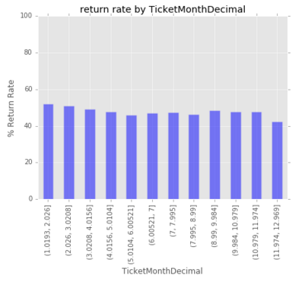
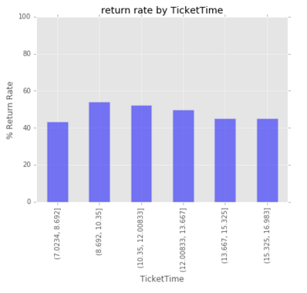
Time series features were not as predictive as hoped
WEEKDAY
MONTH
TIME

Slide 9
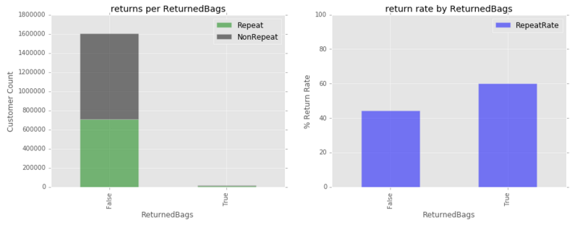
Some engineered features were not representative

Slide 10
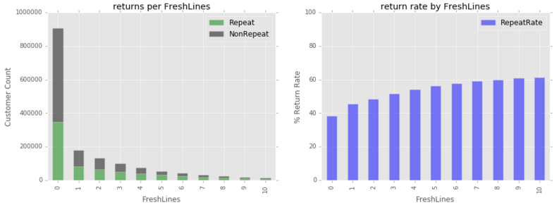
Fresh products seemed to correlate with repeat business

Slide 11
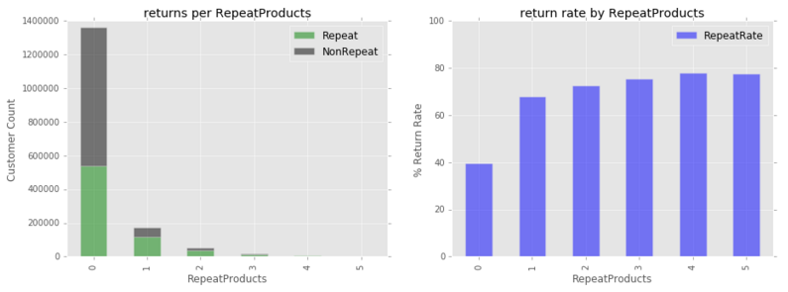
Repeat purchases suggest repeat visits!

Slide 12
Three models delivered more “scientific” feature selection
Dummy Classifier
Helped to set a baseline for predictive performance and feature importance.
Logistic Regression
Great measure of feature selection, and typically yielded the best performance in terms of speed and prediction
Random Forest
Also provided feature importance measures, and would probably be the production model as it handles correlated features better than LR

Slide 13
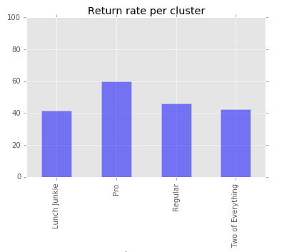
K-means was interesting but not a good feature
k-means clusters
 | 0 | 1 | 2 | 3
Feature | Two of everything | Regular | Lunch Junkie | Pro
PriorVisits | 6.536 | 6.454 | 3.908 | 7.502
NetAmount | 38.653 | 34.342 | 12.97 | 157.862
TopItemLines | 1.421 | 1.131 | 0.734 | 5.023
RepeatProducts | 0.228 | 0.279 | 0.115 | 1.762
IsFrontEnd | 0.719 | 0.995 | 0 | 0.998
FreshLines | 1.612 | 2.598 | 0.166 | 12.187
RetailSpendCnt | 0.967 | 0.948 | 0.127 | 4.328
ProductVariety | 0.598 | 0.989 | 0.999 | 0.917
BizHours | 0.384 | 0.328 | 0.447 | 0.364

Slide 14
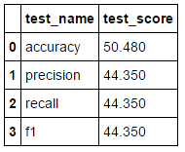
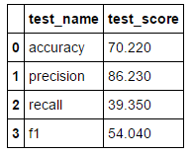
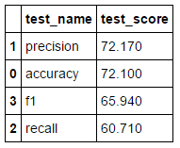
Models scored very well
Dummy Classifier
Did not perform very well. Essentially taking the mean of the data set prediction.
Logistic Regression
Best precision (86%), but model definitely needs exhaustive gridsearch on a more powerful machine.
Random Forest
Great predictive performance across all metrics, but underlying features were clearly biased and need improvement

Slide 15

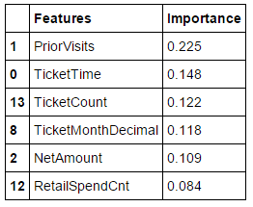
LR and RF did not appreciate my features…
Logistic Regression
Needs new features, as highest coefficient was 0.275, and lasso only yielded two non-zero coefficients
Random Forest
Also needs new features. Prior visits outweighs the other features significantly, and no single feature is “actionable”

Slide 16
The goal is to track new features
Import source data
ETL to data warehouse
Track features in operations
Observe patterns and clusters
Create new features & KPI
project priorities and goals:
Interpretability of the models – The research must yield actionable output. For this reason, random forest and logistic regression are employed alongside k-means clustering to segment customers and show feature importance.
Continuous implementation – The long term goal is to understand features of customer behavior that drive sales and loyalty, and to track these features over time.
problem
dataset
progress

Slide 17
POS application provides a sea of clean data
TicketDate | TicketTime | PriorVisits | SaleLines | ReturnLines | NetAmount | NetRetail Amount | NetQSR Amount | Station Group | Unique Items | UniqueCategories | Has Retail Products | Has QSR Products | Returned Bags | WillReturn
2015-08-31 | 14:07:30 | 0 | 4 | 0 | 13.20 | 13.20 | 0 | Other | 2 | 1 | True | False | False | True
2015-08-31 | 14:15:12 | 30 | 2 | 0 | 6.60 | 6.60 | 0 | Other | 2 | 1 | True | False | False | True
2015-08-31 | 14:17:04 | 1 | 3 | 0 | 6.16 | 6.16 | 0 | Other | 2 | 2 | True | False | False | False
2015-08-31 | 14:25:18 | 0 | 1 | 0 | 2.80 | 2.80 | 0 | Other | 1 | 1 | True | False | False | True
2015-08-31 | 14:25:49 | 0 | 1 | 0 | 3.40 | 3.40 | 0 | Other | 1 | 1 | True | False | False | True
828K observations | 15 features | NYC market | 2015 Jan - Dec
problem
dataset
progress
Notes:
Data
Market (retail grocery business & quick service meals)
2015 NY retail sales
828K observations
17 features
Extracted from counterpoint DW (clean)
Definition
Someone who spends money twice in a 90 day period using a credit card

Slide 18
Questions?

