Slide 1


UNCLONE AI / PRODUCT PITCH
EchoGuard
Hear the voice.
Uncover the risk.
Voice authenticity. Text warning signs.
Community-reported activity.
ECHOGUARD / UNCLONE AI
HEAR THE VOICE. UNCOVER THE RISK.
01
Notes:
TARGET TIME: 00:00–00:15 | 15 seconds
Imagine hearing a familiar voice asking for money. Would you trust the voice, the message, or neither? EchoGuard helps you pause and investigate. Our promise is simple: hear the voice, uncover the risk.
PRESENTATION CUE: Pause after the opening question. Click once to move to the problem.

Slide 2
01 / WHY THIS MATTERS
A convincing voice is only part of the story.
Scams combine believable identities, emotional pressure and risky requests.
01
02
03
BORROWED TRUST
PRESSURE TO ACT
A HARMFUL DEMAND
“It’s me. I need your help.”
“Pay today or lose the offer.”
“Share your OTP.”
A familiar voice can make
a new request feel credible.
Urgency can crowd out
independent verification.
The request can be dangerous
even when the voice is natural.
Authenticity and scam risk need separate checks.
ECHOGUARD / UNCLONE AI
THE PROBLEM
02
Notes:
TARGET TIME: 00:15–00:45 | 30 seconds
Scams are bigger than fake voices. A caller may sound convincing, create urgency, and then ask for money or an authentication code. Students face internship fees; others face banking or investment scams. A natural voice can still deliver a harmful request. We need to examine the voice, the demand, and community context separately.
PRESENTATION CUE: Read only one of the three short quotes aloud. Emphasize “separately.”

Slide 3
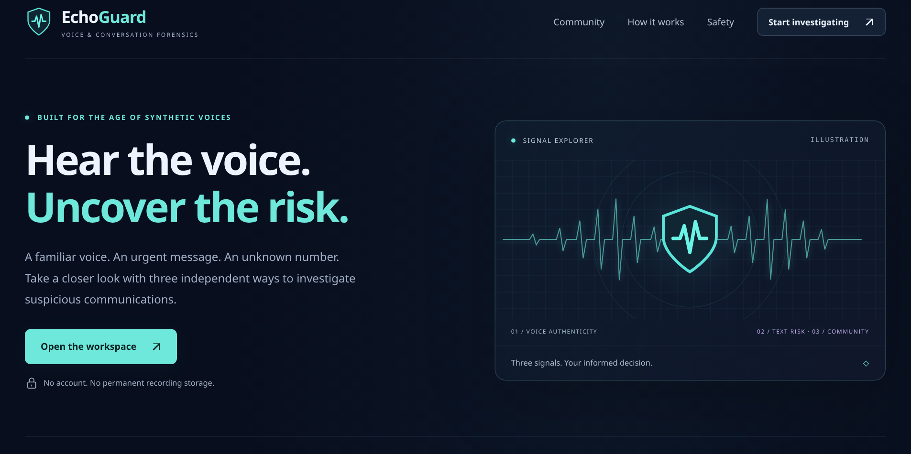
02 / THE PRODUCT
One workspace. Three independent signals.
01
VOICE
ECHOGUARD / ACTUAL WEBSITE
Is the recording synthetic?
02
TEXT
What makes the request risky?
03
COMMUNITY
Has similar activity been reported?
No combined scam score.
Each result keeps its own meaning.
ECHOGUARD / UNCLONE AI
THE WORKSPACE
03
Notes:
TARGET TIME: 00:45–01:10 | 25 seconds
This is the actual EchoGuard interface. Upload an authorized recording, paste a message or manually obtained transcript, or search a phone number. These are independent workflows. We do not automatically transcribe audio or combine results into a scam percentage. Each feature explains what its evidence can and cannot tell us.
PRESENTATION CUE: Point briefly to the three feature labels, then to the real interface image.

Slide 4
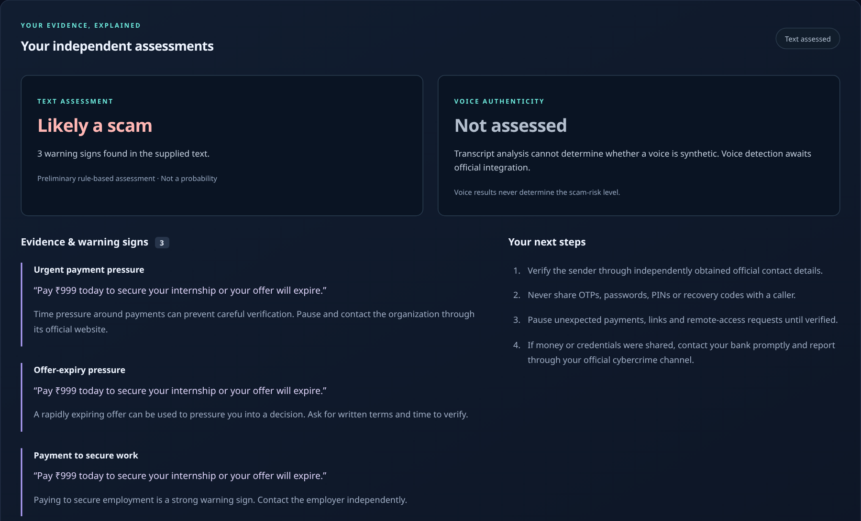
03 / FEATURE SPOTLIGHT
Explain the warning. Show the evidence.
EXAMPLE MESSAGE
“Pay ₹999 today to secure
your internship or your offer
will expire.”
Likely a scam
Upfront payment + urgency
+ offer-expiry pressure
“Never pay upfront internship fees”
is protective advice, not the same demand.
ECHOGUARD / UNCLONE AI
TEXT SCAM ANALYSIS
04
Notes:
TARGET TIME: 01:10–01:50 | 40 seconds
Consider this message: pay nine hundred and ninety-nine rupees today to secure an internship, or the offer expires. EchoGuard flags the payment demand and pressure, with the actual text as evidence. We also fixed a logic gap: guaranteed investment profits previously returned a low assessment because no rule matched. The expanded engine covers broader scam categories and distinguishes common safety advice and incomplete inputs. This is an explainable rule-based assessment, not a trained AI model or proof of fraud.
PRESENTATION CUE: Use this as the main demonstration. The screenshot is a real local result, not a mocked provider response.

Slide 5
04 / VOICE ANALYSIS
Question the signal. Don’t accuse the speaker.
A dedicated DetectifAI adapter keeps provider credentials on the server.
UPLOAD
ANALYZE
INTERPRET
Authorized WAV, MP3 or M4A
Official DetectifAI endpoint
Preserve the provider’s verdict
POSSIBLE PROVIDER OUTCOMES
REAL
FAKE
NOT SURE
No strong synthetic indication
Synthetic indications found
Inconclusive — keep uncertainty
Official schema verified • Real account detection test still requires credentials.
ECHOGUARD / UNCLONE AI
VOICE AUTHENTICITY
05
Notes:
TARGET TIME: 01:50–02:20 | 30 seconds
The voice adapter sends recordings to the official DetectifAI endpoint. We verified its authentication, upload format and response schema. The interface preserves real, fake and not-sure outcomes without turning them into a scam verdict. Keys stay on the server, and EchoGuard does not permanently store recordings. A real account detection test still needs a configured key and credits.
PRESENTATION CUE: These are possible documented outcomes, not claims of live detection results. State the credential limitation once, clearly.

Slide 6
05 / COMMUNITY INTELLIGENCE
Shared experiences. Carefully presented.
Search real submissions, contribute an experience, or flag a misleading result.
SEARCH
Normalize the number
with its country code.
WHAT SEARCH SHOWS
01
Total report submissions
REPORT
Select a category.
Keep descriptions private.
Categories and counts
02
03
Most recent report date
REVIEW
Flag a result for
operator review.
Unverified reports are not proof of wrongdoing.
POSTGRESQL PERSISTENCE TESTED
Duplicates controlled • Submission limits • No identity lookup
ECHOGUARD / UNCLONE AI
COMMUNITY PHONE REPORTS
06
Notes:
TARGET TIME: 02:20–02:55 | 35 seconds
Users can search a number or report an experience without providing their name. Search shows category totals and the latest report date; descriptions stay private. PostgreSQL preserves reports across application restarts. Duplicate handling and persistent limits reduce abuse. Reporting passed a real local database test; a hosted database still needs configuration. These are unverified submissions: counts do not identify a scammer, and no reports does not mean safe.
PRESENTATION CUE: Avoid inventing sample counts. Emphasize persistence and the unverified-report notice.

Slide 7
06 / BUILT TO BE EXPLAINABLE
Simple architecture. Honest failure states.
LOCAL TEXT RULES
No external text API
WEB INTERFACE
EXPRESS API
HTML / CSS / JavaScript
Validation + secure requests
DETECTIFAI
Voice-authenticity adapter
POSTGRESQL
Persistent community reports
76
VERIFIED
NEXT TO ENABLE
automated tests passed
Browser + accessibility checks
Real PostgreSQL integration
Live provider credentials
Hosted database setup
ECHOGUARD / UNCLONE AI
ENGINEERING & VALIDATION
07
Notes:
TARGET TIME: 02:55–03:30 | 35 seconds
Our architecture connects the browser to an Express API, local text rules, DetectifAI and PostgreSQL. Inputs are validated, and service errors never become safe assessments or empty searches. Seventy-six automated tests passed, plus browser and automated accessibility checks. Database tests verified duplicates, aggregation, rate limits and persistence after an application restart. These checks demonstrate implemented behavior, not detection accuracy. Live provider and hosted database setup remain.
PRESENTATION CUE: Point to the architecture first, then the verified-versus-next distinction. Do not call the project fully production-ready.

Slide 8
AI CAN FAKE IT. CAN YOU UNCLONE IT?
EchoGuard
Hear the voice.
Uncover the risk.
PAUSE
EXAMINE
VERIFY
Resist the urgency.
Read the evidence.
Use an independent channel.
Next: configure live services, verify real requests, and pilot responsibly.
ECHOGUARD / UNCLONE AI
THANK YOU
08
Notes:
TARGET TIME: 03:30–04:00 | 30 seconds
EchoGuard turns a rushed reaction into an informed pause. Users get three evidence trails: voice authenticity, text warnings and community-reported activity. Text analysis already works independently. Next, we will configure live services, verify real requests and pilot responsibly. We cannot prove safety, but we can help people ask better questions before they trust, pay or share. Thank you.
PRESENTATION CUE: End on the tagline. Leave this slide visible for questions.

