Slide 1
ML@NOVA
DFJ
Predicting Survival Time in Multiple Myeloma Patients

Slide 2
Team identification
Name 1: José Costa
Number 1: 72899
Name 2: Dinis Santos
Number 2: 72815
Name 3: Francisco Jorge
Number 3: 70293
Final score on the private leaderboard: 2.58777
Leaderboard private ranking: 30

Slide 3
Task [1.1] - Data preparation and validation pipeline
Notes:
Replicate this section for every task. Add slides as needed

Slide 4
What was done in task [1.1]
1. Missing Values Analysis
Visualized missing values using multiple methods (bar plot, heatmap, matrix, dendrogram)
Created comprehensive overview of data completeness
Identified patterns in missing data
2. Data Cleaning
Dropped rows with missing SurvivalTime values
Removed columns containing missing data (baseline approach)
Excluded censored cases (where Censored == 1)
Retained only complete, uncensored observations
3. Feature Exploration
Visualized feature relationships using pairplot
Analyzed correlations between Age, Gender, Stage, TreatmentType, and SurvivalTime
Examined distribution patterns across features

Slide 5
What was done in task [1.1]
Defined feature matrix (X) by dropping target and identifier columns
Isolated target variable (y) as SurvivalTime
Preserved censoring indicator for potential future use
5. Validation Strategy Development
Implemented train/validation/test split (64%/16%/20%)
Tested simple split approach with Linear Regression
Implemented 5-fold cross-validation for more robust evaluation
Compared both validation strategies (simple split vs. cross-validation)
6. Performance Evaluation
Evaluated model performance on validation and test sets
Compared cross-validation results to simple split results
4. Data Preparation
Calculated MSE (Mean Squared Error) and cMSE (Censored MSE)

Slide 6
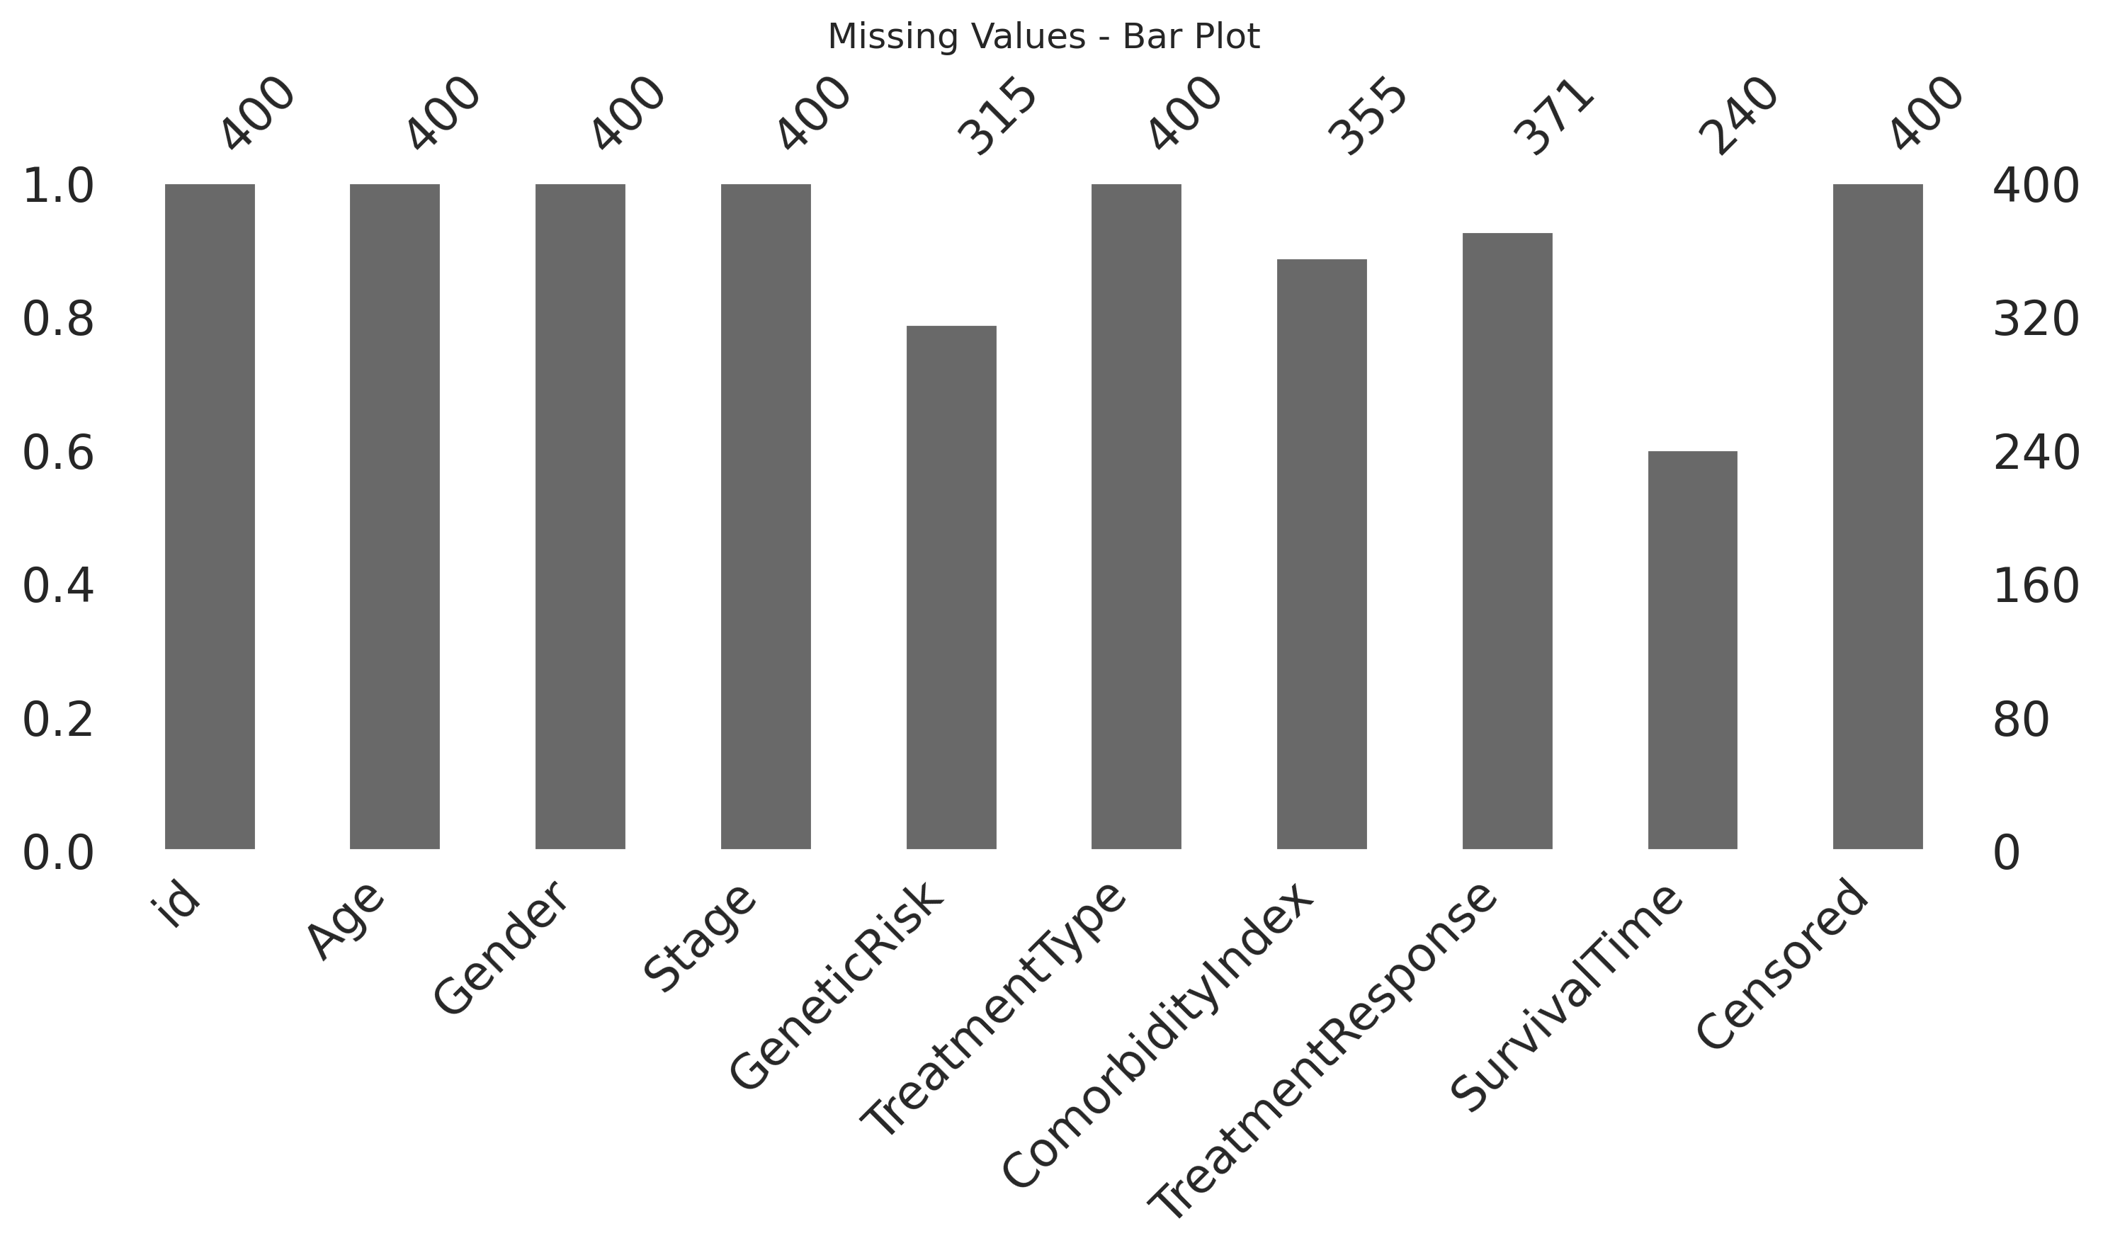
Results and Analysis from task [1.1]

Slide 7
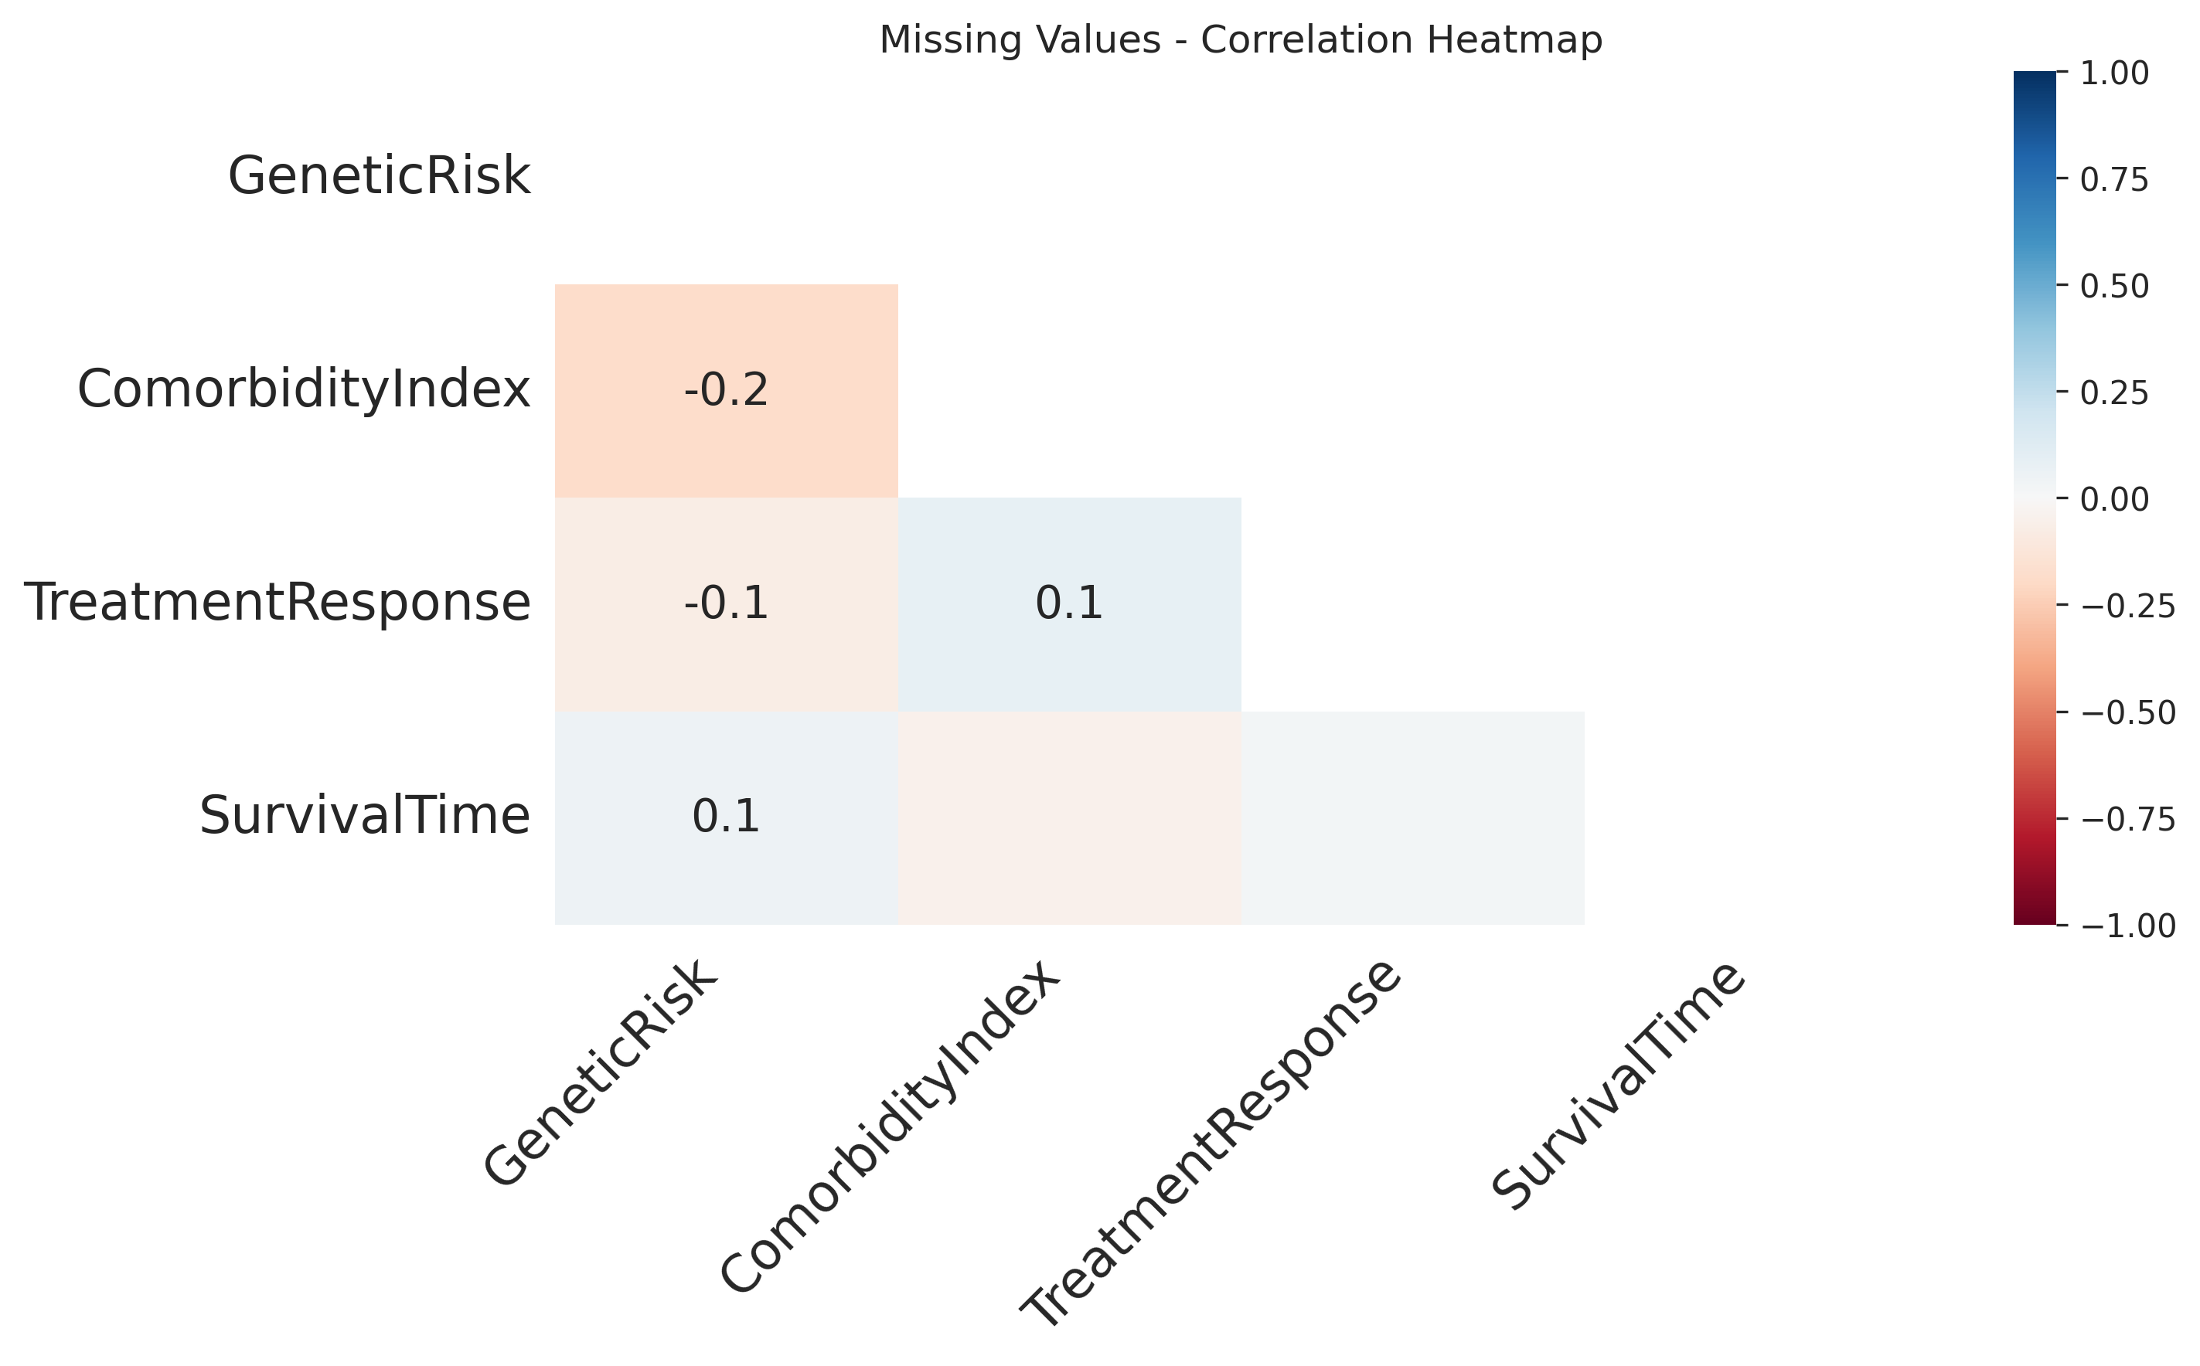
Results and Analysis from task [1.1]

Slide 8
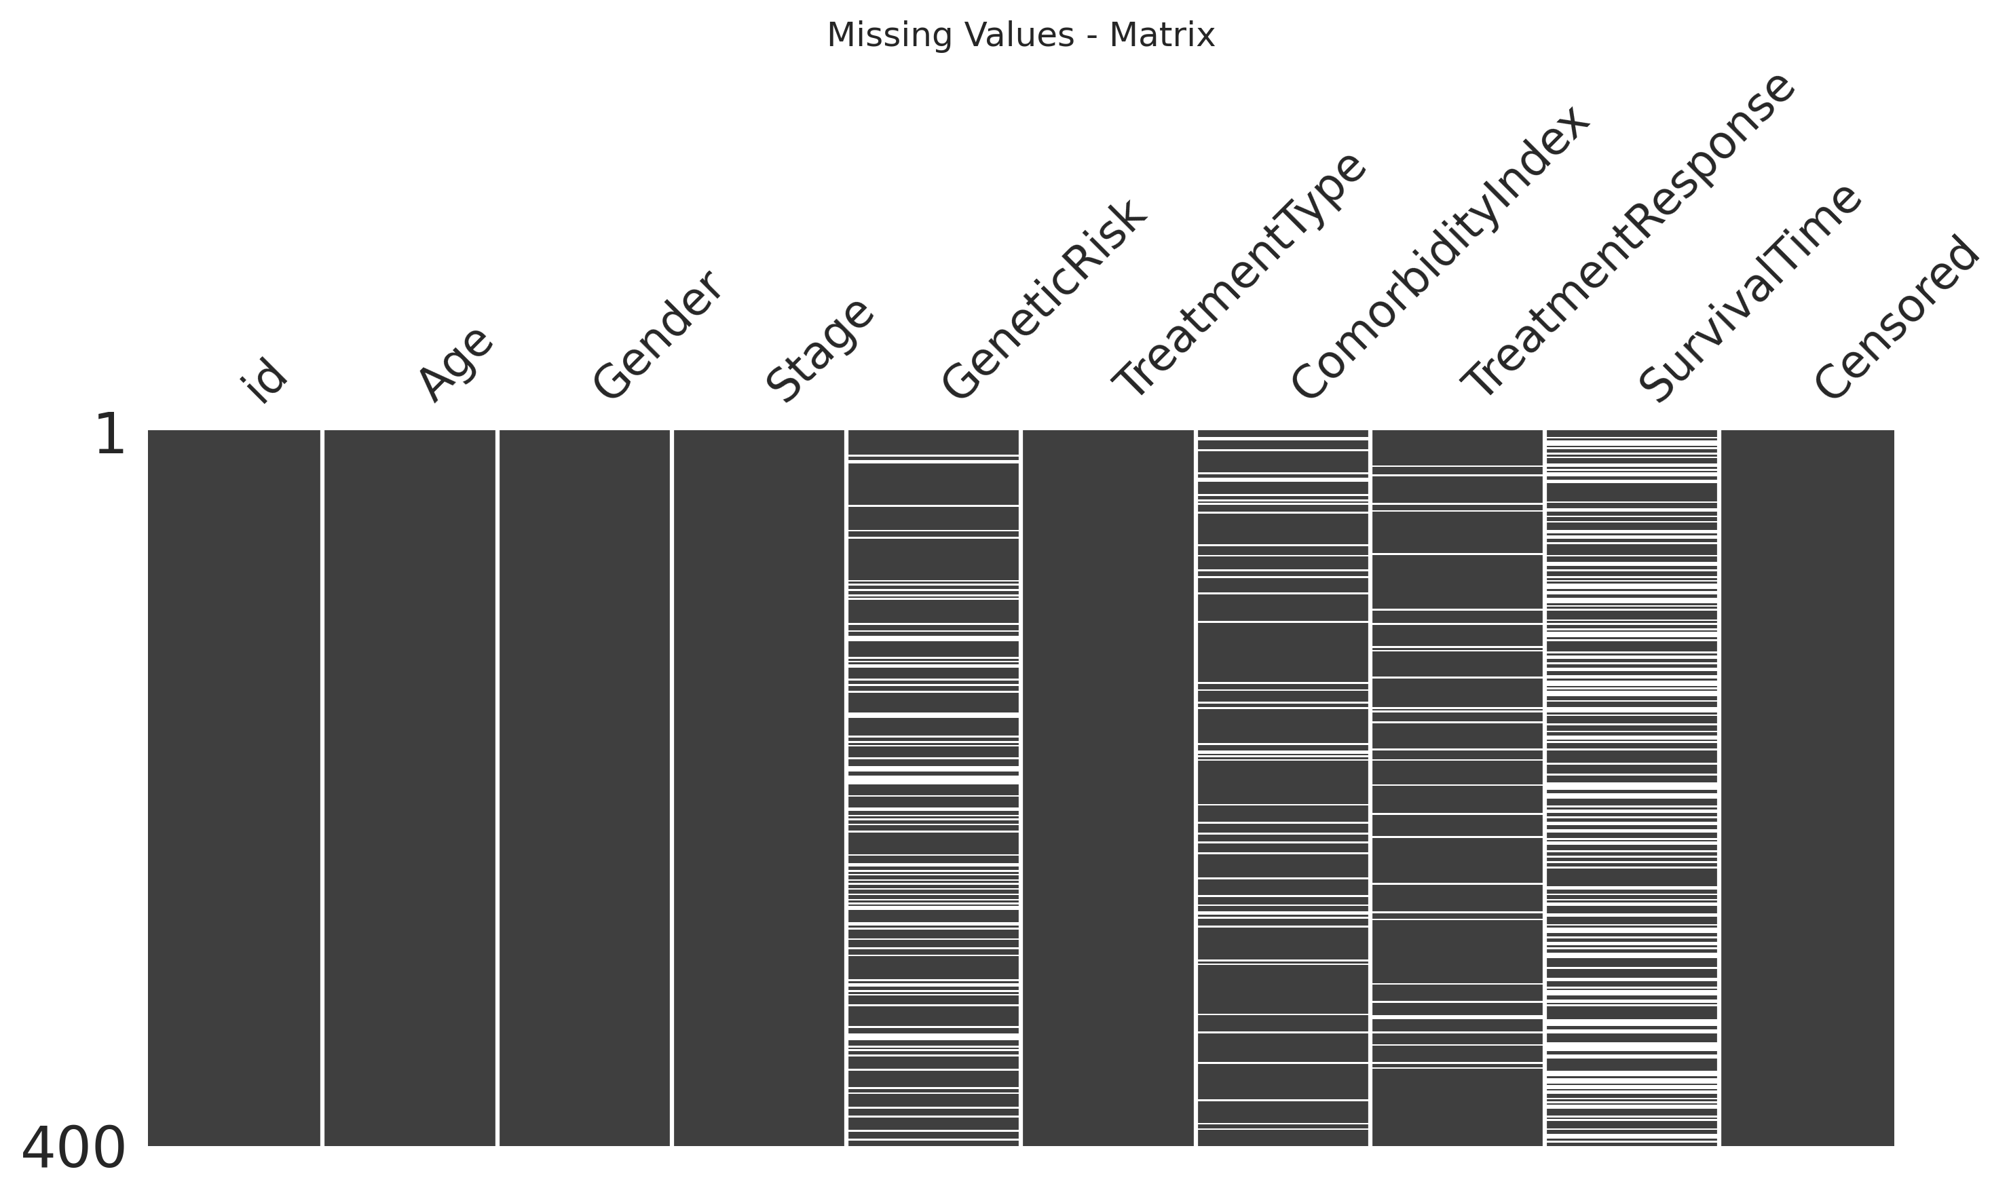
Results and Analysis from task [1.1]

Slide 9
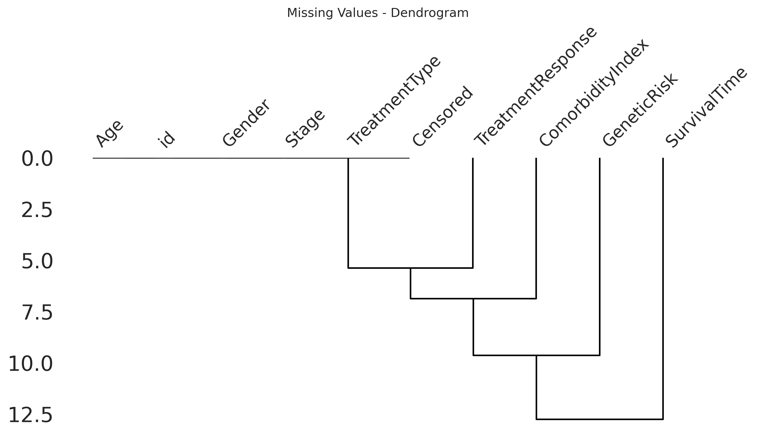
Results and Analysis from task [1.1]

Slide 10
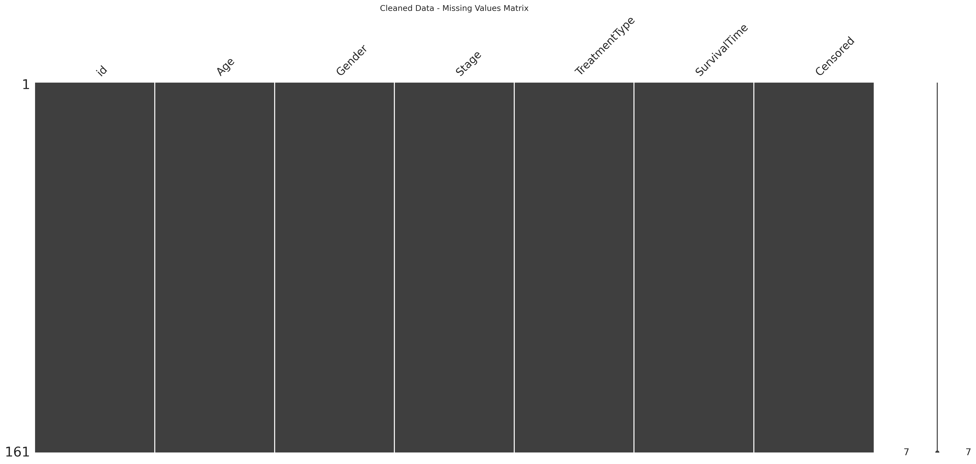
Results and Analysis from task [1.1]

Slide 11
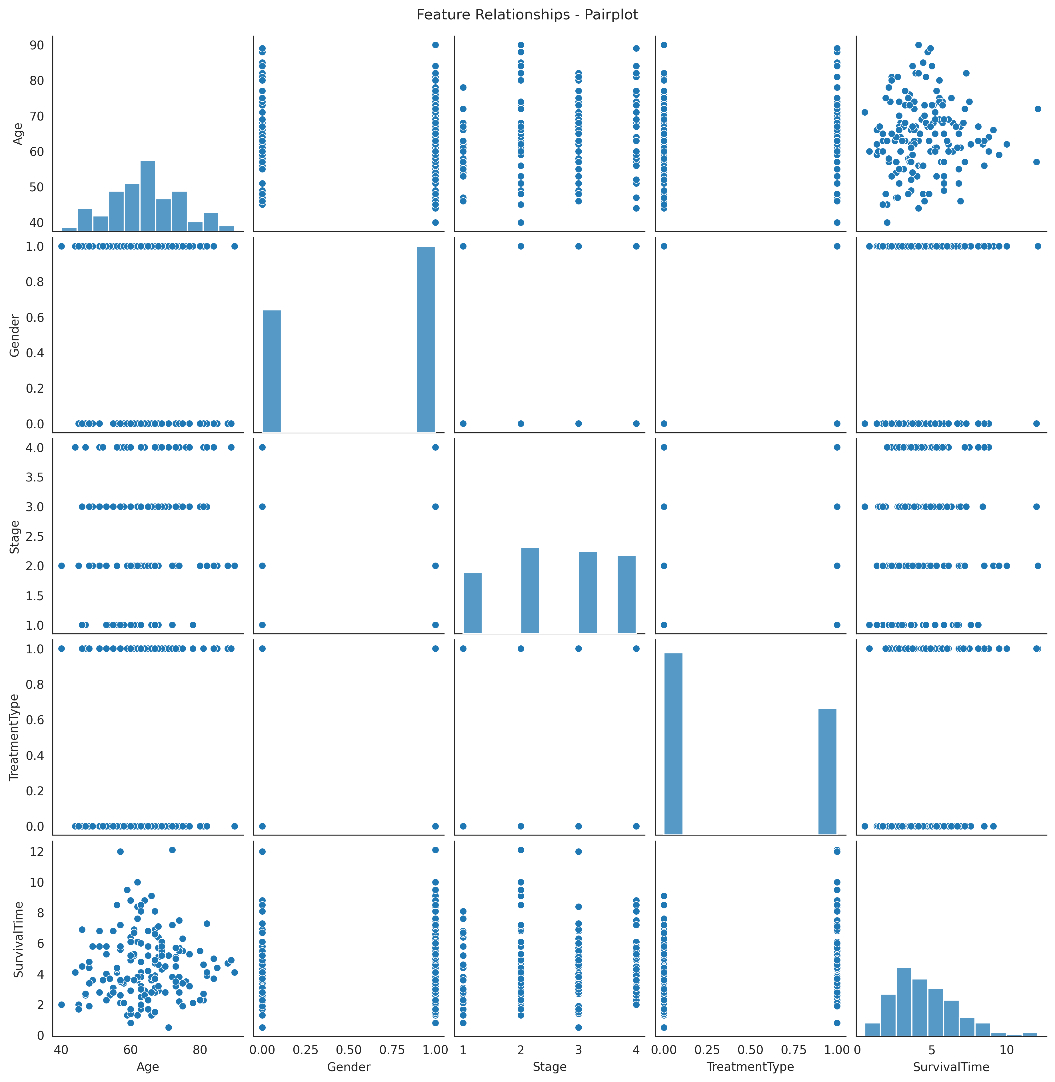
Results and Analysis from task [1.1]

Slide 12
Task [1.2] - Learn the baseline model
Notes:
Replicate this section for every task. Add slides as needed

Slide 13
What was done in task [1.2]
1. Pipeline Construction
- Built baseline pipeline combining StandardScaler and Linear Regression
- Ensured feature scaling for improved model performance
- Created modular, reusable pipeline structure
2. Cross-Validation Training
- Performed 5-fold cross-validation for robust model evaluation
- Calculated CV MSE scores across all folds
- Computed mean and standard deviation of cross-validation performance
3. Final Model Training
- Fitted baseline pipeline on entire training dataset
- Generated predictions on training data
- Maximized use of available data for final model

Slide 14
What was done in task [1.2]
4. Performance Metrics
- Calculated Training MSE (Mean Squared Error)
- Calculated Training cMSE (Censored Mean Squared Error)
- Established baseline performance benchmarks
5. Test Predictions & Submission
- Loaded test dataset and prepared features
- Generated predictions for test samples
- Created submission file for competition/evaluation
6. Model Visualization
- Created scatter plot comparing true vs predicted survival times
- Generated boxplot for distribution comparison
- Visualized model fit quality and prediction patterns
- Saved individual plots for documentation

Slide 15
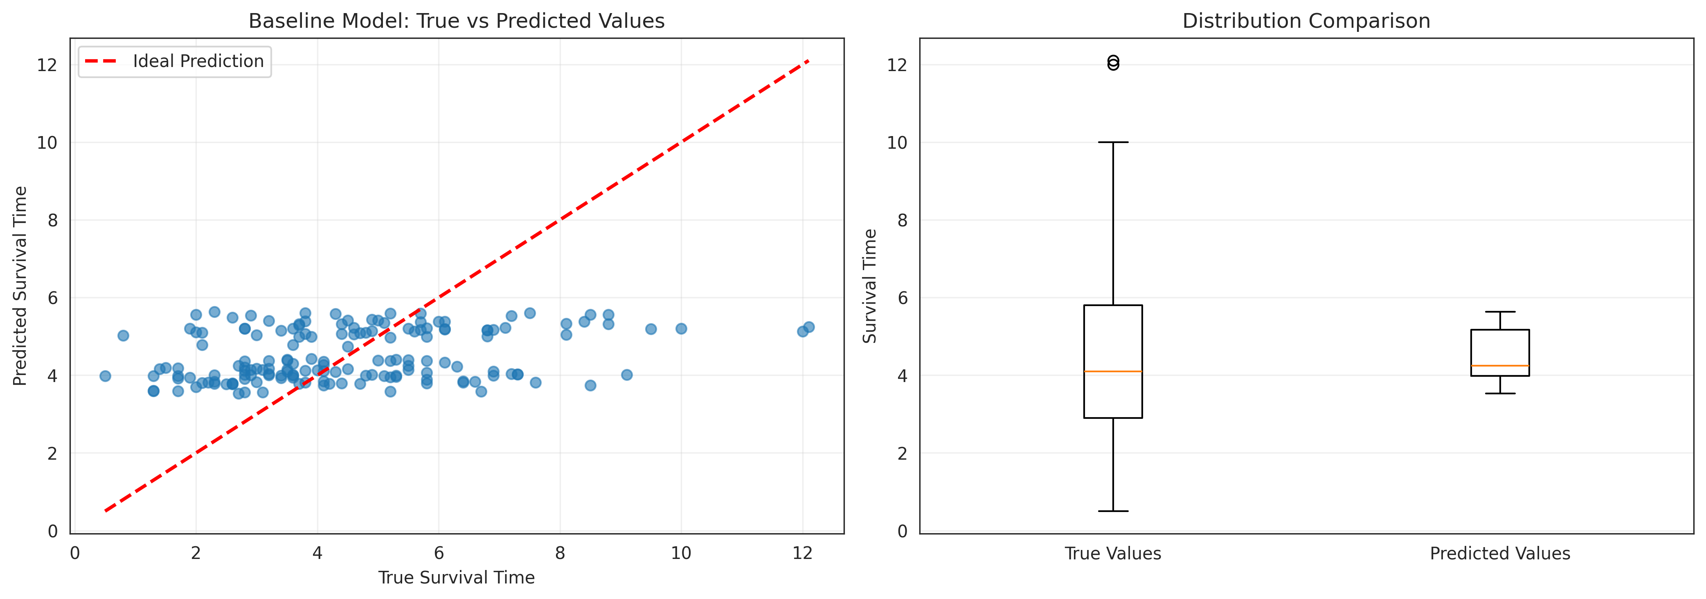
Results and Analysis from task [1.2]

Slide 16
Task [2.1] - Development
Notes:
Replicate this section for every task. Add slides as needed

Slide 17
What was done in task [2.1]
1. Polynomial Regression Function Development
- Created `train_polynomial_regression()` function with hyperparameter search
- Implemented cross-validation for degree selection (testing degrees 1 to max_degree)
- Added early stopping mechanism (stops after 2 consecutive iterations without improvement)
- Returned best degree, trained model, and complete CV results dictionary
2. k-Nearest Neighbors Function Development
- Created `train_knn()` function with hyperparameter search
- Implemented cross-validation for k selection (testing k from 1 to max_k)
- Added early stopping mechanism for efficiency
- Returned best k value, trained model, and complete CV results dictionary
3. Hyperparameter Selection
- Used 5-fold cross-validation for both models
- Searched polynomial degrees from 1 to 10
- Searched k values from 1 to 20
- Tracked MSE scores with standard deviations for each hyperparameter

Slide 18
What was done in task [2.1]
4. Model Training
- Trained Polynomial Regression with optimal degree on full dataset
- Trained k-NN Regression with optimal k on full dataset
- Generated predictions on training data for both models
5. Performance Evaluation
- Calculated training MSE for both models
- Calculated training cMSE for both models
- Compared performance against baseline expectations
- Documented hyperparameter selection results

Slide 19
Results and Analysis from task [2.1]

Slide 20
Task [2.2] - Evaluation
Notes:
Replicate this section for every task. Add slides as needed

Slide 21
What was done in task [2.2]
1. Comprehensive Model Comparison
- Created comparison table with baseline, polynomial regression, and k-NN models
- Included hyperparameter configurations for each model
- Displayed min, max, mean, and standard deviation of errors
- Identified best performing model based on mean cross-validation error
2. Hyperparameter Tuning Visualization
- Plotted polynomial degree vs MSE with confidence intervals
- Plotted k-value vs MSE with confidence intervals
- Marked optimal hyperparameters with vertical lines
- Showed performance trends across hyperparameter ranges
3. Model Predictions Comparison
- Created scatter plots of true vs predicted values for all three models
- Displayed MSE on each plot for direct comparison
- Included ideal prediction line (y=x) as reference
- Generated combined and individual visualization plots

Slide 22
What was done in task [2.2]
4. Statistical Analysis
- Computed cross-validation statistics for each model
- Analyzed variance in predictions across folds
- Compared model stability through standard deviation metrics
- Evaluated improvement over baseline model
5. Test Set Predictions
- Selected best performing model based on CV results
- Generated predictions for test dataset
- Created submission file for evaluation
- Documented model selection rationale
6. Results Documentation
- Saved all comparison plots with task-specific naming
- Generated separate plots for polynomial and k-NN tuning
- Created individual prediction visualizations for each model
- Documented complete evaluation workflow

Slide 23
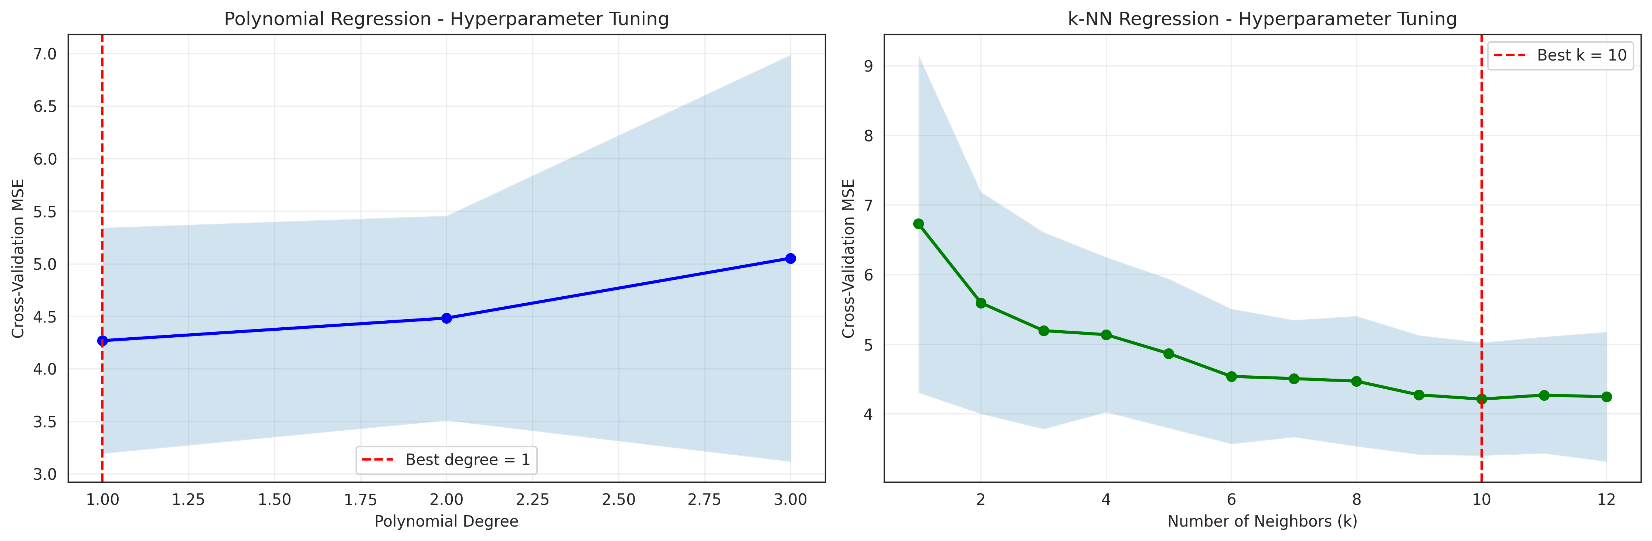
Results and Analysis from task [2.2]

Slide 24
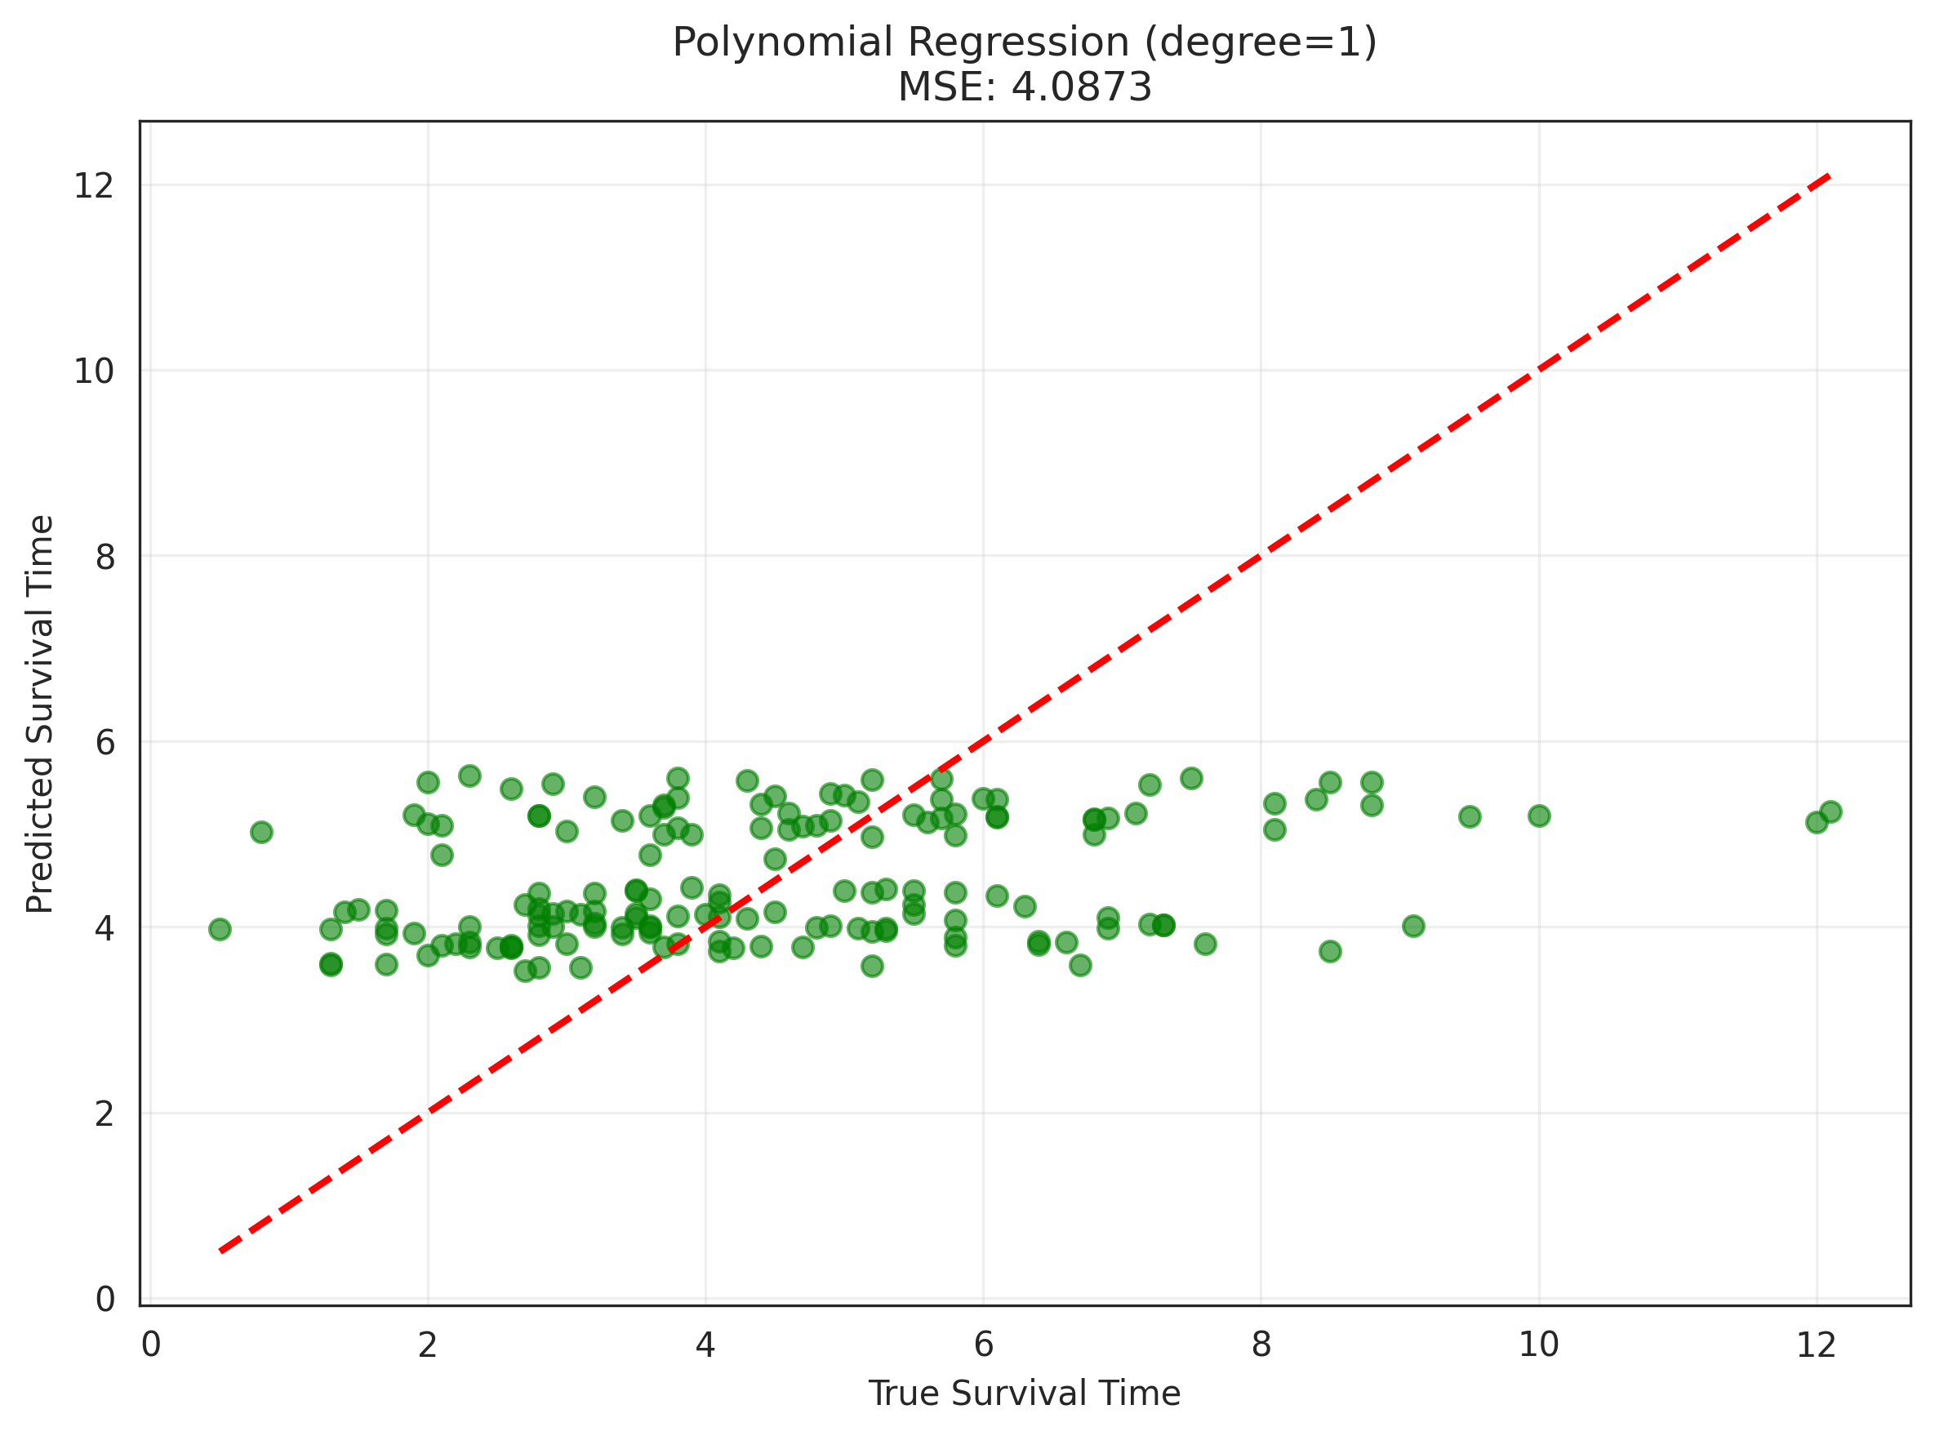
Results and Analysis from task [2.2]

Slide 25
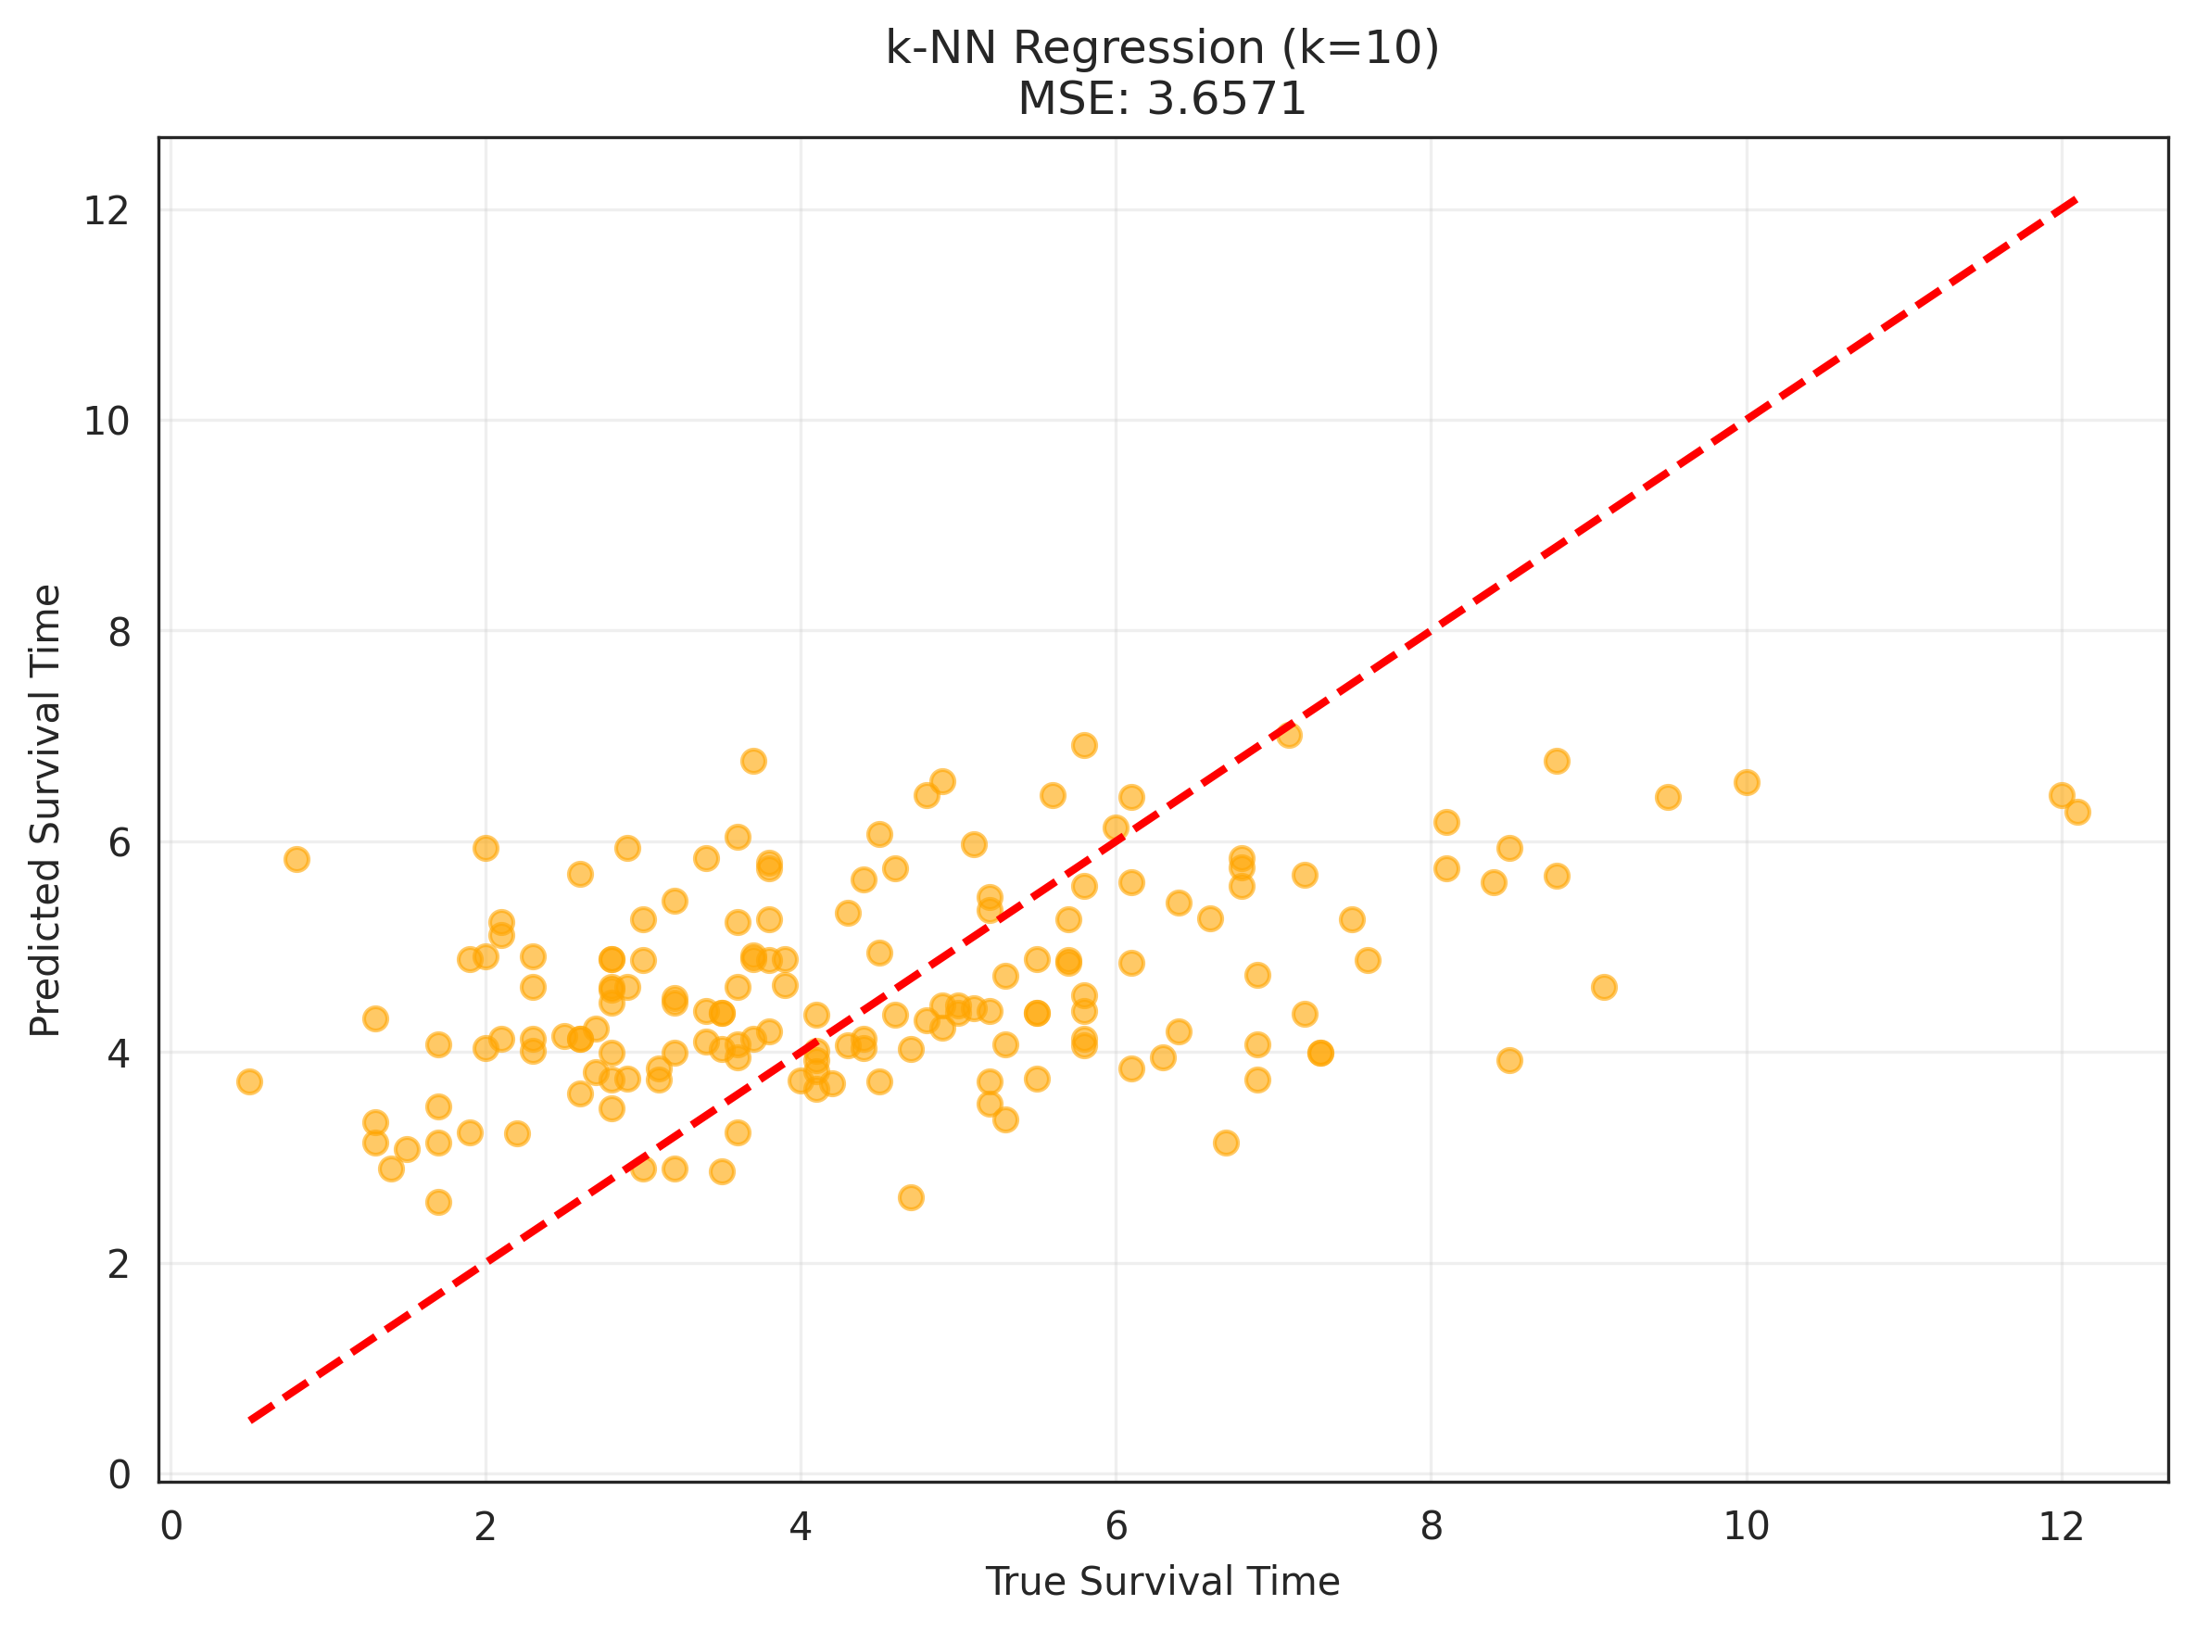
Results and Analysis from task [2.2]

Slide 26
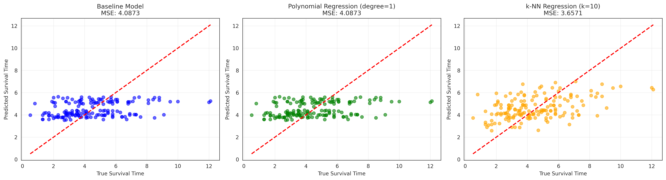
Results and Analysis from task [2.2]

Slide 27
Task [3.1] - Missing data imputation
Notes:
Replicate this section for every task. Add slides as needed

Slide 28
What was done in task [3.1]
1. Data Preparation
- Load original dataset with missing values
- Analyze missing value patterns
- Prepare feature matrix (X) and target variable (y) with missing data intact
2. Imputation Strategies
- Mean Imputation: Replace missing values with column means
- KNN Imputation: Use k-nearest neighbors to estimate missing values
- Iterative Imputation: Use Bayesian Ridge regression for multivariate imputation
3. Model Evaluation
- Train baseline Linear Regression model on each imputed dataset
- Evaluate using both train/test split and cross-validation approaches
- Compare performance using cMSE (Censored Mean Squared Error)
- Test with KNN Regression model for comparison

Slide 29
Results and Analysis from task [3.1]

Slide 30
Task [3.2] - Train models that do not require imputation
Notes:
Replicate this section for every task. Add slides as needed

Slide 31
What was done in task [3.2]

Slide 32
Results and Analysis from task [3.2]

Slide 33
Task [3.3] - Evaluation
Notes:
Replicate this section for every task. Add slides as needed

Slide 34
What was done in task [3.3]
1. Comparison Analysis
- Built comparison table with all strategies: baseline, imputation methods (Mean, KNN, Iterative), and models handling missing data (Decision Tree, HistGradientBoosting, CatBoost AFT)
- Displayed MSE and cMSE metrics for all approaches
- Created y vs y-hat scatter plots for visual comparison of model performance
2. Combined Approach Testing
- Selected best imputation strategy from Task 3.1: Mean Imputation (cMSE: 1.7645)
- Combined with best model from Task 3.2: CatBoost AFT
- Trained CatBoost AFT on mean-imputed data
- Evaluated performance: cMSE of 3.1236 (worse than native missing handling)

Slide 35
What was done in task [3.3]
3. Best Model Selection
- Compared all strategies including combined approach
- Identified CatBoost AFT with native missing support as best performer (cMSE: 1.7339)
4. Test Predictions & Submission
- Generated predictions on test data using best model (CatBoost AFT)
- Created Kaggle submission file: `handle-missing-submission-xx.csv`

Slide 36
Results and Analysis from task [3.3]

Slide 37
Code Demo

Slide 38
Purpose of the above code demo slide
In the final presentation, the group will pause here, use the assignment code to train a model chosen by the professors, and show inference of a few data points.
Due to the tight schedule, problems retrieving the code will cause you unnecessary stress during the presentation and make your work appear unprofessional.
Therefore, ensure that your code is retrievable from a terminal, according to the assignment instructions. We will automatically download all the code by the deadline. The script will make your submission available to you for the presentation and code live demo.
After the code demo, you will return to the presentation for the final slides.

Slide 39
Overall assessment

Slide 40
What went wrong

Slide 41
What went great

