Slide 1
Guided Assembly Station

Slide 2
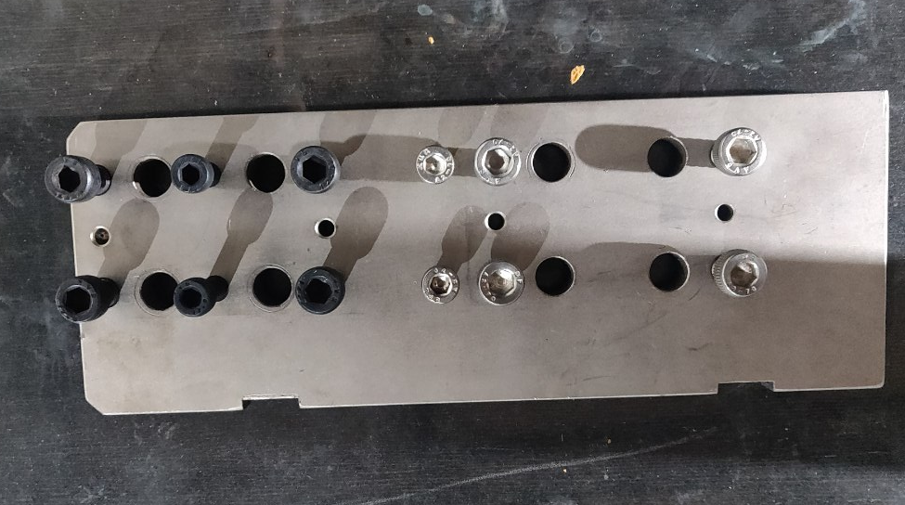
Workpiece

Slide 3
Process
Product loaded into the fixture placed in the conveyor belt
Product stops under the screwdriver setup.
Camera and lighting turn on.
Camera identifies the holes.
Acquires the location for the hole.
Gives the sequence of screwing process.
Completes screwing process.
Identifies screws or checks for holes.
Workpiece to the next station.

Slide 4
Currently Available Tech on screwing & identification- Jam board
Sensopart

Slide 5
Job identification - QR Code
Workpiece 1
Mark the coordinates
Save it to a QR
Name the QR as Job1
Identification of QR code by the camera.
So when the camera identifies the QR it should be able to run a code that has the crew coordinates for that particular job.
What do you save in the QR code ?
Coordinate data.

Slide 6
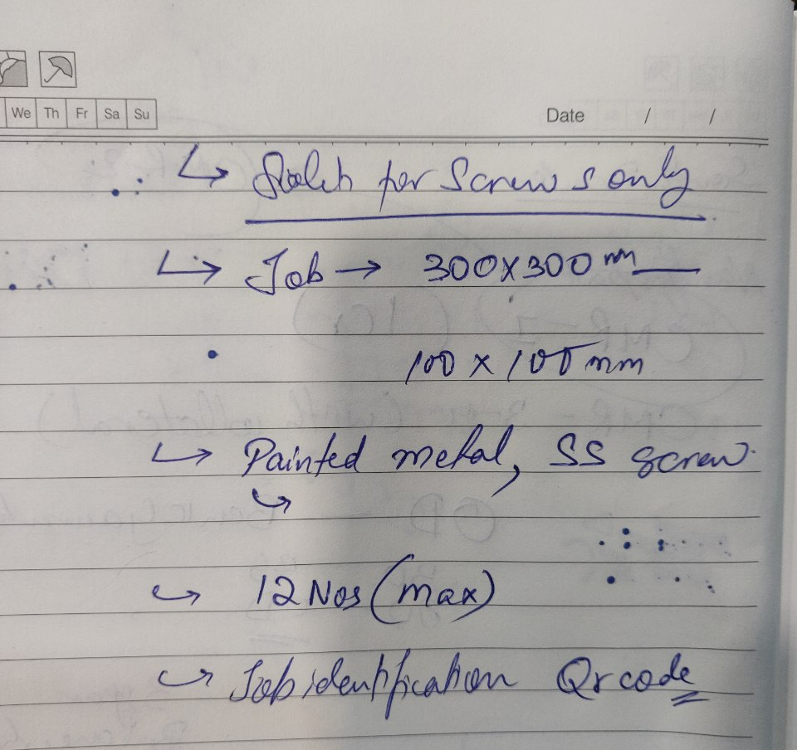
Parameters
Solution for Screws only
Job dimension 300*300 – 100*100
Painted metal – 3 colors
SS screw – silver
12 Nos (max)
Job identification QR Code
Single plane screwing
Workpiece – fixed (fixture)

Slide 7
Questions
Is it a manually operated nut runner or an automated nut runner?

