Slide 1
Final Presentation

Slide 2
Project Description
Team Name: Schoodle
Team Number: 42
Team Members: Erik Holbrook, Ahmed Al Hasani
Vision: Create an application that requires numerous classes to incorporate Object-Oriented Principles and the course’s concepts.
Description: a web-based application for college course-related tasks, like tracking grades, sharing content and submitting assignments.

Slide 3
Demo 1

Slide 4
Demo 2

Slide 5
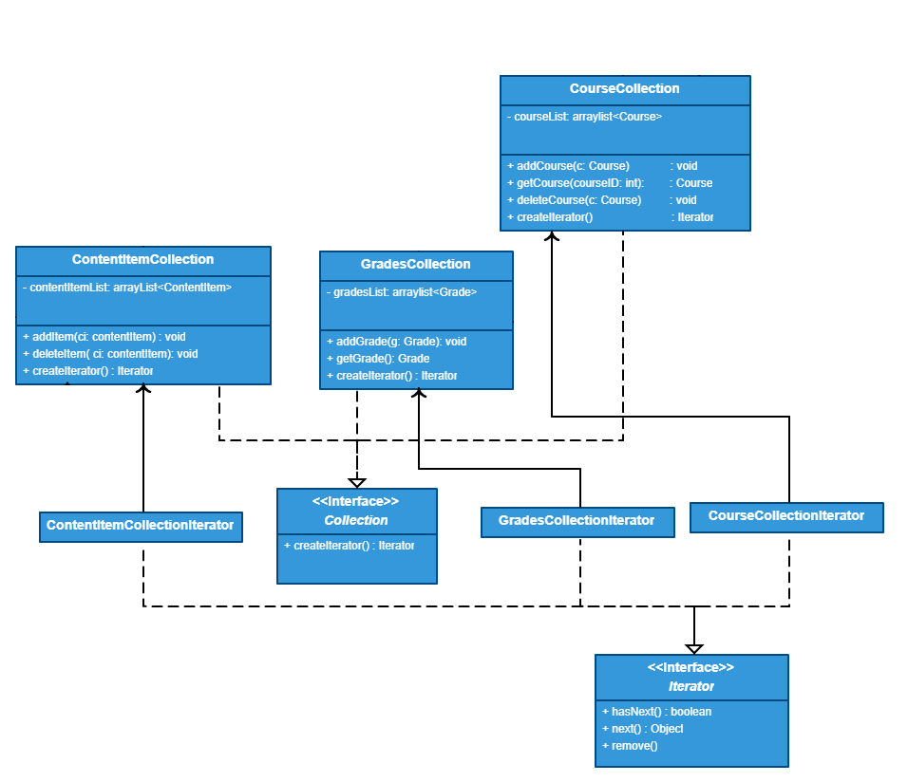
Design Pattern Iterator
Courses, instructors and students will have collections
Grade, content item, course collection
Must iterate through each collection
What was actually implemented

Slide 6
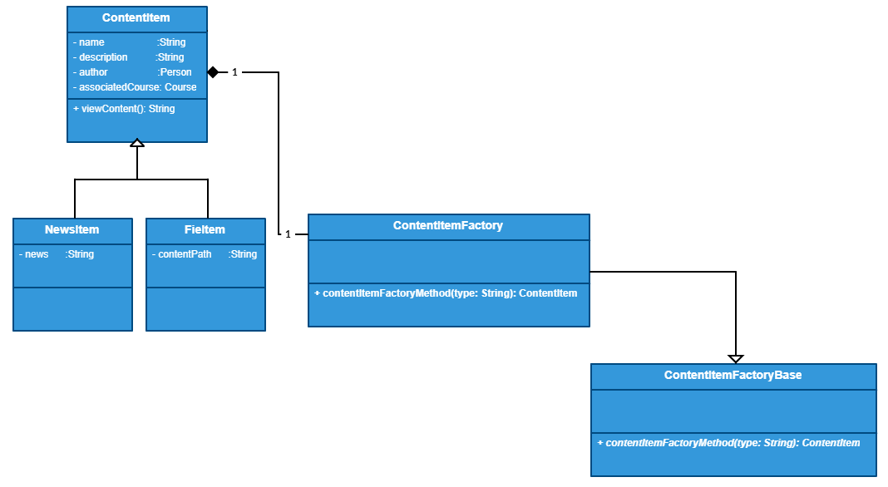
Design Pattern Factory
Dynamically create the appropriate class as needed
Implementation

