Slide 1

Basic Linux Tutorial
BambooFox & NCTUCSC

Slide 2

Who am I?
私はマンゴです。
交通大学の学生です。

Slide 3
Kali Linux
A Debian-based Linux distribution
Aimed at advanced Penetration Testing and Security Auditing.
Include 600 penetration testing tools
Single user, root access by design

Slide 4
User
Root (uid 0) – the God of the local host
The most privileged account on a Unix/Linux system.
Execute the initial program
Able to control and modify anything

Slide 5
Shell
The shell is a program that takes your commands to the operating system to perform.
Syntax
[user]@[host]:[directory]$ [command] -[short opt] --[long opt] args
prompt

Slide 6
ls
List directory contents
-a : do not ignore entries starting with “ . ”
-l : use a long listing format
-R : list subdirectories recursively

Slide 7
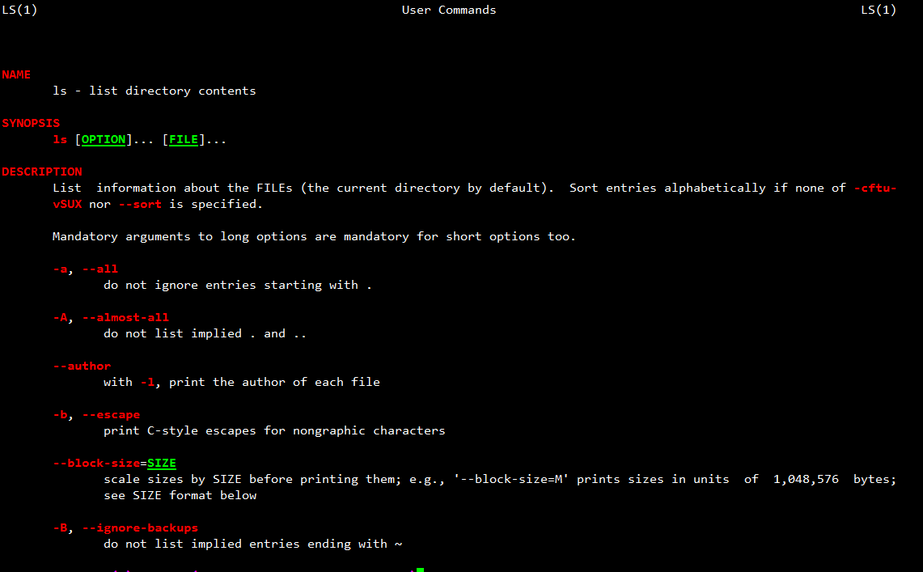
But a command has a lot of options in facts Too hard to remember all of them!!
Let’s welcome the greatest man in the Unix/Linux world
The “man” command - an interface to the reference manuals

Slide 8
Common command
comm | description | example
cd | change the working directory | cd /tmp ; cd - ;
echo | display a line of text | echo “hello world”; echo –e “hello\tworld\n”;
cat | concatenate files and print on the standard output | cat /etc/passwd;
ps | report a snapshot of the current processes | ps auxww;
top | display processes | top;
kill | terminate a process | kill 5566;
nc (netcat) | arbitrary TCP and UDP connections and listens | nc ip/hostname port;

Slide 9
Common command 2
comm | description | example
su | run a command with substitute user and group ID | su nobody;
touch | create a empty file | touch file;
mkdir | create a directory | mkdir dir;
cp | copy files and directories | cp file file2; cp –r dir/ /otherdir ;
mv | move (rename) files | mv file ooxx; mv dir/ newdir/
rm | remove files or directories | rm file2; rm –r newdir/
chmod | change the privilege of file | chmod 755 file; chmod [u|g|o|a][-|+][r|w|x] file;
chown | change the owner of file | chown nobody test;
exit | exit from shell | exit;

Slide 10
Variables & Quotes
var=value | Assign value to variable | var=“test” ;
$var ${var} | Get shell variable | echo $var;
`cmd` $(cmd) | Substitution stdout | echo `date`; $(bash);
‘string’ | Quote character without substitution | echo ‘This is a $var’;
“string” | Quote character with substitution | echo “This is a $var”;
據說 | 網安期末考很多人被這招打死 | $($0)

Slide 11
Special skill !!
Skill | Purpose | Example
* | Match any string of characters | ls test*
? | Match any single alphanumeric character | ls test?
[…] | Match any single character within […] | ls test[123]
[!…] | Match any single character not in […] | ls test[!234]
~ | Home directory | ls ~

Slide 12
Special skill 2 !!
Skill | Purpose | Example
# | Start a shell comment | # this is a comment
; | Command separator | cd /tmp ; ls
&& | executes the first command, and then executes the second if first command success (exit code=0) | cd /fake/dir && touch test cd /tmp && touch test
|| | executes the first command, and then executes the second if first command fail (exit code≠0) | cp x y || touch y
& | Background execution | yes &
\ | Escape character | touch test\*; ls

Slide 13
Pipe and redirect !!
Skill | Purpose | Example
cmd1 | cmd2 | Pipe stdout of cmd1 as stdin of cmd2 (Note : except stderr) | ls | grep ‘c’
cmd > file | Write stdout of cmd into the file | echo “I love 5566” > lies.txt
cmd >> file | Append stdout of cmd into the file | echo “It’s true” >> lies.txt
cmd < file | Read the file as stdin to cmd | tr ‘ ’ ‘_’ < lies.txt
2>&1 | Redirect stderr to stdout | ls file_not_exist 2>&1 | less

Slide 14
Bash Keyboard Shortcuts
Up (Down) key : Previous (Next) command
Ctrl + C : Send kill interrupt to the current process
Ctrl + Z : Suspend the current process, wake up it with “fg” command
Ctrl + D : Send EOF marker
Ctrl + L : Clear screen
Ctrl + A : Go to the beginning of line
Ctrl + E : Go to the end of line
Alt + B : Backward a word
Alt + F : Forward a word
More detail : http://ss64.com/bash/syntax-keyboard.html

Slide 15
Service
service [services] start|stop|restart|status
Services are located at /etc/init.d/
For example
network
xinetd
sshd
httpd (apache)
ftpd

Slide 16
Crontab
/etc/crontab or create one by yourself!
vim /root/root.crontab
Format
[minute] [hour] [day of m] [month] [day of w] [user] [command]
* * * * * root killall –u nobody bash

Slide 17
Thank you
更多Linux相關知識請勞駕到鳥哥的網站 : http://linux.vbird.org/

