Slide 1
Format string
bananaapple

Slide 2
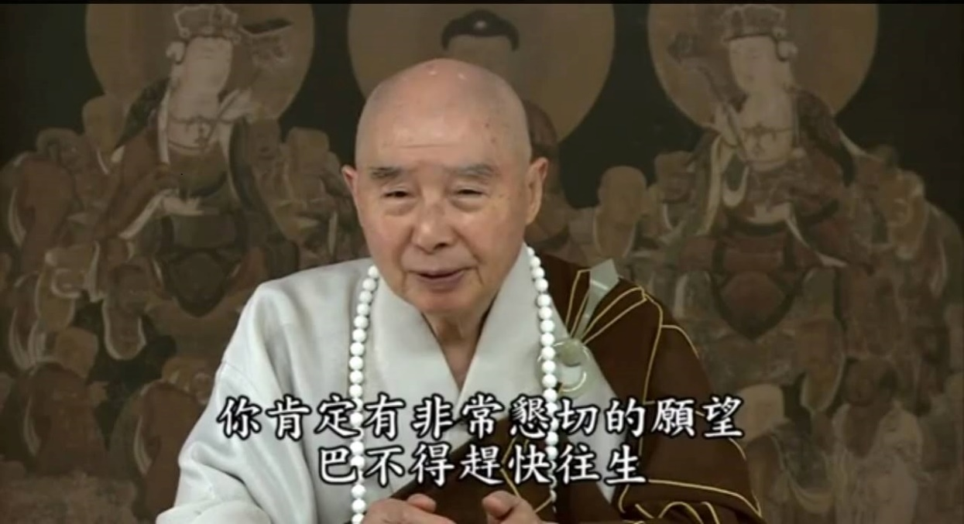
Who am I?
ID : bananaapple
學校科系 : 交通大學資工系
年級 : 大三升大四
目前為 Bamboofox 中的一員

Slide 3
Outline
Dangerous Function
Function call
Format string
Example
Strategy
Practice

Slide 4
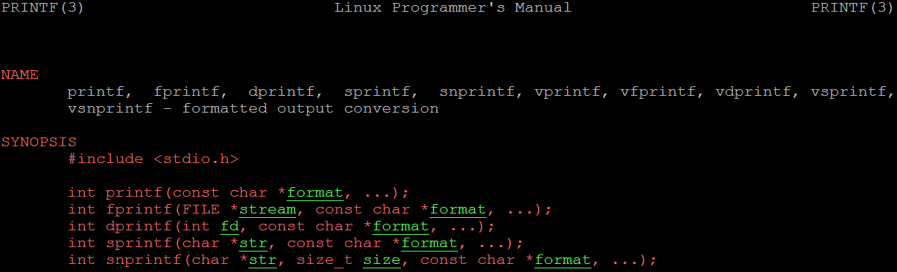
Dangerous Function

Slide 5
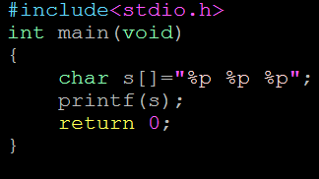
Function call
If we print variable out without parameter?
printf(“%s”,s);
printf(s);

Slide 6
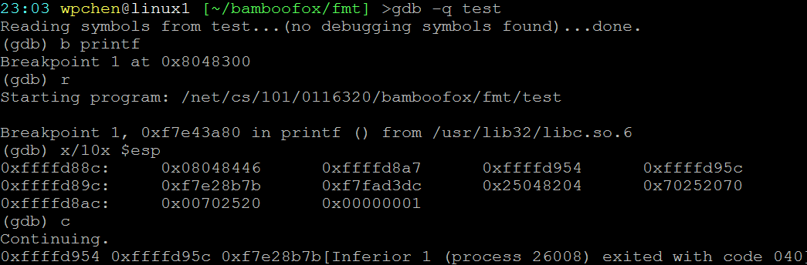
Function call

Slide 7
Format string
Function doesn’t know how many parameter it has.
As result, function will take the value on the stack as parameters.
As this way we could leak any address above the stack.
How about the address below the stack?
We have make our own arguments and use it
How?
The buffer will above the stack pointer
Calculate the offset and point to the buffer

Slide 8
Format string
%x : Unsigned hexadecimal integer
%s : String of characters
%p : Pointer address
%n : The number of characters written so far is stored in the pointed location
%(num)c : Print num characters
%(num)$x : dump num^{th} parameter
Ex : %100$x : dump 100th dword

Slide 9
Format string
Guess the offset?
for i in range(0,1000): payload=“aaaa%”+str(i)+”$x”
We calculate from assembly
Notice three instructions
sub $num,%esp // function prologue
lea offset(%esp),%eax // buffer address
move argument,$esp // num^{th} argument

Slide 10
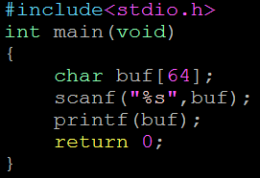
Example

Slide 11
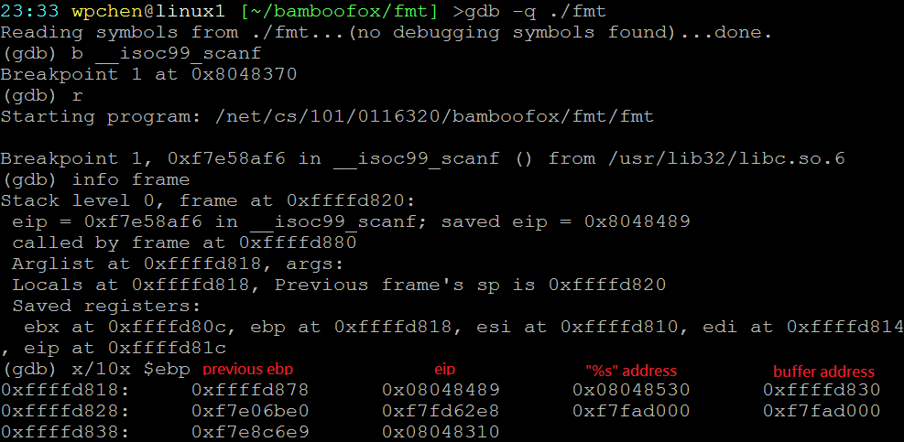
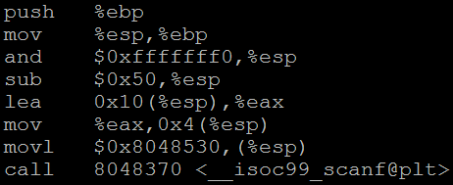
Example

Slide 12
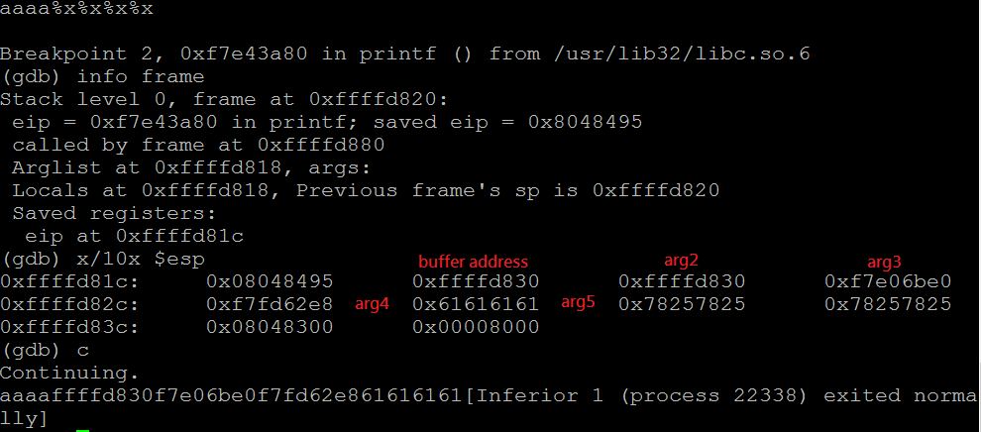
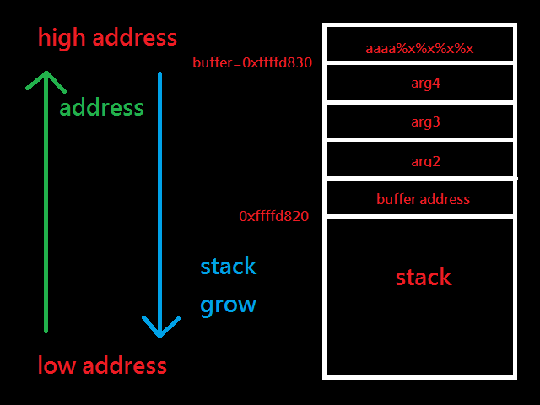
Example

Slide 13
Example
%n
%n : dword : 4 bytes
%hn : word : 2 bytes
%hhn: byte : 1 bytes
Try to write value 0x6a686664 to 0x08045566
0x64 to 0x08045566
0x66 to 0x08045567
0x68 to 0x08045568
0x6a to 0x08045569

Slide 14
Example
Try to write value 0x6a686664 to 0x08045566
Payload will look like this
\x66\x55\x04\x08\x67\x55\x04\x08 // 8 characters
\x68\x55\x04\x08\x69\x55\x04\x08 // 8 characters
%84c%4$hhn
%2c%5$hhn
%2c%6$hhn
%2c%7$hhn

Slide 15
Strategy
With this skill you can do
Read / write any position if map permission is allowed
GOT hijacking
Write variable value
Leak libc base address and calculate offset to get another function address
Leak libc version
Leak stack address

Slide 16
Practice
fmt1
http://secprog.cs.nctu.edu.tw/problems/12
fmt2
http://secprog.cs.nctu.edu.tw/problems/13
Monkey1
http://train.cs.nctu.edu.tw/problems/2
Monkey2
http://train.cs.nctu.edu.tw/problems/3

Slide 17
Reference
http://www.cis.syr.edu/~wedu/Teaching/cis643/LectureNotes_New/Format_String.pdf
Almost by experience ( practice hard, and use gdb to test )

