Slide 1
Basic Reverse Engineering

Slide 2
Outline
Intro. To Static Analysis
Disassemble
Reverse Assembly to C
IDA Pro
Lab: IDA Pro to reverse zbot crypto
Dynamic Analysis
Immunity Debugger
Lab: Use debugger to pass the authentication
Concept to Reverse

Slide 3
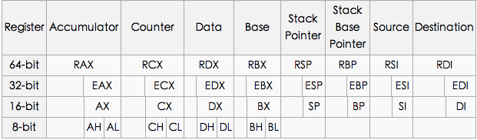
Reverse Assambly to C
Registers Architecture
The EIP register contains the address of the next instruction to be executed if no branching is done.

Slide 4
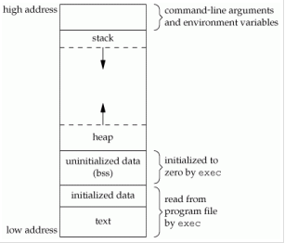
Memory Layout
Stack
Not maintain in Executable
Local Variable
Heap
Not maintain in Executable
Dynamic Allocate Memory
BSS Section
Uninitialized Data
Global variables and static variables that are initialized to zero or do not have explicit initialization in source code
Data Section
Initialized Data
Global variables and static variables
Notes:
未來補充Linux和Windows對照圖

Slide 5
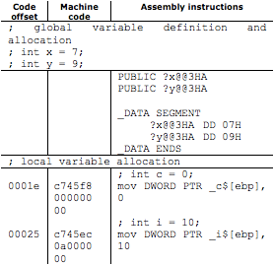
Variables
Disassembled code for local and global variables

Slide 6
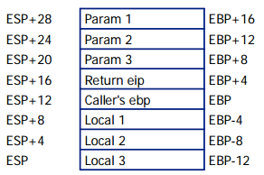
Local Variables/Arguments
Caller push argument into stack
Caller push eip by call instruction
Callee save/push the caller’s ebp
Callee reserve space for local variables
sub
Stack Growing Direction

Slide 7
Data Movement
MOV dst, src
Src <= dst
LEA dst, src
Load effective address of operand into specified register
To calculate the address of a variable which doesn't have a fixed address
Example
mov eax, [ebp - 4] <= get content in [ebp - 4]
mov eax, ebp – 4 <= wrong, no such instruction
lea eax, [ebp - 4] <= get address of [ebp - 4]

Slide 8
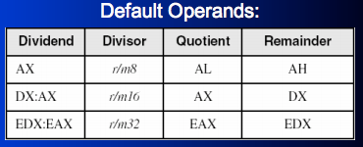
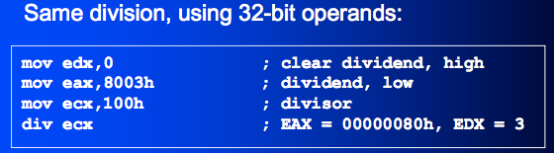
Arithmetic Operator
add dest, src
sub dest, src
mul arg
div
DIV r/m8
DIV r/m16
DIV r/m32
inc
dec

Slide 9
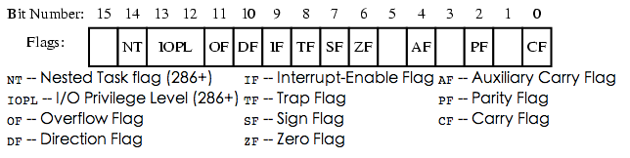
Control Instructions
Flag, each instruction updates some field of flag for future branch
test
Performs a bit-wise logical AND
sets the ZF(zero), SF(sign) and PF(parity) flags
cmp
Performs a comparison operation between arg1 and arg2
Set SF, ZF, PF, CF, OF and AF

Slide 10
Branch Instruction
JE Jump if Equal ZF=1
JNE Jump if Not Equal ZF=0
JG Jump if Greater (ZF=0) AND (SF=OF)
JGE Jump if Greater or Equal SF=OF
JL Jump if Less SF≠OF
JLE Jump if Less or Equal (ZF=1) OR (SF≠OF)

Slide 11
Stack Operation
Stack is the LIFO data structure
PUSH: put data into top of stack
POP: get data from top of stack

Slide 12
Function Call
Call
Similar to jmp, but a CALL stores the current EIP on the stack
RET
Load the address in esp, and jump to that address
RET num
Increase esp by num
Load the address in esp, and jump to that address

Slide 13


Function Pro
Function Prologue
Store current EBP
Save ESP
Leave space for local variables
Function Epilogue
Restore ESP
Restore EBP

Slide 14
Calling Convention
The transition of function arguments must be maintain by assembly programmer, but most case maintain by compiler
Stdcall
function arguments are passed from right to left
the calleé is in charge of cleaning up the stack.
Return values are stored in EAX.
cdecl
The cdecl (short for c declaration) is a calling convention that originates from the C programming language and is used by many C compilers for the x86 architecture.
The main difference of cdecl and stdcall is that in a cdecl, the caller, not the calleé, is responsible for cleaning up the stack.
pascal
The pascal calling convention origins from the Pascal programming language
The main difference between it and stdcall is that the parameters are pushed to the stack from left to right.
fastcall
The fastcall is a non-standardized calling convention.
the fastcall convention tends to load them into registers. This results in less memory interaction and increases the performance of a call.
Notes:
Stdcall => win32 API
Cdedl => variable length api
fastcall

Slide 15

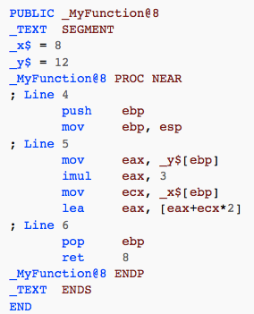
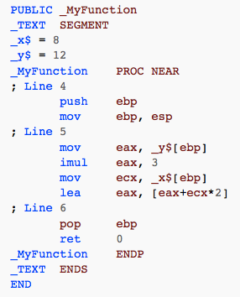
STDCALL v.s CDECL
stdcall
cdecl

Slide 16
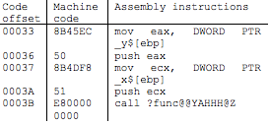

Function Call Structure
Function Call Structure

Slide 17
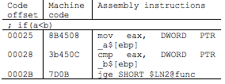
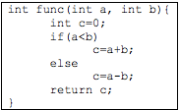
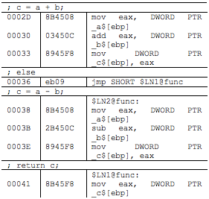
Branch Structure
Branch Structure

Slide 18
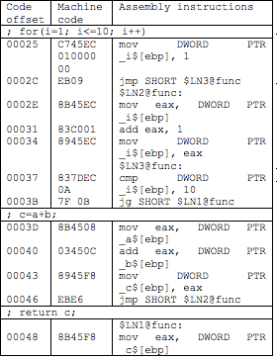

Do-For loop
Do-For loop

Slide 19
IDA Pro
IDA Pro is the most well-known dissemble/decompile tool for reversing
Disassemble
Friendly GUI
Decopiler
Debugger

Slide 20
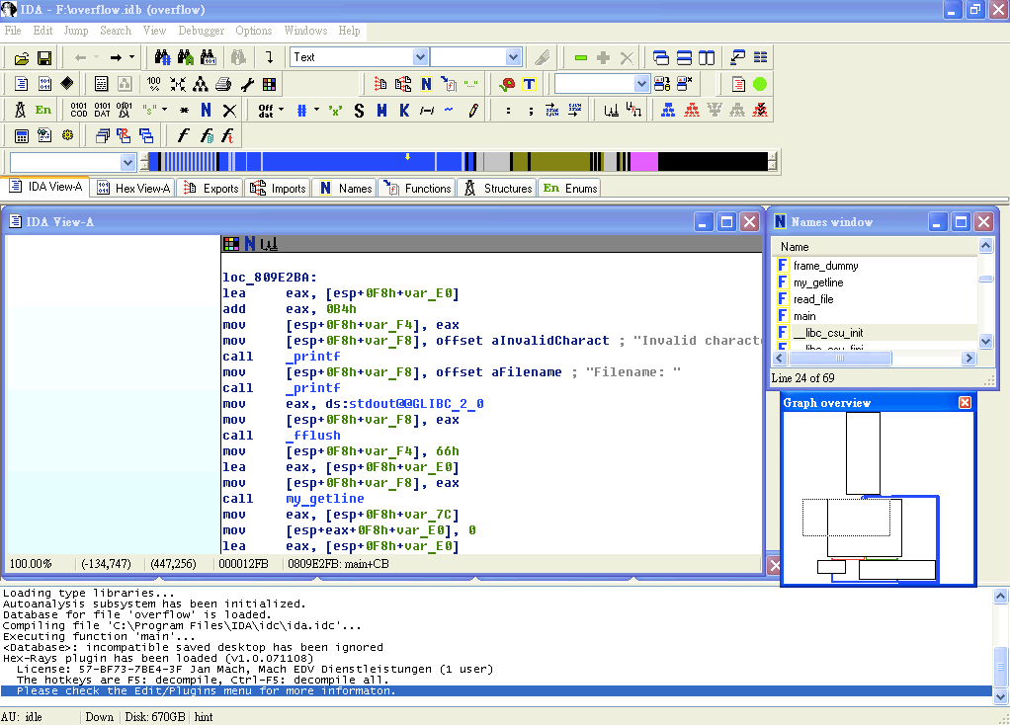
Overview
Assembly and Control Flow View
Control Flow View
Message View

Slide 21
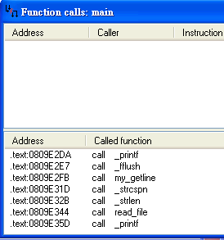
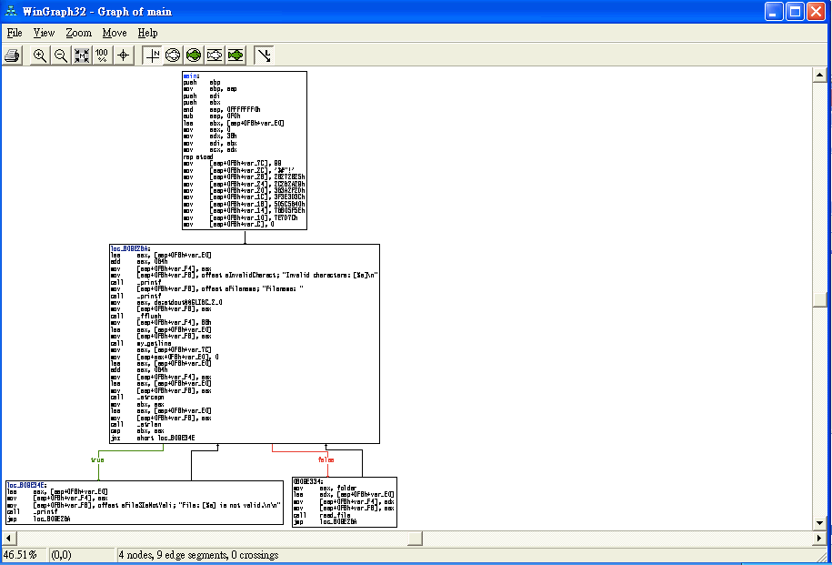

Functionality(1)
Fun Call Window
Graph
Convert Current Location
DATA
Instruction
String
Self-defined Data Structure
Array
Convert Oprand
Offset
Hex/Oct/Dec/Bin
Constant Char
Segment-based Var
Stack-based Var
….
Xref Table
Once The disassemble make mistake, you can fix it yourself

Slide 22
Functionality(2)
Export Function
List functions export to other Binary
DLL, entry point
Import Function
Functions included from other files
Import function can help you to guess the behavior of program
Names
Function Name
Variable Names
Strings
For problem with debugger information inside, names can be useful
Strings
All strings use
For some easy problem, this can help you to get flag
For other problem, it still give you quick look to program

Slide 23
Useful Hotkeys
List of useful hotkeys
 | Function | Hotkey
1 | Strings | Shift+F12
2 | Jump to operand | Enter
3 | Jump to previous position | ESC
4 | Jump to next position | Ctrl+Enter
5 | Jump to address | G
6 | Jump to entry point | Ctrl+E
7 | Sequence of bytes | Alt+B

Slide 24
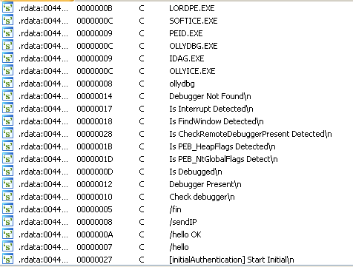
Strings Table
Strings Table can help you to find interesting part

Slide 25
Static Linked Function
Static linked function are functions which added by compiler
The function bodies are directly put into binary
Some static functions cannot be recognize by IDA
FLIRT is a signature database of IDA pro, you can try to study for it ☺

Slide 26
Lab: IDA For zbot
Goal
Use IDA Pro to analysis zbot encryption algorithm
Environment
WinXP

Slide 27
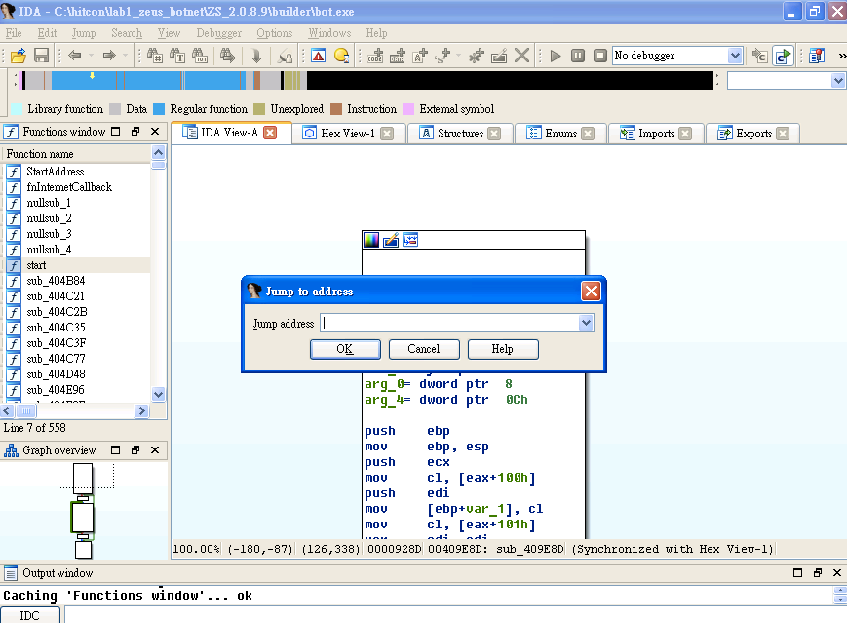
Lab: Go to Target Function
Our encryption function is in sub_409e8d
Press ‘G’
Enter address

Slide 28
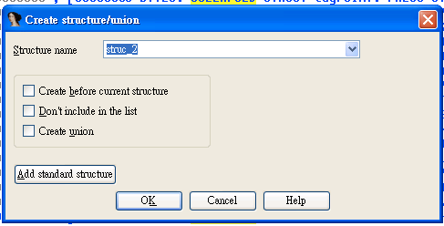
Lab: Construct Structure
Structure is widely used in program
Define structure can help you to understand program semantic
Press ‘ins’ and name the structure as rc4key

Slide 29

Lab: Add Member
Press ‘d’ on structure and new a member
Press ‘d’ * 1 , create data size 1 byte
Press ‘d’ * 2 , create data size 2 byte
Press ‘d’ * 3 , create data size 4 byte
Press ‘n’ to rename the member as ‘stat’

Slide 30
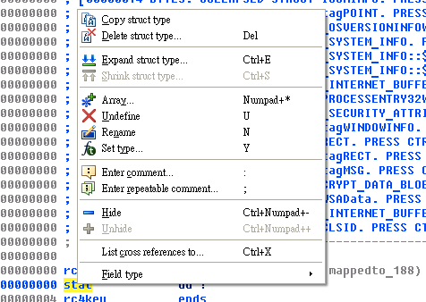
Lab: Make Array
Right click on rc4key and choose Array
Create array size 256

Slide 31

Lab: Finish Structure
Define X with size 1 byte
Define Y with size 1 byte

Slide 32
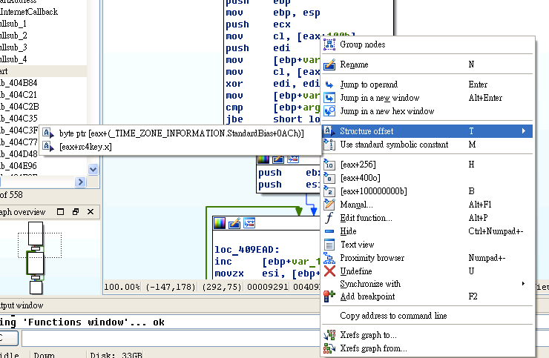
Lab: Map Element to Structure
Eax is argument pass to this function
Eax is in type of rc4key

Slide 33
Lab: Rename Variable
Press n to rename
Var_2 => y
Var_1 => x
Arg_0 => buffer
Arg_4 => size

Slide 34
Lab: Understanding Algorithm
Try to read assembly code
Translate to C code

Slide 35
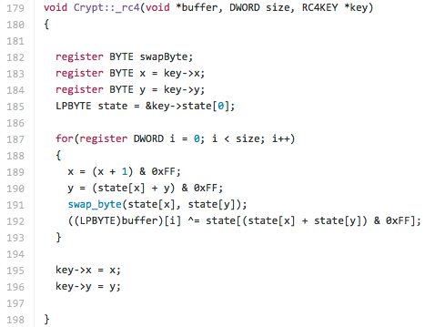
Lab: RC4 Algo

Slide 36
Decompiler
Decompiler can help you to transfer assembly into C code
More easy to read
Press F5
Magic!!!

Slide 37
But
Decompiler result is not perfect
Most of time is buggy
Lack of source code level information
May not support All platform
Arm
X86
X64
…..

Slide 38
Make Decompiled Result Better
We can seen it still hard to understand
Variable name is meaningless
Static link function
Some type not correctly recognize
Without information of structure

Slide 39
Dynamic Analysis
Program must run in the controllable environment
Monitor program’s behaviors in the runtime
Dynamic analysis represents the ability to monitor code as it executes and it allows to reason about actual executions, and thus can perform precise security analysis based upon run-time information
First introduce some useful tool for dynamic analysis
Strace, ltrace in linux system
Process explore, procmon in windows system

Slide 40
Debugger
A debugger or debugging tool is a computer program that is used to test and debug other programs (the "target" program)
Also useful for malware analysis
breakpoint stops your program whenever a particular point in the program is reached
watchpoint stops your program whenever the value of a variable or expression changes
catchpoint stops your program whenever a particular event occurs

Slide 41
Information from Debugger
Runtime information
Memory Address
Register Value
Behavior of Executable
Encrypt/Decrypt

Slide 42
Debuggers
Popular Debugger
OllyDebugger
Win debugger
Immunity Debugger
IDA
GDB

Slide 43
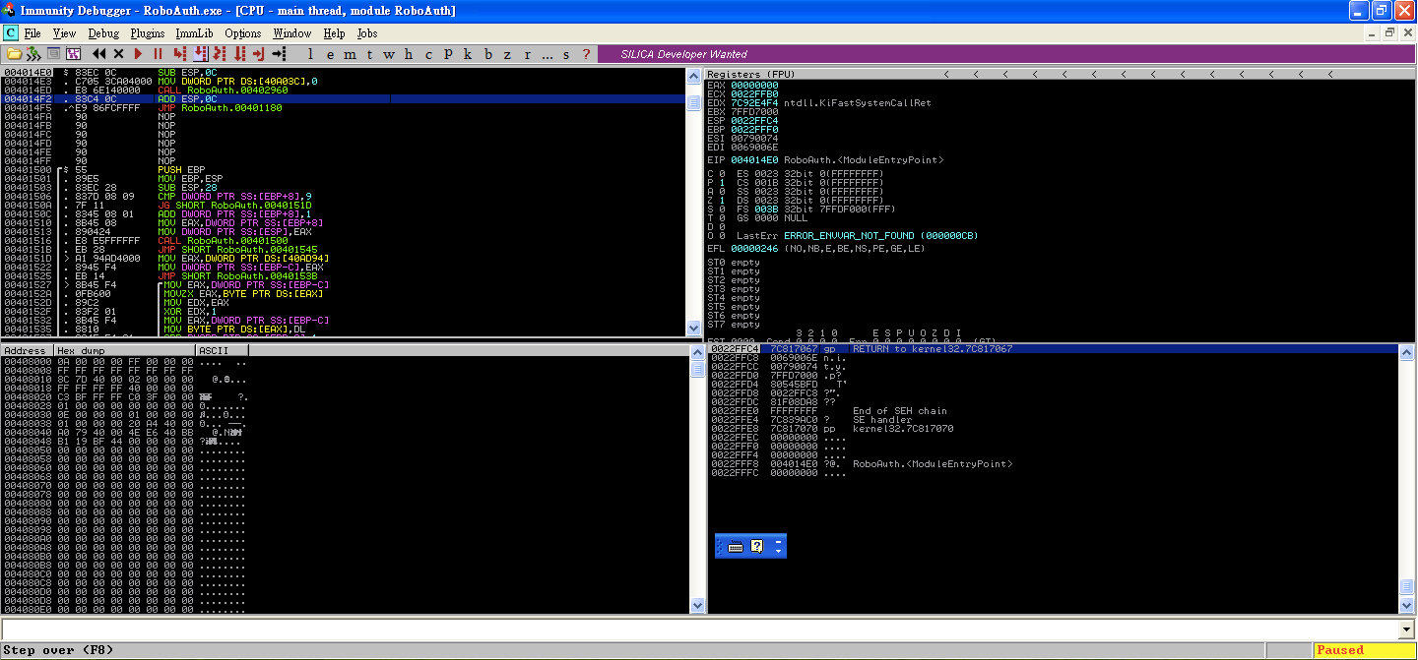
Immunity Debugger
Assembly View
CPU State
Memory State
Stack State

Slide 44
m – memory map
T – show threads
W – show windows
H – Handle List
k – Call Stack

Slide 45
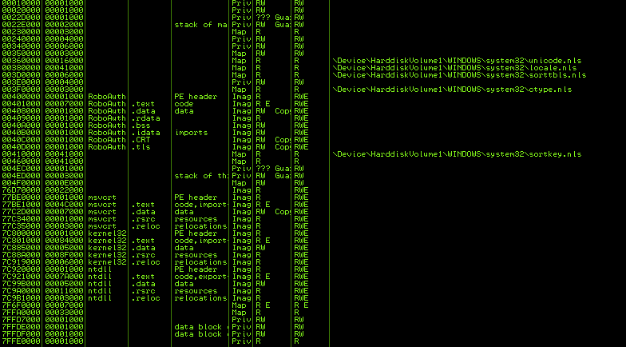
Memory Map
M
List memory mapping
Tell you the information about memory layout
If address inside your target
Suspicious memory sector
Mostly we can ignore system memory

Slide 46
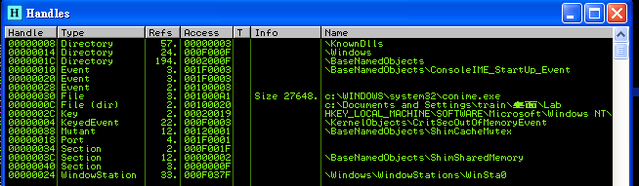
Handle List
Information of used resource
File
Registry
Socket
…….

Slide 47
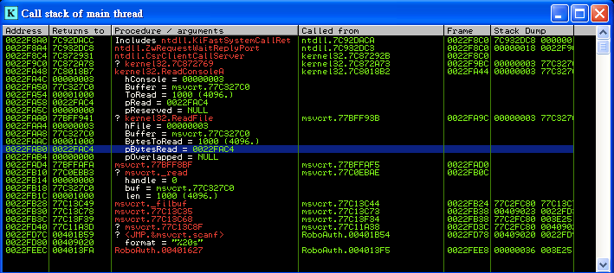
Call Stack
Useful information about which function currently called
Caller, callee dependency
Argument

Slide 48
HOTKEYS
type | hotkey | func
Control Execution | F7 | step in
 | F8 | step over
 | F9 | continue
Breakpoints | F2 | Set breakpoints
 | F4 | Run to the cursor
Location | Ctrl + g | Go to location

Slide 49
Lab: Bypass Authentication
Use debugger to identify key in RoboAuth.exe
Find where to use string comparison function
Observe strings in memory

Slide 50
Reversing Concept
Identify important part of program
Backward tracking user data
Forward tracking interesting API function
Convert back to C code

Slide 51
Identify important part of program
Identify what you interesting
Strings: ‘flag’, ‘key’, ….
Function to read input: scanf(), gets(),…
Function for network communication: recv(), send()
Read/Write file
…..

Slide 52
Backward tracking user data
Most program vulns must be trigger by user input
You can not(or difficult) attack a function independent to your input
Keep track about variables affected by your input
Data Propagate
Data Dependency

Slide 53
Forward tracking interesting API function
Most vulns are cause by some certain functions
strcpy()
memcpy()
scanf()
printf()
strcat()
…..
Try to trigger these functions
Analysis control flow and make strategy to enforce program goto these functions

Slide 54
Convert back to C code
Gather information
IAT
Strings
Dynamic analysis
Identify function of interest
Identify CALLs
Identify algorithms and data structures
Pseudo-code it!
Rename function(s), argument(s), variable(s)

Slide 55
Summary
This course brings the basic idea of reverse
Introduce IDA Pro and Immunity Debugger
Basic ASM
How to reverse asm to c
Function call
Memory

